Slide 1
Musa Capstone
PokemonStay
Ziyuan Cai

Slide 2
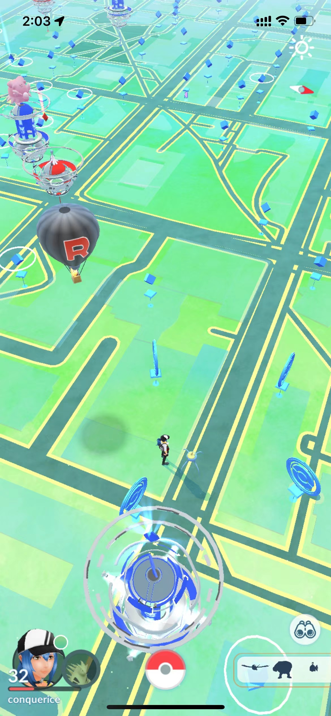
Problem
Nested Pokemon
Poke Stop
Pokemon
Gym
Where should people new to Philadelphia go to get Pokémon faster and safer?

Slide 3

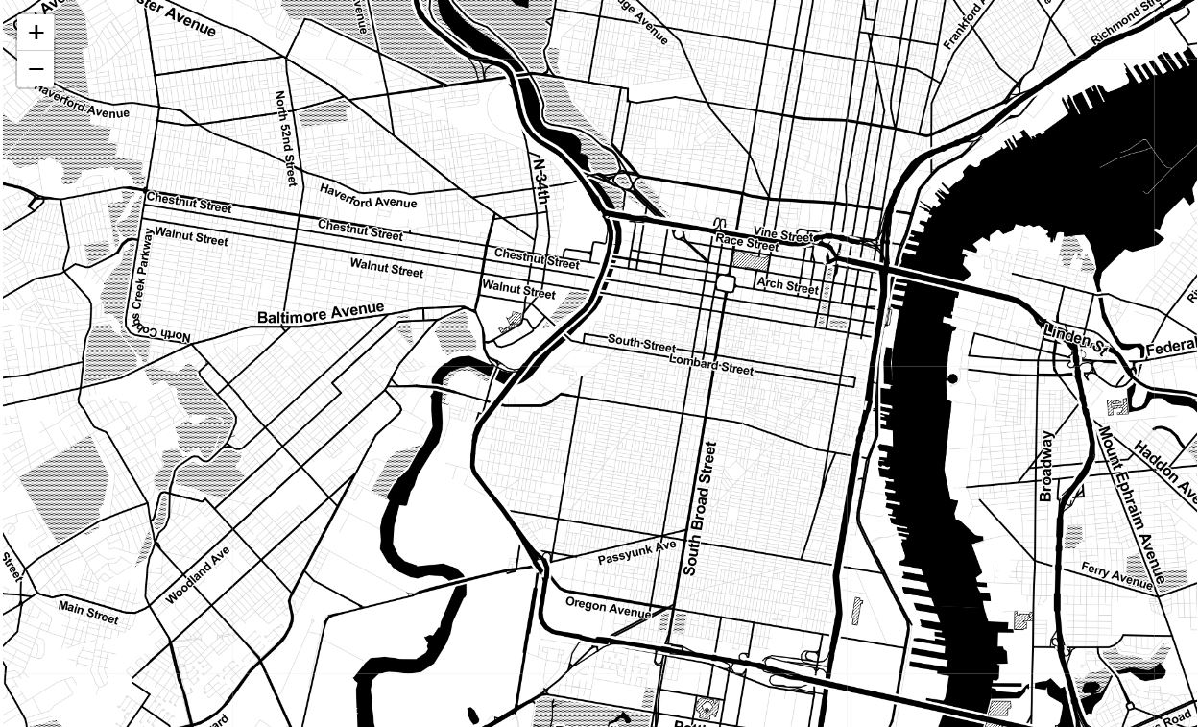



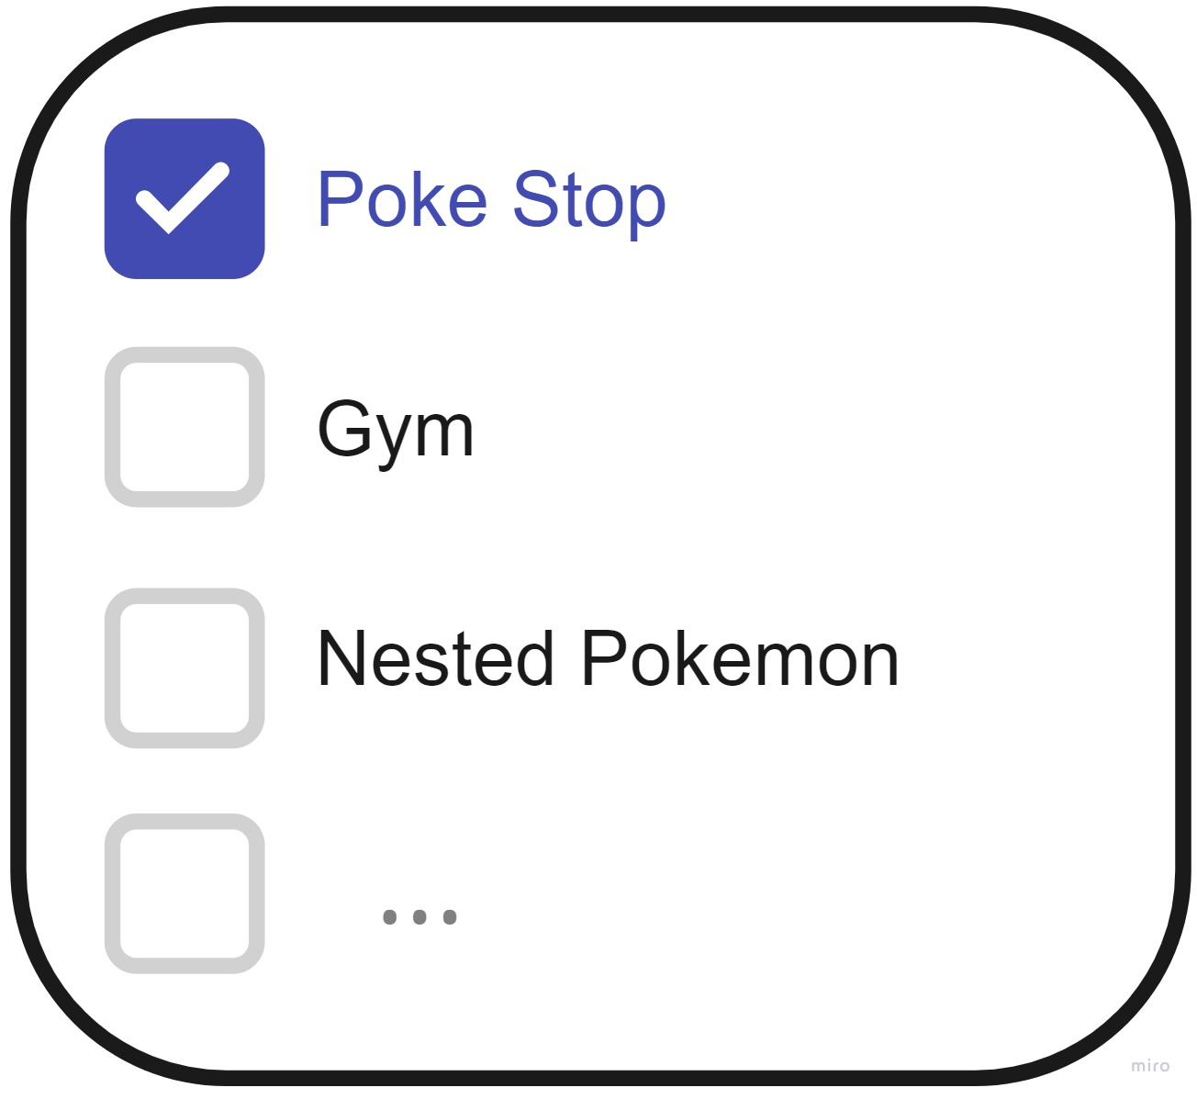
pokemonstop

Slide 4
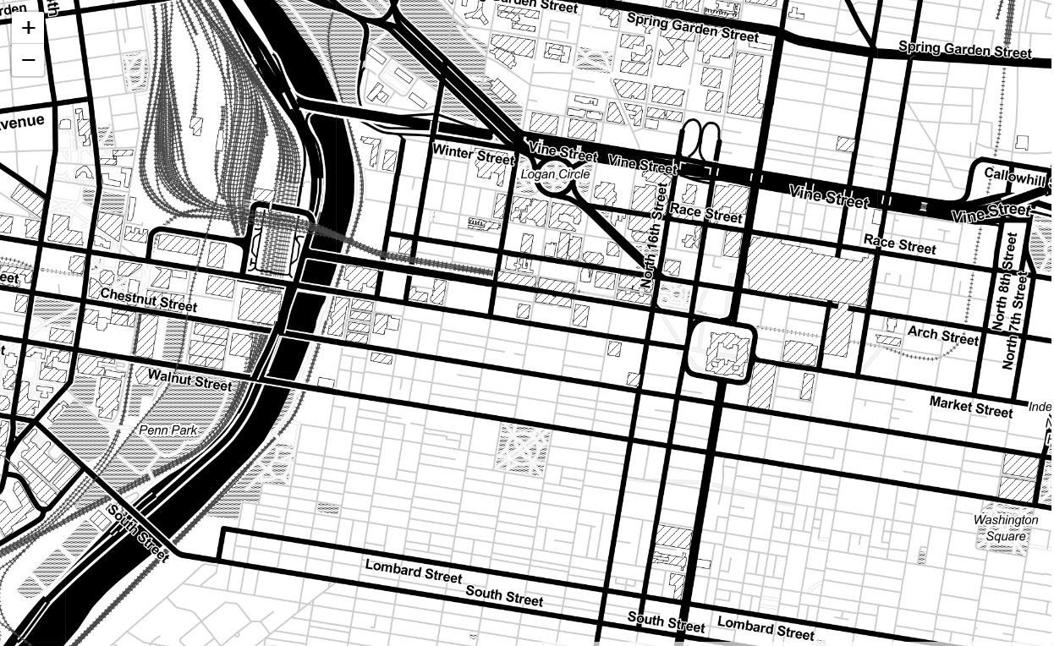

pokemonstop

Slide 5
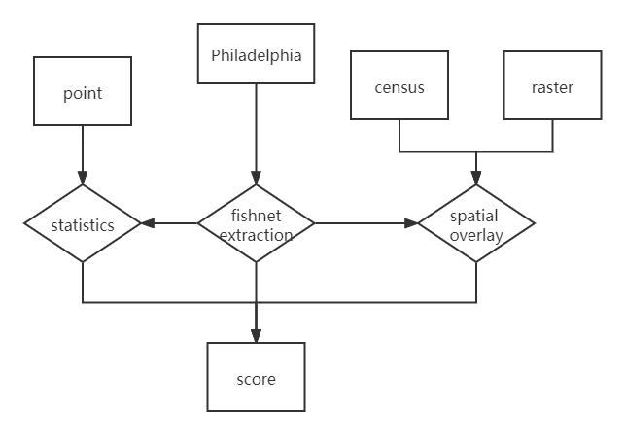
Method
$$des=a_{1}∗NPS+a_{2}∗NR+a_{3}∗C+…$$

Slide 6
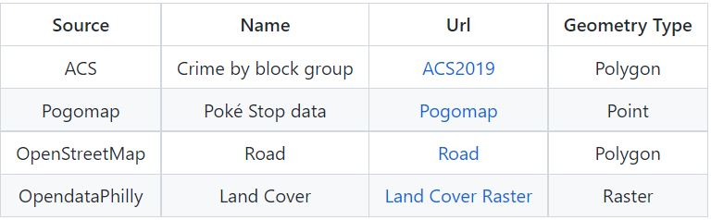
Data

Slide 7
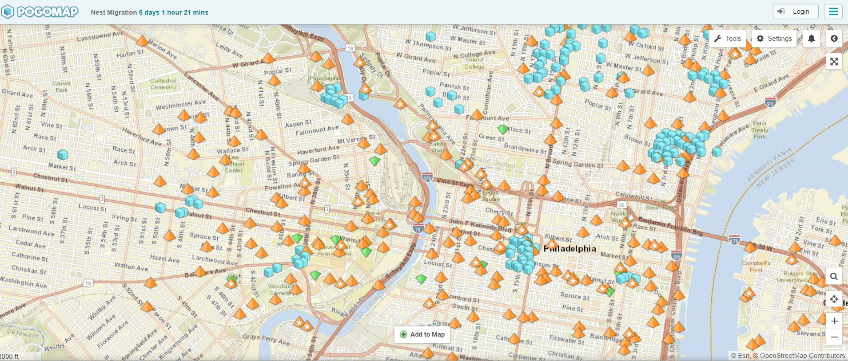
Data
https://www.pogomap.info/location/39,958412/-75,181057/14

Slide 8
Next Step
Analyze and calculate the existing features and experimental simulations are carried out
1
3
Use javascript and html to build a map!
Data Fetching
Preliminary Result
Add Features
Map Building
Use web scraping method to get Poke Stop data from Pogpmap
Add features through data collection and investigation
2
4

Slide 9
Thanks
Musa Capstone
Ziyuan Cai
Q&A

