Slide 1
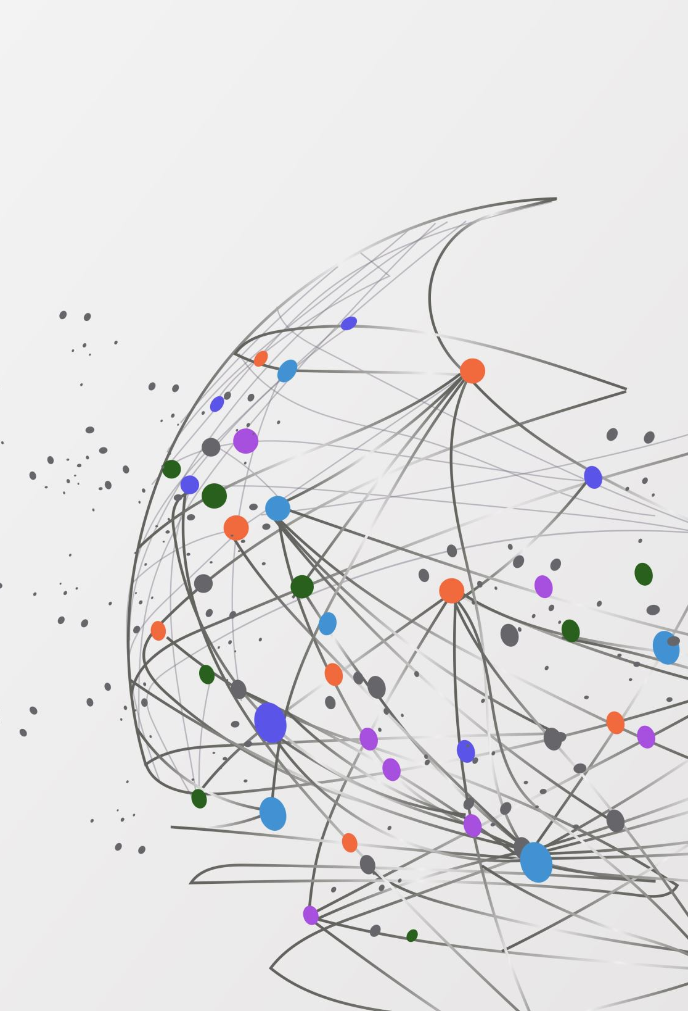
VIR1
CPNV – ES
Software development orientation
4th quarter - 2022-2023
Glassey Nicolas

Slide 2
What is Virtualization ?
nicolas.glassey@cpnv.ch

Slide 3

What is Virtualization ?
Create a software-based-or virtual-representation of applications, servers, storage and network to reduce IT expenses while boosting efficiency and agility.
nicolas.glassey@cpnv.ch

Slide 4

What is Virtualization ?
Virtual software mimics the functions of physical hardware to run multiple virtual machines simultaneously on a single physical machine.
Businesses use virtualization to use their hardware resources efficiently and get greater returns from their investment.
It also powers cloud computing services that help organizations manage infrastructure more efficiently.
nicolas.glassey@cpnv.ch

Slide 5
Characteristics of hypervisors ?
nicolas.glassey@cpnv.ch

Slide 6
Characteristics of hypervisors ?
Performance:
Directly access to the hardware resources
In a bare-metal situation, the guest OS performance should close to native speeds
nicolas.glassey@cpnv.ch

Slide 7
Characteristics of hypervisors ?
Ecosystem:
Documentation and technical support to implement and manage hypervisor (in case of scale across multiples physical servers).
Look for a healthy community that can provide support with agent, plugins that offer capabilities (backup/restore, fail-over)
nicolas.glassey@cpnv.ch

Slide 8
Characteristics of hypervisors ?
Management tools:
Launching and Running VM’s is only the start point…
VM’s need to be:
Provisioned
Maintained
Audited
Clean up (to prevent “VM sprawl” (proliferation in French)
Ensured that the vendor supports the hypervisor architecture with comprehensive management tools.
nicolas.glassey@cpnv.ch

Slide 9
Characteristics of hypervisors ?
Live migration:
Enable you to move VMs between hypervisors.
Fail-over solution.
Workload balancing.
nicolas.glassey@cpnv.ch

Slide 10
Characteristics of hypervisors ?
Cost:
Do not consider only the cost of the Hypervisor.
Saving of human resources (less maintenance load).
Reduces the number of physical machines to be maintained, replaced and replicated.
nicolas.glassey@cpnv.ch

Slide 11
Type of Virtualization ?
nicolas.glassey@cpnv.ch

Slide 12
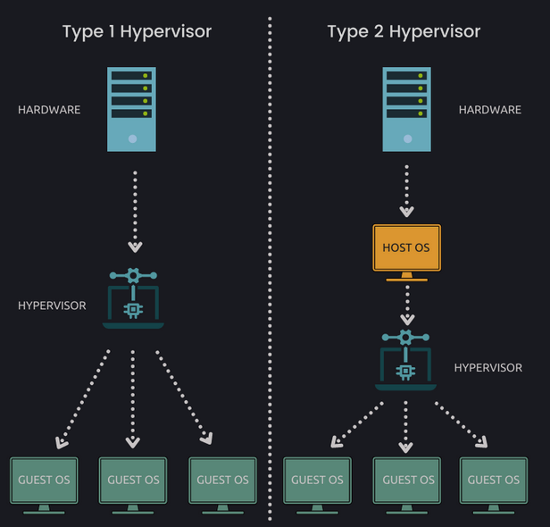
Type of Virtualization ?
nicolas.glassey@cpnv.ch

Slide 13
Type of Virtualization ?
nicolas.glassey@cpnv.ch

Slide 14
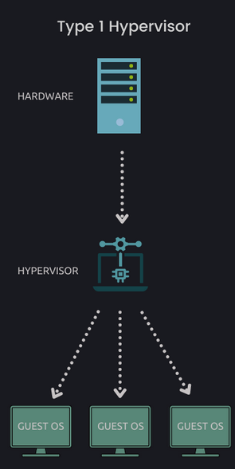
Type of Virtualization ?
Hypervisor - Type I
f
ESXi (VMware vSphere)
Hyper-V (Microsoft)
Open source alternatives (KVM, Xen hypervisor)
Oracle Vm (based on Xen)
Citrix Hypervisor (based on Xen)
nicolas.glassey@cpnv.ch

Slide 15
Type of Virtualization ?
Hypervisor - Type I – Key pointers
Directly installed on a bare-metal system or physical host.
OS installation is not a requirement before installing the Hypervisor itself.
Direct access to hardware (CPU, RAM, Network).
Better security (absence of any extra layer).
1 Hypervisor = 1 Dedicated physical machine.
f
nicolas.glassey@cpnv.ch

Slide 16
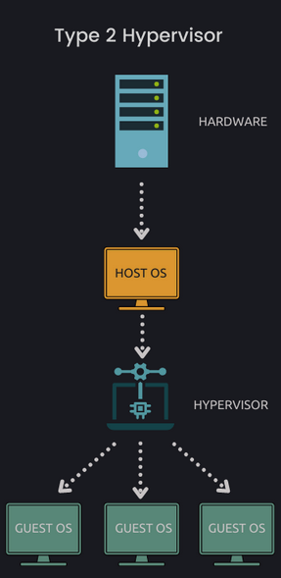
Type of Virtualization ?
Hypervisor - Type II
Virtual Box (Oracle) – Open Source
Workstation and Fusion (VMware)
QEMU
Parallels Desktop
nicolas.glassey@cpnv.ch

Slide 17
Type of Virtualization ?
Hypervisor - Type II – Key pointers
Not Directly installed on a bare-metal system or physical host.
OS installation is a requirement before installing the Hypervisor itself.
Indirect access to hardware (CPU, RAM, Network).
Can cost less and suitable more small business solutions.
N Hypervisors on 1 Dedicated physical machine.
f
nicolas.glassey@cpnv.ch

Slide 18
Benefits of virtualization ?
Virtualization offers substantial benefits for just about any business or development environment.
It has become a core strategy for improving IT efficiency (agility).
nicolas.glassey@cpnv.ch

Slide 19

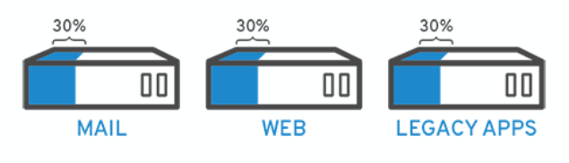
Benefits of virtualization ?
Reduced expenses
f
If the only way to get more resources is to purchase new hardware, that price becomes hefty.
nicolas.glassey@cpnv.ch

Slide 20

Benefits of virtualization ?
Reduced expenses
f
With virtualization tactics, you can take a hard look at your existing infrastructure and identify wasted or idle computing resources.
nicolas.glassey@cpnv.ch

Slide 21
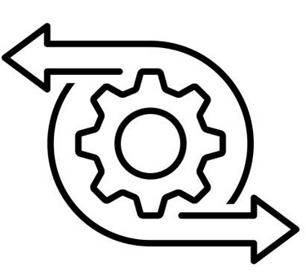
Benefits of virtualization ?
Resiliency
f
nicolas.glassey@cpnv.ch
https://www.flaticon.com

Slide 22
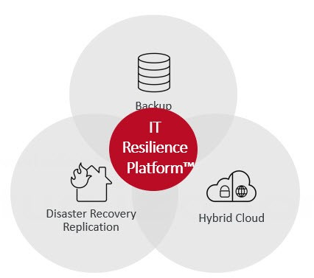
Benefits of virtualization ?
Resiliency – IT Approach
f
IT resilience is this ability of an organization to maintain acceptable service levels when there is a disruption of business operations, critical process, or IT ecosystem.
nicolas.glassey@cpnv.ch
https://ivision.com/blog/modern-disaster-recovery-it-resiliency/

Slide 23

Benefits of virtualization ?
High availability
nicolas.glassey@cpnv.ch
https://www.flaticon.com

Slide 24
Benefits of virtualization ?
High availability
Since you can clone a VM almost effortlessly, you can easily set up redundant virtualized environment.
Virtualization provides an extremely reliable system with no single point of failure in hardware or software (Failover).
Virtualization provides developers constant access (no downtime).
nicolas.glassey@cpnv.ch

Slide 25

Benefits of virtualization ?
Increased efficiency
nicolas.glassey@cpnv.ch
https://www.flaticon.com

Slide 26
Benefits of virtualization ?
Increased efficiency
Virtual environments are much easier to maintain (than physical).
With less hardware to worry about... more time to spend on improving the solution.
By nature, virtual environments are inherently scalable.
nicolas.glassey@cpnv.ch

Slide 27

Benefits of virtualization ?
Easy DevOps
nicolas.glassey@cpnv.ch
https://www.flaticon.com

Slide 28
Benefits of virtualization ?
Easy DevOps
You can test features and squash bugs without affecting your live product.
Facilitates pipeline usage for development, testing and deployment.
Virtualization provides on-demand access to an infinite number of peflectly replicated virtual machines for developers to play with.
nicolas.glassey@cpnv.ch

Slide 29
Bibliography
https://circleci.com/blog/top-6-benefits-of-virtualization/
https://aws.amazon.com/what-is/virtualization/
https://www.redhat.com/en/topics/virtualization/what-is-virtualization
https://www.vmware.com/solutions/virtualization.html
https://linuxhandbook.com/what-is-hypervisor/
https://www.ibm.com/topics/hypervisors
nicolas.glassey@cpnv.ch

