Slide 1
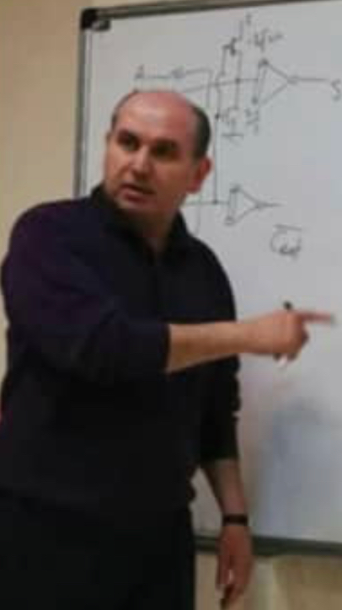
Computer Architecture
Keivan Navi
Cal Poly Pomona University
knavi@cpp.edu
Office hours: Tu/Th 5:25 Pm to 6:55 Pm
Office: 8-49

Slide 2
Outline
Build combinational circuits with basic logic elements
Use Decoder, Encoder, and Multiplexer for implementation of logic circuits.
Explain the structure and function of various adders, registers and counters
Recognize the characteristics of Flip-Flops;
Design sequential circuits using state tables (diagrams) and transition tables;
Describe instruction set architecture and machine organization of a RISC processor (MIPS);
Structure and design arithmetic and logical units for basic integer and floating operations;
Design simple processor architecture, in particular, data paths for a set of basic instructions;
Design the control units for a simple processor architecture;
Explain the principle of pipelining techniques;
Summarize cache and memory organization;
Define cache and storage performance;
Describe alternative computer architectures (multicores, multiprocessors, and clusters).

Slide 3
Detailed Syllabus (Tentative)
Week# 1 | Introduction Basic logic circuits, Buffer, Not, And, Nand, Or, Nor , Xor, Xnor, Majority, Minority, Decoder, Encoder, Mux
Week#2 | Half Adder, Full Adder, Addition, Subtraction
Week# 3 | Logical Unit, Arithmetic Unit, HA+-, FA+-, Approximation Arithmetic
Week# 4 | Multiplication, Division, Compressors, Multi-operand Addition
Week# 5 | Problem solving First Exam

Slide 4
Week# 6 | Latches, Flip Flops, Level triggered versus edge triggered Flip Flops
Week# 7 | Karnaugh Map (K-map), From FF to FF, Sequential circuits using state tables (diagrams) and transition tables
Week# 8 | Counters (Asynchronous, Synchronous) Registers, Shift and Rotate
Week # 9 | Structure and design of the arithmetic and logical units
Week # 10 | Problem solving Second Exam

Slide 5
Week # 11 | Interrupt versus Poling, CD (Error detecting and correcting codes), DVD, Flash memory, I/O and Peripheral devices (Printer. Plotter, Monitors, LED LCD)
Week # 12 | Memory, Cache. Multilevel Cache system Dynamic, Static, Memory Hierarchy, Access time
Week # 13 | Pipeline, Super pipelining, Super Scaling, Super Pipelined Super Scalar
Week # 14 | Designing a simple CPU, Designing more advanced CPU Instruction set architecture and machine organization of a RISC processor
Week #15 | Problem Solving Overall conclusion

Slide 6
Grading Policy
First Exam 25%
Second Exam 25%
Final Exam 30%
Home Work 15%
Final Projects 5%
In-class exercises+ Contribution Positive Effect
Pop up Quizzes 1Extra Credit Maximum 5

Slide 7
Suggested Text & Reference
Patterson and Hennessy, Computer Organization and Design, 5th edition, 2014. Morgan Kaufmann.
State-of-the-art papers

