Slide 1
Unicode with C++
What you never wanted to know and hence never asked for about Unicode and C++

Slide 2
Overview
The Problem
A not so short introduction to Unicode
C++ standard support for Unicode
Some examples using the ICU library

Slide 3
Facing the problem
There are many ways of writing

Slide 4
European scripts
Simple and small character set
  Latin
  Cyrillic
  Greek
Other languages: diacritic symbols
Simple mapping between a code/number and a character

Slide 5
Asian writing systems
Far more complex characters
In many cases a huge number of signs
Different writing direction
Character representation depends on the position in the text.

Slide 6
Example: Arabic script
28 characters but -
Representation depends on the surrounding characters
ه
هـ
ـهـ
ـه

Slide 7
Character Encodings (pre-Unicode)
ASCII – 7Bit (128 characters)
ISO 8859-X – 8Bit (256 characters)
EBCDIC – 8Bit (mainly on mainframes)
GB18030 – 8/16/32Bit (mainly for Chinese)

Slide 8
Different encodings are a problem
You cannot have text in different scripts in a single document!

Slide 9
Intermediate conclusion
The entire IT world is based upon the Latin/English character set!

Slide 10
Unicode
Try to make things better

Slide 11
Unicode at a glance
1.114.112 code points (U+0000 … U+10FFFF)
1.111.998 code points allowed
17 planes (each 65.536 code points)
  Basic Multilingual Plan (BMP) – Plane 0
  Supplementary Multilingual Plane (SMP) – Plane 1
  Supplementary Ideographic Plan (SIP) – Plane 2
  Supplementary Special-purpose Plane (SSP) – Plane 14
  Supplementary Private Use Area A and B (PUA) – Planes 15, 16

Slide 12
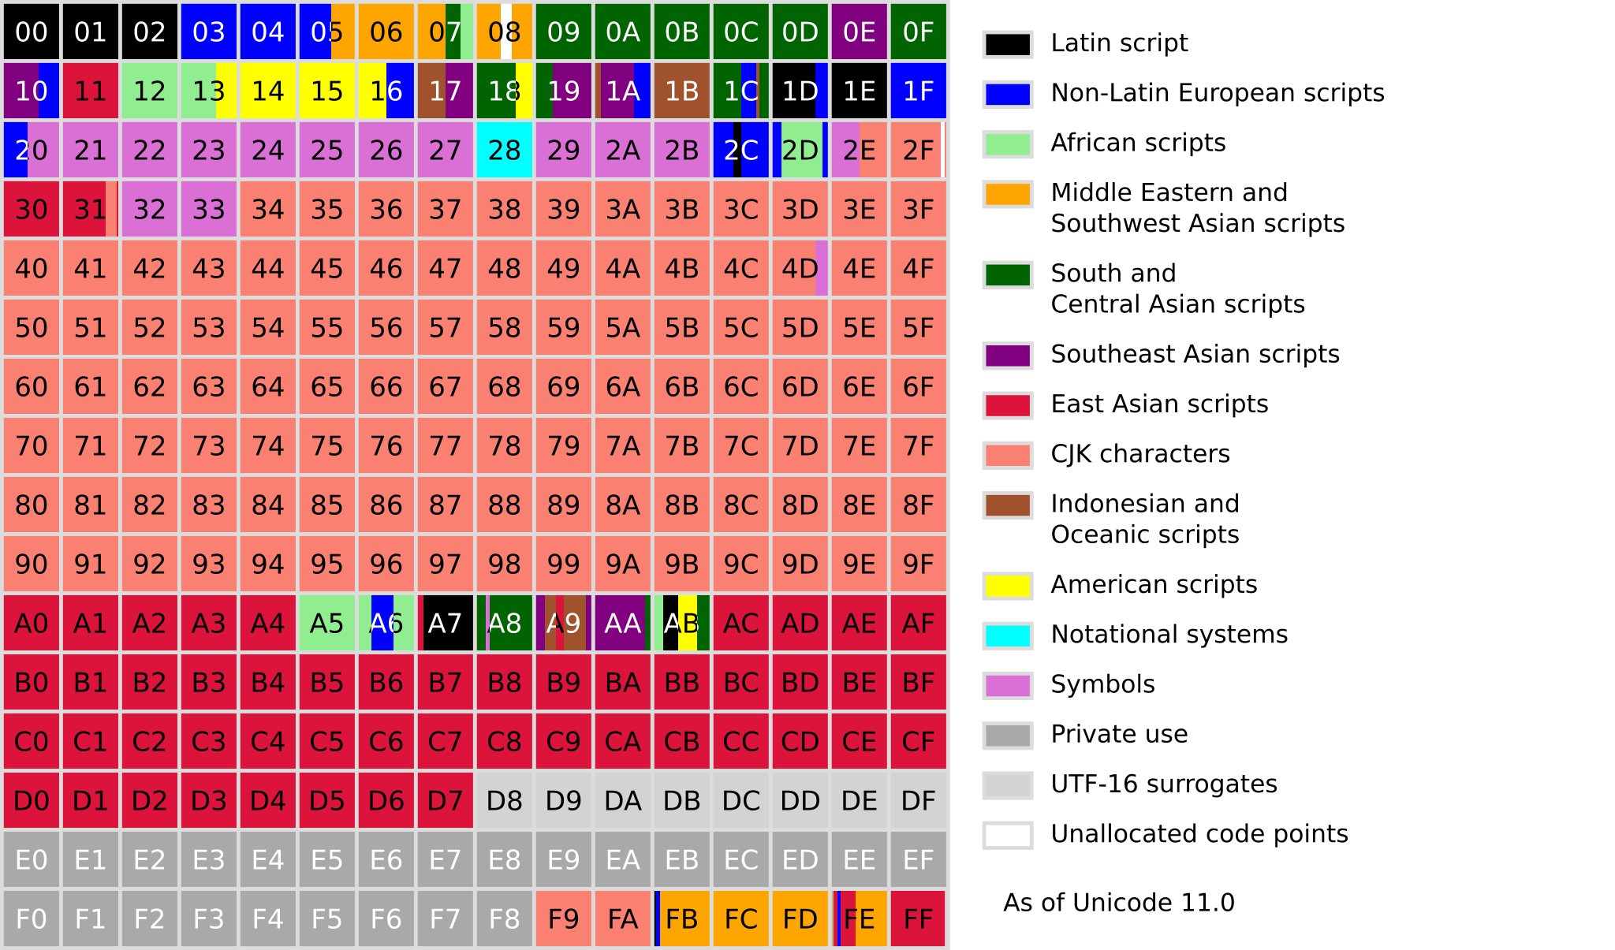
Unicode planes

Slide 13
Unicode is an international standard
Unicode Inc. - develops the standard
ISO 10646 – Universal Coded Character Set (UCS)
History
  1991 – Version 1.0.0
  2018 – Version 11.0

Slide 14
Unicode Encodings (UTF)
UTF = UCS Transformation Format
UTF8 – variable, 1-4 Byte per character
UTF16 – variable, 2 or 4 Byte per character
UTF32 – fixed, 4Byte per character
UTF-EBCDIC

Slide 15
UTF-8 in detail
Unicode area (hex) | UTF8 Bit Encoding
0000 0000 – 0000 007F | 0XXXXXXX
0000 0080 – 0000 07FF | 110XXXXX 10XXXXXX
0000 0800 – 0000 FFFF | 1110XXXX 10XXXXXX 10XXXXXX
0001 0000 – 0010 FFFF | 11110XXX 10XXXXXX 10XXXXXX 10XXXXXX

Slide 16
Unicode Support by the C++ standard
nullptr

Slide 17
Libraries supporting Unicode
GTK
QT
Boost::local (very limitted)
ICU (International Components for Unicode)

Slide 18
C++ via 3rd party libraries
Someone must have done it

