Slide 1
C++ CodeChecker
Ensure Code Quality

Slide 2
Dynamic program analysis
Checking at runtime
uses either annotations or virtualization
strong correlation to testing
tools:
  ASan AddressSanitizer
  valgrind family
  dmalloc and friends
Notes:
valgrind: sandbox/virtual 20fach langsamer
asan: annotations, 2fach langsamer
-> UG Vortrag dazu

Slide 3
Static program analysis
syntax level checks
AST (abstract syntax tree) level checks
Behavioral level checks
Notes:
AST bekannt? Kommt spaeter noch

Slide 4
Static syntax level checks
Lint-like tools
Code convention (google cpplint)
compiler (!)
Notes:
compiler als check tool:
s. compiler switches -> UG Vortrag

Slide 5
AST checker
compiler
clang-tidy
Notes:
zu clang tidy gleich noch mehr

Slide 6
Behavioral check
Abstract interpretation: formal 'execution' of the program as state-changing an abstract machine
  (constexpr evaluation)
Data-flow analysis: follow the instruction flow, calculate sets of possible values
Notes:
keine Tools, weil nichts irgendwie ausgereiftes bekannt
Stand wie vor 25 Jahren beim Studium:(
constexpr eval: s. gcc 5, symbolic execution

Slide 7
Data flow analysis
int f(int i, int j) { // i -> ?, j -> ?
if (i > 0 && i < 10) { // i -> [1,9]
j = i-1; // j -> [0,8]
if (j < 0) { } // dead path
}
part of compiler optimization:
  dead code elimination
  constant folding
  branch prediction
  ...

Slide 8
Overview
Code Checker
dynamisch
statisch
annotations
sandbox
lint-like
AST-based
behavioral

Slide 9
AST abstract syntax tree
tree representation of source code
usually used in compilers
no ambiguity
compact
base for most compiler operations (optimization, code generation)
Notes:
ambiguity: kontext free grammar ->
compact: keine Bloecke, Klammern usw.

Slide 10
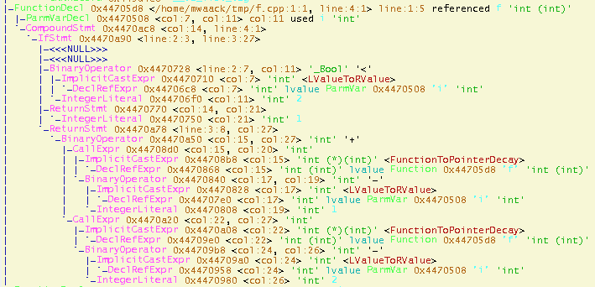
Exploring the AST
clang-check -ast-dump test.cpp
Notes:
Was tut diese Funktion?
test.cpp:
int f(int i) {
if (i < 2) return 1;
else return f(i-1)+f(i-2);
}

Slide 11

clang-tidy
clang based static checker
includes clang analyzer scan-build checks
clang-tidy -list-checks –checks=”*”
clang-tidy -checks=”...” test.cpp --
clang-tidy -fix

Slide 12
clang tidy batteries
boost- Checks related to Boost library.
cert- Checks related to CERT Secure Coding Guidelines.
cppcoreguidelines- Checks related to C++ Core Guidelines.
clang-analyzer- Clang Static Analyzer checks.
google- Checks related to the Google coding conventions.
llvm- Checks related to the LLVM coding conventions.
misc- Checks that we didn’t have a better category for.
modernize- Checks that advocate usage of modern (currently “modern” means “C++11”) language constructs.
mpi- Checks related to MPI (Message Passing Interface).
performance- Checks that target performance-related issues.
readability- Checks that target readability-related issues that don’t relate to any particular coding style.

Slide 13
clang-tidy: do it yourself
add_new_check.py misc variable-shadowing
make check-clang-tools
clang-tidy -checks='-*,misc-variable-shadowing' -list-checks
Notes:
in tools/clang/tools/extra/clang-tidy das add aufrufen
kompilieren, list-checks zeigen,
sourcen in misc/VariableShadowingCheck* zeigen
struktur: registerMatchers – filter auf AST
check – the check
simple.cpp:
class A {
int j;
public:
int i;
};
class B : public A {
int i;
int j;
};

Slide 14
clang-tidy: do it yourself
this page is intentionally left blank
Notes:
registerMatchers auf member decl filtern
Finder->addMatcher(fieldDecl().bind("field"), this);
im check ausgeben:
const auto *field = Result.Nodes.getNodeAs<FieldDecl>("field");
diag(field->getLocation(), "field %0 is here")
<< field
<< FixItHint::CreateInsertion(field->getLocation(), "at this point");
testen
clang-tidy -checks="-*,misc-variable-shadowing" ~/tmp/simple.cpp --
check fertig machen, wieder testen

Slide 15
References
UG Vortrag zu Valgrind und ASan 17.9.2014
Clang compiler warnings https://wiki.attraktor.org/File:ClangCompilerWarnings.pdf
http://bbannier.github.io/blog/2015/05/02/Writing-a-basic-clang-static-analysis-check.html
https://github.com/valpo/clang-tidy-modules
https://en.wikipedia.org/wiki/Data-flow_analysis
https://github.com/google/styleguide

