Slide 1
The power of Enums
Template Techniques

Slide 2
Überblick
Code
Match Enum to Container holding Elements of diverse Types
Wrap Container in Class with Getters & Setters
Static Checks between Enum, Container and any other connected Type
Templatizing functions by Enum
Statically check code to make sure all cases are defined
Bonus: Contained Type Converter
Vorteile
Callable by
  Name
  Index
Name, Index & Type bound together
Dependent Types statically defined
Compile Errors when functions can be called in an unintended way
Functions can be easily augment to incorporate even more static control
Easy and safe expansion

Slide 3
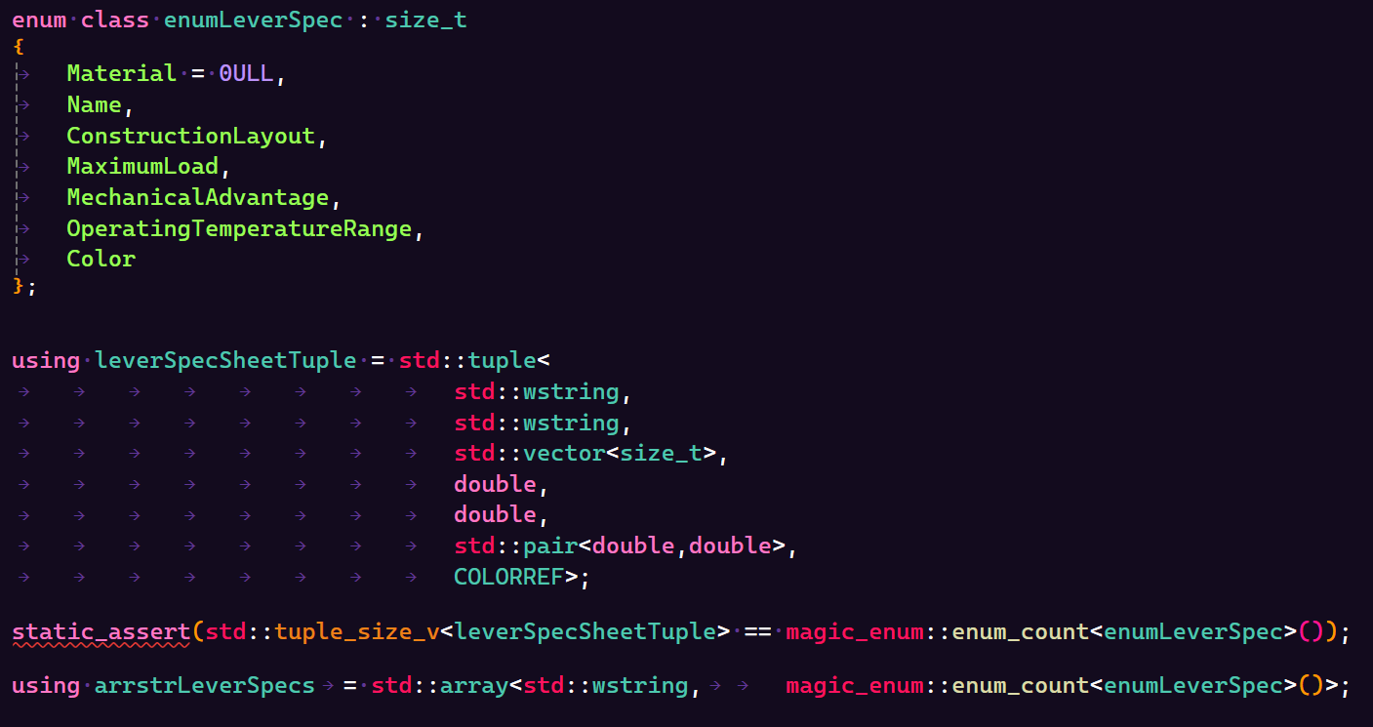
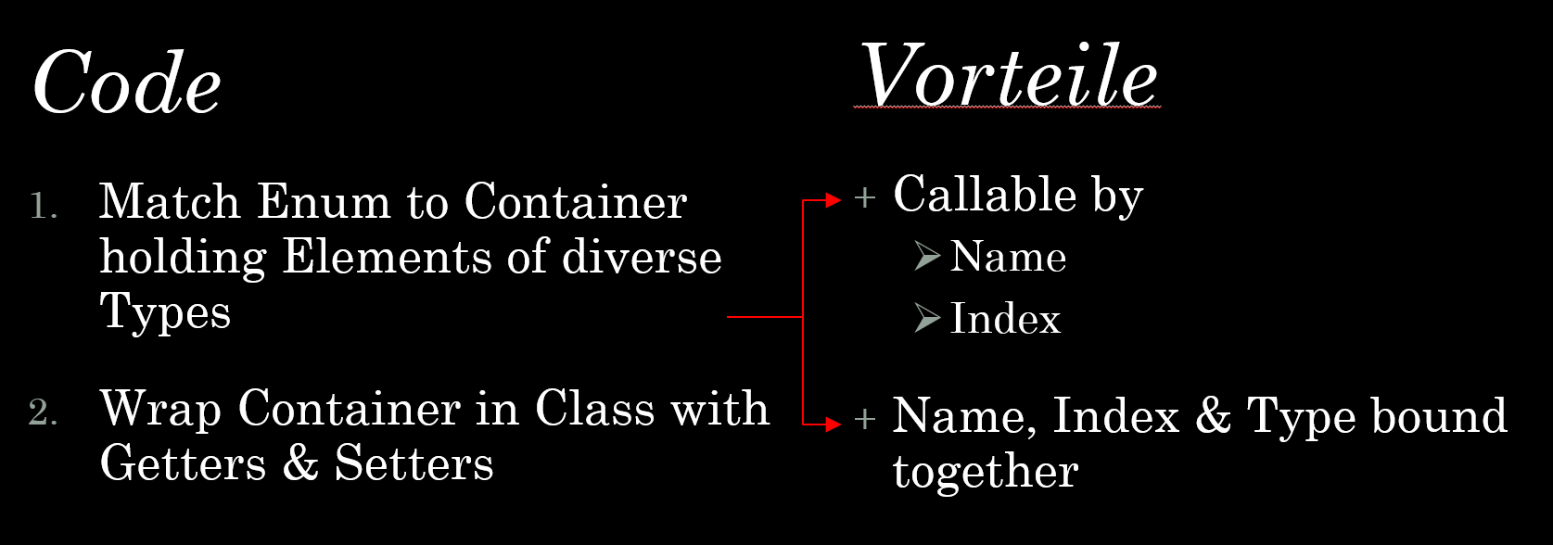

Slide 4
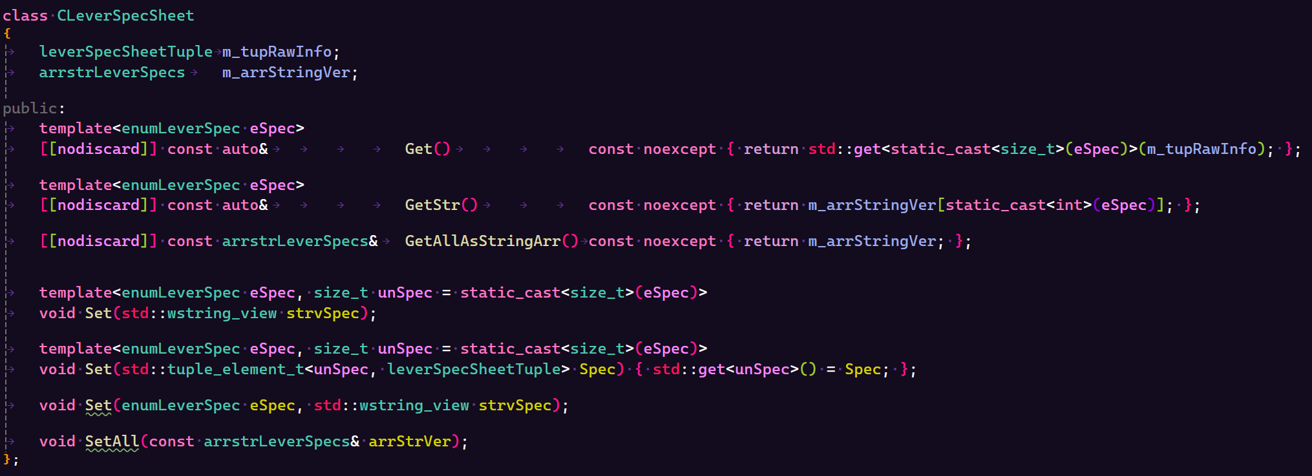

Slide 5
Überblick
Code
Match Enum to Container holding Elements of diverse Types
Wrap Container in Class with Getters & Setters
Static Checks between Enum, Container and any other connected Type
Templatizing functions by Enum
Statically check code to make sure all cases are defined
Bonus: Contained Type Converter
Vorteile
Callable by
  Name
  Index
Name, Index & Type bound together
Dependent Types statically defined
Compile Errors when functions can be called in an unintended way
Functions can be easily augment to incorporate even more static control
Easy and safe expansion

Slide 6
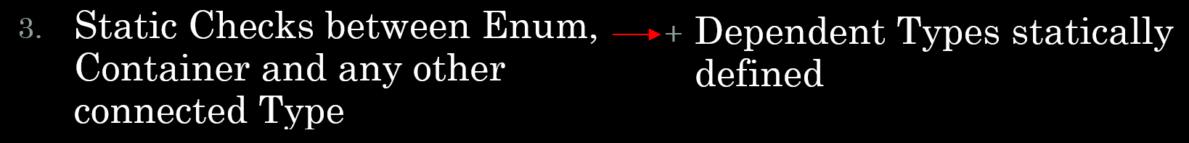

Slide 7
Überblick
Code
Match Enum to Container holding Elements of diverse Types
Wrap Container in Class with Getters & Setters
Static Checks between Enum, Container and any other connected Type
Templatizing functions by Enum
Statically check code to make sure all cases are defined
Bonus: Contained Type Converter
Vorteile
Callable by
  Name
  Index
Name, Index & Type bound together
Dependent Types statically defined
Functions constrained to the finite set of this Enum rather than to infinite possible Types
Functions can be easily augment to incorporate even more static control
Easy and safe expansion

Slide 8
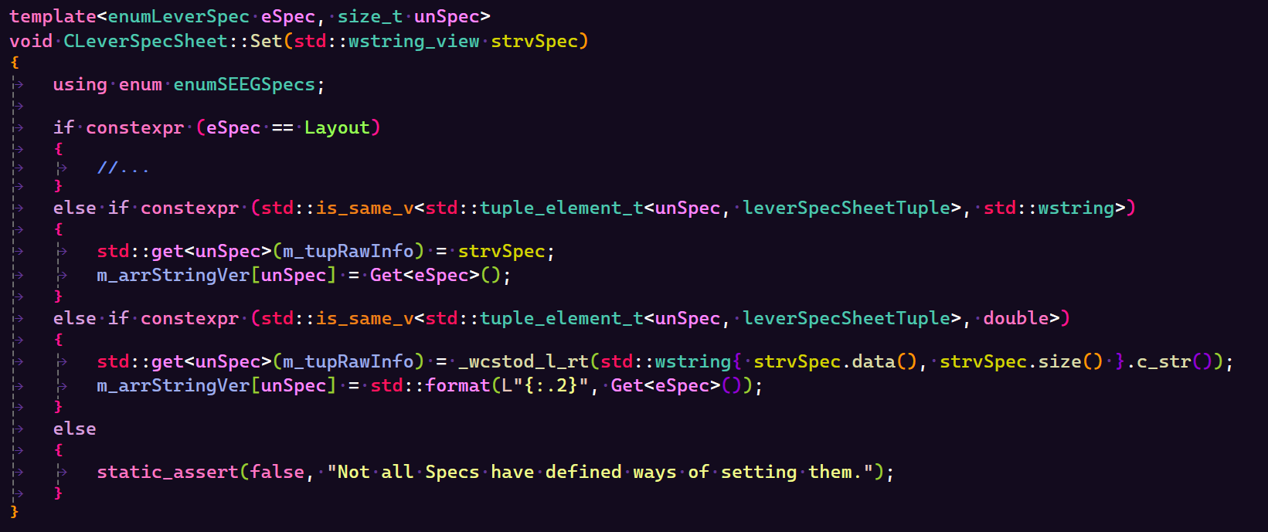
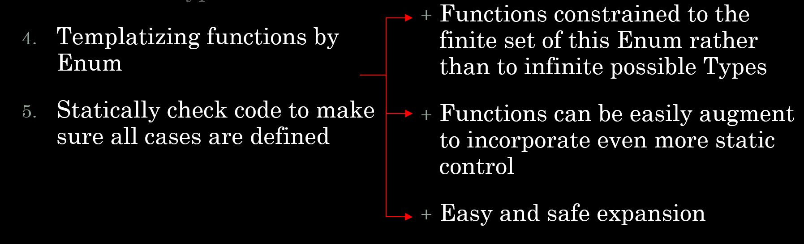

Slide 9
Überblick
Code
Match Enum to Container holding Elements of diverse Types
Wrap Container in Class with Getters & Setters
Static Checks between Enum, Container and any other connected Type
Templatizing functions by Enum
Statically check code to make sure all cases are defined
Bonus: Contained Type Converter
Vorteile
Callable by
  Name
  Index
Name, Index & Type bound together
Dependent Types statically defined
Functions constrained to the finite set of this Enum rather than to infinite possible Types
Functions can be easily augment to incorporate even more static control
Easy and safe expansion

Slide 10
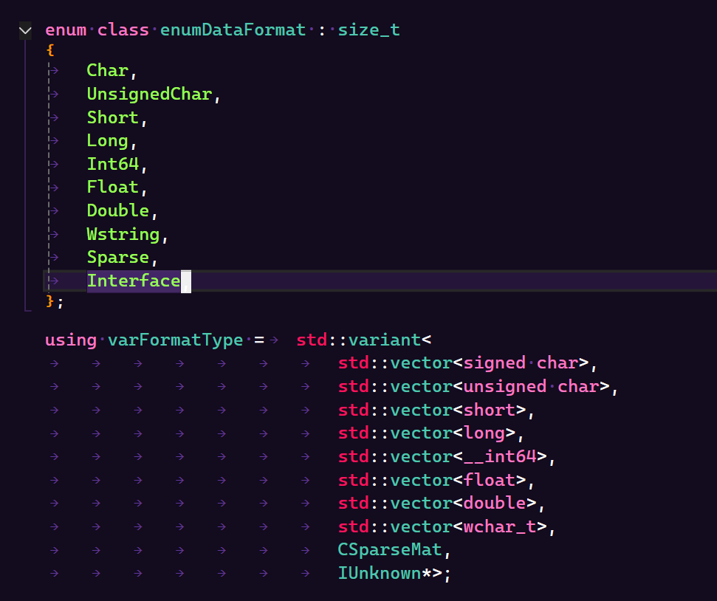
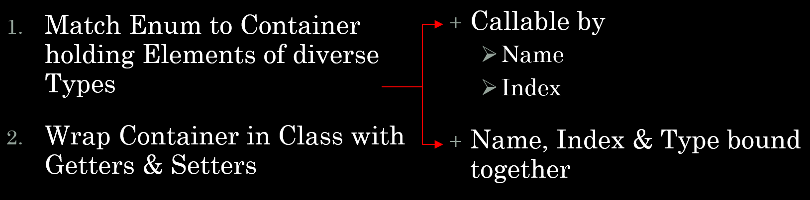

Slide 11
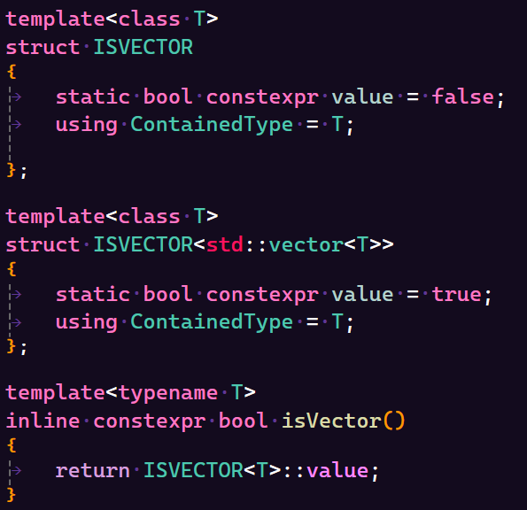


Slide 12
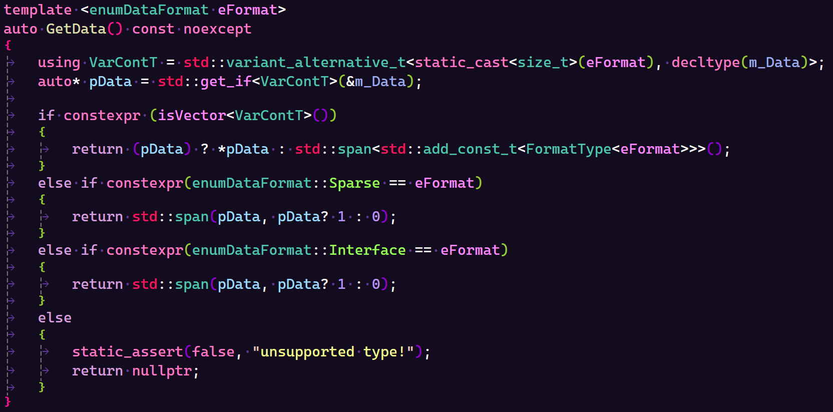

Slide 13

The power of Enums
Template Techniques

