Slide 1
AGO Unduly Lenient Sentencing Application – Beta Assessment Presentation 17 November 2023

Slide 2
Agenda
Introductions to the team | 10 minutes | 12:00-12:10
Introduction to AGO ULS | 15 minutes | 12:10-12:25
Service Show & Tell | 35 minutes | 12:25-13:00
User needs | 20 minutes | 13:00-13:20
Design and Content | 20 minutes | 13:20-13:40
Technology | 20 minutes | 13:40-14:00
Questions and follow-up | 60 minutes | 14:00-15:00

Slide 3
Introductions

Slide 4


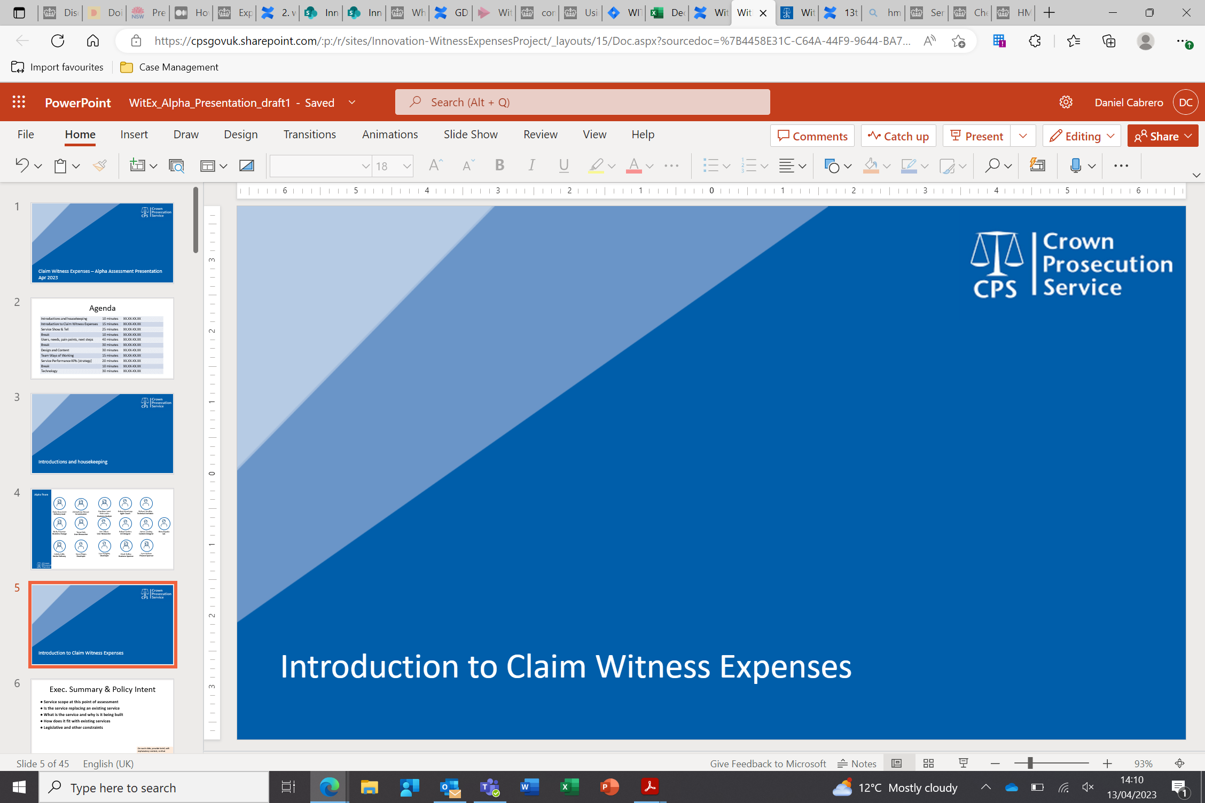
ULS Team
Dave Ward
Product Owner
Balli Sandhu
Product Owner
Nicola Young
Business Lead
Rachael Davies
Product Owner
Still within AGO, not on project
Skill
Ben Wagner
Business Analyst
Nazim Cheema
BA/Delivery
Stephen Lomas
Senior Developer
Muhammed Islam
Developer
AGO Civil servant
Skill
Left CPS
Skill
Bavneet Shergill
Business Analyst
Oluchi Onuoha
Business Analyst
Meadhbh Major
Delivery Manager
Michael Young
Developer
Team members in chronological order
CPS Civil servant
Skill
Contractor
Skill

Slide 5
Sponsors
Astrid Goodwin
Business Sponsor
Janine Durham
Accessibility Testing
Joe Nnabugwu
Accessibility Testing

Slide 6
Current AGO ULS Team
Service Owner
The team wishes to present each section in its entirety first and gather questions at the end of that section
Rachael Davies Product Owner
Nicola Young Business Lead
Business Analysts
Oluchi Onuoha
Business Analyst
Bavneet Shergill
Business Analyst
Technical
Stephen Lomas
Developer
Michael Young
Developer
Delivery
Meadhbh Major
Delivery Manager

Slide 7
Introduction to AGO ULS

Slide 8
Why was this project initiated?
Labour intensive and time-consuming process
Prone to duplication and data quality errors
Increase in number of ULS referrals to AGO
Increase in cases exacerbated existing issues
Opportunity to increase public confidence and support future growth
In 2021 AGO received a recommendation for a single casework management system

Slide 9
Executive Summary
Discovery
March 22 to May 22
Three main processes were identified that form part of overall ULS process, with the addition of a fourth annual stat process
7 user types and their responsibilities were identified
Alpha
May 22 to October 22
Formal assignment of a product owner from AGO
Private Beta
Nov’ 22-Oct’ 23
10 artefacts related to the process were identified
4 reporting views were identified
540 product backlog items
14 features
It was established at this stage that the document management and storage element would not be included in this first phase of delivery
Notes:
Confirm resourcing at this stage Discovery started with Ben, Naz took over. Dave/Balli/Nicola Alpha – Naz and Steve, Mo too. Balli / Rachael / Nicola Private Beta – Naz, Steve, Mo. Bav joined Jan 23, Oluchi joined June, Me July

Slide 10
AGO ULS Show & Tell

Slide 11
Users Needs

Slide 12
1. Understanding users and their needs
What was done
What’s worked well
User identification
AS-IS and TO-BE process mapping
User journey mapping
Products
Key stakeholders/SMEs workshops
What could have enabled
Lessons learnt
Build throwaway prototypes
Utilising UR (User Researcher)
Consistent engagement with users.
User centric approach & user personas
Wireframe feedback
Notes:
- Understanding the problem not solutionising -UR to understand what users need – any additional research/analysis? - quick throwaway prototypes to test hypotheses?
- Products = Document analysis , AS-IS and TO-BE process flows.

Slide 13
2. Solve a whole problem for users
What was done
What’s worked well
Designed strictly in scope
Single Sign On (SSO)
Worked in the open
Implemented requirements to meet AGO policy
Working closely with AGO stakeholders
What could have enabled
Lessons learnt
Feedback from other team, AGO staff etc during show and tells
Engagement with users at every cycle of the project
Utilise AGO all staff meeting
Notes:
- any constraints found?
- services scope on how users think and what they need -how service will join up with other parts of user journey so whole problem for users
- alternatives to creating a service considered?
- work in the open so orgs know what is happening (collaboration and reducing duplication) - minimising #of times users have to provide same info

Slide 14
3. Provide a joined-up experience across all channels
Engagement with AGO front life staff and key stakeholders
E2E testing prior to UAT
Handover process
What was done
What’s worked well
Inviting AGO frontline staff to all the relevant ceremonies
Process to resolve issues/bugs once live
Improvements on offline services
What could have enabled
Lessons learnt
Feedback during S&Ts
User Researcher sessions
Importance of feedbacks from key stakeholders during show and tell
User researcher resource
Traceability of requirements
Notes:
- service (proj) team empowered to find best way to solve problem - front line op staff / users attend UR and contribute to prioritisation - designers and UR working with end users
- data/UR gathered on online service aspect informs offline improvements - front line ops staff know how online service works, can share with users and have a process for keeping end users up to date with changes
- understanding of how service will impact offline services/processes - plans to increase digital uptake to not involve making it more difficult to access offline channels

Slide 15
4. Make a service simple
What was done
What’s worked well
Straightforward navigation
AGO UAT
Training guides and videos
Creating accessible service
Engagement with Customer Management team
Preparing user for “go live”
Service works with a range of devices
What could have enabled
Lessons learnt
User Research & sessions
Content designer
Setting expectations
Maximise UAT
Notes:
- user can use service intuitively and it is as simple as possible – success first time with minimum help
- test for usability frequently with actual /future users using appropriate research techniques
- test all parts of service user interacts with (online and offline)
- design service to work with range of devices as required by users

Slide 16
5. Make sure everyone can use the service
What was done
What’s worked well
Engagement with the accessibility team
Integrated speech recognition software and screen readers
SSO
“Need help” functionality
ITA engagement
Preparation for go live sessions
What could have enabled
Lessons learnt
UR sessions
Access to accessibility software earlier
Absence of UR – BA user sessions
Notes:
- meet accessibility standards
- avoid exclusion of any users
- carry out research with service audience including those with access needs
- make sure digital skills and internet access do not exclude any users

Slide 17
Providing a Good Service

Slide 18
6. Have a multidisciplinary team
What was done
What’s worked well
Resources assigned from the Low Code team
Flexibility of role responsibilities
Access to business knowledge
Access to SMEs in central functions
Used available skills
What could have enabled
Lessons learnt
User Researcher
QA Tester
Clearer routes to specific SMEs
More F2F AGO project meet ups
Lack of QA testing and UAT design expertise
Consistent access SME resources and understanding availability
Notes:
- multidisciplinary meeting what needs to be achieved and co-located
- people on team with expertise in service delivery (Rachael and Nicola for offline) and Steve for back end - access to SMEs
- any contractors on a sustainable basis
1. BA/Devs functioned as testers during E2E testing.
The development team consists of Developers and Business Analysts, supported by the Delivery Manager and Business Lead where appropriate/ required
The delivery aspect includes Product Owner, Business Lead and Delivery Manager
2. central SME function - to support with delivery including, but not limited to, Data protection for DPIA, Cyber sec for pen test planning / reviewal
3. Clearer routes to SMEs – struggling to access some resources, e..g May- end of July to access cyber sec, , especially during the start and end of each project phase to encourage reflection/lessons learnt (this would have also been helpful changes in project team, handover etc)
4. Testing gaps filled by BA/DM/Devs - but UAT not just structured scripts encourage natural use of test system and protect time for it. Consistent access i.e. repeatable method

Slide 19
7. Use agile ways of working
What was done
What’s worked well
Scrum framework and ceremonies
Azure DevOps for work tracking
Miro for collaboration (BA workshops/Retro)
Trust in team members
Level of support
Access to senior AGO stakeholders
Adaptation
What could have enabled
Lessons learnt
Tools – handover
Central governance
MoU
Utilising functionality of tools more effectively, e.g., templates in DevOps
Velocity and capacity
Structured planning sessions – goals, effort and prioritisation
Work tracking (accountability and clarity)
Notes:
- Inspect, learn, adapt (agile)
- governance arrangements
- Test service with senior stakeholders where appropriate
- adapt given the amount of change within project team

Slide 20
WoW - Ceremony calendar view
TUESDAY | WEDNESDAY | THURSDAY | FRIDAY | MONDAY
Daily Stand Up Show & Tell | Daily Stand Up Retrospective | Daily Stand Up | Daily Stand Up | Daily Stand Up
Daily Stand Up | Daily Stand Up | Daily Stand Up | Daily Stand Up | Daily Stand Up Sprint Planning
SPRINT WEEK 1
SPRINT WEEK 2
Additional ceremonies ran ad-hoc, e.g. backlog refinement
Used S&Ts bi-weekly to presents most recent developments to stakeholders
MS Teams is primary tool outside of ceremonies
DevOps used for work management and MS Teams to store project artefacts
Miro has been used to capture the output brainstorm sessions and workshops
Notes:
S&T - incorporating their feedback into the iteration of the design of the new solution

Slide 21
8. Iterate and improve frequently
What was done
What’s worked well
Feedback from S&Ts
Feedback process during public beta
Wireframes
Feedback from product owner and business lead
What could have enabled
Lessons learnt
More open dialogue with business
Focussed UR resource
Prototypes
Actively engage end users
Increased interactivity for Sprint Reviews
Prototypes
Notes:
- Iteration for all phases including live.
1. Wireframe fed app design 2. feedback throughout to shape iterations and improvements as well as S&T and UAT feedback, another example is colour schemes for the app
3. Business dialect – S&T sometimes feel one sided or light touch 3. UR resource to support feedback from users and involve users more deeply to invoke feedback
4. Iteration and improvement could be more effective if there was more involvement from end users and their feedback 4. Even without a UR, could project team make sprint reviews more interactive
4. Prototype in alpha (ULS alpha more focussed on process, data fields + data modelling / architecture)– would have enabled more/early user feedback HOWEVER would have required more development resource or UI

Slide 22
9. Create a secure service which protects users’ privacy
What was done
What’s worked well
Security by design – DPIA and auditing requirements
Retention designed to match AGO policy
Permissions based access
SSO validating via Azure
Penetration testing
Data encrypted at rest (include DB storage & backups)
Encrypted databases with industry standard AES-256 encryption algorithm
HTTPS/SSL encryption is enforced at platform level for all web applications
Data in transit uses TLS 1.2
Outsystems Sentry – more details later
Access to stakeholders
What could have enabled
Access to SMEs for sign off
MoU for budgeting
Lessons learnt
RTP led to creation of platform level collation of RTP – opportunity to explore platform
Notes:
- Actively identify security/ privacy threats - Plan + budget to manage security for service lifecycles
- Collect/ process user personal info in secure and private way - follow cookie guidance - approach to identity assurance/ authentication that balances risk proportionately
- work w business and info risk tams to ensure service meets security risk requirements - vulnerability and pen testing
2. Stakeholder access– Cyber Security for pen testing and Data Protection
3. Delay in access to stakeholder for auditing/ dpia from cyber sec

Slide 23
10. Define what success looks like and publish performance data
GDS Standards
CPS Benefits Process
This was not in the original scope as no performance measurements were designed into the system, aside from any standard platform measurements
Could have spent more time designing performance /reporting?
A cost benefit analysis was undertaken during Discovery (March 2022 - Discovery Cost Benefit Analysis.pdf) with the summary being that they will need to be revalidated after the process improvement work
Lessons learnt: Benefits by design if a new project
Publishing to gov stats
Proposed
The system supports the publish of stats posted to gov.uk that AGO are required to publish on a weekly and an annual basis
CSAT
Have arranged opportunity for user feedback within MS Forms initially
Notes:
- identify metrics to measure performance + Track against and use data to support problem fixing
- CSAT (at Alpha this was agreed that CSAT would be captured externally from the system) which can be captured within Outsystems

Slide 24
Using the Right Technology

Slide 25
11. Choose the right tools and technology
What was done
What’s worked well
Outsystems chosen as appropriate platform
New Outsystems pipeline provisioned
Legacy system to be managed by AGO
Mirrored the SSO process currently used by CPS
Provision of new pipeline went smoothly
Existing Outsystems experience on the team
Joined up working between project team and CPS IT to enable authentication
What could have enabled
Lessons learnt
Visio – for process mapping
Better developer understanding of SSO and authentication process
Access to relevant tools/technology needed prior to project start
More detail needed in plans for enabling authentication for a new pipeline
Notes:
- tool/ tech to create a good quality cost effective service - show good decisions re which technology - understand total cost of ownership of tech
- effective approach to legacy tech service integrates with/depends on – N/A

Slide 26
12. Make new source code open
What was done
What’s worked well
New AGO global config and styling created
Audit module designed to potentially form the basis of a global Audit system
Source code cannot be currently made open due to licensing and data portability
AGO global modules and styling are ready for use on other Low Code projects
Time spent on improved audit functionality will benefit other projects in the long run
What could have enabled
Lessons learnt
Clarity on making code or components open and recommended best practice
Centralised governance on sharing low code components to the Outsystems Forge
Need more clarity on Outsystems data portability
Spend more time considering if components can be designed for reuse on other projects
Notes:
-write code in open from start and publish in open repository (minus sensitive info)
- keep ownership of intellectual property of code created as part of service but make it available under open license

Slide 27
13. Use and contribute to open standards, common components and patterns
What was done
What’s worked well
Utilised existing Azure config when setting up authentication on the new pipeline
Basis of re-useable global Audit module created.
CPS global modules used as template for AGO
AGO global modules available for new projects
Followed Outsystems architectural best practice
The global config and styling for the new pipeline means future projects will benefit in time saved
Work on Audit module provides the basis for a re-useable global audit system
Benefitted from years of development and refinement of the CPS global components
What could have enabled
Lessons learnt
A pre-existing library of global modules and styles for the new pipeline would have saved time
More defined AGO branding would have enabled the theme to be designed more efficiently
Factor in more time to spend in development to assess re-useability of components being created
Communicate more often with developer community regarding re-useable components
Notes:
- use open standards (propose new one if not existing)
- use standard gov tech components - maximise flexibility in use of technology
- use common components/patterns and share any new ones created/adapted

Slide 28
14. Operate a reliable service
What was done
What’s worked well
Post-live patches pushed to production
Project team provided feedback from end users and fed through the CI/CD process promptly
Monitoring of error logs through service centre
Testing of new environments to ensure reliability
App has had no downtime since going live
Encouraging feedback from end users
No showstopper bugs
Audit functionality has enabled effective incident resolution
What could have enabled
Lessons learnt
Implementation of CSAT functionality
Improved engagement from some user groups to reinforce common understanding of requirements and their implementation
Improve engagement with Application Support
More UAT for data migration to identify additional potential bug scenarios
Notes:
- maximise uptime/ speed of response for service - able to deploy regular software changes - carry out QAT - test service in environ as similar to live as possible - appropriate monitoring in place - actively work towards any org/contract issues that could impact availability

Slide 29
Closing remarks

