Slide 1


Future Case Management
Technical Approaches for Integrating with the CMS system
23rd May 2023

Slide 2

Contents
This pack includes:
The latest depiction of the technical approaches available for delivering benefit (once the need is understood through e.g. Discovery )
A description of when we would look to use those technical approaches
A start on describing how much we need to build, which ultimately depends on the Discoveries into business problems in scope for FCT

Slide 3
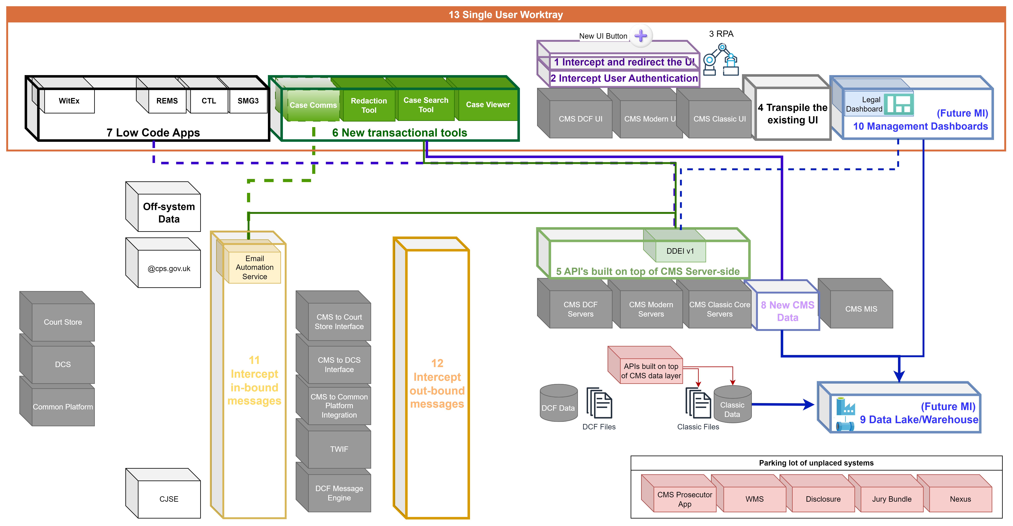
Technical Approaches

Slide 4
What techniques can we use to tackle problems without changing CMS?
Technical Approaches
Technique | When to use the technique
1 Build on top of the existing UI | If the problem is with “20%” of the existing functionality, this technique saves having to recreate the “80%” that is fine
2 Use corporate authentication
3 Transpile the Uis to latest standards
4 Automate a user’s actions | If the user’s actions aren’t adding intellectual value, but simply manually bridging disconnects between systems, and there is ultimately a strategic solution
5 Create an API “on top” of CMS server-side services i.e. DDEI | If the problem needs data to be retrieved from and/or returned to CMS Limited to existing CMS data and ‘manual’ workloads
6 New transactional casework tools | With APIs to CMS available, new tools can be built provided they don’t overload the underlying system
7 Low Code Applications | A Low Code Platform accelerates solutions provided that the problem fits within the constraints of the platform.
8 New CMS Data | We can create new data services for new and migrated datasets
9 Data Lake / Warehouse | If required volume of data is too great for the API approach and the timeliness aspect of the requirement is weekly or daily (maybe hourly depending on CMS performance) we can take a read-only copy of the data
10 Management Dashboards | Once the data is available we can create dashboards for both operational and performance management
11 Intercept in-bound messages | If the problem is with ingesting messages being received from an external party
12 Intercept out-bound messages | If the problem is with generating messages to be sent to an external party
13 Add to a single User Homepage | If a user is required to work across multiple caseworking tools seamlessly
Create an API “on top” of CMS database and file store | If the problem needs to read & write the raw data underlying CMS and not through the application logic that manages it

Slide 5
What techniques can we use to tackle problems without changing CMS?
Technical Approaches
Technique | How much do we need? | Current coverage
1 Build on top of the existing UI | Depends on the Business Need | Proposed as the next PoC
2 Use corporate authentication | Likely to be a single iteration of a service | Proposed as the next PoC
3 Transpile the Uis to latest standards | Likely to be the whole UI or not | Proposed as the next PoC
4 Automate a user’s actions | They should only be temporary, so we keep a count of them for the backlog | An interim data extract method for Dashboards A way to generate Test Data
5 Create an API “on top” of CMS server-side services i.e. DDEI | Maximum extent would be the full scope of CMS, but we might not need all of that | Core to Polaris and Email Automation. Soon to be in Production
6 New transactional casework tools | Depends on the Business Need | Polaris is building 3 – a new display for case data, a search tool and a redaction process
7 Low Code Applications | Depends on the Business Need | ~30 applications not integrated with CMS
8 New CMS Data | Depends on the Business Need | Not in any current proposal
9 Data Lake / Warehouse | Maximum extent would be a full copy of CMS data and files Future MI should ask for it all as a single CR. | The approach for Future MI and Operational Dashboards. Future MI is going to ask for a 10 year anonymised extract and then a daily update
10 Management Dashboards | Depends on the Business Need | 1 under construction
11 Intercept in-bound messages | There is a finite number of in-bound channels and messages within them. Receipt of Police Files Discovery will prioritise | The Email Automation Service will go live for North and South London areas. The Files Received from Policing discovery may highlight more
12 Intercept out-bound messages | As above | None. The Files Received from Policing discovery may highlight more
13 Add to a single User Homepage | One | None. We could start by brining Low Code, Polaris and the Operational Dashboard together.
Create an API “on top” of CMS database and file store | Only required as an option if DDEI isn’t performant | CDA and CDE both failed because of technical and commercial difficulties with this approach

