Slide 1
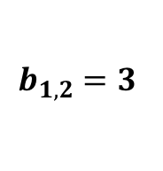
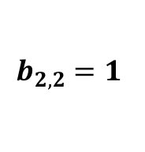
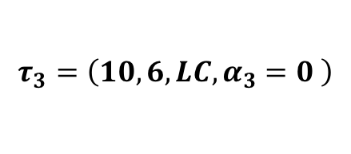

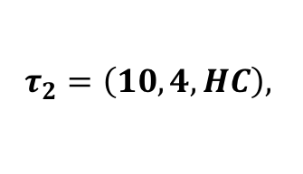
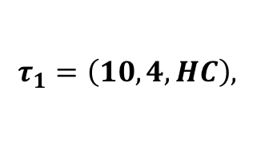
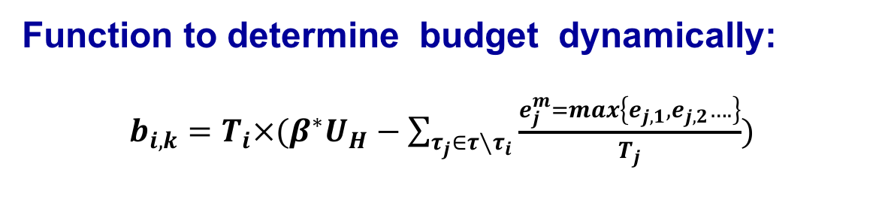
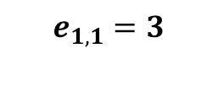


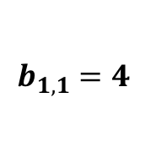
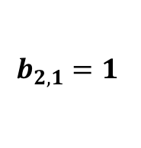
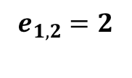
Function to determine budget dynamically:
$b_{i,k}=T_{i}×(β^{∗}U_{H}−\sum_{τ_{j}∈τ∖τ_{i}}{\frac{e_{j}^{m}=max\left\{e_{j,1},e_{j,2}….\right\}}{T_{j}}})$
$$τ_{1}=\left(10,4,HC\right),$$
$$b_{1,1}=4$$
$$b_{1,2}=3$$
$$e_{1,1}=3$$
$$e_{1,2}=2$$
$$τ_{2}=\left(10,4,HC\right),$$
mode-switch
$$b_{2,1}=1$$
$$b_{2,2}=1$$
$$e_{2,1}=1$$
$$τ_{3}=\left(10,6,LC,α_{3}=0 \right)$$
$$B_{3}\left(L\right)=6$$
$$e_{3,1}=6$$

