Slide 1
Federated Adaptation of Foundation Models
From Time-Series Modeling to Knowledge Transfer
1
2
3
FedTime
FedPFT
FedPromo
Temporal inputs and
parameter-efficient adaptation
Proxy construction and
update fidelity
Cross-architecture features
and classifier transfer
4
5
FedMKT
FedProxy
Output alignment and
mutual knowledge transfer
Proxy compression and
conflict-aware fusion
1

Slide 2
FedPFT
Mapped proxy parameters
Proxy fidelity
Feature compatibility
FedTime
FedPromo
Task / input interface
Aligned features + head
Output alignment
FedProxy
FedMKT
Conflict-aware parameter fusion
Update conflicts
Aligned output knowledge
2

Slide 3

Paper 1
FedTime：A Federated Large Language Model for Long-Term Time Series Forecasting
Raed Abdel-Sater and A. Ben Hamza
Published in: European Conference on Artificial Intelligence (ECAI)
Published Time: 2024
3

Slide 4
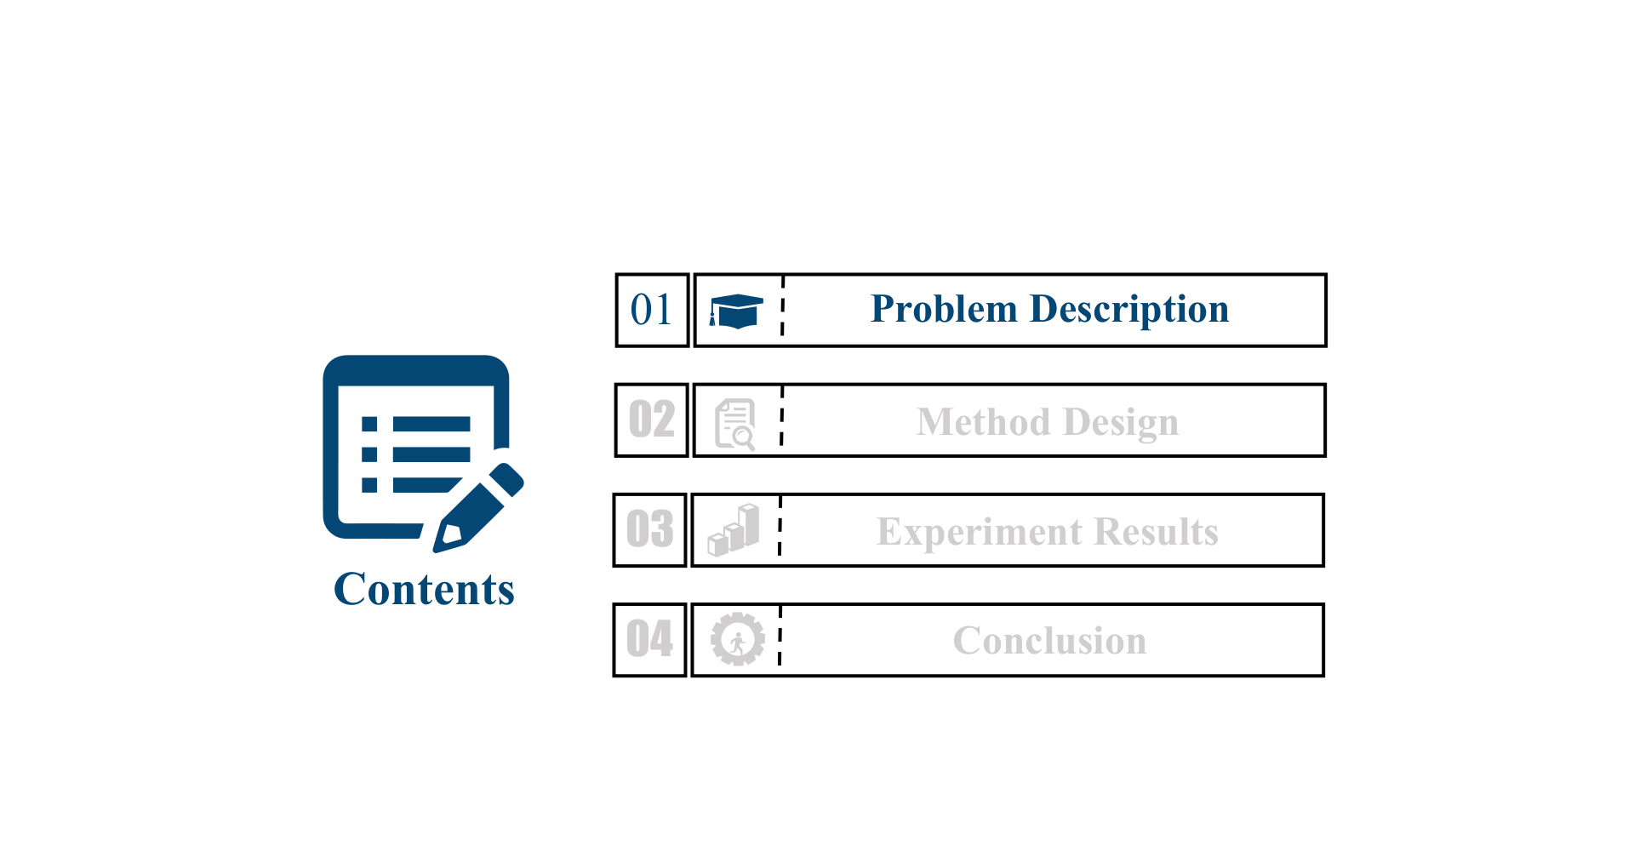

4

Slide 5
Distributed data and a non-text prediction task
Private time series remain on different devices, while a server coordinates collaborative learning.
A language-model backbone requires an explicit interface for continuous numerical inputs and future-value prediction.
5

Slide 6
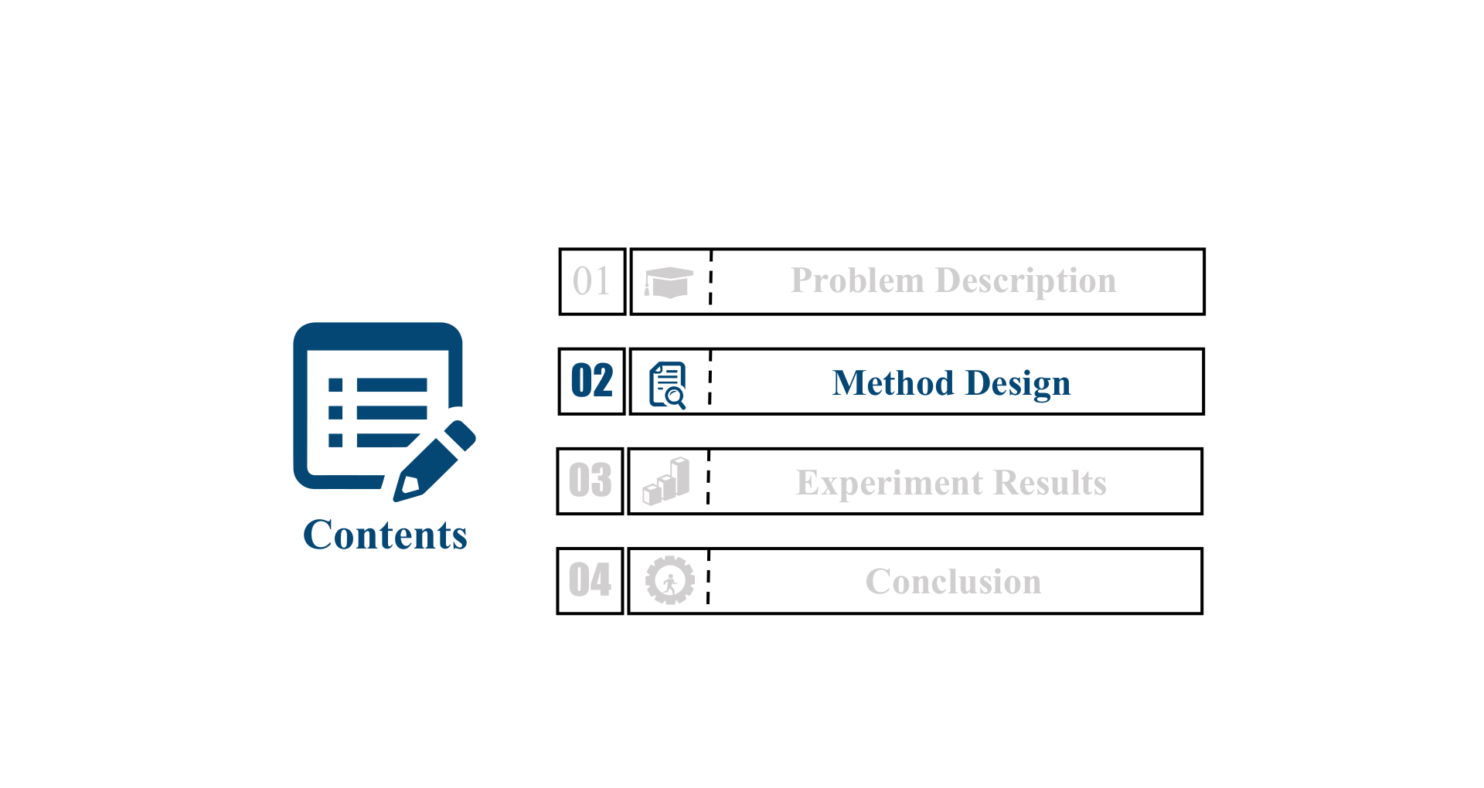
6

Slide 7
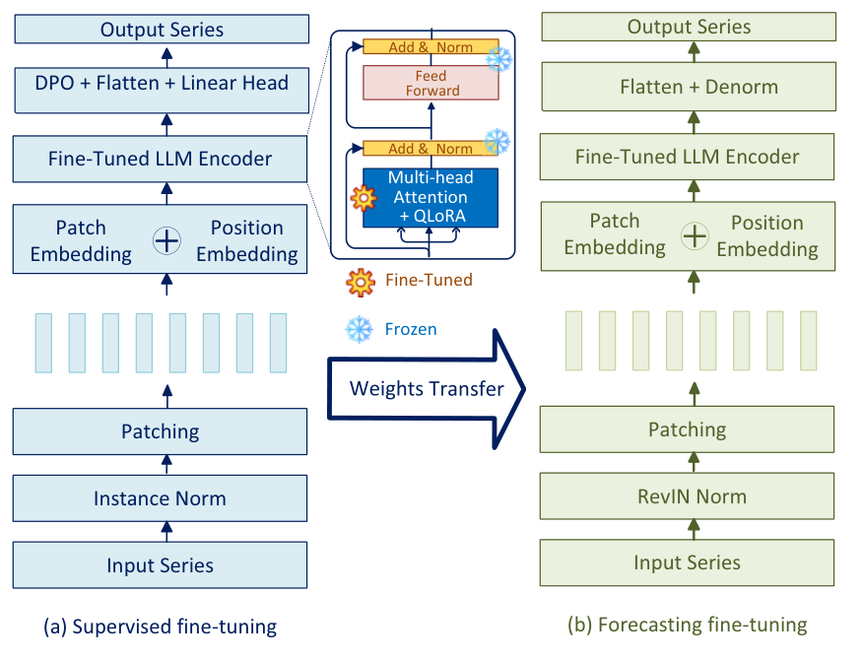
A two-stage local forecasting architecture
Supervised fine-tuning and model alignment precede forecasting fine-tuning.
The backbone is transferred between stages; normalization and output processing differ.
7

Slide 8
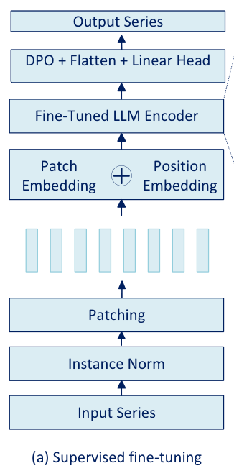

Channel independence and patch embeddings
Each variable is treated as a univariate series with shared backbone weights.
Each patch is projected to the hidden dimension; positional embeddings preserve patch order.
8

Slide 9
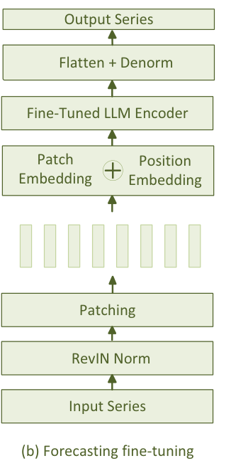
Normalization and recovery of numerical scale
Instance normalization is used in the supervised stage.
RevIN normalizes each input and reverses the transformation after forecasting.
9

Slide 10
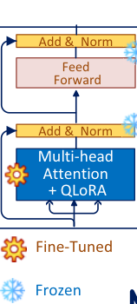
QLoRA reduces trainable state, not backbone execution
Low-rank updates are combined with quantized pretrained weights.
The paper reports 1.2% trainable parameters; the LLM backbone still runs on each client.
10

Slide 11
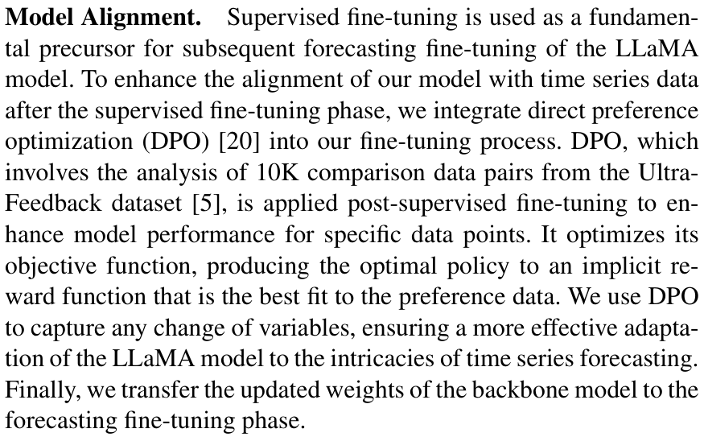
DPO alignment: the reported procedure and an open detail
The authors apply DPO after supervised fine-tuning using 10K UltraFeedback comparison pairs.
The paper does not fully specify how these preference pairs connect to numerical forecasting targets.
11

Slide 12
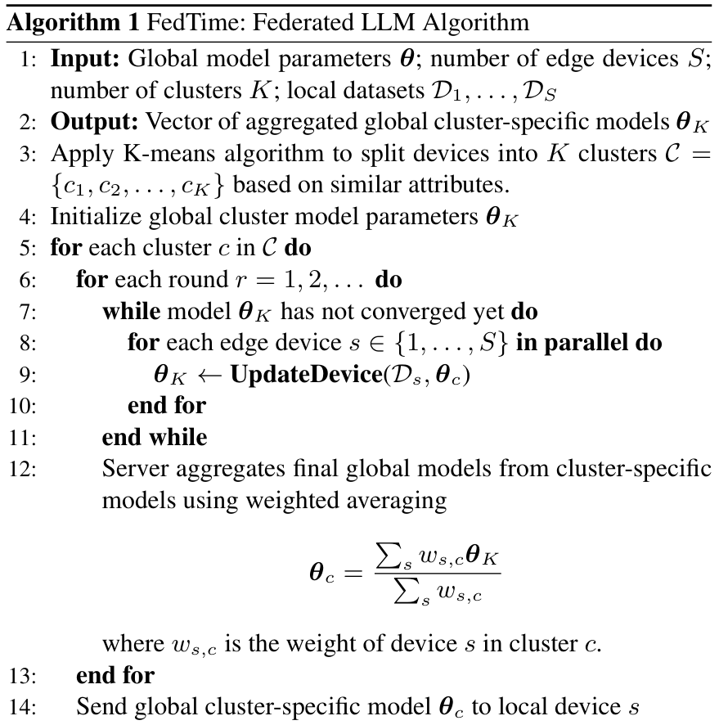
Clustered collaboration and local updates
K-means groups clients before training; cluster-specific models are aggregated.
Clients train on local sequences. The implementation uses FedAdam to update QLoRA parameters.
12

Slide 13
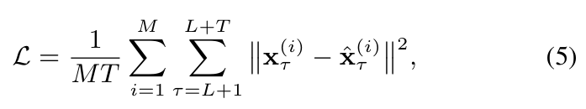
The optimization target is future numerical error
The loss averages squared errors over M variables and T future time steps.
The forecasting objective is separate from language preference alignment.
13

Slide 14
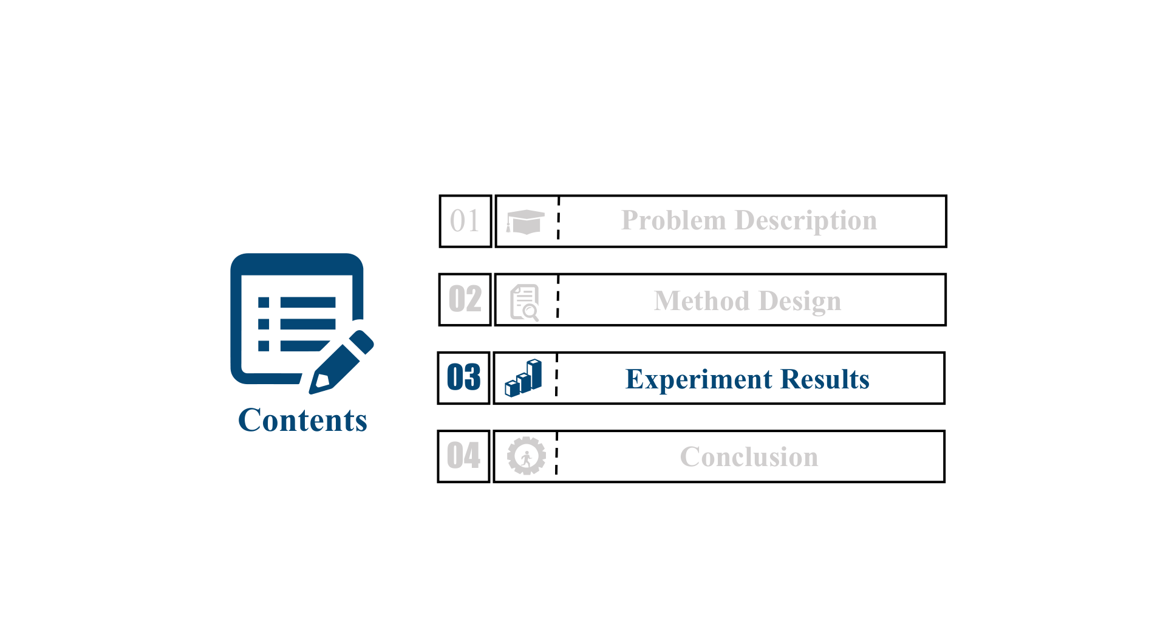
14

Slide 15
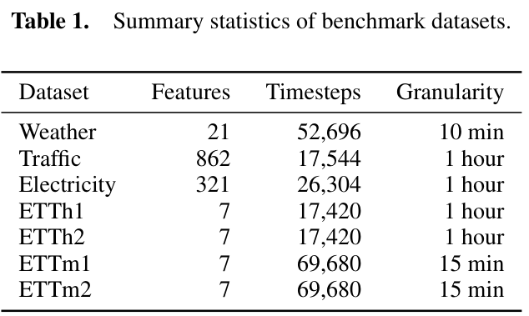
Seven datasets and four forecasting horizons
Weather, Traffic, Electricity, and four ETT datasets; T = 96, 192, 336, or 720.
Metrics: MSE and MAE. The paper simulates 555 eligible devices and reports an 80/20 train/test split.
15

Slide 16
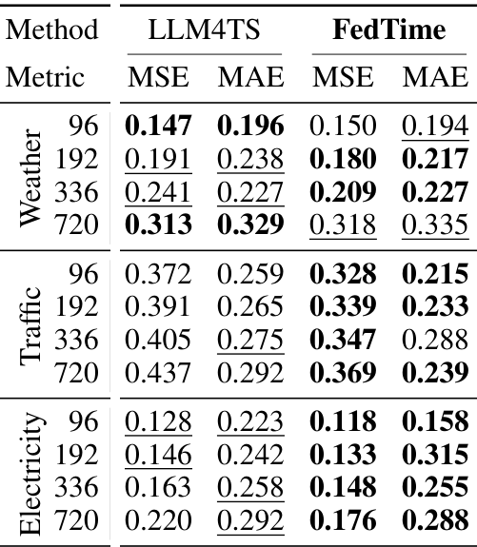
Long-horizon gains, with a counterexample
At T = 720, Traffic MSE: 0.437 → 0.369; Electricity MSE: 0.220 → 0.176.
Weather at the same horizon: 0.313 → 0.318. FedTime is not best in every setting.
16

Slide 17
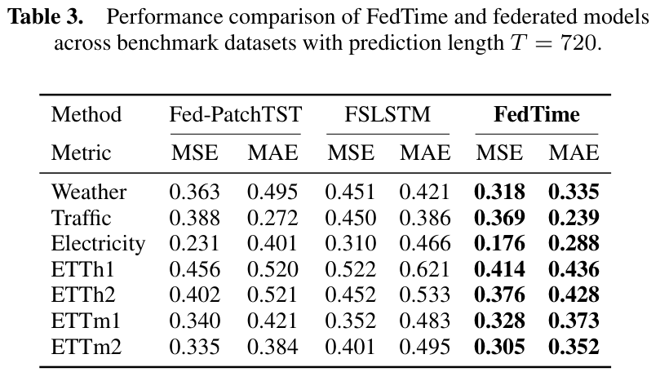
Comparison with federated forecasting baselines
Table 3 fixes T = 720 for Fed-PatchTST, FSLSTM, and FedTime.
Electricity MSE is 0.231, 0.310, and 0.176, respectively.
17

Slide 18
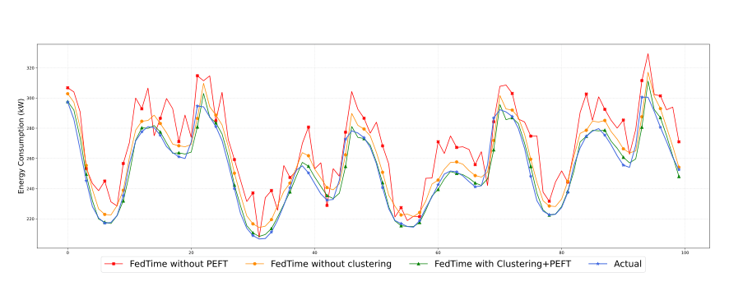
Clustering and PEFT: a qualitative ablation
The ACN example compares no clustering, no PEFT, and the complete method.
The full model tracks the displayed energy-consumption segment more closely; this is a scenario-specific visualization.
18

Slide 19
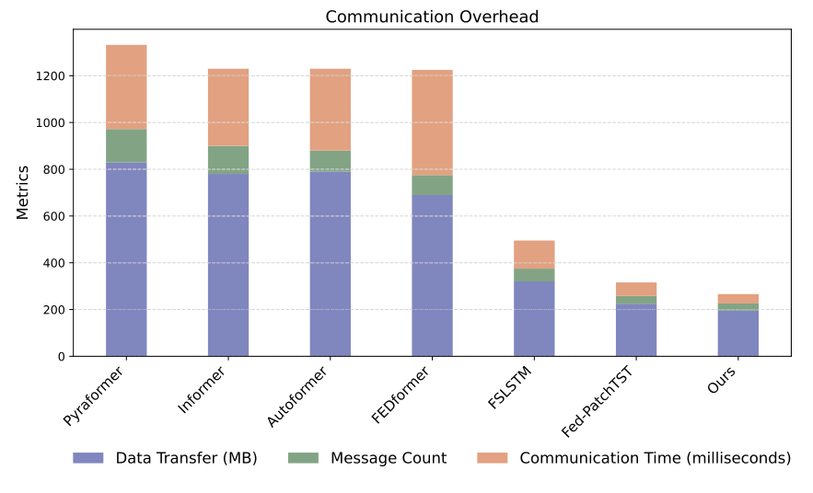
Efficiency claims require separate measurements
Figure 5 mixes data volume, message count, and time: the stacked height has no common unit.
Convergence in fewer epochs is not the same as lower end-to-end runtime under a matched budget.
19

Slide 20
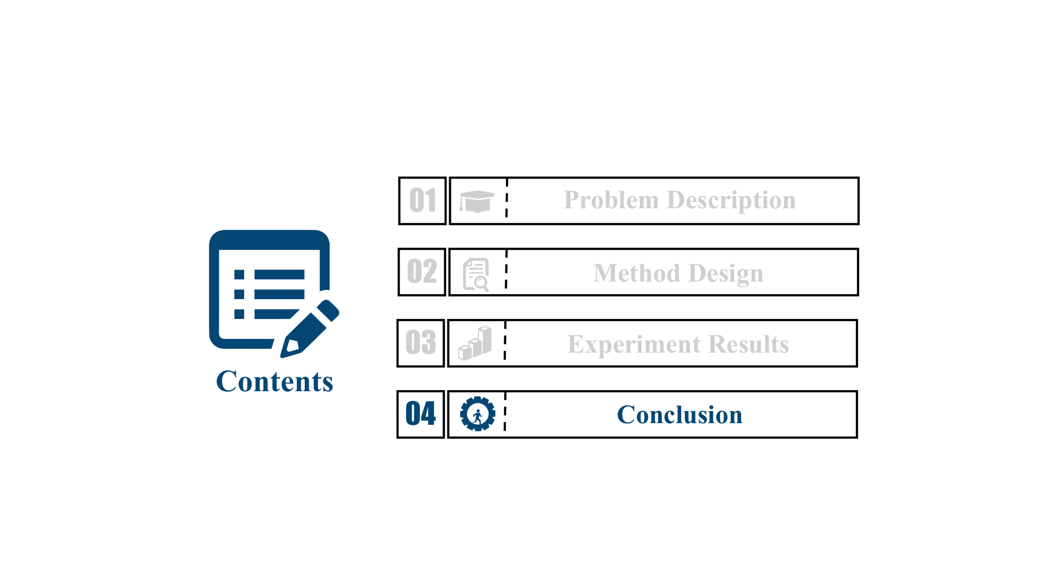
20

Slide 21
FedTime
Conclusion: FedTime combines numerical patches, parameter-efficient LLM adaptation, and clustered FL. Several forecasting settings improve, but preference alignment and system costs need clearer specification.
Inspiration: Validate the input–target interface first. For FedTAF, separate temporal value and private federated gain from public-data preparation and backbone size.
21

Slide 22
Paper 2
FedPFT: Federated Proxy Fine-Tuning of Foundation Models
Zhaopeng Peng, Xiaoliang Fan, Yufan Chen, Zheng Wang, Shirui Pan, Chenglu Wen, Ruisheng Zhang, and Cheng Wang
Published in: International Joint Conference on Artificial Intelligence (IJCAI)
Published Time: 2024
22

Slide 23
23

Slide 24
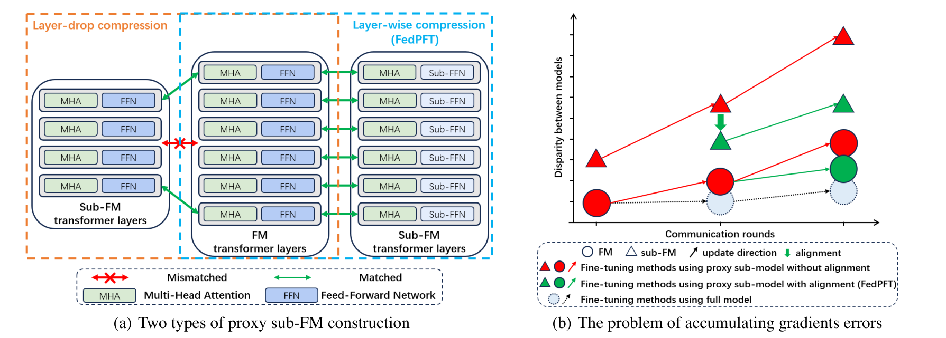
A compact proxy can still produce the wrong update
Layer dropping leaves some original layers without corresponding adaptation updates.
Even compatible parameters may receive biased gradients because the proxy computation differs from the full model.
24

Slide 25
25

Slide 26
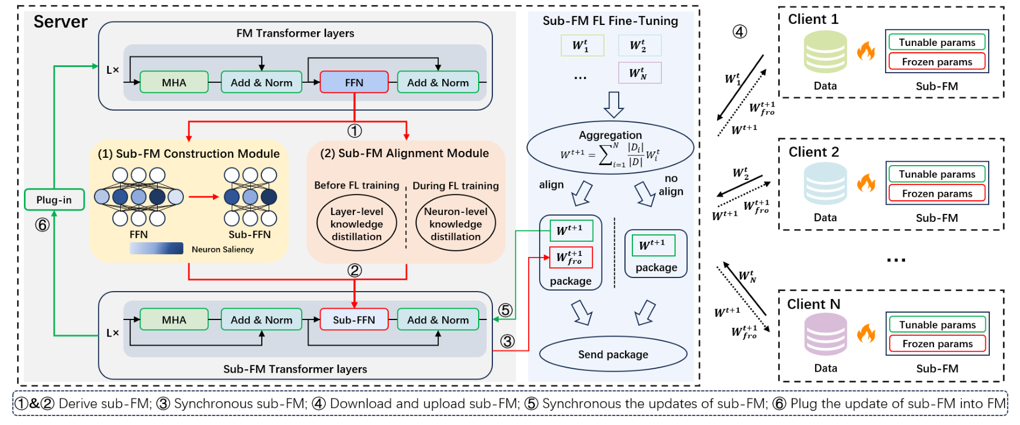
Construction, alignment, federated tuning, and plug-in
The server builds a layer-wise compressed sub-FM and aligns it with the full FM.
Clients tune compatible parameters; the server aggregates them and plugs the updates back into the FM.
26

Slide 27
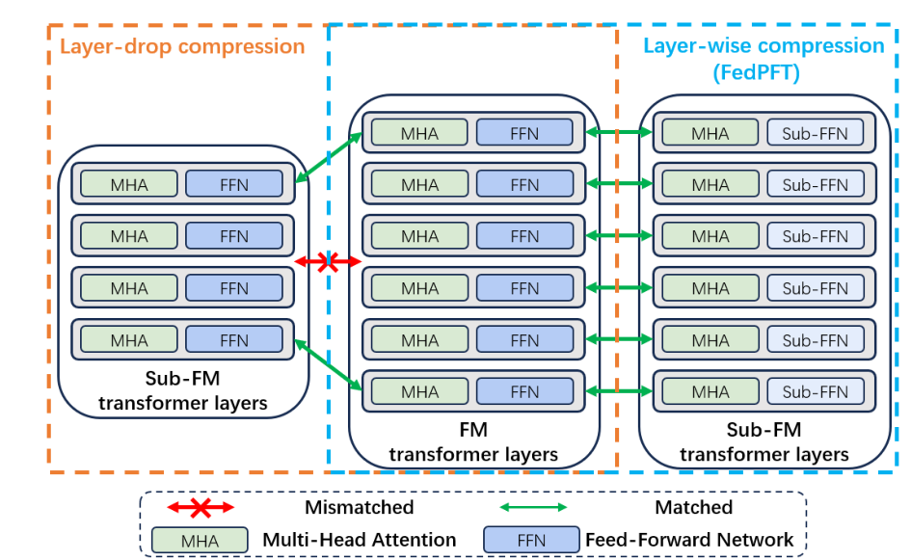
Compress FFN width while preserving layer correspondence
The method removes low-saliency FFN neurons rather than deleting entire intermediate layers.
MHA parameters retain their layer-wise mapping to the full model.
27

Slide 28
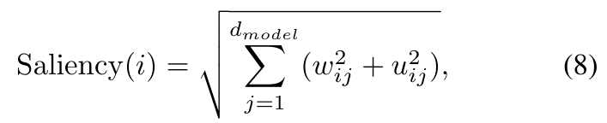
Neuron saliency defines the compressed FFN
Saliency uses the L2 norm of a neuron’s incoming and outgoing connections.
A fixed fraction of low-saliency neurons is removed within each compressed layer.
28

Slide 29
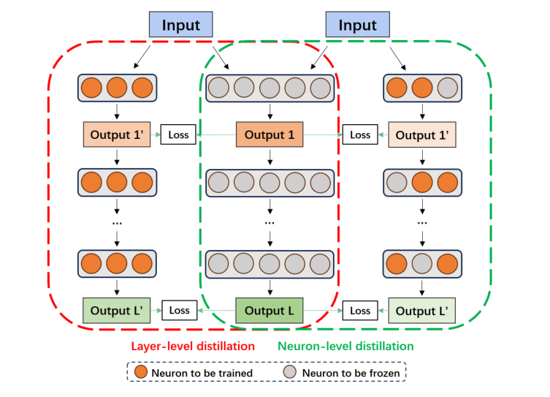
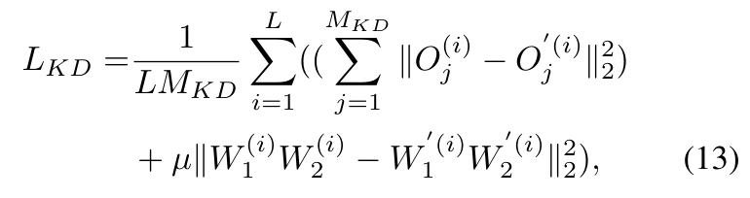
Before FL: layer-level distillation
Match corresponding intermediate outputs of the FM and sub-FM.
Add a regularizer on the effective FFN weight mapping to reduce proxy discrepancy.
29

Slide 30
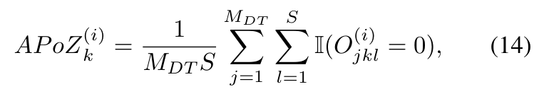
During FL: selective neuron-level realignment
APoZ measures the proportion of zero activations on downstream data.
Realign a subset of less-active neurons to limit drift without overwriting local task adaptation.
30

Slide 31
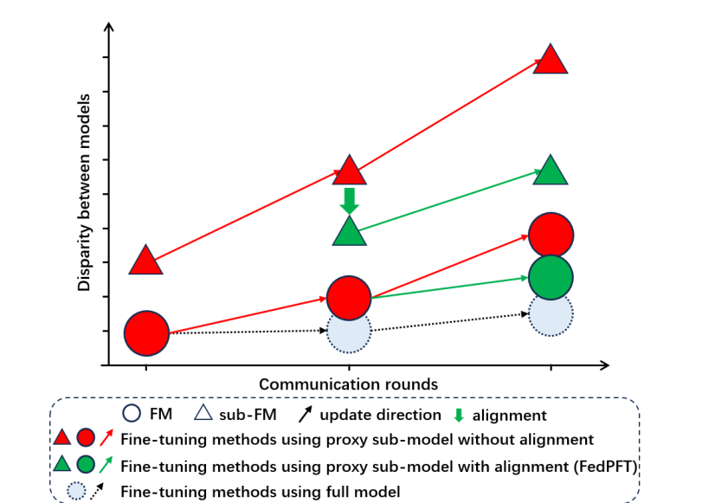
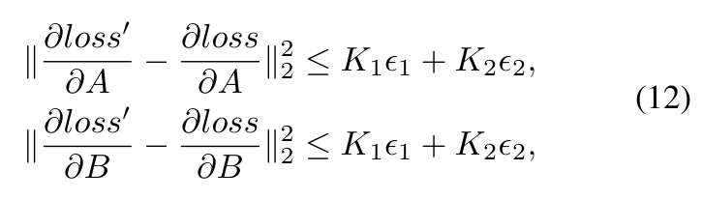
Why alignment matters: a restricted gradient analysis
The analysis links gradient discrepancy to output and effective-weight mismatch.
The stated assumptions are restrictive; they are not an unconditional convergence guarantee for real Transformers.
31

Slide 32
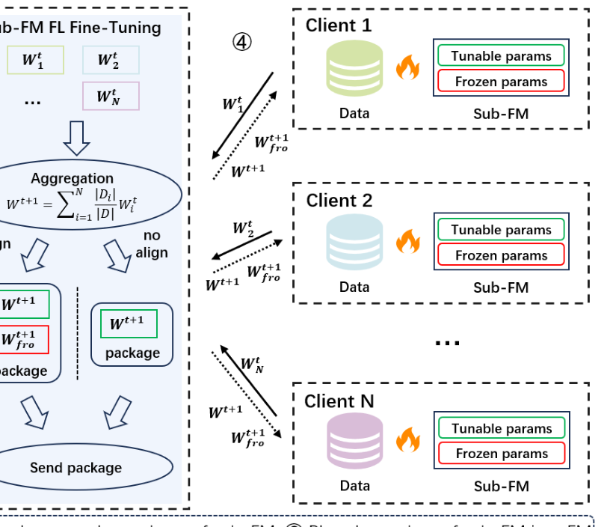
Training responsibilities and the communication cycle
Compressed FFNs remain frozen during client FL tuning; compatible parameters are updated.
The server applies FedAvg and periodically performs the specified realignment.
32

Slide 33
33

Slide 34
Matched baselines and federated settings
BERT, RoBERTa, and ViT; text classification and image recognition tasks.
100 clients, 10 participants per round, and 500 rounds. The paper matches trainable parameter counts across methods.
34

Slide 35
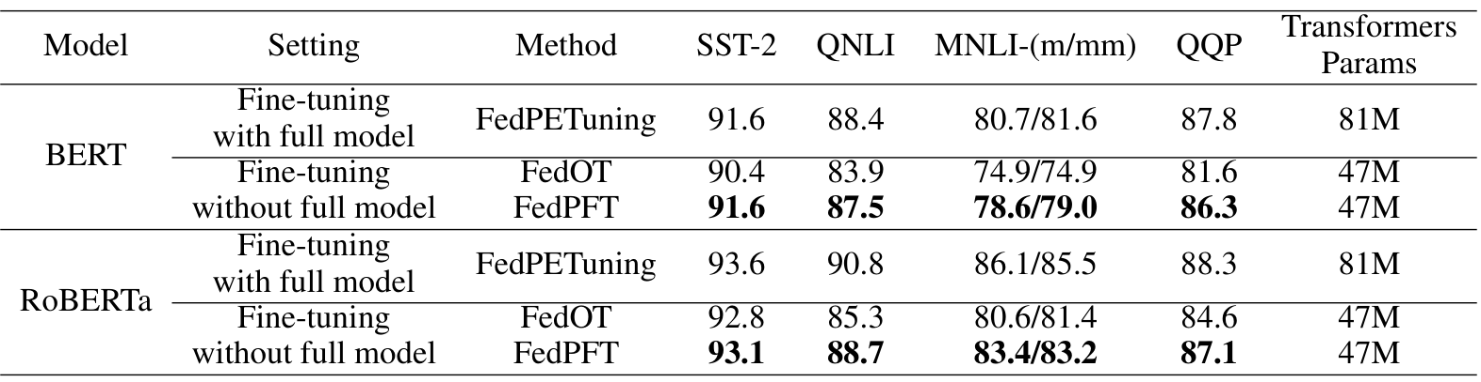
Text tasks: better adaptation at the same proxy size
BERT/QNLI accuracy: FedOT 83.9, FedPFT 87.5, full-model FedPETuning 88.4.
FedOT and FedPFT both use 47M Transformer parameters in this comparison.
35

Slide 36
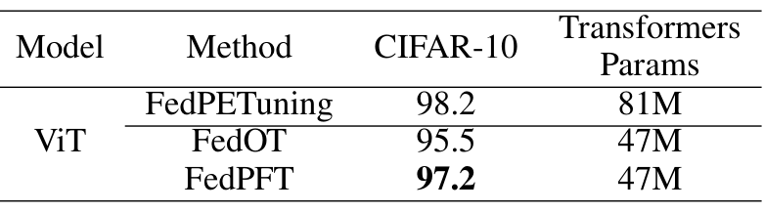
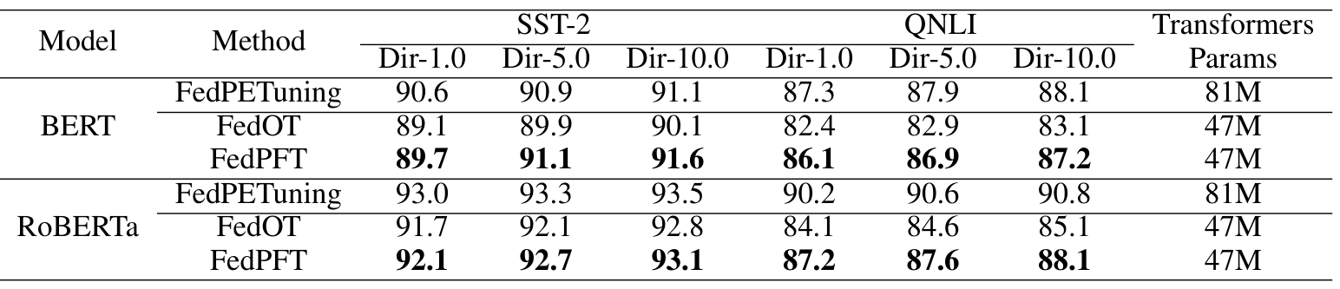
Transfer across modality and label skew
ViT/CIFAR-10 accuracy: 95.5 → 97.2 for FedOT → FedPFT.
Under Dirichlet label skew, FedPFT remains stronger than FedOT in the reported text-task comparisons.
36

Slide 37
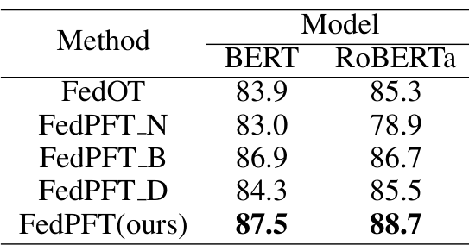
Ablation: initial alignment is essential
On BERT/QNLI: no alignment 83.0; before only 86.9; during only 84.3; full method 87.5.
Both stages matter, but the initial alignment supplies the stronger foundation in this setting.
37

Slide 38
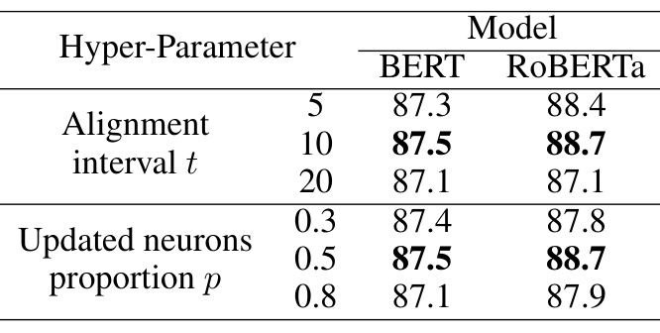
Alignment frequency trades consistency for adaptation
The reported QNLI study favors t = 10 and p = 0.5 among the tested settings.
More frequent realignment is not always better; theory-level cost reductions are not measured hardware speedups.
38

Slide 39
39

Slide 40
FedPFT
Conclusion: Layer-wise FFN compression preserves a compatible update path, while pre-FL and in-FL distillation reduce proxy mismatch. Transfer still depends on structural correspondence.
Inspiration: Similar features do not guarantee useful updates. For FedTAF, compare feature-only, single-state gradient, and multi-state calibration by their effect on the receiving model.
40

Slide 41
Paper 3
FedPromo: Federated Lightweight Proxy Models at the Edge
for Fine-Grained Image Classification With Foundation Models
Matteo Caligiuri, Francesco Barbato, Donald Shenaj, Umberto Michieli, and Pietro Zanuttigh
Published in: IEEE Internet of Things Journal (IEEE IoT-J)
Published Time: 2026
41

Slide 42
42

Slide 43
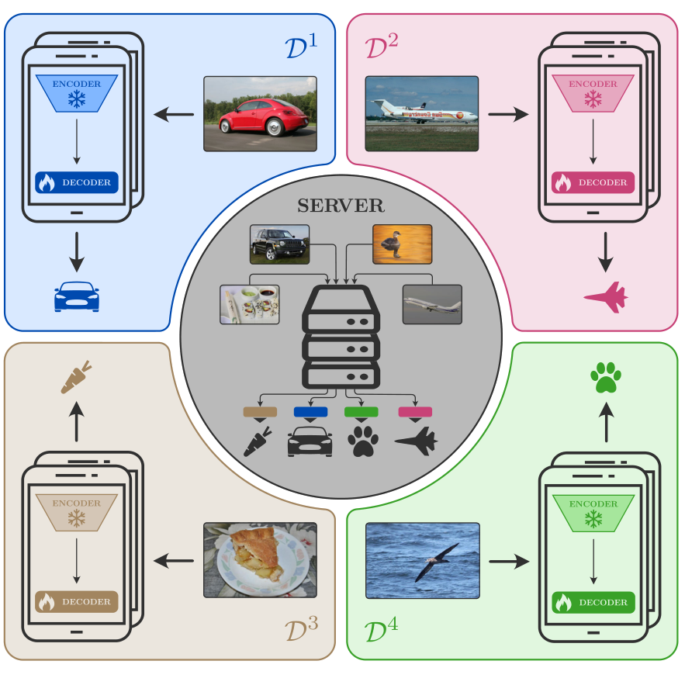
Different encoders, one transferable classifier
The server holds a large vision FM; clients use lightweight proxy encoders and private fine-grained data.
Cross-architecture transfer requires compatible feature semantics, not matching encoder parameters.
43

Slide 44
44

Slide 45
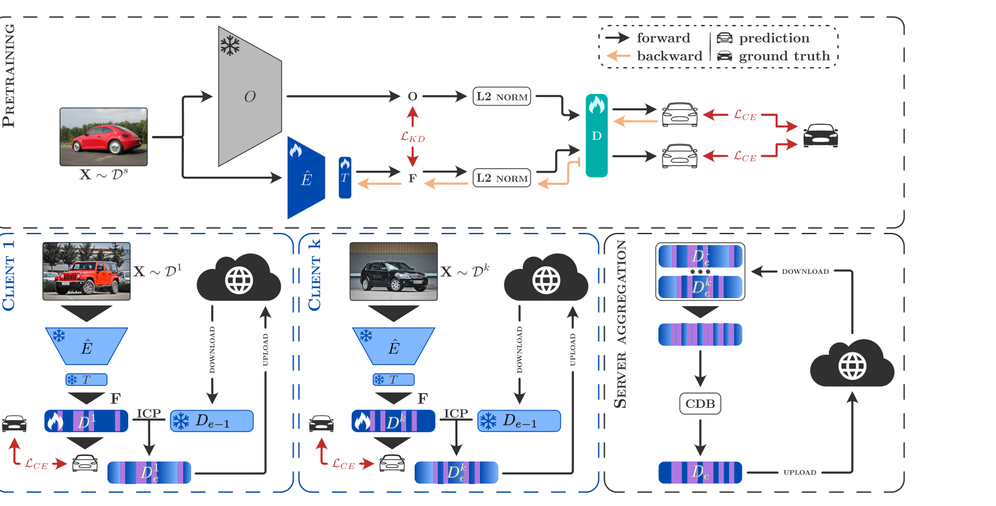
Two stages: align representations, then federate heads
Server-side pretraining aligns a lightweight encoder with the frozen Oracle encoder.
Federated training freezes encoders and the translator, and updates the classifier head.
45

Slide 46
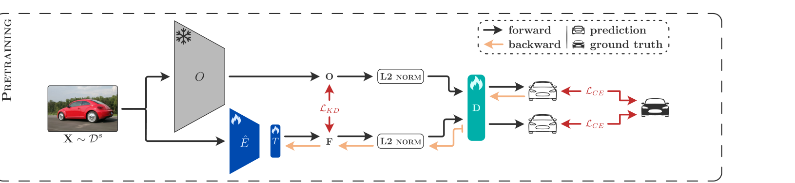
A translator maps the lightweight feature interface
MobileNetV3-small produces 576-dimensional features; the DINOv2 interface has 2,048 dimensions.
A pretrained linear translator maps client features into the server feature space and stays frozen during FL.
46

Slide 47
Cross-architecture pretraining combines feature and task losses
Feature KD combines L1, L2, and cosine distances.
The classifier learns from Oracle features; the student must produce features compatible with that classifier.
47

Slide 48
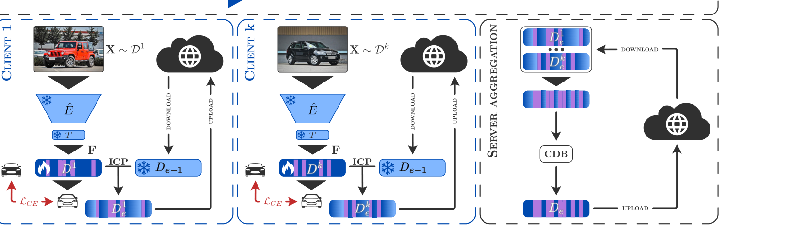
Local learning communicates a small task-specific head
Clients keep their raw data, the aligned encoder, and the frozen translator locally.
Only the task head is optimized and aggregated; the receiving Oracle encoder remains frozen.
48

Slide 49
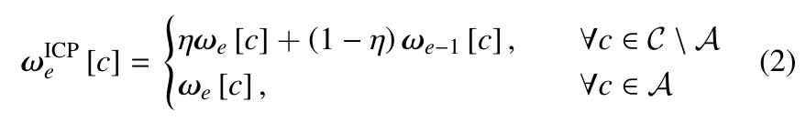
ICP preserves classes absent from a local client
Local cross-entropy can suppress classes that are missing from a client’s data.
Inactive Classes Preservation reduces updates to the corresponding classifier weights.
49

Slide 50
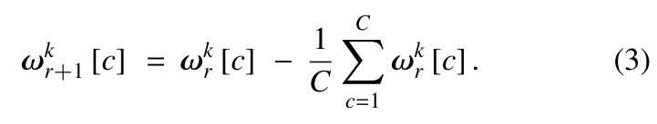
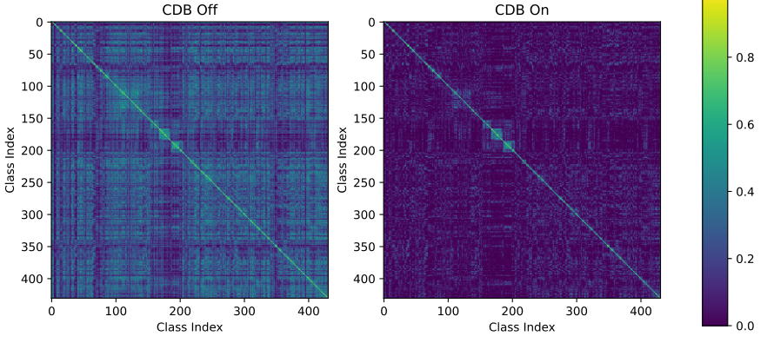
CDB removes a shared component from classifier weights
Class De-Biasing centers class-weight vectors before aggregation and at the server.
The authors use this as a whitening heuristic to reduce cross-class interference.
50

Slide 51
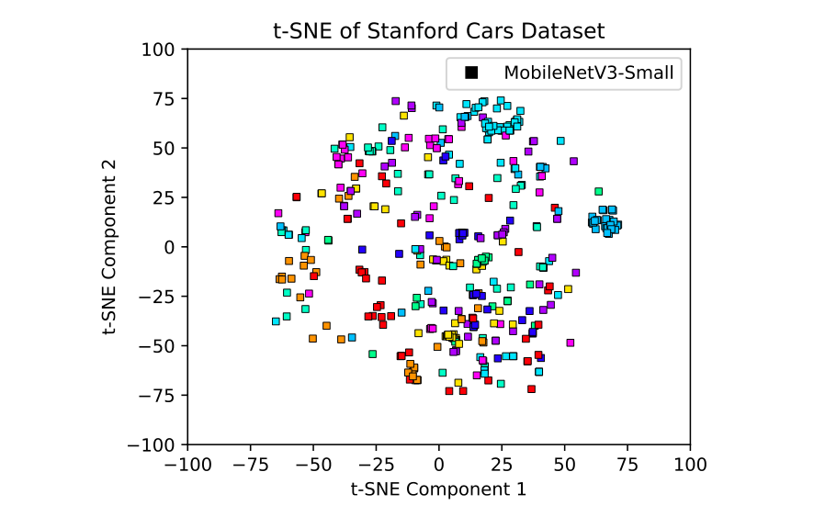
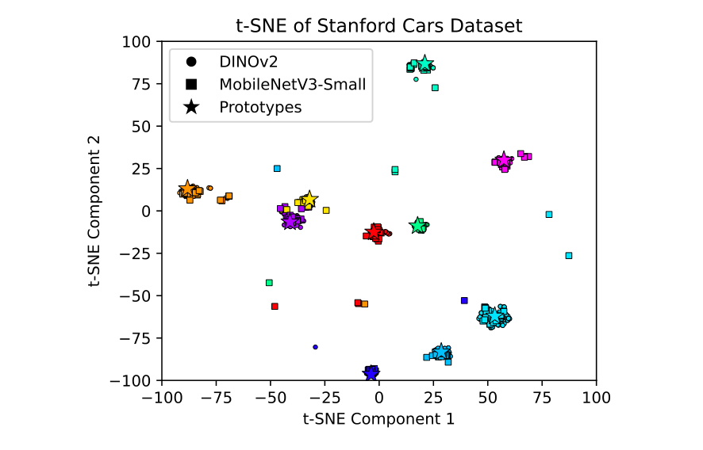
Evidence for the shared-feature interface
After pretraining, teacher and student embeddings form more compatible class clusters.
An aggregated head can be attached to the Oracle; multi-domain heads can be concatenated.
51

Slide 52
52

Slide 53
Fine-grained domains and resource-constrained clients
Five source-to-target domain pairs; 100 clients, 10 selected per round, and Dirichlet alpha = 1.
Proxy: about 3M parameters. Oracle: about 300M parameters. Both are evaluated after aggregation.
53

Slide 54
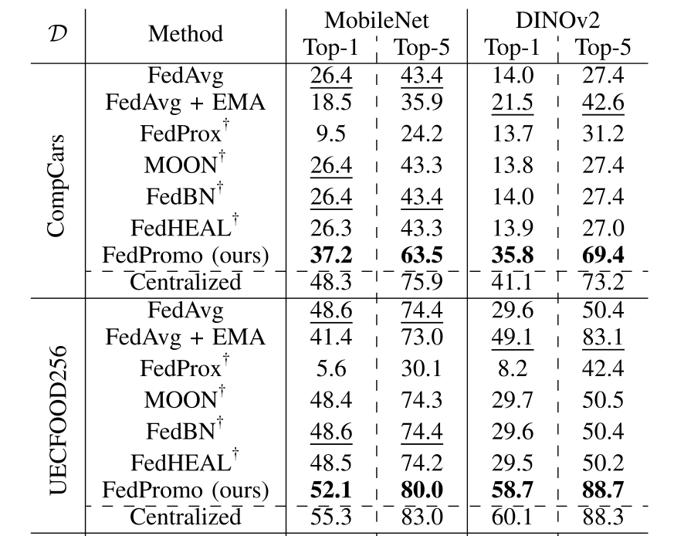
In-domain pretraining enables useful head transfer
CompCars proxy Top-1: best listed competitor 26.4% versus FedPromo 37.2%.
CompCars Oracle Top-1: best listed competitor 21.5% versus FedPromo 35.8%.
54

Slide 55
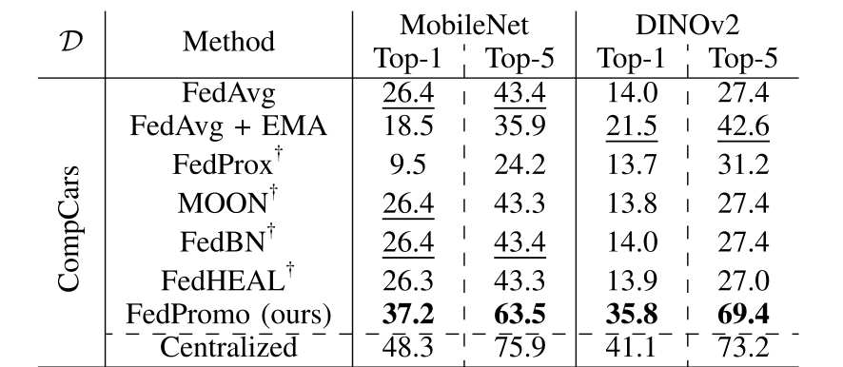
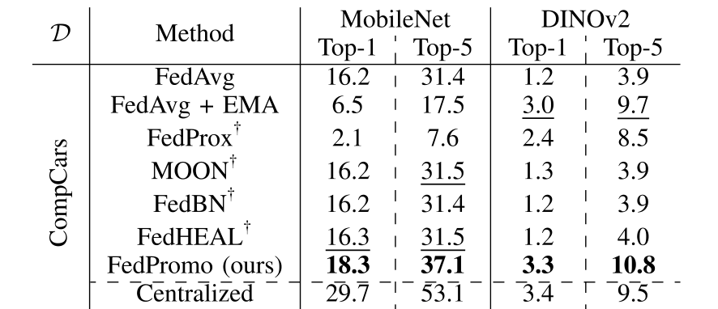
Public-data relevance is a major condition
CompCars Oracle Top-1 is 35.8% after StanfordCars pretraining, but 3.3% after ImageNet-1k pretraining.
The comparison exposes source-domain sensitivity; it is not evidence of universal cross-domain transfer.
55

Slide 56
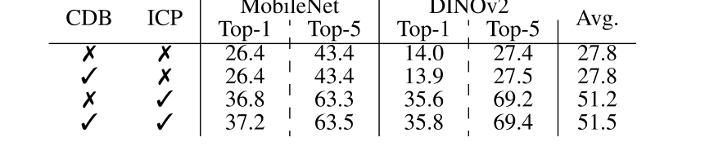
Ablation: ICP provides most of the observed gain
CompCars Oracle Top-1: 14.0% without ICP/CDB; 35.6% with ICP; 35.8% with both.
CDB gives an additional, smaller gain in this setting.
56

Slide 57
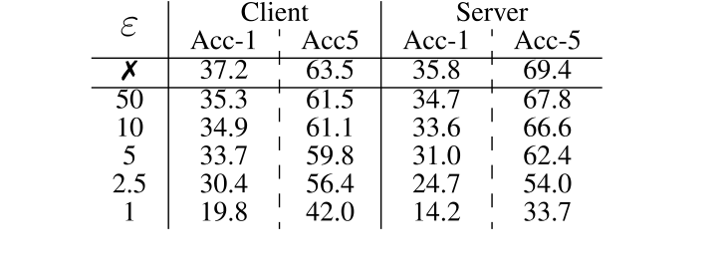
Privacy and deployment remain trade-offs
The DP study fixes delta = 10^-5 and varies epsilon; smaller epsilon reduces utility in the table.
The architecture reduces client-side model size, but pretraining and alignment still have costs.
57

Slide 58
58

Slide 59
FedPromo
Conclusion: Aligned features enable classifier transfer between different encoders. The benefits depend on public-domain relevance, class coverage, and the classification setting.
Inspiration: Shared coordinates can enable transfer but also restrict the server. For FedTAF, compare server-native and client-defined readouts before assuming that stronger alignment is always better.
59

Slide 60
Paper 4
FedMKT: Federated Mutual Knowledge Transfer
for Large and Small Language Models
Tao Fan, Guoqiang Ma, Yan Kang, Hanlin Gu, Yuanfeng Song, Lixin Fan, Kai Chen, and Qiang Yang
Published in: International Conference on Computational Linguistics (COLING)
Published Time: 2025
60

Slide 61
61

Slide 62
Mutual improvement with incompatible output spaces
Client SLMs learn private-domain knowledge; the server LLM provides complementary general knowledge.
Different tokenizers and vocabularies prevent direct position-wise logit distillation.
62

Slide 63
63

Slide 64
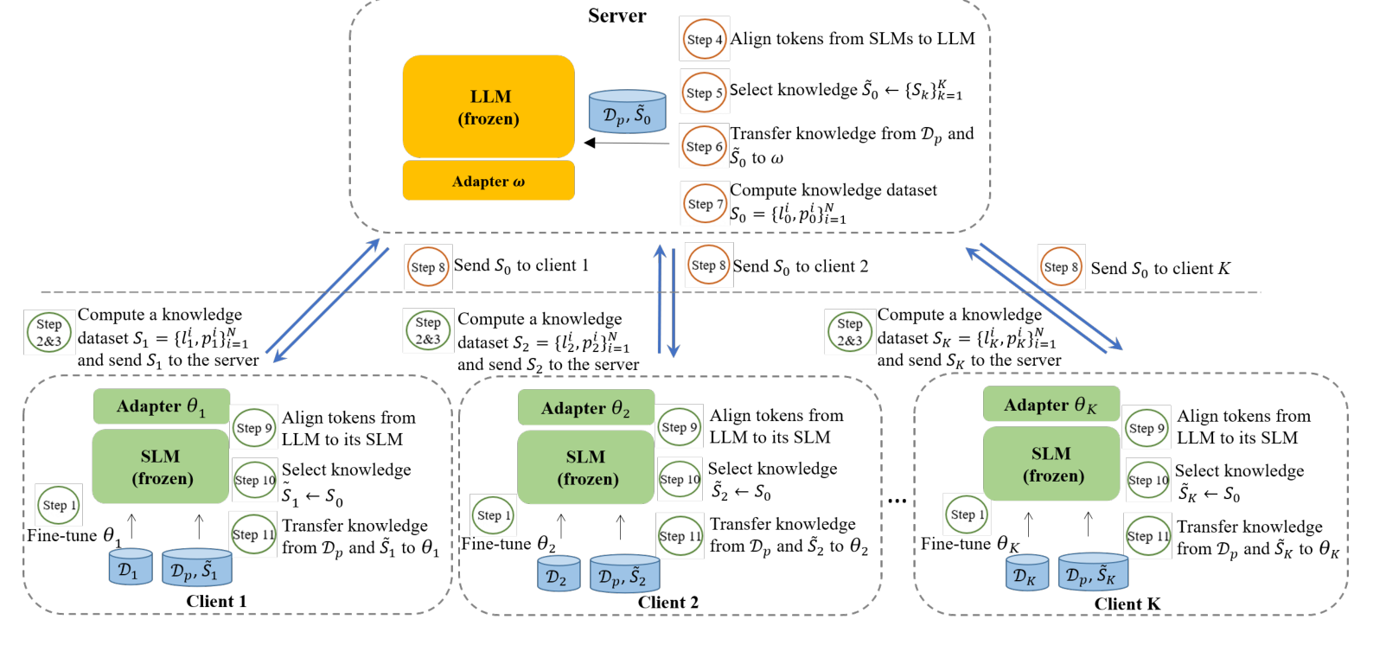
Private learning, client-to-server transfer, and feedback
Clients first tune local LoRA adapters using private data.
Public loss–logit pairs support selective transfer to the server and then back to clients.
64

Slide 65
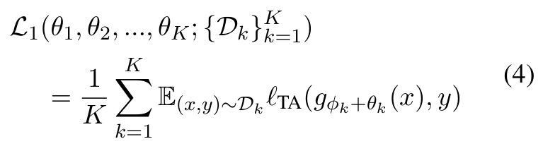
LoRA is the local update mechanism, not the shared parameter space
LLM and SLM backbones stay frozen; each participant trains its own adapter.
Public labeled data support both supervised fine-tuning and teacher-quality comparison.
65

Slide 66
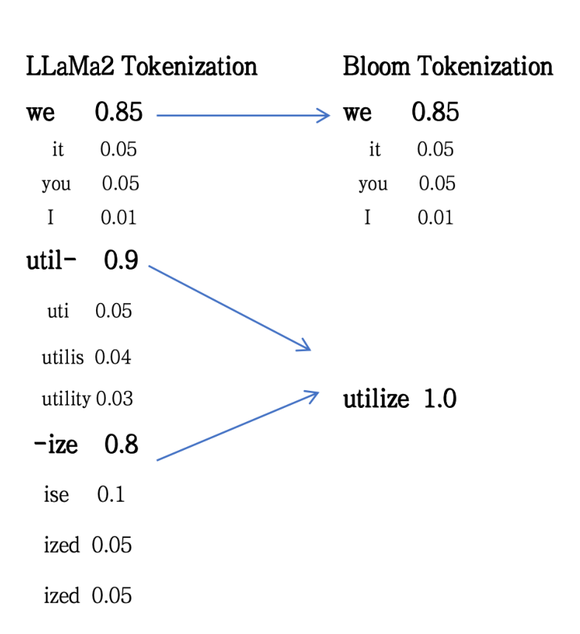
MinED aligns vocabulary and token positions
A vocabulary mapping is constructed using minimum edit distance.
Dynamic programming aligns token sequences; logits are mapped with a fallback for non-unique matches.
66

Slide 67
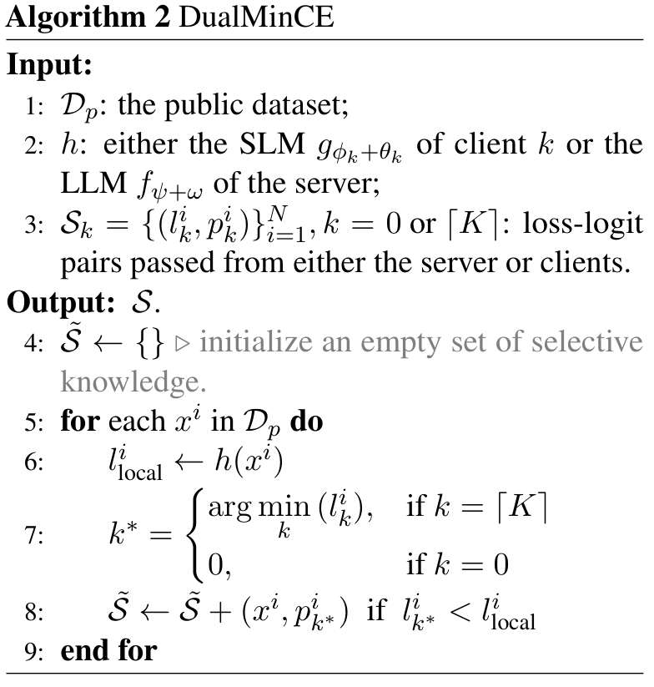
DualMinCE transfers only locally beneficial knowledge
For each public sample, choose the client teacher with the smallest cross-entropy.
Accept that teacher only when its loss is lower than the receiving model’s loss.
67

Slide 68
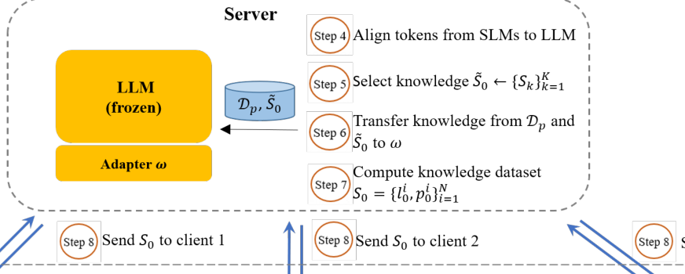

Client-to-server transfer learns complementary knowledge
Different public samples may select different client teachers.
The server updates its LoRA using the selected aligned distributions.
68

Slide 69

Server-to-client transfer keeps useful local specialization
The server recomputes public outputs after its update and sends them to clients.
Each client performs token alignment and accepts only teacher outputs selected by its own loss comparison.
69

Slide 70


Supervised loss, distillation, and communication size
The objective combines public-label fine-tuning and selected knowledge distillation; lambda = 0.9 in the reported setup.
Logit payload scales with public samples × sequence length × top-k, plus losses and indexing overhead.
70

Slide 71
71

Slide 72

Heterogeneous, homogeneous, and one-to-one settings
Server: LLaMA2-7B. Clients include GPT-2-xlarge, OPT-1.3B, Bloom-1.1B, and LLaMA2-1.3B.
Six QA-style tasks use accuracy; two instruction-following tasks use Rouge-L.
72

Slide 73

Heterogeneous clients benefit from mutual learning
RTE/GPT-2-xlarge: Standalone 65.7 → FedMKT 70.4.
RTE/OPT-1.3B: 62.5 → 65.7. The reported improvement varies across models and tasks.
73

Slide 74

The server improves, but does not always match centralized tuning
RTE: FedMKT 82.3 versus Centralized 85.9.
CQA: 71.8 versus 69.5; WIC: 61.3 versus 70.4. The centralized gap is task-dependent.
74

Slide 75

Homogeneous clients: comparison with FedAvg
CQA/LLaMA2-1.3B: FedAvg 56.4 versus FedMKT 58.6.
CQA/OPT-1.3B: 58.6 versus 61.5. Values refer to the reported client averages.
75

Slide 76

One-to-one learning and evidence limits
LLM2SLM freezes the teacher, while FedMKT updates both participants.
The gains can be small: CQA/LLaMA2-1.3B is 56.76 → 56.84. The paper has no separate MinED/DualMinCE ablation table.
76

Slide 77
77

Slide 78
FedMKT
Conclusion: MinED aligns cross-tokenizer outputs, and DualMinCE selects knowledge in both directions. The method requires labeled public data and does not provide a formal privacy guarantee.
Inspiration: Contribution should reflect useful transfer, not response or gradient magnitude alone. For FedTAF, test transfer selection and direction using fixed public rules without future labels.
78

Slide 79
Paper 5
FedProxy: Federated Fine-Tuning of LLMs via Proxy SLMs
and Heterogeneity-Aware Fusion
Tao Fan, Guoqiang Ma, Yuanfeng Song, Lixin Fan, Kai Chen, and Qiang Yang
Published in: Annual Meeting of the Association for Computational Linguistics (ACL)
Published Time: 2026
79

Slide 80
80

Slide 81
A useful proxy must learn across conflicting client tasks
Offsite-tuning baselines restrict adaptation through an adapter–emulator structure.
FedProxy uses one compressed proxy architecture and explicitly handles magnitude and directional interference across updates.
81

Slide 82
82

Slide 83

Three stages connect private training to the server LLM
Server-guided compression builds a shared proxy SLM.
Conflict-aware local training and aggregation precede training-free parameter plug-in.
83

Slide 84


Block Influence selects a structurally compatible proxy
BI measures how much a Transformer block changes hidden representations on public inputs.
Whole blocks are removed; the retained blocks keep a mapping to the original LLM.
84

Slide 85


Task vectors describe how clients differ
A task vector is the client update relative to the previous global proxy.
Pairwise cosine similarities determine heterogeneity coefficients and aggregation weights.
85

Slide 86


PCR uses parameter-level disagreement in the next round
Eq.(7) assigns larger conflict scores to sign disagreement; Eq.(9) weights the local penalty by that score.
The adjacent prose reverses the high/low labels. The interpretation here follows the displayed equations.
86

Slide 87

H-TIES sparsifies and merges dominant update signs
Adjust retention by heterogeneity, then scale client updates by aggregation weights.
For each parameter, merge the sufficiently dominant sign; otherwise use no update.
87

Slide 88

Plug-in fusion depends on the retained-layer mapping
The trained proxy layers overwrite their corresponding layers in the full LLM.
No extra fusion training or dual-model decoding is required by this final step.
88

Slide 89


Current-round fusion and next-round regularization
The server distributes the proxy and previous conflict scores before local training.
New updates are fused now; newly estimated conflict scores guide the next round.
89

Slide 90
90

Slide 91

Shared architectures, heterogeneous tasks
Backbones: LLaMA2-7B and Mistral-7B. Homogeneous tasks use 4 clients; heterogeneous tasks use 8.
QA and GLUE tasks are evaluated by accuracy. Compression ratios refer to the fraction removed.
91

Slide 92

Heterogeneous tasks: a substantial gap over FedOT
LLaMA2-7B, 50% compression: QA mean 0.4750 → 0.6011.
GLUE mean 0.5933 → 0.7944. These are accuracy gains of 12.61 and 20.11 percentage points.
92

Slide 93

Aggregation ablations: overall gain, not universal dominance
LLaMA2 ALL: full 0.6977; without PCR 0.6904; without H-TIES 0.6788.
TIES has a higher GLUE score and FedAvg a higher QA score in that same table.
93

Slide 94

Training the OT emulator does not close the full gap
In the homogeneous 50% setting, FedOT-ET trains both adapters and the emulator.
LLaMA2 ALL: FedOT 0.5300; FedOT-ET 0.5314; FedProxy 0.6987.
94

Slide 95


The performance gain comes with a resource trade-off
Initial transfer is about 3.5B parameters for both FedOT and FedProxy.
FedProxy uses about 4× the iterative parameter traffic and trainable parameters; stronger compression further reduces accuracy.
95

Slide 96
96

Slide 97
FedProxy
Conclusion: A mapped proxy, PCR, and H-TIES support parameter plug-in. The performance gains involve additional training and communication rather than a cost-free improvement.
Inspiration: Separate proxy capacity, alignment, and fusion benefits. For FedTAF, compare contribution weighting with uniform, shuffled, and conflict-aware controls under matched budgets.
97

Slide 98
My Reflections on Writing FedTAF
From large gradients to useful contributions. I should explain what a single client weight overlooks, then test whether token-level attribution preserves complementary knowledge rather than simply favoring large sensitivities.
From similar features to transferable updates. The alignment argument should concern what happens after client updates enter the server. I need evidence that contribution-gradient alignment improves this transfer, not only that calibration loss decreases.
From temporal inputs to justified temporal adaptation. I should test whether attribution drift reveals when a fixed SAM radius becomes unsuitable. This would connect temporal optimization to token contributions, rather than simply adding SAM.
98

Slide 99
Thank you for listening
99

