Slide 1
Heterogeneous Multi-Sensor Representation Alignment
汇报人：何俊楠
汇报时间：2026.09.22
CPS Computational Learning Laboratory
1

Slide 2
Signal-Level Alignment
②
①
A Two-Level Multisensor Fusion Network With Incremental Learning for Insulation Defect Diagnosis in Gas-Insulated Switchgear
A unified representation and fusion framework of multi-source heterogeneous data for fault diagnosis in industrial processes
③
Relation-Level Alignment
④
MGTN-DSI: A multi-sensor graph transfer network considering dual structural information for fault diagnosis under varying working conditions
SEA++: Multi-Graph-Based Higher-Order Sensor Alignment for Multivariate Time-Series Unsupervised Domain Adaptation
Multi-domain Alignment
⑤
Time-frequency-spatial fusion-driven local-global contrastive discrepancy learning for industrial multisensor time-series anomaly detection

Slide 3

Paper 1
A Two-Level Multisensor Fusion Network With Incremental Learning for Insulation Defect Diagnosis in Gas-Insulated Switchgear
Yanxin Wang, Jing Yan, Zhengrun Zhang, Jianhua Wang, Yingsan Geng, Dipti Srinivasan
Published in: IEEETRANSACTIONSONINDUSTRIALINFORMATIC
Published Time: 2026
CPS Computational Learning Laboratory
3

Slide 4
01
Problem Description
02
Method Design
03
Experiment Results
Contents
04
Conclusion
CPS Computational Learning Laboratory
4
Notes:
主要分为以下四个部分

Slide 5
01
Problem Description
02
Method Design
03
Experiment Results
Contents
04
Conclusion
CPS Computational Learning Laboratory
5

Slide 6
Problem Description
Gas‑insulated switchgear (GIS) is a critical component in modern power systems due to its compact design, environmental compatibility, high reliability, and long maintenance intervals. However, partial discharge (PD) is almost inevitable throughout the GIS lifecycle — from design and manufacturing to operation. Persistent PD can degrade insulation, leading to flashovers, breakdowns, or even catastrophic failures, posing safety risks and economic losses. Accurate diagnosis of PD caused by insulation defects is therefore essential to ensure GIS reliability.
Convolutional neural networks (CNNs) and long short-term memory networks, using ultrahigh-frequency (UHF) or acoustic emission (AE) signals, have shown strong capability in extracting spatial and temporal features of PD. However, their dependence on single-sensor data makes them vulnerable to electromagnetic interference in on-site environments, often resulting in false alarms.
Multisensor fusion techniques combining UHF, AE, and chemical emission (CE) have gained attention. Unlike single-stage fusion schemes that directly mix modalities, the proposed structure decomposes fusion into homogeneous-level aggregation and heterogeneous-level integration, following the signal formation characteristics of UHF, AE, and chemical sensors.
CPS Computational Learning Laboratory
6
Notes:
GIS（Gas-Insulated Switchgear，气体绝缘开关设备）是电网里的关键设备。它内部充 SF₆ 气体做绝缘。如果内部出现绝缘缺陷，就会发生局部放电（Partial Discharge, PD）。局部放电长期存在会逐步破坏绝缘，最终导致闪络、击穿甚至爆炸。所以任务是：通过监测局部放电，判断 GIS 内部是哪种绝缘缺陷。这三类传感器物理机理不同、时间尺度不同、信号形态不同——这就是“异构” 的含义。UHF/AE 是瞬态信号，CE 是累积效应
UHF：电磁波信号，反映放电电气特性
AE：超声波信号，反映放电声学响应
CE：SF₆ 分解气体，反映累积绝缘劣化
两级融合网络（Two-Level Fusion）

Slide 7
01
Problem Description
02
Method Design
03
Experiment Results
Contents
04
Conclusion
CPS Computational Learning Laboratory
7

Slide 8
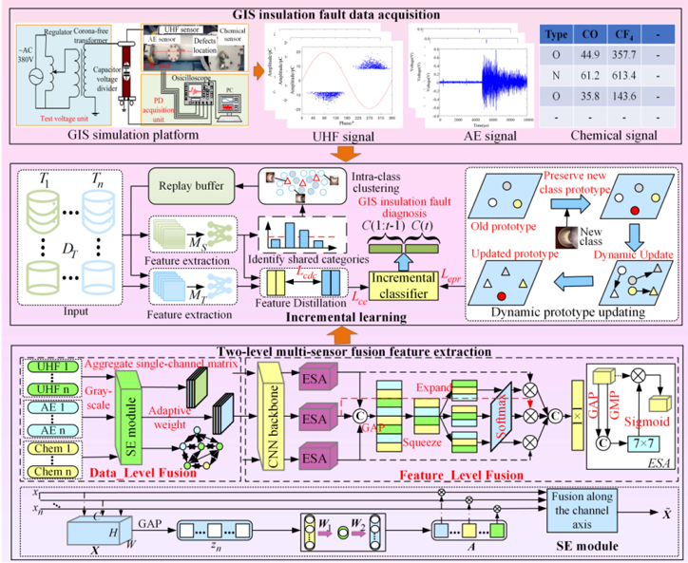
Method Design
Deep Two-Level Multisensor
Fusion Network
Unlike single-stage fusion schemes that directly mix modalities, the proposed structure decomposes fusion into homogeneous-level aggregation and heterogeneous-level integration, following the signal formation characteristics of UHF, AE, and chemical sensors.
CPS Computational Learning Laboratory
8

Slide 9
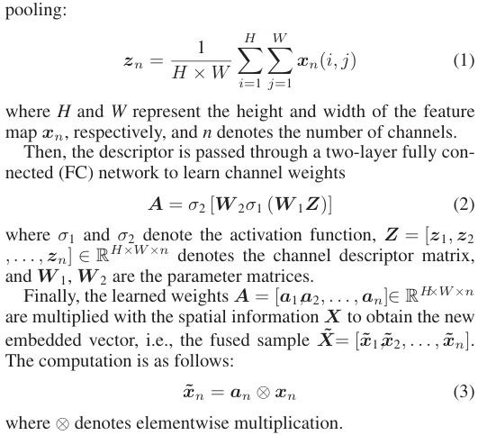
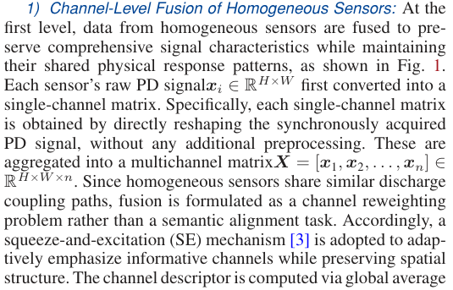
Method Design
At the first level, homogeneous sensor data are fused to preserve sensor-consistent physical characteristics and suppress redundant or noisy responses.
CPS Computational Learning Laboratory
9
Notes:
同类传感器（如多个 UHF）放电耦合路径相似，不需要语义对齐，只需要通道重加权。
采用SE

Slide 10
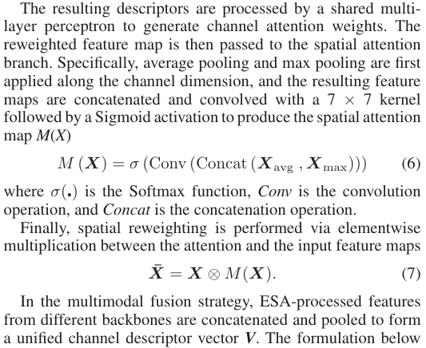

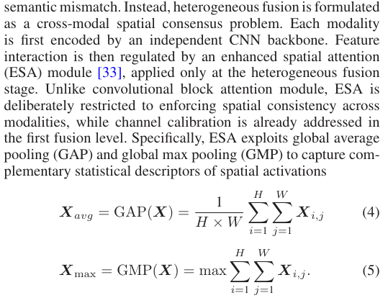
Method Design
At the second level, heterogeneous features extracted from UHF, AE, and CE are integrated through a deep feature fusion network that explicitly models cross-modal semantic discrepancies.
CPS Computational Learning Laboratory
10

Slide 11
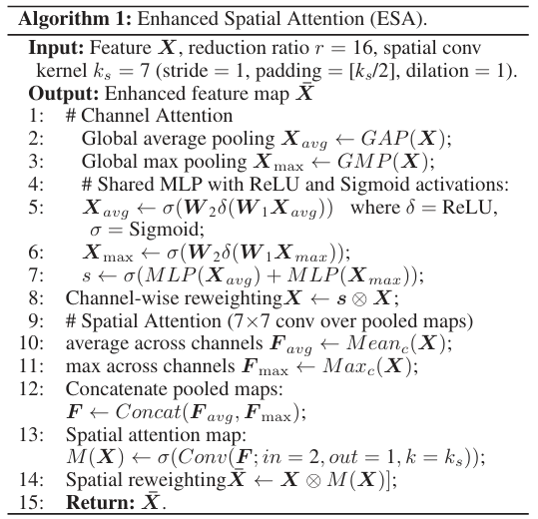
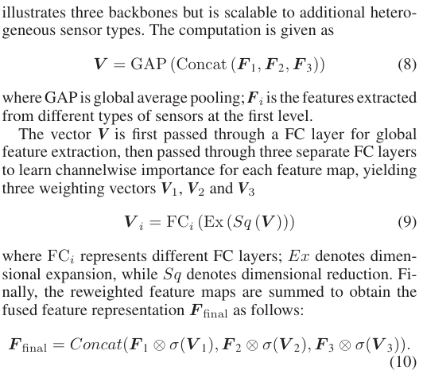
Method Design
CPS Computational Learning Laboratory
11

Slide 12
01
Problem Description
02
Method Design
03
Experiment Results
Contents
04
Conclusion
CPS Computational Learning Laboratory
12

Slide 13
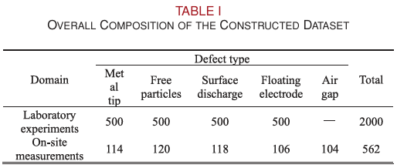
Experiment Results
datasets
A 252 kV GIS simulation platform, as shown in Fig. 2 was built to acquire representative insulation defect samples.
Field data were collected from long-term operational records
and ON-site monitoring of 110–750 kV SF6 GIS units deployed
across multiple substations, focusing on equipment exhibiting
detectable PD activity.
CPS Computational Learning Laboratory
13
Notes:
252 kV GIS仿真平台 + 现场长期监测
三类传感器：UHF、AE、CE
五类缺陷：金属尖端、自由颗粒、表面放电、悬浮电极、气隙

Slide 14
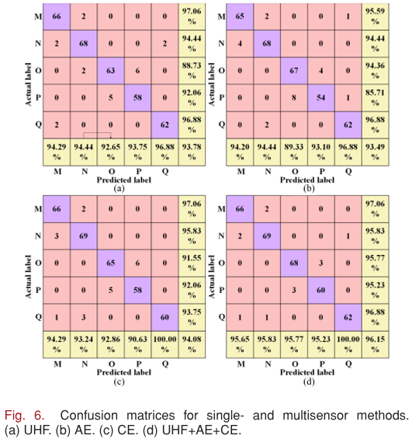
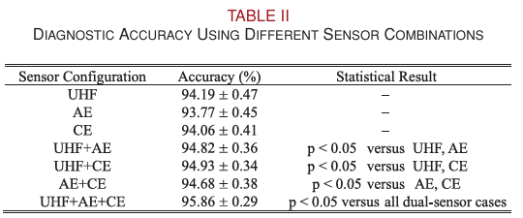
Experiment Results
Comparison of single‑, dual‑, and triple‑sensor configurations
CPS Computational Learning Laboratory
14
Notes:
根据表格可以看出：
单传感器：93.77%-94.19%
双传感器：94.68%-94.93%
三传感器：95.86%，显著优于所有双传感器组合
根据混淆矩阵可以看出：
单传感器模型表现不稳定：UHF对绝缘子表面放电识别差、AE和CE单独无法覆盖所有特征缺陷
多传感器融合在所有缺陷类型上一致提升

Slide 15
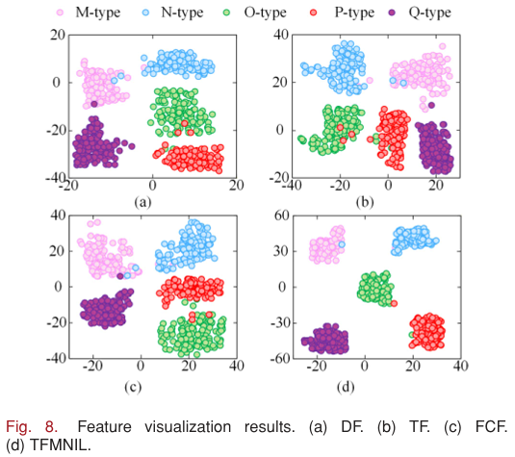
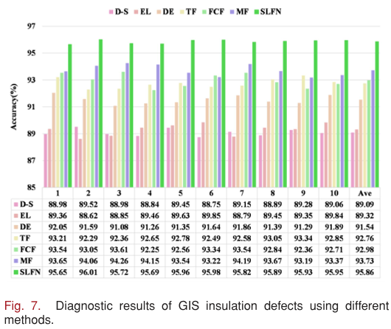
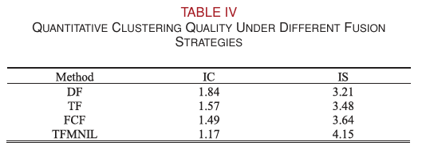
Experiment Results
Comparison With Different Sensor Fusion Strategies
CPS Computational Learning Laboratory
15
Notes:
D-S：Dempster-Shafer 证据理论
EL：Ensemble Learning
DF：只用第一级同类融合
TF：只用第二级异类融合
FCF：直接拼接替代自适应融合
MF：去掉 ESA 的多模态融合
TFMNIL：完整两级融合
TFMNIL 类内紧凑度最低（IC=1.17），类间可分性最高（IS=4.15）
比 DF 降低 IC 34.2%，比 TF 提高 IS 29.8%
两级融合产生更可分、更鲁棒的特征

Slide 16
01
Problem Description
02
Method Design
03
Experiment Results
Contents
04
Conclusion
CPS Computational Learning Laboratory
16
CPS Computational Learning Laboratory
2
18

Slide 17
Conclusion
A novel two-level multisensor fusion architecture integrates UHF, AE, and CE data and features, enhancing representations and achieving 95.86% diagnostic accuracy, significantly outperforming single-sensor baselines.\
Future work will focus on improving robustness to rare defect types and label noise, extending the framework to PD-based diagnosis of other power equipment.
CPS Computational Learning Laboratory
17
Notes:
两级融合实现异构多传感器表征对齐：
第一级：同类传感器通道级融合，保持物理一致性
第二级：异类传感器特征级融合 + ESA，建立跨模态语义一致性
三传感器融合 95.86%，显著优于单/双传感器
两级缺一不可：DF 和 TF 都不如完整 TFMNIL
ESA 非冗余：与 SE 互补，增强跨模态空间一致性
稀有缺陷和标签噪声下鲁棒性有待提升
未来扩展到变压器、电缆等其他电力设备
构建标准化、公开的多传感器 PD 数据集

Slide 18
Paper 2
A unified representation and fusion framework of multi-source heterogeneous data for fault diagnosis in industrial processes
Liang Ma, Qikai Yang, Kaixiang Peng
Published in: Advanced Engineering Informatics
Published Time: 2025
CPS Computational Learning Laboratory
18

Slide 19
01
Problem Description
02
Method Design
03
Experiment Results
Contents
04
Conclusion
CPS Computational Learning Laboratory
19
Notes:
主要分为以下四个部分

Slide 20
01
Problem Description
02
Method Design
03
Experiment Results
Contents
04
Conclusion
CPS Computational Learning Laboratory
20
Notes:
首先是问题描述

Slide 21
Problem Description
In the increasingly integrated and complex industrial processes, it is difficult for a single type of data to adequately characterize faults due to the correlation and multi-source heterogeneity of process data.
A fault often leads to abnormal changes in multiple types of data. Accordingly, the loss of fault information may be caused by analysing only a single type of data, affecting the fault diagnosis accuracy.
Significant differences in dimensions and structures are exhibited by multi-source heterogeneous data, which may make the high-quality data fusion difficult to achieve.
The types of fault data captured by different sensors are usually diverse, such as time series data, image data, etc., with significant differences in dimensions and structures, making it difficult to achieve multi-source heterogeneous data fusion.
In order to achieve high-quality multi-source heterogeneous data fusion and avoid fault information loss, in this paper, a unified representation and fusion framework of multi-source heterogeneous data is proposed.
CPS Computational Learning Laboratory
21
Notes:
现代工业过程高度耦合，故障会引发多种类型数据同时异常
单一类型数据无法完整刻画故障
仅分析单一数据源 → 故障信息丢失 → 诊断精度下降
因此必须整合多源异构数据
不同传感器采集的数据类型不同、维度不同、结构不同，简单拼接无法实现有效融合

Slide 22
01
Problem Description
02
Method Design
03
Experiment Results
Contents
04
Conclusion
CPS Computational Learning Laboratory
22

Slide 23
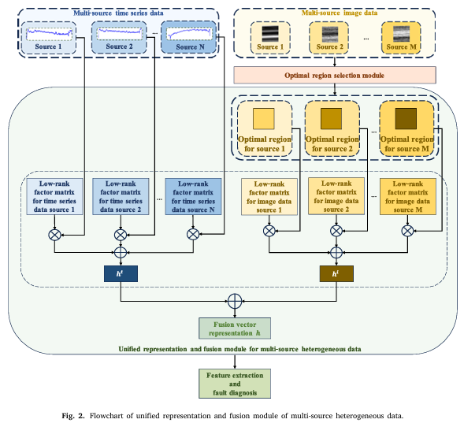
Method Design
Overall method framework
CPS Computational Learning Laboratory
23
Notes:
框架由三个模块组成：
最优区域选择模块（图像数据预处理）
统一表征与融合模块（核心，低秩分解）
多尺度轻量 CNN 诊断模块
主线：异构数据 → 统一表征 → 对齐融合 → 诊断

Slide 24
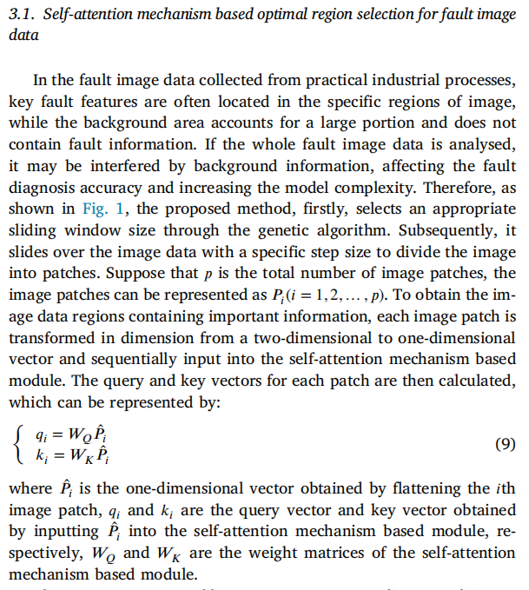
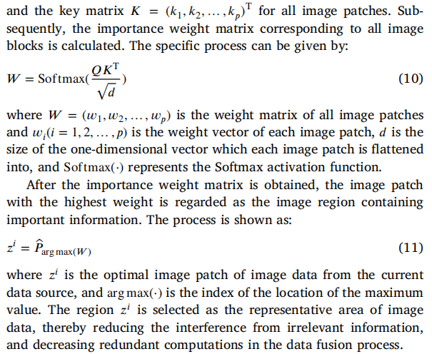
Method Design
CPS Computational Learning Laboratory
24
Notes:
图像数据最优区域选择
故障图像中，关键特征只占特定区域，背景占大部分。直接分析整图，受背景干扰，模型复杂度上升。作者提出的方法：
1.通过滑动窗口将图像分成patches
2.自注意力机制计算每个patch的重要性权重
3.选权重最高的patch作为代表区域
最终实现减少冗余，为后续对齐提供干净输入。

Slide 25
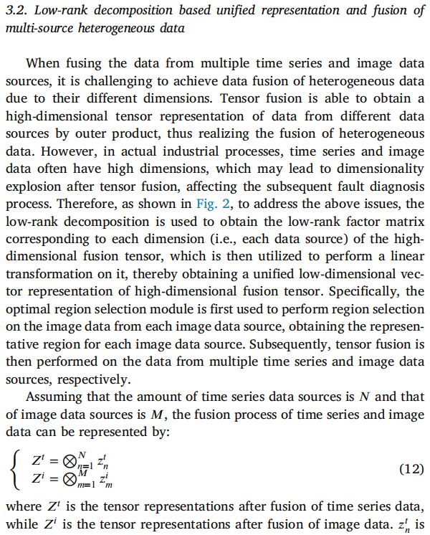
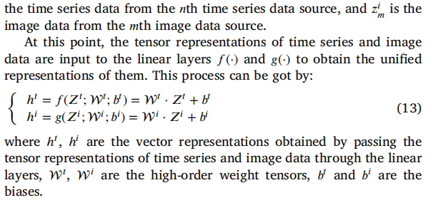
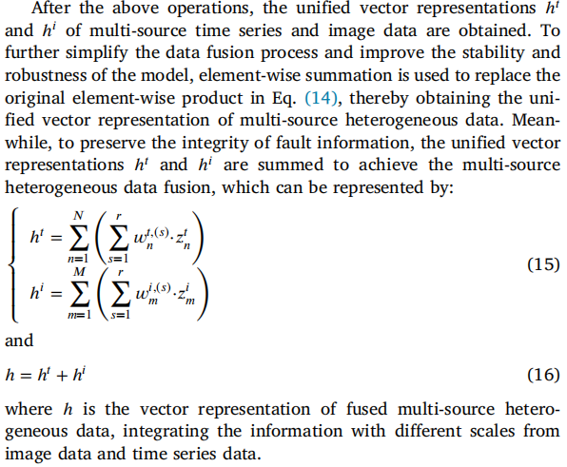
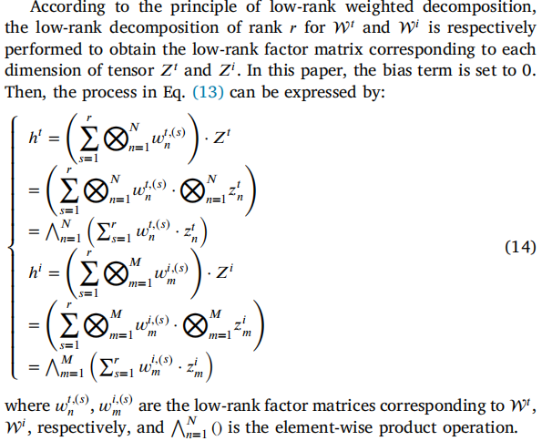
Method Design
CPS Computational Learning Laboratory
25
Notes:
低秩分解统一表征与融合
第一步张量融合：对时间序列数据和图像数据分别做张量外积，得到高维张量表示，保留原始信息
第二步低秩分解：将高维张量分解为低秩因子矩阵，得到低维统一向量表示
对齐逻辑：异构数据→同一张量空间→同一低维向量空间
张量融合把异构数据放到同一个高维张量空间→这是第一层对齐
低秩分解把高维张量压缩到低维统一向量空间→这是第二层对齐
每个低秩因子对应张量的一个维度（即一个数据源），不同数据源在低维空间中获得统一、可比较的表示

Slide 26
01
Problem Description
02
Method Design
03
Experiment Results
Contents
04
Conclusion
CPS Computational Learning Laboratory
26

Slide 27
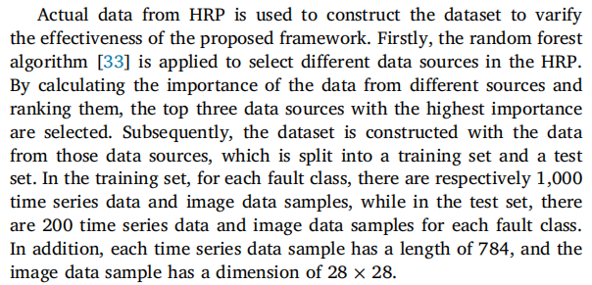
Experiment Results
dataset
The dataset is constructed using actual data from HRP, and comparative experiments are set up to verify the effectiveness and superiority of the proposed framework.
Case 1: 3 classes
Case 2: 4 classes
CPS Computational Learning Laboratory
27
Notes:
数据集为热轧过程实际数据，数据类型包括时间序列数据和图像数据。分为两个案例展示模型效果，案例1是3分类，案例2是4分类。

Slide 28
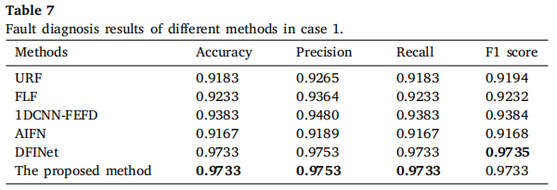
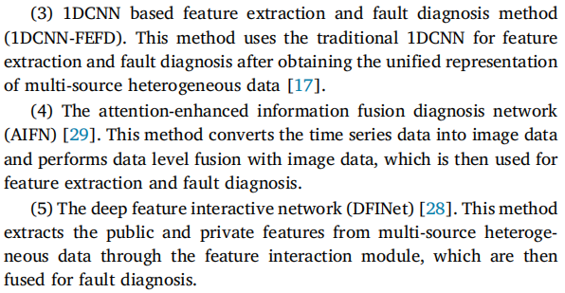
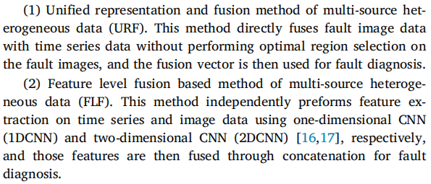
Experiment Results
Case 1
CPS Computational Learning Laboratory
28
Notes:
URF：不做最优区域选择，直接融合图像和时间序列
FLF：特征级融合：1DCNN+2DCNN分别提特征后拼接
1DCNN-FFED：统一表征后用传统1DCNN提特征诊断
AIFN：将时间序列转图像后做数据级融合
DFINet：提取公共/私有特征后融合诊断
由表7可以看出，本文方法与DFINet在无噪条件下持平；URF比本文方法低0.055，证明了最优区域选择有效；FLF比本文方法低0.05，证明了低秩统一表征能够避免信息丢失。

Slide 29
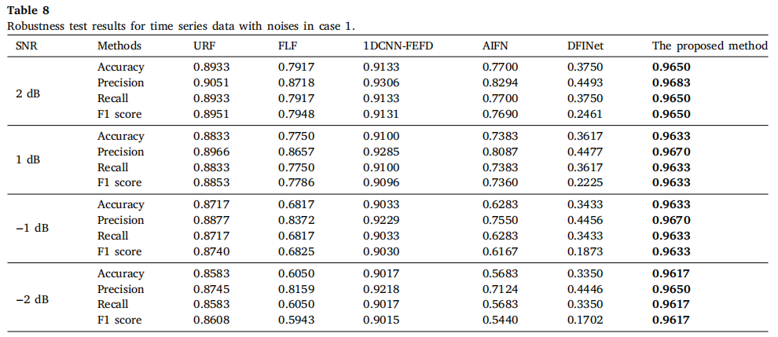
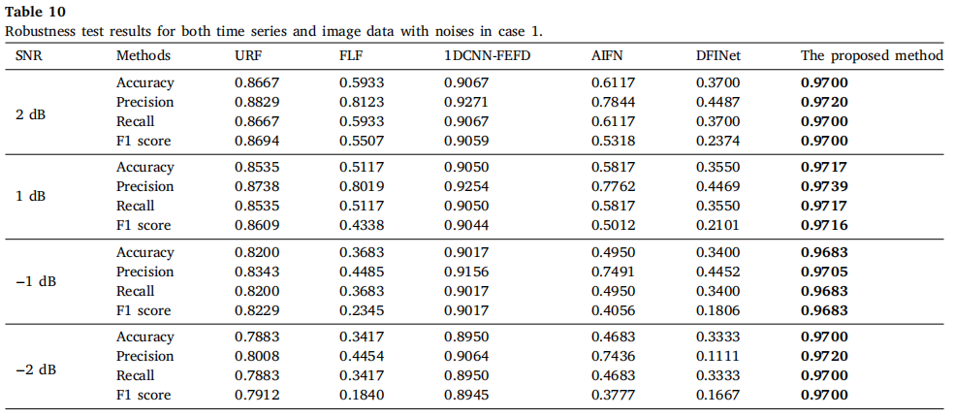
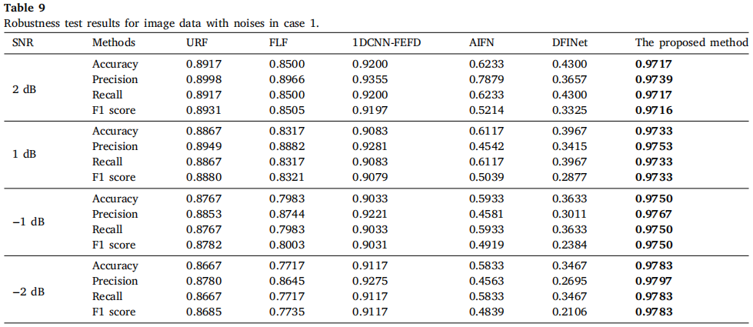
Experiment Results
Case 1
CPS Computational Learning Laboratory
29
Notes:
三种加噪场景：仅时间序列加噪、仅图像加噪、两者同时加噪
DFINet无噪时表现好，但加噪后最大下降0.8068
本文方法在-2dB强噪声下仍保持0.97准确率

Slide 30
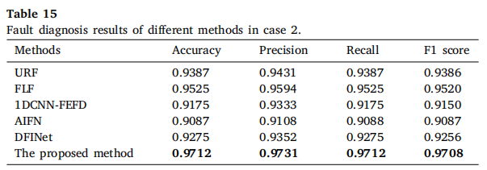
Experiment Results
Case 2
CPS Computational Learning Laboratory
30
Notes:
验证泛化性
由表可以看出，在4分类场景下，本文方法全面领先

Slide 31
01
Problem Description
02
Method Design
03
Experiment Results
Contents
04
Conclusion
CPS Computational Learning Laboratory
31
CPS Computational Learning Laboratory
2
18

Slide 32
Conclusion
①
A unified representation and fusion framework of multi-source heterogeneous data is proposed for fault diagnosis.
Tensor fusion is performed on the time series data and the selected image data region, and low-rank decomposition is utilized to obtain a low-dimensional unified vector representation, thereby achieving the multi-source heterogeneous data fusion.
②
In the process of selecting the optimal image regions from fault image data, the proposed method firstly divides the image data into patches by a sliding window, where its size and step length are fixed. It may lead to the repetitive selection of non-fault regions, causing computational redundancy.
CPS Computational Learning Laboratory
32
Notes:
总结：
1. 统一表征对齐：通过张量融合 + 低秩分解，将时间序列和图像数据统一到低维向量空间
2. 最优区域选择：减少图像冗余，为对齐提供干净输入
3. 多尺度轻量 CNN：从融合向量中提取多尺度特征，实现高精度诊断
4. 实验结果：
· Case 1 和 Case 2 中四项指标全面领先
· 强噪声下仍保持 0.97 准确率
未来：
· 滑动窗口尺寸和步长固定，可能重复选择非故障区域
· 未来：研究自适应调整窗口和步长的方法
· 提升故障区域选择的准确性

Slide 33
Paper 3
MGTN-DSI: A multi-sensor graph transfer network considering dual
structural information for fault diagnosis under varying working conditions
Jianjie Liu, Xianfeng Yuan, Xilin Yang, Weijie Zhu, Yansong Zhang, Tianyi Ye, Xinxin Yao, Fengyu Zhou
Published in: Advanced Engineering Informatics
Published Time: 2025
CPS Computational Learning Laboratory
33

Slide 34
01
Problem Description
02
Method Design
03
Experiment Results
Contents
04
Conclusion
CPS Computational Learning Laboratory
34
Notes:
主要分为以下四个部分

Slide 35
01
Problem Description
02
Method Design
03
Experiment Results
Contents
04
Conclusion
CPS Computational Learning Laboratory
35
Notes:
首先是问题描述

Slide 36
Problem Description
In recent years, mechanical systems have increasingly integrated multiple sensors to monitor equipment
status more effectively.
There exist topological relationships among multi-sensors at both the data level and the feature level.
Different sensors yield diverse representations of the same fault. This variability exacerbates the complexity of high-dimensional features in multi-sensor data, complicating both model training and domain alignment.
There exist topological relationships among multi-sensors at both the data level and the feature level.
The objective of the proposed MGNT-DSI is to learn the domain-invariant features from the SD, which is enabled to achieve satisfactory diagnostic results in TD tasks.
CPS Computational Learning Laboratory
36
Notes:
机械系统越来越多地部署多个传感器，实现有效监测设备状态。同一个故障，不同传感器给出不同的表征，这种差异性导致模型训练和域对齐更加困难。
多传感器数据中存在双重结构信息：
数据层结构：不同传感器之间的拓扑关系
特征层结构：融合后高层特征之间的相关性
现有方法只关注单一传感器数据，只利用单一结构信息，需要同时挖掘传感器间结构和特征间结构
本文提出的MGNT-DSI方法的对齐目标是从多传感器数据中学习域不变特征。首先构建传感器间结构关系，其次构建融合特征间相关性，最后形成双重结构信息的统一表征。

Slide 37
01
Problem Description
02
Method Design
03
Experiment Results
Contents
04
Conclusion
CPS Computational Learning Laboratory
37
Notes:
研究现状

Slide 38
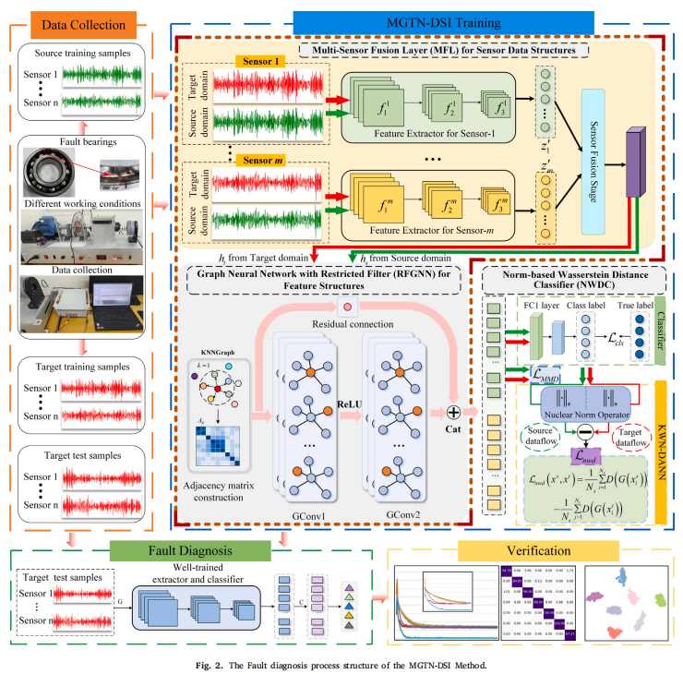
Method Design
CPS Computational Learning Laboratory
38
Notes:
MGTN-DSI由三部分组成：
1.多传感器融合层MFL：构建传感器关系，融合多传感器特征
2.RFGNN：构建特征关系图，提取双重结构信息
3.分类器+NWDC
核心流程为：多传感器信号→并行CNN特征提取→MFL融合→RFGNN图卷积→分类

Slide 39
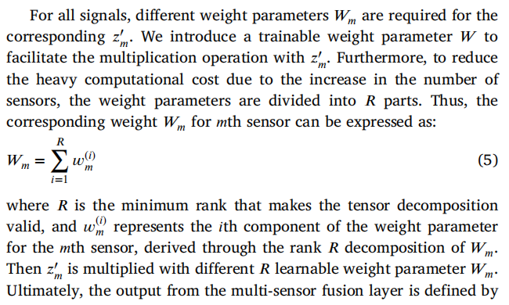
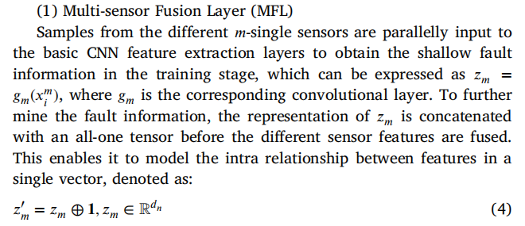
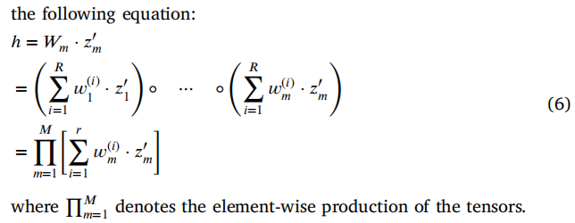
Method Design
Multi-Sensor Fusion Layer (MFL)
CPS Computational Learning Laboratory
39
Notes:
每个传感器的信号并行输入独立CNN提取浅层特征；
将每个传感器的特征与全1张量拼接，建模单向量内部关系，如公式4所示；
低秩分解权重：为每个传感器学习权重参数Wm，通过秩R分解降低计算量，如公式5所示；
融合输出，如公式6所示。
最终得到融合紧凑的特征h。
不同传感器的特征zm维度可能不同，通过拼接全1张量+低秩权重分解，将各传感器特征映射到统一维度，保留各传感器的互补信息

Slide 40
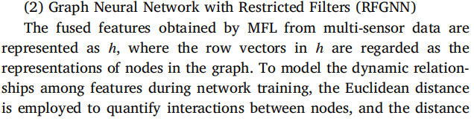
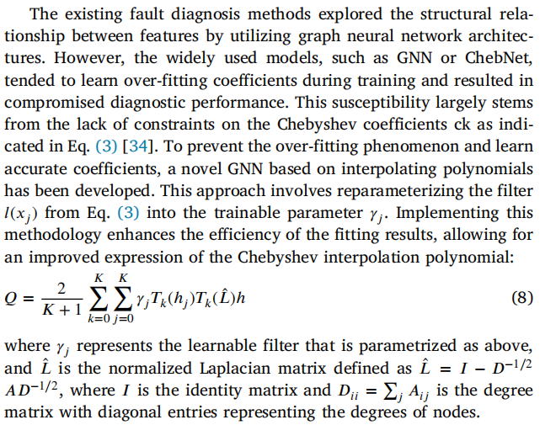
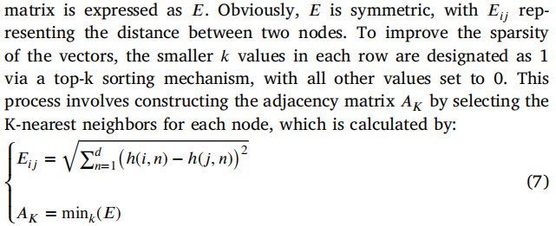
Method Design
Graph Neural Network with Restricted Filter（RFGNN）
CPS Computational Learning Laboratory
40
Notes:
第一步：构图
将融合特征h的行向量视为图的节点
用欧氏距离量化节点间交互，如公式7所示
用top-k排序构造邻接矩阵AK，如公式7所示
第二步：Chebyshev插值重参数化滤波器
传统ChebNet容易过拟合→用Chebyshev插值重参数化滤波器，如公式8所示。
实现构建特征间关系图，提取特征层结构信息
现在实现了双重对齐：
一是MFL对齐：把不同传感器的异构表征映射到统一融合空间
二是RFGNN对齐：在融合空间内，通过图结构挖掘特征间的深层关联
最终得到同时包含传感器结构信息和特征结构信息的双重结构表征

Slide 41
01
Problem Description
02
Method Design
03
Experiment Results
Contents
04
Conclusion
CPS Computational Learning Laboratory
41

Slide 42
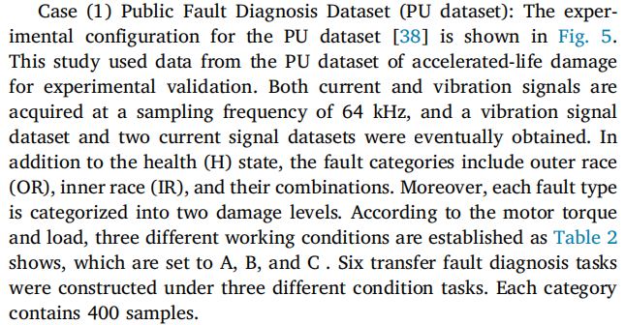
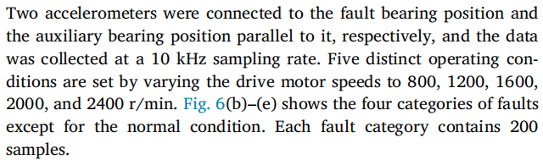
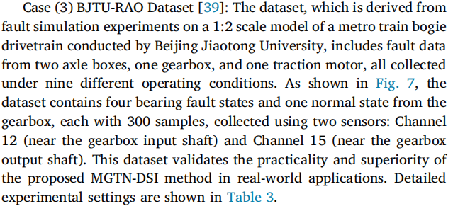







Experiment Results
dataset
CPS Computational Learning Laboratory
42

Slide 43
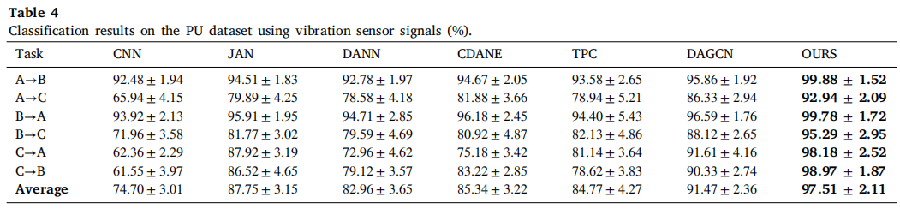
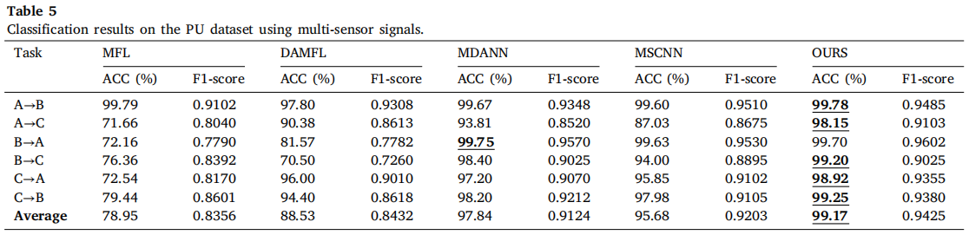
Experiment Results
Single Sensor vs Multiple Sensors
CPS Computational Learning Laboratory
43
Notes:
表4为单振动传感器，表5为多传感器

Slide 44
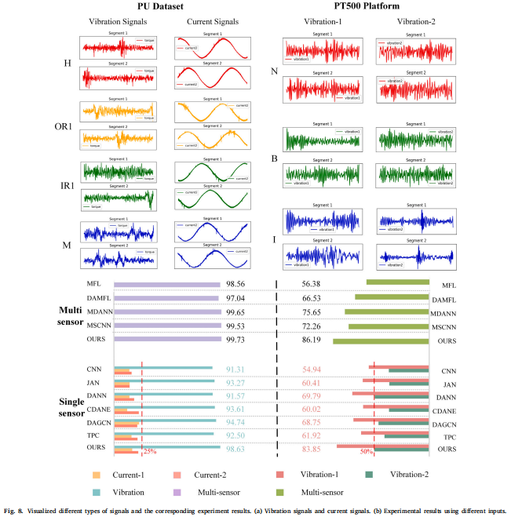
Experiment Results
Effects of Different Signal Types
CPS Computational Learning Laboratory
44
Notes:
电流信号区分度低，振动信号区分度高
但加入电流信号后，MFL将诊断精度从98.63%提升到99.73%，说明MFL多传感器融合有效利用了电流信号的补充信息。
PT500平台的两个振动信号区分度更高，MFL融合后效果进一步提升

Slide 45
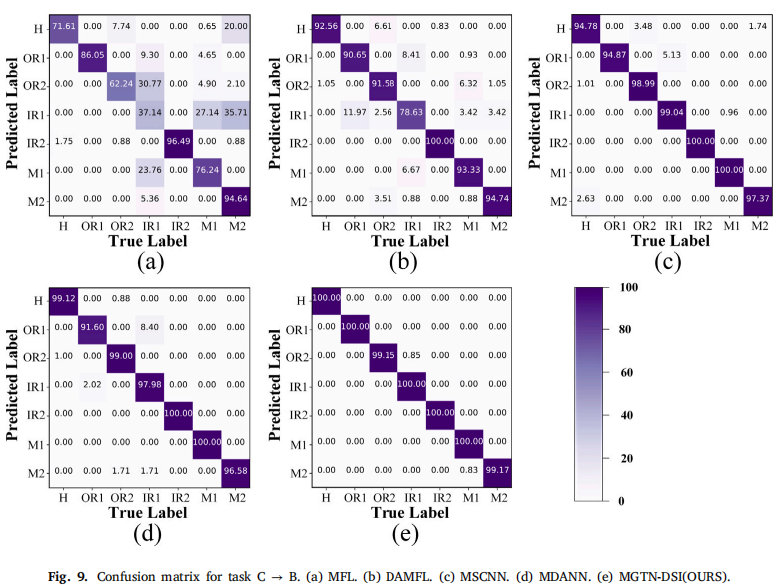
Experiment Results
CPS Computational Learning Laboratory
45
Notes:
MGTN-DSI完美识别了5各故障类别，其余2个类别精度也超过99%。而对比方法存在明显误分类。
说明双重结构信息+细粒度对齐的有效性

Slide 46
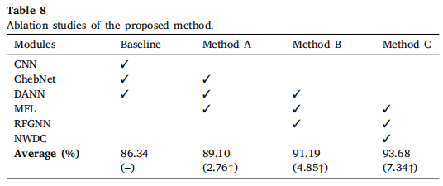
Experiment Results
Ablation studies
CPS Computational Learning Laboratory
46
Notes:
MFL贡献+2.76%，证明多传感器融合层有效
RFGNN贡献+2.09%，证明双重结构信息提取有效

Slide 47
01
Problem Description
02
Method Design
03
Experiment Results
Contents
04
Conclusion
CPS Computational Learning Laboratory
47
CPS Computational Learning Laboratory
2
18

Slide 48
Conclusion
A novel multi-sensor graph transfer network considering dual structural information (MGTN-DSI) is designed for fault diagnosis under varying working conditions.
Future investigations might focus on devising hypergraphs for multi-sensor data and refining MGTN-DSI to integrate hypergraph data more effectively.
CPS Computational Learning Laboratory
48
Notes:
MGTN-DSI 通过多传感器融合层（MFL）构建传感器间关系、通过 RFGNN 构建特征间相关性，形成双重结构信息的统一表征，实现了异构多传感器数据的表征对齐，在变工况故障诊断中达到 SOTA 性能。
· 训练时间略长（GNN 构图开销）
· 未来方向：
· 优化图构建效率
· 扩展到更多传感器类型
· 适应更复杂的工业场景

Slide 49
Paper 4
SEA++: Multi-Graph-Based Higher-Order Sensor Alignment for Multivariate Time-Series Unsupervised Domain Adaptation
Yucheng Wang, Yuecong Xu, Jianfei Yang, Min Wu, Xiaoli Li, Lihua Xie, Zhenghua Chen
Published in: IEEE Transactions on Knowledge and Data Engineering
Published Time: 2026
CPS Computational Learning Laboratory
49

Slide 50
01
Problem Description
02
Method Design
03
Experiment Results
Contents
04
Conclusion
CPS Computational Learning Laboratory
50
Notes:
主要分为以下四个部分

Slide 51
01
Problem Description
02
Method Design
03
Experiment Results
Contents
04
Conclusion
CPS Computational Learning Laboratory
51
Notes:
首先是问题描述

Slide 52
Problem Description
MTS data typically originates from multiple sensors, each with its unique distribution.
When adapting existing TS UDA methods to MTS-UDA, they primarily focus on aligning global features across domains by treating signals from various sensors as a whole. However, these approaches ignore the diverse distributions across sensors, leading to misalignment at the sensor level.
To address the above challenges, we propose Sensor Alignment (SEA) for MTS-UDA. First, we aim to reduce domain discrepancy at both the local and global sensor levels.
CPS Computational Learning Laboratory
52
Notes:
多变量时间序列（MTS）数据来自多个传感器，每个传感器因类型不同、部署位置不同，具有独特的分布，这种多传感器特性带来了异构性
现有 TS UDA 方法把多传感器信号当作一个整体，只对齐全局特征，忽略传感器间的分布差异，结果：传感器级错位
提出SEA方法在局部传感器级和全局传感器级同时减少域差异。

Slide 53
01
Problem Description
02
Method Design
03
Experiment Results
Contents
04
Conclusion
CPS Computational Learning Laboratory
53
Notes:
研究现状

Slide 54
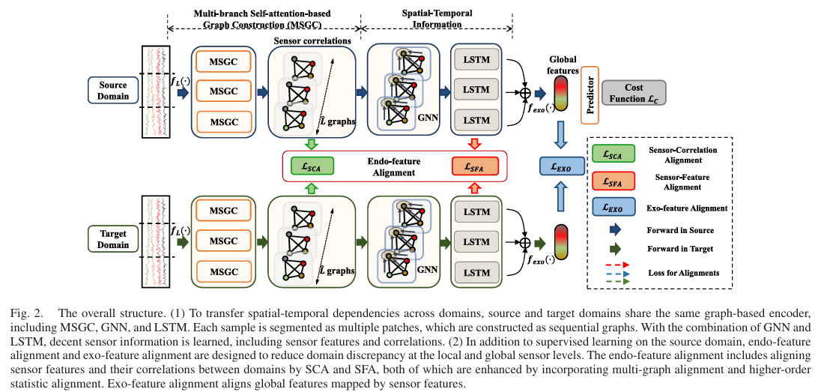
Method Design
CPS Computational Learning Laboratory
54
Notes:
SEA 由三部分组成：
Graph-Based Encoder：MSGC + GNN + LSTM，捕获时空依赖
Endo-Feature Alignment：传感器级对齐（SCA + SFA）
Exo-Feature Alignment：全局对齐（Deep CORAL）
源域和目标域共享同一个 graph-based encoder
对齐在两个层级同时进行：局部传感器级 + 全局传感器级

Slide 55
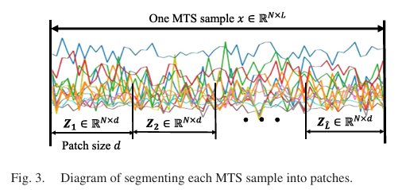
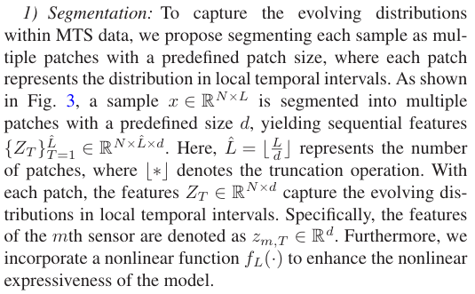
Method Design
Graph-Based Encoder
CPS Computational Learning Laboratory
55

Slide 56
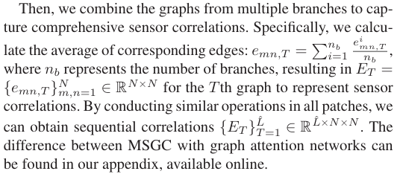
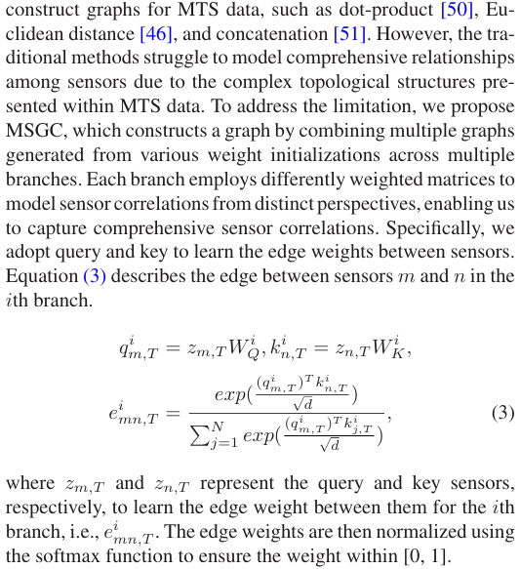
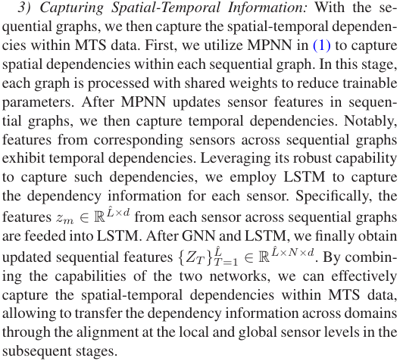
Method Design
CPS Computational Learning Laboratory
56

Slide 57
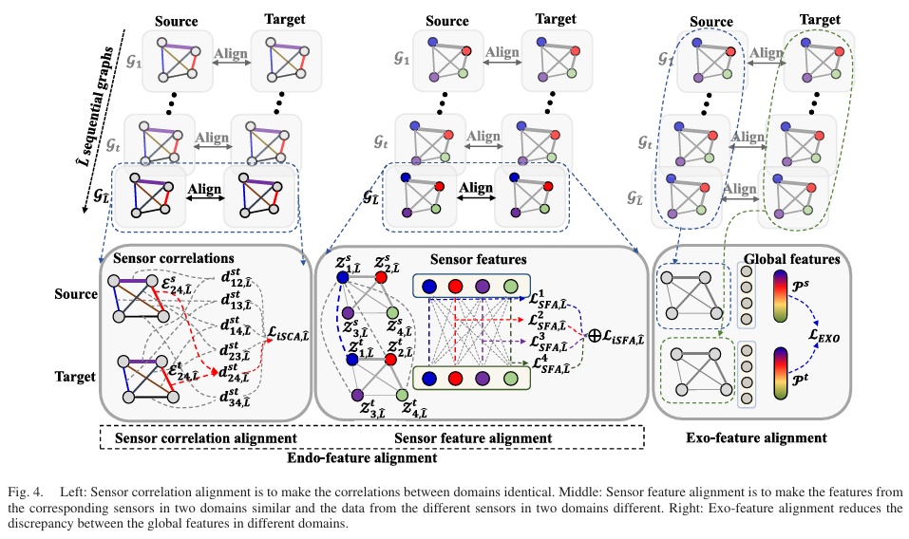
Method Design
Endo-Feature Alignment
CPS Computational Learning Laboratory
57
Notes:
传感器级信息包含两部分：
传感器特征：每个传感器自身的独特分布
传感器关联：传感器之间的交互信息
需要同时对齐这两部分，才能实现完整的传感器级对齐

Slide 58
01
Problem Description
02
Method Design
03
Experiment Results
Contents
04
Conclusion
CPS Computational Learning Laboratory
58

Slide 59

Experiment Results
dataset
CPS Computational Learning Laboratory
59
Notes:
6 个公开 MTS 数据集：
覆盖 RUL 预测 + 人类活动识别 + 睡眠分期 + 手写识别
传感器数量从 3 到 110 不等
每个子数据集/受试者/条件视为一个域

Slide 60


Experiment Results
Comparisons
CPS Computational Learning Laboratory
60
Notes:
SEA 和 SEA++ 在多数跨域场景中优于 SOTA
SEA++ 在 C-MAPSS、UCI-HAR、Sleep-EDF 上进一步超越 SEA
说明传感器级对齐的必要性

Slide 61

Experiment Results
Ablation
CPS Computational Learning Laboratory
61
Notes:
引入 SCA 提升 9.38%，引入 SFA 提升 11.71% → 传感器级对齐有效
加入 MGA（多图对齐）和二阶统计 → 进一步提升
组合 iSCA + iSFA → 提升 24.39%
endo-feature alignment 是性能提升的关键

Slide 62

Experiment Results
Improvements of SEA++ over SEA
CPS Computational Learning Laboratory
62
Notes:
SEA++ 通过高阶统计对齐 + 多图对齐
在所有数据集上进一步提升
建立了 MTS-UDA 的 SOTA

Slide 63
01
Problem Description
02
Method Design
03
Experiment Results
Contents
04
Conclusion
CPS Computational Learning Laboratory
63
CPS Computational Learning Laboratory
2
18

Slide 64
Conclusion
By analyzing the problems underlying this task, we propose SEnSor Alignment (SEA) to address these issues. To reduce the domain discrepancy at both the local and global sensor levels, we design endo-feature alignment and exo-feature alignment.
CPS Computational Learning Laboratory
64
Notes:
SEA/SEA++ 通过在局部传感器级（SCA + SFA）和全局传感器级（Exo）同时对齐传感器特征与关联，并进一步用高阶统计对齐和多图对齐增强，实现了异构多传感器 MTS 数据的表征对齐，在六个公开数据集上达到 SOTA。

Slide 65
Paper 5
Time-frequency-spatial fusion-driven local-global contrastive discrepancy learning for industrial multisensor time-series anomaly detection
Lei Chen, Yuhao Peng, Ming Lu, Ying Zou, Mingyang Lv, Jiaao Peng
Published in: Information Fusion
Published Time: 2026
CPS Computational Learning Laboratory
65

Slide 66
01
Problem Description
02
Method Design
03
Experiment Results
Contents
04
Conclusion
CPS Computational Learning Laboratory
66
Notes:
主要分为以下四个部分

Slide 67
01
Problem Description
02
Method Design
03
Experiment Results
Contents
04
Conclusion
CPS Computational Learning Laboratory
67
Notes:
首先是问题描述

Slide 68
Problem Description
Industrial sensor signals exhibit rich and heterogeneous characteristics. Cyclic operations, repetitive control commands, and rotating machinery introduce multi-periodicity, seasonality, and long-term trends, while multisensor systems induce strong inter-variable coupling and spatial dependencies.
Noise, measurement errors, and external disturbances further complicate signal behaviors.
Industrial sensors typically produce 1D discrete time-series signals, the representation characteristics of the anomalies are compressed and entangled within these 1D signals.
It is difficult to represent diverse characteristics, such as multi-periodic dynamics, noise disturbances, and inter-sensor coupling, using these 1D signals. In this case, it limits discriminability.
The time, frequency, and spatial domains are jointly modeled and integrated throughout the entire anomaly detection pipeline, spanning data-level representation, feature-level learning, and decision-level inference.
CPS Computational Learning Laboratory
68
Notes:
工业传感器信号具有丰富且异构的特性：
周期性、季节性、长期趋势；多传感器系统变量间强耦合与空间依赖；噪声、测量误差、外部干扰进一步加剧复杂性。这些因素交互导致不规则波动，模糊了正常与异常的边界
工业传感器输出的是1D 离散时间序列
异常的表征特征被压缩并纠缠在 1D 信号中
1D 空间难以表示：
多周期动态
噪声干扰
传感器间耦合
根本问题：异构特征在 1D 空间中无法有效对齐
对齐目标：将时间域、频率域、空间域三种异构表征对齐到统一的可比较表示空间，获得更全面的模式表示，提升异常检测精度

Slide 69
01
Problem Description
02
Method Design
03
Experiment Results
Contents
04
Conclusion
CPS Computational Learning Laboratory
69
Notes:
研究现状

Slide 70


Method Design
CPS Computational Learning Laboratory
70
Notes:
TFSAD 由四个关键组件组成：
Local-global 4 阶张量构建（数据级 TFS 融合）
双向大核卷积特征提取（特征级 TFS 融合）
双视图局部-全局对比差异学习（决策级 TFS 融合）
对比差异异常评分

Slide 71

Method Design
data-level TFS fusion
CPS Computational Learning Laboratory
71

Slide 72




Method Design
Bidirectional large-kernel convolution-based feature extraction
CPS Computational Learning Laboratory
72

Slide 73




Method Design
Bidirectional large-kernel convolution (feature-level TFS fusion )
CPS Computational Learning Laboratory
73

Slide 74
01
Problem Description
02
Method Design
03
Experiment Results
Contents
04
Conclusion
CPS Computational Learning Laboratory
74

Slide 75

Experiment Results
dataset
CPS Computational Learning Laboratory
75
Notes:
8 个公开真实工业多传感器数据集
覆盖多种工业领域：水质监测、水处理、服务器、卫星、工厂模型等
变量数从 8 到 86 不等

Slide 76

Experiment Results
DS point determination: XJTU-SY dataset
CPS Computational Learning Laboratory
76

Slide 77

Experiment Results
Accuracy analysis
CPS Computational Learning Laboratory
77
Notes:
TFSAD 在所有 8 个数据集的 ACC 指标上排名第一或第二
尤其 GECCO、Genesis、PSM、HAI、SMD 上明显领先
说明 TFS 多级融合的有效性

Slide 78

Experiment Results
Ablation experiments-Effectiveness of time-frequency-spatial joint learnin
CPS Computational Learning Laboratory
78
Notes:
消融实验——TFS 联合学习有效性
单域模型持续低于联合学习
时频/时空间联合部分缓解局限
TFS 三域联合最有效，充分利用跨域互补信息
SWAT 数据集上：TFS 联合 VROC=0.9744, VPR=0.9596，优于两域变体
SMAP 数据集上：TFS 联合 VPR=0.9077，明显超越竞争变体

Slide 79

Experiment Results
Ablation experiments-Effectiveness of orthogonal tensor decomposition
CPS Computational Learning Laboratory
79
Notes:
消融实验——正交张量分解有效性
正交张量分解在不同数据集和指标上取得最佳整体性能
SWAT 数据集：F1=0.9778，优于两个竞争变体

Slide 80
01
Problem Description
02
Method Design
03
Experiment Results
Contents
04
Conclusion
CPS Computational Learning Laboratory
80
CPS Computational Learning Laboratory
2
18

Slide 81
Conclusion
①
TFSAD addresses an underexplored research gap by introducing time-frequency-spatial multi-level fusion for the TSAD task.
②
TFSAD exhibits good efficiency, satisfactory inference speed and low resource consumption owing to its compact model size.
CPS Computational Learning Laboratory
81
Notes:
TFSAD 通过“Local-global 4 阶张量构建 + 正交张量分解 + 双向大核卷积”三级处理，将工业多传感器信号中的时间、频率、空间三种异构表征对齐到统一的可比较表示空间，为多传感器异常检测提供了系统性的表征对齐方案。
未来方向：
优化正交张量分解效率
扩展到更多传感器类型与工业场景
自适应超参数选择

Slide 82
Inspiration
Heterogeneous multi-sensor alignment should be built as a multi-level alignment framework, rather than alignment at a single level.
The alignment target should include both the features themselves and the relationships among features.
Removing redundancy and decoupling heterogeneous components before alignment can significantly improve the alignment performance.
CPS Computational Learning Laboratory
82
Notes:
异构多传感器对齐应该构建多层级对齐框架，而不是单一层级的对齐。
对齐的目标应包含特征本身和特征间关系两部分。
对齐前先去除冗余、解耦异构成分，能显著提升对齐效果。

Slide 83
Thank you for listening

