Slide 1
State Abstraction for Efficient Reinforcement Learning
②
Sample Efficient Deep RL With Online State Abstraction and Causal Transformer Model Prediction
①
③
State Abstraction via Deep Supervised Hash Learning
Cooperative Multi-Agent Learning for Navigation via Structured State Abstraction
④
⑤
Compact Goal Representation Learning via Information Bottleneck in Goal-Conditioned RL
Robust Multi-Agent Reinforcement Learning by Mutual Information Regularization
CPS Computational Learning Laboratory
1

Slide 2
①
State Abstraction via Deep Supervised Hash Learning
②
Sample Efficient Deep RL With Online State Abstraction and Causal Transformer Model Prediction
③
Cooperative Multi-Agent Learning for Navigation via Structured State Abstraction
State Abstraction.
State Abstraction + World Model.
State Abstraction + Multi-Agent Communication.
Information Bottleneck for Goal Representation.
Mutual Information for Robust MARL.
④
Compact Goal Representation Learning via Information Bottleneck in Goal-Conditioned RL
⑤
Robust Multi-Agent Reinforcement Learning by Mutual Information Regularization
CPS Computational Learning Laboratory
2

Slide 3

Paper 1
State Abstraction via Deep Supervised Hash Learning
Guang Yang, Zheng Xu, Jing Huo, Shangdong Yang, Tianyu Ding, Xingguo Chen, and Yang Gao, Senior Member, IEEE
This paper was published in: IEEE Transactions on Neural Networks and Learning Systems (IF: 9.7)
Published Time: 2025
Reference: G. Yang, Z. Xu, J. Huo, S. Yang, T. Ding, X. Chen, and Y. Gao, “State Abstraction via Deep Supervised Hash Learning,” IEEE Transactions on Neural Networks and Learning Systems, vol. 36, no. 7, pp. 13608–13614, Jul. 2025, doi: 10.1109/TNNLS.2024.3467338.
CPS Computational Learning Laboratory
3

Slide 4
01
Problem Description
02
Method Design
03
Experiment Results
Contents
04
Conclusion
CPS Computational Learning Laboratory
4

Slide 5
Problem Description
Challenge:
Large or high-dimensional state spaces make policy learning expensive and sample inefficient.
Model-based abstraction requires learning transition/reward models, while existing model-free similarity metrics can be unstable or biased.
Method:
Use deep supervised hash learning (DSH) to map states into compact binary-like codes.
Construct pairwise supervision directly from target-network Q values, avoiding an explicit environment model or expert policy.
Optimize DSH as an auxiliary loss for DQN and SAC, with a theoretical near-optimality bound.
CPS Computational Learning Laboratory
5

Slide 6


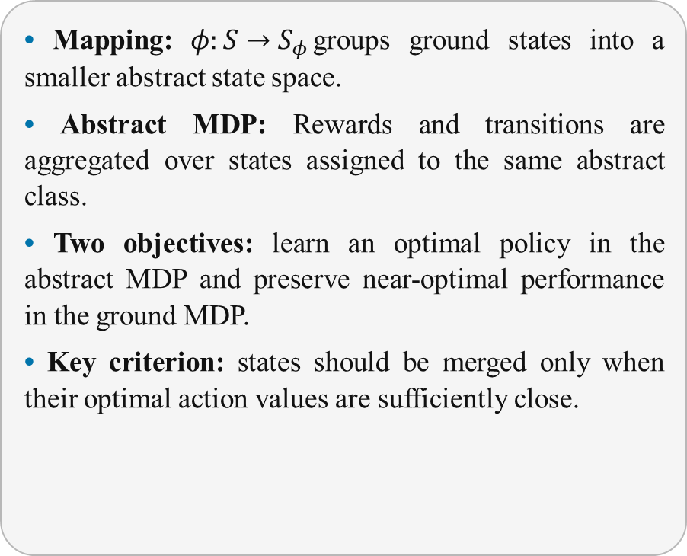

Problem Description
State Abstraction in Markov Decision Processes
• Mapping: $φ:S→S_{φ}$groups ground states into a smaller abstract state space.
• Abstract MDP: Rewards and transitions are aggregated over states assigned to the same abstract class.
• Two objectives: learn an optimal policy in the abstract MDP and preserve near-optimal performance in the ground MDP.
• Key criterion: states should be merged only when their optimal action values are sufficiently close.
Ground State Space
Abstract State Space
$$φ$$
Near-optimality requires Q*-consistent aggregation
φ(sᵢ)=φ(sⱼ) ⇒ |Q*(sᵢ,a)−Q*(sⱼ,a)| ≤ ε, ∀a
CPS Computational Learning Laboratory
6

Slide 7
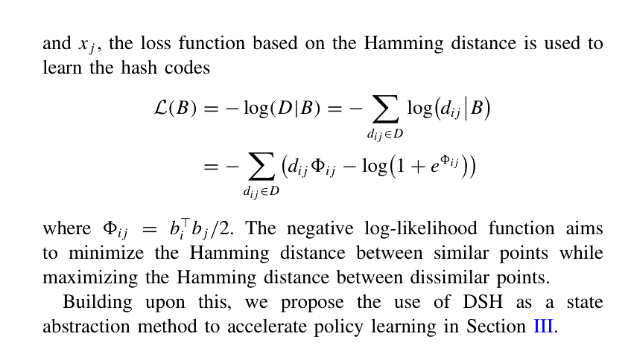
Problem Description
Deep Supervised Hashing as State Aggregation
• Binary-like code: a K-bit hash vector defines up to 2ᴷ abstract states and enables efficient state clustering.
• Pairwise similarity: similar samples are pulled together in Hamming space; dissimilar samples are pushed apart.
• RL-specific supervision: semantic labels are unavailable, so the paper derives state-pair labels from target Q-value similarity.
• Smooth optimization: continuous representations are trained toward their sign-discretized codes rather than enforcing hard quantization from the start.
CPS Computational Learning Laboratory
7

Slide 8
01
Problem Description
02
Method Design
03
Experiment Results
Contents
04
Conclusion
CPS Computational Learning Laboratory
8

Slide 9
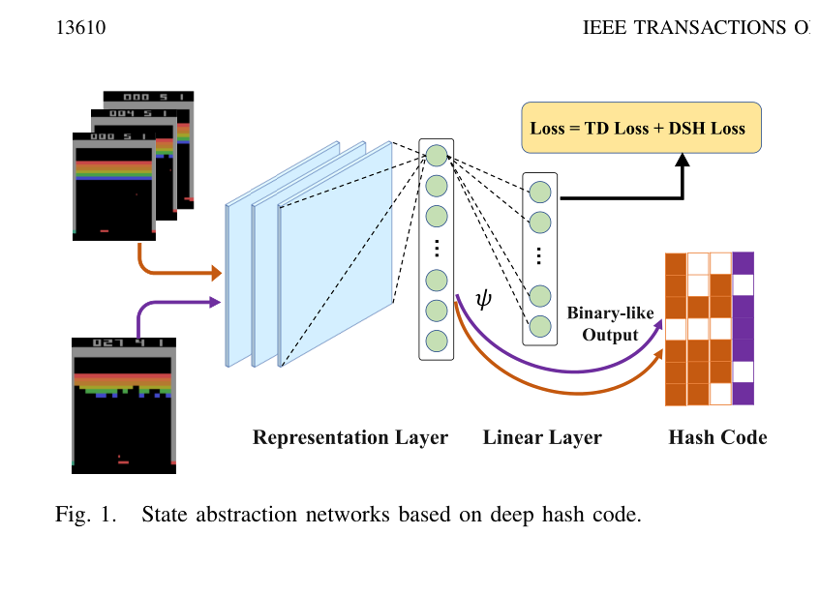
Method Design
1 DSH-Based State Abstraction Network
• Q-network decomposition: the representation layer outputs ψW(s), while a linear layer maps it to action values.
• Abstract code: sign(ψW(s)) produces a binary state representation; the hash dimension controls abstraction granularity.
• Modularity: the abstraction loss is attached to the value network and can be optimized jointly with standard RL losses.
Q(s,·;W,θ)=ψW(s)ᵀθ makes the representation directly responsible for value-preserving abstraction.
CPS Computational Learning Laboratory
9

Slide 10
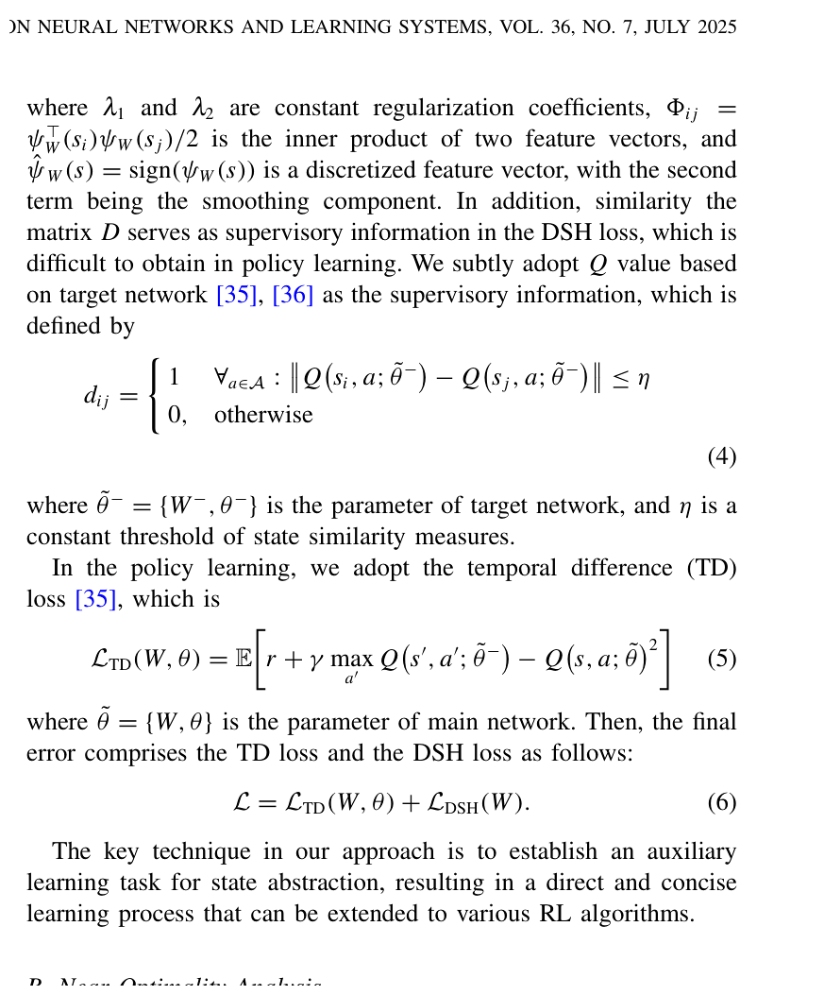
Method Design
2 Target-Q Supervision and the DSH Objective
• Similarity label dᵢⱼ: two states are positive pairs when all target-network Q values differ by no more than threshold η.
• Pairwise likelihood: the DSH term minimizes Hamming distance for positive pairs and enlarges it for negative pairs.
• Quantization term: penalizes the gap between ψW(s) and sign(ψW(s)), yielding binary-like but differentiable representations.
• Stable labels: a delayed target network is used to reduce supervision drift during policy learning.
CPS Computational Learning Laboratory
10

Slide 11
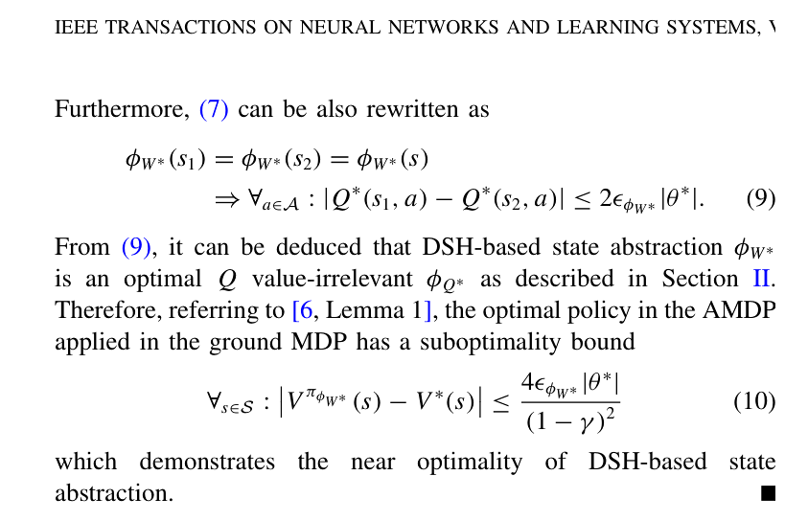
Method Design
4 Near-Optimality Analysis
• Q-value irrelevance: if two states share the same optimal hash code, their optimal Q values differ by a bounded amount.
• Suboptimality bound: the policy learned in the abstract MDP has a value loss bounded by the hash quantization error, the linear-layer norm, and (1−γ)⁻².
• Interpretation: smaller discretization error yields a tighter guarantee; the code is therefore both compact and policy-aware.
• Scope: the guarantee is derived under the optimal representation/value parameters and mainly motivates the auxiliary learning design.
CPS Computational Learning Laboratory
11

Slide 12
01
Problem Description
02
Method Design
03
Experiment Results
Contents
04
Conclusion
CPS Computational Learning Laboratory
12

Slide 13
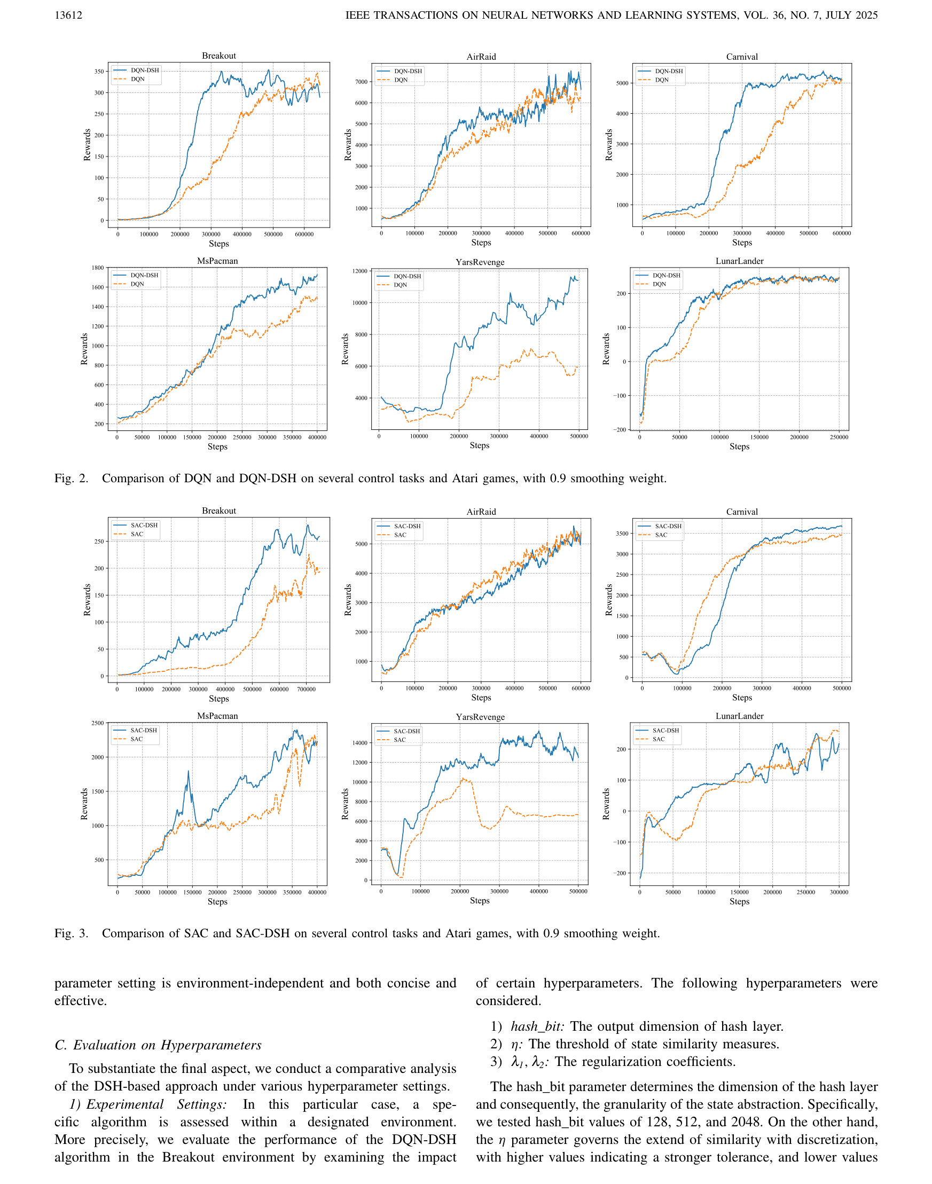
Experiment Results
1 Integration With DQN and SAC
CPS Computational Learning Laboratory
13

Slide 14
Experiment Results
1 Integration With DQN and SAC
CPS Computational Learning Laboratory
14

Slide 15
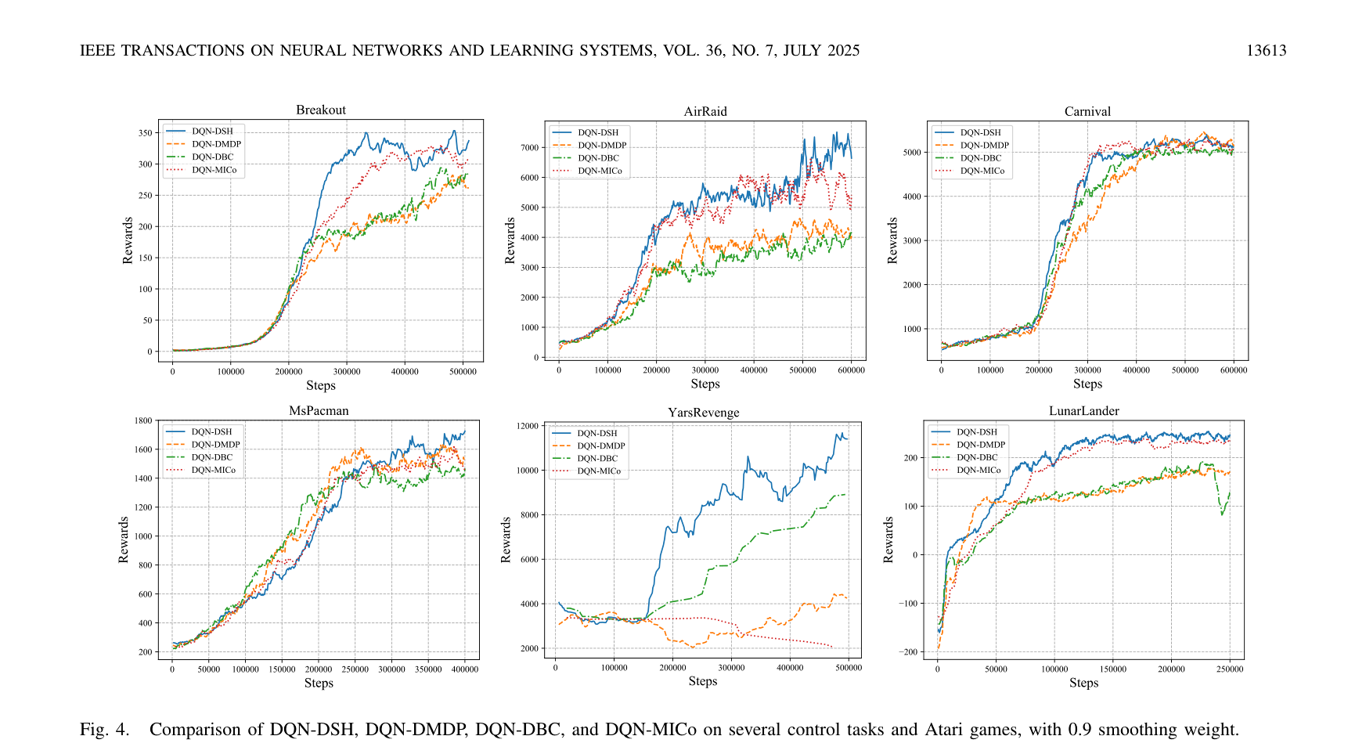
Experiment Results
2 Comparison With Deep State-Abstraction Baselines
CPS Computational Learning Laboratory
15

Slide 16
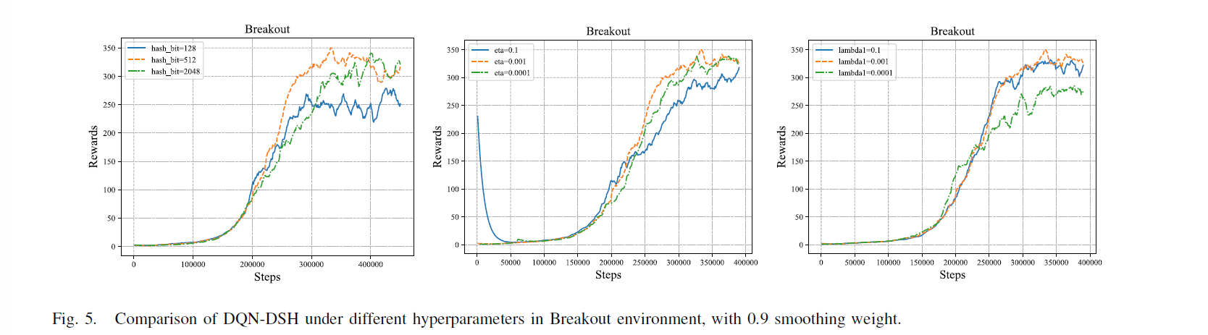
Experiment Results
3 Sensitivity to Abstraction Granularity
CPS Computational Learning Laboratory
16

Slide 17
01
Problem Description
02
Method Design
03
Experiment Results
Contents
04
Conclusion
CPS Computational Learning Laboratory
17
CPS Computational Learning Laboratory
2
18

Slide 18
Conclusion
①
The paper formulates state abstraction as Q-value-consistent deep hashing. Target-network Q values generate pairwise supervision, while the DSH loss learns compact binary-like codes that can be optimized jointly with DQN or SAC.
②
Theory links the learned hash representation to optimal Q-value-irrelevant abstraction and bounds the policy loss. Experiments show faster learning than several deep abstraction baselines; future work includes continuous-action and multi-agent state abstraction.
CPS Computational Learning Laboratory
18

Slide 19
Paper 2
Sample Efficient Deep Reinforcement Learning With Online State Abstraction and Causal Transformer Model Prediction
Yixing Lan, Xin Xu, Senior Member, IEEE, Qiang Fang, and Jianye Hao, Member, IEEE
This paper was published in: IEEE Transactions on Neural Networks and Learning Systems (IF: 9.7)
Published Time: 2024
Reference: Y. Lan, X. Xu, Q. Fang, and J. Hao, “Sample Efficient Deep Reinforcement Learning With Online State Abstraction and Causal Transformer Model Prediction,” IEEE Transactions on Neural Networks and Learning Systems, vol. 35, no. 11, pp. 16574–16588, Nov. 2024, doi: 10.1109/TNNLS.2023.3296642.
CPS Computational Learning Laboratory
19

Slide 20
01
Problem Description
02
Method Design
03
Experiment Results
Contents
04
Conclusion
CPS Computational Learning Laboratory
20

Slide 21
Problem Description
Challenge:
State abstraction can remove task-relevant information, while learned world models introduce transition/reward approximation errors.
One-step prediction errors compound over long rollouts, so model-generated data may degrade rather than improve policy learning.
Method:
Use state abstraction via multistep bisimulation (SAMB) to obtain task-related latent MDPs with adaptive coarseness.
Use a causal transformer model predictor (CTMP) and a multistep SAC λ-target to exploit long-horizon model rollouts efficiently.
CPS Computational Learning Laboratory
21

Slide 22
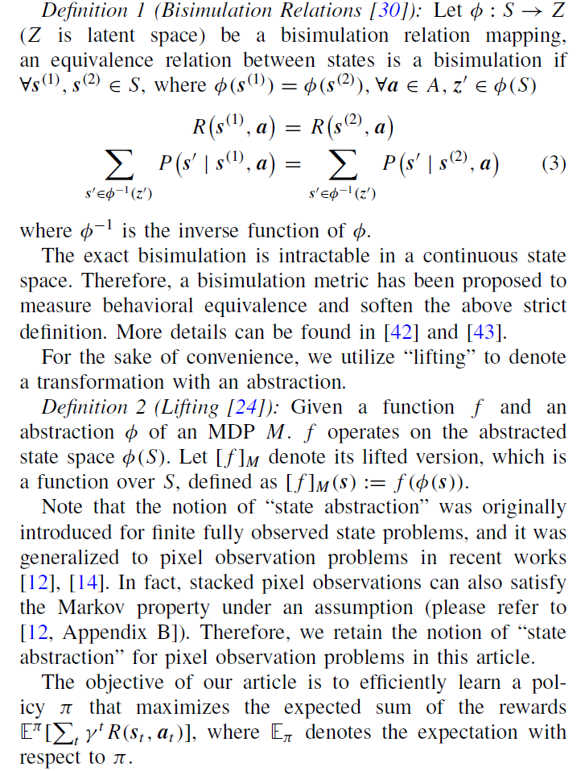
Problem Description
CPS Computational Learning Laboratory
22

Slide 23
01
Problem Description
02
Method Design
03
Experiment Results
Contents
04
Future Work
CPS Computational Learning Laboratory
23
Notes:
研究现状

Slide 24
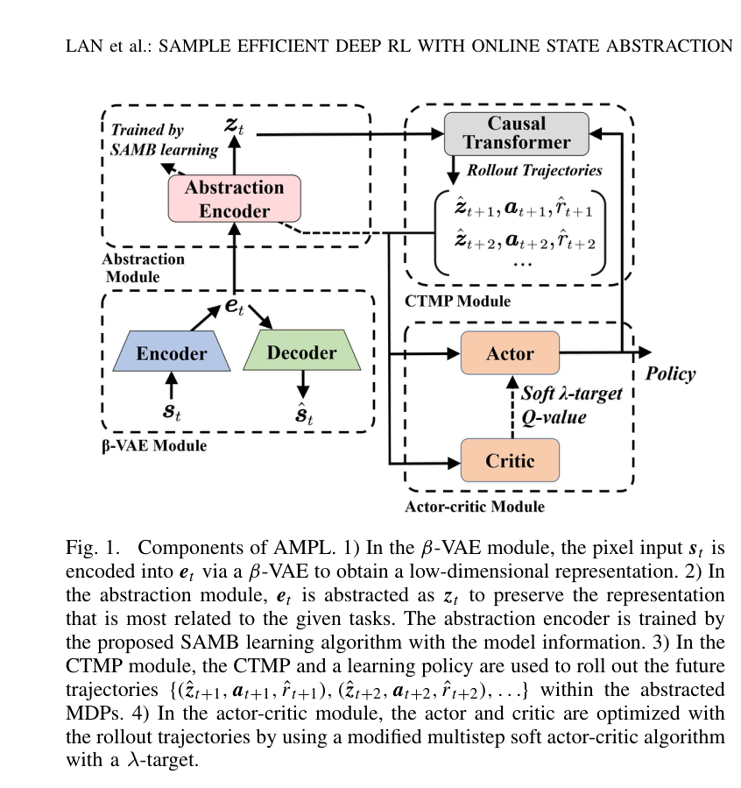

Method Design
1 Overall AMPL Architecture
• β-VAE: rapidly obtains disentangled low-dimensional image features.
• SAMB: extracts task-related abstract states using multistep bisimulation losses.
• CTMP: predicts abstract latent states and rewards over long horizons.
• Actor–critic: learns from real and imagined trajectories using a soft multistep λ-target.
CPS Computational Learning Laboratory
24

Slide 25
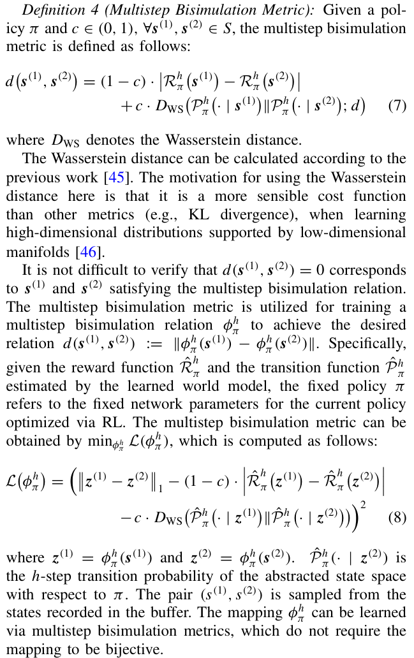
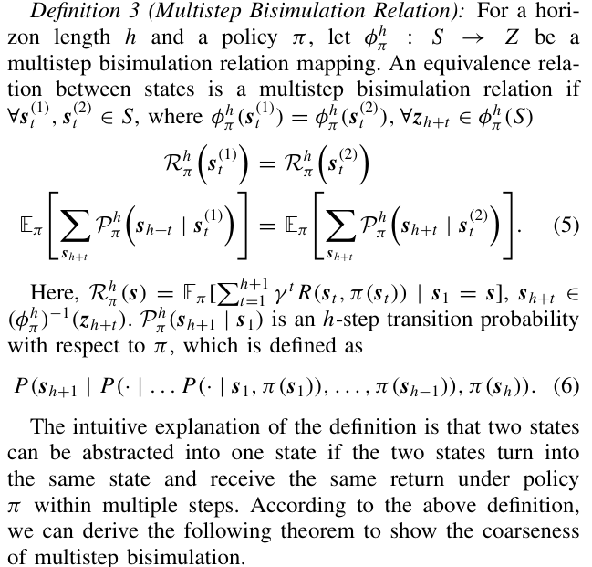
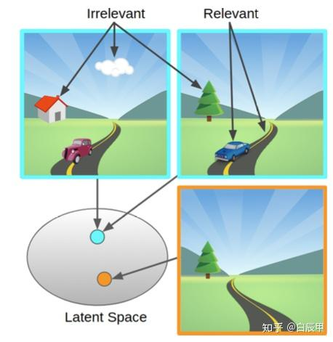
Method Design
2 State Abstraction via Multistep Bisimulation (SAMB)
CPS Computational Learning Laboratory
25

Slide 26
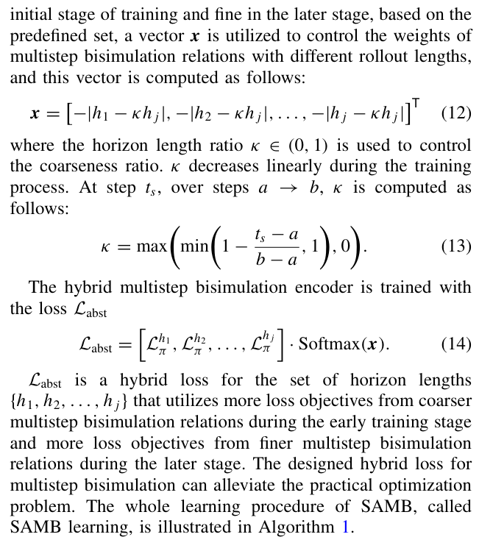
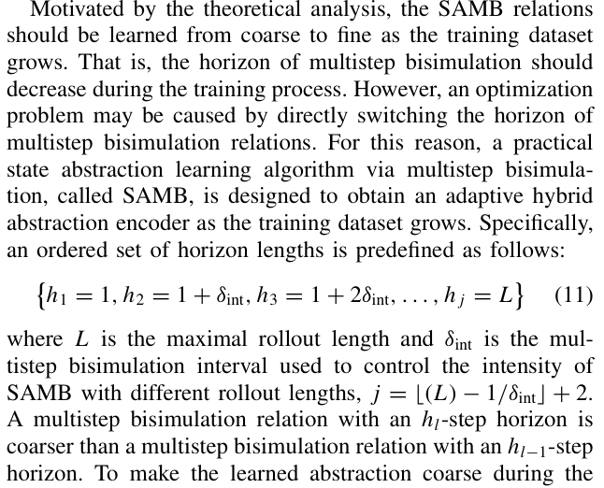
Method Design
2 State Abstraction via Multistep Bisimulation (SAMB)
CPS Computational Learning Laboratory
26

Slide 27
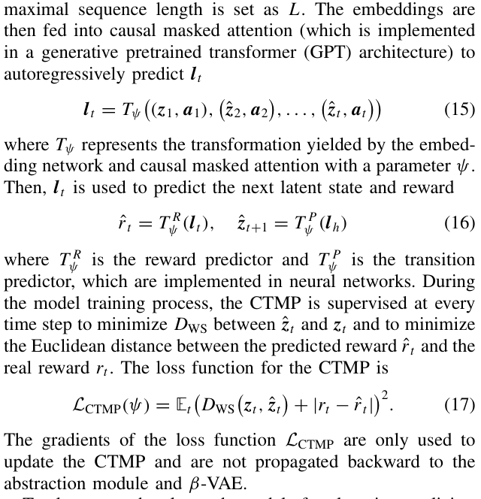
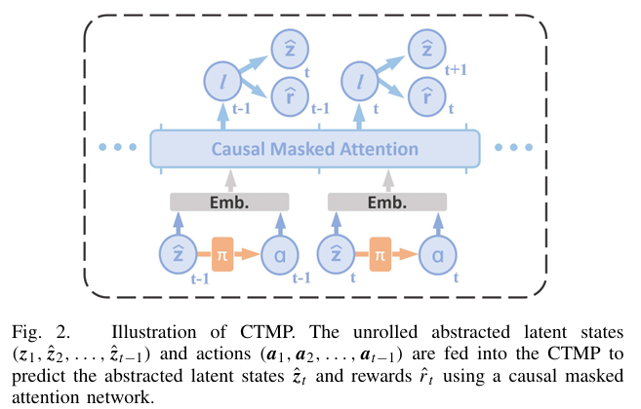
Method Design
3 Causal Transformer Model Prediction and Policy Learning
CPS Computational Learning Laboratory
27

Slide 28
01
Problem Description
02
Method Design
03
Experiment Results
Contents
04
Conclusion
CPS Computational Learning Laboratory
28

Slide 29
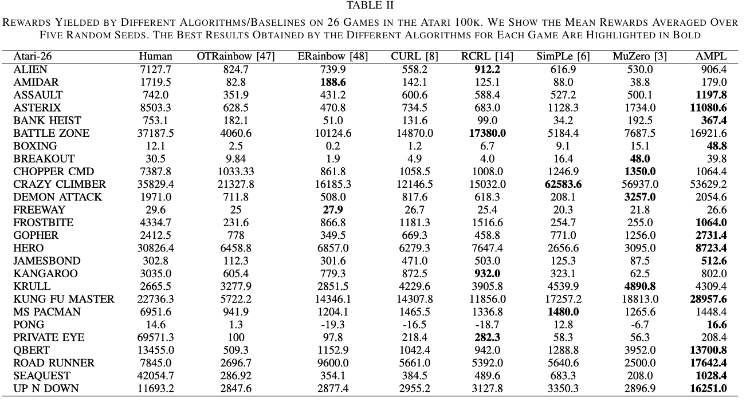
Experiment Results
1 Atari 100K Results
CPS Computational Learning Laboratory
29

Slide 30
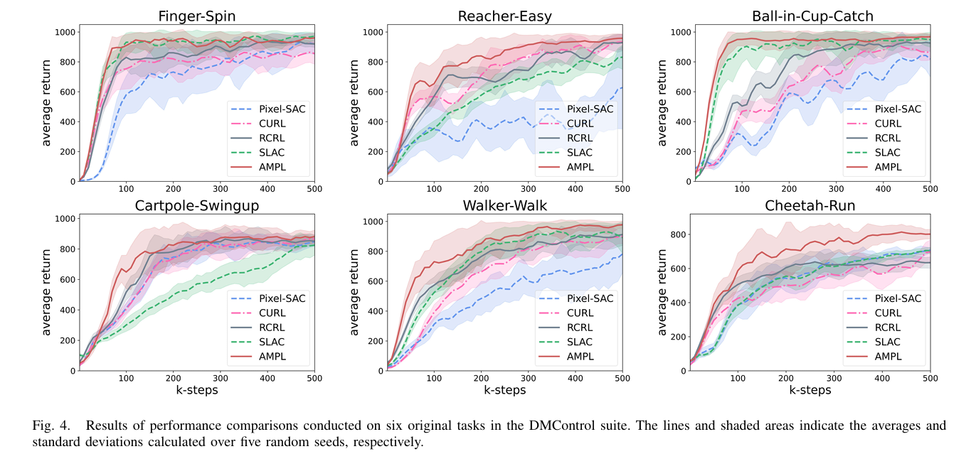
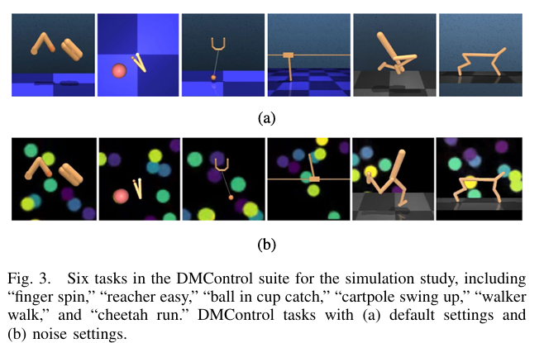
Experiment Results
2 DMControl With 500K Environment Steps
CPS Computational Learning Laboratory
30

Slide 31
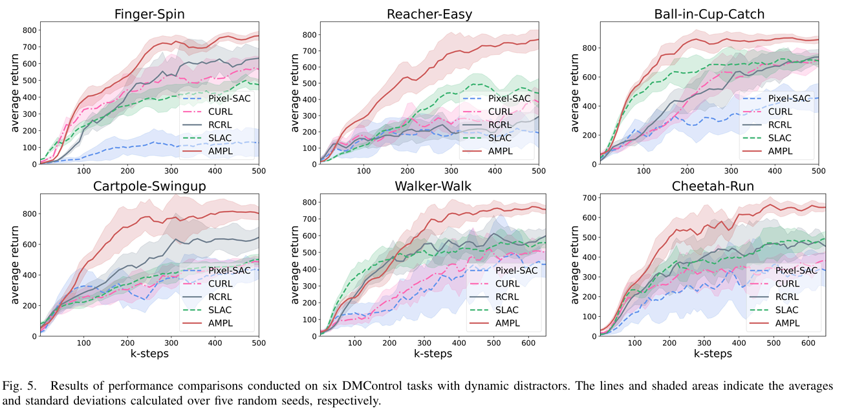
Experiment Results
2 DMControl With 500K Environment Steps
CPS Computational Learning Laboratory
31

Slide 32
Experiment Results
3 Evaluation on DMControl Tasks With Dynamic Distractors
CPS Computational Learning Laboratory
32

Slide 33
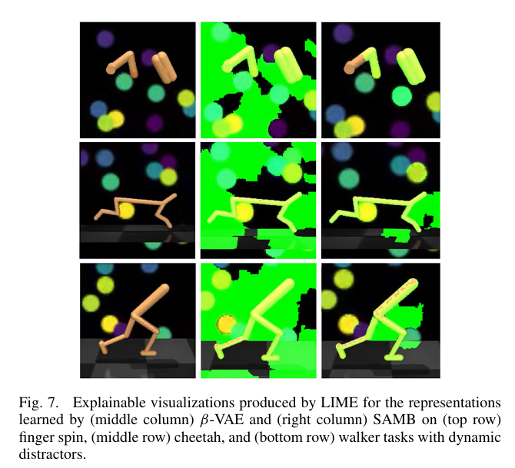
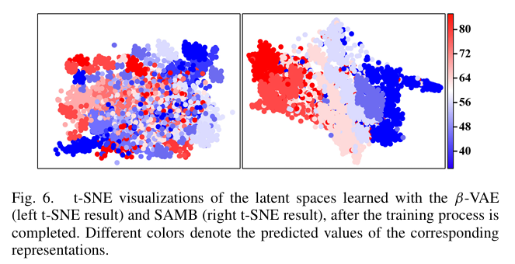
Experiment Results
3 Evaluation on DMControl Tasks With Dynamic Distractors
CPS Computational Learning Laboratory
33

Slide 34
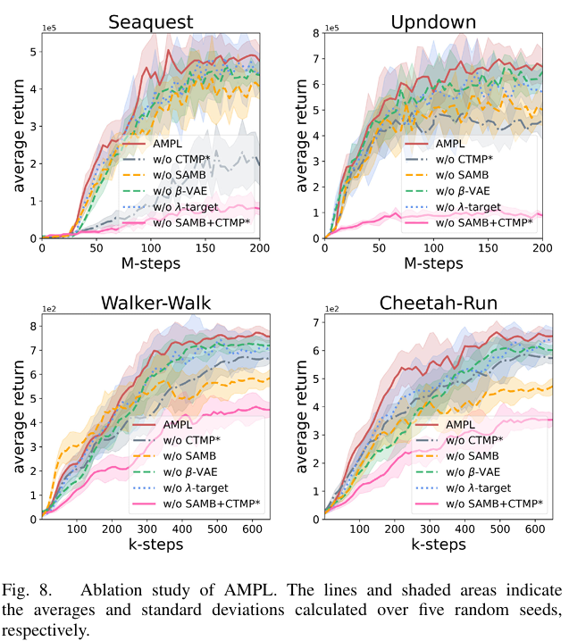
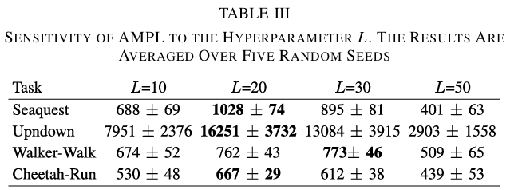
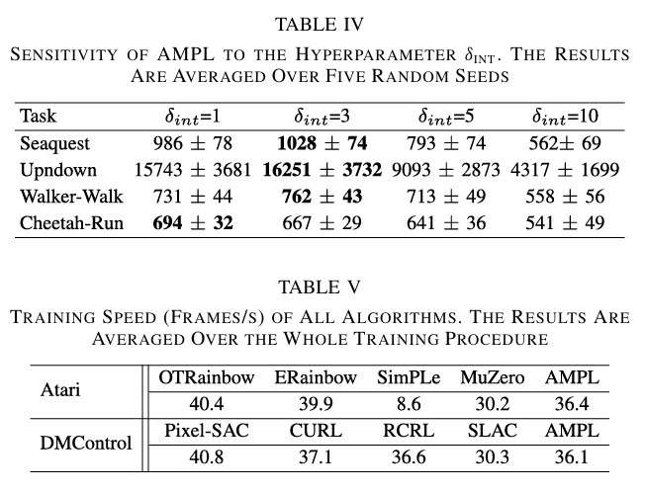
Experiment Results
4 Ablation Study & Hyperparameter Study
CPS Computational Learning Laboratory
34

Slide 35
01
Problem Description
02
Method Design
03
Experiment Results
Contents
04
Conclusion
CPS Computational Learning Laboratory
35
CPS Computational Learning Laboratory
2
18

Slide 36
Conclusion
①
The proposed AMPL framework improves the sample efficiency of deep reinforcement learning by jointly integrating online state abstraction and model-based policy learning. It introduces State Abstraction via Multistep Bisimulation (SAMB) to learn task-relevant latent state spaces whose abstraction degree gradually changes from coarse to fine during training.
Within the abstract state space, a Causal Transformer Model Predictor (CTMP) performs multistep state and reward prediction, while a modified SAC with multistep λ-targets utilizes model-generated trajectories for efficient long-horizon policy optimization.
②
The results further show that dynamically balancing abstraction granularity and model estimation accuracy can reduce both abstraction-induced performance loss and long-horizon model prediction errors, providing an effective framework for sample-efficient reinforcement learning from high-dimensional observations.
CPS Computational Learning Laboratory
36

Slide 37
Paper 3
Cooperative Multi-Agent Learning for Navigation via Structured State Abstraction
Mohamed K. Abdel-Aziz, Member, IEEE, Mohammed S. Elbamby, Member, IEEE, Sumudu Samarakoon, Member, IEEE, and Mehdi Bennis, Fellow, IEEE
This paper was published in: IEEE Transactions on Communications (IF: 8.4)
Published Time: 2024
Reference: M. K. Abdel-Aziz, M. S. Elbamby, S. Samarakoon, and M. Bennis, “Cooperative Multi-Agent Learning for Navigation via Structured State Abstraction,” IEEE Transactions on Communications, vol. 72, no. 6, pp. 3454–3462, Jun. 2024, doi: 10.1109/TCOMM.2024.3365520.
CPS Computational Learning Laboratory
37

Slide 38
01
Problem Description
02
Method Design
03
Experiment Results
Contents
04
Conclusion
CPS Computational Learning Laboratory
38

Slide 39
Problem Description
Challenge:
Cooperative field-of-view navigation is partially observable: each agent sees only a small local region and must rely on messages from teammates.
Jointly exploring raw observations, navigation actions, and communication symbols creates a very large learning space.
Method:
Represent each local observation as a structured quadtree rather than unstructured pixels.
Learn an adaptive branch-pruning abstractor conditioned on the observation, agent position, and received communication symbols.
CPS Computational Learning Laboratory
39

Slide 40
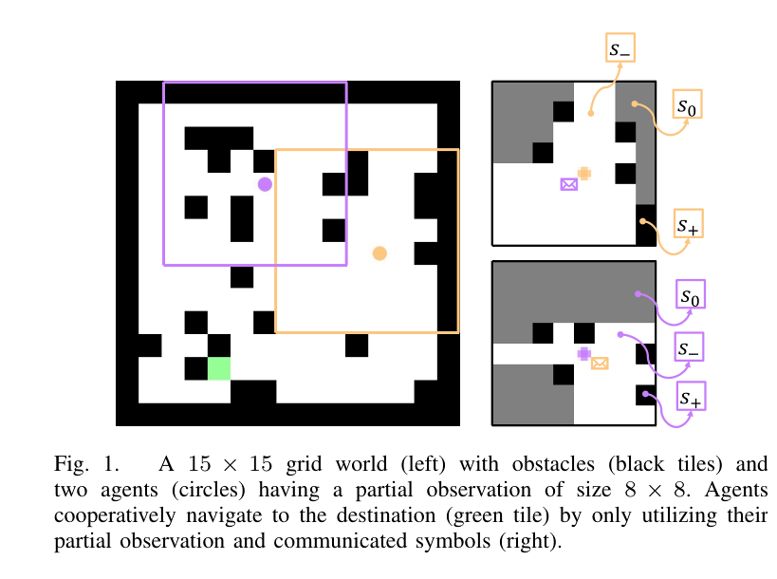
Problem Description
Cooperative FoV Navigation as a Dec-POMDP
• Environment: 15×15 grid, randomly placed destination and obstacles, and two agents with 8×8 local fields of view.
• Local cell states: occupied, unoccupied, destination, or unknown behind an obstacle.
• Agent output: one navigation action and one communication symbol at every time step.
• Cooperative objective: both agents must reach the unknown goal using only local observations and exchanged symbols.
CPS Computational Learning Laboratory
40

Slide 41
01
Problem Description
02
Method Design
03
Experiment Results
Contents
04
Conclusion
CPS Computational Learning Laboratory
41

Slide 42
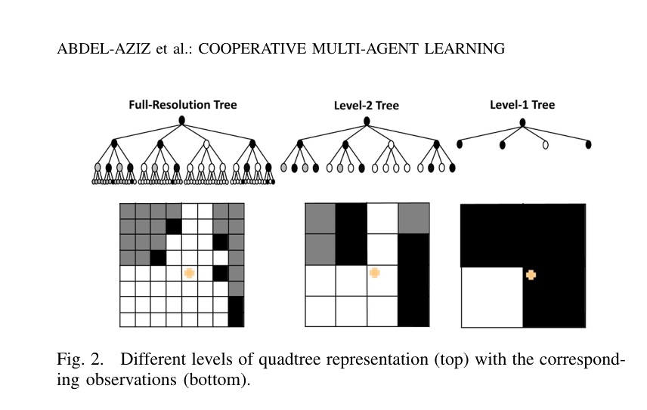
Method Design
1 Structured State Representation With Quadtrees
• Structure: an M×M observation is recursively partitioned into four regions until cells are homogeneous or the maximum depth is reached.
• Graph view: quadtree nodes carry region/state features and branches form the adjacency structure.
• Abstraction: trimming a branch replaces its descendants with a coarser regional representation.
• Adaptive requirement: the useful level of detail depends on the current view and the meaning of received messages.
CPS Computational Learning Laboratory
42

Slide 43
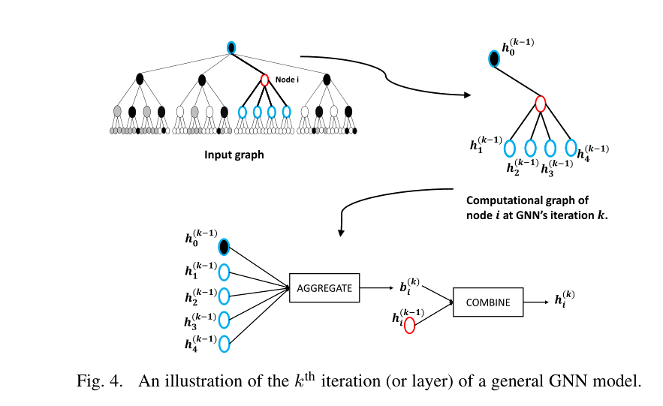
Method Design
2 Graph Encoding and Differentiable Branch Merging
• GIN encoder: aggregates node neighborhoods and produces a representation of the full-resolution quadtree.
• Context fusion: the graph embedding is concatenated with the agent location and received symbols.
• Merge decision: an MLP predicts merge/non-merge scores for each internal node.
• Straight-through Gumbel-softmax: produces discrete pruning decisions in the forward pass while retaining differentiability during backpropagation.
CPS Computational Learning Laboratory
43

Slide 44
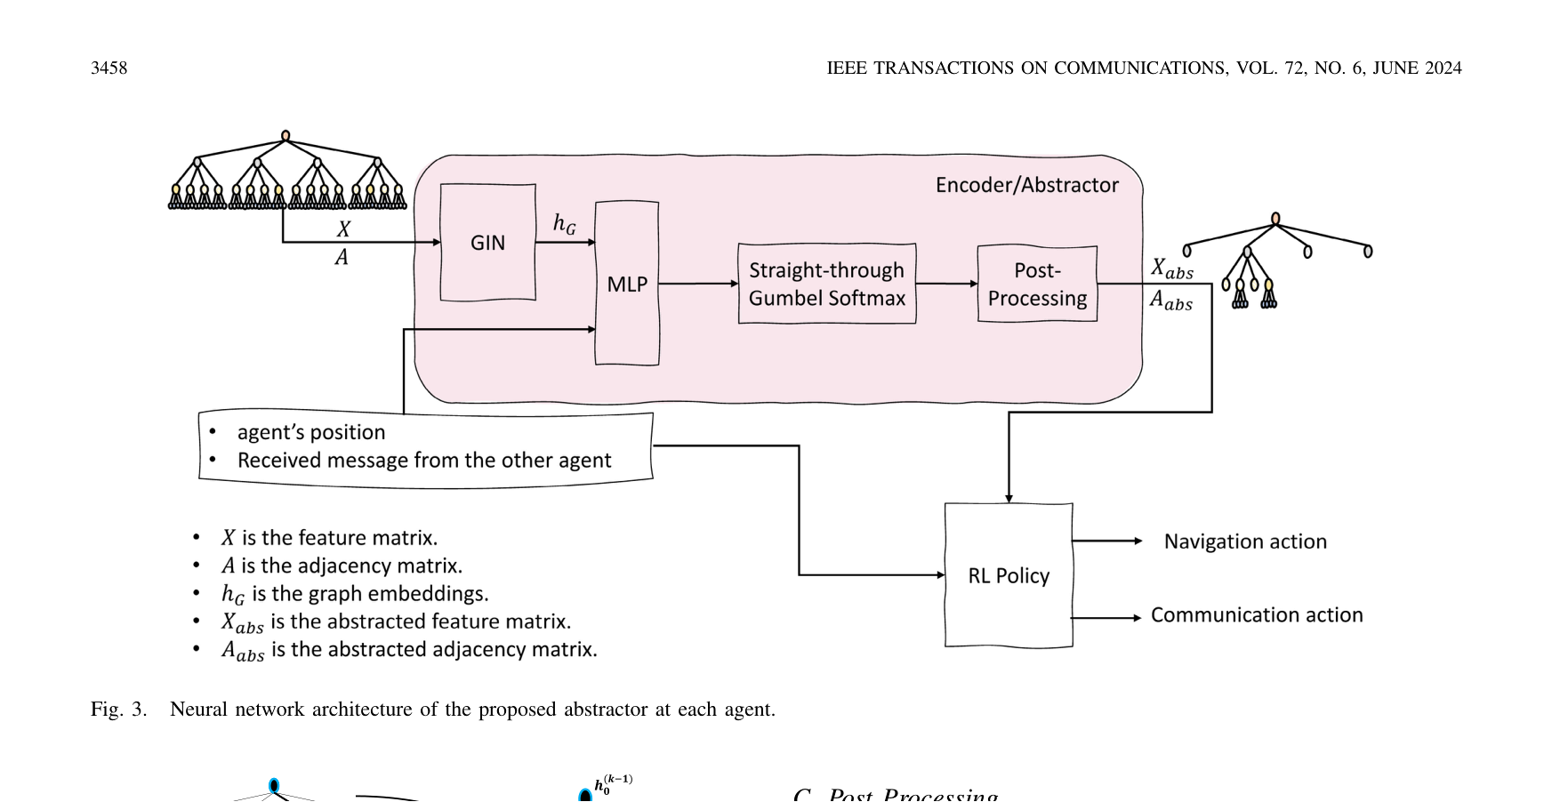
Method Design
3 Adaptive Abstractor and Decentralized Training
• Policy input: the trimmed quadtree, agent position, and received symbol.
• Joint output: navigation action and communication action.
• Training objective: L = LRL + ‖Aabs‖F rewards task completion while penalizing tree size.
• Learning mode: each agent has an independent GRU policy and the abstractor is optimized simultaneously with A3C.
CPS Computational Learning Laboratory
44

Slide 45
01
Problem Description
02
Method Design
03
Experiment Results
Contents
04
Conclusion
CPS Computational Learning Laboratory
45

Slide 46
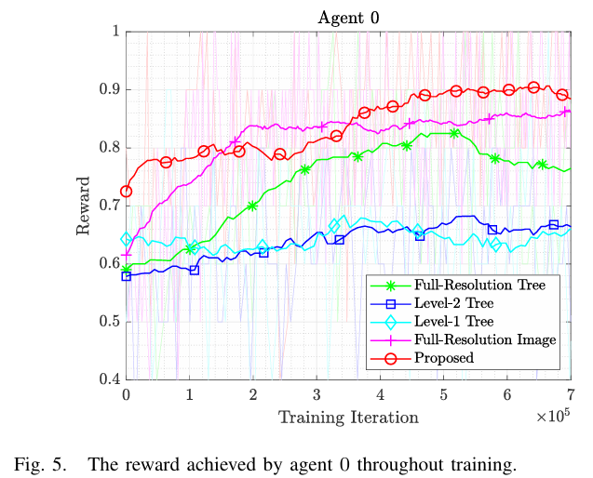
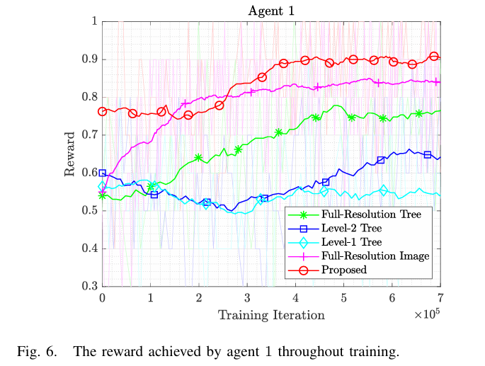
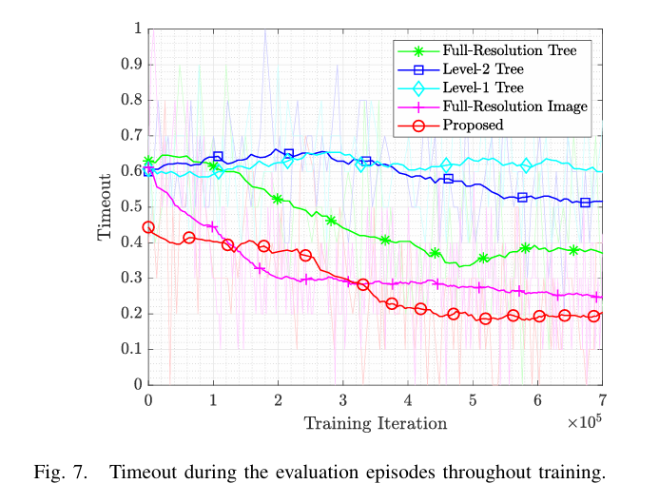
Experiment Results
1 Training Performance Evaluation
CPS Computational Learning Laboratory
46

Slide 47
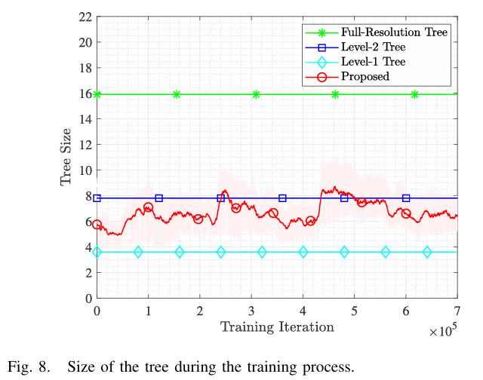
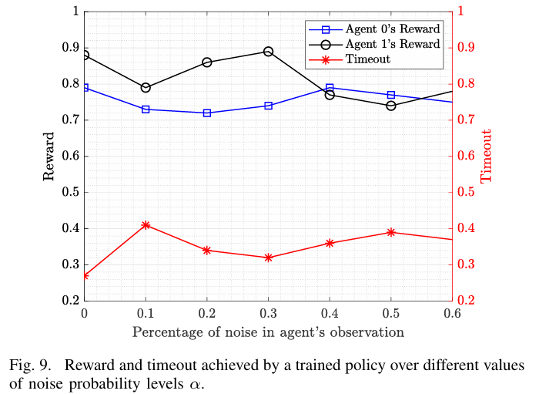
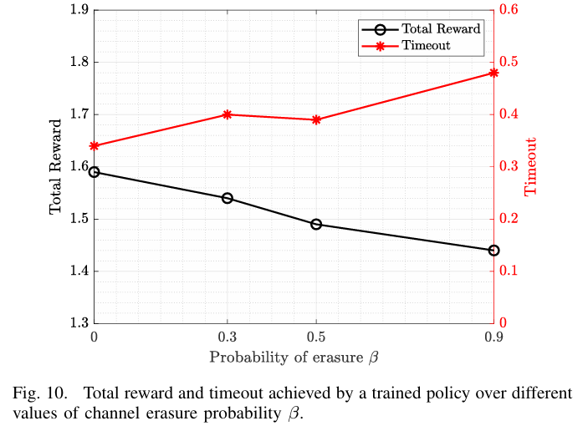
Experiment Results
2 Abstraction & Generalization
CPS Computational Learning Laboratory
47

Slide 48
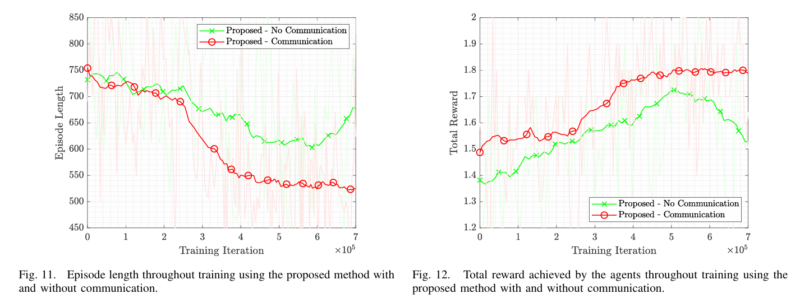
Experiment Results
3 Emergent Communication
CPS Computational Learning Laboratory
48

Slide 49
01
Problem Description
02
Method Design
03
Experiment Results
Contents
04
Conclusion
CPS Computational Learning Laboratory
49
CPS Computational Learning Laboratory
2
18

Slide 50
Conclusion
①
The paper converts each agent’s local observation into a quadtree and learns which branches to prune using a GIN, context features, and straight-through Gumbel-softmax. The resulting structured abstract state is used jointly for navigation and communication decisions.
Adaptive abstraction reduces training complexity without sacrificing policy quality and improves robustness to noisy observations and erased messages. Communication emerges during training, but scalability and the semantics of the learned protocol remain important future directions.
②
For multi-agent state abstraction, structure and communication can be treated as part of the representation-learning problem rather than as separate modules.
CPS Computational Learning Laboratory
50

Slide 51
Paper 4
Compact Goal Representation Learning via Information Bottleneck
in Goal-Conditioned Reinforcement Learning
Wei Wei, Haibin Li, Shiyuan Zhou, Baifeng Li, and Xue Liu
This paper was published in: IEEE Transactions on Neural Networks and Learning Systems (IF: 9.7)
Published Time: 2025
Reference: Q. Zou and E. Suzuki, “Compact Goal Representation Learning via Information Bottleneck in Goal-Conditioned Reinforcement Learning,” IEEE Transactions on Neural Networks and Learning Systems, vol. 36, no. 2, pp. 2368–2380, Feb. 2025, doi: 10.1109/TNNLS.2023.3344880.
CPS Computational Learning Laboratory
51

Slide 52
01
Problem Description
02
Method Design
03
Experiment Results
Contents
04
Conclusion
CPS Computational Learning Laboratory
52

Slide 53
Problem Description
Challenge:
Goal-Conditioned Reinforcement Learning (GCRL) agents overfit to irrelevant goal information, leading to poor generalization to unseen goals.
Reward signals are sparse and delayed, making it difficult to extract dense supervision for goal representation learning.
Method:
Proposes InfoGoal, a self-supervised information bottleneck framework that learns compact yet sufficient goal representations.
Defines an intrinsic reward based on representation distance in latent space, guiding goal-oriented exploration under sparse rewards.
CPS Computational Learning Laboratory
53

Slide 54
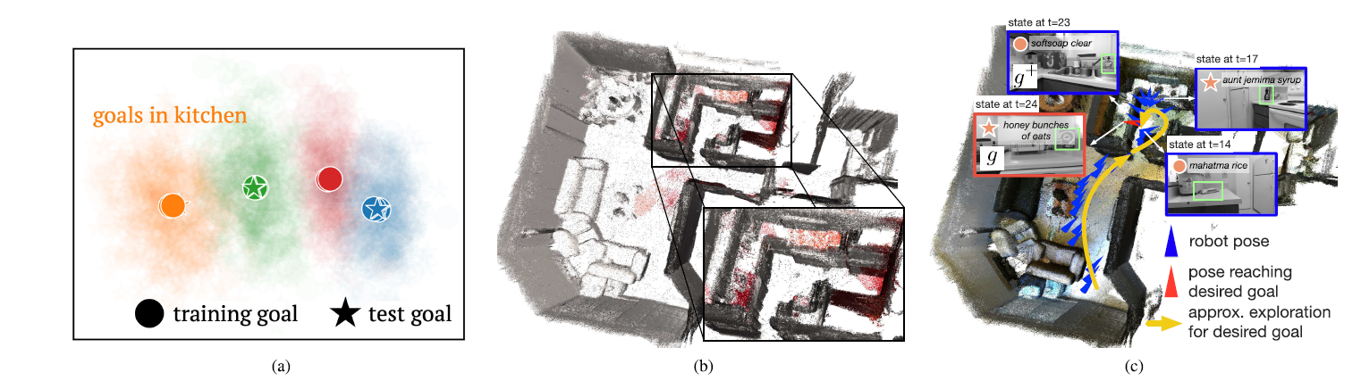
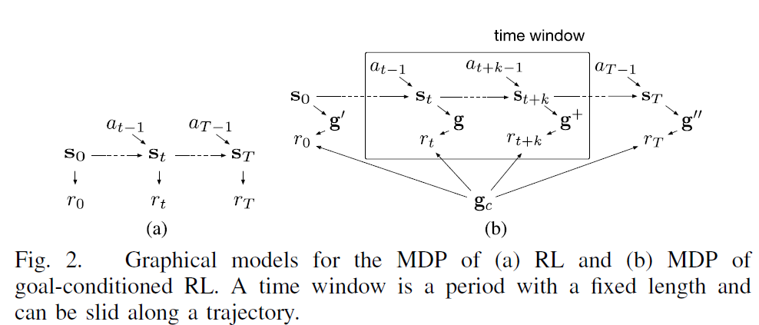
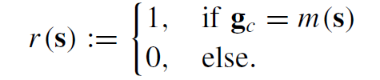
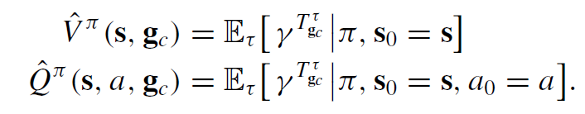
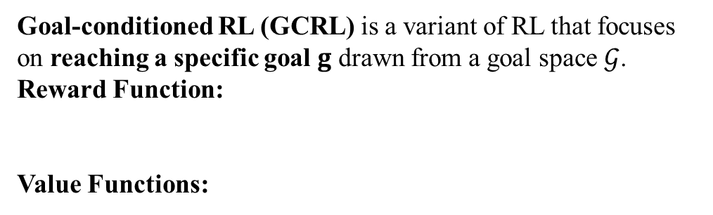
Problem Description
Motivation of InfoGoal:
Goal-Conditioned RL:
Goal-conditioned RL (GCRL) is a variant of RL that focuses on reaching a specific goal $g$ drawn from a goal space $𝒢$.
Reward Function:
Value Functions:
CPS Computational Learning Laboratory
54

Slide 55
01
Problem Description
02
Method Design
03
Experiment Results
Contents
04
Conclusion
CPS Computational Learning Laboratory
55

Slide 56
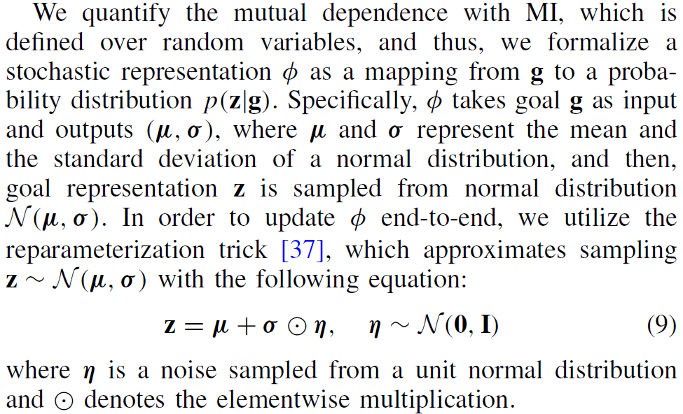
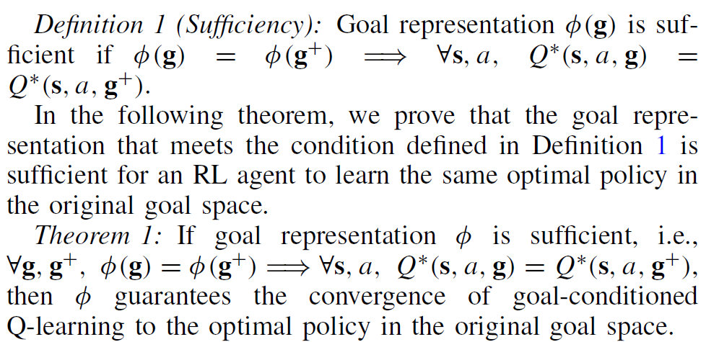
Method Design
1 Sufficient Goal Representation
CPS Computational Learning Laboratory
56

Slide 57
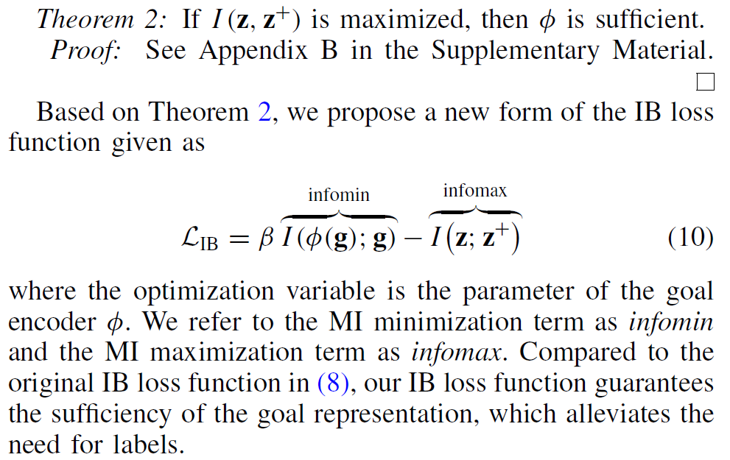
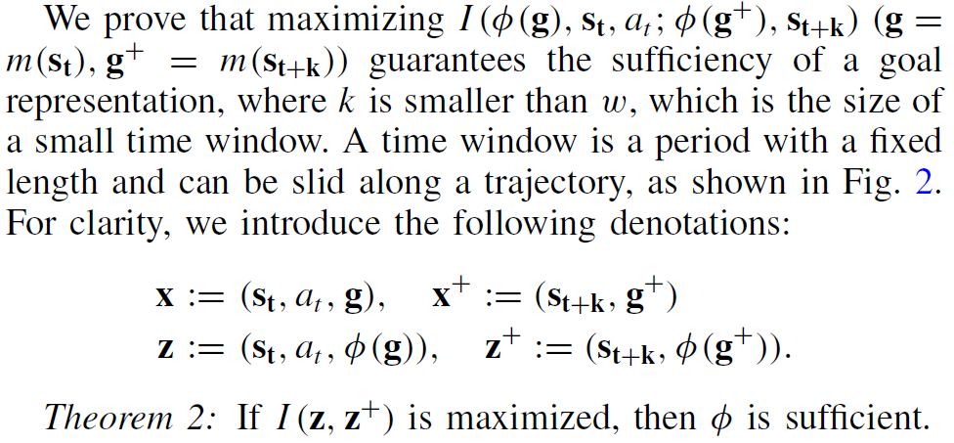
Method Design
2 Information Bottleneck Loss
CPS Computational Learning Laboratory
57

Slide 58
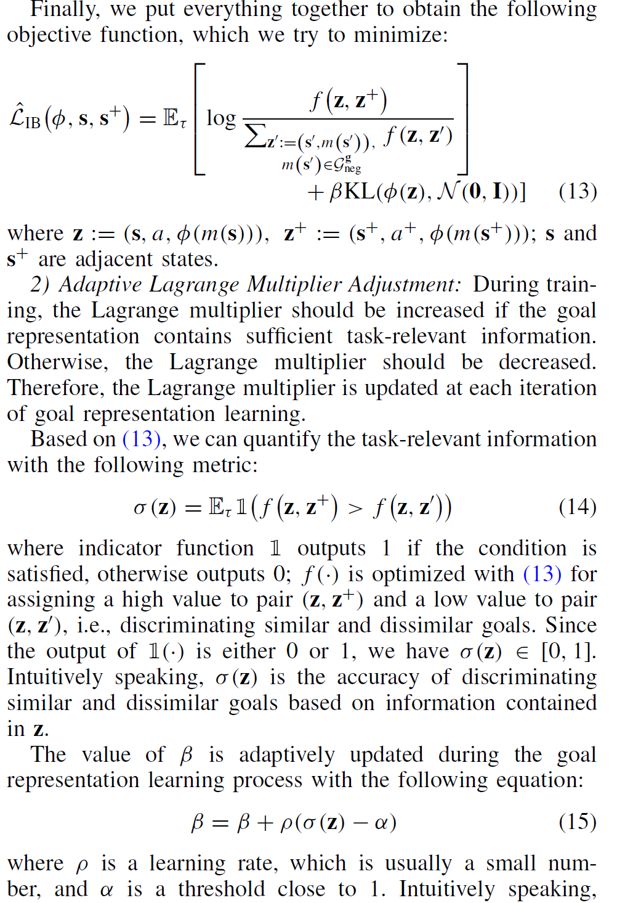
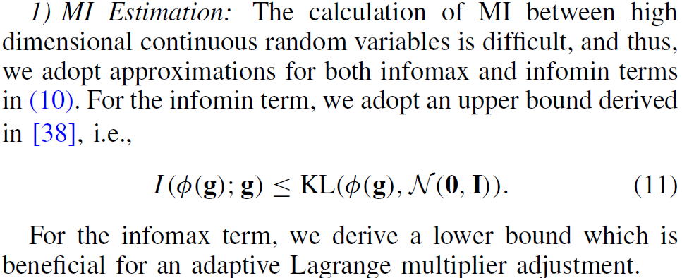
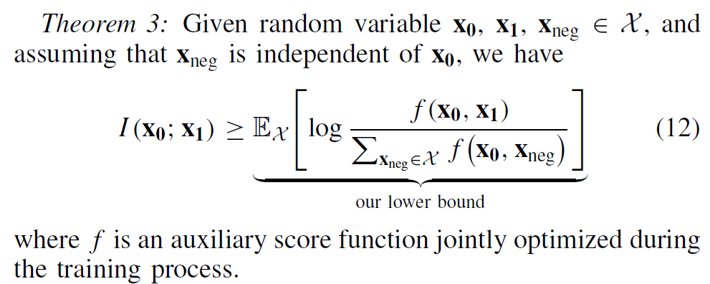
Method Design
3 MI Estimation and Adaptive Lagrange Multiplier Adjustment
CPS Computational Learning Laboratory
58

Slide 59
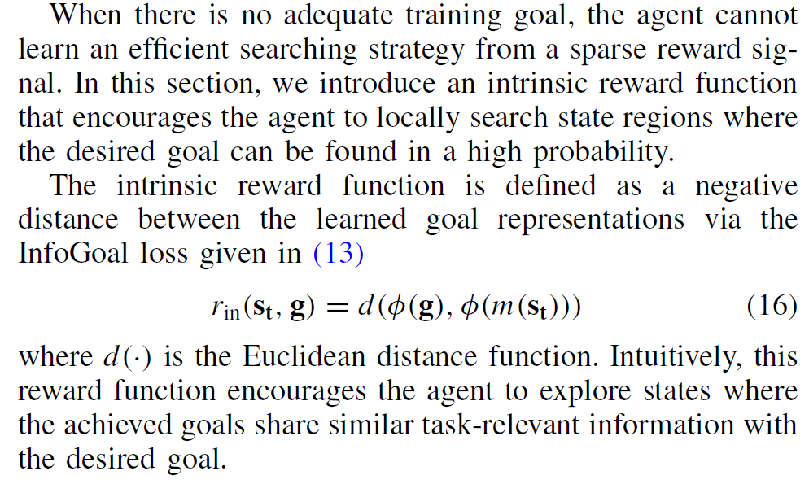
Method Design
3 Local Searching With Intrinsic Reward
CPS Computational Learning Laboratory
59

Slide 60
01
Problem Description
02
Method Design
03
Experiment Results
Contents
04
Conclusion
CPS Computational Learning Laboratory
60

Slide 61



Experiment Results
Environments
CPS Computational Learning Laboratory
61

Slide 62

Experiment Results
Environments
CPS Computational Learning Laboratory
62

Slide 63

Experiment Results
CPS Computational Learning Laboratory
63

Slide 64



Experiment Results
CPS Computational Learning Laboratory
64

Slide 65


Experiment Results
CPS Computational Learning Laboratory
65

Slide 66

Experiment Results
CPS Computational Learning Laboratory
66

Slide 67
01
Problem Description
02
Method Design
03
Experiment Results
Contents
04
Conclusion
CPS Computational Learning Laboratory
67
CPS Computational Learning Laboratory
2
18

Slide 68
Conclusion
①
The proposed InfoGoal framework—a self-supervised information bottleneck approach for goal-conditioned reinforcement learning—learns compact yet task-relevant goal representations, achieving superior generalization, sample efficiency, and training stability.
The integration of adaptive information compression, self-supervised objectives, and intrinsic rewards enables agents to learn effectively under sparse or delayed rewards, capturing task semantics while filtering irrelevant goal noise..
②
Extensive experiments on multiple GCRL benchmarks (Fetch, Object Search, Object Manipulation, Embodied QA) demonstrate that InfoGoal outperforms state-of-the-art methods (e.g., InfoBot, COGOAL) in both success rate and policy robustness.
Future work will extend the framework to multi-agent goal-conditioned RL and explore hierarchical bottleneck mechanisms for better scalability in visual and real-world robotic control tasks
CPS Computational Learning Laboratory
68

Slide 69
Paper 5
Robust Multi-Agent Reinforcement Learning by
Mutual Information Regularization
Simin Li, Ruixiao Xu, Jingqiao Xiu, Yuwei Zheng, Pu Feng, Yuqing Ma, Bo An, Senior Member, IEEE, Yaodong Yang, Member, IEEE, and
Xianglong Liu, Senior Member, IEEE
This paper was published in: IEEE Transactions on Neural Networks and Learning Systems (IF: 9.7)
Published Time: 2025
Reference: S. Li, R. Xu, J. Xiu, Y. Zheng, P. Feng, Y. Ma, B. An, Y. Yang, and X. Liu, “Robust Multi-Agent Reinforcement Learning by Mutual Information Regularization,” IEEE Transactions on Neural Networks and Learning Systems, vol. 36, no. 10, pp. 18118–18132, Oct. 2025, doi: 10.1109/TNNLS.2025.3577259.
CPS Computational Learning Laboratory
69

Slide 70
01
Problem Description
02
Method Design
03
Experiment Results
Contents
04
Conclusion
CPS Computational Learning Laboratory
70

Slide 71
Problem Description
Challenge:
Cooperative MARL policies can fail when some teammates malfunction, act unpredictably, or are controlled by worst-case adversaries.
With N agents, the possible defender/adversary partitions grow exponentially, making explicit max–min training expensive and incomplete.
Method:
Formulate robust MARL as a control-as-inference problem with off-policy evaluation over threat scenarios.
• Derive mutual-information regularization (MIR3), which maximizes a lower bound on worst-case robustness while training only in normal cooperative environments.
• Estimate history–action mutual information with CLUB and add it as a reward penalty to standard MARL backbones.
CPS Computational Learning Laboratory
71

Slide 72


Problem Description
CPS Computational Learning Laboratory
72

Slide 73

Problem Description
CPS Computational Learning Laboratory
73

Slide 74
01
Problem Description
02
Method Design
03
Experiment Results
Contents
04
Future Work
CPS Computational Learning Laboratory
74

Slide 75


Method Design
1 MIR3: Train Normally, Defend Broadly
CPS Computational Learning Laboratory
75

Slide 76


Method Design
1 MIR3: Train Normally, Defend Broadly
CPS Computational Learning Laboratory
76

Slide 77

Method Design
2 Practical Algorithm and Architecture-Agnostic Integration
• CLUB estimates an upper bound on mutual information.
• The shaped reward is rMI = r − λ·I(h;a).
• Only the ordinary policy-update step changes across MADDPG, QMIX, and MAPPO.
• No additional network or computation is needed at test time.
CPS Computational Learning Laboratory
77

Slide 78
01
Problem Description
02
Method Design
03
Experiment Results
Contents
04
Conclusion
CPS Computational Learning Laboratory
78

Slide 79

Experiment Results
1 Simulation Results
CPS Computational Learning Laboratory
79

Slide 80

Experiment Results
1 Simulation Results
CPS Computational Learning Laboratory
80

Slide 81



Experiment Results
1 Simulation Results
CPS Computational Learning Laboratory
81

Slide 82



Experiment Results
1 Simulation Results
CPS Computational Learning Laboratory
82

Slide 83


Experiment Results
2 Real-World Experiments
CPS Computational Learning Laboratory
83

Slide 84
01
Problem Description
02
Method Design
03
Experiment Results
Contents
04
Conclusion
CPS Computational Learning Laboratory
84
CPS Computational Learning Laboratory
2
18

Slide 85
Conclusion
①
MIR3 derives a history–action mutual-information penalty as a lower-bound surrogate for robust MARL. The regularizer is learned entirely in routine cooperative environments, can be added to different MARL backbones, and introduces no additional execution-time cost.
②
By suppressing spurious inter-agent dependencies and learning a robust action prior, MIR3 improves resistance to worst-case and ordinary disturbances while preserving cooperation. Results span SMAC, continuous quadrotor control, and real robot swarms; the uniform-coverage assumption remains a key theoretical caveat.
CPS Computational Learning Laboratory
85

Slide 86

Research Inspiration
• Abstraction is task-dependent: the right equivalence relation is defined by values, transitions, goals, communication context, or robustness—not by visual similarity alone.
• Granularity should adapt: coarse representations help early sample efficiency, while finer distinctions become useful as data, tasks, and uncertainty grow.
• Explicit and implicit abstraction are complementary: hash codes, bisimulation, structured pruning, information bottlenecks, and MI regularization all control what information influences decisions.
• Research direction: develop unified multi-agent state abstraction with theoretical guarantees, dynamic graph structure, real-world validation, and robustness to changing agents and environments.
Raw state / goal / history information
Task-relevant equivalence
Compact representation
with policy fidelity
CPS Computational Learning Laboratory
86

Slide 87
Thank you for listening
CPS Computational Learning Laboratory
108

