Slide 1
FINAL PROJECT PRESENTATION
KineticPulse
A Multimodal Edge-AI Prototype for Fall Detection and Caregiver Escalation
Wearable
Edge AI
Caregiver
Embedded Systems, Cyber-Physical Systems and Robotics Technical University of Munich
Youngwon Cho · Chang-Ting Zhong · Hao-Yuan Weng · Yule Xu Ren-Yi Huang · Yuanhao Chen · Yiyuan Chen · Yong Zhe Sam
01
Notes:
Presenter: Youngwon Cho · Target: 40–45 seconds
Good morning everyone. We are Team KineticPulse, and this is our final project for Embedded Systems, Cyber-Physical Systems and Robotics.
KineticPulse is a multimodal edge-AI prototype for fall detection and caregiver escalation. In one sentence: it watches, listens to the body, and connects a fall to the right caregiver response.
The whole talk follows one path — the wearable senses, the Jetson edge AI understands, and the caregiver responds. Let me start with why we built it.

Slide 2
MOTIVATION
Why One Sensor Is Not Enough
Camera
Wearable
Sees posture and movement
Moves with the user
Provides scene context
Provides motion and physiological events
Depends on viewpoint and visibility
Adds evidence outside the camera image
Combined at the edge
Compares complementary signals
Supports an explainable decision
Connects detection to caregiver response
“KineticPulse combines what the camera sees with what the wearable senses.”
02
Notes:
Presenter: Youngwon Cho · Target: 50–55 seconds
Our starting point: a fall is not only a detection problem. The system must understand the situation and help someone respond.
A camera sees posture and movement and gives scene context — but it depends on viewpoint and visibility. A wearable moves with the user and gives motion and physiological events — evidence outside the camera image.
Each one alone is too easy to fool. Combined at the edge, they compare complementary signals, support an explainable decision, and connect detection to caregiver response.
That is the core idea: combine what the camera sees with what the wearable senses.

Slide 3
SYSTEM JOURNEY
From Sensing to Response
01
02
03
04
Sense
Understand
Verify
Respond
Camera + wristband
Detection + pose + temporal analysis + fusion
Spoken check for ambiguous events
Incident session + dashboard + live video + notification
“The system follows one connected path from physical signals to caregiver action.”
03
Notes:
Presenter: Chang-Ting Zhong · Target: 55–60 seconds
The system follows one connected path from physical signals to caregiver action. Four stages.
Stage one, Sense: the camera plus the wristband capture raw signals. Stage two, Understand: detection, pose estimation, temporal analysis, and fusion run on the edge. Stage three, Verify: for ambiguous events the system asks "Are you okay?" by voice. Stage four, Respond: an incident session opens with dashboard, live video, and notification.
Keep these four words in mind — Sense, Understand, Verify, Respond. Every slide that follows sits on one of these stages.

Slide 4
ARCHITECTURE
One Connected Edge Architecture
ESP32-S3 wearable
Sensor receiver
Tier 0 — Monitor
NDJSON over TCP · :5555
continue observing
RESOLUTION
Tier 1 — Verify
Tier 1 → voice verification
Jetson
spoken voice check
YOLO detector
fusion engine
Tier 2 → incident creation
Camera
pose + TSSTG
Tier 2 — Escalate
incident creation
Web dashboard
Signaling server
WebRTC video
HTTP webhook
monitoring JSON · port 8790
session registry · port 8787
live video to caregiver
notification service
web and mobile clients
Tailscale — laboratory network
“Signaling carries connection data; WebRTC carries the video.”
04
Notes:
Presenter: Chang-Ting Zhong · Target: 70–75 seconds
Here is the full topology. Every path runs through the Jetson — one connected, inspectable edge system.
On the input side, the ESP32-S3 wearable sends newline-delimited JSON over TCP port 5555 to the sensor receiver. The camera feeds YOLO detection, pose, and TSSTG into the fusion engine. Fusion outputs Tier 0, 1, or 2 — monitor, verify, or escalate.
On the output side, four paths leave the Jetson: monitoring JSON on port 8790 for the dashboard, signaling on port 8787 for caregiver clients, WebRTC video to the caregiver, and an HTTP webhook to the notification service. All of this runs inside a Tailscale laboratory network.
One clarification: signaling carries connection data; WebRTC carries the video.

Slide 5
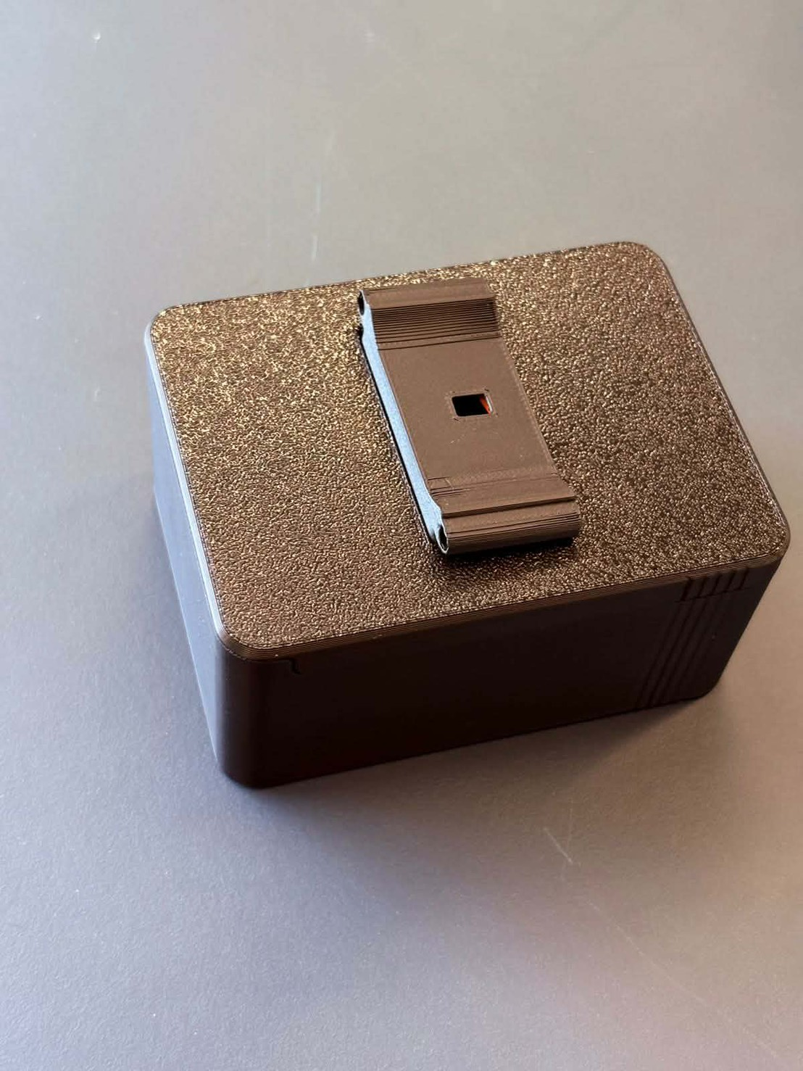
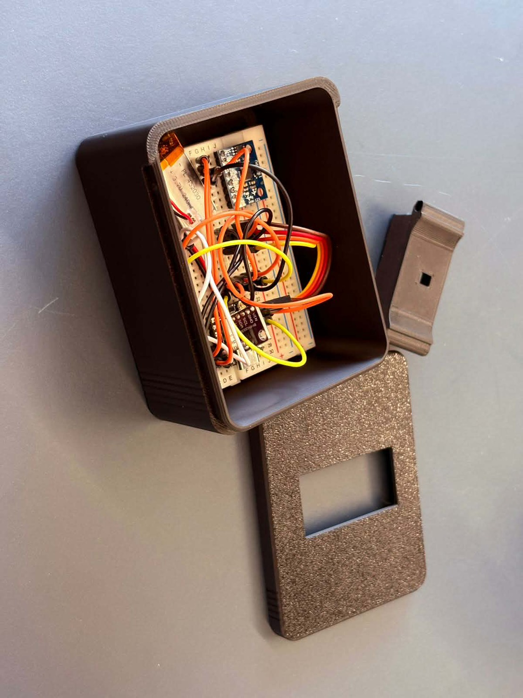
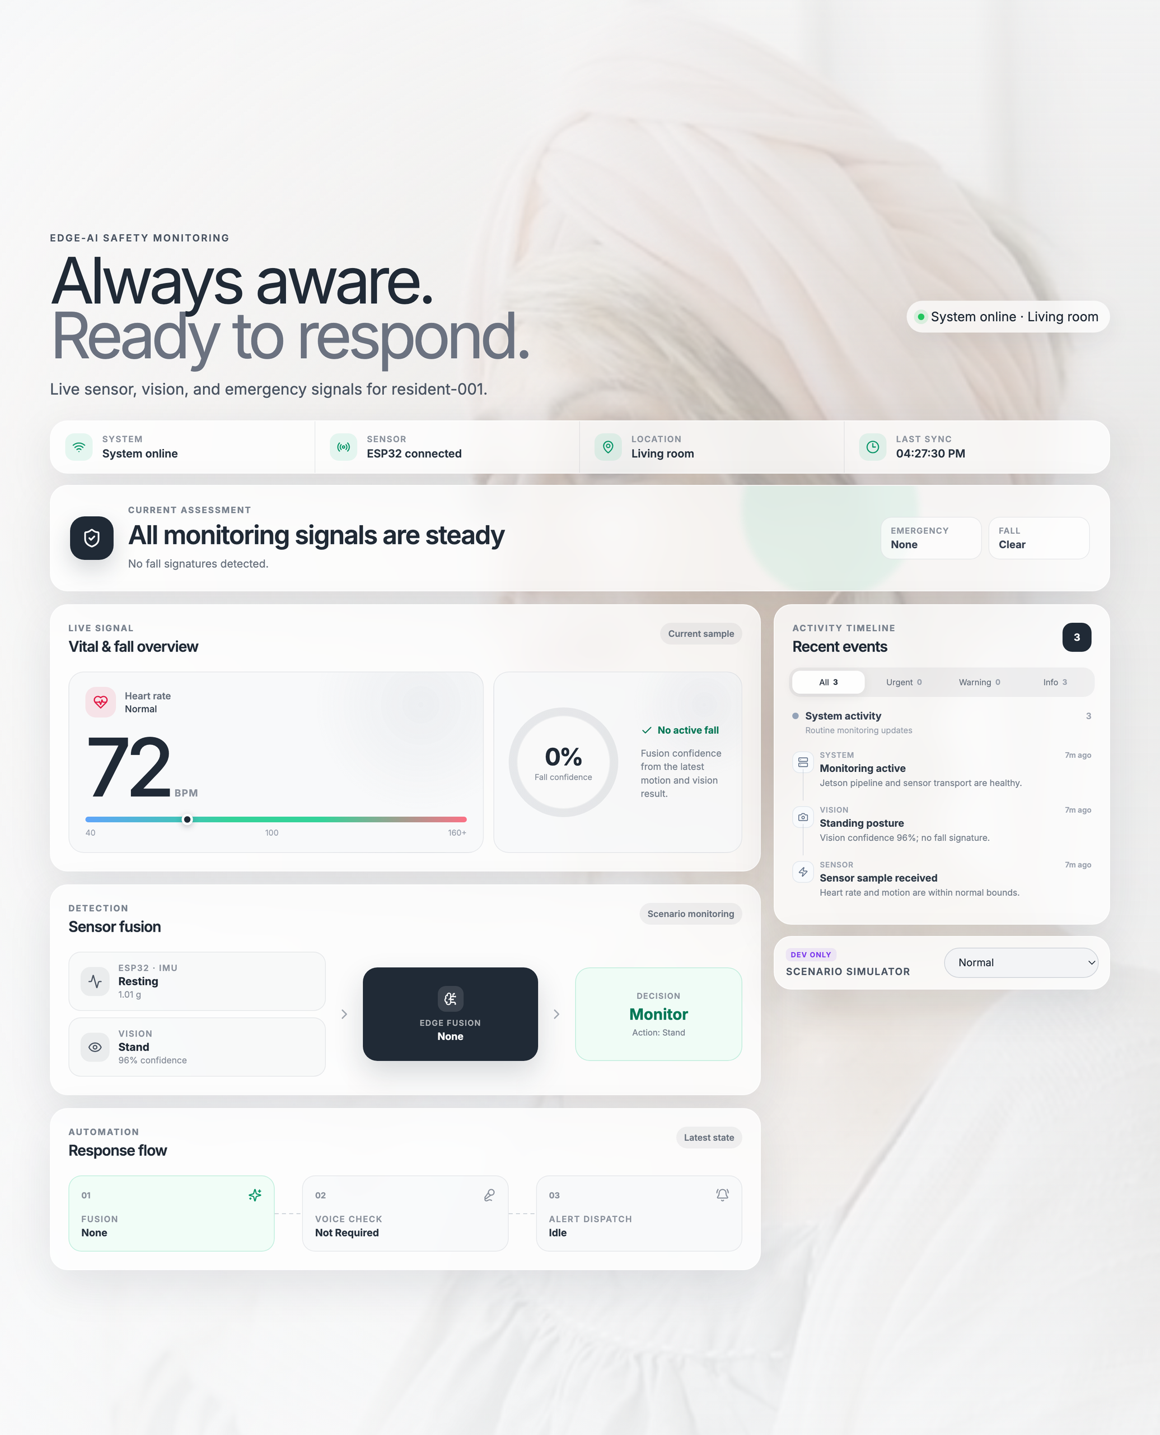
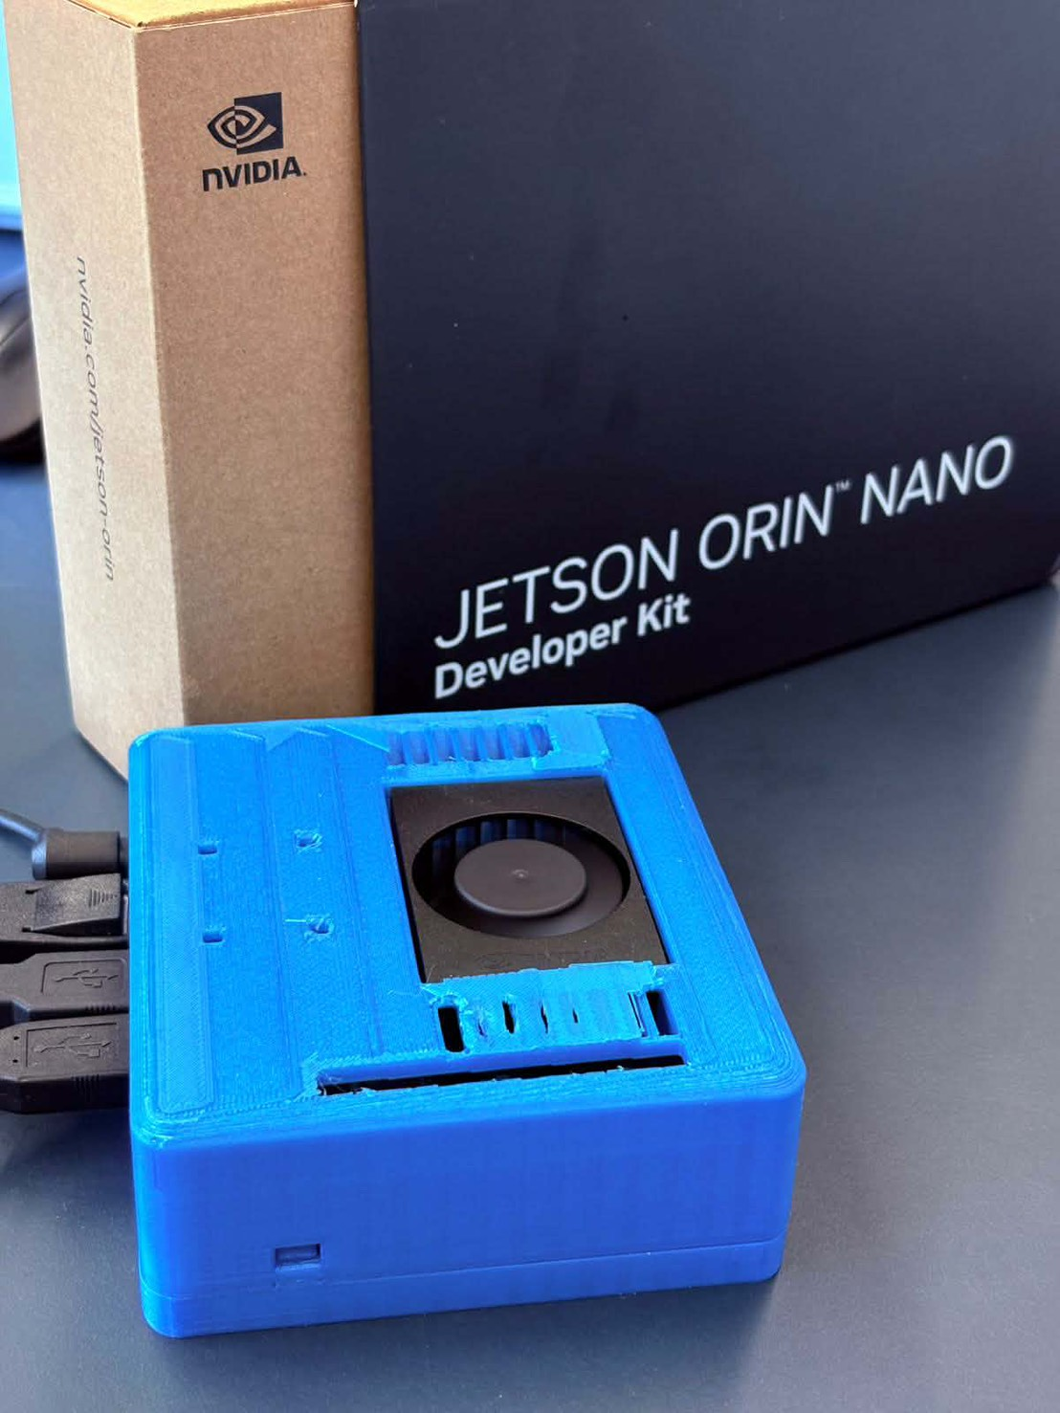
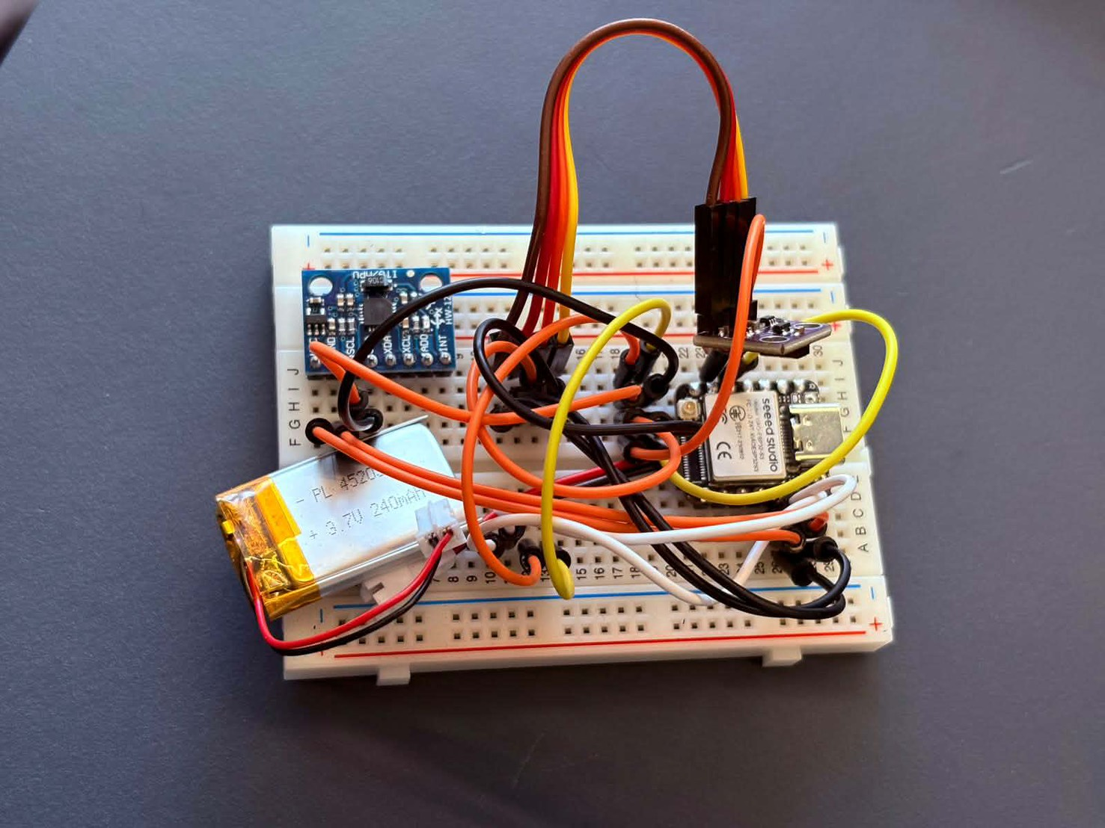
PROTOTYPE
The Prototype We Built
Assembled wearable enclosure with belt clip
Opened enclosure with the prototype board inside
XIAO ESP32-S3, MPU-6050, MAX30102, and LiPo battery
Jetson Orin Nano in its 3D-printed case
KineticPulse web monitoring dashboard
05
Notes:
Presenter: Hao-Yuan Weng · Target: 60–65 seconds
This is not a simulation — the prototype is real hardware and a real dashboard.
Top left, the assembled wearable enclosure with its belt clip. Next to it, the same enclosure opened, showing the prototype board inside. Bottom left, the core components on the breadboard: the XIAO ESP32-S3, the MPU-6050 IMU, the MAX30102 sensor, and a 3.7-volt 240 milliamp-hour LiPo battery. Bottom right, the Jetson Orin Nano in its 3D-printed case with active cooling.
On the right you see the real web monitoring dashboard, captured during development. Everything we describe next is running on exactly these parts.

Slide 6
WEARABLE LINK
Wearable Data, One Event per Line
ESP32-S3 wearable
CONNECTION
NDJSON OVER TCP
SUPPORTED EVENTS
Jetson listens on TCP port 5555
hello — device and capabilities
ESP32 connects as the client
{"type":"hello", ...}
Wi-Fi carries newline-delimited JSON
hr — heart-rate value
{"type":"hr", ...}
accel — three-axis motion in g
ppg — infrared and red sample arrays
{"type":"accel", ...}
pulse_lost — loss-of-contact event
EXAMPLE
{"type":"accel","ax":0.10,"ay":0.02,"az":0.99,"ts":123456}
“A simple typed contract keeps the wearable and Jetson independently testable.”
06
Notes:
Presenter: Hao-Yuan Weng · Target: 60–65 seconds
How does the wearable talk to the Jetson? With a simple typed contract — one event per line.
The Jetson listens on TCP port 5555, the ESP32 connects as the client, and Wi-Fi carries newline-delimited JSON. Five event types: hello announces device and capabilities; hr carries a heart-rate value; accel carries three-axis motion in g; ppg carries infrared and red sample arrays; and pulse_lost signals loss of contact.
You can see the format in the example — type, values, timestamp. A simple typed contract keeps the wearable and the Jetson independently testable.

Slide 7
VISUAL PIPELINE
Visual Intelligence Across Time
Camera frame
YOLOv8 posture detection
Seventeen pose keypoints
TSSTG temporal classification
FOUR POSTURE CLASSES
fallen
falling
stand
sitting
WHY TEMPORAL ANALYSIS MATTERS
A single frame describes posture
Validation mAP50
0.885
A sequence describes movement
Smoothing reduces unstable label changes
The final action state is sent to fusion
Validation mAP50–95
0.556
07
Notes:
Presenter: Yule Xu · Target: 85–90 seconds
Now the visual pipeline. A camera frame goes through four steps: YOLOv8 posture detection, seventeen pose keypoints, and TSSTG temporal classification.
We detect four posture classes: fallen, falling, stand, and sitting.
Why does temporal analysis matter? A single frame describes posture — a sequence describes movement. Smoothing reduces unstable label changes, and only the final action state goes to fusion.
Two validation numbers to remember: mAP50 is 0.885, and mAP50–95 is 0.556. The first says the detector finds postures reliably; the second is the stricter localization metric. A sequence, not a frame, is what makes these labels stable enough to act on.

Slide 8
FUSION & ESCALATION
Transparent Fusion, Three Actions
INPUT LAYER
OUTPUT TIERS
Vision evidence
Tier 0 — Monitor
Continue observing the situation
Motion evidence
DECISION LAYER
Tier 1 — Verify
Ask: “Are you okay?”
Heart-rate evidence
Rule-based
multimodal fusion
Tier 2 — Escalate
Create the incident immediately
Sensor freshness
TIER 1 RESPONSE LOGIC
Safe response → return to monitoring
Help, silence, unclear response, or continued hazard → create incident
“Each escalation can be traced back to the evidence that caused it.”
08
Notes:
Presenter: Ren-Yi Huang · Target: 85–90 seconds
Fusion is where everything comes together — and the rules are explicit, so every escalation can be traced back to its evidence.
The input layer takes four things: vision evidence, motion evidence, heart-rate evidence, and sensor freshness. The decision layer is rule-based multimodal fusion — no black box.
Three possible actions. Tier 0, Monitor: keep observing. Tier 1, Verify: the system asks "Are you okay?" — a safe response returns to monitoring, but help, silence, an unclear answer, or continued hazard creates the incident. Tier 2, Escalate: create the incident immediately, no question asked.
That is the whole decision logic — transparent on purpose.

Slide 9
INCIDENT FLOW
From Incident to Caregiver
Jetson
Signaling server
Caregiver client
Notification
SUPPORTING DETAILS
service
Signaling server: port 8787
1 · Fusion confirms an incident
Monitoring endpoint: port 8790
2 · Jetson generates a session ID
WebRTC carries video
3 · Webhook dispatch and WebRTC startup begin in parallel
separately from signaling
4 · Signaling server registers the session
Web and mobile caregivers use
the same incident-session concept
5 · Caregiver dashboard or mobile app discovers it
6 · Caregiver joins
7 · Offer, answer, and ICE information are exchanged
8 · Live video begins
“An alert is not just a message—it opens a live incident session.”
09
Notes:
Presenter: Yuanhao Chen · Target: 80–85 seconds
What actually happens when fusion confirms an incident? Eight steps.
First, the Jetson generates a session ID. Then two things start in parallel: the webhook dispatch and the WebRTC startup. The signaling server registers the session, and the caregiver dashboard or mobile app discovers it. The caregiver joins, offer, answer, and ICE information are exchanged, and live video begins.
Three supporting facts: the signaling server runs on port 8787, the monitoring endpoint on port 8790, and WebRTC carries video separately from signaling. Web and mobile caregivers use the same incident-session concept.
The key point: an alert is not just a message — it opens a live incident session.

Slide 10
CAREGIVER DASHBOARD
A Dashboard Built Around Decisions
One normalized
Overview
Vitals
Detection
Events
Live Sessions
MonitoringModel
WHAT THE CAREGIVER SEES
real UI shown on Slide 5
Edge and wearable connection status
Current fusion decision
Heart rate and fall confidence
Voice and alert status
Vision and wearable inputs
Recent operational events
TECHNICAL FOUNDATION
GET /monitoring on port 8790
SQLite event history through EventStore
Browser refresh approximately every three seconds
Monitoring and WebRTC signaling remain separate
“The interface turns sensor outputs into a clear response workflow.”
10
Notes:
Presenter: Yiyuan Chen · Target: 80–85 seconds
The caregiver side is one dashboard built around decisions. One normalized MonitoringModel supports five areas: Overview, Vitals, Detection, Events, and Live Sessions — the real UI you saw on Slide 5.
What does the caregiver see? Edge and wearable connection status, heart rate and fall confidence, vision and wearable inputs, the current fusion decision, voice and alert status, and recent operational events.
Under the hood: GET monitoring on port 8790, browser refresh about every three seconds, SQLite event history through EventStore, and monitoring stays separate from WebRTC signaling.
The interface turns sensor outputs into a clear response workflow.

Slide 11
LIVE DEMO
Live Demo: Detection to Caregiver View
WHAT TO WATCH
Wearable and edge connection
Live monitoring values
Fall interpretation
Fusion tier decision
[INSERT DEMO VIDEO HERE]
Caregiver incident and video
Recommended file: KineticPulse_Demo.mp4 Recommended duration: 60–75 seconds · Fit: 16:9, contain without cropping
11
Notes:
Presenter: Yiyuan Chen · Target: 50–55 seconds
Now let's watch the system work end to end. [Demo video placeholder — insert KineticPulse_Demo.mp4 here before presenting.]
While it plays, five things to watch: the wearable and edge connection coming up, the live monitoring values, the fall interpretation, the fusion tier decision, and finally the caregiver incident with live video.
One incident, the full path — from wearable connection to caregiver live video.

Slide 12
EVIDENCE
Evidence Across the Whole Pipeline
Perception
Wearable communication
Decision logic
Caregiver path
Four-class posture detector
Typed NDJSON contract
Fusion scenarios and escalation tiers
Monitoring publisher and dashboard
TCP framing and reconnection handling
Pose and temporal action processing
Temporal stabilization
Incident sessions and signaling
Motion, heart-rate, PPG, and contact events
Sensor-availability- aware decisions
Validation mAP50: 0.885
WebRTC and webhook control flow
Validation mAP50–95: 0.556
“The result is an integrated path from sensing to response—not a collection of isolated modules.”
12
Notes:
Presenter: Yong Zhe Sam · Target: 75–80 seconds
Before closing, the evidence. Every link in the chain has verifiable proof.
Perception: a four-class posture detector with pose and temporal processing, validated at mAP50 0.885 and mAP50–95 0.556. Wearable communication: the typed NDJSON contract with TCP framing and reconnection handling, covering motion, heart-rate, PPG, and contact events. Decision logic: fusion scenarios and escalation tiers with temporal stabilization and sensor-availability-aware decisions. Caregiver path: the monitoring publisher and dashboard, incident sessions and signaling, and the WebRTC and webhook control flow.
The result is an integrated path from sensing to response — not a collection of isolated modules.

Slide 13
We built one connected workflow that turns camera and wearable signals into an understandable caregiver response.
Thank you — Questions?
13
Notes:
Presenter: Yong Zhe Sam · Target: 55–60 seconds
To sum up, KineticPulse connects five things: multimodal sensing, local edge intelligence, explainable escalation, spoken verification, and caregiver monitoring with live video.
Our concluding sentence: we built one connected workflow that turns camera and wearable signals into an understandable caregiver response.
Sense. Understand. Verify. Respond.
Thank you — we are happy to take questions.

