Slide 1
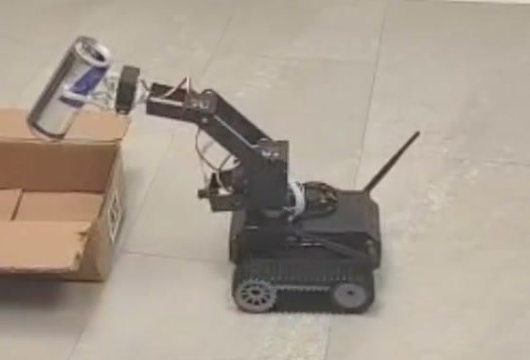
Self-Propelled Arm System
Monocular vision based mobile manipulation for indoor can collection
Project presentation
Filip Chekalkin, Huaijing Hou, Spaska Janeva, Kamen Kanev,
Giorgi Khundadze, Xiaosheng Tan, Stoyan Vlaev, Weiye Yuan
Embedded Systems, Cyber-Physical Systems and Robotics
Technical University of Munich, Campus Heilbronn
S.P.A.S. | Embedded Systems, Cyber-Physical Systems and Robotics | TUM Campus Heilbronn
Notes:
[about 0:40]
CUE: Title slide up before you start speaking. Say the team name, not the acronym letters.
Good morning, and thank you for coming. We are the S.P.A.S. team, and our
project is the Self-Propelled Arm System.
It is a small tracked robot with a robotic arm on top. Its job is to find drink
cans on the floor of an indoor room, pick them up, and drop them into a
collection bin.
The interesting part of the project is the constraint we worked under. The robot
has one camera and no other sensor. Everything you will see today is decided
from that single image.
I will start with a short overview, and then my colleagues will take you through
the system and the results.

Slide 2

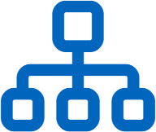

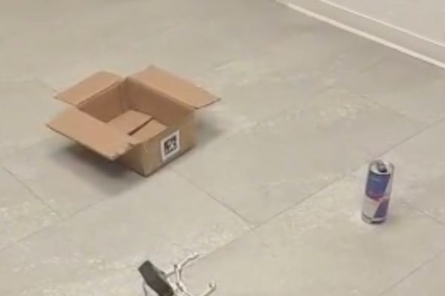


Introduction and Outline
Overview
System summary
Outline
Autonomous can collection robot
Problem and platform
Tracked indoor platform with a four link arm and a parallel gripper
Task definition and hardware constraints
A single RGB camera as the only sensor
Architecture and control
No depth sensor, no range finder, no wheel encoders, no force sensing
System components, state machine, grasping
Vision in the loop at every stage
Search, approach, grasp and delivery are decided from the image
Perception and demonstration
Detection results and a complete run on hardware
Operating environment: drink cans on the floor and an AprilTag marked collection bin
Experimental results
Detector accuracy and mission timing
Limitations and conclusion
Open issues, summary and future work
S.P.A.S. | Embedded Systems, Cyber-Physical Systems and Robotics | TUM Campus Heilbronn
2
Notes:
[about 1:10]
CUE: Point at the photograph on the left, then run down the outline on the right.
Here is the system in three lines.
First, it is an autonomous can collection robot: a tracked indoor platform with a
four link arm and a parallel gripper.
Second, and this is the important one, a single RGB camera is the only sensor.
There is no depth sensor, no range finder, no wheel encoders, and no force
sensing in the gripper.
Third, because of that, vision is in the loop at every stage. Search, approach,
grasp and delivery are all decided from the image.
The photograph on the left shows the environment we work in: drink cans standing
on the floor, and a bin marked with an AprilTag.
The outline on the right is how we will proceed. We start with the problem and
the platform, then the architecture and the control logic, then perception and a
complete run on hardware, then the measured results, and we close with the
limitations and the conclusion.

Slide 3


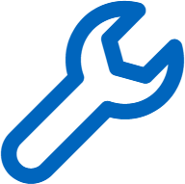

Problem Statement
Objective and constraints
Drink cans accumulate in indoor public spaces
Collection is repetitive, low risk manual work
The task combines perception, navigation, decision making and manipulation
Sensor configuration
Single RGB camera
320 x 240 pixels, 60 degree field of view
Detection
No depth sensing
Rotate in place until the detector accepts a target
No stereo pair and no range finder
Approach
No wheel encoders
Steer on the image error, stop on apparent size
The base returns no motion feedback
Grasp
No force sensing
Lower the arm, push, close, lift
The gripper cannot detect contact
Delivery
Dock on the AprilTag and release above the bin
The base is an open loop actuator
Motion is confirmed only in the image
S.P.A.S. | Embedded Systems, Cyber-Physical Systems and Robotics | TUM Campus Heilbronn
3
Notes:
[about 1:20]
CUE: Left column is the four stages, right column is the sensor list. Land on the bottom right line.
First, why this task.
Drink cans accumulate in indoor public spaces, and collecting them is
repetitive, low risk manual work. For us it was a good project task because it
combines everything at once: perception, navigation, decision making and
manipulation.
The mission breaks into four stages, shown on the left.
In detection, the robot rotates in place until the detector accepts a target.
In approach, it steers on the image error and stops when the target looks large
enough. In grasp, it lowers the arm, pushes, closes and lifts. In delivery, it
docks on the AprilTag and releases the can above the bin.
On the right is the hardware we had to do this with. One RGB camera, 320 by 240
pixels, with a 60 degree field of view. No depth sensing, no stereo pair, no
range finder. No wheel encoders, so the base returns no motion feedback at all.
And no force sensing, so the gripper cannot detect contact.
The consequence is at the bottom right, and it is the sentence that shapes the
whole system: the base is an open loop actuator. We command it to move, and the
only way to confirm that it moved is to look at the next camera image.

Slide 4


System Architecture
Components and software framework
Three subsystems are connected to the Jetson Nano. Only the servo chain reports its state back.
Two track motors
PWM via motor driver
no position feedback
CSI camera
320 x 240
CSI-2
Jetson Nano
4 GB shared
frames in
Five bus servos
one TTL serial chain
position readable
Battery and power rail
power
S1
S2
S3
S4
S5
S4 closes the gripper
Software stack
Mission layer
Perception layer
Hardware layer
Configuration
demo_core state machine, 16 states
detectNet, pupil_apriltags, OpenCV
jetbot Robot and Camera, TTLServo
config.json, empirical_parameters.json
S.P.A.S. | Embedded Systems, Cyber-Physical Systems and Robotics | TUM Campus Heilbronn
4
Notes:
[about 1:15]
CUE: Trace the diagram outward from the Jetson in the middle, then drop to the software stack.
This is the hardware architecture.
In the middle is the Jetson Nano with four gigabytes of shared memory. It runs
everything on board. There is no external computer and no remote control.
Three subsystems are connected to it. On the left, the CSI camera delivers 320 by
240 frames over CSI-2. On the right, two track motors are driven with PWM through
a motor driver, and they report nothing back. Below them, five bus servos are
connected in one TTL serial chain, and these are the only devices in the system
whose position we can read. Servo four closes the gripper.
The dashed lines are the power rail, from the battery to the drive and to the
computer.
At the bottom is the software stack, in four layers. The mission layer is our
demo_core state machine with sixteen states. The perception layer uses detectNet,
the pupil_apriltags library and OpenCV. The hardware layer wraps the jetbot Robot
and Camera classes and the TTLServo driver. And all tuning constants live in two
JSON configuration files, so no threshold is hard coded in the logic.

Slide 5
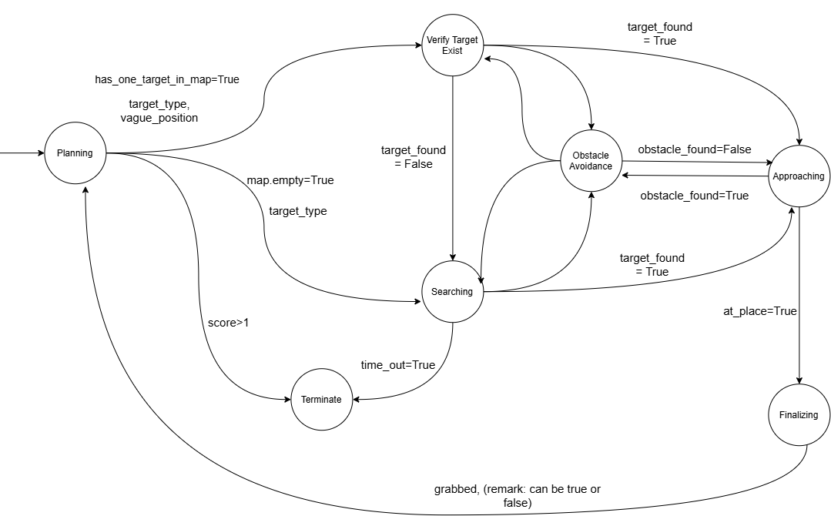
State Machine and Control Logic
Mission control
Vision driven states
Searching
Rotate until a target is accepted or the timeout expires
Aligning
Turn to tolerance, abort if the target is lost
Approaching
Steer or drive forward, stop on apparent size
Final verification
Tighter tolerance over consecutive frames
ex = ( xc - W/2 ) / W
Design level state graph. Transition guards are fields of a single shared context object.
Range -0.5 to 0.5, negative to the left of centre
Stop thresholds: 0.36 box height, 0.15 tag height
Transitions are held in an explicit table, so an undeclared state and event pair raises an error
Finalising requires a stable target, a condition map based navigation never reaches, so dead reckoning triggers no action
S.P.A.S. | Embedded Systems, Cyber-Physical Systems and Robotics | TUM Campus Heilbronn
5
Notes:
[about 1:45]
CUE: Give the graph two seconds of silence before speaking. Read the formula aloud slowly.
The mission logic is an explicit finite state machine, sixteen states in total.
The graph on the left is the design level view. The guards on the transitions are
fields of a single shared context object, so every state reads the same picture
of the world.
On the right are the four states that are driven by vision.
In searching, the robot rotates until a target is accepted or the timeout
expires. In aligning, it turns until the target is within tolerance, and it
aborts if the target is lost. In approaching, it steers or drives forward and
stops on apparent size. Final verification repeats the check with a tighter
tolerance over several consecutive frames, so a single lucky frame cannot trigger
a grasp.
The formula below is the whole control input. e_x is the horizontal position of
the target centre, minus half the image width, divided by the image width. It
ranges from minus zero point five to plus zero point five, negative to the left of
centre. We steer to drive that error to zero.
Distance is handled the same way. We do not estimate range. We stop when the
detection box reaches 0.36 of the image height for a can, or 0.15 for the tag.
Apparent size replaces a distance measurement.
Two design decisions at the bottom. Transitions are held in an explicit table, so
an undeclared state and event pair raises an error instead of failing silently.
And finalising requires a stable target, which map based navigation never
provides, so dead reckoning alone can never trigger a grasp.

Slide 6
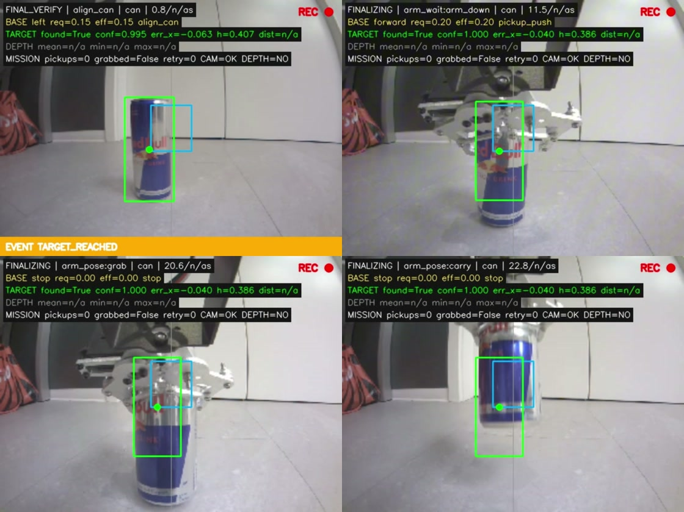
Grasping Strategy
Manipulation sequence
Fixed poses — no inverse kinematics
1
2
3
4
5
6
Wait
Lower
Push
Hold
Close
Lift
2.0 s settle
arm_down pose
Slow forward drive
5.0 s lock
Grab pose
Carry pose
Why push, not reach
Short arm, imprecise gripper
Base drives reliably
Can driven into open gripper
Coarse motion beats fine manipulation
Servo feedback
Polled until readings stabilise
Push blocked until settled
4.94 s settle · 7.0 s push · 5.0 s hold
Verify · push · close · carry
Limitation: light objects, low-friction floor
S.P.A.S. | Embedded Systems, Cyber-Physical Systems and Robotics | TUM Campus Heilbronn
6
Notes:
[about 1:35]
CUE: Walk the six chips left to right, then the four photographs, then the two blocks on the right.
Now the grasp itself.
The line at the top is the whole idea: fixed poses, no inverse kinematics. The
arm only ever moves between poses we defined in advance, and the base drives the
can into the open gripper.
The six chips are the sequence. Two seconds of settling. Lower the arm to the
down pose, polling the servos as it goes. Push forward slowly, which is the step
highlighted in blue. Hold the arm locked for five seconds. Close to the grab
pose. Lift to the carry pose.
The four frames below are recorded on board during a real pickup: verify, push,
close, carry.
Then the question on the right: why push, rather than reach out and grasp? The
arm is short and the gripper closes imprecisely, but the base moves reliably over
short distances. So we lower the open gripper to the floor and drive the can into
it. We trade fine manipulation, which our hardware is bad at, for coarse base
motion, which it does well.
The block underneath is the one place in the whole system with real feedback.
Servo positions are polled until the readings stop changing, instead of waiting
out a fixed delay, and the push is blocked while the arm has not settled. In the
archived run that came to 4.94 seconds of settling, 7 seconds of pushing and 5
seconds of holding.
The limitation is on the slide and we will not talk around it: this works for
light objects on a low friction floor.

Slide 7
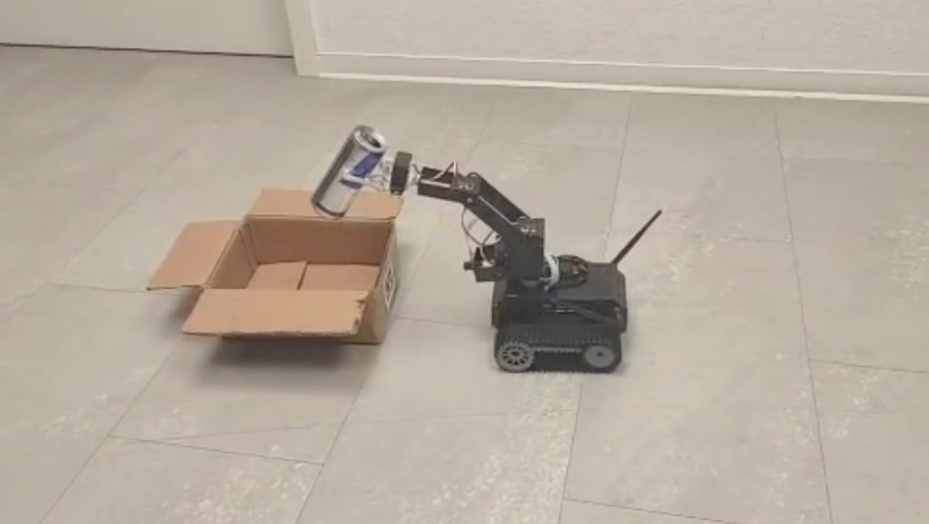
Experimental Setup
Platform, arena and reference run
Platform with grasped can
Arena: can, AprilTag bin
Release above bin
73.8 s
1
98
41 / 59
Full run
Camera only
Can detections
Tag reads
Reference run
Search · grasp · transport · release
Camera only — DEPTH = NO
S.P.A.S. | Embedded Systems, Cyber-Physical Systems and Robotics | TUM Campus Heilbronn
7
Notes:
[about 1:05]
CUE: Three photographs first, then the four numbers. This is the slide to slow down on.
This is the experimental setup and one complete reference run.
On the left, the platform holding a grasped can. In the middle, the arena: a 250
millilitre can and the bin with the AprilTag. On the right, the end of the run,
with the can held above the bin.
The four numbers describe that run. 73.8 seconds from the start of the search to
the release over the bin. One camera, and nothing else: no depth sensor, no range
finder, no encoders. 98 can detections during the run. And 41 successful tag
reads out of 59 attempts.
So search, grasp, transport and release were all completed on real hardware using
the camera alone. That is not a claim we are asking you to take on trust: the
on-board overlay records DEPTH equals NO on every single frame of that run.

Slide 8
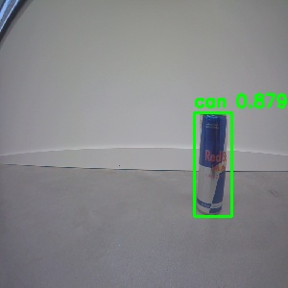
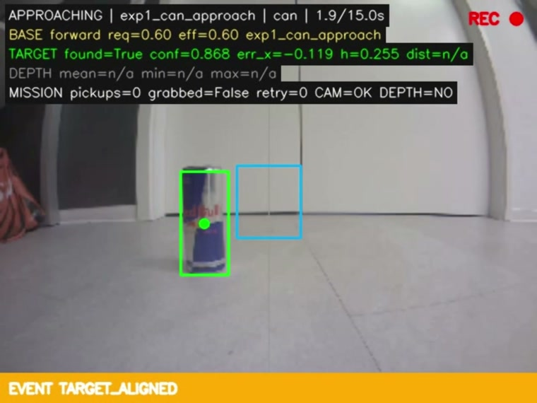
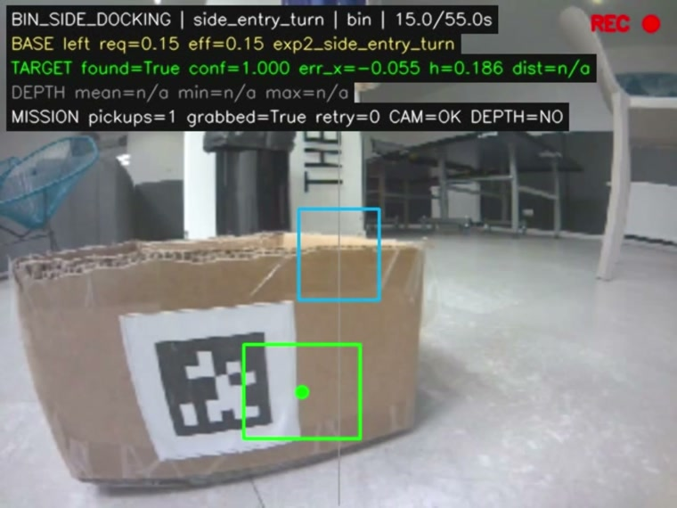
Object and Marker Detection
Perception
Two detectors, every controller input
Detector output
Can detection
Tag detection
SSD-MobileNet-V1 · 300 × 300
error −0.119 · height 0.255
tag36h11 id 0 · height 0.186
No calibration needed
Image ratios — focal length cancels
PnP pose available, unused
S.P.A.S. | Embedded Systems, Cyber-Physical Systems and Robotics | TUM Campus Heilbronn
8
Notes:
[about 1:20]
CUE: Point at the overlay values in the middle image; those are the two numbers the controller reads.
Perception is two detectors, and between them they produce every measurement the
controller uses.
On the left is the object detector, SSD-MobileNet-V1, at 300 by 300 input
resolution, with the confidence score.
In the middle is the same detector running inside the mission, with our overlay
on top. The two values under the image are exactly what the controller consumes:
a horizontal error of minus 0.119, so the can is slightly left of centre, and a
box height of 0.255, which is still below the 0.36 stopping threshold. So at this
moment the robot keeps approaching.
On the right is the AprilTag detector during docking at the bin. Family tag36h11,
identifier zero, and a tag height of 0.186 against the 0.15 threshold.
The heading at the bottom says no calibration needed, and that is worth one
sentence. We never calibrated this camera. Tag height, edge ratio and corner
angle are all ratios measured inside the image, so the focal length cancels out
of every one of them. The AprilTag library will also hand us a metric pose
through perspective-n-point, and we deliberately do not use it.

Slide 9
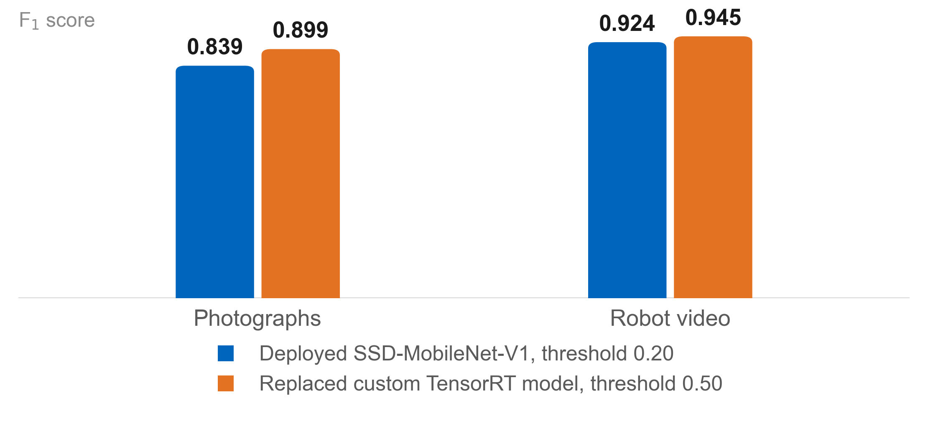
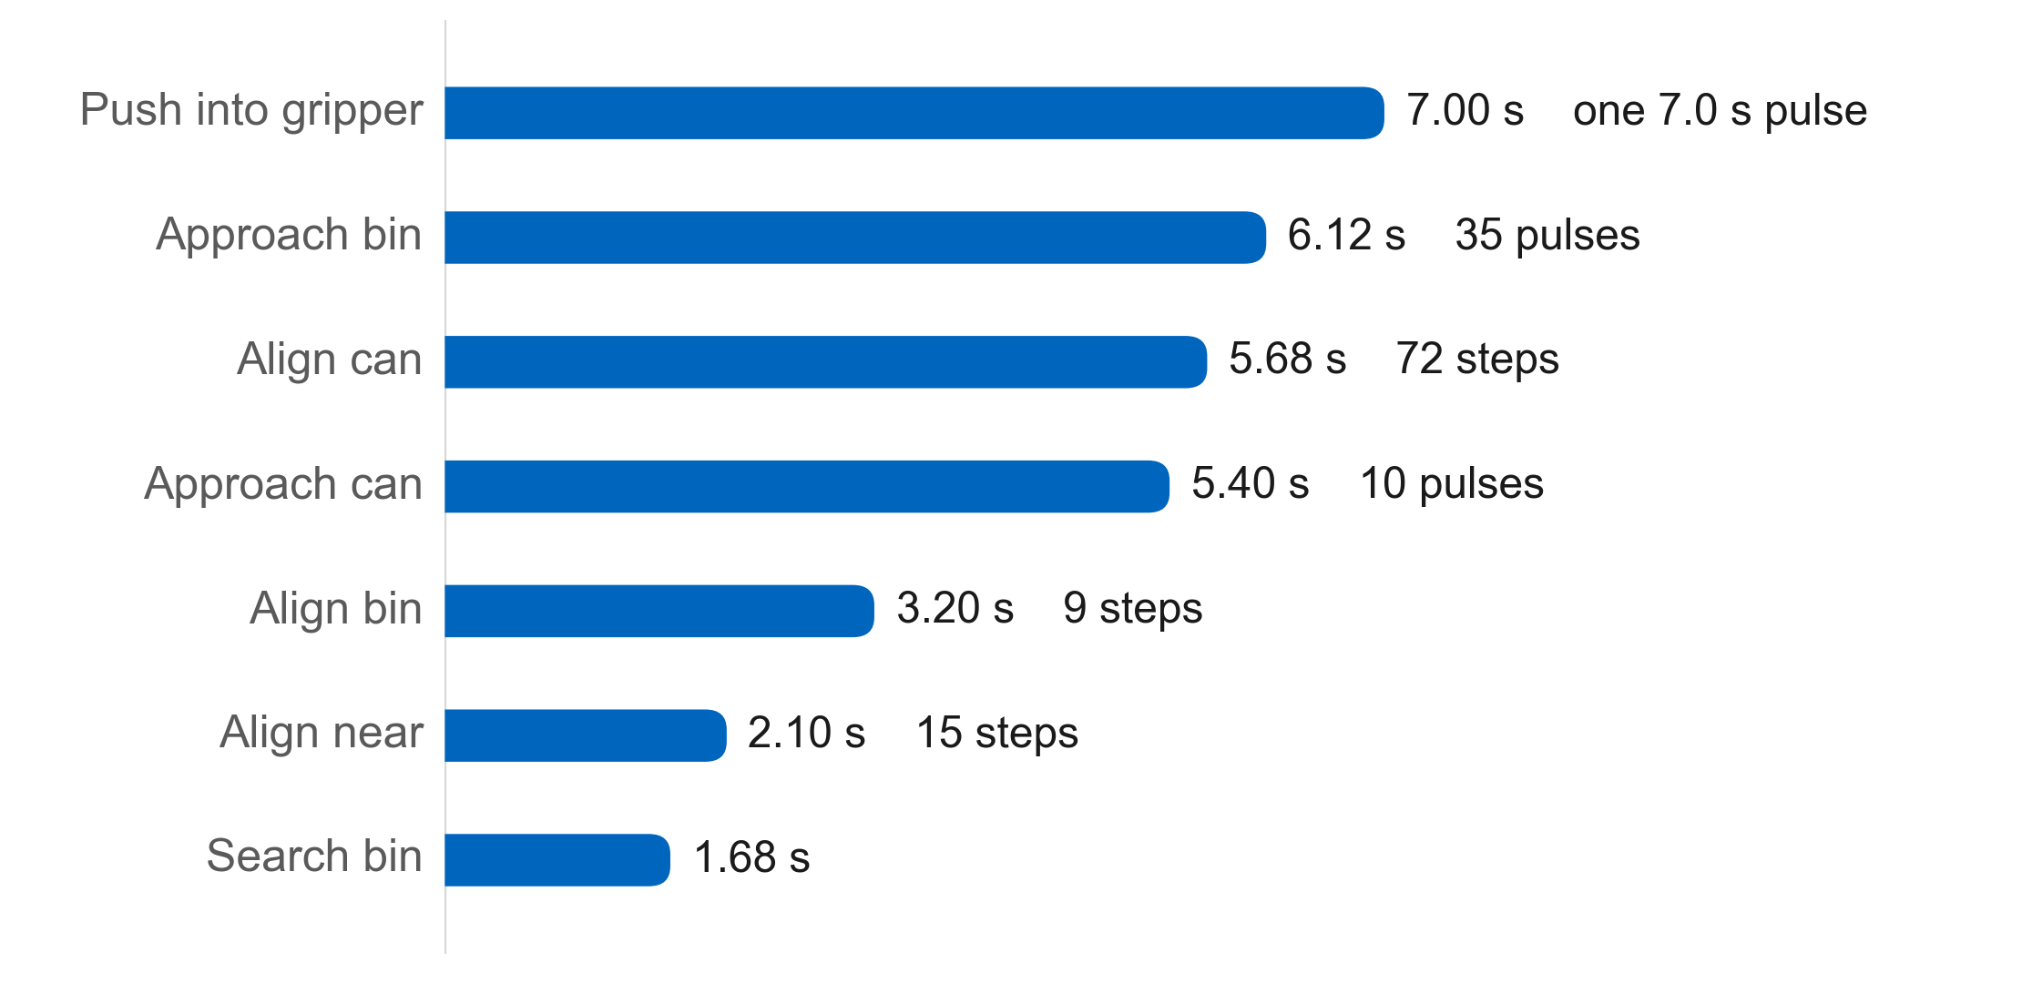
Experimental Results
Detector accuracy and mission timing
Detector accuracy, F1
Base motion per phase
73.8 s
31.2 s
11.9 s
4.4 × 10⁻⁷
Full mission
Base motion, 42 %
Deliberate holds
PyTorch vs. ONNX
Accuracy vs. deployability
Caveat: archived run
−6 F1 photos, −2 video
No custom post-processing
Native NVIDIA path
Earlier prototype, TensorRT detector
Legacy thresholds 0.400 / 0.500
Counts and timings exact
S.P.A.S. | Embedded Systems, Cyber-Physical Systems and Robotics | TUM Campus Heilbronn
9
Notes:
[about 1:35]
CUE: Left chart, then the four numbers, then the caveat box on the right. Do not skip the caveat.
Now the measurements.
The left chart is detector accuracy as F1 score. The two bars in each group
compare the model we actually deployed against the stronger custom model. On
photographs we give up about six F1 points, and on video about two.
We accepted that, and the three bullets underneath are the reason. The deployed
model drops a custom post-processing layer and a custom inference backend, and it
runs on the inference path NVIDIA supports natively on the Nano. We traded a
small amount of accuracy for a deployment that works reliably on the device we
have. The conversion itself is lossless in practice: the deviation between the
PyTorch model and the exported ONNX model is 4.4 times ten to the minus seven.
The right chart is where the time goes in the 73.8 second run. Only 31.2 seconds,
about 42 percent, is commanded base motion. Another 11.9 seconds are deliberate
holds, the settling and locking we saw in the grasp sequence. The remainder is
perception and decision time.
One caveat, and it is on the slide rather than hidden in a footnote. That run was
recorded by the earlier prototype, with the legacy parameter set and the custom
TensorRT detector. Its stop thresholds were 0.400 and 0.500, not the 0.36 and
0.15 we use today. The counts and the timings are exact; the thresholds behind
them are not the current ones.

Slide 10



Limitations and Challenges
Evaluation
Depth excluded
Pose drifts
Silent failure
0.3 m general scenes
1 m white surfaces
Detector reaches 3 m
Left / right: 1–3 rad/s
Modelled 0.471 / 0.942
Error exceeds model
Verification disabled
Pickup always recorded
Empty gripper reports success
Removed from control path
AprilTag: only anchor
First fix: verification flag
Missing capability: relocalisation
Principal challenges
Open-loop turning unreliable
Model deployment
Pulses + visual correction
Accuracy traded for reliability
No gripper feedback
Depth underperformed
Full and empty identical
Unreliable at useful ranges
10–15 fps
Grasp timing
Pulsed motion, low speeds
Polling beat fixed delay
S.P.A.S. | Embedded Systems, Cyber-Physical Systems and Robotics | TUM Campus Heilbronn
10
Notes:
[about 1:35]
CUE: Three orange cards left to right. Pause on the third one, it is the honest one.
We want to be clear about what does not work.
First card, depth excluded. We tested a depth network. It was reliable to about
0.3 metres in a general scene, and to about one metre only on clean white
surfaces. Our can detector already works out to three metres, so the depth
estimate was worse than the detector it was meant to help. We took it out of the
control path completely.
Second card, the pose estimate drifts. The two tracks turn at different rates,
somewhere between one and three radians per second, while our model assumes fixed
values of 0.471 and 0.942. The error is larger than the quantity being modelled,
so dead reckoning is not trustworthy, and the AprilTag on the bin is the only
absolute anchor the robot has.
Third card, and this is the one that worries us, a silent failure. Grasp
verification is currently disabled, so a pickup is recorded whether or not the
can is in the gripper. The robot can report success holding nothing. Enabling
that verification flag is the first item on our list.
Taken together, the missing capability is relocalisation. The map can direct the
robot's attention, but it can never trigger an action on its own.
The row at the bottom is the practical side. Open loop turning was unreliable, so
we replaced it with short pulses and visual correction. The gripper gives no
feedback, so full and empty are indistinguishable. We get 10 to 15 frames per
second, so motion is pulsed and speeds stay low. Deployment cost accuracy and
bought reliability. Depth underperformed. And grasp timing needed real feedback,
because a fixed delay simply did not work.

Slide 11

Conclusion and Future Work
Summary
Summary
Sensors worth adding
Mobile manipulator, single camera
Closed on appearance, not geometry
Errors degrade, never break
Drifting map lengthens search
Asymmetric turning needs corrections
Forward distance sensor
First metric measurement
Gripper force sensing
Fixes empty gripper
Exception: undetected empty gripper
No proprioception — prefer caution
Wheel odometry
Next steps
Map becomes measurement
Enable grasp verification
One observation per pickup
More room tags
Cheap relocalisation anchors
Calibrate turn constants
Both factors still one
Thank you. Questions welcome.
S.P.A.S. | Embedded Systems, Cyber-Physical Systems and Robotics | TUM Campus Heilbronn
11
Notes:
[about 1:10]
CUE: Summary on the left, sensors on the right. Stop talking on the thank you line.
To summarise.
We built an indoor mobile manipulator that runs on a single camera. Its control
loops close on how the target appears in the image, not on estimated geometry.
The practical effect is the third line: errors degrade performance instead of
breaking the mission. When the map drifts, the robot searches longer. When
turning is asymmetric, it makes a few more corrections. It still finishes.
The one exception is in the blue box, the undetected empty gripper, and we have
said why. In general, on hardware with no proprioception, we would rather be
conservative and slow than confidently wrong.
The next steps are deliberately small. Enable grasp verification, which costs one
extra observation per pickup. And calibrate the two turn constants, because the
per direction scale factors already exist in the configuration and are simply
left at one.
If we had a budget for sensors, the order is on the right. A forward distance
sensor, which would be the first true metric measurement in the system. Force or
current sensing in the gripper, which addresses the empty gripper failure
directly. Wheel odometry, which turns the map from a hint into a measurement.
And more tags around the room as cheap relocalisation anchors.
Thank you for your attention. We are happy to take your questions.

