Slide 1
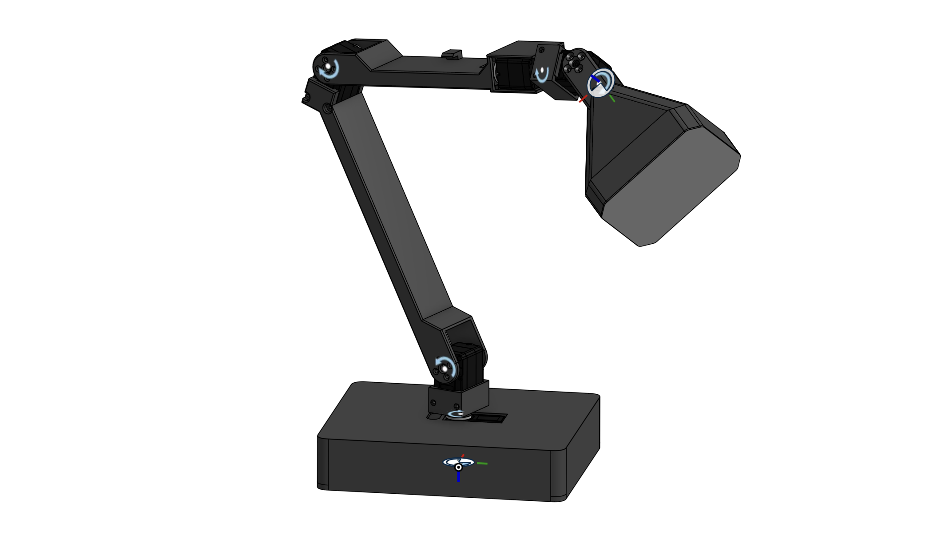
AILamp
An expressive robotic lamp
on a Jetson Nano
Group 8
Embedded Systems, Cyber-Physical Systems and Robotics (INHN0018)
Technische Universität München, Campus Heilbronn
September 2026
Notes:
Speaker A | Slide 1 | 35 seconds
Good afternoon. We are Group 8, and this is AILamp, our expressive robotic desk lamp built around a Jetson Nano. The idea is to let a familiar object communicate through movement. Today, we will explain our mechanical and software work, show the physical prototype in action, and discuss what we learned about controlling a real mechanism. My teammate and I will share the presentation.
中文提示：开场看观众。关键词是 expressive motion 和 physical prototype，不把台灯介绍成已完成的自主语音机器人。
操作提示：

Slide 2
Idea & goals
A lamp with five axes
01
The idea
A familiar desk object
Gestures express intent
Motion is our focus
02
Expressive motion
Inspired by ELEGNT
Recorded gestures
Five degrees of freedom
03
Our objective
Adapt LeLamp to Jetson
Replay selected motions
Verify each execution step
2
Notes:
Speaker A | Slide 2 | 50 seconds
A normal desk lamp changes where light falls. A moving lamp can also suggest attention or a response. For example, a small nod can look like acknowledgment, while a tilted posture can suggest curiosity. Research such as ELEGNT helped motivate this direction.
We chose a five-axis mechanism so that several joints could contribute to an expression. Our practical goal was to adapt the platform to Jetson Nano and make selected gestures easy to run, inspect and repeat. The current operator selects those gestures through a control interface.
中文提示：用点头和好奇两个例子解释“表达”，不要把动作名称说成情绪识别结果。
操作提示：

Slide 3
Contribution
On the LeLamp base (GPL-3.0)
01
Inherited
Mechanics and printed parts
MuJoCo model
Base runtime
Motion recordings
02
Our engineering
Jetson deployment
Replacement base design
Action control console
Home-relative playback
03
Demonstrated
Physical lamp movements
Saved home and poses
Operator-triggered actions
LeLamp (Human Computer Lab): an open-source expressive robot lamp.
3
Notes:
Speaker A | Slide 3 | 50 seconds
Our starting point is LeLamp, the open-source project from Human Computer Lab. We use its mechanical baseline, robot model and reference motion recordings, and we keep that attribution explicit.
Our contribution is the Jetson integration, a replacement base design, and the action control workflow. The console lets an operator select a gesture, save poses and return home. We also adapted recordings to a user-defined home position. This distinction matters: the original platform gives us a strong starting point, while our work makes it usable in our own hardware setup.
中文提示：左边讲继承，右边讲自己的贡献。不要说机械、模型和所有动作都从零原创。
操作提示：

Slide 4
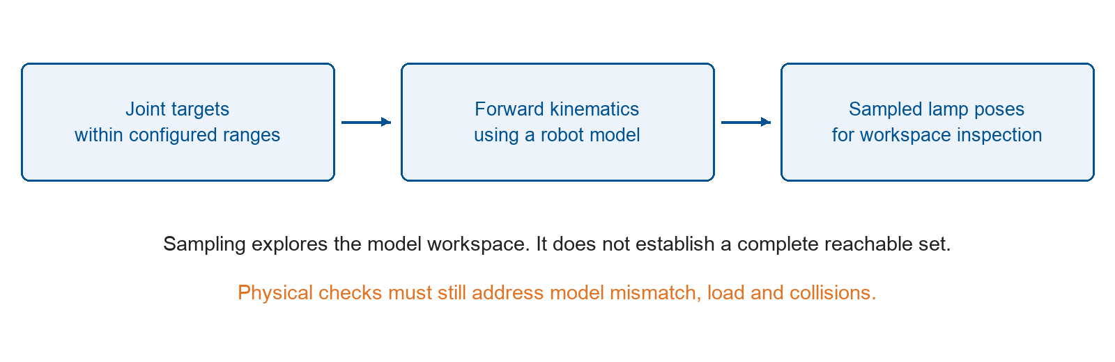
Reachability analysis
Joint ranges and forward kinematics guide workspace inspection
Method illustration based on the LeLamp model. No certified workspace boundary.
Model sampling does not prove collision-free physical motion.
4
Notes:
Speaker A | Slide 4 | 40 seconds
Before commanding a motion, we need to understand where the mechanism can move. A robot model lets us sample joint configurations and use forward kinematics to inspect possible lamp positions.
This is useful for planning and spotting obvious problems. However, the result depends on the model and joint limits, and a sampled workspace does not cover every physical situation. We therefore combine model inspection with checks on the assembled lamp, especially for clearance, cables and load.
中文提示：指向图中关节范围和运动学步骤。结论是“帮助检查”，不说已经证明无碰撞。
操作提示：

Slide 5
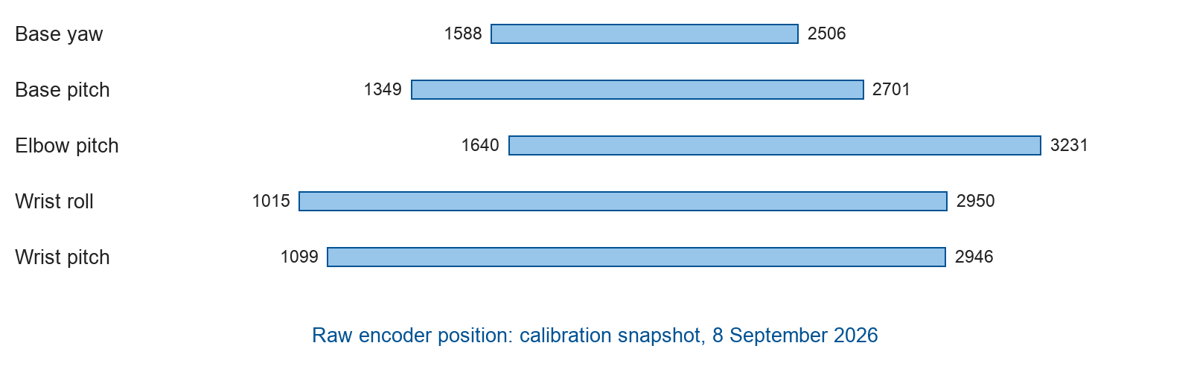
Motion constraints
Calibration, bounded targets and explicit motor enable
CSV targets use normalized units [-100, 100], not degrees.
Stop reads the current position and holds it. Release switches torque off.
Position and communication faults block playback until checked.
Runtime checks reduce risk. Physical safety still requires validation.
5
Notes:
Speaker A | Slide 5 | 50 seconds
The controller needs a consistent meaning for every position command. This figure shows raw encoder ranges from the calibration file. The recordings use normalized values between minus one hundred and one hundred. These values are not degrees.
Before playback, we validate the calibration and the target positions. We also distinguish two operations that sound similar. Stop cancels the remaining motion and tries to hold the measured position. Release switches off motor torque, so the arm must be supported. That distinction became particularly important during manual pose teaching and fault recovery.
中文提示：不要逐个读范围数字。停住保持和释放卸力是本页重点，可用手势表达两个状态。
操作提示：

Slide 6
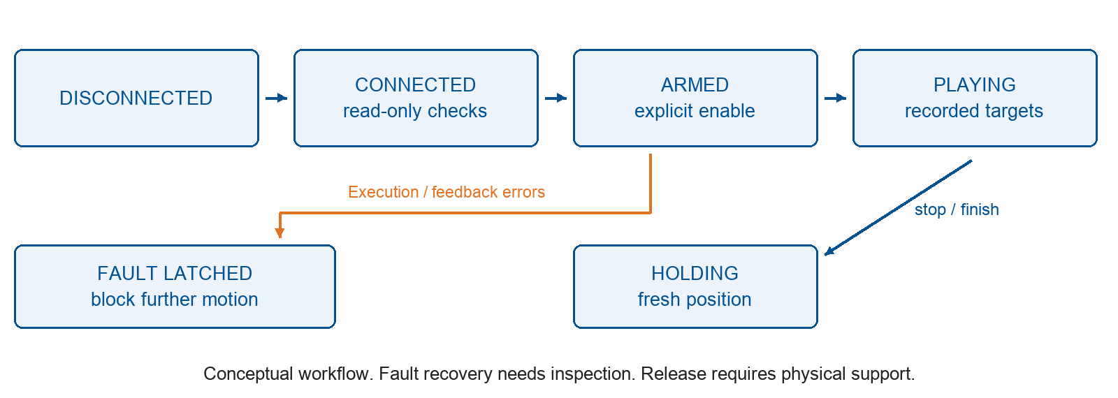
Execution states
A conceptual view of connection, enable, playback and recovery
6
Notes:
Speaker A | Slide 6 | 40 seconds
The state diagram summarizes how the operator gains control of the lamp. Connecting first reads the device state. Enabling the motors is a separate step. Once the lamp is ready, the operator can play a gesture or return to a saved pose.
Feedback tells us whether the motors actually reached the target. If something goes wrong, the controller stops the sequence and reports the problem. Recovery depends on the fault. This gives us a concrete example of state management: being connected, being enabled and actively moving are different conditions.
中文提示：沿图从左到右讲，避免逐个念英文框。图是概念流程，不称形式化验证结果。
操作提示：

Slide 7
Motion functions
Save a home pose once, then select actions and return home
Function | Current implementation
Select | Browser action selection
Replay | Home-relative joint targets
Home | Return to saved pose
Stop | Read position and hold
Selected gestures
wake_up: attentive posture
nod: acknowledgment
headshake: disagreement
scanning: looking around
Browser controls running on Nano
One worker controls the motor bus
Voice integration is the next step
The console triggers movement. Saved home, rest and awake poses persist.
7
Notes:
Speaker A | Slide 7 | 45 seconds
For everyday operation, the workflow is simple. We save a home pose once, choose an action, and use the return-home button before choosing the next action. Returning home can also interrupt a gesture that is still playing.
The saved poses remain available after a restart. We keep home, rest and awake separate because they serve different purposes. Home is the common reference for ordinary gestures. Rest and awake are specific poses taught by the operator. The browser console exposes these functions without requiring a new command-line instruction each time.
中文提示：指表格并讲一轮实际操作。归位不是释放，不需要每个动作后重新使能。
操作提示：

Slide 8
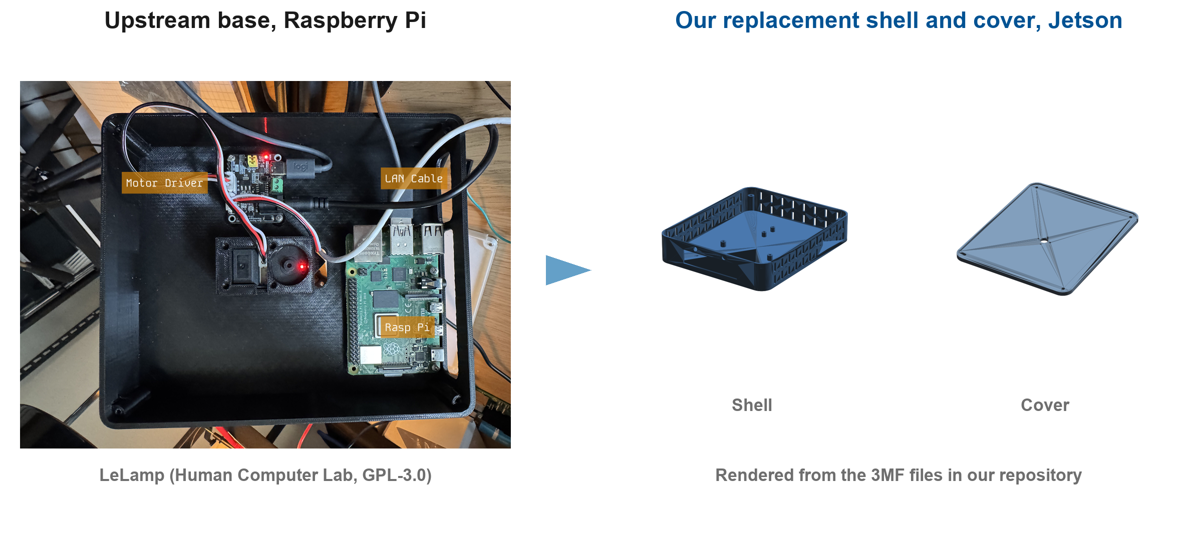
Base & assembly
Replacement shell and cover for the Jetson configuration
The Jetson board needs a different electronics layout from the Pi baseline.
We designed a replacement shell and cover with ventilation and cable routes.
The video shows the assembled prototype with external wiring.
8
Notes:
Speaker A | Slide 8 | 40 seconds
Moving to Jetson also changes the mechanical integration. The board and its connections need a different layout from the Raspberry Pi baseline. We designed a replacement shell and cover, with space for ventilation and cable routing. Source scripts generate the design files so that we can revise them consistently.
The images distinguish the upstream base from our replacement design. Our assembled prototype still has external wiring, so cable management remains part of the refinement work.
That covers the physical platform. My teammate will now explain the control software and show the demonstration.
中文提示：图片是上游底座与替换件设计；视频才是本组实物。交接后停顿，让女生自然接话。
操作提示：最后一句后切到第 9 页，女生接讲。

Slide 9
Software architecture
A dedicated motor execution path
Web console
operator input
Inputs
CSV recordings
and saved poses
Executor
relative targets
home and stop
Hardware
five servos
on one bus
Jetson Nano 4 GB runs the action console.
One worker sends joint targets and reads motor feedback.
Voice recognition is not connected to this execution path.
9
Notes:
Speaker B | Slide 9 | 45 seconds
Thank you. I will now explain how an operator request becomes a motor action. The browser console runs on the Jetson Nano. It passes the selected action to the executor, which uses a recording, the calibration and the saved poses to prepare joint targets.
One worker controls the motor bus and coordinates feedback from the five servos. Keeping a single owner helps prevent competing commands. This architecture also gives us a clear integration point for future inputs: a recognized voice command could request the same validated action that a button requests today.
中文提示：开头接住男生最后一句。沿控制台、执行器、电机讲清信息路径，不念全部模块名称。
操作提示：

Slide 10
Action playback workflow
One saved home pose provides a consistent starting point
01 Set home
Position, save and enable
02 Select action
Move relative to home
03 Return home
Then select the next action
Returning home can interrupt playback. Incomplete returns remain visible.
10
Notes:
Speaker B | Slide 10 | 45 seconds
The main operating loop is shown here. First, the operator saves a suitable home pose and enables the lamp. Then they choose an action. After the gesture, they can return home and select another action without teaching the pose again.
We learned that returning home is also a feedback problem. Sending the home command does not prove arrival. The console reports an incomplete return separately. It allows further selection only after the relevant checks confirm a stable hold, while position and communication faults remain blocking conditions.
中文提示：强调“发出命令”和“实际到位”不同。不要声称目前归位已无误差或每次都完全到位。
操作提示：

Slide 11
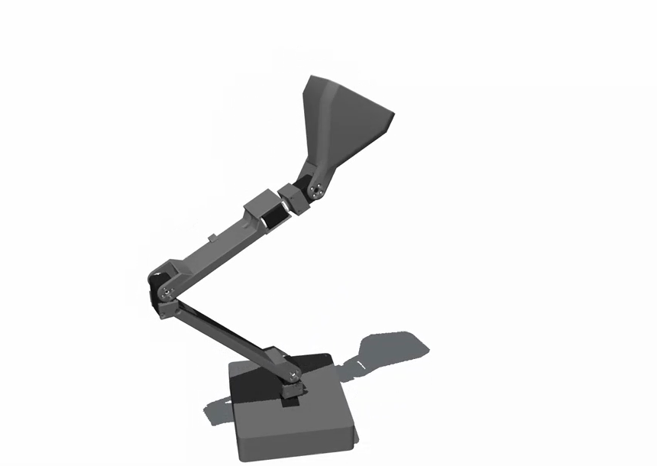
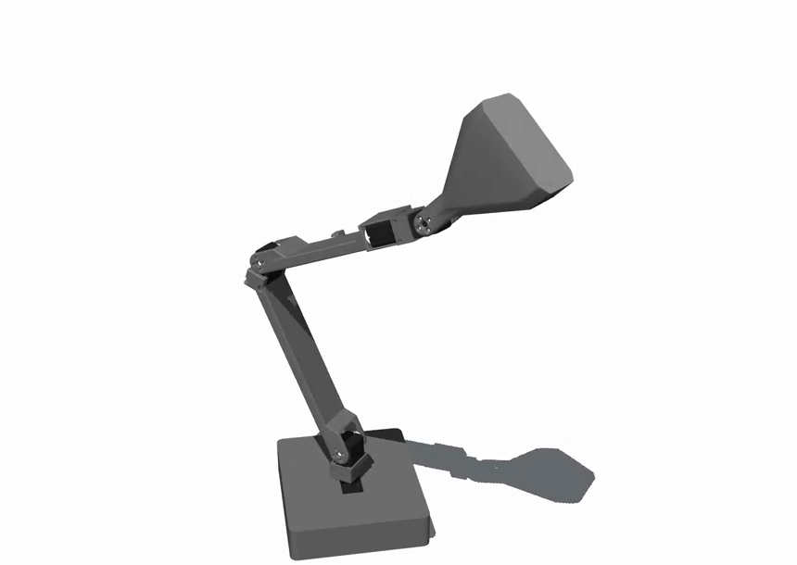
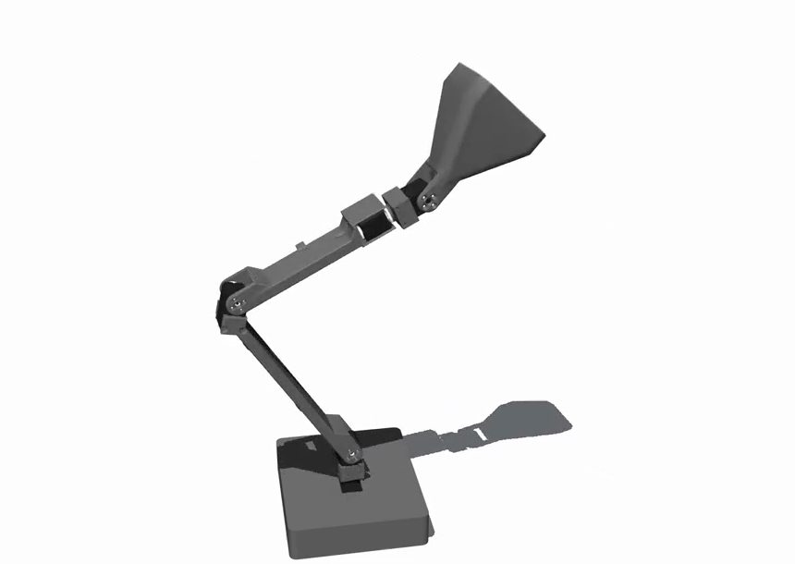
Simulation & replay
Reference recordings and a user-defined starting posture
Recordings contain five normalized joint targets per frame at 30 Hz.
Current target = saved home + source frame - source first frame.
Wake-up
Curiosity
Scanning
Frames from the supplied simulation video; LeLamp model (GPL-3.0).
Every converted frame is checked against calibration bounds before playback.
11
Notes:
Speaker B | Slide 11 | 50 seconds
The source recordings contain five joint targets per frame, sampled at thirty hertz. Initially, each recording retained its own starting pose. That caused an unwanted effect: the lamp first moved toward an old recorded posture before performing the selected gesture.
We changed the ordinary playback path to preserve the movement relative to the first frame, while anchoring it at the user's home pose. The formula on this slide expresses that translation. We check the complete converted trajectory before sending it. These frames from our simulation video show wake-up, curiosity and scanning. The physical demonstration follows in two slides.
中文提示：指向新视频的三张截图：唤醒、好奇、扫视。截图是仿真效果；口头解释公式，不逐字读符号。相对关节变化不保证动作观感完全相同。
操作提示：
Visual source: supplied simulation video a3caaa4ef8d272cafad7368aa2e84334.mp4; frames 6s, 11s, 29s; LeLamp model (GPL-3.0).

Slide 12
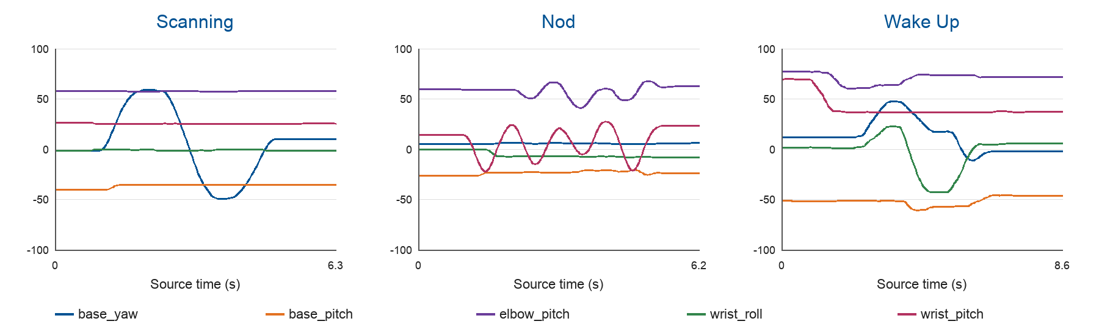
Evidence
Software checks and physical observations
13 source recordings checked. Physical gestures shown in the next slide.
Normalized CSV targets [-100, 100]. Source trajectories, not measured motion.
12
Notes:
Speaker B | Slide 12 | 85 seconds
We separate software evidence from physical observations. The source library contains thirteen recordings and five thousand four hundred and eighty-eight frames. The checks cover calibration, position bounds, interruption, saved poses and relative trajectory conversion.
The plots here show requested positions from source recordings. They are not measurements of motor accuracy. We now also have a recording of the physical prototype moving. During testing, we observed incomplete returns and differences between commanded and measured positions. Those observations guide further tuning instead of being hidden by the software results.
We will now show the physical prototype first, followed immediately by the simulation animation. Together, the two clips last about two minutes and eighteen seconds.
Before we play them, one clarification: the spoken interaction in the physical clip illustrates our intended voice-control scenario. The actual motor actions were triggered through the control console. Speech recognition is not yet connected to the motor controller.
中文提示：图是源指令，不是实测误差曲线。视频证明实物运动，不把它当作最新相对轨迹算法的逐项验收。
操作提示：说完视频开场说明后再切第 13 页，视频会自动播放。

Slide 13

Demonstration
Physical demo → simulation animation | 2 min 18 sec
Voice-trigger scenario simulated; lamp movements triggered from the control console.
13
Notes:
Speaker B | Slide 13 | 150 seconds
[The combined video starts automatically on entering this slide. Physical demo first, simulation second. Do not speak over it.]
The physical clip shows the assembled mechanism moving. The animation makes the intended gestures easier to compare. Our next step is reliable, automatic input-to-action control.
中文提示：第 12 页末已介绍视频。此页自动播放：实物约 92 秒，再接无声仿真约 46 秒，共约 2:18。视频播放时不讲话；结束后再收尾。
操作提示：进入第 13 页后自动连续播放两段，无须点击封面。不要在第一段结束时翻页；全部播完后，女生说最后一段，再切第 14 页。
Video sources: user-supplied physical demonstration followed by simulation. 138.07 seconds. Autoplay; no visible cover. Voice scenario is simulated, physical motion is console-triggered.

Slide 14
Course concepts in practice
Hybrid systems: sampled commands interact with continuous motor motion.
State management: connection, enable and active playback are distinct.
Actuator limits: calibration, dead band and load affect the result.
Shared I/O: five motors share a bus controlled by one worker.
Verification: command acceptance and physical arrival are different events.
14
Notes:
Speaker B | Slide 14 | 45 seconds
Several course concepts became tangible in this project. The software sends sampled targets, while the motors move continuously through their own position controllers. That gives us a hybrid-system perspective.
The shared communication bus makes command ownership and timing important. Calibration, load and motor dead band explain why requested and measured positions can differ. State management then determines what the system may do next. Our most useful lesson is that a successful software command and a successful physical action are separate events, and the controller needs evidence for both.
中文提示：挑课程概念与实际问题的对应关系讲，不背术语清单。dead band 发音可读成 “dead band”。
操作提示：

Slide 15
Status & open work
Implemented and demonstrated
Nano action console deployed
Physical gesture video recorded
Home, rest and awake saved
Relative playback implemented
Next steps
Connect real voice commands
Reduce home-position error
Tune each physical gesture
Integrate vision and lighting
15
Notes:
Speaker B | Slide 15 | 30 seconds
Our current result is a deployed action console, saved poses and a physical gesture demonstration. We have also implemented home-relative playback to remove the old starting-pose transition.
The next priorities are reliable voice-to-action integration, better repeatability when returning home, and gesture tuning on the assembled lamp. Vision and lighting remain part of the wider project, with their integration still to be completed.
中文提示：左边已做，右边后续。不要临时承诺“所有模块都已完成”或给未经测试的成功率。
操作提示：

Slide 16
Conclusion
An operating prototype for expressive motion
We adapted LeLamp for Jetson Nano and built an action console.
The prototype performs physical movements and stores user-defined poses.
Next, we will connect voice input and improve repeatability.
Thank you. Questions welcome.
16
Notes:
Speaker B | Slide 16 | 30 seconds
To conclude, we adapted LeLamp to a Jetson Nano setup and built a console for expressive movement. The prototype can perform physical gestures, while saved poses make its operation easier to repeat.
The work also showed us why calibration, feedback and clear execution states matter in a cyber-physical system. We now have a practical base for connecting real voice input and improving reliability. Thank you for your attention. We are happy to take questions.
中文提示：讲完停在结论页看观众。第 17–22 页是备用资料，不继续逐页讲。
操作提示：

Slide 17
Sources & acknowledgements
• LeLamp (Human Computer Lab): mechanics, model, runtime, recordings, base photo. GPL-3.0.
• Apple ML Research, "ELEGNT", 2025.
• Lee & Seshia, Introduction to Embedded Systems.
• Our fork: GPL-3.0, provenance in NOTICE.md.
17
Notes:
Backup only. LeLamp, Human Computer Lab: https://github.com/humancomputerlab/LeLamp . ELEGNT: listed in the original project reference deck. Lee and Seshia: Introduction to Embedded Systems. This slide credits the inherited mechanics, model and recordings. The team supplied the physical demonstration video.

Slide 18
Backup: vision & voice
Voice-triggered interaction is the target, not the current trigger
The video illustrates a voice-triggered interaction scenario.
Actual motor actions are triggered from the control console.
Vision and voice prototypes exist in the wider repository.
Next integration: one recognized command calls one validated action.
Then test recognition errors, repeated requests and stop behavior.
Current demonstration: real motor motion with simulated voice triggering.
18
Notes:
Backup only. If asked whether voice is implemented: the video stages the intended voice-triggered interaction. Actual motor actions came from the control console. Existing voice and vision prototypes have not been connected and jointly validated with the current motor workflow.

Slide 19
Backup: BOM & power
Current compute: Jetson Nano 4 GB and microSD storage.
Actuation: five ST3215 servos through a USB-connected servo driver.
The hardware design separates compute, motor and LED power domains.
Pico, LED matrix, camera and audio parts remain in the wider project BOM.
LED operation and speaker playback are not claimed in this demonstration.
19
Notes:
Backup only. The current controller is Jetson Nano 4 GB, with five ST3215 servos and a USB-connected bus driver. The wider project BOM includes audio, vision and lighting parts. Their presence in the BOM is not evidence of completed integration.

Slide 20
Backup: test coverage
Reported software checks, with dates and boundaries
13 reference recordings contain 5,488 source frames.
Tests cover calibration identity, bounds, stopping and pose persistence.
New checks cover interrupted returns and relative trajectory conversion.
Recorded physical motion provides evidence beyond the simulated bus.
Position error, collisions and long-run reliability need further measurement.
Offline command: PYTHONPATH=ailamp_runtime python3 -m ailamp.motor_cli preflight
20
Notes:
Backup only. Tests validate software behavior and accepted inputs. They do not establish collision clearance, load capacity, positioning accuracy, or a measured hardware success rate. Reference library: 13 CSV recordings and 5,488 frames. Simulation and physical evidence must be distinguished.

Slide 21
Backup: timeline
Early work: select the LeLamp platform and plan Jetson integration.
Build phase: assemble the mechanism and design the replacement base.
8-9 September: deploy the console and improve home and motion handling.
Presentation preparation: record physical gestures and integrate the video.
Next milestone: validated voice-to-action control on the physical lamp.
21
Notes:
Backup only. The dated project notes and this session document deployment, pose teaching, return-home handling, relative trajectory conversion and physical video preparation. Dates in this slide summarize that development sequence.

Slide 22
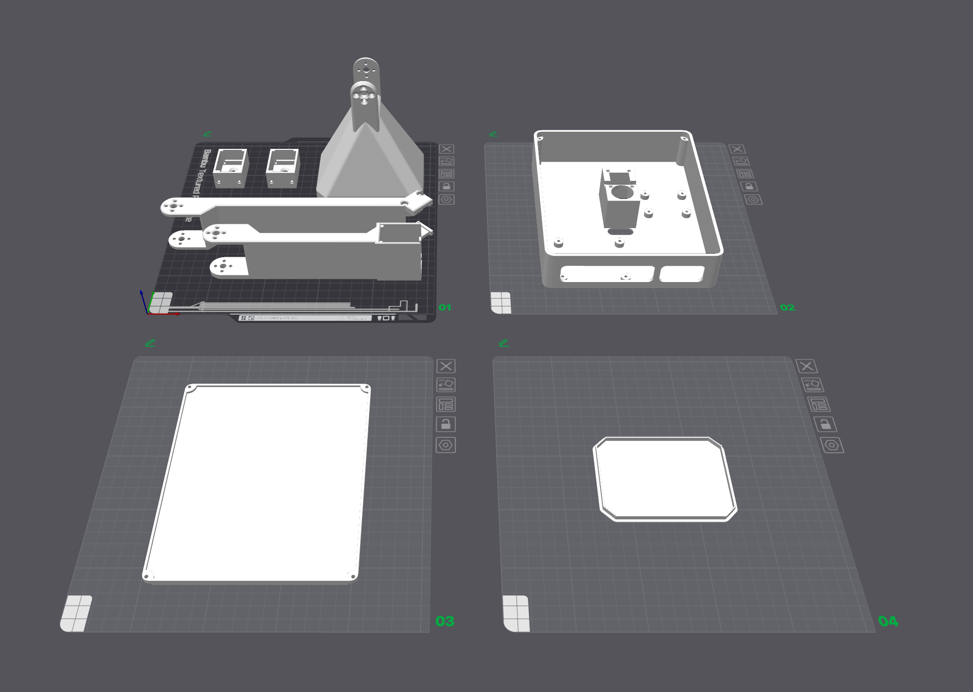
Backup: printable parts
Seven upstream parts, two replaced by ours
Our Shell and Cover replace LampBase and Cover. Arm, head, diffuser unchanged.
Print plate, LeLamp documentation (GPL-3.0)
22
Notes:
The print plate is an upstream LeLamp image. Replacement shell/cover designs are project-generated. Keep the original arm, head and diffuser attribution.
Sources: project handover 00_接手必读.md; 交接资料/当前状态与下一步.md; AILamp/output/motor_demo/离线验证报告_20260908.md; AILamp/docs/zh/五轴电机实验CLI.md; current motor_cli.py and services/motor_runtime.py. Preflight rerun 2026-09-09. The 327 test result is reported from 2026-09-08, not rerun for this deck.

