Slide 1

Blue Pulse– User Guide
Last Update: 6 April 2025

Slide 2
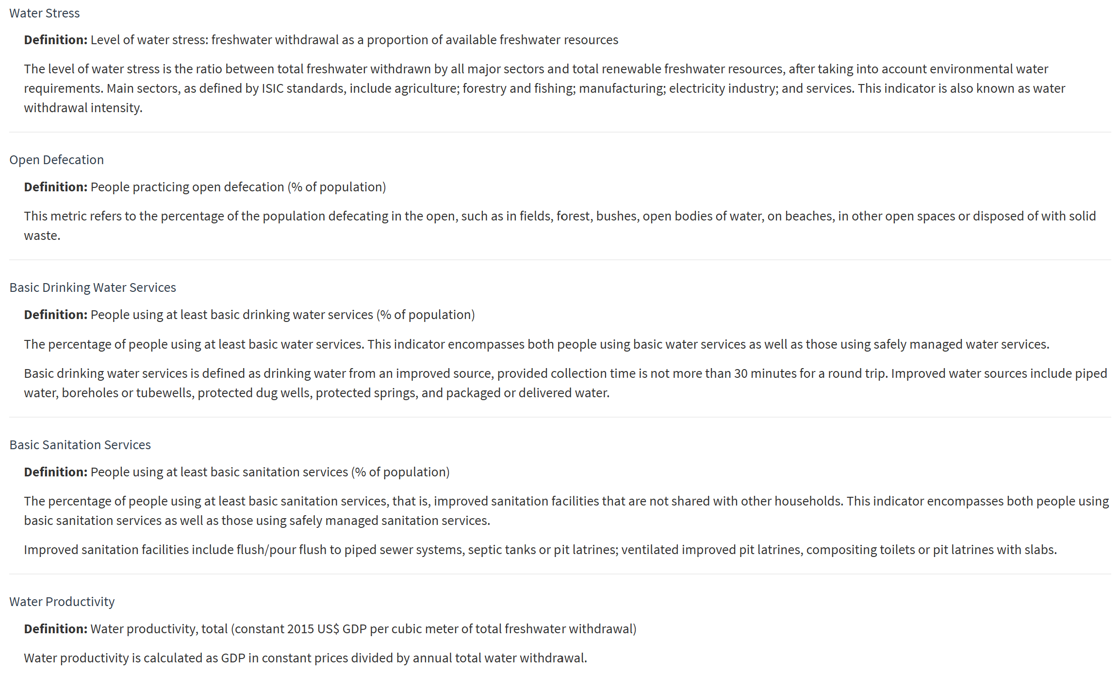
Water and Health Indicators Dictionary- Overview
Our Shiny app deals with environmental, health, or sustainability data.
The first part of dictionary allows users to get familiar with technical terms and indicators commonly used in the fields of water, sanitation, and health: water stress, open defecation, basic drinking water services, basic sanitation services, and water productivity.
The purposes of dictionary are:
Improve user understanding
Ensure consistent interpretation
Build trust and transparency
Enhances data literacy
Support decision-making
Improve usability

Slide 3
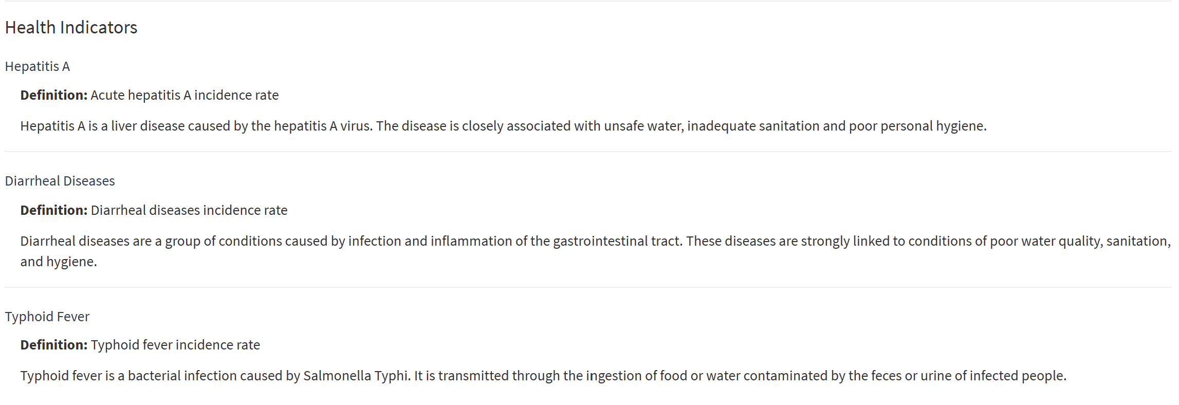
Water and Health Indicators Dictionary- Overview (cont’d)
Our Shiny app deals with environmental, health, or sustainability data.
The second part of dictionary allows users to get familiar with key health-related terms and disease indicators: Hepatitis A, Diarrheal Diseases, and Typhoid Fever.
The purposes of dictionary are:
Improve user understanding
Ensure consistent interpretation
Build trust and transparency
Enhances data literacy
Support decision-making
Improve usability

Slide 4
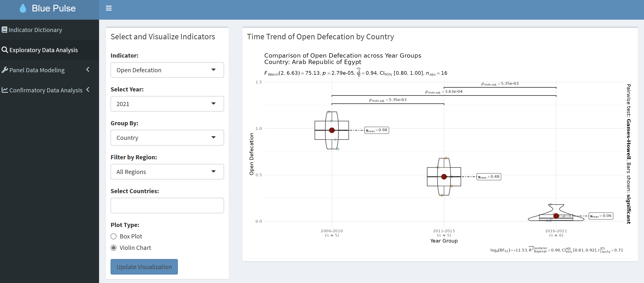


Exploratory Data Analysis (EDA) EDA allows users to interact with the data intuitively and visually explore trends and patterns, understand data distributions across water and health indicators using historical data from 2006 to 2021, covering 140 countries and seven global regions. This section helps users generate hypotheses and build a deeper understanding of the dataset before conducting more detailed or targeted analyses.
Options for water and disease indicators visualization. Users can specify the parameters to explore and compare water and health indicators.
Users can:
Specify a year (2006-2021)
Filter by region or country
Choose a region name if
"Region" is selected
d. Choose a country name if
"Country" is selected
Plot type: Users can
Select Boxplot to visualize
differences between regions
and country (highlights
median, quartiles, and outliers)
Select Violin Chart to visualize
the changes by region or
country using group data by
year ranges: 2006-2010, 2011-
2015, 2016-2021
a
b
c
d

Slide 5
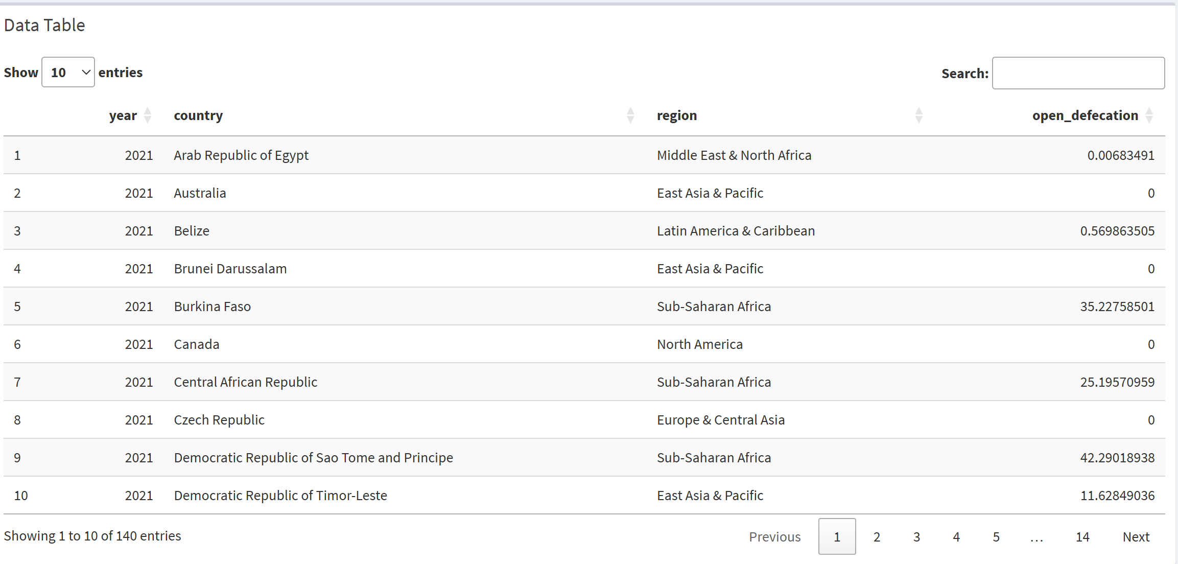

Exploratory Data Analysis (EDA) (cont’d) EDA allows users to interact with the data intuitively and visually explore trends and patterns, understand data distributions across water and health indicators using historical data from 2006 to 2021, covering 140 countries and seven global regions. This section helps users generate hypotheses and build a deeper understanding of the dataset before conducting more detailed or targeted analyses.
3) Data Table: Display detailed data for any country/ region based on the selected parameters from the chosen indicator.

Slide 6
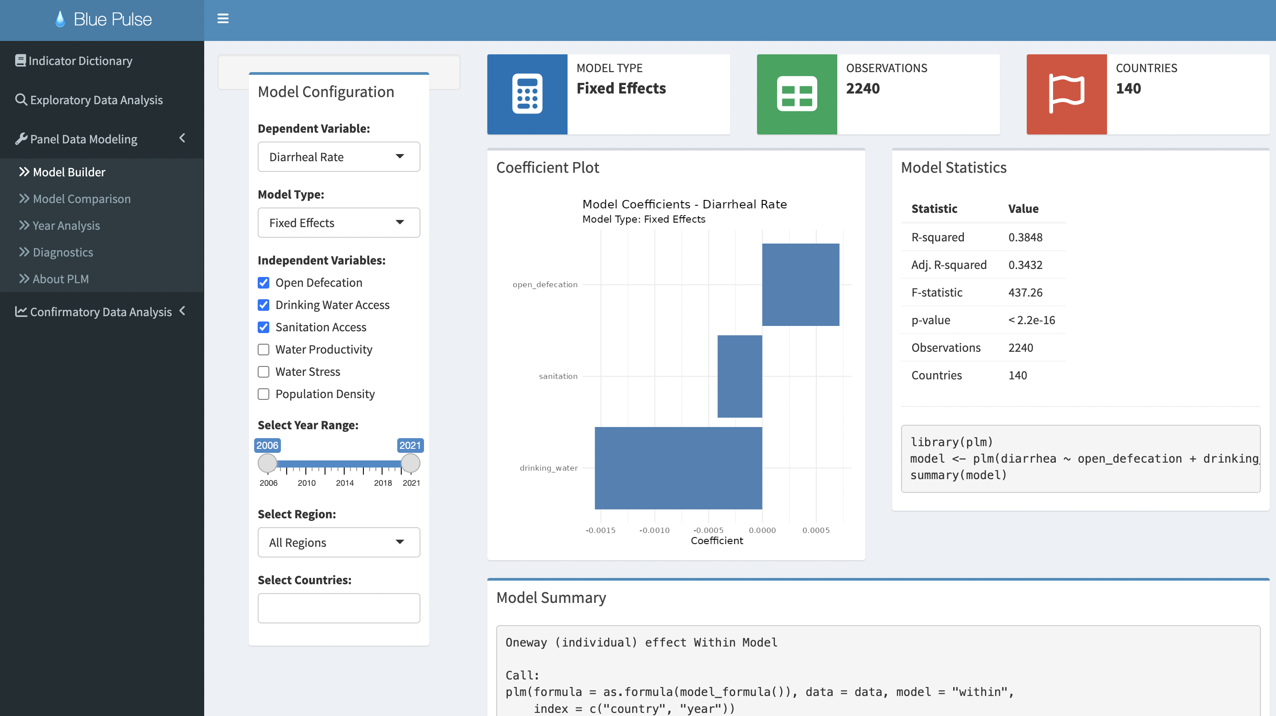



Panel Data Modeling- Model Builder This part allows users to analyze data that combines across-region and time-series. It provides more informative data, more variability, and more complex relationships than purely cross-sectional or time-series data. Users can select and build customized panel data models: Fixed Effects, Random Effects, Pooled OLS, Fixed effects with Time, and Dynamic panel. It provides users with flexibility to test various approaches.
1) Options for Model Settings.
User can:
Select one dependent variable: any one of disease indicators
Select one Model Type
Select multiple independent variables: water indicators
Select year range between 2006 and 2021
Select all regions/ any one region
User is not able to select country
2) Model Statistics: Help users evaluate the performance, significance, and appropriateness of the model.
3) Model Summary: Help users identify the water indictors have significant associations with the disease indicator.
a
b
c
d
e
f

Slide 7
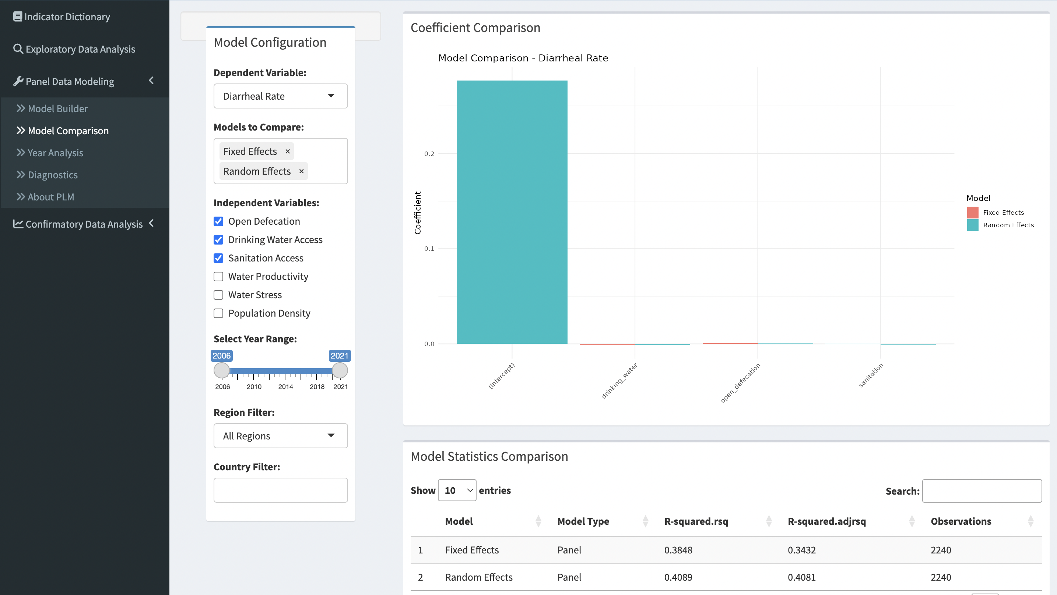
Panel Data Modeling- Model Comparison This part allows users to analyze data that combines across-region and time-series. It provides more informative data, more variability, and more complex relationships than purely cross-sectional or time-series data. It allows user to select multiple models to make side-by-side comparisons.
Options for Model Comparison.
User can:
Select one dependent variable: any one of disease indicator
Select multiple Model Types they wish to make comparison
Select multiple independent variables: water indicators
Select year range between 2006 and 2021
Select all regions/ any one region
User is not able to select country
2) Model statistics Comparison: Indicates how much variation in the dependent variable is explained by the model.
a
b
c
d
e
f

Slide 8
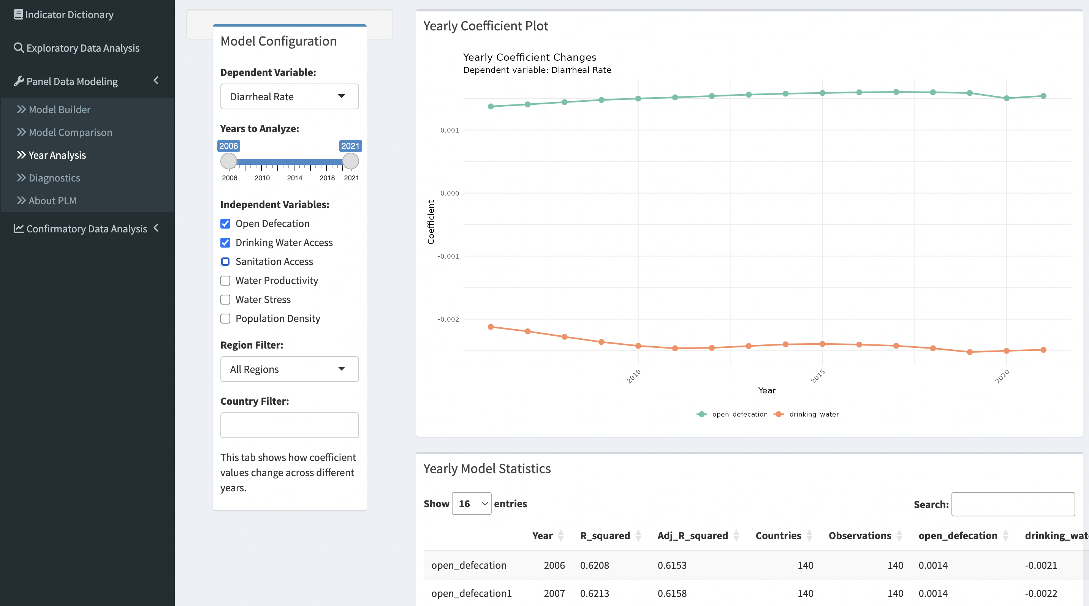
Panel Data Modeling- Year Analysis This part allows users to analyze data that combines across-region and time-series. It provides more informative data, more variability, and more complex relationships than purely cross-sectional or time-series data. It allows user to explore how independent variables change over time.
Options for Year Analysis for variables.
User can:
Select one dependent variable: any one of disease indicator
Select year range between 2006 and 2021
Select multiple independent variables: water indicators
Select all regions/ any one region
User is not able to select country
2) Yearly Model statistics:
Helps user to compare the effect of multiple water indicators on one disease indictor over time.
a
b
c
d
e

Slide 9
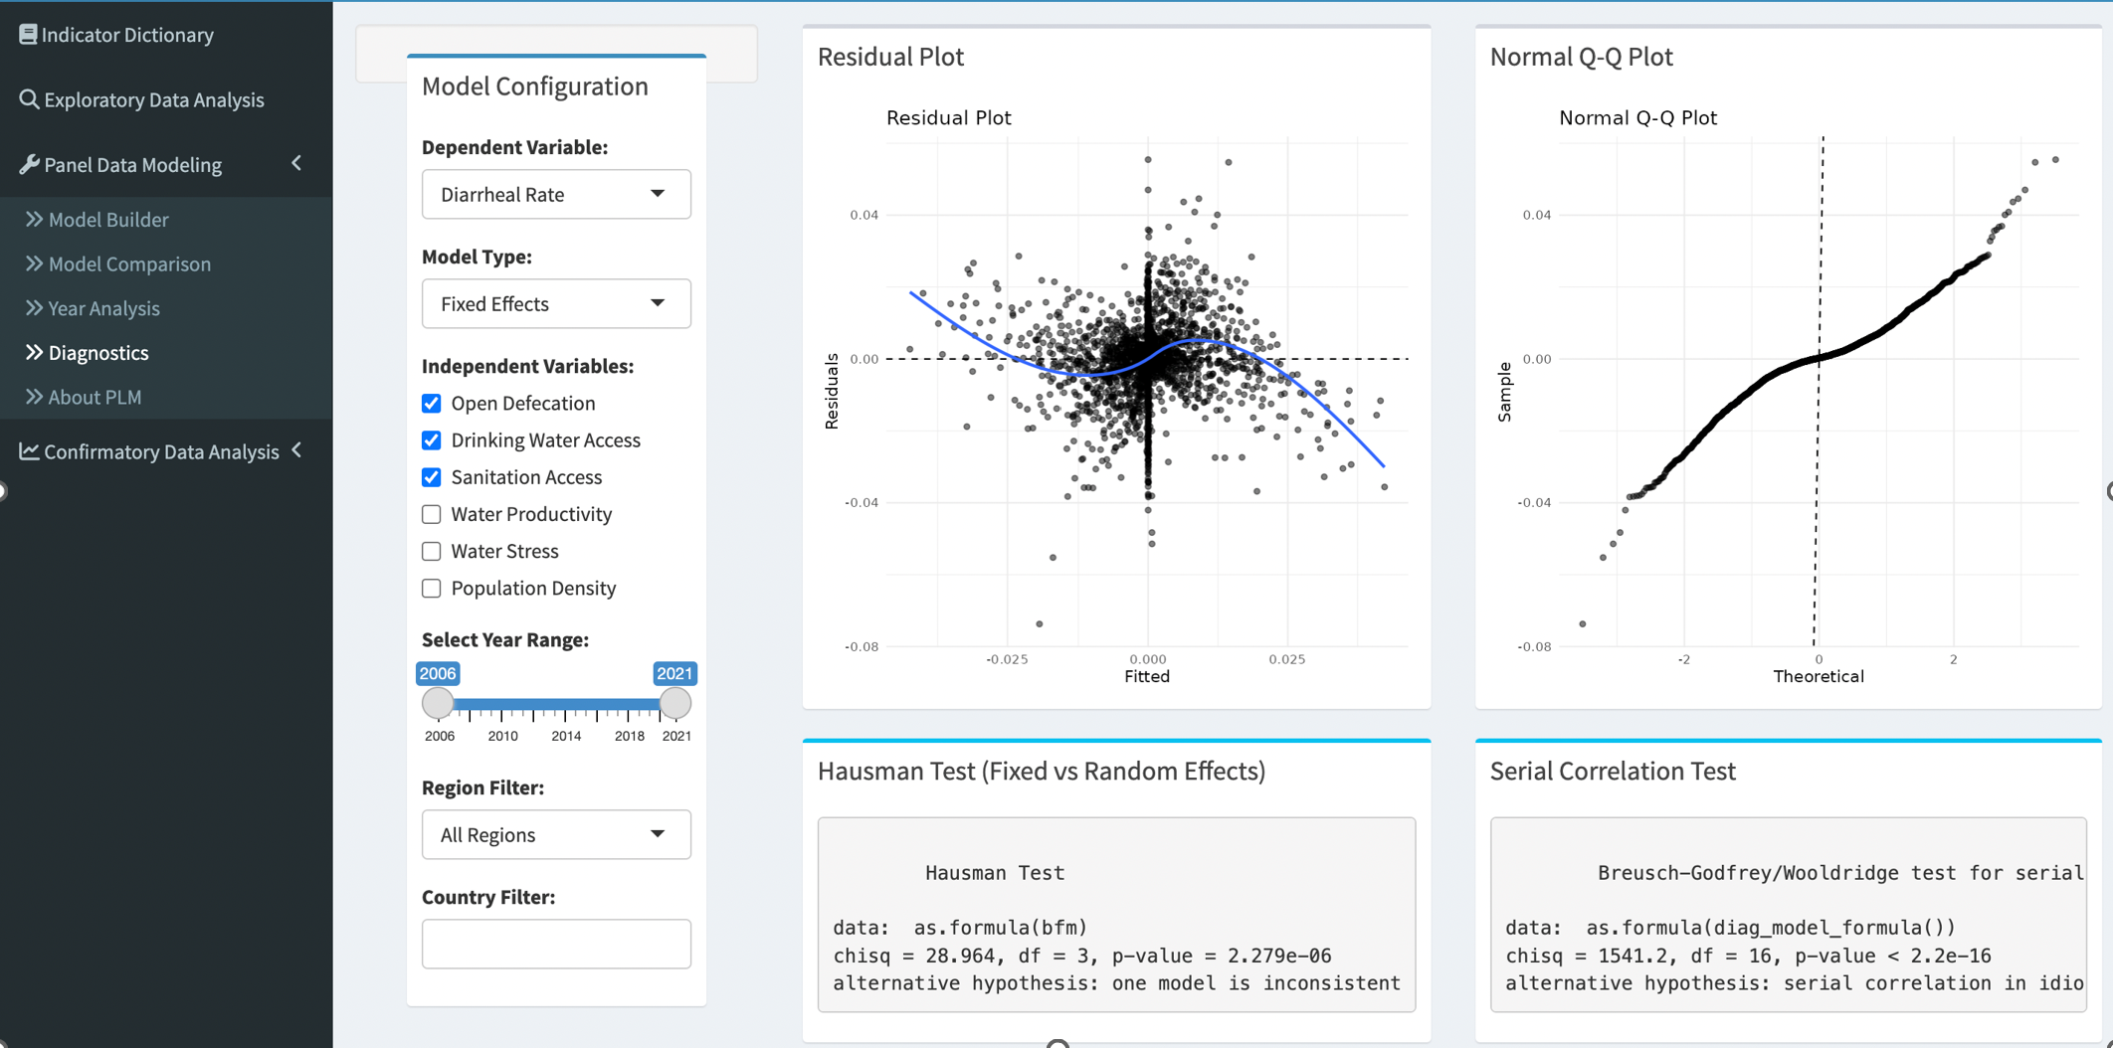
Panel Data Modeling- Diagnostics This part allows users to analyze data that combines across-region and time-series. It provides more informative data, more variability, and more complex relationships than purely cross-sectional or time-series data. Users can visually assess model assumptions such as linearity, homoscedasticity, and normality of residuals.
Options for Model Diagnostic plots
User can:
Select one dependent variable: any one of disease indicator
Select one Model Type
Select multiple independent variables: water indicators
Select year range between 2006 and 2021
Select all regions/ any one region
User is not able to select country
2) Hausman Test and Serial correlation Test: help users decide between model types and assess assumptions.
3) Residual Plot and Normal Q-Q Plot: Visually check the assumptions of models.
a
b
c
d
e
f

Slide 10
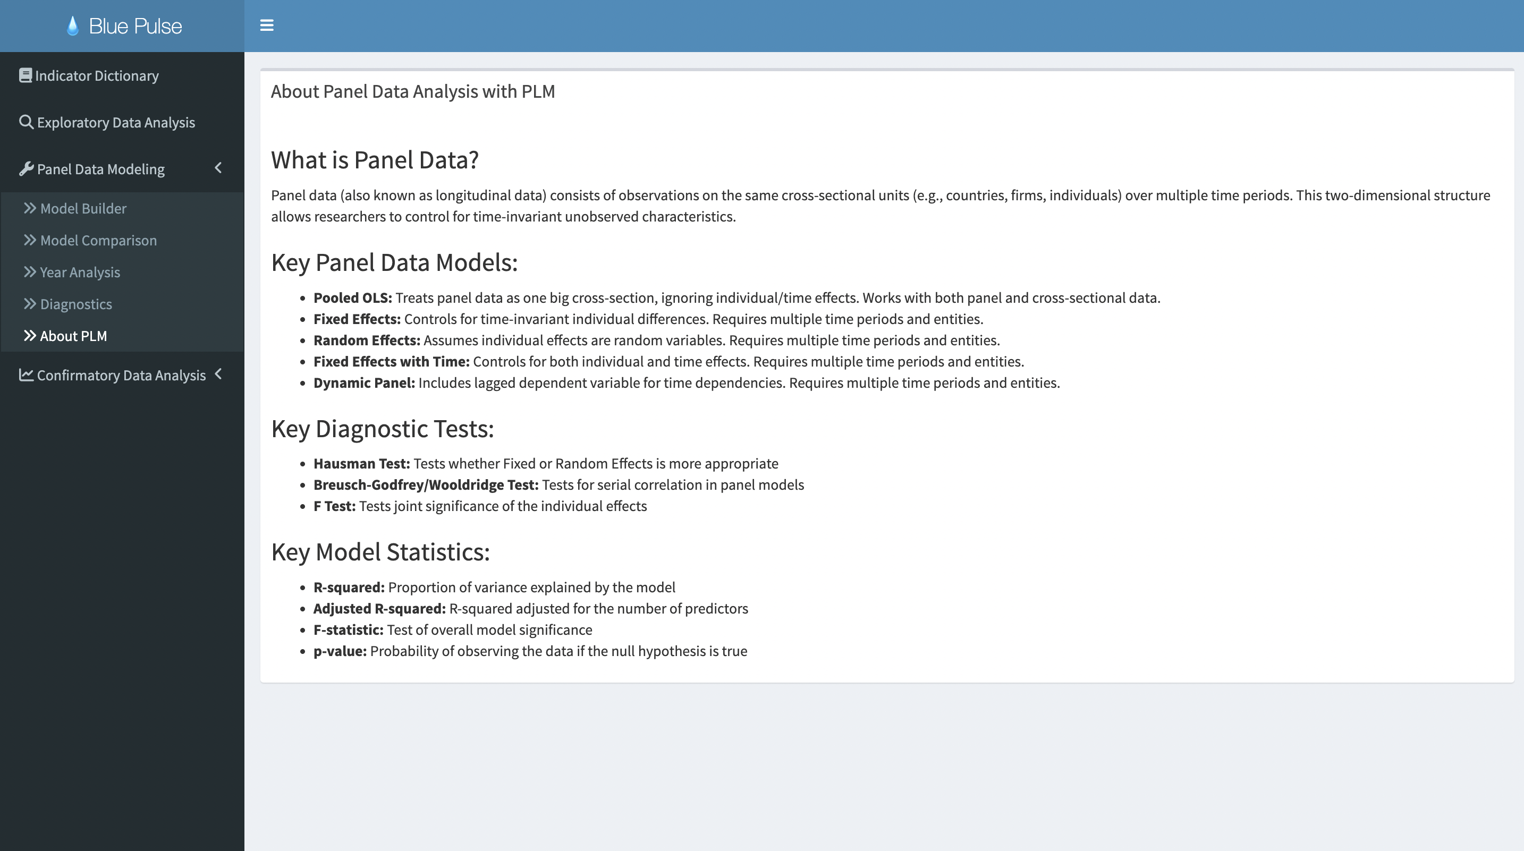
Panel Data Modeling- About Panel Data Analysis with PLM This part educates users on panel data, explains key concepts, guides users in model selection, and enhances App usability

Slide 11
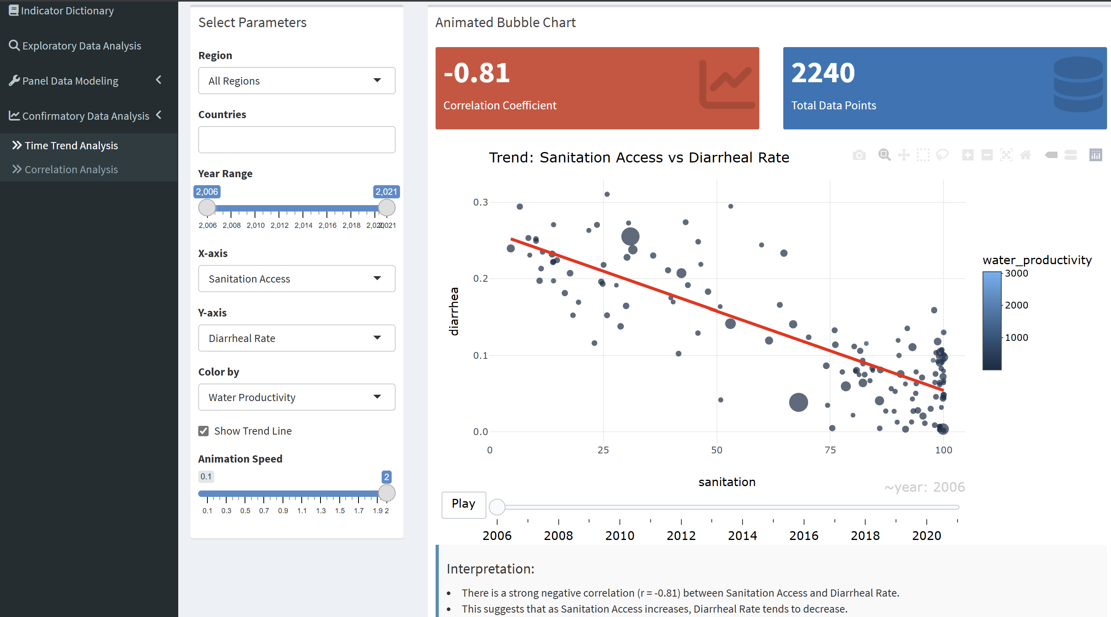

Confirmatory Data Analysis (CDA) – Time Trend Analysis
CDA will help you validate the assumptions or patterns observed in your Exploratory Data Analysis (EDA) and determine if there's a real relationship between water and health outcomes. Incorporating an Animated Bubble Chart for Time Trend Analysis is a great way to visualize the relationship over time between water indicators and health indicators
Options to plot animated bubble chart over time.
Users can:
a. Specify region (all regions or any one region)
b. Specify country
c. Choose a year range between 2006 to 2021
d. Choose one of water indicators as x-axis
e. Choose one of disease indicators as y-axis
f. Visualize a third indicator using color in a chart
2) Animation Speed: Users can adjust animation speed to control how long each frame of the animation is displayed
3) Trend Line: Users can select the check box to display trend line based on the selected parameters
4) Chart Interpretation: users can get a brief explanation on how to interpret the correlation value and what the details on the chart mean
a
b
c
d
e
f

Slide 12
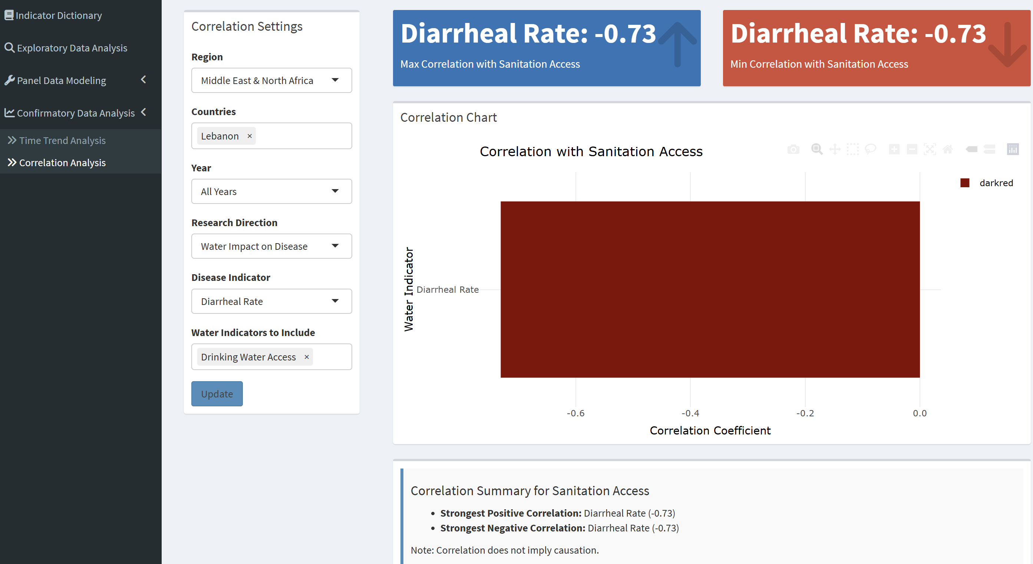
Confirmatory Data Analysis (CDA) – Correlation Analysis
CDA will help you validate the assumptions or patterns observed in your Exploratory Data Analysis (EDA) and determine if there's a real relationship between water and health outcomes. This part helps user to distinguish between the directions of the relationships
Options to plot animated bubble chart over time.
Users can:
a. Specify region (all regions or any one region)
b. Specify country
c. Choose a year between 2006 to 2021 when selecting region and choose “all years” when selecting country
d. Correlation Setting: Causal Hypothesis V.S Reverse Causality Hypothesis
e. Choose one of disease indicators
f. Choose one of water indicators
2) Chart Interpretation: users can get exact value of positive correlation and negative correlation.
Positive correlation suggests that both variables move in the same direction
Negative correlation suggests that one variable increases while the other decreases
a
b
c
d
e
f

