Slide 1
CampusSafe Sprint 2
Jasmine Hurt, Joe Bucholz, Sean Duffy, Doc Manuel Jose

Slide 2
CampusSafe
CampusSafe is a mobile app, designed to enhance safety on university campuses by providing real-time alerts and emergency communication tools
Main Features:
Report Incidents
Receive Notification
Access Safety Resources
Browse Previous Reports
Sprint 2 Objectives:
Frontend
Incident Report Screen
User Profile Screen
Settings Screen - Opt in/out Notifications
Navigation between screens
Logout
Backend
Send Notifications
Incident Report API

Slide 3
Sprint Backlog Overview

Slide 4
Kanban Board Walkthrough

Slide 5
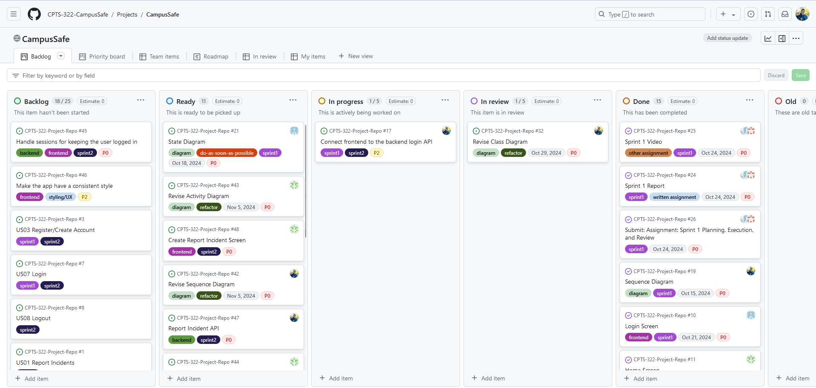
Kanban Board at the start of Sprint 2

Slide 6
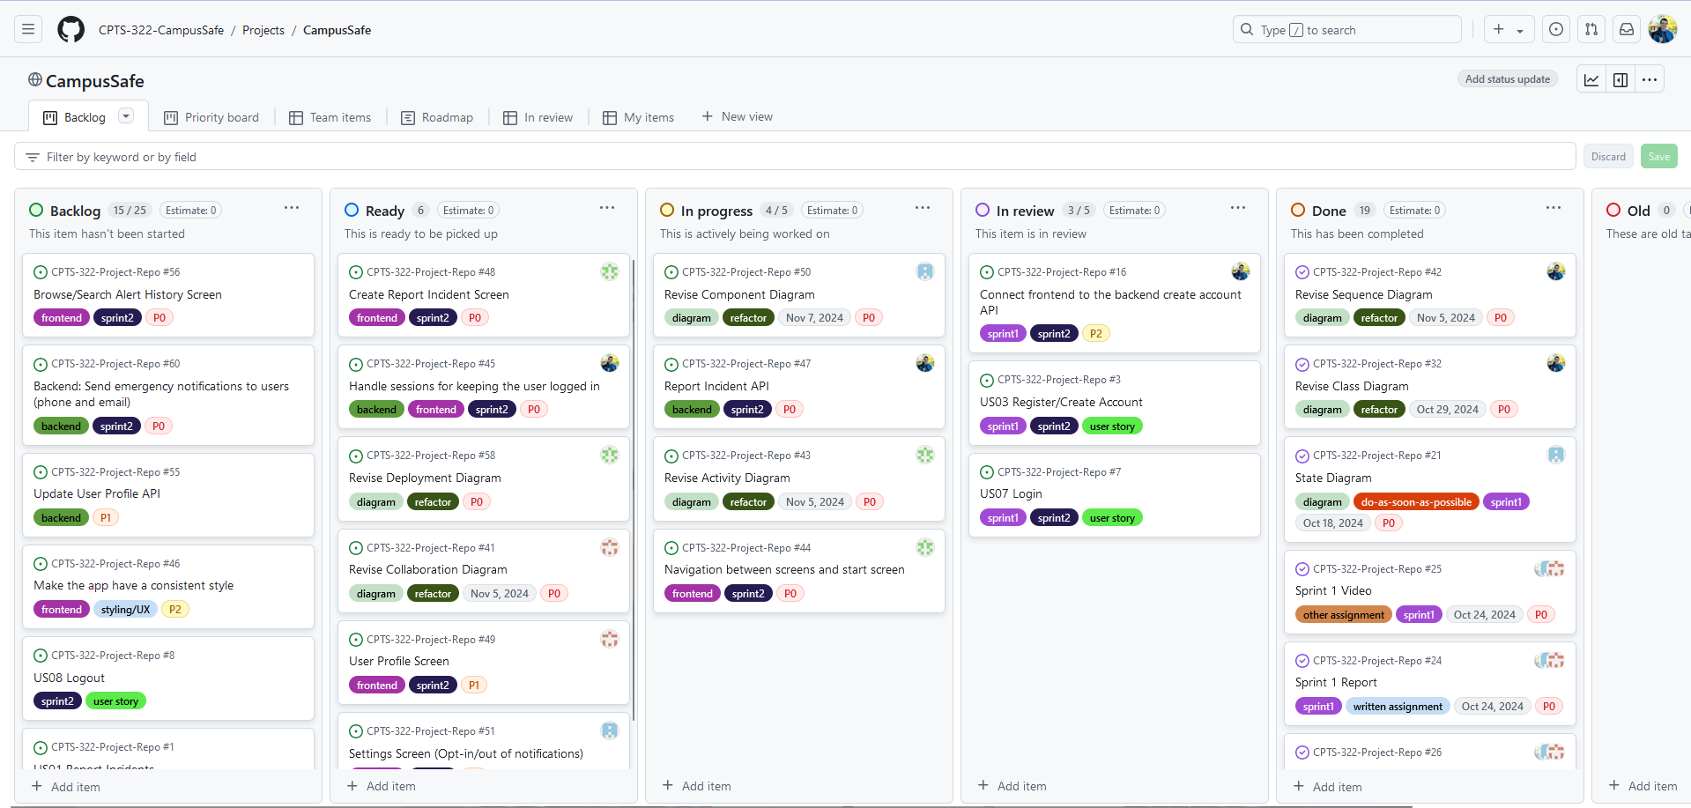
Almost done with login system

Slide 7
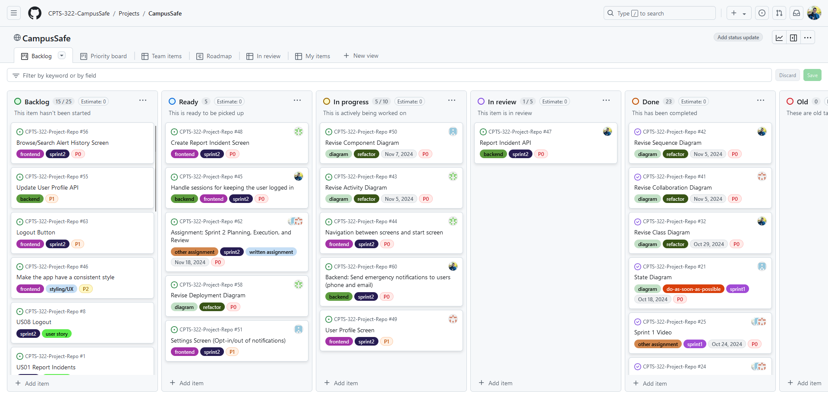
Working on new features

Slide 8
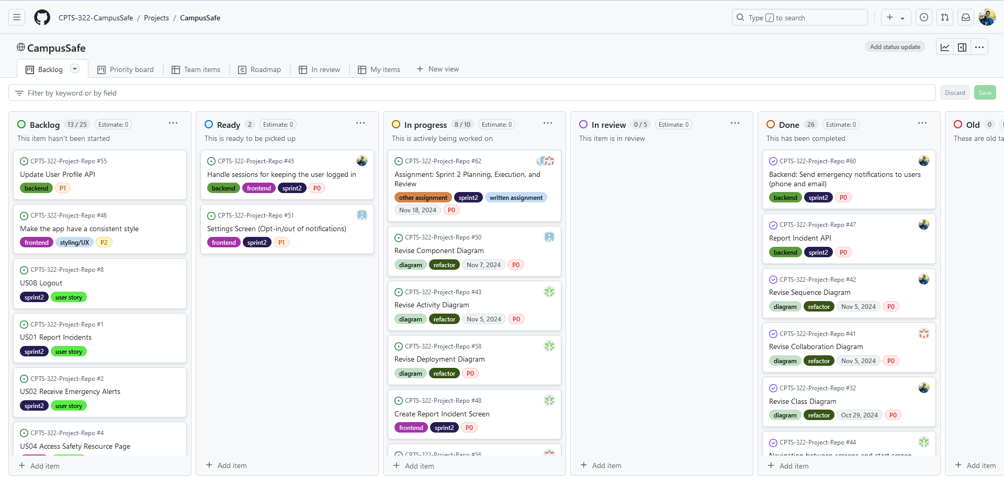
Almost done with Sprint 2

Slide 9
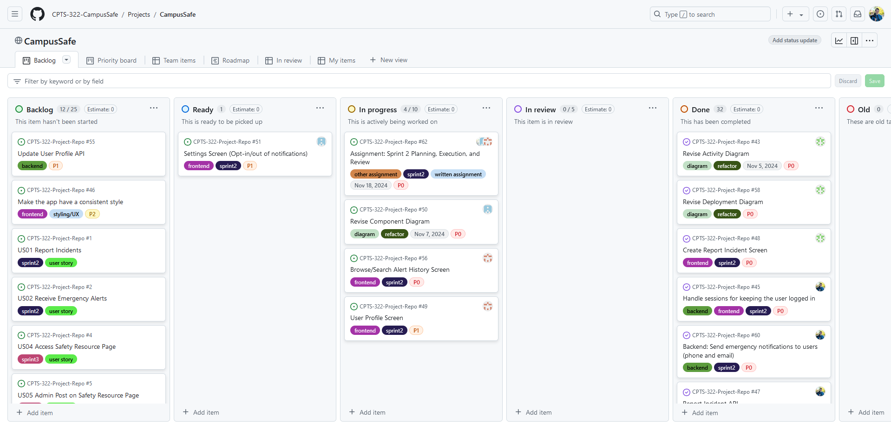
Sprint Finished

Slide 10
Feature Demonstrations

Slide 11
Sprint Review

Slide 12
Retrospective Summary
What Went Well:
Everyone completed the task they were assigned
More experienced team member was able to help us learn the tools we used
We were organized
What Did Not go Well:
Each member only completed one task
Improvements:
Complete more tasks in order to make more substantial progress on our project.
Update KanBan board more frequently and improve communication

Slide 13
Conclusion
Sprint 1 was overall successful
Learned a lot about the tools we are using
Going into sprint 2 we are much more prepared

