Slide 1
CampusSafe Sprint 1
Jasmine Hurt, Joe Bucholz, Sean Duffy, Doc Manuel Jose

Slide 2
CampusSafe
CampusSafe is a mobile app, designed to enhance safety on university campuses by providing real-time alerts and emergency communication tools
Main Features:
Report Incidents
Receive Notification
Access Safety Resources
Browse Previous Reports
Sprint 1 Objectives:
Frontend
Login Screen
Register Screen
Home Screen
Backend
User Database
Login API

Slide 3
Sprint Backlog Overview

Slide 4
Kanban Board Walkthrough

Slide 5
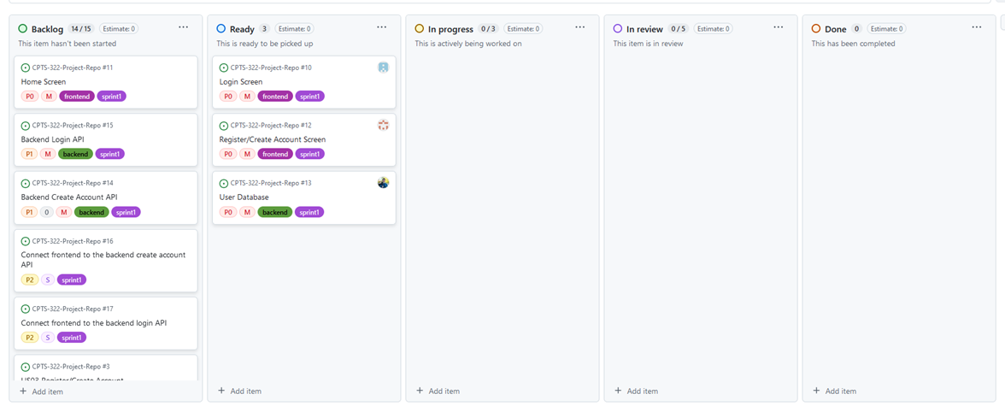
Kanban Board at the start of Sprint 1

Slide 6
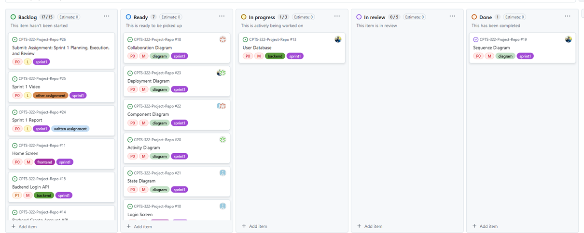
Diagrams Added

Slide 7
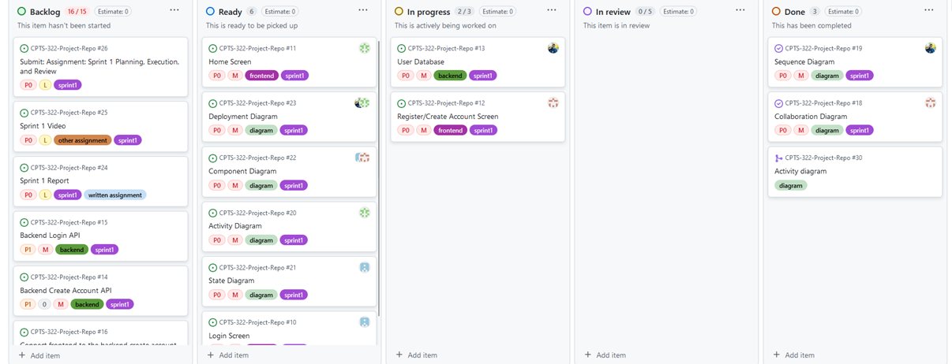
More Development

Slide 8
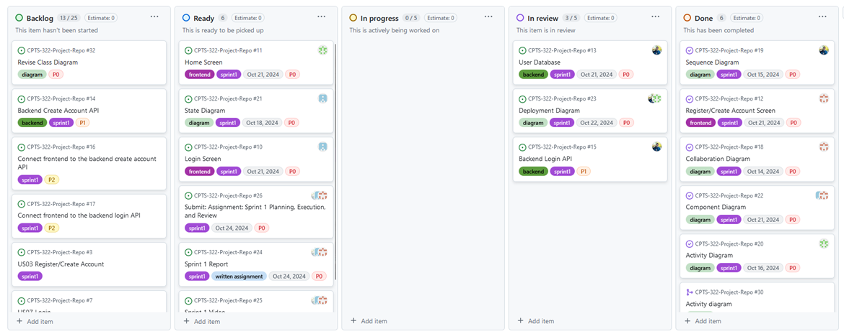
Sprint Almost Done

Slide 9
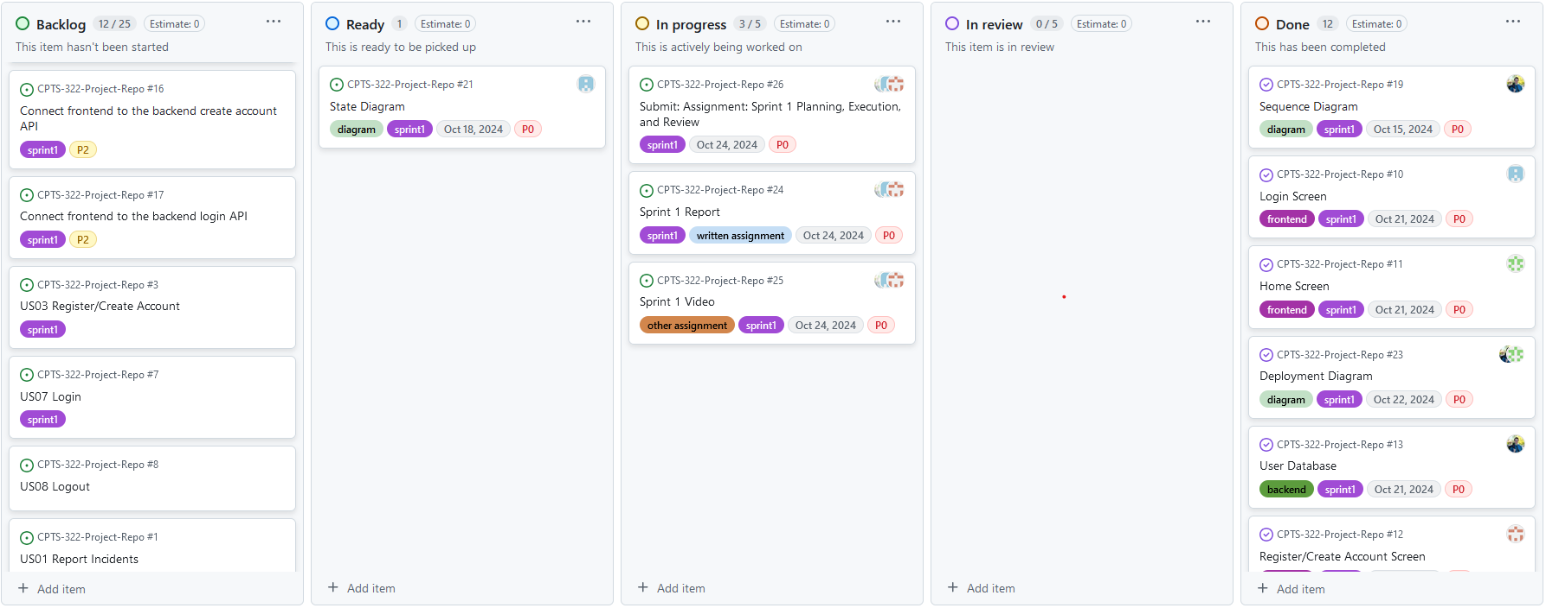
Sprint Finished

Slide 10
Feature Demonstrations

Slide 11
Sprint Review

Slide 12
Retrospective Summary
What Went Well:
Everyone completed the task they were assigned
More experienced team member was able to help us learn the tools we used
We were organized
What Did Not go Well:
Each member only completed one task
Improvements:
Complete more tasks in order to make more substantial progress on our project.
Update KanBan board more frequently and improve communication

Slide 13
Conclusion
Sprint 1 was overall successful
Learned a lot about the tools we are using
Going into sprint 2 we are much more prepared

