Slide 1

Deployment of interdependent services in a Docker infrastructure
Notes:
Hi everyone, and thanks for your attention
This presentation is about the deployement of interpedent services in a Docker infrastructure
Docker in a new way to manage contenairs, a bit different from LXC.
You will learn it through this presention.
We hope you will enjoy

Slide 2
Presentation plan
Presentation and goals of our project
What is docker
What we did with Docker
Technical presentation
Conclusion
Notes:
This how the presentation will take place
1 first we will quicly present our project and the goals
2 Then we will explain what docker is , what the needs he cover
3 After that we will show you what we set up
We will describe how we did it , how it function
4 At the end we will make a short technical demonstration , to show you how using docker could look like (with the docker's integrated tools)

Slide 3
The team
Mathieu KERN
Simon fesnien
Florent Fillion
Tutor : Emmanuel JEANVOINE, Engineer at INRIA
Notes:
Our Team is composed of three persons :
And we are supervized by our tutor, who are Emmanuelle Jeanvoine. He is engineer at INRIA (National recherche institut in Information technology and automation

Slide 4
The goals
Study Docker utilization
Deploying interdependent services using contenairs
Principles and use of contenairs
Notes:
Our project have multiple goals :
*The first is to take in hand docker and the manipulation of contenairs
*Then we can manage to deploy interdependent services in contenairs in order to make a complete infrastructure

Slide 5
The tools
Obviously GNU/Linux (Debian in our case)
Docker : lib contenair and Docker software
Linux kernel integrated networks tools
A little ruby for automatization
A keyboard

Slide 6

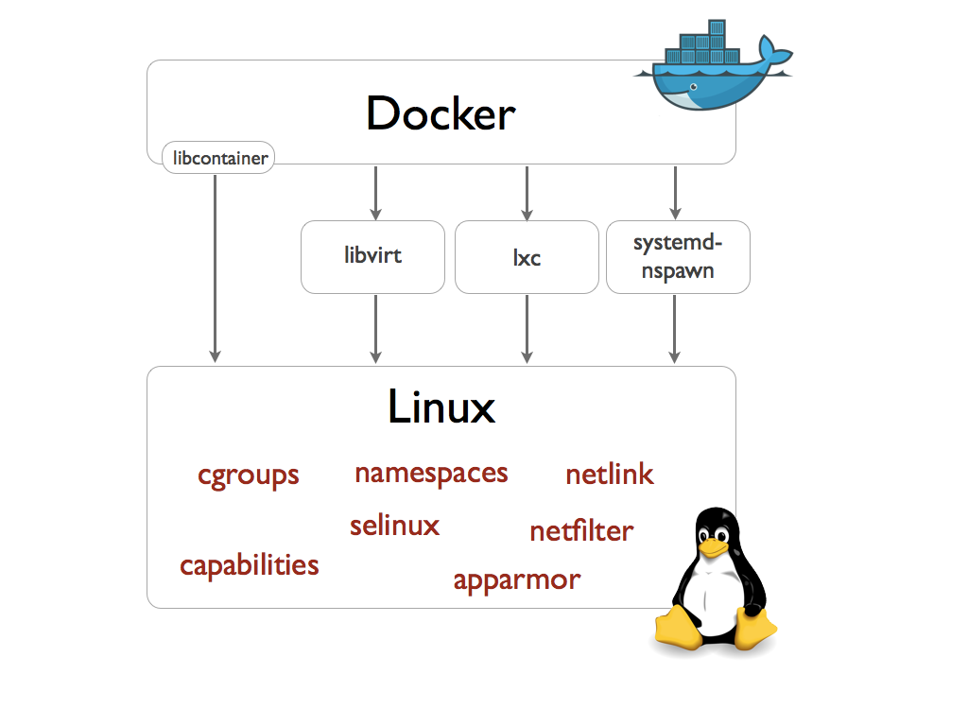
What is docker

