Slide 1

Deployment of interdependent services in a Docker infrastructure
Notes:
Hi everyone, and thanks for your attention
This presentation is about the deployement of interpedent services in a Docker infrastructure
Docker in a new way to manage contenairs, a bit different from LXC.
You will learn it through this presention.
We hope you will enjoy

Slide 2
Group members
Mathieu Kern
Simon Fesnien
Florent Fillion
Tutor : Emmanuel Jeanvoine, Engineer at INRIA
Notes:
Our group is composed of three persons :
…
And we are supervized by our tutor Emmanuelle Jeanvoine who is engineer at INRIA, a search laboratory.

Slide 3
Summary
Presentation and objectives of our project
What is docker
What we did with Docker
Technical demonstration
Conclusion
Notes:
This presentation is divided into 5 parts :
Firstly we will quicly present our project and the objectives.
Then we will explain what is docker and what the needs that it cover.
After that, we will show you what we set up. So we will describe how we did it and how it works.
At the end we will make a short technical demonstration, to show you how using docker could look like (with the docker's integrated tools)

Slide 4
The goals
Study Docker utilization
Deploying interdependent services using containers
Principles and use of contenairs
Notes:
Our project have several objectives :
- The first objective is to take in hand docker and the containers manipulation.
- Then, after studying how docker works, we can deploy interdependent services in containers, in order to make a complete infrastructure (at least something which is a reduced model of an infrastructure).
- The advantage and limits of containers : when it can be useful, and when it useless and the gain is not significant.

Slide 5
The tools
Obviously GNU/Linux (Debian in our case)
Docker : lib container and Docker software
Linux kernel integrated networks tools
A little ruby for automatization
A keyboard

Slide 6

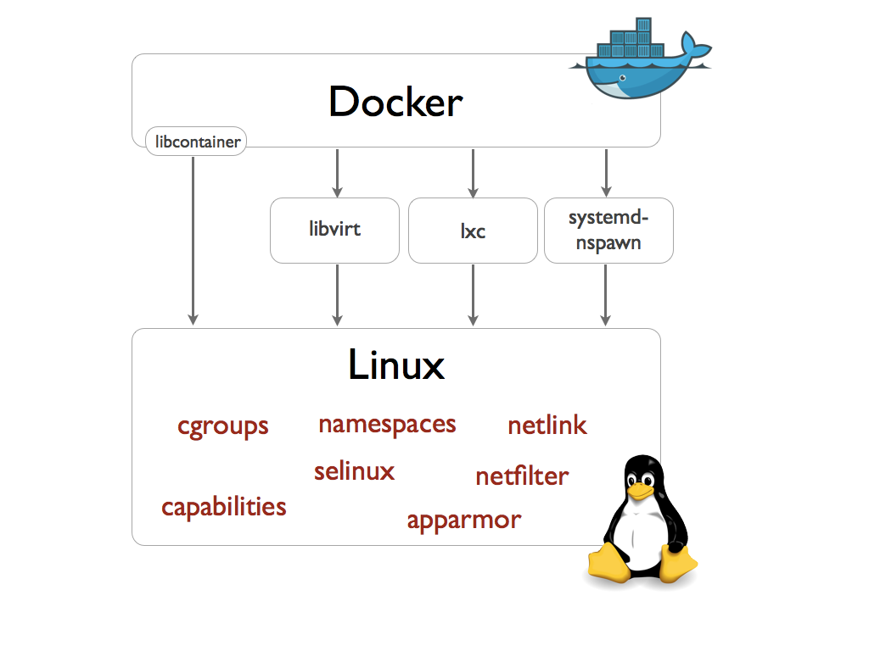
What is docker

Slide 7
What we did
Build docker images
Deploying services into contenairs
Make them communicate on the same host
Make them communicate on multiple host
Trying to automate it using ruby
and Net::SSH

Slide 8
Building images
#Apache2 auto install
#+
#owncloud 7
#image de base
FROM projet_tutore:wheezy
MAINTAINER Mathieu KERN "asrall"
#Evite les messgaes d'erreur de debconf
ENV DEBIAN_FRONTEND noninteractive
#Installation d'apache2 et les dépendances pour owncloud
RUN apt-get update ; apt-get upgrade -y; apt-get install -y apache2 php5 php5-cli php5-mcrypt php5-curl php5-pgsql php5-gd php5-json php5-intl php5-imagick openssh-server wget bzip2
+ENV APACHE_RUN_USER www-data
+ENV APACHE_RUN_GROUP www-data
+ENV APACHE_LOG_DIR /var/web/log/apache2
+ENV APACHE_PID_FILE /var/run/apache2.pid
+ENV APACHE_RUN_DIR /var/run/apache2
+ENV APACHE_LOCK_DIR /var/lock/apache2
+ENV APACHE_SERVERADMIN admin@localhost
+ENV APACHE_SERVERNAME localhost
+ENV APACHE_SERVERALIAS docker.localhost
+ENV APACHE_DOCUMENTROOT /var/www
#Telechargement de owncloud 7
RUN cd /var/www
RUN wget https://download.owncloud.org/community/owncloud-7.0.4.tar.bz2
RUN mv owncloud-7.0.4.tar.bz2 /var/www/
RUN cd /var/www && tar -xjvf owncloud-7.0.4.tar.bz2
RUN chown www-data.www-data /var/www -R
RUN a2ensite default-ssl
#ssl pour owncloud
ADD htaccess /var/owncloud/.htaccess
EXPOSE 80 443
Notes:
Multiples directives read one after another
It build the images
From > depositories where to retrieve the image
ENV > Environnement variable (accessing through session or system)

Slide 9
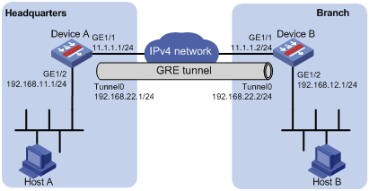
Interconnexion of contenairs
Notes:
Easy on the same host
A bit tricky on more
GRE=Generic Routing Encapsulation protocol
Communicate on the same netswork as other > bt can not be seen and can't seen others
Easy to set up
Complicated to manage w/ more than 2host (routing)

Slide 10
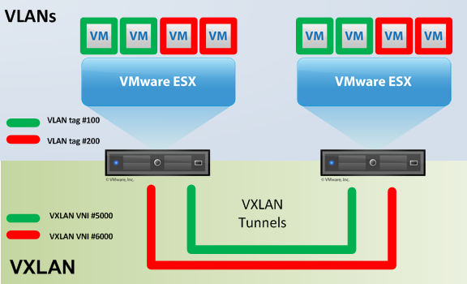
Multiple hosts
Notes:
Encapsulation protocol
Tag frames with vlan number
Up to 16 million logical networks
Only 4000 for VLAN

Slide 11
Automatic deployement with ruby
Net::SSH GEM
How the script work :
  * Ask Ip of the host where to deploy contenairs
  *Automitacally configuring virtual network interfaces to wok with vxlan

Slide 12
Thanks for listening us
Don't hesitate if you have any questions

