Slide 1
CapsVoxGAN
Franz Papst

Slide 2
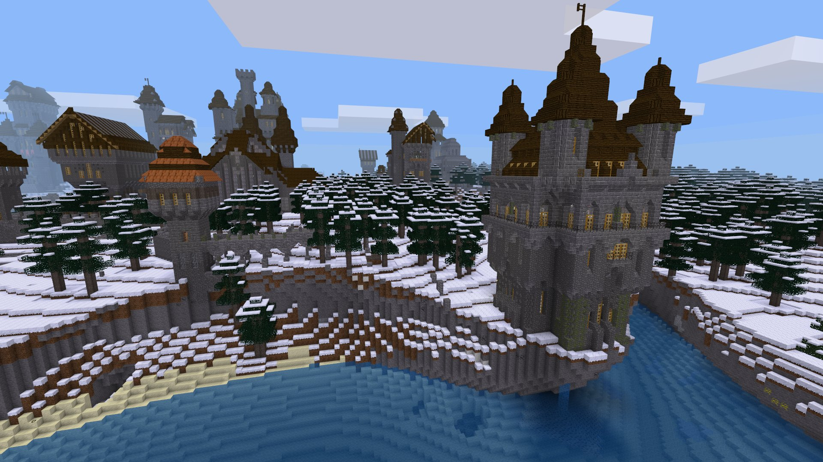
CapsVoxGAN
GAN
for Voxel Models
using a capsule network
https://www.minetest.net/media/gallery/3.jpg

Slide 3
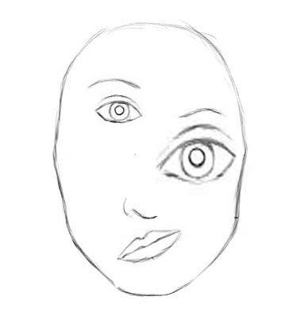
Capsule Network
new approach for a neural network
“tackling drawbacks of CNNs”
first introduced by Geoffrey Hinton
  due to his dissatisfaction with max pooling
operates on vectors instead of scalars
https://towardsdatascience.com/capsule-networks-the-new-deep-learning-network-bd917e6818e8

Slide 4
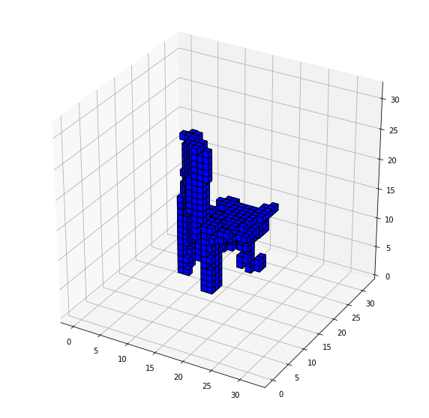
Results
voxel GAN works
…. capsule network does not
  it took Hinton himself 6 years to come up with
  an implementation
  3D machine learning is a challenging task
system deployed
  desktop application (using Qt)
  web application (using Flask + Docker)

Slide 5
References
Code
  https://github.com/CPUFronz/CapsVoxGAN
First introduction
  G. E. Hinton, A. Krizhevsky, and S. D. Wang, ‘Transforming Auto-Encoders’, in Artificial Neural Networks and Machine Learning – ICANN 2011, pp. 44–51, doi: 10.1007/978-3-642-21735-7_6.
First implementation
  S. Sabour, N. Frosst, and G. E. Hinton, ‘Dynamic Routing Between Capsules’, in Advances in Neural Information Processing Systems 30, 2017, pp. 3856–3866. https://papers.nips.cc/paper/6975-dynamic-routing-between-capsules
General Introductions
  https://towardsdatascience.com/capsule-networks-the-new-deep-learning-network-bd917e6818e8
  https://medium.com/ai%C2%B3-theory-practice-business/understanding-hintons-capsule-networks-part-i-intuition-b4b559d1159b
Videos
  Aurélien Géron: https://www.youtube.com/watch?v=pPN8d0E3900
  Sara Sabour: https://www.youtube.com/watch?v=zRg3IuxaJ6I
  Siraj Raval also has a video on this topic … if you dare watching it

