Slide 1

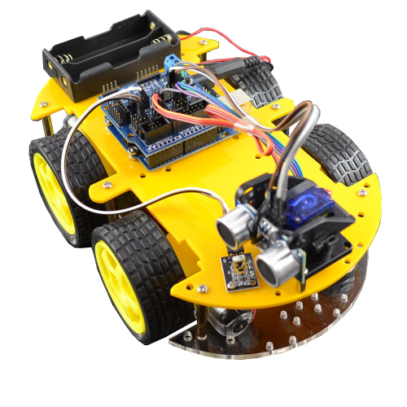
A Web Enabled Robot

Slide 2
Hardware
Raspberry Pi
Raspberry Pi Camera
LD293 PWM Chip
MAX98306 Amplifier Chip
5V and 6V voltage regulators
Motors and 11.1V Battery

Slide 3
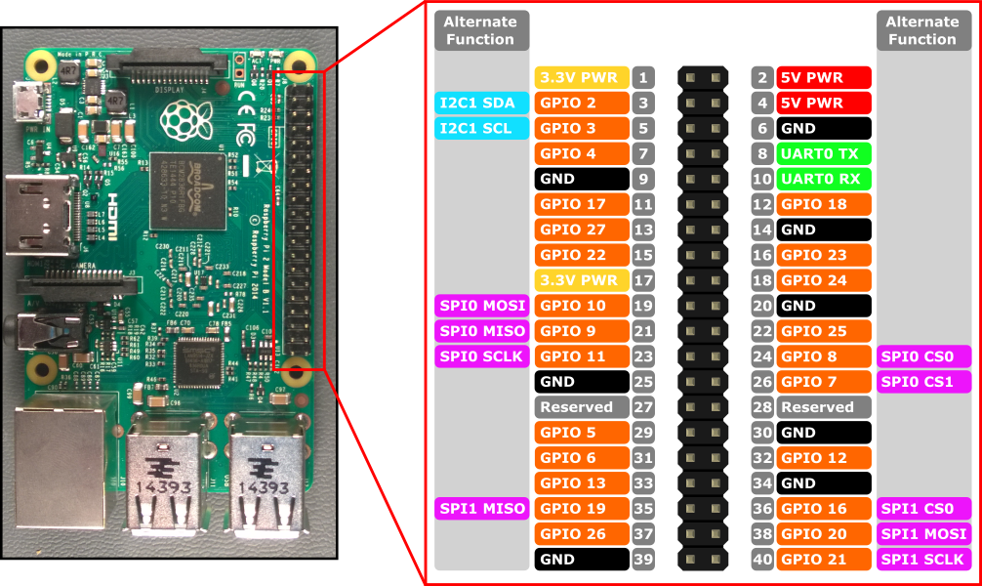
Raspberry Pi

Slide 4
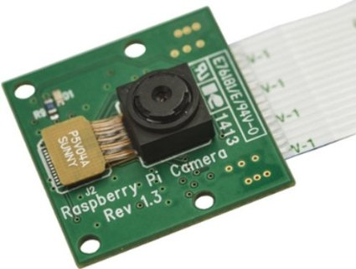
Raspberry Pi Camera

Slide 5
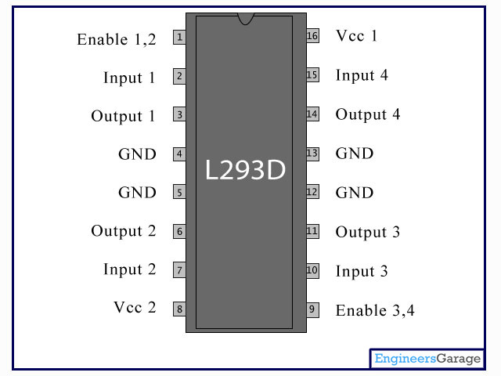
L293D PWM Chip

Slide 6
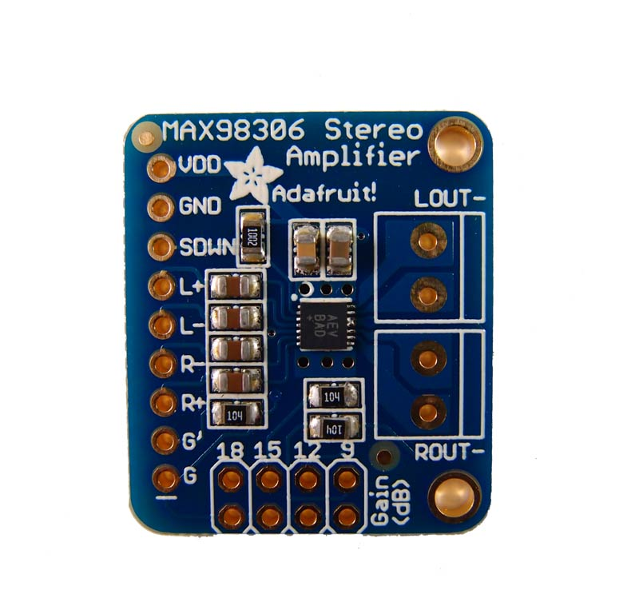
MAX98306 Amplifier Chip

Slide 7
Raspberry Pi Software
Python
BaseHTTPServer
Pymongo
Netifaces
Pygame
RPI GPIO Library
RPi-Cam-Web-Interface

Slide 8
Python
BaseHTTPServer
GET - Video Stream from Camera
POST - Action Requests (Movement, Horn)
Netifaces & Pymongo
Get IP address and store into database
Pygame
Allows async audio playback

Slide 9
Python
RPI-GPIO Library
Class control to GPIO on Raspberry Pi
Allows software PWM
RPi-Cam-Web Interface
Override ~45 FPS still images in a directory

Slide 10
Application Software
Node/Express
Mongoose
bCrypt
Axios
React & React-Router
React-Bootstrap

Slide 11
Node/Express
MVC Design
Model
User
View
React
Controller
User
Robot
Routes used for API and Root Directory

Slide 12
Mongoose/bCrypt/Axios
Mongoose
Create/Read user data
Add/Remove Raspi-Bots
bCrypt
Encrypt user password in database
Axios
Allows HTTP requests from React

Slide 13
React/React-Router/Bootstrap
HashHistory for Routing
Bootstrap used for styling
Components
Main
Home, About, Contact, Dashboard, Controls
3 Utility Function Files
BotHelper, ContactHelper, UserHelper

Slide 14
Thank you!

