Slide 1
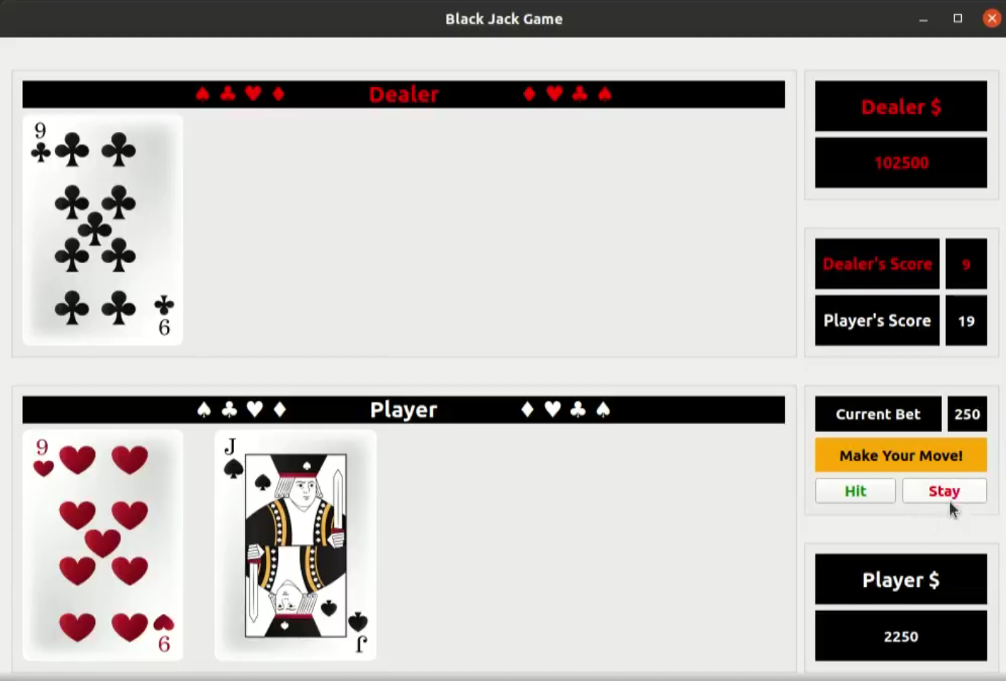
(3) Instances of class Card owned by “Dealer_” CardsField instance
(1) Instance of class Window
(2) Instances of class CardsField
(4) Instances of class Card owned by “Player_” CardsField instance

Slide 2
QGridLayout *GameGrid_
QGroupBox *DealersFundPrompt_
QLabel *ParticipantCards_[0] Owned by Dealer_
QLabel *ParticipantCards_[1] Owned by Dealer_
QLabel *ParticipantCards_[2] Owned by Dealer_
QLabel *ParticipantCards_[3] Owned by Dealer_
QGroupBox *DealersCardPrompt_
QGroupBox *ScoreBoardPrompt_
QGroupBox *HitNStayPrompt_
Here, we will have *FirstBetPrompt_ and *MessageBoxPrompt_ as well
QLabel *ParticipantCards_[0] Owned by Player_
QLabel *ParticipantCards_[1] Owned by Player_
QLabel *ParticipantCards_[2] Owned by Player_
QLabel *ParticipantCards_[3] Owned by Player_
QGroupBox *PlayersCardPrompt_
QGroupBox *PlayersFundPrompt_

Slide 3
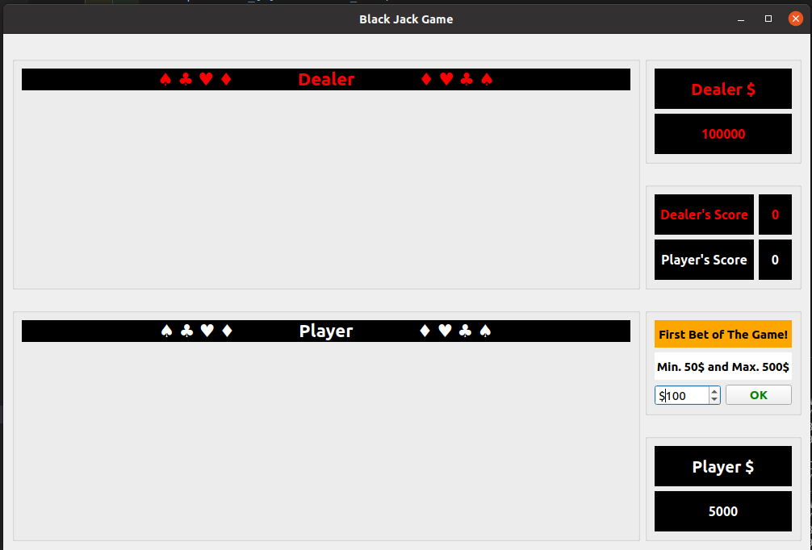
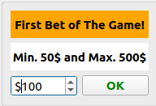

Slide 4
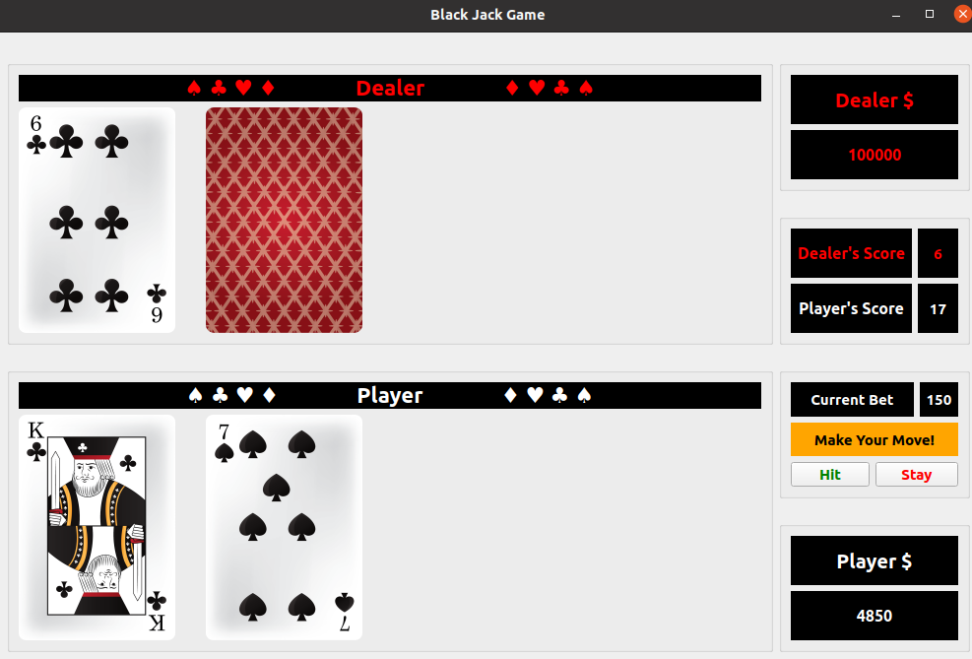
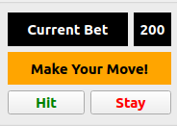

Slide 5
