Slide 1
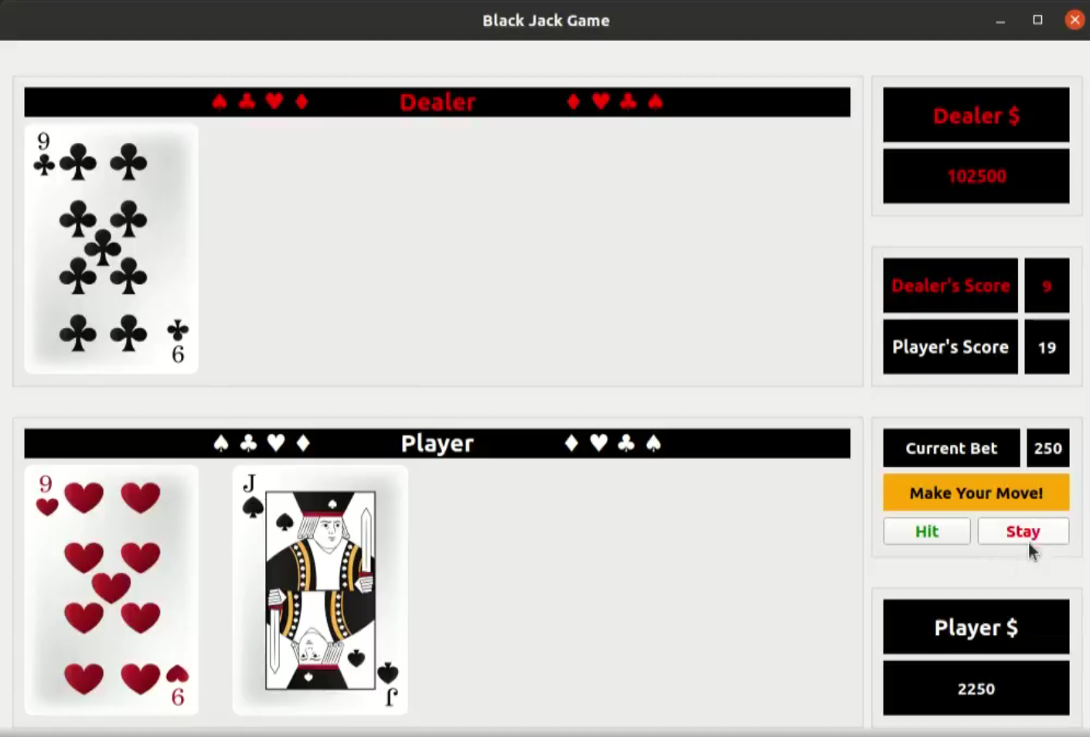
(3) Instances of class CARD owned by “Dealer_” CardsField instance
(1) Instance of class Window
(2) Instances of class CardsField
(4) Instances of class CARD owned by “Player_” CardsField instance

