Slide 1
Sample Portfolio
Chris Pecaut - June 2020

Slide 2
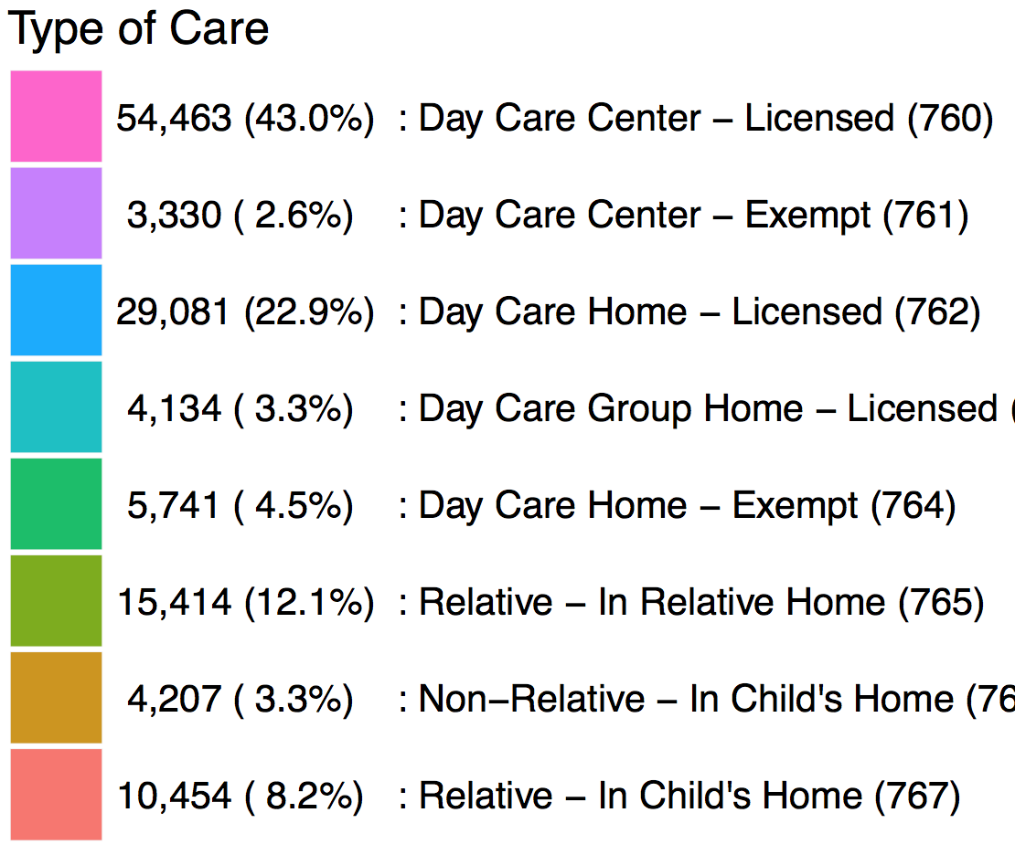
Child Care Assistance Program (CCAP) : Type of Care
August 2016 : Number of Children = 126,923
14,439
14,402
13,481
Type of Care
13,079
54,462 (43.0%) : Day Care Center – Licensed (760)
3,330 ( 2.6%) : Day Care Center – Exempt (761)
8,223
29,081 (22.9%) : Day Care Home – Licensed (762)
10,710
7,334
8,076
10,273
4,134 ( 3.3%) : Day Care Group Home – Licensed (763)
7,003
9,737
5,741 ( 4.5%) : Day Care Home – Exempt (764)
9,144
15,414 (12.1%) : Relative – In Relative Home (765)
5,280
4,231
3,435
8,327
4,207 ( 3.3%) : Non-Relative – In Child’s Home (766)
2,876
10,454 ( 8.2%) : Relative – In Child’s Home (767)
# of Children
2,304
7,038
25
79
1,680
5,865
Source: CCMS Payments Report:
August 2016
Note: Child care for the 126,923 unique children was paid for with 149,733 vouchers dispensed in August 2016. These vouchers paid for service that was provided during the month:
July (85.1%) 127,383
June (9.2%) 13,720
May (2.4%) 3,607
April (1.2%) 1,718
< March (2.2%) 3,305 payments.
156
251
504
469
508
469
5,050
13
351
1,191
2,992
3,015
2,710
2,626
2,296
2,355
2,261
2,114
4,615
2,234
2,603
1,795
321
616
1,486
150
330
321
317
264
227
1,180
6
386
459
450
404
416
485
480
488
481
443
199
1,361
464
457
435
450
150
150
433
1,196
1,233
1,264
1,362
1,360
1,330
1,260
1,095
371
1,113
1,198
1,179
981
180
399
411
419
367
830
258
258
284
271
293
308
332
333
336
595
622
725
765
772
792
831
916
923
945
915
848
831
114
71
53
31
19
6
103
313
11%
11%
11%
10%
8%
8%
7%
7%
6%
5%
4%
8%
4%
0.7%
0.09%
0.06%
0.04%
0.02%
0.02%
0.005%
Child’s Age

Slide 3
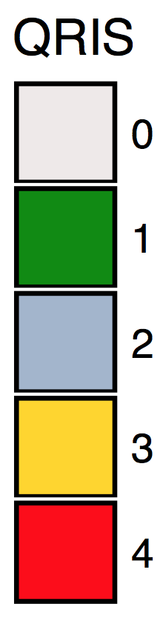
Only 23.4% of CCAP Children Aged 0 to 3 attend Quality Providers
(6,860 out of 29,241 children -- 3,918 Silver (10.9%) : 3,662 Gold (12.5%)
14,439
14,042
Child Care Assistance Program (CCAP) : Quality Ratings
August 2016 : Number of Children = 126,923
13,481
13,079
79%
(~ 90 % No Quality Rating or Add-On)
(~ 10 % ExceleRate Bronze Rated) *
10,710
<1%
QRS Star 1 (+5%) : 531 – 0.01%
10,577
10,273
10,083
9,737
9%
ExceleRate Silver (+10%) : 11,608**
9,993
9,663
9,144
8,326
11%
ExceleRate Gold (+15%) : 13,966**
# of Children
<.1%
QRS Star 4 (+20%) : 9
8,241
8,239
7,038
Source: CCMS Payments August 2016
8,055
* Estimate based on INCCRRA Data (August 31) with 9.7% of CCAP Children listed as attending a Bronze Circle of Quality provider. Because Bronze receives no Add-On payment, there is no separate designation in the payment source data for this rating.
** An estimated 5% of these ratings are Provisional Silver or Gold rated. Estimated based on INCCRRA Data (August 31).
7,691
5,865
7,168
5,050
6,187
4,615
3,998
5,269
1,768
1,746
4,311
1,568
1,484
1,113
887
2,033
2,168
755
622
830
517
1,303
1,843
1,880
504
359
114
71
53
53
19
6
516
1,098
896
787
623
451
229
110
788
344
182
4%
8%
11%
11%
11%
10%
8%
8%
7%
7%
6%
5%
4%
0.7%
0.09%
0.06%
0.04%
0.02%
0.02%
0.005%
Child’s Age

Slide 4
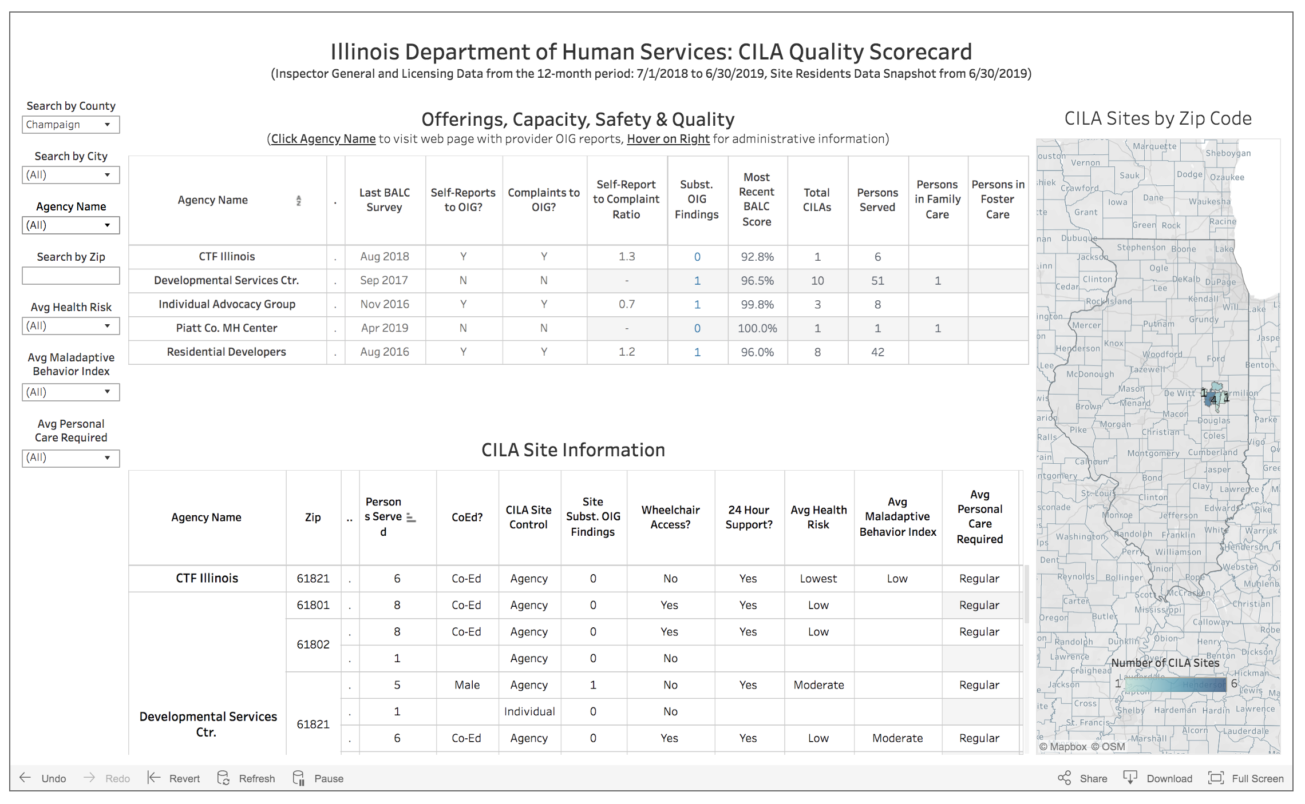

Slide 5
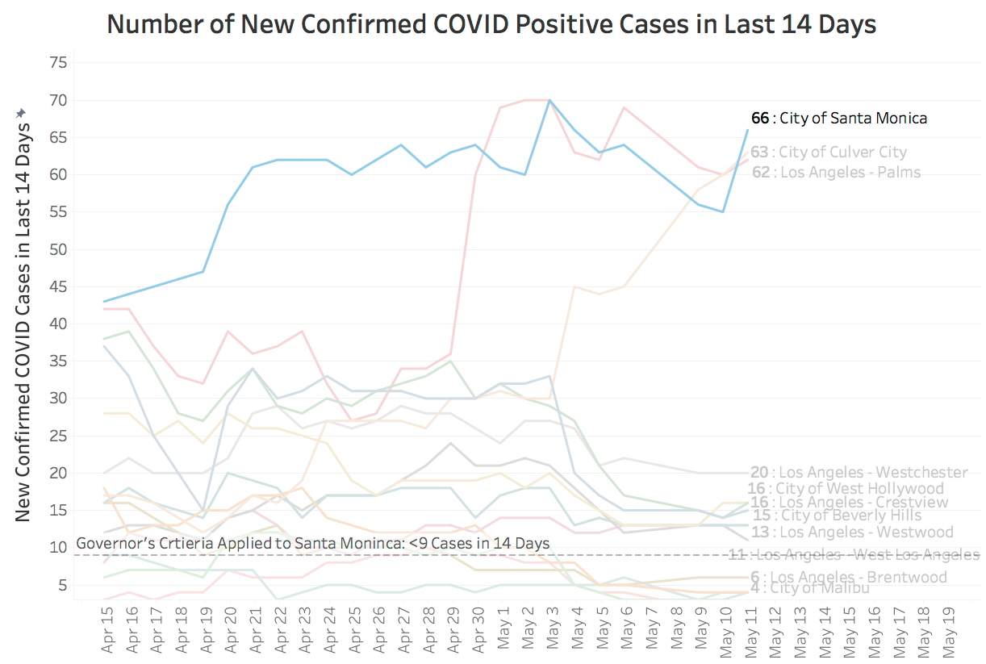
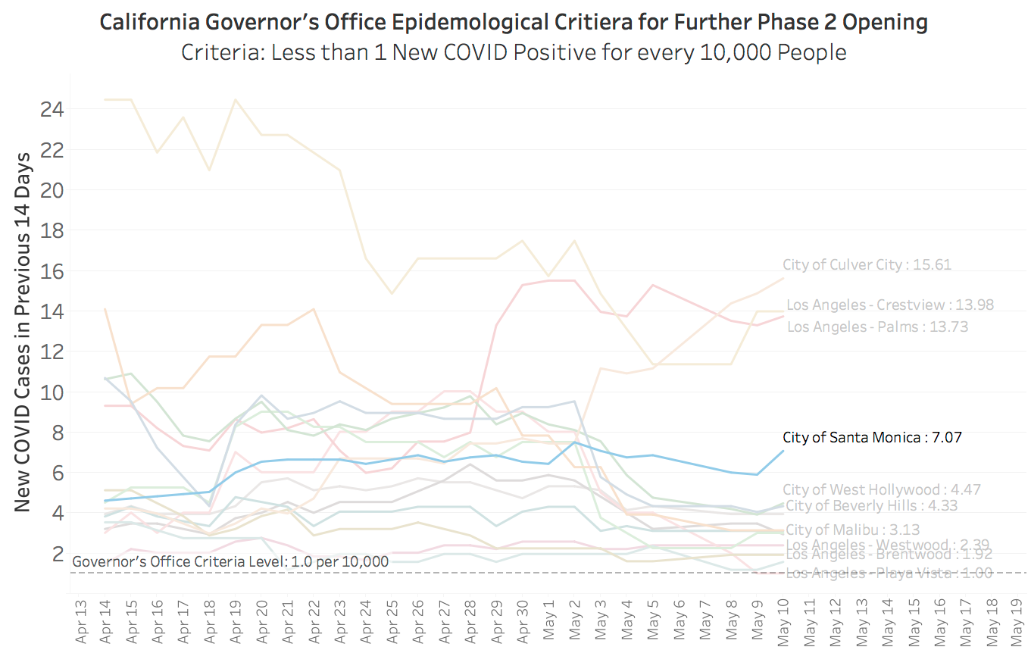
Local Westside LA COVID Infection Rates Analysis for
City of Santa Monica Emergency Operations Center
Note: Data compiled by scraping data from LADPH website, and compiling outcomes into time series

Slide 6
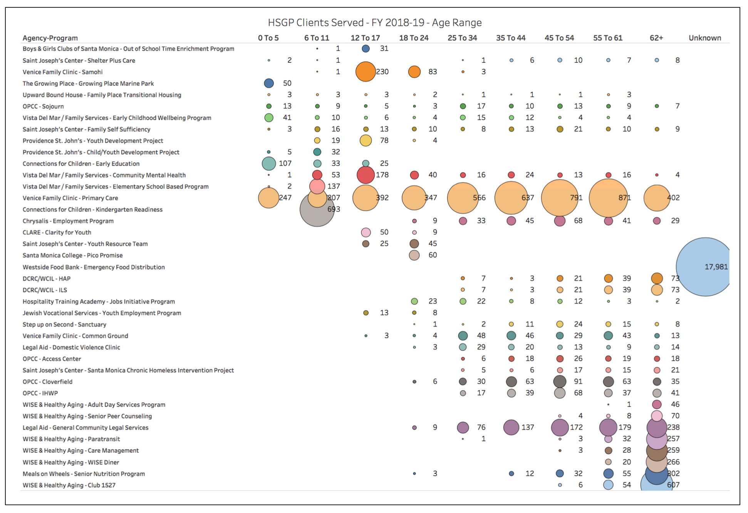
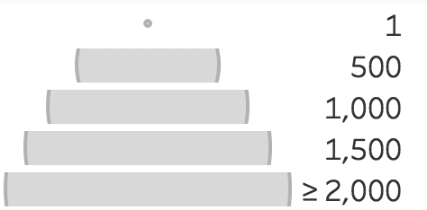
Size of Dot: # Served

Slide 7
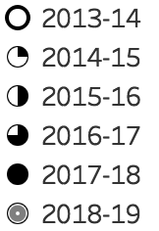
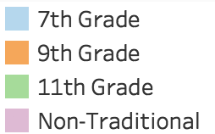
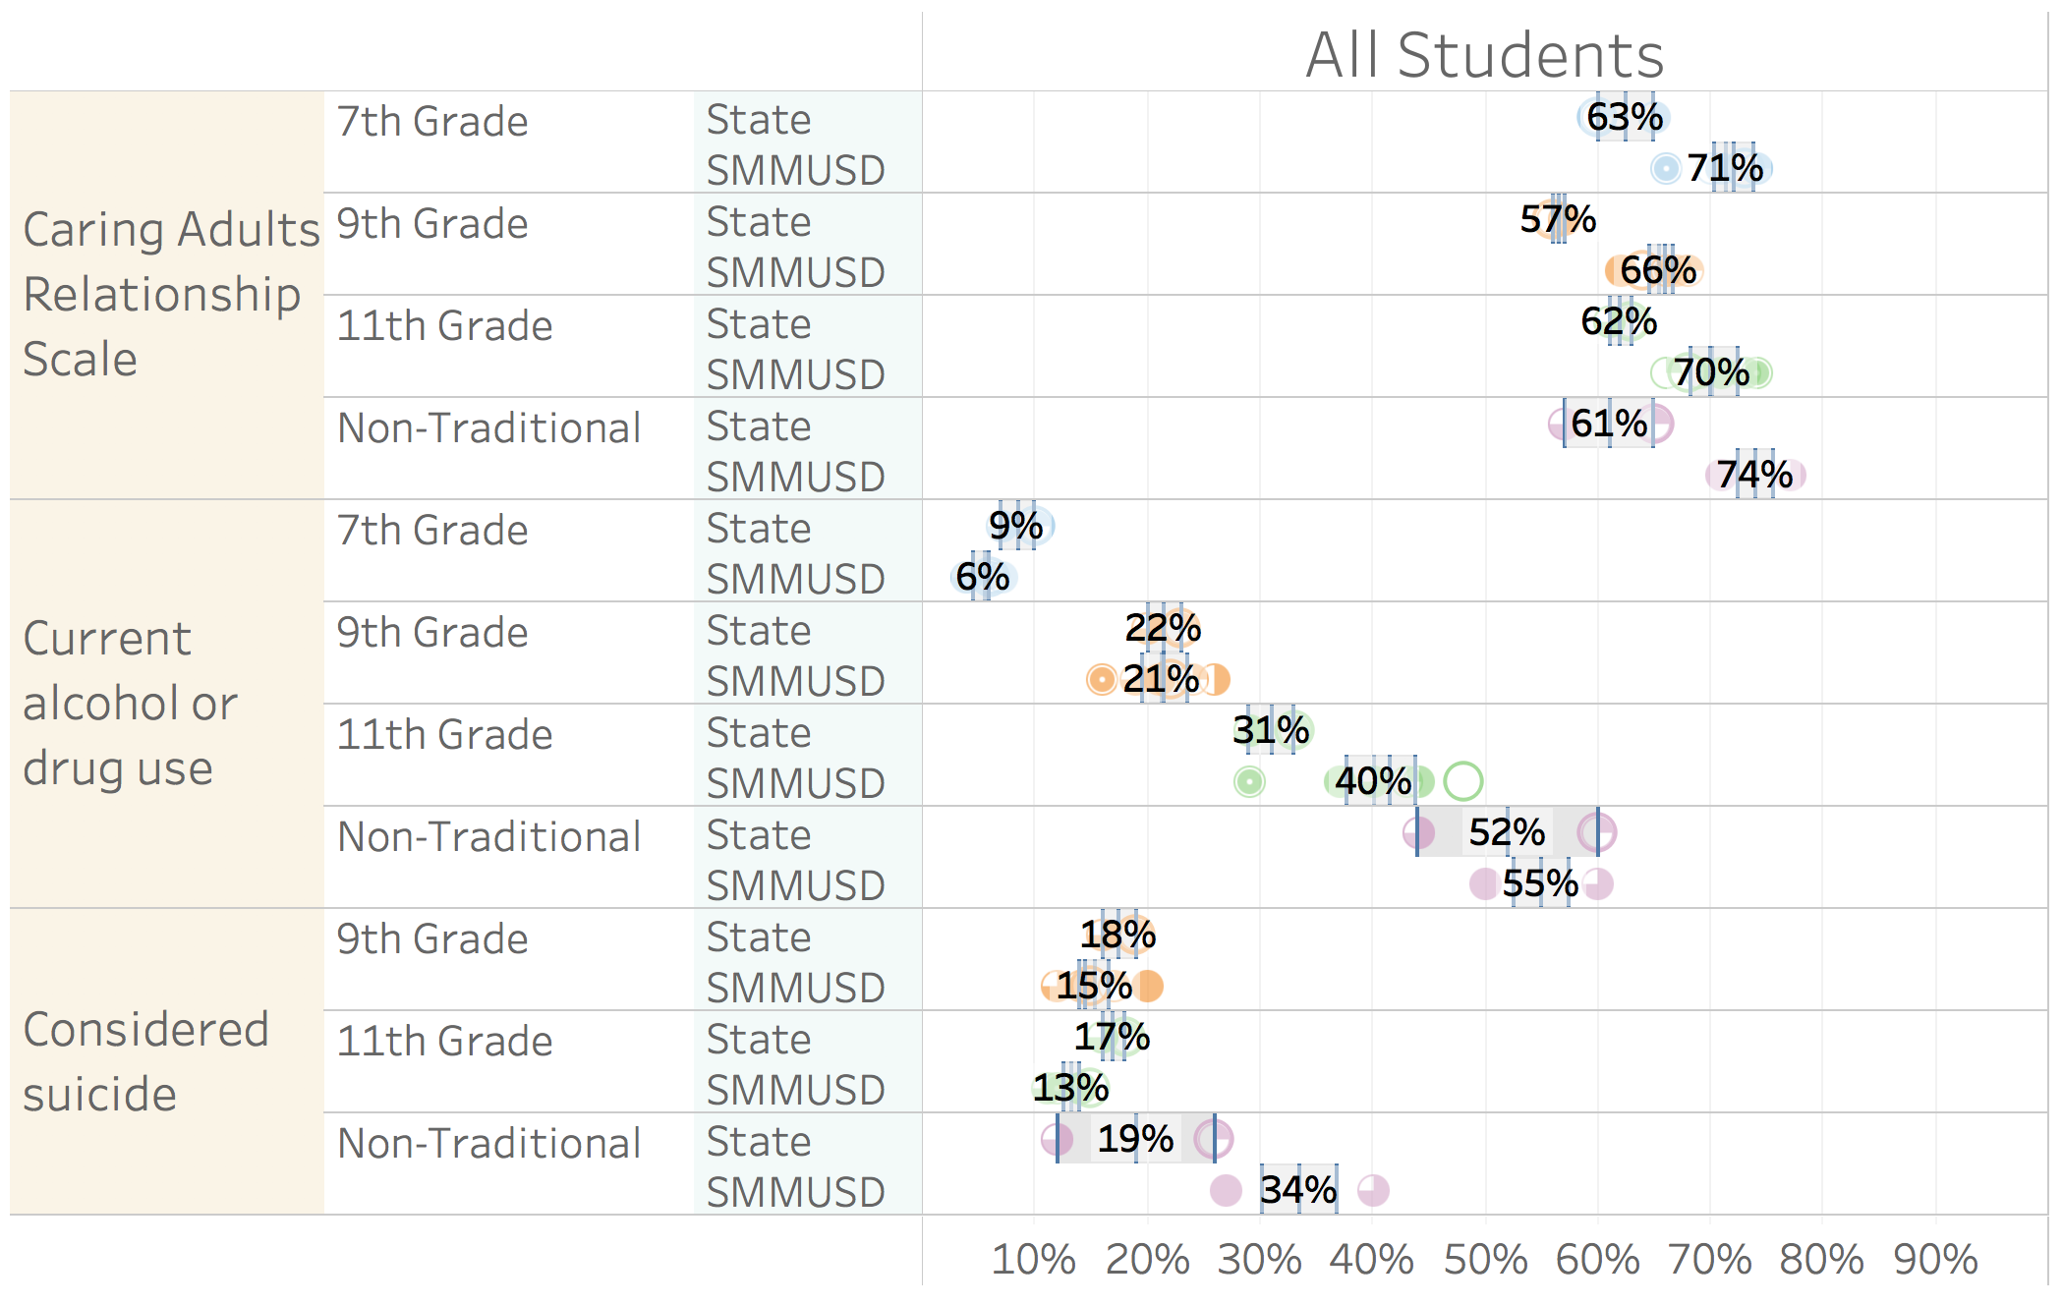
How does Santa Monica compare to the whole state of California?
(California Health Kids Survey Data)
+8
Santa Monica students have more caring adults in their lives, especially at Olympic.
+9
+8
+13
- 3
Older Santa Monica students use drugs and alcohol at a higher rate.
- 1
+ 9
+ 3
- 3
While this rate is significantly higher for Olympic students, it should be interpreted cautiously as only 1/3 of the student body (28/87) took the survey and 1/3 (10/28) of those answered yes.
- 4
+ 15

Slide 8
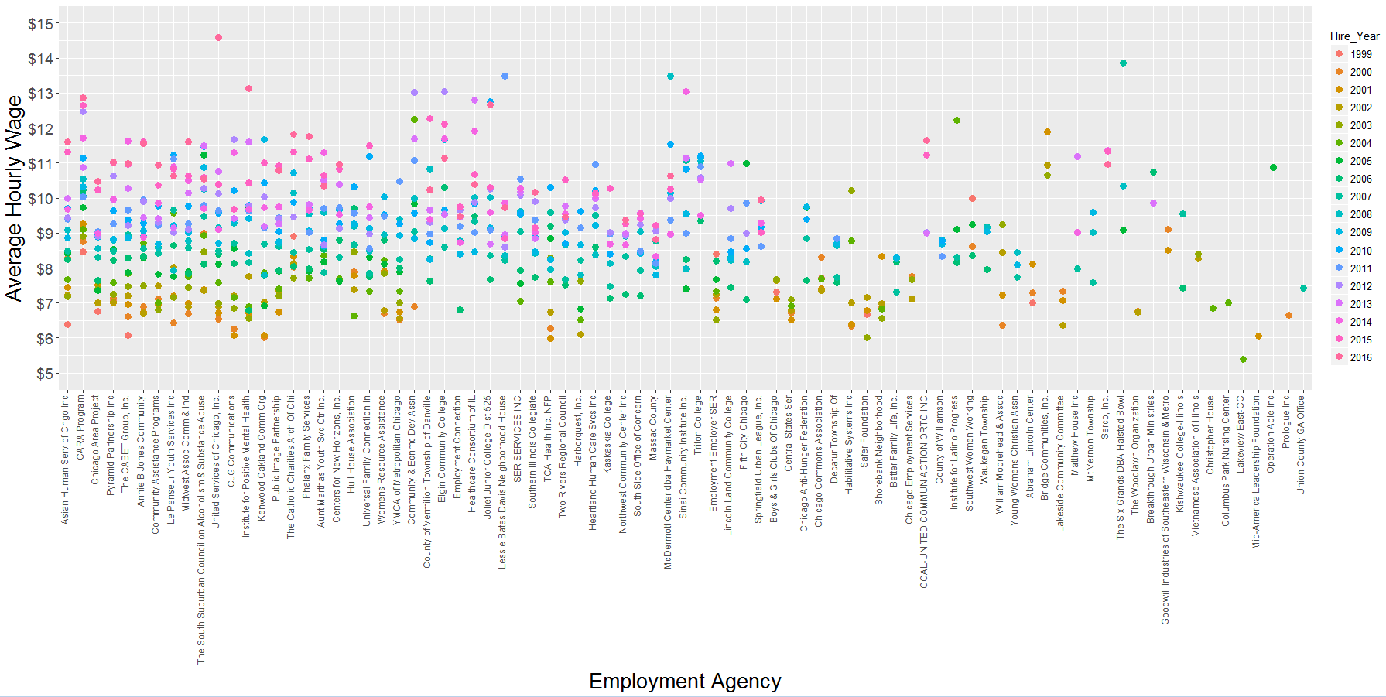
Wages Achieved from Employment and Training agencies under Illinois SNAP

