Slide 1

Notes:
© The University of Edinburgh

Slide 2
Module: | Techniques & Physics
Lecture: | Functional Imaging Basics 1 Neurophysiological techniques
Description: | A review of neurophysiological techniques, in particular Electro- and Magneto- Encephalography
Author: | Dr. Cyril Pernet
Notes:
© The University of Edinburgh

Slide 3
Objectives:
Being able to discuss the relative strengths and weaknesses of neurophysiological techniques, in particular Electro- and Magneto- Encephalography.
Notes:
© The University of Edinburgh

Slide 4
Prerequisites:
basics in neurophysiology
Notes:
© The University of Edinburgh

Slide 5
Module Outline: Functional Imaging Basics
This module will …
Review major functional neurophysiological techniques
Details Electro- and Magneto- Encephalographic techniques
Provide an overview of advantages and weakness of each techniques
Notes:
© The University of Edinburgh

Slide 6
What is functional neuroimaging?
Functional neuroimaging is the use of neuroimaging technology to measure an aspect of brain function, often with a view to understanding the relationship between activity in certain brain areas or within a network and specific mental functions.
It is primarily used as a research tool in cognitive neuroscience, cognitive psychology, neuropsychology, and social neuroscience.
Clinical applications do exists but are still limited, in part because functional neuroimaging results are primarily statistical and dependent on the experimental design and/or protocol set-up.
http://en.wikipedia.org/wiki/Functional_neuroimaging
Notes:
© The University of Edinburgh

Slide 7
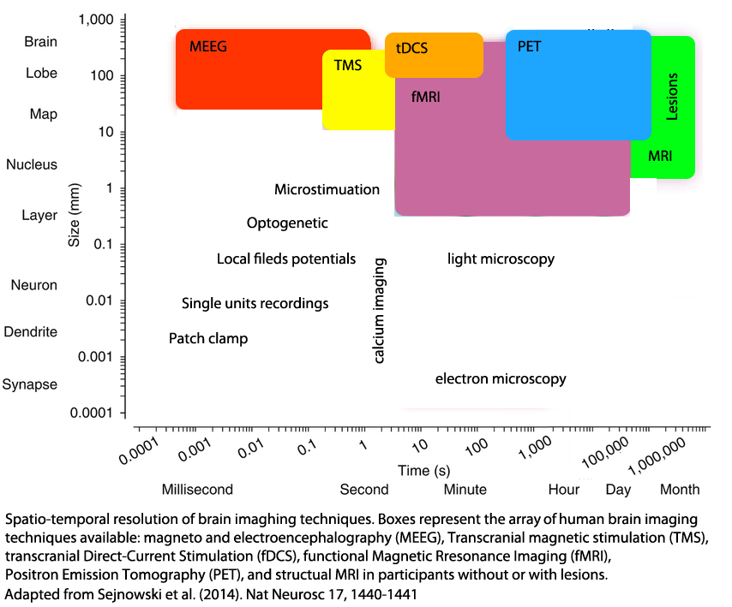
What techniques are used?
There are many techniques that can be considered. For human brain imaging, the spatial resolution is limited to the millimetre scale.
Notes:
Different types of functional imaging have different temporal resolutions – either because the differ in the time they take to record the activity and/or because the recorded responses have different inherent temporal resolution (think for instance of the recording of neural activity vs. recording the vascular response evoked by neural activity). Different types of functional imaging also have different spatial resolutions – i.e. some can pinpoint the active neurones very precisely, while others can only indicate a general area of increased activity.
For human brain imaging, Electro- and Magneto- Encephalography (EEG and MEG) are the techniques of choice to investigate the time course of neural event in relation to various behavioural tasks. As illustrated on the graph, recordings can be extremely accurate, below the millisecond – although in practice data are often down-sampled and analysed with a millisecond precision. Transcranial magnetic stimulation (TMS) and direct current stimulation (tDCS) offer way to disrupt or increase neural communication with effects lasting from seconds to minutes. These tools are well suited to study the role of large regions (tens of millimetres to few centimetres) and there low scale temporal dynamic. Functional and structural MRI on the other hand, are the best tools to localize with precision which areas are involved in different behavioural task. With high magnetic field strength (7Tesla) and dedicated coils, fMRI can nowadays (as in 2014) localise changes in activation in separate cortical layers. This is the most commonly used method to study function, although it has inherent temporal dynamic limitations (down to a few seconds). Finally, Positon Emission Tomography (PET) provides a relatively high spatial precision to uniquely localize neuromediator circuits (nut not only),but is more suited for steady-state behavioural tasks, rather than complex dynamic (changing) behaviours.
© The University of Edinburgh

Slide 8
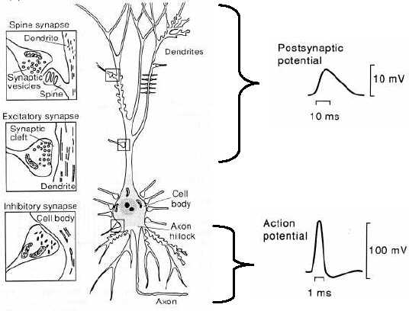
Neurophysiology reminder
3 Na⁺
Dendrites
Na⁺
K⁺
Cl⁻
2K⁺
Ca²⁺
Cl⁻
Ca²⁺
-70mV
Resting potential
(at equilibrium)
Cell body
Axon hillock
Line Garnero, LENA, Paris
Axon
Notes:
In the main panel we see a schematic picture of a neuron, the basic information-processing cell of the brain. The neuron contains many dendrites, through which it senses inputs from other neurons, a cell body, much like other living cells, and a long axon which it uses to signal to the dendrites of other neurons. Neurons do not, in general, make physical contact with one another: instead, there is a gap called a synapse between the axon of one neuron and the dendrites or cell body of the next. Chemicals called neurotransmitters are released from the axon of one
neuron, diffuse across the gap, and activate receptors in the next neuron.
The release of neurotransmitters, and their effect on the ‘post-synaptic’ neuron, brings us to the next essential point about neuronal transmission. Neurons carry information by electrochemical means: chemical because of the release of the neurotransmitter, and electro because of electrical travelling ‘wave’ corresponding to depolarisation or hyperpolarisation of the cell membrane via ions exchanges, cause by the neurotransmitters.
Here we see a cross-section through the neuron at rest. There is a potential difference between the inside and the outside of the neuron, due to the different concentrations of ions between the two regions (this is call resting potential and is around -70mv). When a neuron is stimulated, either via direct transduction of energy (if the neuron is a receptor) or via the effects of another neuron via a synapse, the resting potential will increase slightly, i.e. become less negative, and this changes evolve over 10s of milliseconds. If enough postsynaptic potentials occur together (their effects are additive), or if a single postsynaptic potential is large enough, the initial small depolarization is rapidly followed by a rapid change in cell membrane potential as sodium ions rush into the cell. This process is over in roughly 1ms, and is called an action potential. It causes the ‘wave’ of depolarisation that travels down the axon to the synapse, causing the release of neurotransmitters. While both postsynaptic potentials and actions potentials cause changes in cell membrane potentials, the changes for a single neuron are tiny. The speed of action potentials also means that many would need to happen simultaneously for a change to be detectable, and so the most likely neuronal event underlying the signals detected by functional neuroimaging is many, many postsynaptic potentials occurring.
© The University of Edinburgh

Slide 9
Intra vs. Extracellualr recordings
Intracellular recording
Single cell recording
Compares intracellular & extracellular environments
Amplitude measured in millivolts
Recording signal is always positive
Extracellular recording
Multi-unit recording and local filed potentials
Variation in potential depends on importance of Excitatory Post Synaptic Potentials (EPSP) & resistance of extracellular environment (extracell recording) or EPSP vs IPSP (Inhibitory PSP) relative to the electrode position (LFP)
Amplitude measured in microvolts
Notes:
This slide contains an animation or narration. Press the play button to view it.
Voice over: Recordings can be intracellular or extracellular.
For intracellular recordings, measuring the electrical potential relies on comparing between the intracellular environment with the extracellular environment across the neural membrane. By contrast, for extracellular recording (i.e. close to cells), the variation of the electrical potential depends on the importance and type of synaptic potentials and the resistance of the extracellular environment.
Because intracellular recordings measure membrane depolarization, the amplitudes are measured in millivolts; for extracellular recordings, the amplitude is measured in microvolts. More importantly, intracellular recordings are always positive whereas extracellular recordings exhibit different polarities.

Slide 10
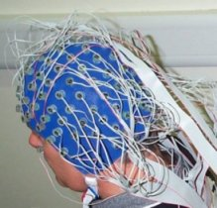
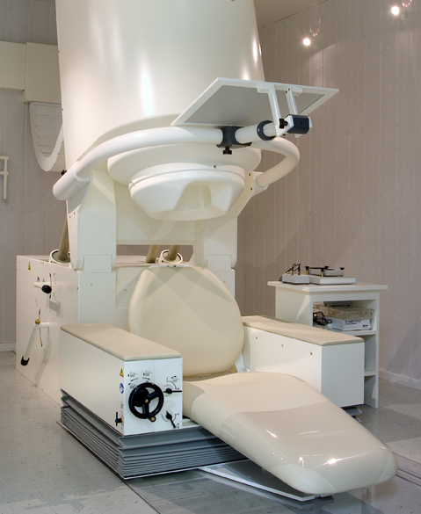
Magneto- / Electro- EncephaloGraphy
(MEG / EEG)
Electrical activity generates magnetic fields – and both can be recorded using scalp macro-detectors
Electric and magnetic fields provide large-scale, short-time measures of the modulations of synaptic potential fields around their background levels. They correspond directly to the sum of synchronous firing of neurons.
EEG
MEG
Notes:
This slide contains an animation or narration. Press the play button to view it.
Voice over: Magneto- and Electro- EncephaloGraphy (MEG / EEG) are two types of far-field methods available for assessing neural activity non-invasively. They rely on the simultaneous activation of many neurons at the same time, generating electrical activity and concurrent magnetic fields. The recording depends on macro-detectors on the scalp surface.
Electric and magnetic fields provide large-scale, short-time measures of the modulations of synaptic potential fields around their background levels. They correspond directly to the sum of extracellular potentials elicited by the synchronous firing of neurons.

Slide 11
ElectroEncephaloGraphy (EEG)
No issues with motion - EEG cap is put on the subjects head
Relatively long set-up time (~30min to put and test electrodes)
Excellent temporal resolution – record event at ms scale
Relatively low spatial resolution (cm) – finding the origin of the signal is very difficult and in EEG the problem is worsened by blurring due to the skull/scalp which diffuse the electrical signal
Easy experimental set-up (almost any task can be used)
Cheap equipment (£500 to £1500) with little running cost (need to buy gel to allow conductance between the scalp and the electrodes, caps need to be renewed every couple of years)
Notes:
This slide contains an animation or narration. Press the play button to view it.
Voice over: With EEG, a cap with electrodes is put on the scalp to record from the whole cortex. Compared to any other whole brain imaging technique, this has the advantage that subject can move without causing much trouble to the recorded data. The downside is that it take about ½ hour to set-up the cap and test the conductivity of each electrode.
EEG has an excellent temporal resolution, recording neural event at the millisecond scale. It has however a relatively low spatial resolution of several centimetres. Using specialised algorithm, it is possible to locate the ‘source’ that is the origin of the signal recorded on the scalp. While the details of this process are beyond the scope of this tutorial, if you imagine throwing a pebble into a lake and watching the waves produced, you will have some grasp of what is involved. If you are the person throwing the pebble, you can see clearly that the pebble ‘generates’ the
wave pattern. But imagine if you arrived after the pebble had been thrown. You could still find out something of the pebble’s location by looking at the waves: the centre point, in this case, would be where the pebble, the ‘generator’ lay. Now working in 3 dimensions, and possibly with multiple sources (that is multiple pebbles thrown at different places and times) things get more complicated. In addition, with EEG the signal recorded is blurred by the skull and scalp which diffuse the electrical signal.
Because EEG doesn’t involve any other set-up than the cap and amplifier, and because it record neural events with high temporal accuracy – the experimental set-up is easy, meaning that almost any cognitive task can be used without specific constraints – but a high number of trials (because data are noisy). EEG also has the advantage of being rather inexpensive relative to other brain function recording techniques.

Slide 12
MagnetoEncephaloGraphy (MEG)
Vey quick set-up time (just seat)
Small issues due to motion - Sensors are ‘above’ the head
Excellent temporal resolution – record event at ms scale
Variable spatial resolution (mm to cm) – finding the origin of the signal is the same as with EEG but the data are cleaner because magnetic fields are not affected by tissues)
Easy experimental set-up (almost any task can be used)
Expensive equipment (>£1 million) with relatively high running cost (need to fill-up the machine regularly the machine with helium to cool down the sensors).
Notes:
This slide contains an animation or narration. Press the play button to view it.
Voice over: With MEG, the subject simply sits on a couch and the machine which looks like a large old-fashioned hair dryer comes down over the head. This implies that while there is no set-up time, motion can be an issue since the sensors are not in contact with the head.
Like EEG, MEG has an excellent temporal resolution and a relatively low spatial resolution. Because magnetic fields are not affected by tissues, the signal is somehow ‘cleaner’ and when a single source is involved, MEG can localize the group of neurons involved with a millimeter resolution, just as functional MRI.
Finally, like EEG, the experimental set-up is easy, meaning that almost any cognitive task can be used without specific constraints – but it is a very expensive equipment.

Slide 13
Summary
You should now be able to:
List the main human – whole brain imaging techniques
Distinguish intra- extra- cell recordings
Identify and compare EEG from MEG
Notes:
© The University of Edinburgh

Slide 14
End of presentation
Notes:
All slides that follow are further examples that you can adapt
© The University of Edinburgh

Slide 15
Notes:
Official UoE pre-title slide – must go first + last in presentation
© The University of Edinburgh

Slide 16
Module Resources: Imaging Basics
Articles
Sejnowski et al. (2014). Putting big data to good use in neuroscience. Nat Neurosc. 17, 1440-1441
Teplan M (2002). Fundamentals of EEG Measurements. Measurement Science Review, 2. http://www.measurement.sk/2002/S2/Teplan.pdf
Web-resource
http://imaging.mrc-cbu.cam.ac.uk/meg/IntroEEGMEG
Notes:
Note to Author: This example module contains ‘reading resources’ - extra reading material that the student could study. Please provide a short list of books and papers related to your presentation topic.
© The University of Edinburgh

Slide 17
Learning Activities: Functional Imaging Basics
Question (Ranking):
Rank (from high to low precision) the following technique based on their spatial accuracy
MEG
Local Field potential
fMRI
Single cell recording
EEG
Notes:
© The University of Edinburgh

Slide 18
Learning Activities: Functional Imaging Basics
Answer:
Rank (from high to low precision) the following technique based on their spatial accuracy
MEG | 4
Local Field potential | 2
fMRI | 3
Single cell recording | 1
EEG | 5
Notes:
© The University of Edinburgh

Slide 19
Learning Activities: Imaging Basics
Question (True/False):
(2) Comparing intra and extra cell recording:
Intracell recordings have much higher temporal resolution than extracell recordings
Intracell recordings have different polarities depending on EPSP or IPSP
Intracell recordings have amplitudes a thousand times stronger than extracell recordings
Intra and extracell recordings depends on the synchroneous activity of many neurons
Notes:
© The University of Edinburgh

Slide 20
Learning Activities: Imaging Basics
Answer:
(2) Comparing intra and extra cell recording:
Intracell recordings have much higher temporal resolution than extracell recordings | False
Intracell recordings have different polarities depending on EPSP or IPSP | False (always positive)
Intracell recordings have amplitudes a thousand times stronger than extracell recordings | True (millivolt vs microvolt)
Intra and extracell recordings depends on the synchronous activity of many neurons | False
Notes:
© The University of Edinburgh

Slide 21
Learning Activities: Imaging Basics
Question (True/False):
(3) With regard to EEG and MEG:
They can localize ‘sources’ (the neural origin of the recorded signal) at the cm scale
They reflect action potentials of neurons
They have the same temporal accuracy
Recordings depends on the synchronous activity of many neurons
Notes:
© The University of Edinburgh

Slide 22
Learning Activities: Imaging Basics
Answer:
(3) With regard to EEG and MEG:
They can localize ‘sources’ (the neural origin of the recorded signal) at the cm scale | True
They reflect action potentials of neurons | False (sum of all synaptic activity – including AP)
They have the same temporal accuracy | True
Recordings depends on the synchronous activity of many neurons | True
Notes:
© The University of Edinburgh

Slide 23
Learning Activities: Imaging Basics
Question (Matrix):
(4) Match these attributes with the corresponding technique:
Excellent temporal resolution | EEG | MEG
Cheap | EEG | MEG
Easy to set up | EEG | MEG
Sensitive to motion | EEG | MEG
Can be of high spatial precision | EEG | MEG
Notes:
© The University of Edinburgh

Slide 24
Learning Activities: Imaging Basics
Answers:
(4) Match these attributes with the corresponding technique:
Excellent temporal resolution | EEG | MEG
Cheap | EEG | MEG
Easy to set up | EEG | MEG
Sensitive to motion | EEG | MEG
Can be of high spatial precision | EEG | MEG
Notes:
© The University of Edinburgh

Slide 25
Notes:
Official UoE pre-title slide – must go first + last in presentation
© The University of Edinburgh

