Slide 1

Notes:
Official UoE pre-title slide – must go first + last in presentation

Slide 2
Module: | Techniques & Physics
Lecture: | Functional Imaging Basics 2 Neurovascular techniques
Description: | Physiological and physical basis of Positron Emission Tomography and functional Magnetic Resonance Imaging
Author: | Dr Cyril Pernet

Slide 3
Objectives:
Know the physiological mechanisms recorded
Understand the basis of PET and fMRI
Understand the strength and weaknesses of these techniques

Slide 4
Prerequisites:
No prerequisite

Slide 5
The Brain Metabolism
We can exploit a feature of neuronal metabolism to image the brain in action:
The brain weight ~1.4Kg ie only ~2% of the total body weight.
The brain has large metabolic need:
it uses ~20% of the whole blood oxygen
It uses ~750ml of blood every minute, extracting 900mg of glucose from it (ie ~10% of the ~1.2mg/ml)
This extraordinary consumption of oxygen and glucose is explained by the absence of energetic reserve in the brain which ‘burns’ from 30 to 50 micro-mol of ATP every min per gram of tissue (Attwell and Laughtin, 2001).
Notes:
This slide contains an animation or narration. Press the play button to view it.
Voice over: In the previous lecture on neurophysiological techniques we focused on recording neurons ‘directly’ – or at least recording the electrical or magnetic changes accompanying their electrochemical means of communication. Here we will look at techniques that exploit neuronal metabolism and in particular the brain dependence on glucose and oxygen delivered through the vascular system.
The brain weights about 1.4Kg, that is only 2% of the total body mass, yet it consumes 20% of the whole blood oxygen, and 900mg of glucose per minute. This extraordinary consumption of oxygen and glucose is explained by the absence of energetic reserve in the brain which ‘burns’ from 30 to 50 micro-mol of ATP every min per gram of tissue.

Slide 6
Positron Emission Tomography (PET)
Ketty & Sokoloff (USA, 1960, animals)
Ingvar & Lassen (Scandinavia, 1963, humans)
Typical ‘Brain Activation’ PET Protocol:
Subjects injected with radioactively-labelled water (made with ¹⁵O)
This radioactive water accumulates within the brain in direct
Proportional with local blood flow
The greater the blood flow (due to increase local neuronal activity), the greater the radioactive count-rate in specific brain areas
H₂O¹⁵ decays rapidly with a half life of 2 min and disappear to background after roughly ten minutes. This means that while we minimize subject exposure, the quality of images is degraded (spatial resolution is ~10mm)
Water is the best tracer for functional experiments as it allows several observations (typically blocks of activations) to be made in a shorter time period
Notes:
This slide contains an animation or narration. Press the play button to view it.
Voice over: Positron Emission Tomography was one of the first techniques to be used in both animals and humans to exploit the links between neuronal activity and metabolism to study brain function. While PET technology had been used with limited success since the late 1930s, major advances in the technique had to wait until the 1960s, where animal experiments which allowed the technique to be refined and eventually applied to the study of human brain function were performed. The first commercial PET scanner was manufactured in 1975.
In a typical PET protocol, subjects are 1st injected with radioactive water. Since neurons consumes lots of oxygen, the radioactive oxygen (from the water injection) accumulates in the brain. While it accumulates everywhere, it is proportional with the local blood flow and therefore the greater the blood flow (due to increase local neuronal activity), the greater the radioactive count-rate in specific brain areas.
Water is used because it decays rapidly giving functional PET imaging a temporal resolution of ~2 min and a spatial resolution of 10 mm. This short half life makes water the best tracer for functional experiments as it allows several observations (typically blocks of activations) to be made in a shorter time period

Slide 7
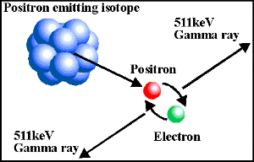
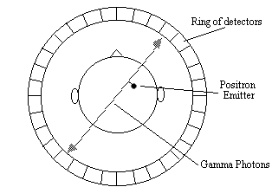
Positron Emission Tomography (PET)
PET with O-15 is the ‘gold standard’ for brain activation studies
Emits positrons which collide with electrons and emit gamma rays at 90°
to collision
Simultaneous gamma ray emission is picked up by ring of coincidence
detectors arranged around subject’s head in scanner.
Notes:
This slide contains an animation or narration. Press the play button to view it.
Voice over: PET works by having a ring of gamma ray (radiation) detectors around the subjects head. In the subject’s brain, the injected radioisotope (ie radioactive oxygen) will undergo radioactive decay and emits positrons, which are positively charged subatomic particles. The positrons typically pass a very short distance through the brain tissue before colliding with an electron (a negatively charged subatomic participle) in the outer shell of a nearby atom. This collision annihilates the particles and the corresponding energy is released as two gamma rays, which are emitted perpendicular to the initial collision. Some of these gamma rays are detected by the ring of detectors, As the simultaneous arrival at different opposite points are likely to have arisen from the same collision, it pinpoints the position of the radioisotope. The more isotope that accumulates in a particular spot, the greater the amount of gamma rays that will be detected as coming from that spot, and this means that the position of greater blood flow in the brain can be localised.

Slide 8
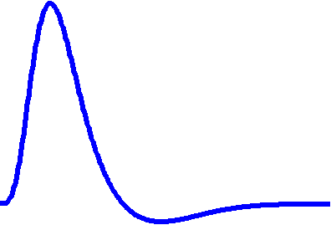
Functional MRI
Contrast Mechanisms
BOLD system output to ‘impulse’
‘Hemodynamic response function’
arterioles
capillary bed
venules
Initial peak
(delayed 5/8s)
signal
intensity
signal intensity
flow
‘rest’
Undershoot –
recovery of CBV
arterioles
capillary bed
venules
time
‘active’
Increased flow
Increased local flow
Increase : ratio
Increased MR signal
‘Neuronal Event’
Convolution
Notes:
This slide contains an animation or narration. Press the play button to view it.
Voice over: PET was used as the ‘Gold Standard’ for the functional neuroimaging community until the development of functional magnetic imaging (fMRI) in the early 1990s. fMRI using the Blood Oxygen Level Dependent (BOLD) contrast required no exogenous tracers.
MR is very sensitive to molecules with magnetic properties, and turns out that oxyhaemoglobin and deoxyhaemoglobin have different magnetic properties, so any change in the ratio of one to the other will change the amount of local magnetization and can thus be used as a contrast. When neurons become active, the blood flow to the active area of brain increases, so more oxyhaemoglobin is delivered for neurons who require more glucose and oxygen. As the quantity of blood flow increase a lot more than what is consumed, the ratio oxy/deoxyhaemoglobin increase in the venous system, leading to an increase in the MR signal. These changes in blood oxygen are tiny and require complex image processing to extract the changes. This type of fMRI is the most commonly used method but it exist other methods than the BOLD contrast.
The graph on the right shows the development of BOLD signal over time in response to a very short increase in neuronal activity. Called the hemodynamic response function or hrf, this curve can be used to predict how the MR signal in individual voxels will change to differing patterns of neuronal activity. The panel at the bottom shows this principle: by using a technique called convolution, which can be thought of as smoothing a pattern of neuronal activity with the hrf, a time series can be produced. This time series corresponds to the different stimuli presented to the subjects and is used as explanatory variable in a time regression model. Using statistical tests, the similarities between voxel time series and the explanatory variable are computed, resulting in maps of brain function showing where in the brain voxels’ activity increased along with the experiment.

Slide 9
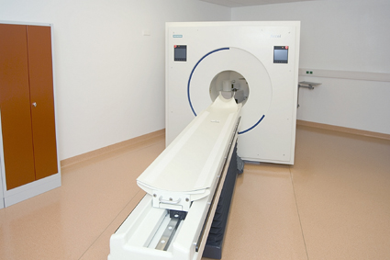
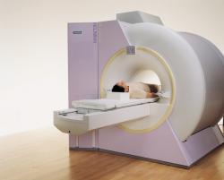
Summary
PET
Uses radioactive tracers
Low temporal and medium spatial resolution
Measures regional cerebral blood flow (rCBF)
Many tracers can be used (not just H2O15)
fMRI
Magnet in high static field (=safety issues)
Non-invasive
High spatial (mm), medium temporal (ms to s) resolution
Measure local blood oxygenation levels
Both methods measure the results of neuronal activation, rather than the neuronal signal itself.
Notes:
This slide contains an animation or narration. Press the play button to view it.
Voice Over: Both PET and fMRI rely upon the links between neuronal activity, neuronal metabolism, and local oxygenated blood flow to produce their images of brain activation. PET is being used less and less in the 21st century as a pure ‘brain activation’ technique due to its invasiveness and cost, but 1 – there is a unique relationship between the amount of tracer and regional cerebral blood flow and 2 – it has a unique ability to map specific neurotransmitters such as dopamine which can be used to study specific pathological disorders.
fMRI is the favourite tool used to study brain function because it is non invasive and has high spatial resolution – it however measures local blood oxygenation and the relationship to neural metabolism and activity is not straightforward.

Slide 10
End of presentation
Notes:
All slides that follow are further examples that you can adapt

Slide 11
Notes:
Official UoE pre-title slide – must go first + last in presentation

Slide 12
Module Resources: Imaging Basics
Journal Articles
Attwell, D. & Laughlin, S.B. (2001). An energy budget for signaling in the grey matter of the brain. Journal of Cerebral Blood Flow & Metabolism 21, 1133–1145; doi:10.1097/00004647-200110000-00001
Logothetis, N. (2008). What we can do and cannot do with fMRI. Nature, 453, 869-879 doi: 10.1038/nature06976

Slide 13
Learning Activities: Imaging Basics
Question (True/False):
(1) The brain
Uses 30 to 50 micromol of ATP per gram
Consumes 20% of the whole blood oxygen
Consumes its weight in glucose
Weight 20% of the whole body mass
Consumes lots of proteins

Slide 14
Learning Activities: Imaging Basics
Question (True/False):
(1) The brain
Uses 30 to 50 micromol of ATP per gram
Consumes 20% of the whole blood oxygen
Consumes its weight in glucose
Weight 20% of the whole body mass
Consumes lots of proteins
True
True
False
False
False

Slide 15
Learning Activities: Imaging Basics
Question (Multiple response):
(2) Positron Emission Tomography
Measures positrons
Measures gamma ray
Can map active areas using glucose
Can map active areas using water
Relies on radioactivity
Relies on magnetism

Slide 16
Learning Activities: Imaging Basics
Question (Multiple response):
(2) Positron Emission Tomography
Measures positrons
Measures gamma ray
Can map active areas using glucose
Can map active areas using water
Relies on radioactivity
Relies on magnetism

Slide 17
Learning Activities: Imaging Basics
Question (Multiple response):
(3) Functional MRI
Depends on the magnetic properties of the blood
Needs injection of a tracer
Has an excellent temporal resolution
Show maximal BOLD response right after neuron start firing
Relies on dedicated statistical methods to ‘see’ activations

Slide 18
Learning Activities: Imaging Basics
Question (Multiple response):
(3) Functional MRI
Depends on the magnetic properties of the blood
Needs injection of a tracer
Has an excellent temporal resolution
Show maximal BOLD response right after neuron start firing
Relies on dedicated statistical methods to ‘see’ activations

Slide 19
Learning Activities: Imaging Basics
Question (Matrix):
(4) Match each proposition with a method
Depends on blood flow | PET | fMRI
Measures blood flow | PET | fMRI
Uses radioactive tracers | PET | fMRI
Medium spatial resolution | PET | fMRI
Medium temporal resolution | PET | fMRI

Slide 20
Learning Activities: Imaging Basics
Question (Matrix):
(4) Match each proposition with a method
Depends on blood flow | PET | fMRI
Measures blood flow | PET | fMRI
Uses radioactive tracers | PET | fMRI
Medium spatial resolution | PET | fMRI
Medium temporal resolution | PET | fMRI

Slide 21
Notes:
Official UoE pre-title slide – must go first + last in presentation

