Slide 1
Simulation testing our trend detection methods

Slide 2
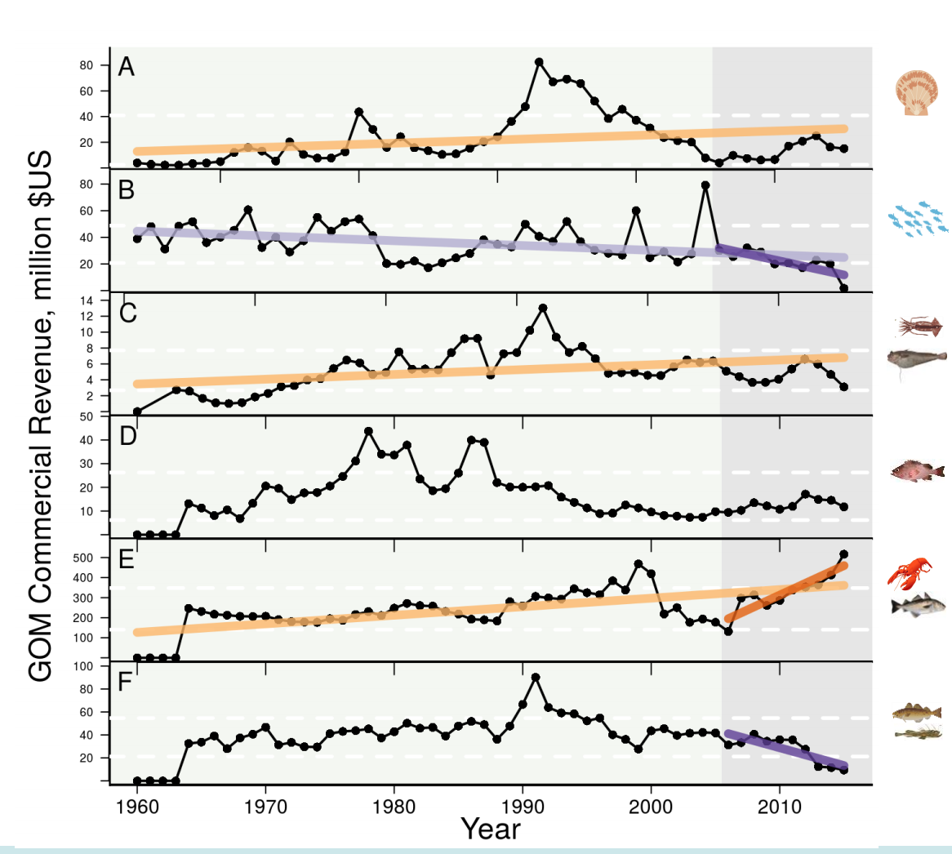
Motivation
Assumption is that there is no autocorrelation.

Slide 3
Research approach
Perform a simulation study to compare three trend estimation methods.
Simulate time series with similar characteristics to the real data (linear trend with autocorrelated residuals).
Compare the MK test to two alternative methods.

Slide 4
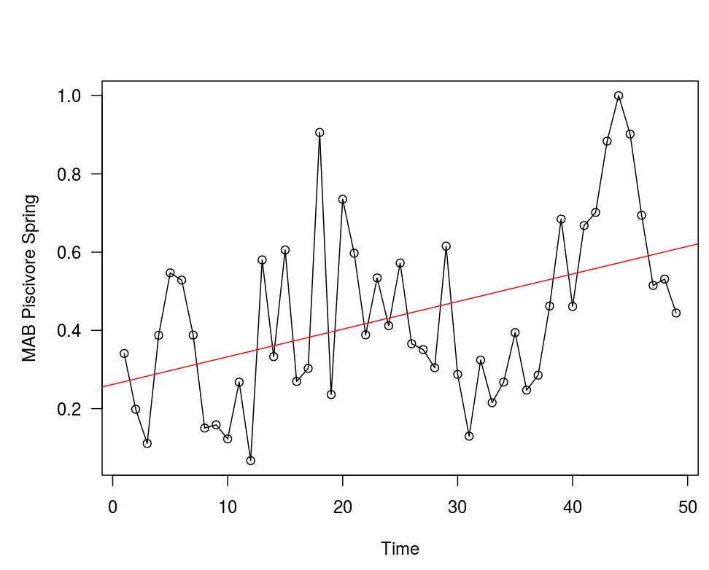
Choosing simulation parameters
For each time series in the SOE, we fit a linear regression and to normalized data and recorded parameters of the fit and autocorrelation of the residuals.

Slide 5
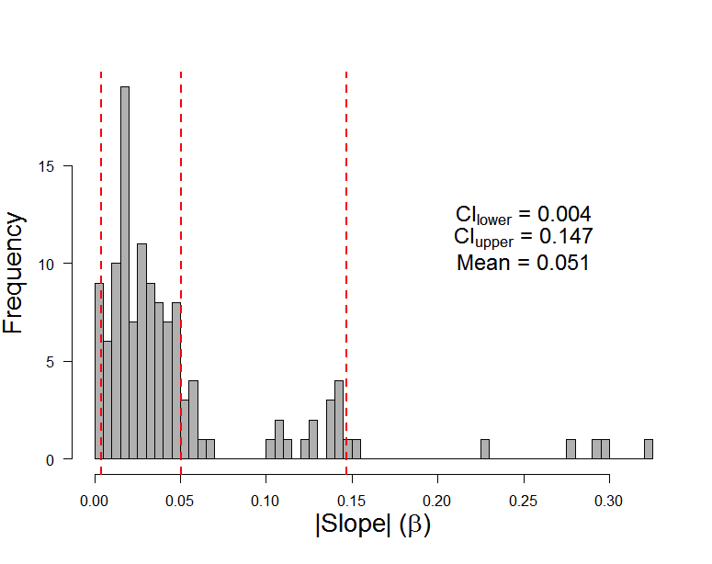
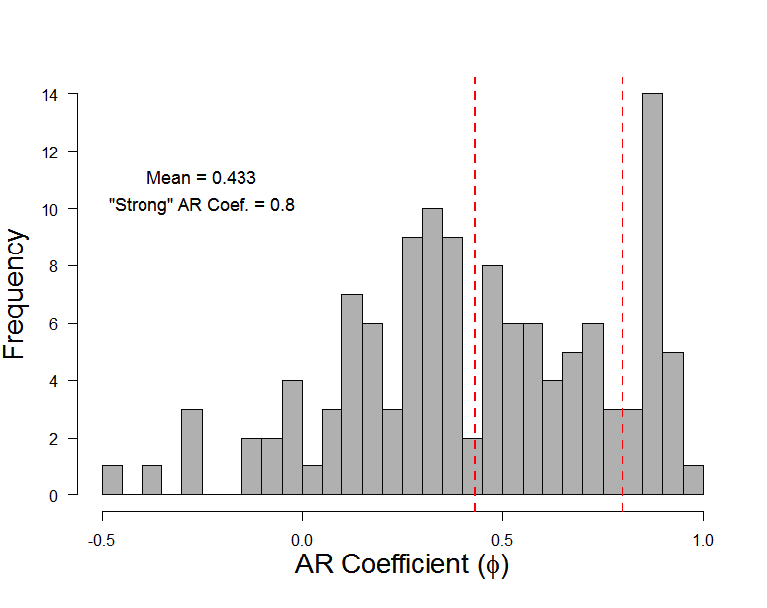
Choosing simulation parameters
This gives us a distribution of intercepts, slopes, and autocorrelation parameters.

Slide 6
Simulation scenarios
Four trend scenarios (1000 replicates):
1) No trend
2) Weak trend (0.004/year)
3) Medium trend (0.05/year)
4) Strong trend (0.15/year)
Three autocorrelation scenarios:
1) No autocorrelation
2) Medium autocorrelation (0.43)
3) Strong autocorrelation (0.8)
Notes:
1000 replicates for each combination of scenarios

Slide 7
Simulation scenarios
Three time series lengths:
1) 10 observations
2) 20 observations
3) 30 observations
Notes:
1000 replicates for each combination of scenarios

Slide 8
Example simulations (strong trend)

Slide 9
Example simulations (medium trend)

Slide 10
Three methods of trend detection
Mann-Kendall Test (MK)
Mann-Kendall with pre-whitening (PW)
Generalized Least Squares model selection (GLS)

Slide 11
Mann-Kendall Test and Mann Kendall with Pre-whitening
MK Test (MK): Nonparametric test that uses the sign of differences between observations to detect a trend.
MK w/Pre-whitening (PW): Remove autocorrelation by pre-whitening first (Y_{t} = X_{t} – r₁X_{t-1}), then apply the MK Test.

Slide 12
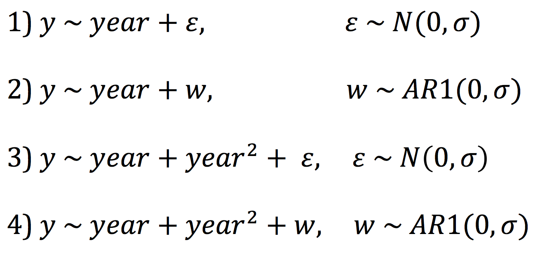
GLS model selection
Fit four models, chose best using AICc:

Slide 13
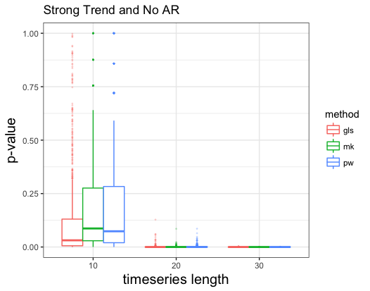
Results

Slide 14
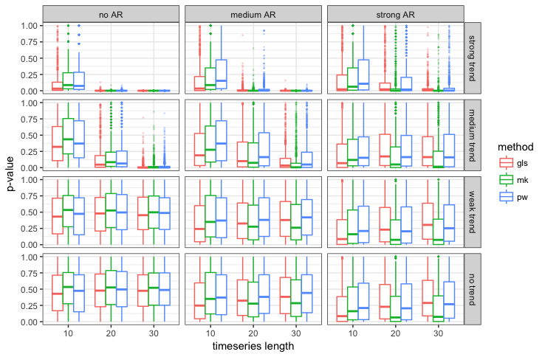

Slide 15
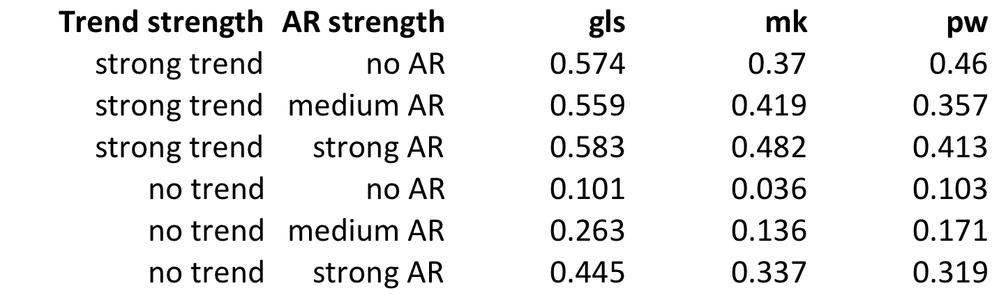
Proportion of runs labeled significant (Timeseries length = 10)

Slide 16
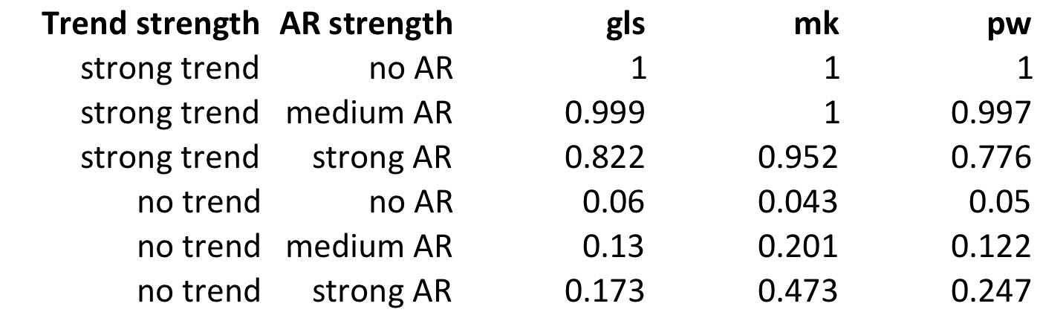
Proportion of runs labeled significant (Timeseries length = 30)

Slide 17
Summary
1) Good performance when trend is strong, N = 30, and autocorrelation is weak.
2) Poor performance when N = 10.
3) High autocorrelation leads to high false positive rate.

Slide 19
Extra slides

Slide 20
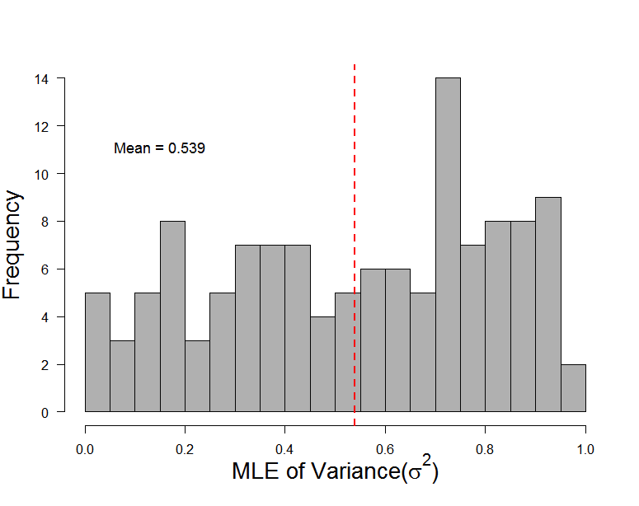

Slide 21
