Slide 1
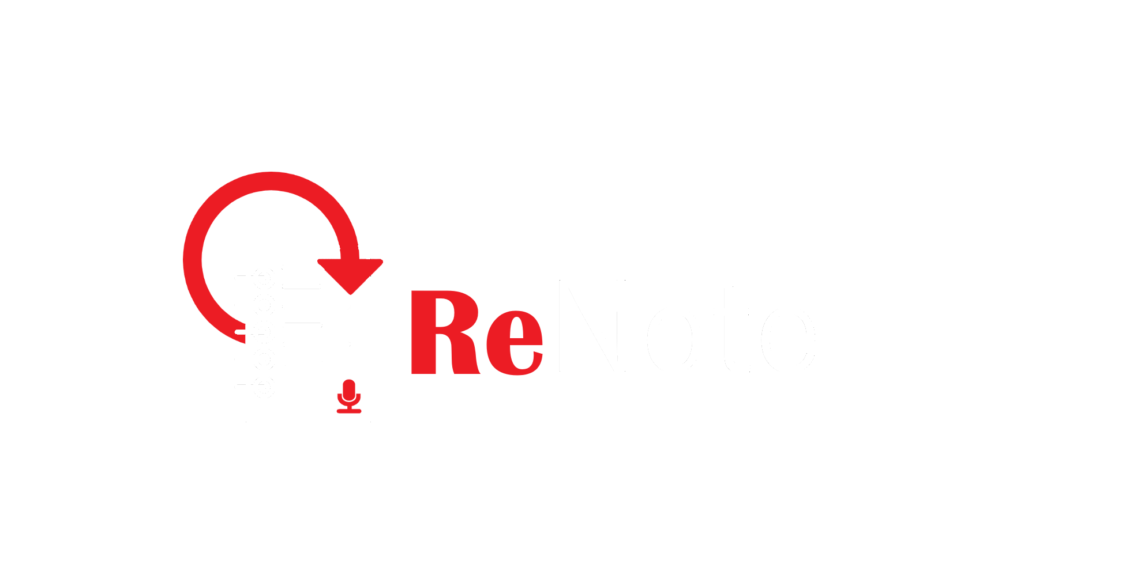
Our vision for the future of note-taking
Team 107: Colin He, Ivan Igoshev, Adam LaPorta, Henry Xue

Slide 2

Listening to community’s needs
At ReNote, we decided to develop an app that would best suit our vast and diverse community of students.
Image and video support can make my notes more interactive!
Rewind feature will make my lectures less stressful!

Slide 4
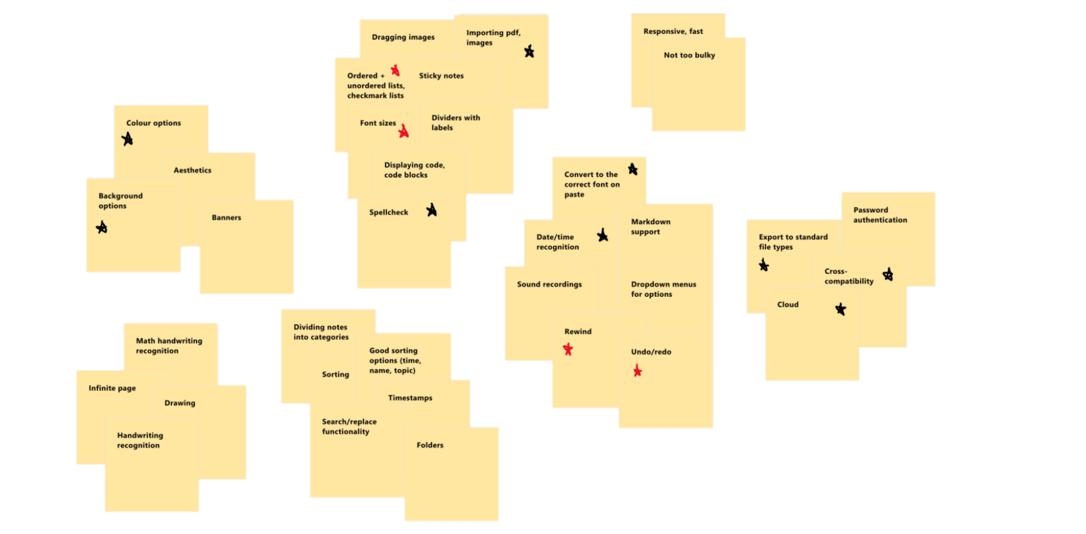


Affinity chart
= Core Features = Our Other Requirements
Rich text
UI design
NFRs
Out-of-app
Input mechanisms
Drawing
Administrative

Slide 5
Non-Functional Requirements
Non-functional requirements are critical to the success of the platform. Some specific examples:
App launching in under 5 seconds
Responsive operations within the application
Low memory/storage footprints
To achieve these, we need to:
Take them into consideration during app development
Measure the performance through integration testing
Notes:
Non-functional requirements are critical to the success of the platform. Some specific examples:
The program should be lightweight, launching in under 5 seconds and, if possible, recovering the state from the previous session. We will test this through performance measurement in integration testing.
Commands in the app should be extremely responsive. Typed letters should appear nearly instantly (~10 ms), saving should be performed in under a second, scrolling should be well-synced, etc. Heavy integration testing will be performed to ensure these requirements.
Each page of notes should not take up more than 100kB on disk without recordings, and recordings should use considerable compression to ensure reasonable space limits. This will be factored into our implementation details.

Slide 6
Our plan
Create a note-taking experience for students who don’t want to miss anything
The “Rewind” system: a killer feature for audio recording and real-time playback of your notetaking as-it-happened
Think: the best of Notability, Apple Notes and Google Keep, all in one app

Slide 7
Our vision

Slide 8
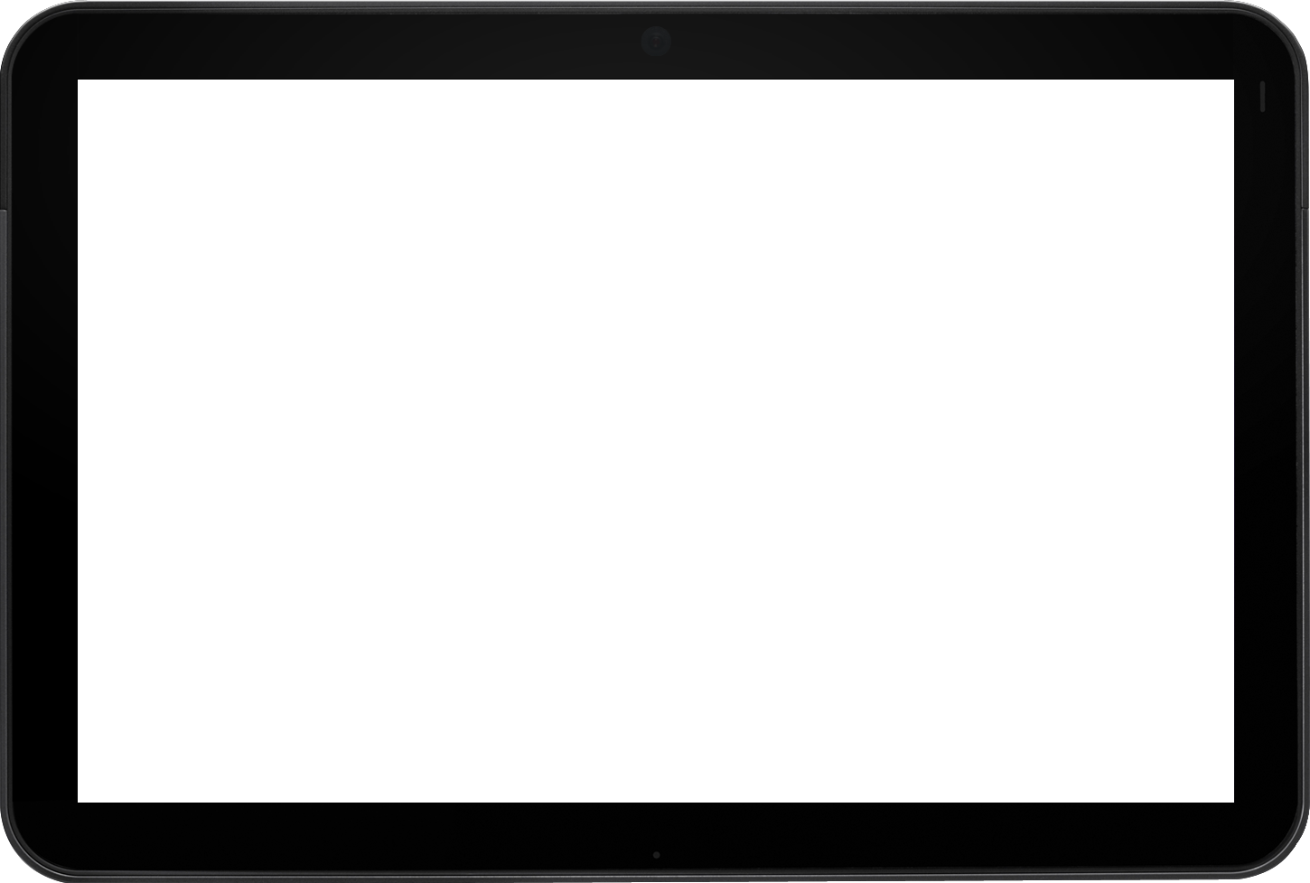
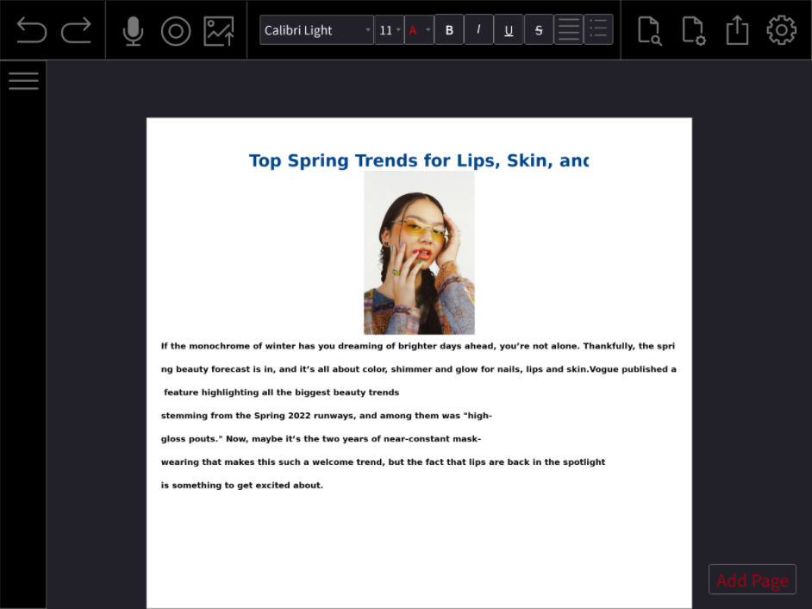

Slide 9
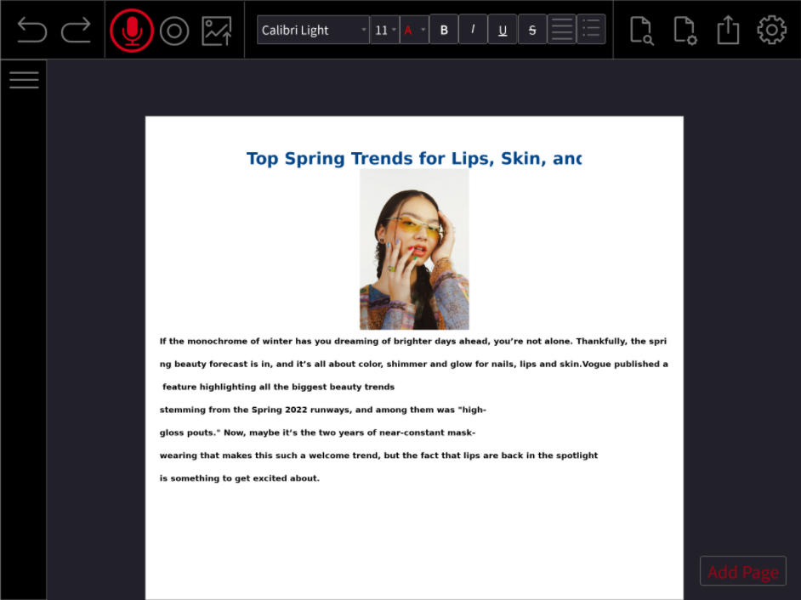

Slide 10
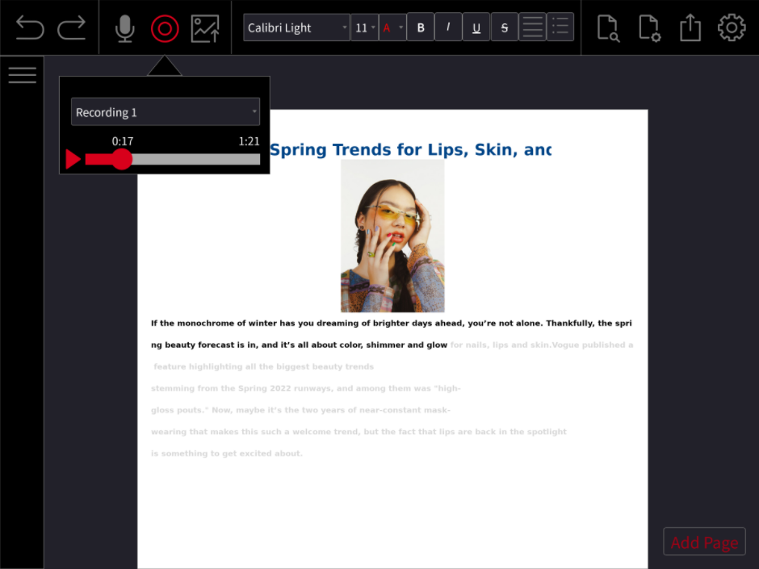

Slide 11
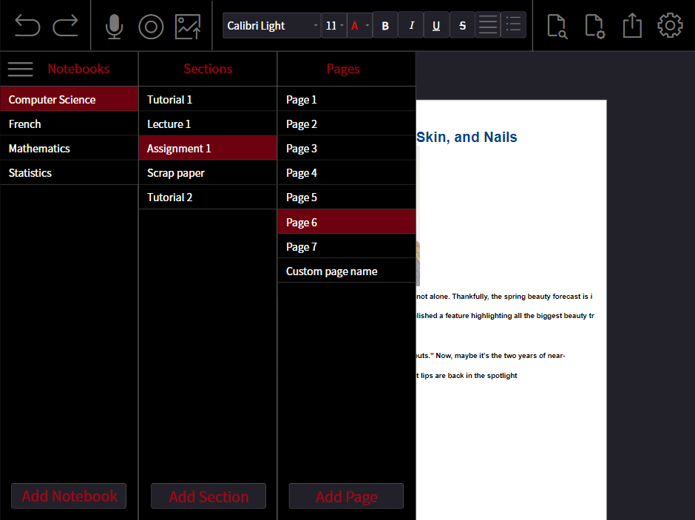

Slide 12
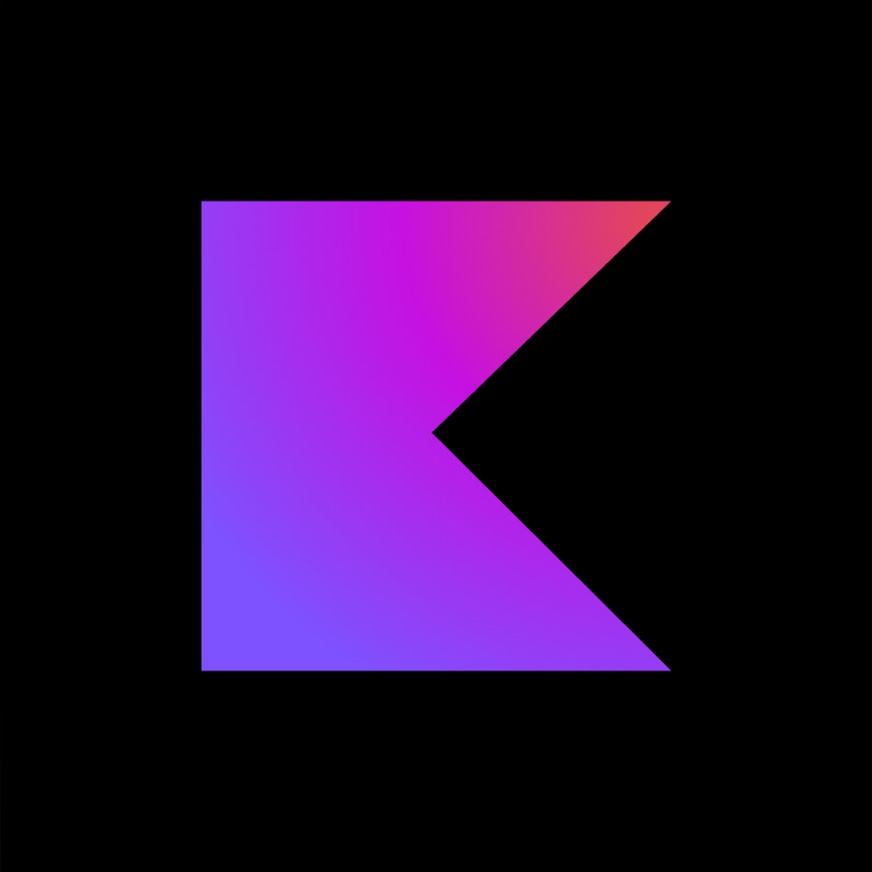

Architecture & Design
Presentation Layer
Tool Palette
Note Editor
Notebook Manager
Command
Singleton
Singleton
Business Layer
Undo/Redo Manager
Rewind Engine
Spellchecker
Import/Export
Command
Observer
Persistence Layer
User Settings
Raw Note Data
Rewind Recordings

Slide 13
Project Plan
Team Members: Colin, Ivan, Adam, Henry
Constraints:
None. All group members are present in Waterloo.
Deadlines:
Based on the Sprint deadlines. See the Gantt chart.
Risks?
The looming risk of COVID-19, hindering in-person collaboration.
Resources:
Four developers w/ technical equipment (laptops, iPad, tablet).

Slide 14
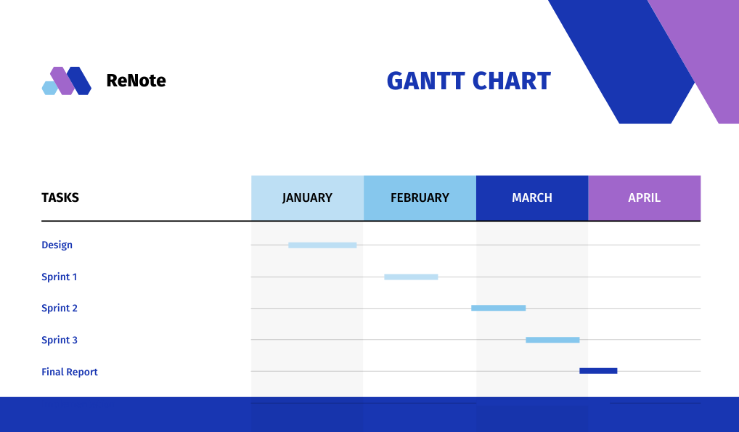
Timeline

Slide 15
ReNote: coming sooner than you think

