Slide 1

Agentic AI Framework for Automated Evaluation of Machine Learning Assignments
Aum Amriteshwaryai Namah!!!!
Mohan C P
AM.EN.P2WNA25007
Amrita Center for Wireless Networks and Applications
Amrita Vishwa Vidyapeetham
Amritapuri Campus, Kollam
Advisor:
Dr. Rahul Krishnan
Co-Advisor:
Ms.Vidya S Nair

Slide 2
Contents
Introduction
Motivation
Problem Definition
Objectives
Research Challenges
Literature Review Resources
Summary
Research Gaps
Innovation & Novelty
Proposed Solution
Architecture
Mathematical Modeling
System Requirements
Deliverables
Conclusion
Agentic AI Framework for Automated Evaluation of Machine Learning Assignments

Slide 3
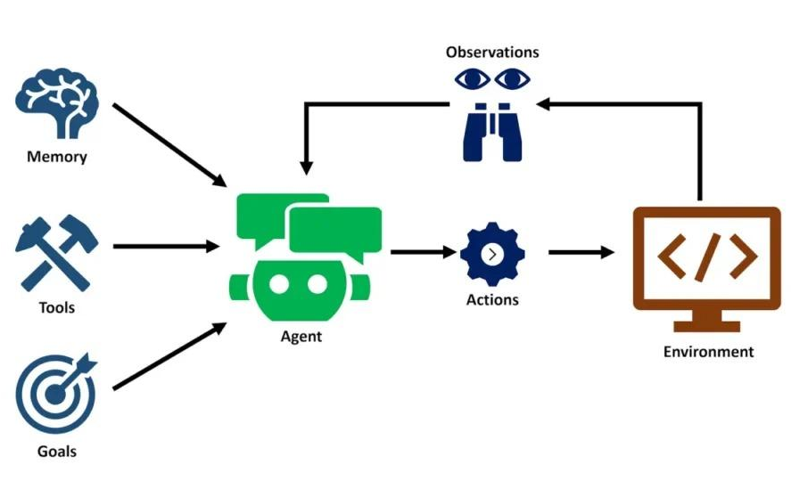
Introduction
Agentic AI Basic Framework
Makes use of multiple intelligent agents
Agentic AI systems can autonomously set goals, create multi-step plans.
Execute actions with minimal human supervision.
Enable autonomous task execution such as CrewAI, Microsoft AutoGen, and LangGraph .
Figure 1 : General Architecture of an Agentic AI system
Agentic AI Framework for Automated Evaluation of Machine Learning Assignments

Slide 4
Introduction
AI AGENT
AGENTIC AI
CREWAI
AI Agent = A small AI worker with a specific job.
Receives inputs
Performs one specific task
Uses available data/tools if needed
Returns a clear, structured result
Multi-Agent System = A team of AI agents working together.
Multiple agents handle different tasks
Agents share their results with each other
Each agent contributes to part of the solution
.
Framework having agents
CrewAI manages orchestration
Evaluates one framework in this study
Assignment evidence
Specialized agents
Rubric mapping
Score + feedback
Agentic AI Framework for Automated Evaluation of Machine Learning Assignments

Slide 5
Introduction
Machine Learning assignments involve both implementation and conceptual understanding.
Assignment evaluation requires checking multiple aspects of a student’s work.
Manual evaluation can become time-consuming for repeated student submissions.
Agentic AI provides a way to support complex, multi-step evaluation tasks.
This work explores Agentic AI for automated evaluation of ML assignments.
Agentic AI Framework for Automated Evaluation of Machine Learning Assignments

Slide 6

Motivation
Manual evaluation of ML assignments is time-consuming.
Evaluation involves multiple technical criteria (preprocessing, model selection, implementation, metrics, results & interpretation).
Different evaluators may assign different scores.
Limited evidence on Agentic AI evaluation of ML assignments.
Need to validate AI evaluation against human grading.
Agentic AI Framework for Automated Evaluation of Machine Learning Assignments

Slide 7
Problem Definition
Time-Consuming Evaluation: Manual evaluation requires significant expert effort.
Domain Specificity: Require evaluation of technical and section-wise criteria.
Rubric Compliance: AI may not consistently follow ML-specific evaluation criteria.
Scoring Reliability: AI-generated scores may differ from human grading.
Limited Validation: Lack of systematic validation of Agentic AI on human-graded ML assignments.
Agentic AI Framework for Automated Evaluation of Machine Learning Assignments

Slide 8
Objectives
Develop a rubric for structured evaluation of ML assignments.
Configure CrewAI to evaluate ML assignments using the rubric.
Compare AI-generated scores with human grades.
Measure scoring accuracy and consistency.
Identify rubric-specific evaluation errors.
Identify, document, and analyze the systematic deficiencies, and error rates of these frameworks.
Conduct a detailed statistical comparative analysis between AI-generated feedback and human evaluator scores.
Agentic AI Framework for Automated Evaluation of Machine Learning Assignments

Slide 9
Research Challenges
Domain-Specific Rubric Design
Developing clear and well-defined evaluation criteria specifically for ML assignments.
Section-Wise Evaluation
Ensuring each assignment section is evaluated according to its corresponding rubric criteria.
AI–Human Score Comparison
Quantitatively comparing CrewAI-generated scores with human-assigned grades.
Cross-Submission Consistency
Ensuring consistent evaluation across multiple students submitting the same assignment.
Rubric Alignment & Error Detection
Identifying deviations from rubric criteria and detecting errors in AI-generated evaluation.
Agentic AI Framework for Automated Evaluation of Machine Learning Assignments

Slide 10
Literature Review Resources
Sl No | Title | Authors | Conference/Journal/Book/Website (Impact factor & Link) | Year of Publication
1 | A Systematic Review of Pretrained Models in Automated Essay Scoring | Ahmed M. Elmassry, et al. | Conference: IEEE Conference Proceedings (Impact Factor: N/A (Conference Proceedings)) Link: https://ieeexplore.ieee.org/document/11062635 | 2025
2 | An LLM-based hybrid approach for enhanced automated essay scoring | John Atkinson, Diego Palma | Journal: Scientific Reports (Nature Portfolio) (https://doi.org/10.1038/s41598-025-87862-3, Impact Factor: 3.8 (Q1)) | 2025
3 | Multi-Agent LLM Collaboration for Adaptive Code Review, Debugging, and Security Analysis | Tanush Sharanarthi, Sreenidhi Polineni | Conference: IEEE Conference Proceedings (Impact Factor: N/A (Conference Proceedings)) Link: https://ieeexplore.ieee.org/document/11135756 | 2025
Agentic AI Framework for Automated Evaluation of Machine Learning Assignments

Slide 11
Literature Review Resources
Sl No | Title | Authors | Conference/Journal/Book/Website (Impact factor & Link) | Year of Publication
4 | Multi-Agent-as-Judge: Aligning LLM-Agent-Based Automated Evaluation with Multi-Dimensional Human Evaluation | Jiaju Chen et al. | Conference: 64th Annual Meeting of the Association for Computational Linguistics (ACL 2026) Impact Factor: N/A https://aclanthology.org/2026.acl-long.790.pdf | 2026
5 | LLM-Rubric: A Multidimensional, Calibrated Approach to Automated Evaluation of Natural Language Texts | Helia Hashemi et al. | Conference:62nd Annual Meeting of the Association for Computational Linguistics (ACL 2024) Impact Factor: N/A https://aclanthology.org/2024.acl-long.745/ | 2024
Agentic AI Framework for Automated Evaluation of Machine Learning Assignments

Slide 12
Summary
Multi-agent systems support structured evaluation.
Rubric-based LLMs show human-aligned evaluation.
LLMs perform well in educational assessment tasks.
Multi-agent workflows can improve consistency and reasoning.
Long documents remain challenging due to context limitations.
Reliable evaluation of large documents is still an open problem.
Agentic AI Framework for Automated Evaluation of Machine Learning Assignments

Slide 13
Research Gaps
Limited validation of agentic AI on ML-specific assignments
Lack of domain-specific and section-wise rubrics
Limited AI-human score comparison
Limited analysis of evaluation consistency
Insufficient error-level analysis
Lack of ML-specific reliability benchmarking
Agentic AI Framework for Automated Evaluation of Machine Learning Assignments

Slide 14



Innovation & Novelty
“Domain-specific rubric-based evaluation of ML assignments using Agentic AI and validation against human grading.”
1. ML-Specific Evaluation
Evaluation tailored to assignment structure and criteria.
2. Structured Rubric
Section-wise rubric for consistent assignment assessment.
3. Human-AI Validation
Comparison of CrewAI scores with human grades.
Identifies rubric misalignment and scoring errors.
Measures AI–human agreement and consistency.
Quantitative Evaluation: Measures agreement, correlation, error and consistency with human evaluations.
Agentic AI Framework for Automated Evaluation of Machine Learning Assignments

Slide 15
Proposed Solution
“Develop a CrewAI-based evaluation framework for structured ML assignments using a domain-specific rubric and human-graded reference assignments.”
CrewAI-Based Evaluation using specialized agents for ML assignment assessment.
ML-Specific Rubric Assessment using predefined, section-wise evaluation criteria.
Human–AI Comparison using human-graded ML assignments as the reference baseline.
Statistical Evaluation using correlation, error and agreement measures.
Deficiency Analysis to identify rubric misalignment, missed technical content and scoring inconsistencies.
Input: ML Assignment + ML-Specific Rubric
Output: AI Evaluation + Human–AI Comparison + Deficiency Analysis
Agentic AI Framework for Automated Evaluation of Machine Learning Assignments

Slide 16
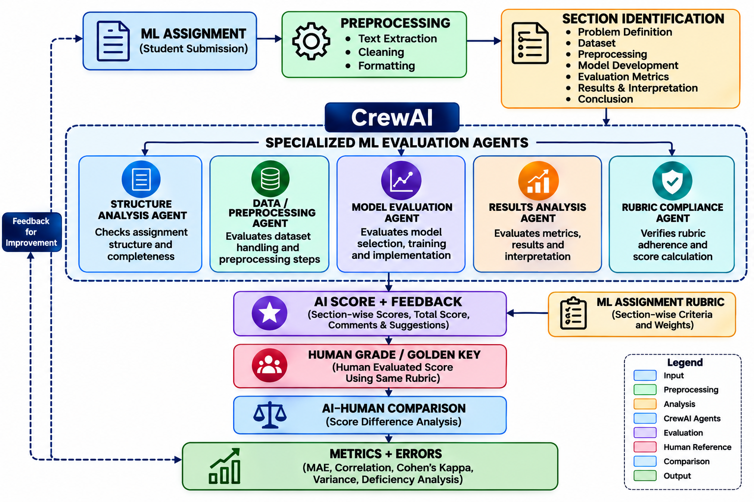
Architecture
Agentic AI Framework for Automated Evaluation of Machine Learning Assignments

Slide 17
Key Evaluation Elements of ML Assignment
1. Data Preprocessing Agent
4. Model Evaluation Agent
Checks missing values, scaling, encoding, splitting, and leakage.
Checks metrics and validation strategy.
2. ML Code Agent
5. Results Interpretation Agent
Checks implementation and code correctness.
Checks whether conclusions match results.
3. Methodology Agent
6. Rubric Agent
Evaluates algorithm and methodological choices.
Maps findings to marks.
Agentic AI Framework for Automated Evaluation of Machine Learning Assignments

Slide 18
Dataset Description
Parameter | Description
Dataset | 28 ML assignments
Assignment Name | U1A1 – Linear Regression
ML Model | Linear Regression
Document Format | PDF
Questions / Criteria | Dataset, predictor analysis, sample count, train/test split, evaluation metrics, reflection
Page Count | Minimum: 4 pages / Maximum: 10 pages
Evaluation Scale | 10 marks
Evidence Type | Text, code, plots, numerical outputs, screenshots
Agentic AI Framework for Automated Evaluation of Machine Learning Assignments

Slide 19
PDF Preprocessing & Evidence Preparation
1. PDF Input
Student assignment submitted as PDF
Multi-page document
2. Text Extraction
Extract text from each page
Preserve page-wise content
Identify headings and sections
3. JSON Conversion
Convert extracted content into structured JSON
Store:
Page number
Extracted text
Section information
Evidence references
Agentic AI Framework for Automated Evaluation of Machine Learning Assignments

Slide 20
PDF Preprocessing & Evidence Preparation
4. Image / Visual Evidence
Detect pages with low or missing extracted text
Flag pages containing screenshots, plots or images
Preserve these pages for visual verification
5. Evidence Preparation
Organize text and visual evidence
Prepare structured input for agent evaluation
Agentic AI Framework for Automated Evaluation of Machine Learning Assignments

Slide 21
Rubric Design
Rubric Designing for ML Assignment Evaluation
Purpose: Define measurable criteria to evaluate the student's ML assignment consistently.
Rubric Design Process
Step 1: Assignment Questions
Step 4: Assign Maximum Marks
Step 2: Identify Evaluation Criteria
Step 5: Define Scoring Rules
Step 3: Define Required Evidence
Step 6: Criterion-wise AI Evaluation
Agentic AI Framework for Automated Evaluation of Machine Learning Assignments

Slide 22
TOKENIZATION
Tokenization of Assignment Content
Purpose: Convert extracted assignment text into smaller meaningful units that can be processed and searched.
Tokenization Process:
Tokenization: BPE/Subword tokenization.
Tokens per word: Variable; typically 1–3 tokens per English word.
Tokens per sentence: Depends on sentence length; no fixed number.
Normalization: L2 normalization of embedding vectors.
Cleaned Assignment Text
↓
Sentence / Word Split
↓
Tokens
↓
Normalization
↓
Processable Text
Agentic AI Framework for Automated Evaluation of Machine Learning Assignments

Slide 23

Similarity Metric
Cosine Similarity:
Importance of Cosine similarity:
Where:
Semantic meaning
Word-order independent
Handles different wording
Works well with embeddings
Simple & efficient
C= vector representing the rubric criterion/query
D = vector representing an assignment text chunk
C dot D = dot product
|C| and |D| = vector magnitudes
Interpretation
1 → highly similar
0 → no similarity
Values closer to 1 → more relevant evidence
Agentic AI Framework for Automated Evaluation of Machine Learning Assignments

Slide 24


Mathematical Modeling/Algorithm
1: Mathematical Model of Report Evaluation
Let:
A = Machine Learning Assignment
Cᵢ = Evaluation criterion
Wᵢ = Weight of criterion
Sᵢ = AI-assigned score
Hᵢ = Human-assigned score
N = Number of criteria
Then: Overall ML Assignment Score
Then compare:
Agentic AI Framework for Automated Evaluation of Machine Learning Assignments

Slide 25
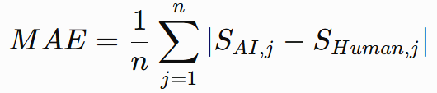



Mathematical Modeling/Algorithm
2: Evaluation Metrics
a. Mean Absolute Error
c. Variance Difference
Lower MAE → Better agreement
Measures grading consistency
b. Correlation
d. Cohen's Kappa
Higher r → Stronger agreement
Measures agreement beyond chance
Agentic AI Framework for Automated Evaluation of Machine Learning Assignments

Slide 26
Mathematical Modeling/Algorithm
4: Evaluation Algorithm
Input:
ML Assignment A
ML Rubric C
Human Score H
1. Preprocess Assignment
↓
2. Extract Code + Data + Methodology + Results
↓
3. Select Agentic Framework
↓
4. Configure ML Evaluation Agents
↓
5. Evaluate Each Rubric Criterion
6. Generate AI Score + Feedback
↓
7. Compare AI Score with Human Score
↓
8. Calculate
MAE
Correlation
QWK/Kappa
Variance
↓
9. Identify ML-specific Errors
↓
Output:
Framework Benchmark + Error Analysis + AI-Human Agreement
Agentic AI Framework for Automated Evaluation of Machine Learning Assignments

Slide 27
28-Assignment Evaluation Results
Completed v1 run: 28 U1A1 Linear Regression PDFs
All 28 produced a provisional total. Five criteria per submission yielded 140 score decisions and 140 feedback items.
Question | Evaluation criterion | Marks
Q1 | Dataset understanding | 1
Q2 | Scatter plots and predictor selection | 4
Q3 | Sample count: 414 | 1
Q4 | Evidence for the chosen train/test split | 1
Q5 | MAE, MSE and MAPE | 3
AI scores are provisional; human review is required before use as final grades.
Agentic AI Framework for Automated Evaluation of Machine Learning Assignments
Notes:
Sources inspected: https://github.com/CPmohan/ml-assignment-evaluator/blob/3d7933e27dee86293594297fa8b80b90d0b10358/rubric.json ; https://github.com/CPmohan/ml-assignment-evaluator/blob/3d7933e27dee86293594297fa8b80b90d0b10358/evaluation_core.py ; https://github.com/CPmohan/ml-assignment-evaluator/blob/3d7933e27dee86293594297fa8b80b90d0b10358/grade_dataset.py ; https://github.com/CPmohan/ml-assignment-evaluator/blob/3d7933e27dee86293594297fa8b80b90d0b10358/performance_analysis.py ; https://github.com/CPmohan/ml-assignment-evaluator/blob/3d7933e27dee86293594297fa8b80b90d0b10358/app.py . Repository inspected 17 October 2026 UTC. The tracked repository contains code but no PDFs, saved evaluation outputs or human review data. The README mentions 28 locally held PDFs; none are in the checkout. Thirty assignments is the requested study target. No completed evaluation counts, agreement rates or feedback correctness labels can be verified. Correct/wrong labels concern evaluator decisions, not whether a student's answer earned full marks. Human feedback review is a proposed extension. Unverified cases must not be silently counted as wrong. Separate held-out human reference scores should be established before seeing AI scores. Other slides retain the user's original content and may describe an earlier implementation.

Slide 28
Score and Feedback Assessment
Score and feedback generation
Total-score comparison
All 28 reports returned valid totals: 107/280 overall, or 3.82/10 on average.
Each report covers five criteria and includes a score, evidence, feedback and limitations.
Generated feedback: 140 of 140 criterion items.
Transcribed human totals averaged 9.30/10; AI totals averaged 3.82/10.
AI totals were lower in 28/28 matched records, with a mean gap of 5.48 marks.
This flags under-scoring at total level; it does not identify which criteria were mis-scored.
Human totals were transcribed from screenshots; verify the duplicate Asha submission mapping before formal reporting.
Agentic AI Framework for Automated Evaluation of Machine Learning Assignments
Notes:
Sources inspected: https://github.com/CPmohan/ml-assignment-evaluator/blob/3d7933e27dee86293594297fa8b80b90d0b10358/rubric.json ; https://github.com/CPmohan/ml-assignment-evaluator/blob/3d7933e27dee86293594297fa8b80b90d0b10358/evaluation_core.py ; https://github.com/CPmohan/ml-assignment-evaluator/blob/3d7933e27dee86293594297fa8b80b90d0b10358/grade_dataset.py ; https://github.com/CPmohan/ml-assignment-evaluator/blob/3d7933e27dee86293594297fa8b80b90d0b10358/performance_analysis.py ; https://github.com/CPmohan/ml-assignment-evaluator/blob/3d7933e27dee86293594297fa8b80b90d0b10358/app.py . Repository inspected 17 October 2026 UTC. The tracked repository contains code but no PDFs, saved evaluation outputs or human review data. The README mentions 28 locally held PDFs; none are in the checkout. Thirty assignments is the requested study target. No completed evaluation counts, agreement rates or feedback correctness labels can be verified. Correct/wrong labels concern evaluator decisions, not whether a student's answer earned full marks. Human feedback review is a proposed extension. Unverified cases must not be silently counted as wrong. Separate held-out human reference scores should be established before seeing AI scores. Other slides retain the user's original content and may describe an earlier implementation.

Slide 29
Question-Wise Score Accuracy
28 submissions × 5 criteria = 140 possible score comparisons.
Criterion | Possible pairs | Correct | Wrong | Status
Q1 | 28 | Not assessed | Not assessed | No criterion labels
Q2 | 28 | Not assessed | Not assessed | No criterion labels
Q3 | 28 | Not assessed | Not assessed | No criterion labels
Q4 | 28 | Not assessed | Not assessed | No criterion labels
Q5 | 28 | Not assessed | Not assessed | No criterion labels
Total | 140 | Not assessed | Not assessed | Pending review
The 28 human reference values are totals only; criterion-level human scores are not recorded.
Correct / wrong counts and accuracy require human-approved marks for each criterion.
Agentic AI Framework for Automated Evaluation of Machine Learning Assignments
Notes:
Sources inspected: https://github.com/CPmohan/ml-assignment-evaluator/blob/3d7933e27dee86293594297fa8b80b90d0b10358/rubric.json ; https://github.com/CPmohan/ml-assignment-evaluator/blob/3d7933e27dee86293594297fa8b80b90d0b10358/evaluation_core.py ; https://github.com/CPmohan/ml-assignment-evaluator/blob/3d7933e27dee86293594297fa8b80b90d0b10358/grade_dataset.py ; https://github.com/CPmohan/ml-assignment-evaluator/blob/3d7933e27dee86293594297fa8b80b90d0b10358/performance_analysis.py ; https://github.com/CPmohan/ml-assignment-evaluator/blob/3d7933e27dee86293594297fa8b80b90d0b10358/app.py . Repository inspected 17 October 2026 UTC. The tracked repository contains code but no PDFs, saved evaluation outputs or human review data. The README mentions 28 locally held PDFs; none are in the checkout. Thirty assignments is the requested study target. No completed evaluation counts, agreement rates or feedback correctness labels can be verified. Correct/wrong labels concern evaluator decisions, not whether a student's answer earned full marks. Human feedback review is a proposed extension. Unverified cases must not be silently counted as wrong. Separate held-out human reference scores should be established before seeing AI scores. Other slides retain the user's original content and may describe an earlier implementation.

Slide 30
Feedback Accuracy Assessment
The evaluator generated 140 criterion-level feedback items across 28 submissions.
Review outcome | Decision rule | Count
Correct | Accurate, relevant and supported by the PDF; follows the rubric. | Not assessed
Wrong | Factual error, unsupported claim, missed issue or incorrect advice. | Not assessed
Unverified | Missing output or unresolved reviewer judgment. | Not assessed
Feedback accuracy = correct / (correct + wrong), once items are independently reviewed.
No human feedback labels are stored; 140 items still need review against the PDF.
Agentic AI Framework for Automated Evaluation of Machine Learning Assignments
Notes:
Sources inspected: https://github.com/CPmohan/ml-assignment-evaluator/blob/3d7933e27dee86293594297fa8b80b90d0b10358/rubric.json ; https://github.com/CPmohan/ml-assignment-evaluator/blob/3d7933e27dee86293594297fa8b80b90d0b10358/evaluation_core.py ; https://github.com/CPmohan/ml-assignment-evaluator/blob/3d7933e27dee86293594297fa8b80b90d0b10358/grade_dataset.py ; https://github.com/CPmohan/ml-assignment-evaluator/blob/3d7933e27dee86293594297fa8b80b90d0b10358/performance_analysis.py ; https://github.com/CPmohan/ml-assignment-evaluator/blob/3d7933e27dee86293594297fa8b80b90d0b10358/app.py . Repository inspected 17 October 2026 UTC. The tracked repository contains code but no PDFs, saved evaluation outputs or human review data. The README mentions 28 locally held PDFs; none are in the checkout. Thirty assignments is the requested study target. No completed evaluation counts, agreement rates or feedback correctness labels can be verified. Correct/wrong labels concern evaluator decisions, not whether a student's answer earned full marks. Human feedback review is a proposed extension. Unverified cases must not be silently counted as wrong. Separate held-out human reference scores should be established before seeing AI scores. Other slides retain the user's original content and may describe an earlier implementation.

Slide 31
System Requirements
Hardware Requirements
Sl No | Component Name | Vendor | Available/To be purchased?
1 | Standard Development Workstation (Minimum 16GB RAM, multi-core processor) | Intel | Yes
Software Requirements
Sl No | Software Name | Open source/Licensed | Been installed in lab PC
1 | Python; Streamlit; PyMuPDF; local Ollama runtime; qwen3:4b-instruct model. | Open source / local | Installed
Agentic AI Framework for Automated Evaluation of Machine Learning Assignments

Slide 32
Publication Details (Targeted)
Name of Conference/Journal | Place & Conference Date | Submission Date | Acceptance Date | Scopus Indexed(Y/N)
2026 International Conference on Advanced VLSI Design, AI Solutions, and Reconfigurable Technology Applications (AVARTA) | Thanjavur, Tamil Nadu, India Sastra University | 9-11- 2026 | 19-12-2026 | yes
Agentic AI Framework for Automated Evaluation of Machine Learning Assignments

Slide 33
Deliverables
Automated ML Assignment Evaluator
Agentic AI system for rubric-based evaluation.
Evaluation Dataset
ML assignments with AI scores, human scores and feedback.
Performance & Error Analysis
AI–human comparison using evaluation metrics and identified errors.
Agentic AI Framework for Automated Evaluation of Machine Learning Assignments

Slide 34
Agent-Count Experiment
One U1A1 submission; same rubric and local model (qwen3:4b-instruct). Each reviewer was a seeded independent request.
1 reviewer: 6/10 consensus; 100% agreement*
2 reviewers: 5/10; 90.0% agreement
3 reviewers: 6/10; 86.7% agreement
4 reviewers: 6/10; 90.0% agreement
*The one-reviewer baseline is 100% by definition.
The consensus stayed at 6/10 from three to four reviewers. This measures repeatability on one PDF, not agreement with human grading; feedback quality was not measured.
Agentic AI Framework for Automated Evaluation of Machine Learning Assignments

Slide 35
Limitations and Next Steps
Limitations
• Human criterion-level marks are not recorded, so question-wise correct/wrong counts cannot be calculated.
• Feedback correctness has not been independently reviewed against the original PDFs.
• The reviewer-count experiment covers one submission and repeated calls to one model; it measures consistency only.
• Text extraction may miss plots and screenshots; visual verification remains necessary.
Next steps
Review all 140 score decisions and 140 feedback items, calculate criterion-level accuracy, and repeat the reviewer-count study across the 28 submissions. Apply the same analysis to SA-type assignments when those submissions are available.
Agentic AI Framework for Automated Evaluation of Machine Learning Assignments

