Slide 1
IBM University Engagement Project Submission
“Exploring the Power of Agentic AI with IBM Granite and IBM Bob”

Slide 2

Project Tile –AI-Driven NSAP Eligibility Evaluator
Domain of Project-GovTech & Public Welfare Administration
Student Name | Recent Passport Photo | Email ID | Mobile number [WhatsApp]
Preeti Mishrilal Choudhary |  | preetichoudhary032006@gmail.com | 9307389805

Slide 3
Problem Statement -
The Challenge
The National Social Assistance Program (NSAP) is a flagship social security and welfare program by the Government of India. It aims to provide financial assistance to the elderly, widows, and persons with disabilities belonging to below-poverty-line (BPL) households. The program consists of several sub-schemes, each with specific eligibility criteria. Manually verifying applications and assigning the correct scheme can be a time-consuming and error-prone process. Delays or incorrect allocation can prevent deserving individuals from receiving timely financial aid. Your task is to design, build, and evaluate a multi-class classification model that can accurately predict the most appropriate NSAP scheme for an applicant based on their demographic and socio-economic data.
The Objective
To build an AI-powered web application that automates the eligibility prediction for India's National Social Assistance Programme (NSAP) schemes — IGNOAPS, IGNWPS, IGNDPS, and NFBS — using a hybrid classification approach combining deterministic rule-based logic with IBM watsonx Granite-4 large language model inference.
The system assists government officials and applicants in accurately and efficiently determining the most appropriate welfare scheme based on demographic and socio-economic inputs, reducing manual processing time and minimizing mis-allocation of social benefits to BPL households.

Slide 4
Proposed Solution -
Proposed Solution: AI-Powered NSAP Eligibility Evaluator
Interactive Citizen Portal: A clean, accessible frontend interface for citizens and Common Service Centre (CSC) operators to input socio-economic and demographic parameters.
Hybrid Classification & Rule Engine: Machine learning models predict the primary welfare scheme, backed by deterministic Python tools to enforce strict statutory guidelines.
Agentic Orchestration via watsonx: Leverages IBM watsonx Orchestrate and Granite foundation models to dynamically route inputs, call validation tools, and handle edge cases.
Automated Audit & Decision Explanations: Instantly generates auditable eligibility reports, benefit calculations, and missing-document checklists for welfare verification officers.
Scalable IBM Cloud Deployment: Built on IBM Cloud Lite infrastructure to deliver secure, low-latency, and cost-effective welfare categorization.

Slide 5
Technology Used
IBM watsonx Granite-4 (LLM classification)
IBM watsonx.ai (inference API)
IBM watsonx Orchestrate (agent deployment)
Python 3 with pydantic, requests, python- dotenv
HTML5 / CSS3 / Vanilla JavaScript (frontend)
Git & GitHub (version control)
AI Kosh dataset link https://aikosh.indiaai.gov.in/web/datasets/details/district_wise_pension_data_under_the_national_social_assistance_programme_nsap_1.html

Slide 6
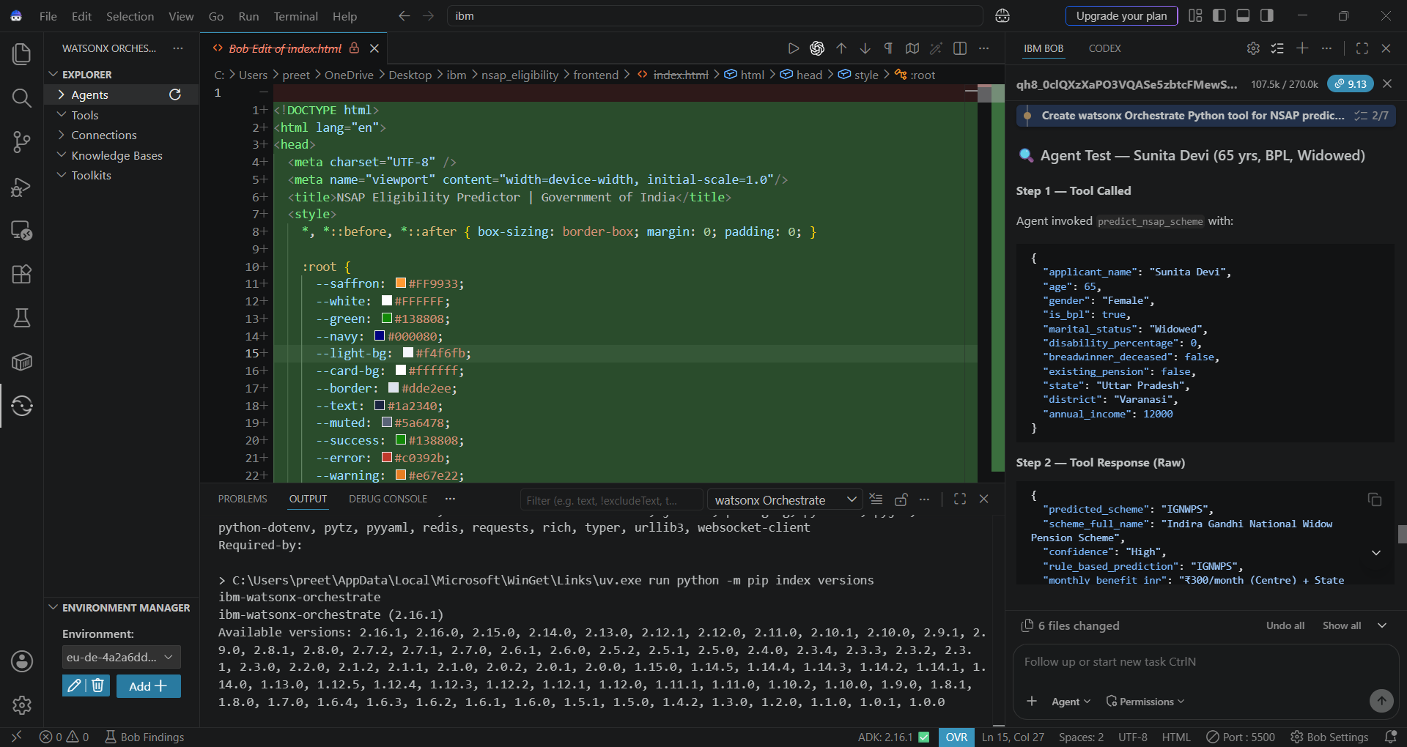
Required Files created using IBM bob -

Slide 7
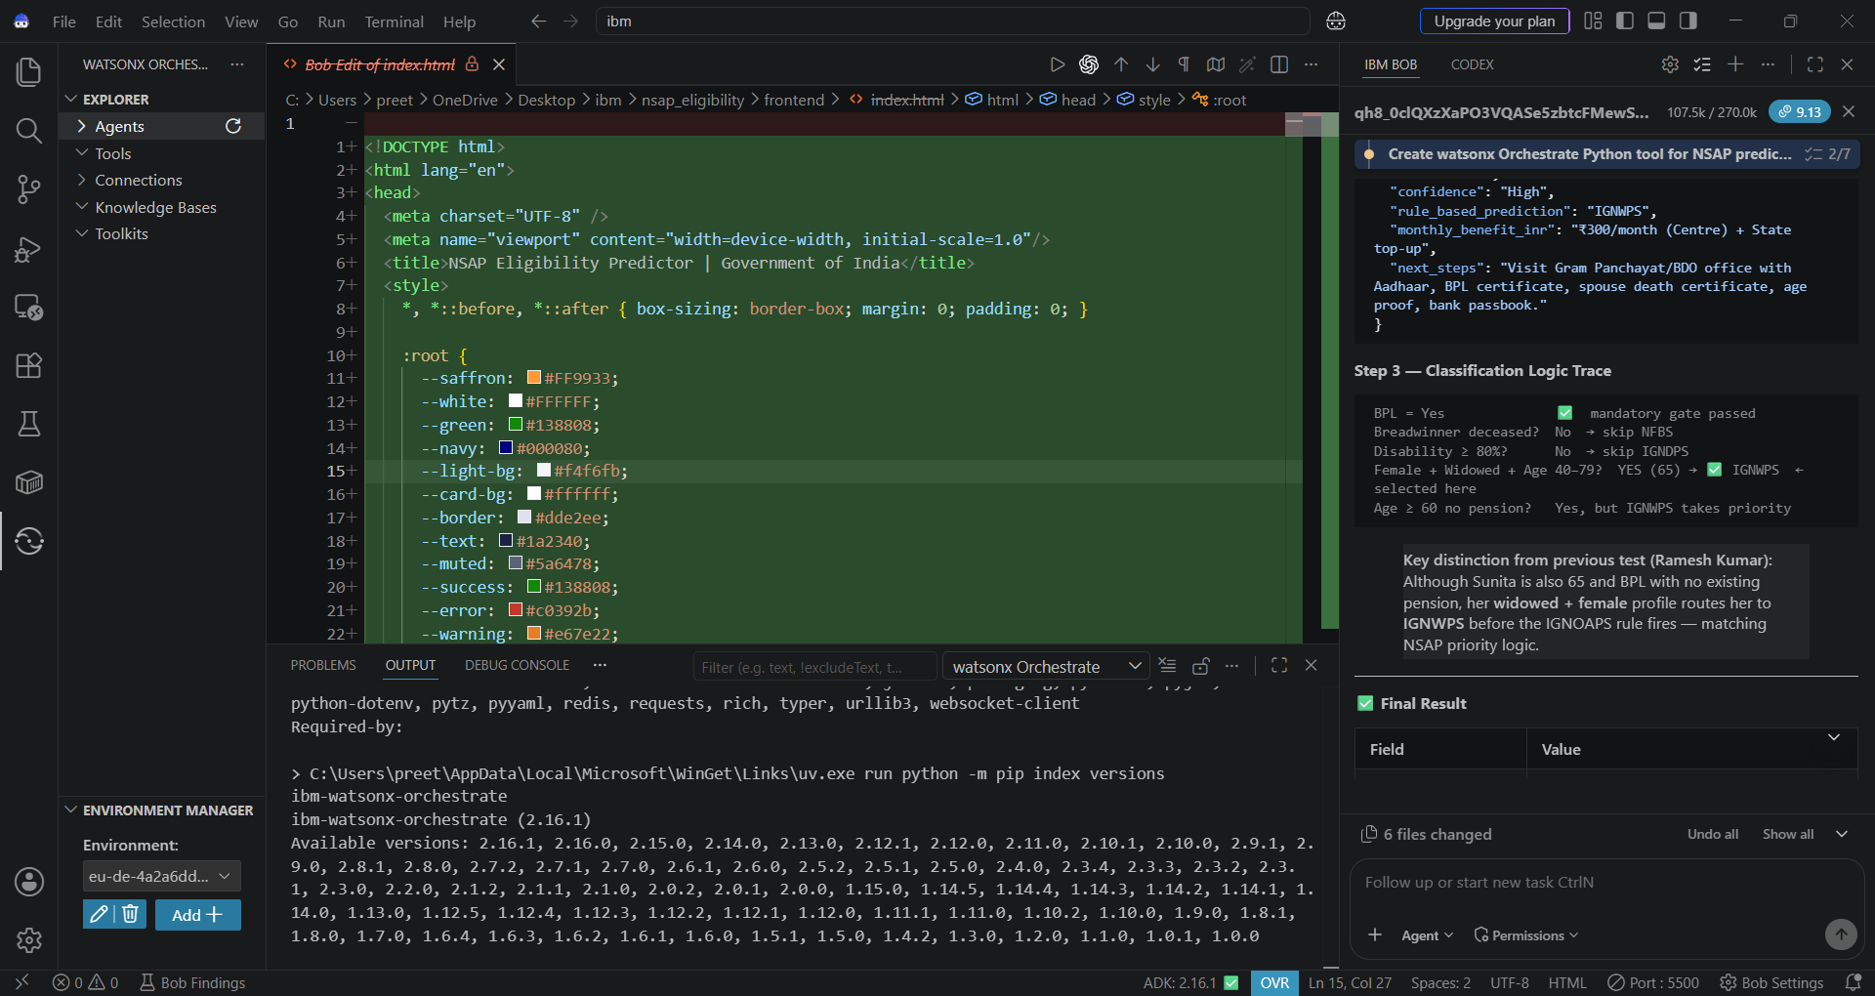

Slide 8
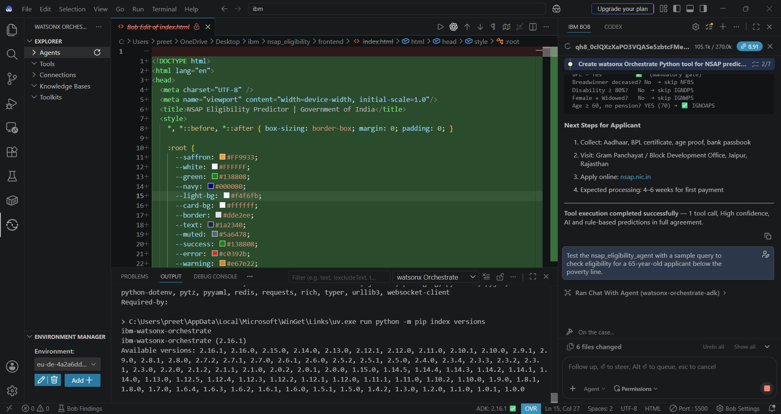

Slide 9
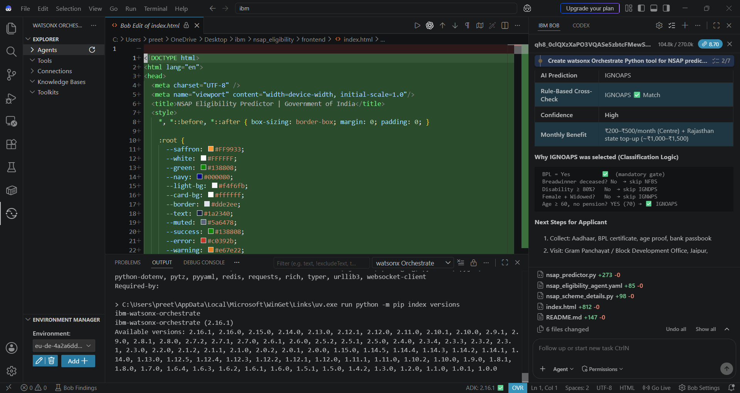

Slide 10
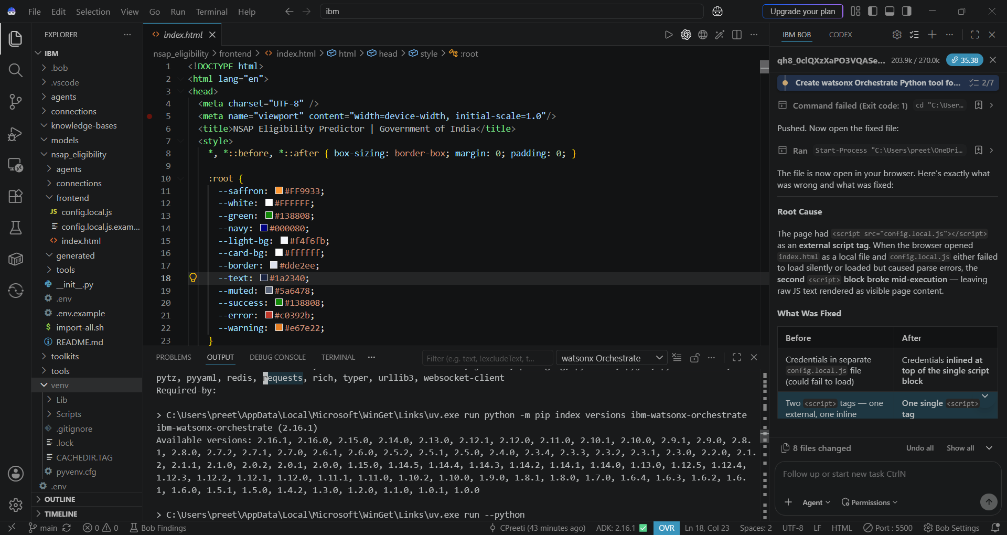
IBM Bob Screenshots:

Slide 11
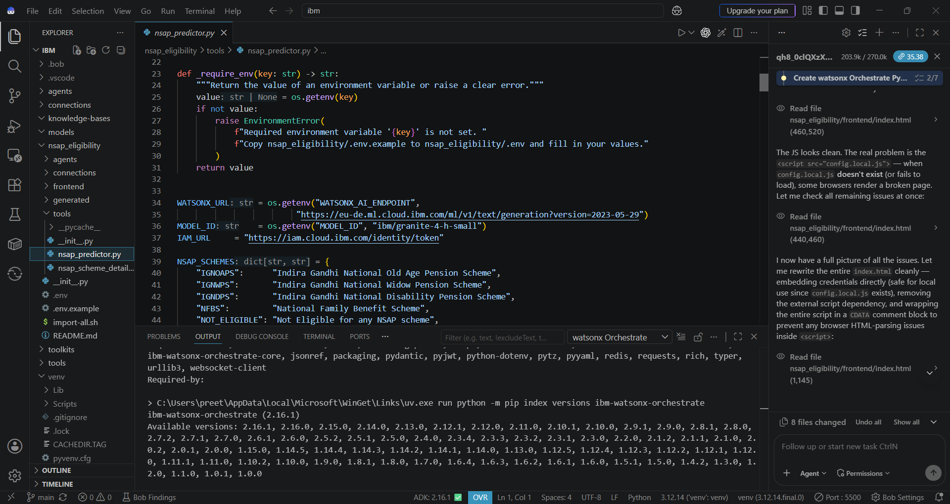

Slide 12
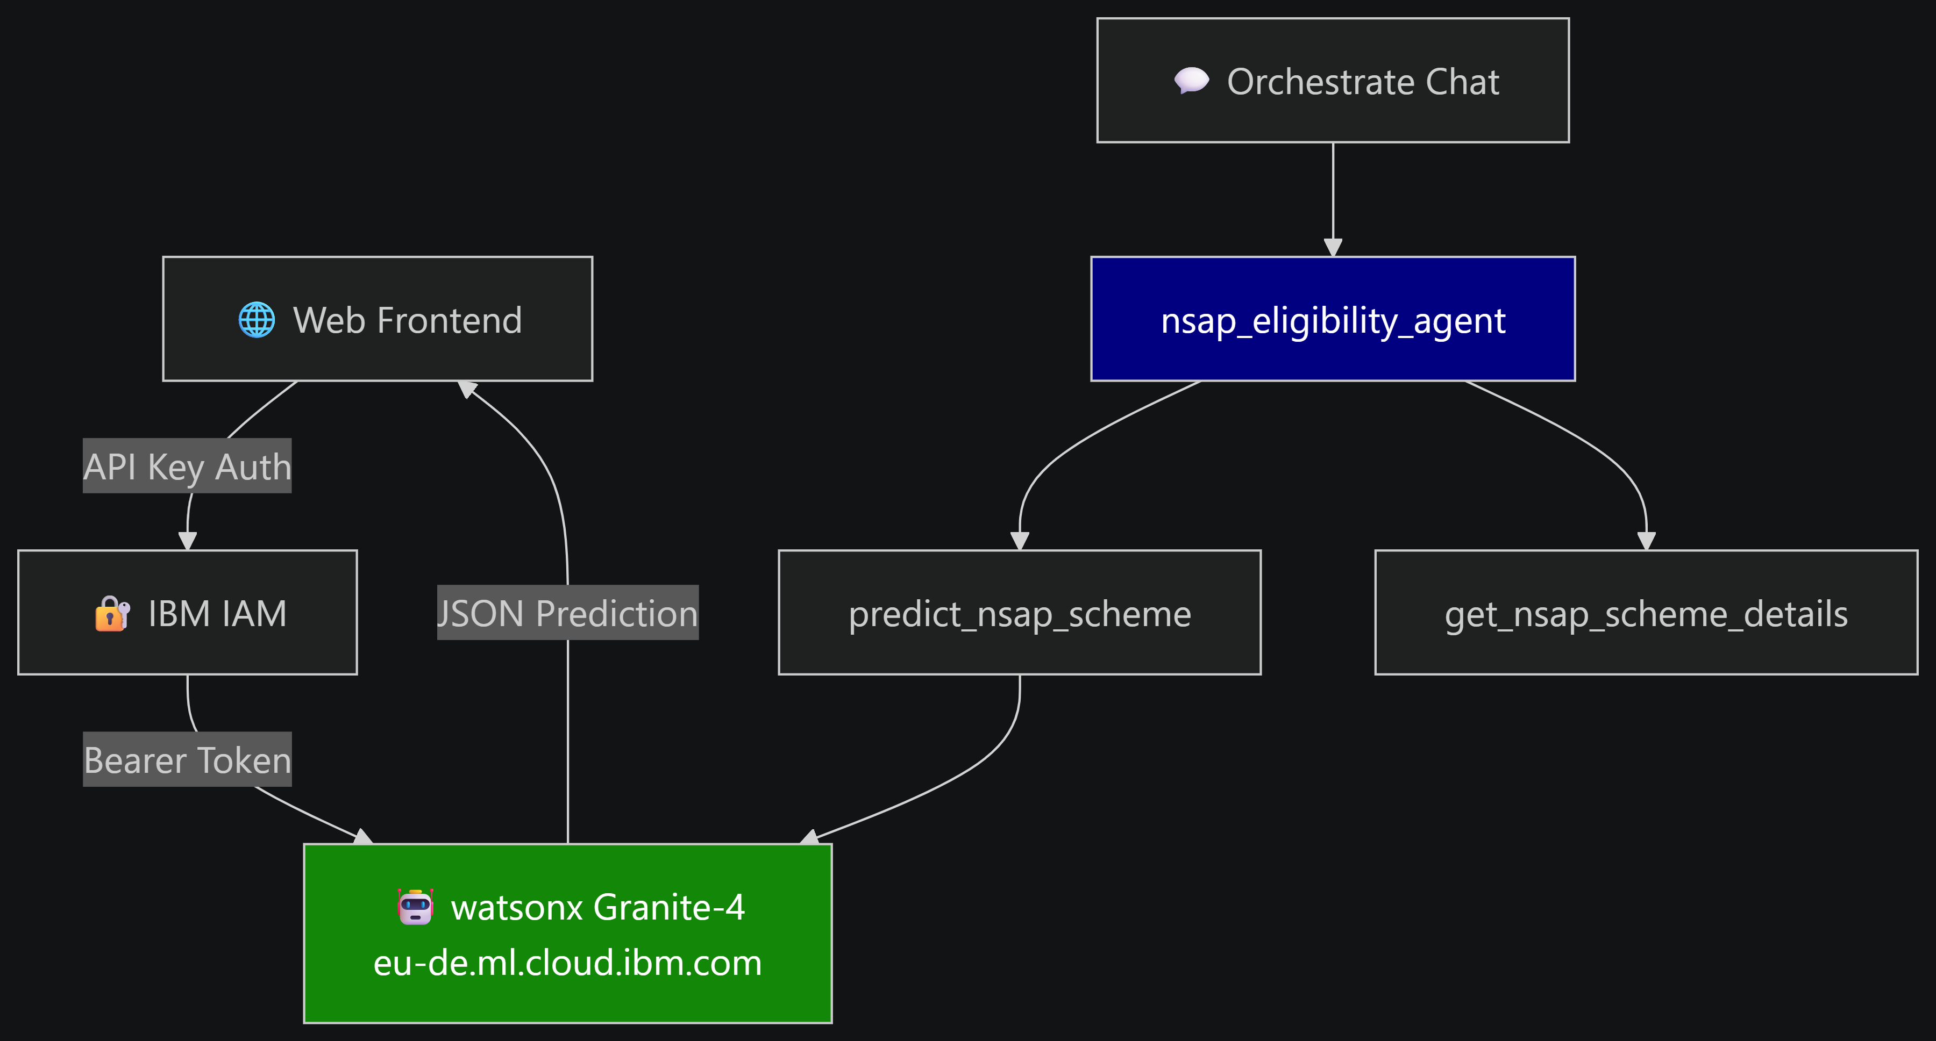
Architecture blueprint for IBM bob:

Slide 13
Role of Agentic AI in the solution
Autonomous Orchestration: Evaluates applicant profiles dynamically and routes cases to the correct NSAP sub-scheme (IGNOAPS, IGNWPS, IGNDPS, NFBS, Annapurna).
Deterministic Tool Calling: Triggers backend policy logic (nsap_scheme_details.py) via watsonx Orchestrate to strictly enforce BPL, age, and disability criteria.
Explainable Reasoning: Uses IBM Granite models to generate transparent, auditable Human-in-the-Loop Safeguards: Flags borderline or conflicting demographic data for officer review, preventing fund misallocation.

Slide 14
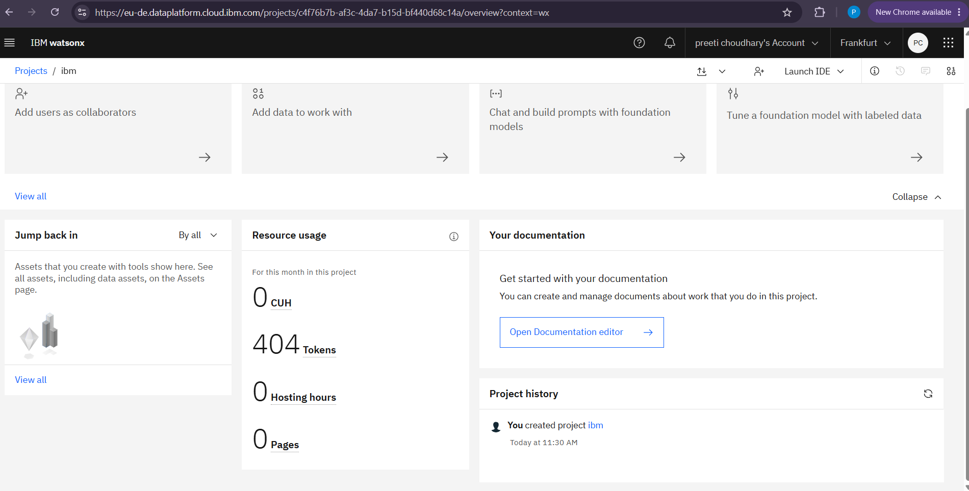
Token Usage
404 token are used
·
·
·

Slide 15
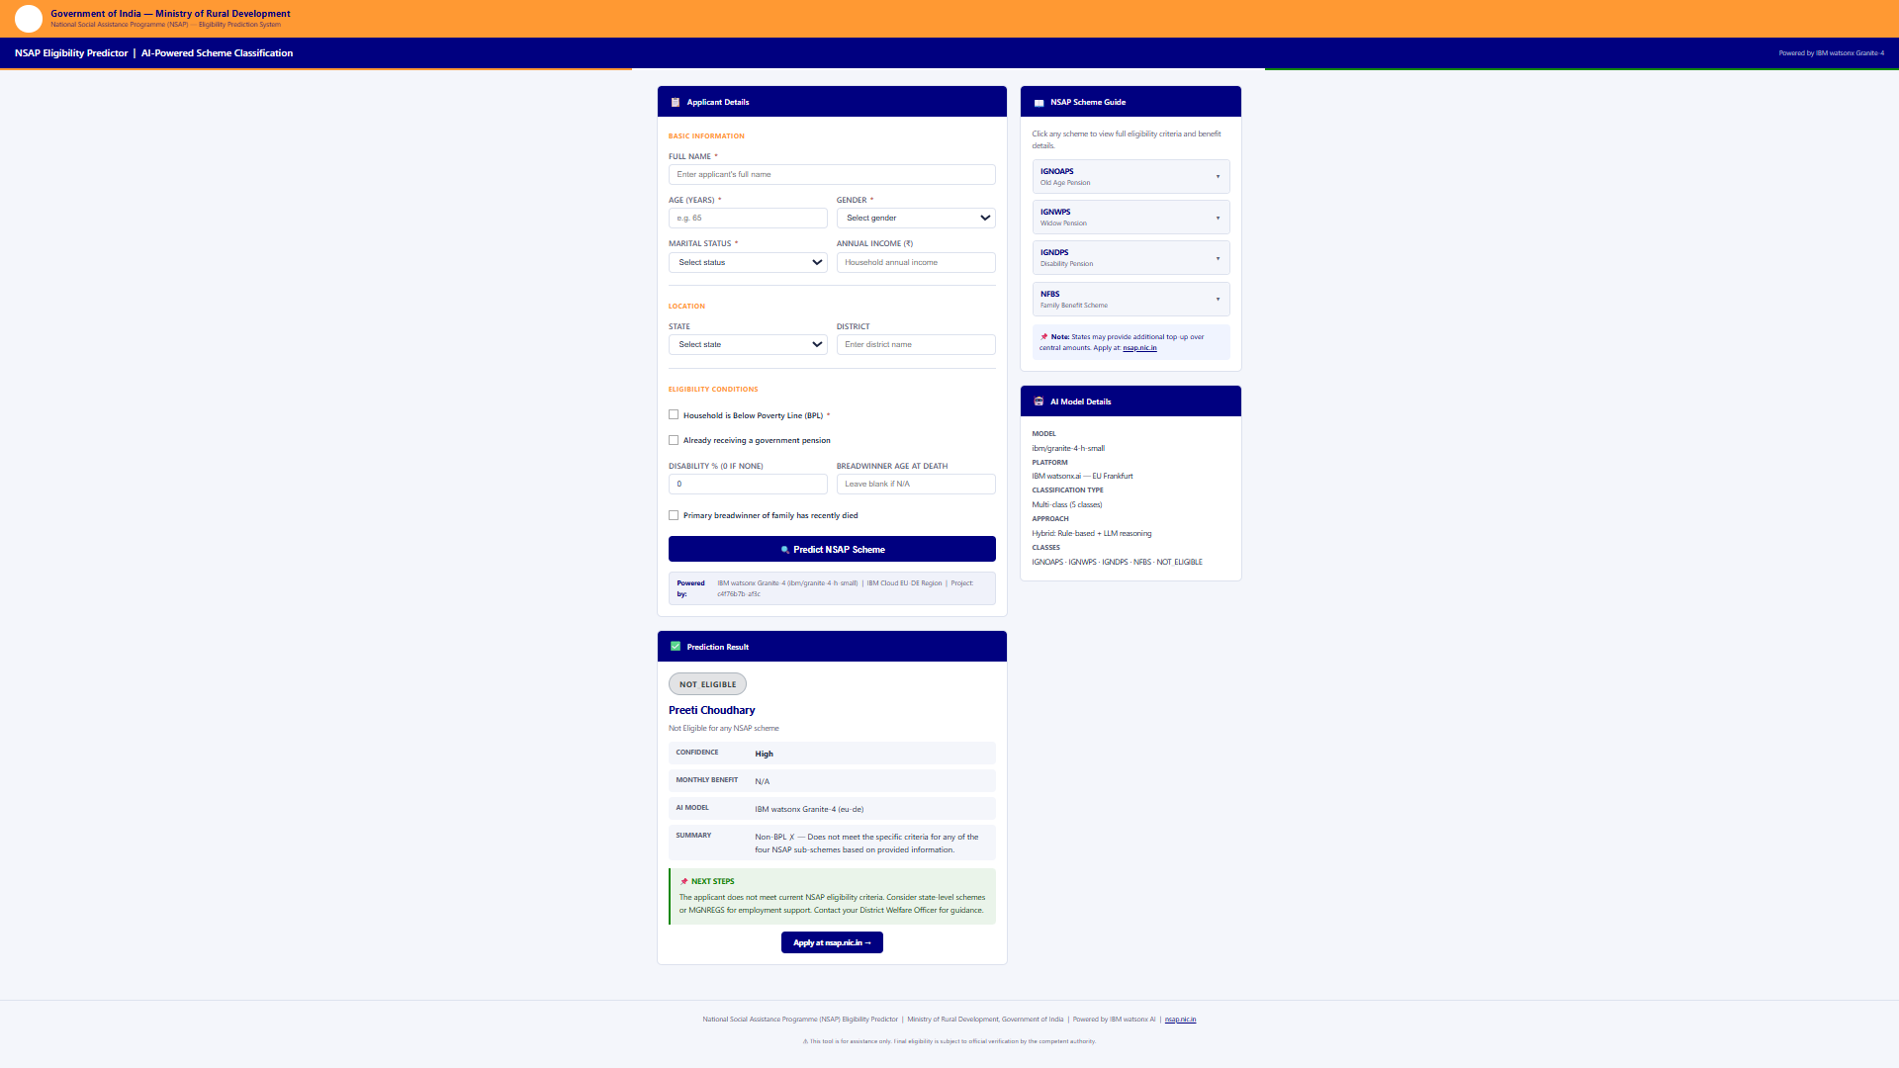
Project Output Screenshot
·
·
·

Slide 16
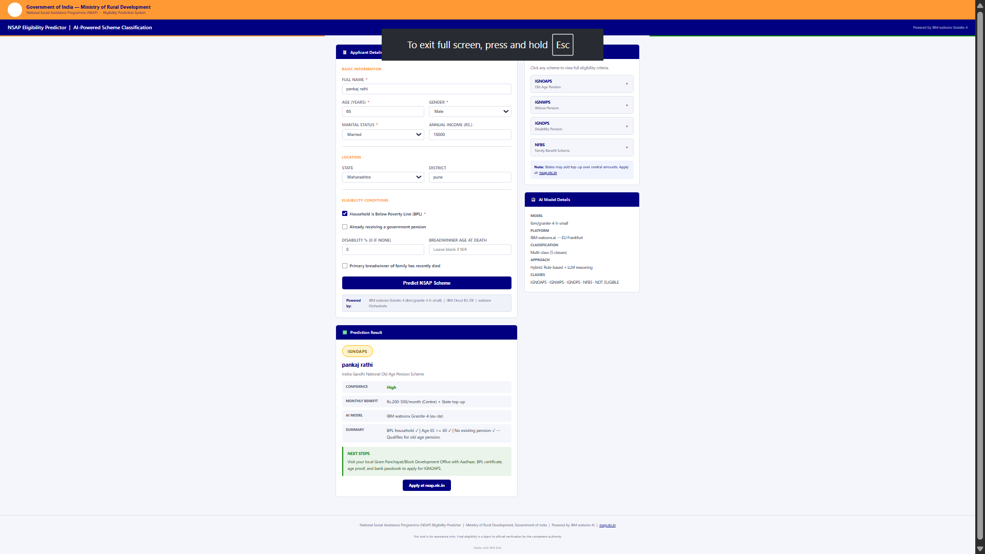
Project Output Screenshot
·
·
·

Slide 17
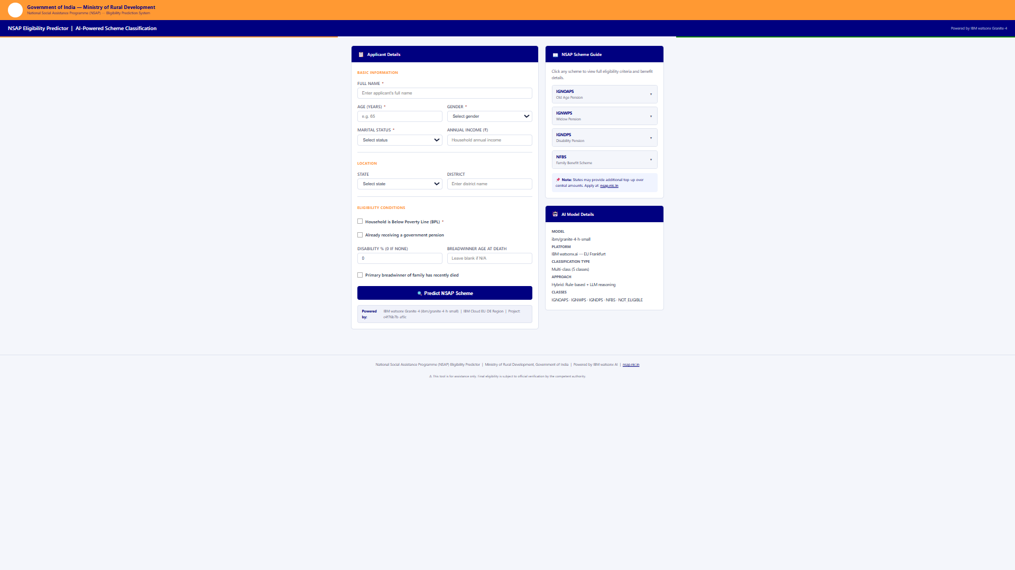
Project Output Screenshot
·
·
·

Slide 18
Novelty and Uniqueness
1. Hybrid Decision Architecture (ML + Deterministic Policy Guardrails)
Combines multi-class machine learning prediction with deterministic statutory validation tools.
Eliminates generative AI hallucinations and classification drift by strictly verifying output against Government of India gazette rules.
2. Agentic Autonomous Tool Calling via watsonx Orchestrate
Moves beyond static form processing to an active multi-agent pipeline using IBM Granite foundation models.
Automatically queries sub-scheme rule engines, computes state/central pension shares, and validates edge cases without manual routing.
3. Explainable & Auditable Welfare AI (XAI)
Delivers transparent, step-by-step audit trails alongside every eligibility verdict for government verification officers.
Provides clear, jargon-free explanations to applicants detailing approval criteria or specific missing documentation.
4. Low-Resource, Production-Ready Cloud Deployment
Optimized for IBM Cloud Lite environments using parameter-efficient foundation models (ibm/granite-4-h-small).
Minimizes computational overhead while maintaining enterprise-grade latency and high precision across rural demographic distributions.

Slide 19
Git Hub Link
https://github.com/CPreeti/nsap-eligibility-agent.git
·
·
·

Slide 20
Future Scope
1. Multimodal Document Ingestion & Verification
Integrate OCR and computer vision pipelines to automatically extract and verify data directly from physical ration cards, disability certificates, and Aadhaar cards.
Reduce manual data entry errors at common service centers (CSCs) by automating document authenticity checks.
2. Multilingual Voice & Vernacular Conversational Agents
Deploy speech-to-text and text-to-speech interfaces supporting regional Indian languages to bridge digital literacy barriers for rural citizens.
Enable applicants to check scheme status, eligibility criteria, and grievance resolutions via conversational voice bots.
3. Direct Integration with National Databases & Portals
Establish secure API bridges with the National Social Assistance Programme (NSAP) portal, SECC database, and DigiLocker for instant beneficiary record synchronization.
Automate Direct Benefit Transfer (DBT) eligibility checks to accelerate disbursal timelines from months to minutes.
4. Predictive Fraud Detection & Ghost Beneficiary Audits
Implement unsupervised anomaly detection to identify duplicate applications, false BPL claims, or fraudulent scheme enrollments across districts.
Continuously update eligibility profiles against municipal mortality registers to ensure social welfare funds reach genuine beneficiaries.
·
·
·

Slide 21
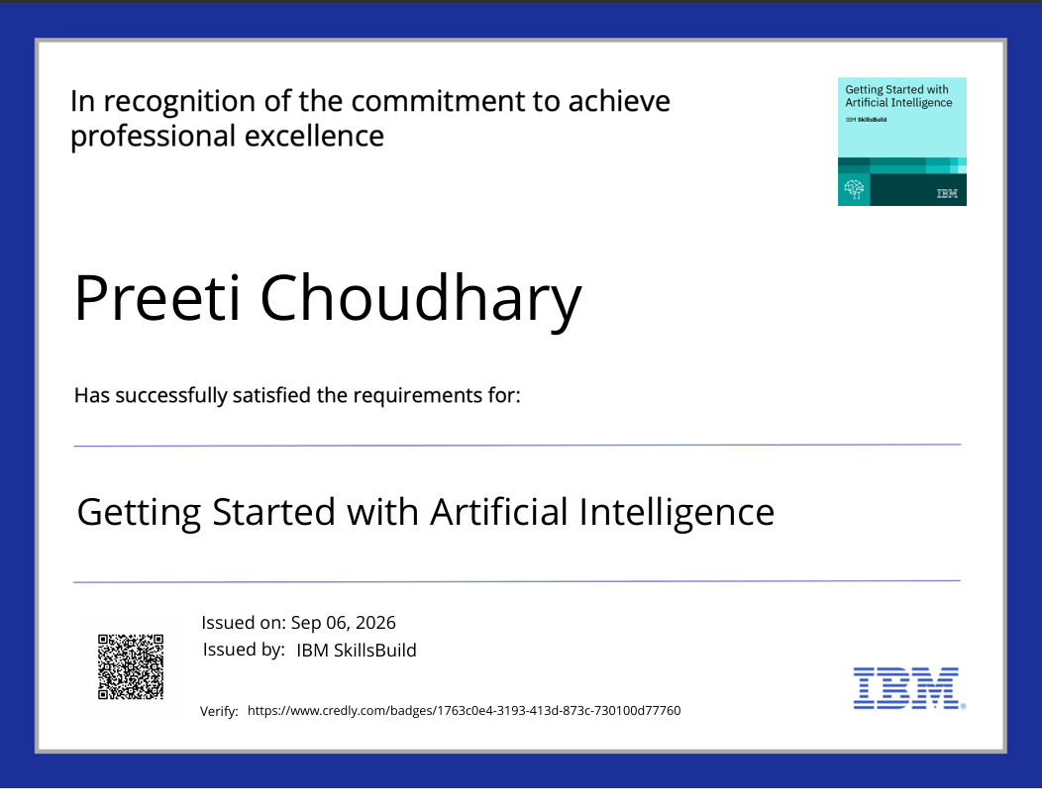
Certificates Earned:

Slide 22
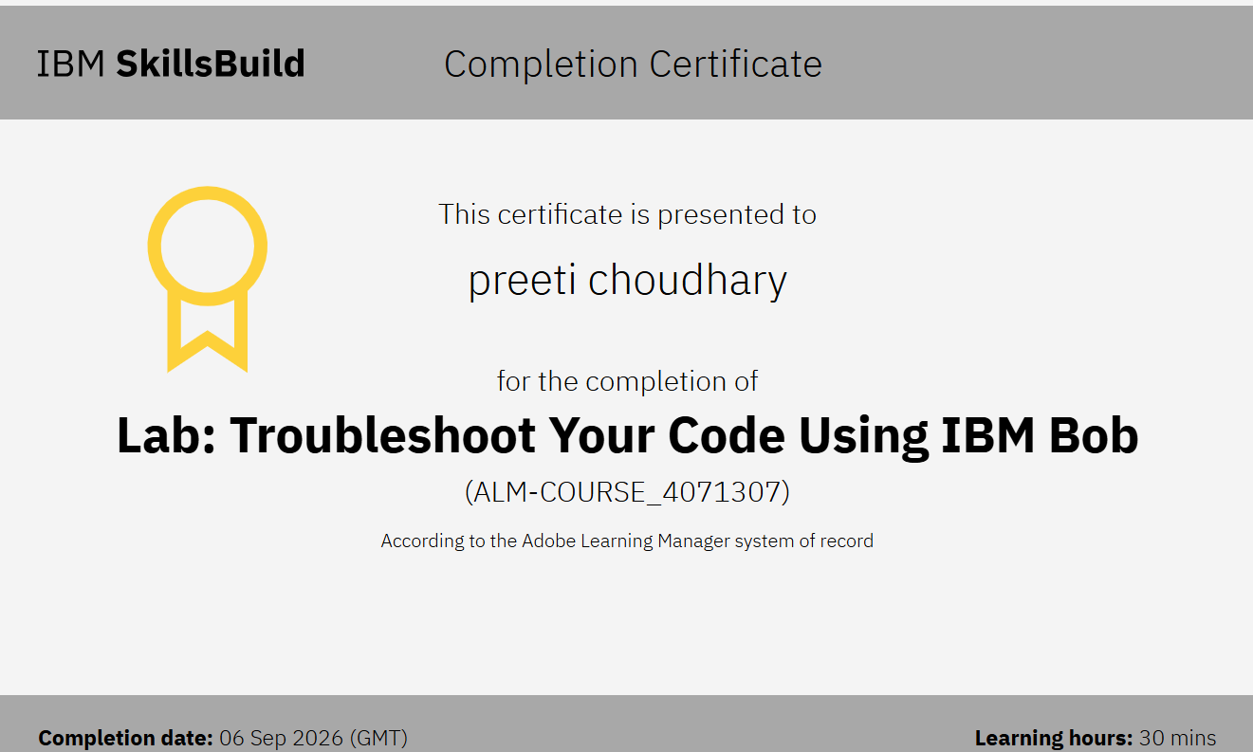
Certificates Earned:​

Slide 23


