Slide 1

Hypothesis testing of quantum Monte Carlo calculations
Markus Wallerberger*
in collaboration with:
Alexander Gaenko, Emanuel Gull (University of Michigan)
*mwallerb@umich.edu
1

Slide 2
How can we know if a stochastic algorithm works in a way that can be automatized?

Slide 3
Testing of deterministic algorithms
Contract-oriented programming: invariants testing
Unit tests: small, user-facing, correctness tests
Fuzzing: large-scale reliability tests
Benchmarks: checks for "physical" cases¹
[1] e.g., J.P.F. LeBlanc et al., Phys. Rev. X 5, 041041 (2015); K. Lejaeghere et al, Science (2016)
M. Wallerberger
3

Slide 4
Testing of stochastic algorithms
Contract-oriented programming: invariants testing
Unit tests: small, user-facing, correctness tests
Fuzzing: large-scale reliability tests
Benchmarks: checks for "physical" cases¹
M. Wallerberger
4

Slide 5
Testing of stochastic algorithms
Contract-oriented programming: invariants testing
Unit tests: small, user-facing, correctness tests
Fuzzing: large-scale reliability tests
Benchmarks: checks for "physical" cases¹
Example: Solvers for the Anderson model
1960s bath level discretization¹ ~ 200 LOC
1980s imagimary time discretization¹ ~ 2,000 LOC
2000s no systematic approximation² ~ 20,000 LOC
[1] review: A Georges et al., Rev. Mod. Phys. 68, 13 (1996) [2] review: E. Gull et al., Rev. Mod. Phys. 83, 349 (2011)
M. Wallerberger
5

Slide 6
Statistical Hypothesis testing
Ubiquitous in life sciences etc.
(aside: formal validity from a frequentist p.o.v.?)
Verification of stochastic algorithms: urban simulations¹ and image recognition²
H₀ … simulation follows trusted result
H₀ rejected = failed test
[1] H. Ševčíková et al., Proc. Int. Symp. Softw. Test. Anal., p. 215 (2006)
[2] K. Subr and J. Arvo, Proc. 15th Pacif. Conf. Comput. Graph. Appl., p. 106 (2007)
M. Wallerberger
6

Slide 7
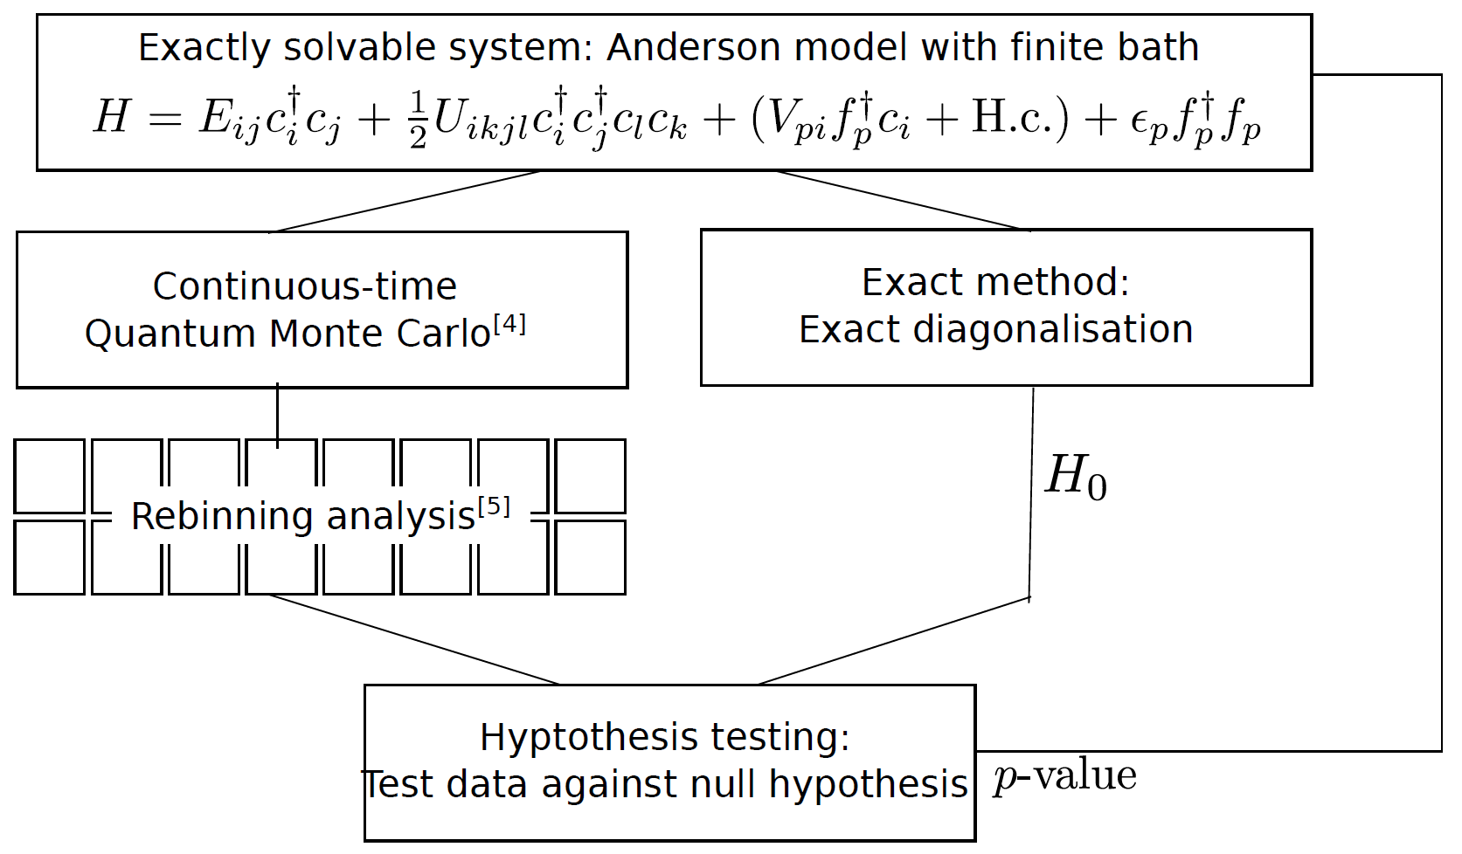
Statistical Hypothesis testing
Exactly solvable system
Stochastic method
Exact method or trusted simulation
M. Wallerberger
7

Slide 8
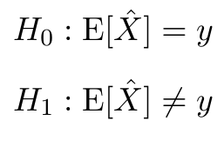
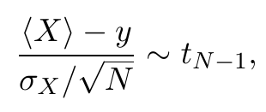

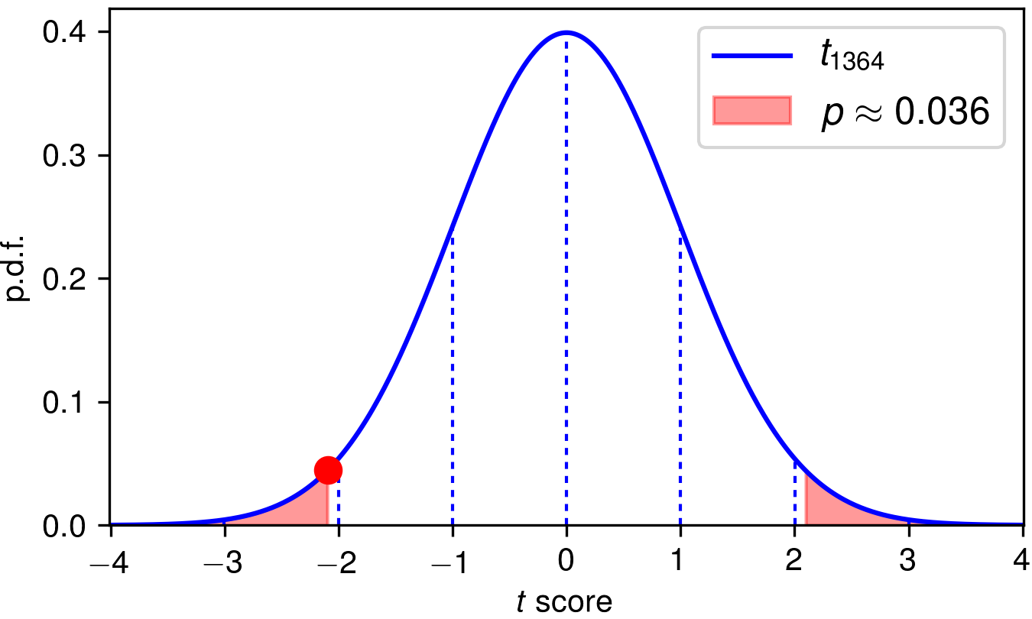

Simple scalar test
null hypothesis
alternative
score
p-value
Student's t test
.
M. Wallerberger
8

Slide 9
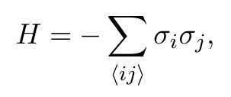
Step 1: Testing
finite square lattice L x L, periodic boundary cond.
h=0: we know from SU(2) that: m = 0
Test against Monte Carlo estimator <m>
Single spin flips

Slide 10
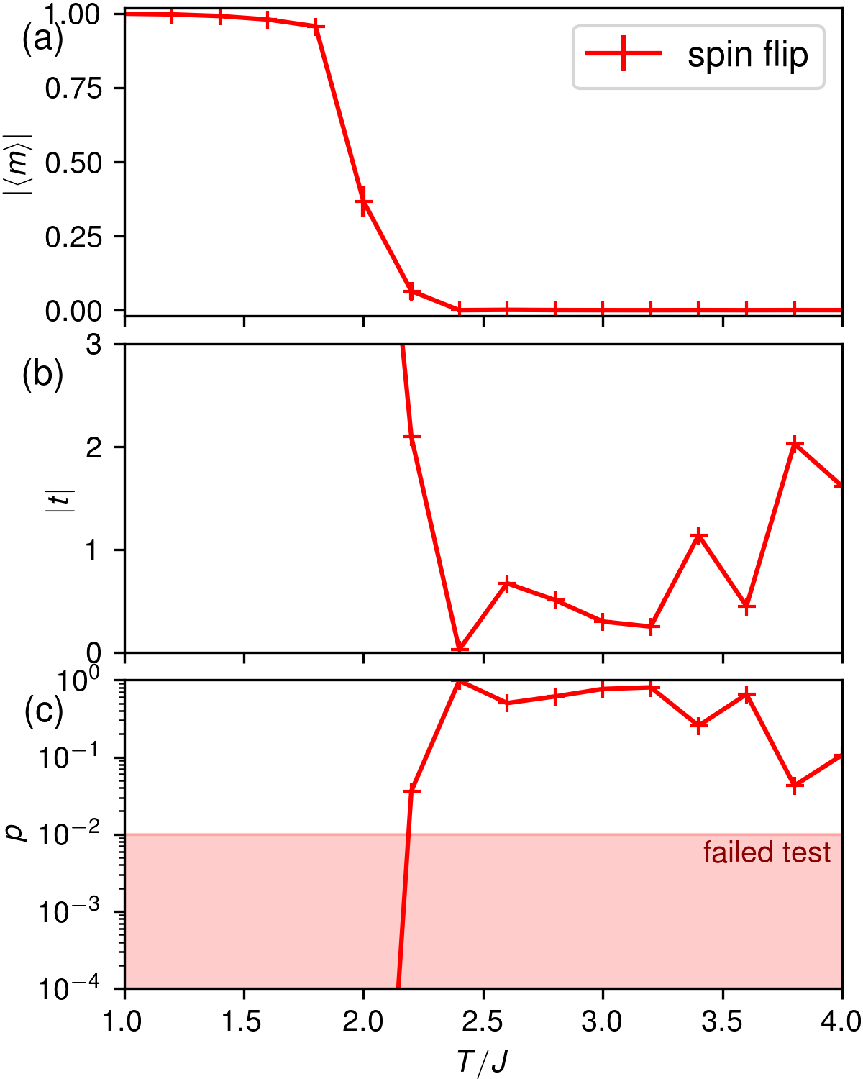
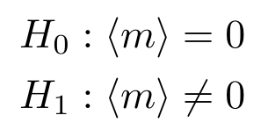

Slide 11
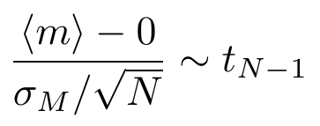

Slide 12
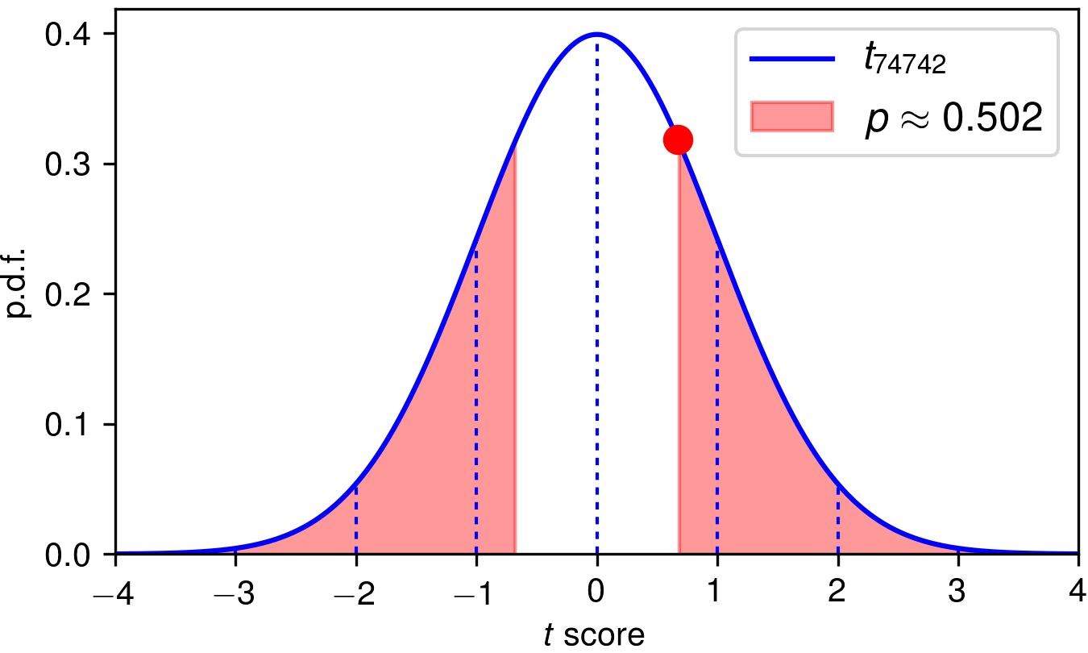

Slide 14
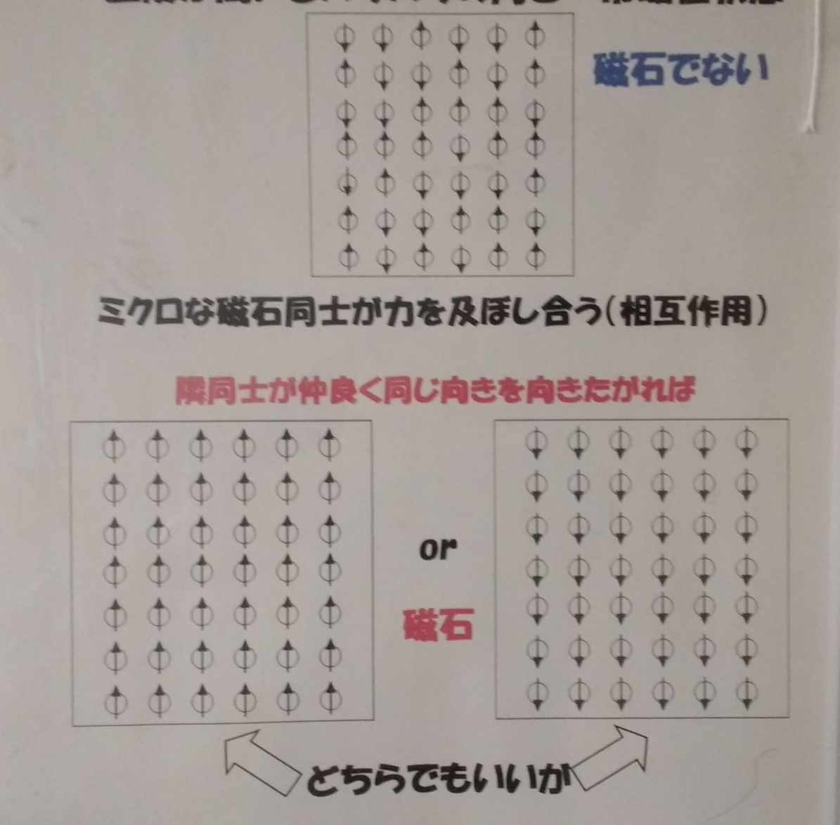
Step 2: Debugging
Single spin flips are bad!
Cluster updates!

Slide 15
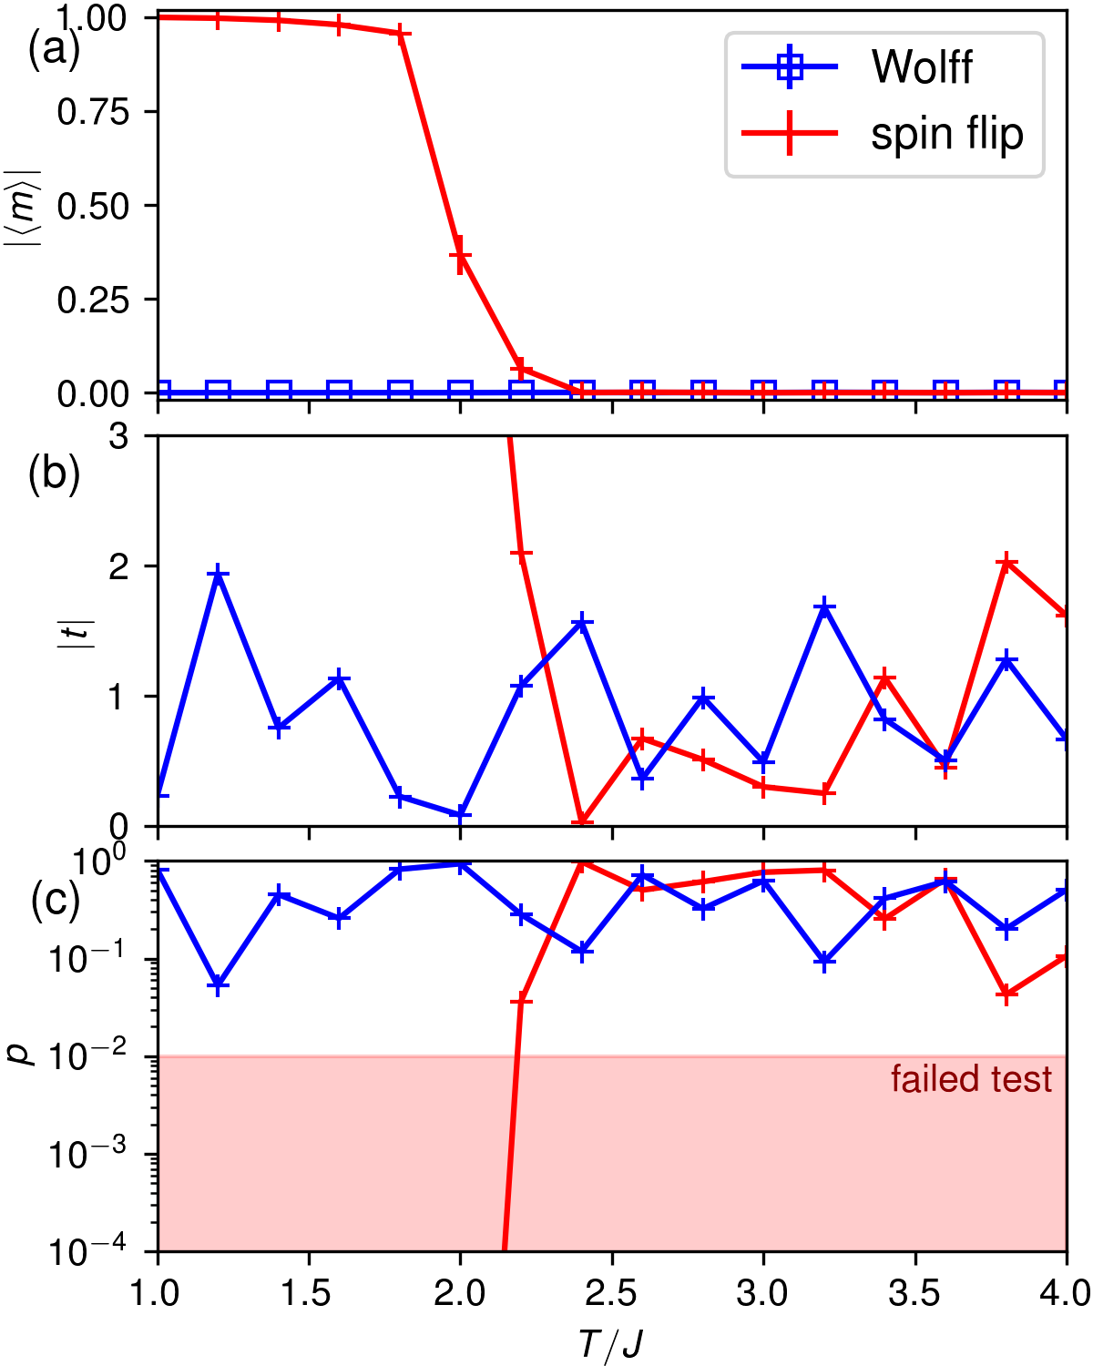

Slide 16
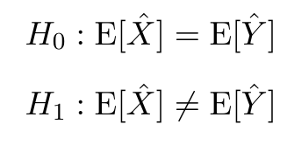
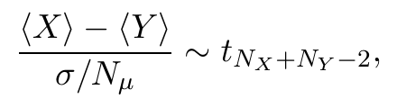
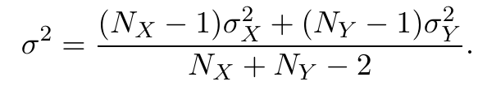

Testing against stochastic result
null hypothesis
alternative
score
pooled variance
.
M. Wallerberger
16

Slide 17
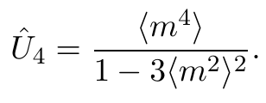
Example: Ising model again
Binder cumulant:
Hard to compute analytically
→ Compare with trusted simulation result
Non-linear error propagation:
Problem for Student's t test
Bootstrap/Jackknife resampling as preprocessing
Alternative: parametric bootstrapt
Artificial error: open boundary condition for corners

Slide 18
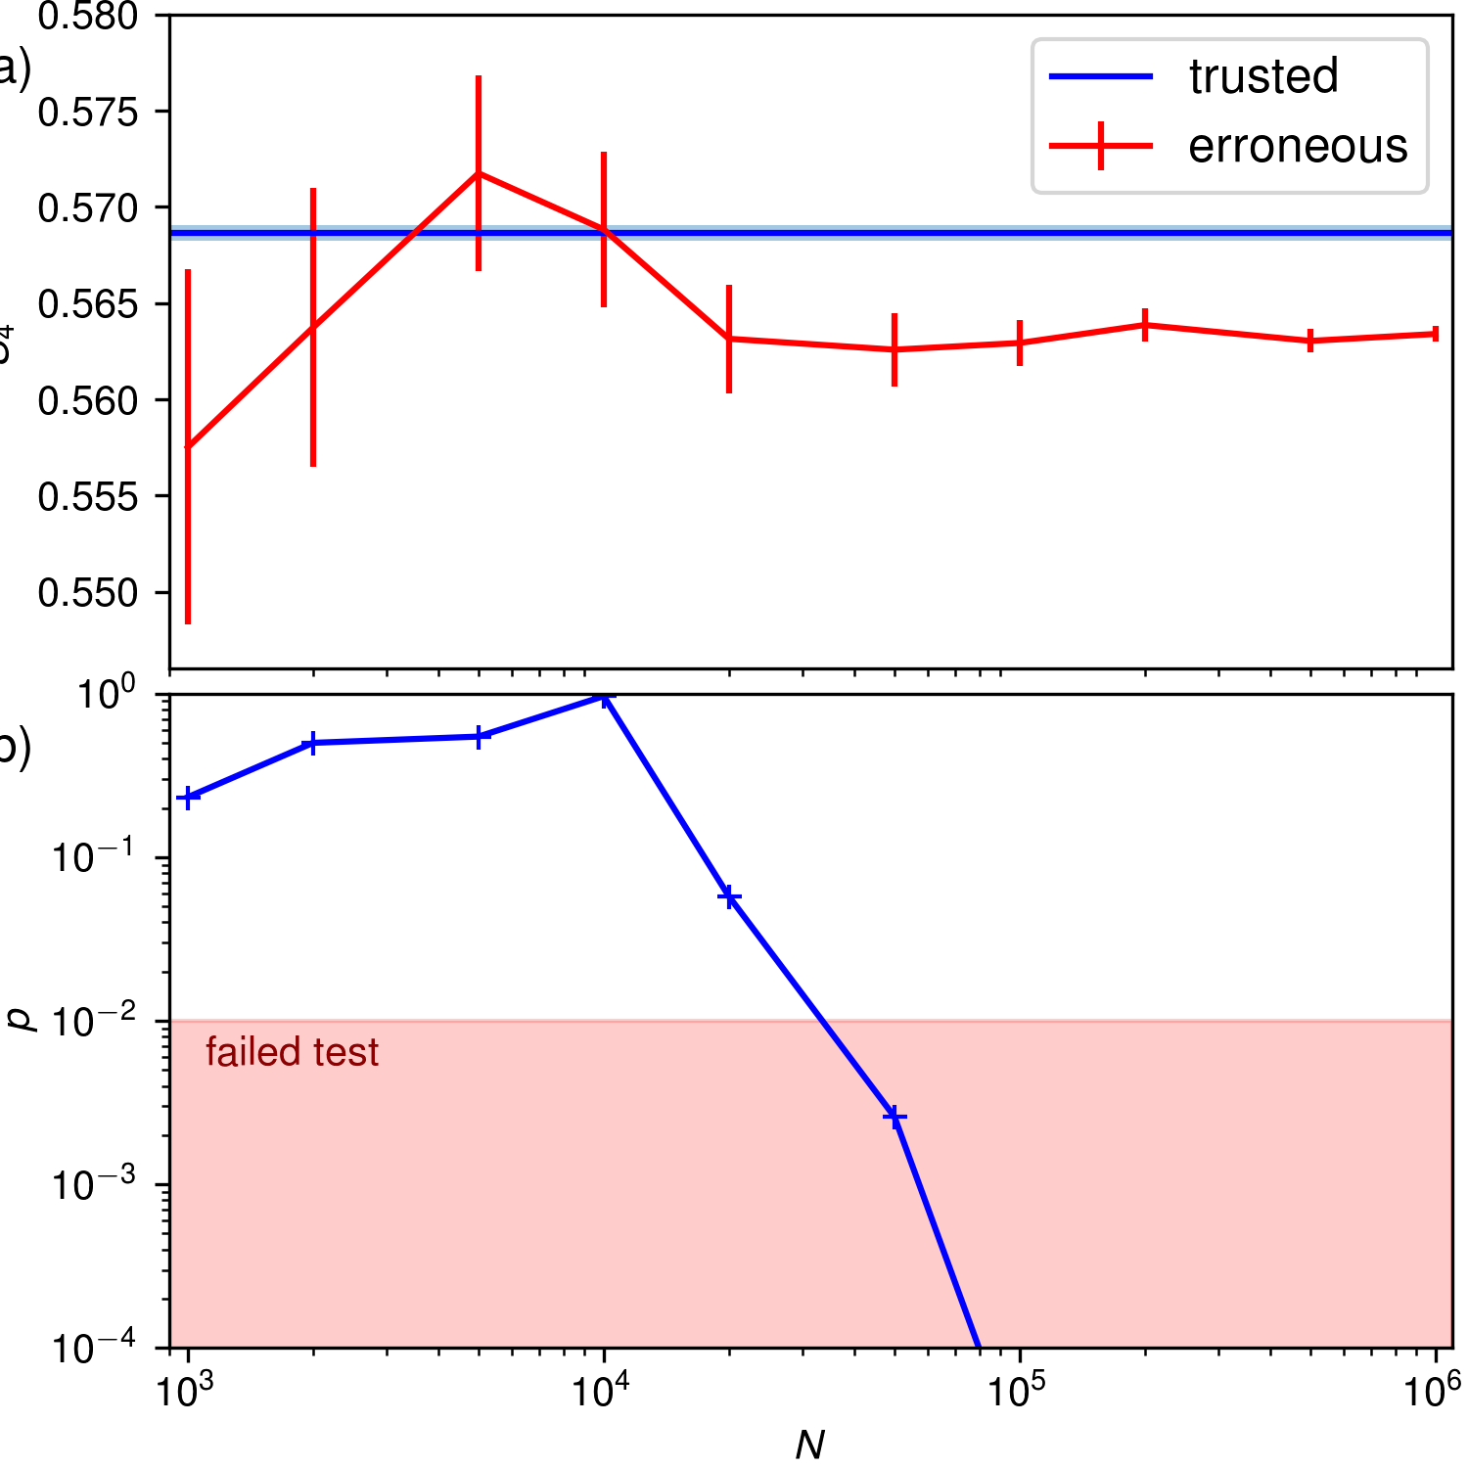
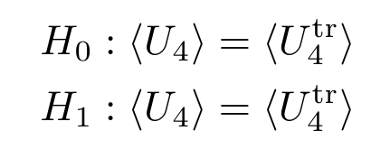
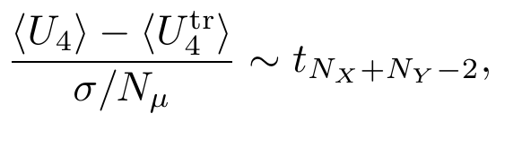

Slide 19
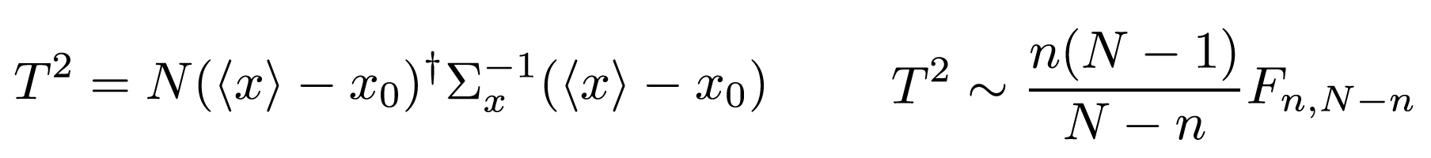
Testing data series
often stricter criterion!
null hypothesis
alternative
score
p-value
Hotelling's T² test; generalizable for N<n^{[1]}
.
[1] M. Marozzi: Stat. Meth. Med. Res. 25(6) 2593–2610 (2016)
M. Wallerberger
19

Slide 20
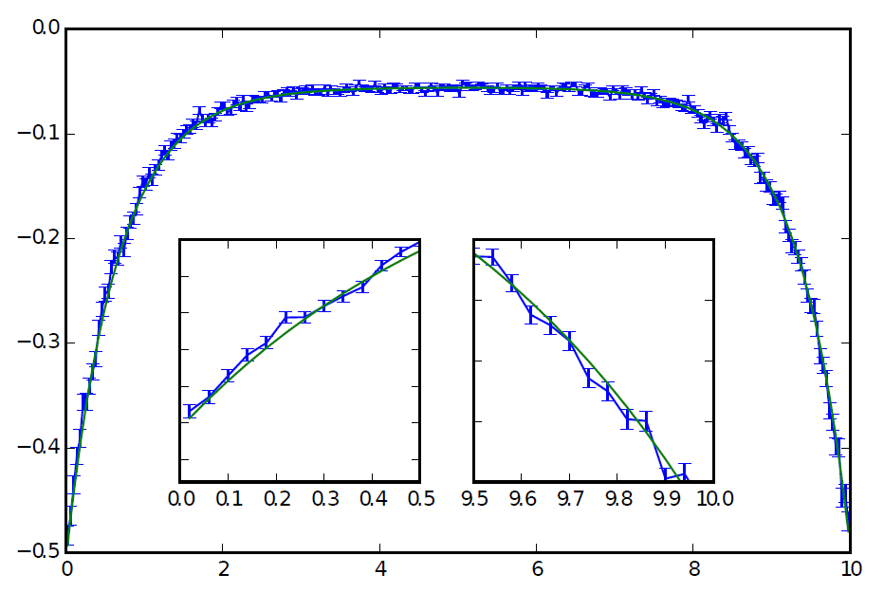
Example: chi(iw)
G(τ)
G_{exact}(τ)
τ
AIM: 1-orbital, 2 bath states (+/-0.5), V=1, U=1, mu=0.42
M. Wallerberger
20

Slide 21
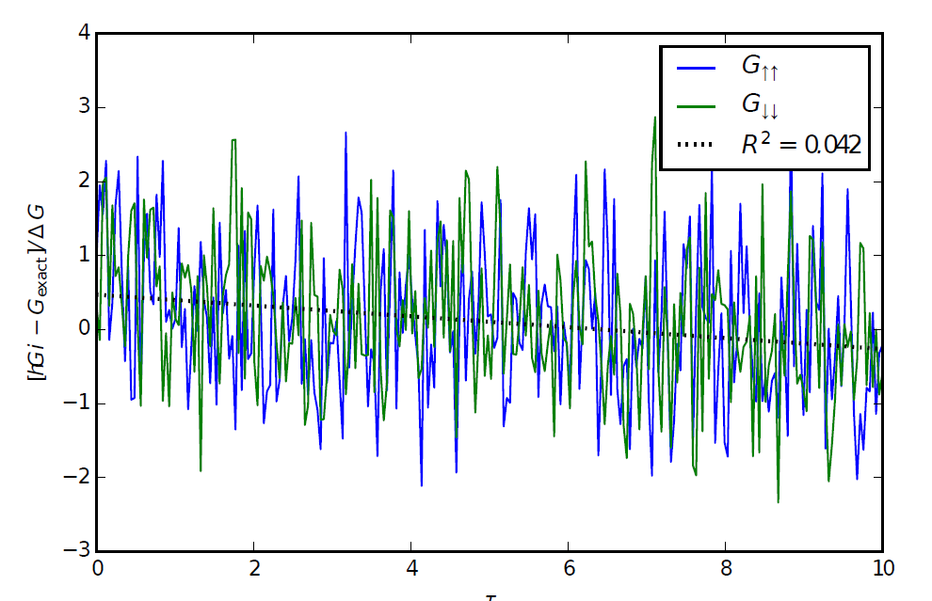
Example: chi(iw)
G(τ)
(G – G_{exact})/ΔG
G_{exact}(τ)
τ
M. Wallerberger
21

Slide 22
Example: chi(iw)
G(τ)
(G – G_{exact})/ΔG
G_{exact}(τ)
τ
M. Wallerberger
22

Slide 23
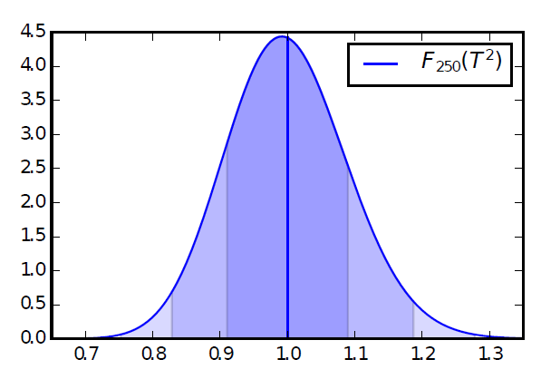
Example: chi(iw)
G(τ)
(G – G_{exact})/ΔG
G_{exact}(τ)
τ
one-sided F test:
M. Wallerberger
23

Slide 24
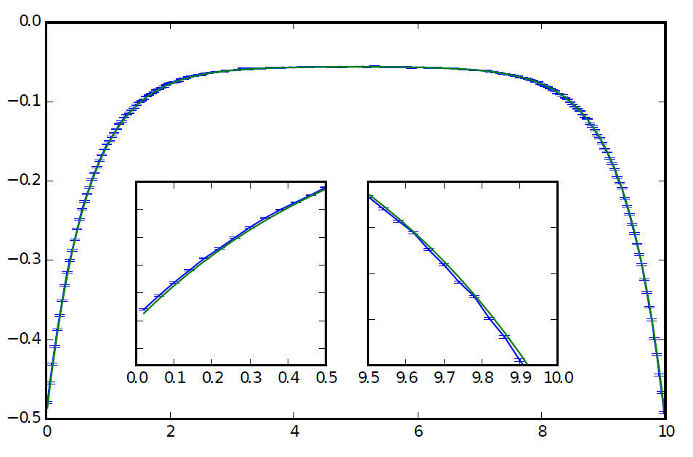
Example: chi(iw)
G(τ)
(G – G_{exact})/ΔG
G(τ)
G_{exact}(τ)
G_{exact}(τ)
τ
τ
one-sided F test:
M. Wallerberger
24

Slide 25
Example: chi(iw)
G(τ)
(G – G_{exact})/ΔG
G(τ)
G_{exact}(τ)
G_{exact}(τ)
τ
τ
Reason: bin shifting error.
one-sided F test:
M. Wallerberger
25

Slide 26
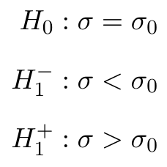
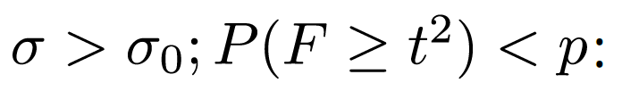

Test for the error bars
possible for data series!
null hypothesis
lower alternate
upper alternate
Hotelling's T² test

Slide 27
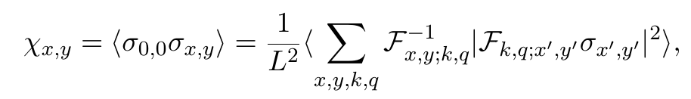
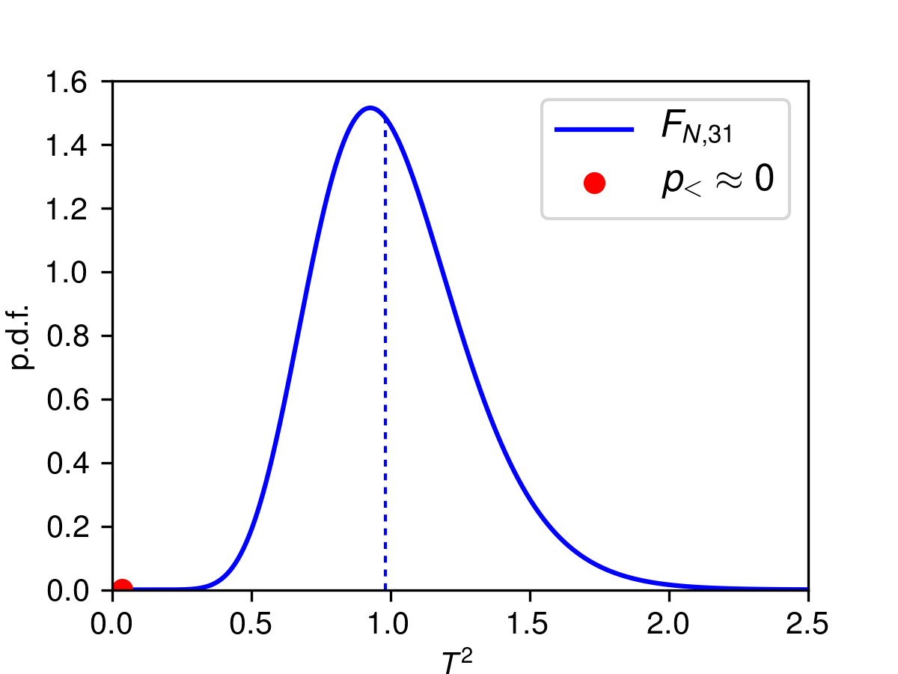
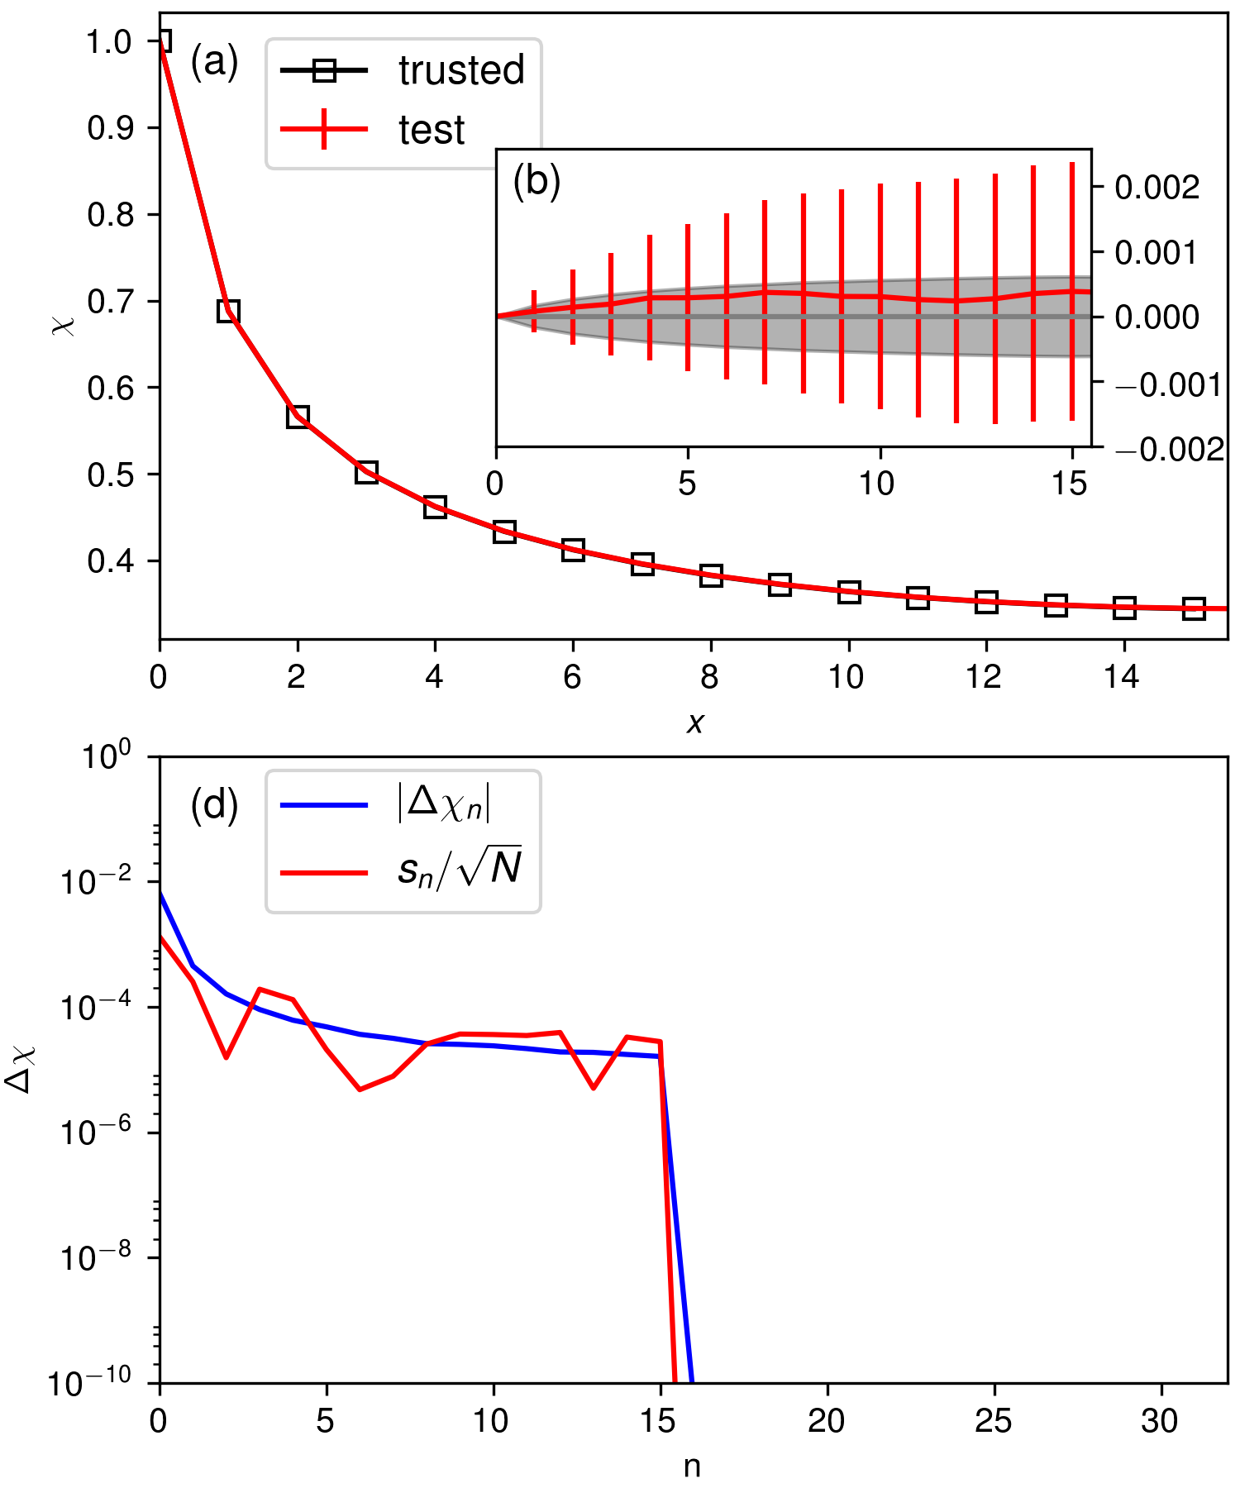
Cross-correlated data

Slide 28

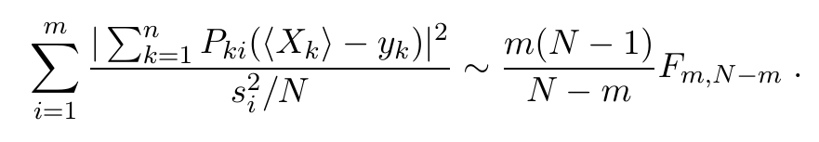
Cross correlated data
use covariance matrix
common complication: duplicates
solution: projection to non-zero eigenvalues
Hotelling's T² test

Slide 29
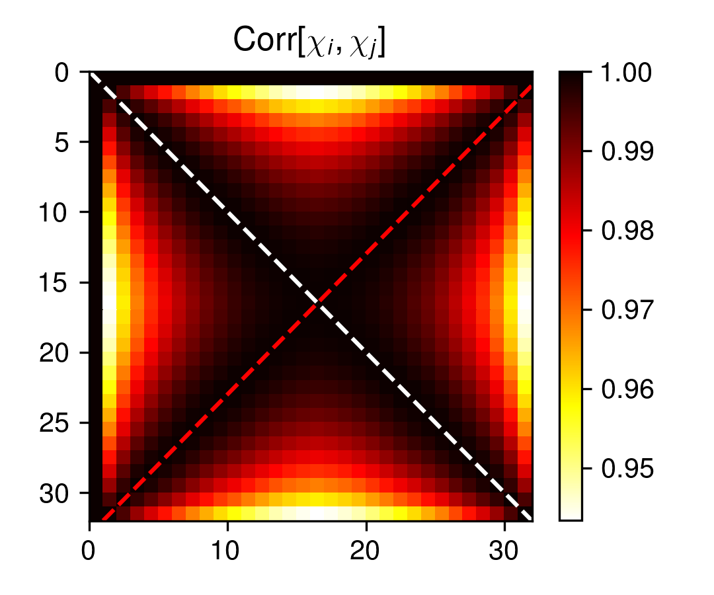
Cross-correlated data

Slide 30
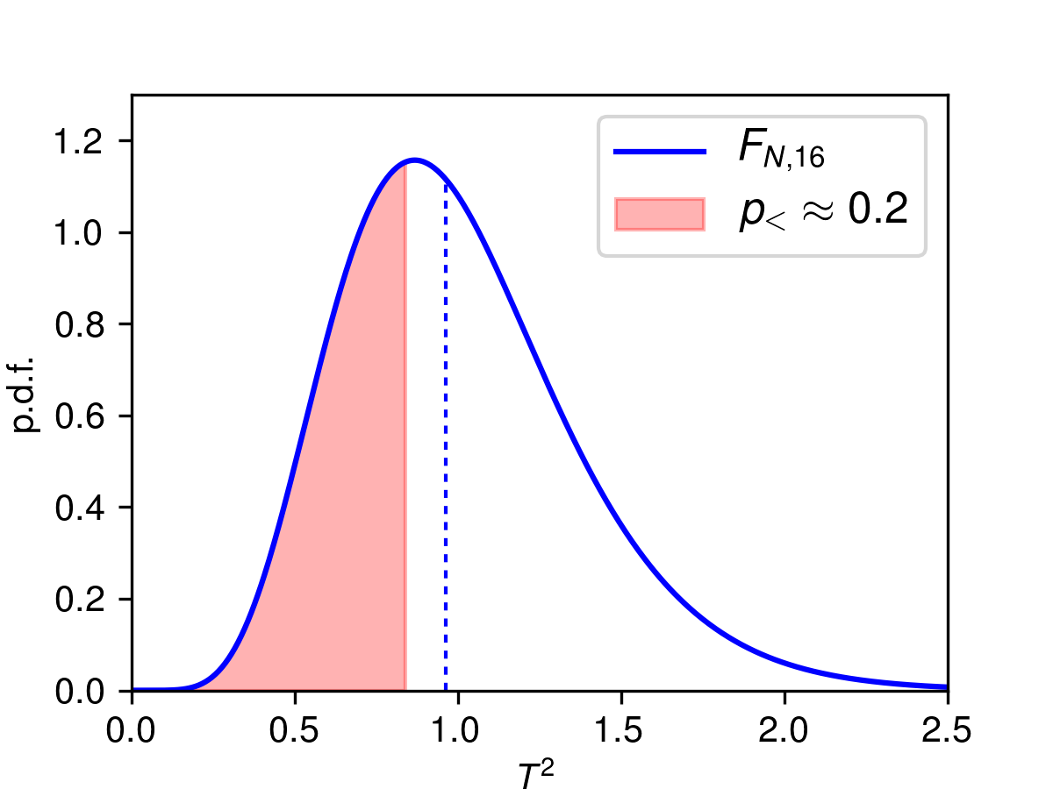
Cross-correlated data

Slide 31
Conclusions
Testing of stochastic codes
Hypothesis testing powerful framework
Should become standard tool in testing arsenal
Outlook: stochastic fuzzing
Outlook: part of ALPSCore testing framework¹
[1] A. Gaenko et al., Comput. Phys. Commun. 213, 235 (2017); http://www.alpscore.org
M. Wallerberger
31

Slide 32
BACKUP
M. Wallerberger
32

Slide 33
Quantum Monte Carlo algorithms
e.g., Anderson impurity model (AIM)
Solvers
Exact diagonalization¹ 1960s bath levels ~ 200 LOC
Hirsch-Fye QMC¹ 1980s imag. time ~ 2,000 LOC
Continuous-time QMC² 2000s none ~ 20,000 LOC
impurity
hybridization
bath
[1] review: A Georges et al., Rev. Mod. Phys. 68, 13 (1996)
[2] review: E. Gull et al., Rev. Mod. Phys. 83, 349 (2011)
M. Wallerberger
33

Slide 34
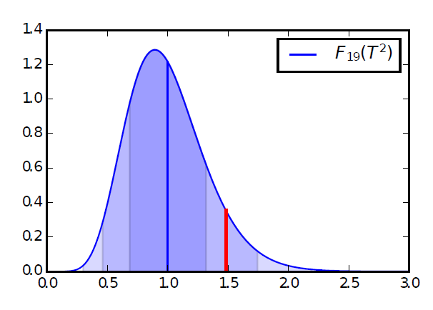
Testing data series
Usually stricter criterion
Hotelling's T²-test: e.g., Green's function
a
systematic error
: error bars too large
Non-Gaussian batches/low statistics¹
p.d.f.
T²
[1] M. Marozzi: Stat. Meth. Med. Res. 25(6) 2593–2610 (2016)
M. Wallerberger
34

Slide 35
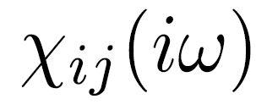
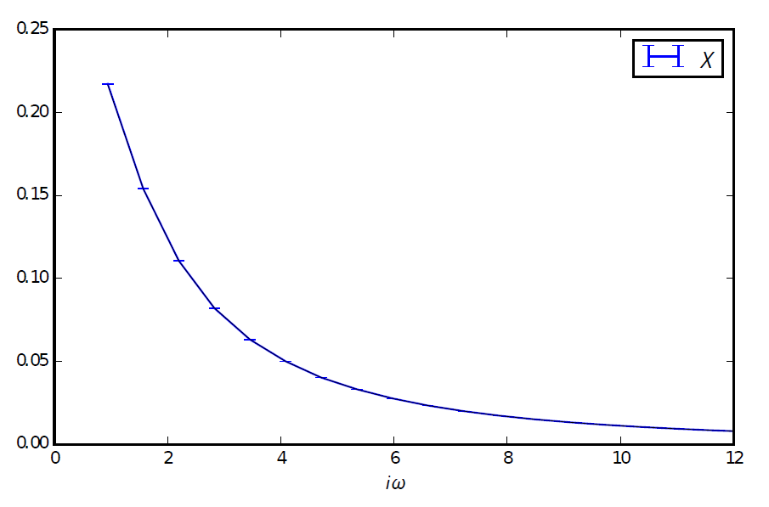
Example I:
1-orbital, 2 bath states (+/-0.5), V=1, U=1, mu=0.42
iω
i\
[1] M. Wallerberger, PhD thesis (2016)
M. Wallerberger
35

Slide 36
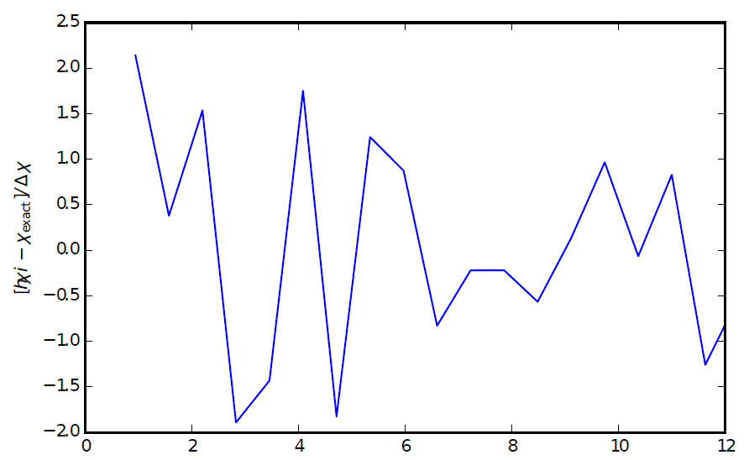
Example I:
1-orbital, 2 bath states (+/-0.5), V=1, U=1, mu=0.42
(χ – χ_{exact})/Δχ
iω
iω
[1] M. Wallerberger, PhD thesis (2016)
M. Wallerberger
36

Slide 37
Example I:
1-orbital, 2 bath states (+/-0.5), V=1, U=1, mu=0.42
(χ – χ_{exact})/Δχ
iω
iω
M. Wallerberger
37

Slide 38

Example I:
1-orbital, 2 bath states (+/-0.5), V=1, U=1, mu=0.42
(χ – χ_{exact})/Δχ
iω
iω
one-sided F test: )
M. Wallerberger
38

