Slide 1
NQCH/QCIF Update - Hardware
14/9/26 - Paul

Slide 2
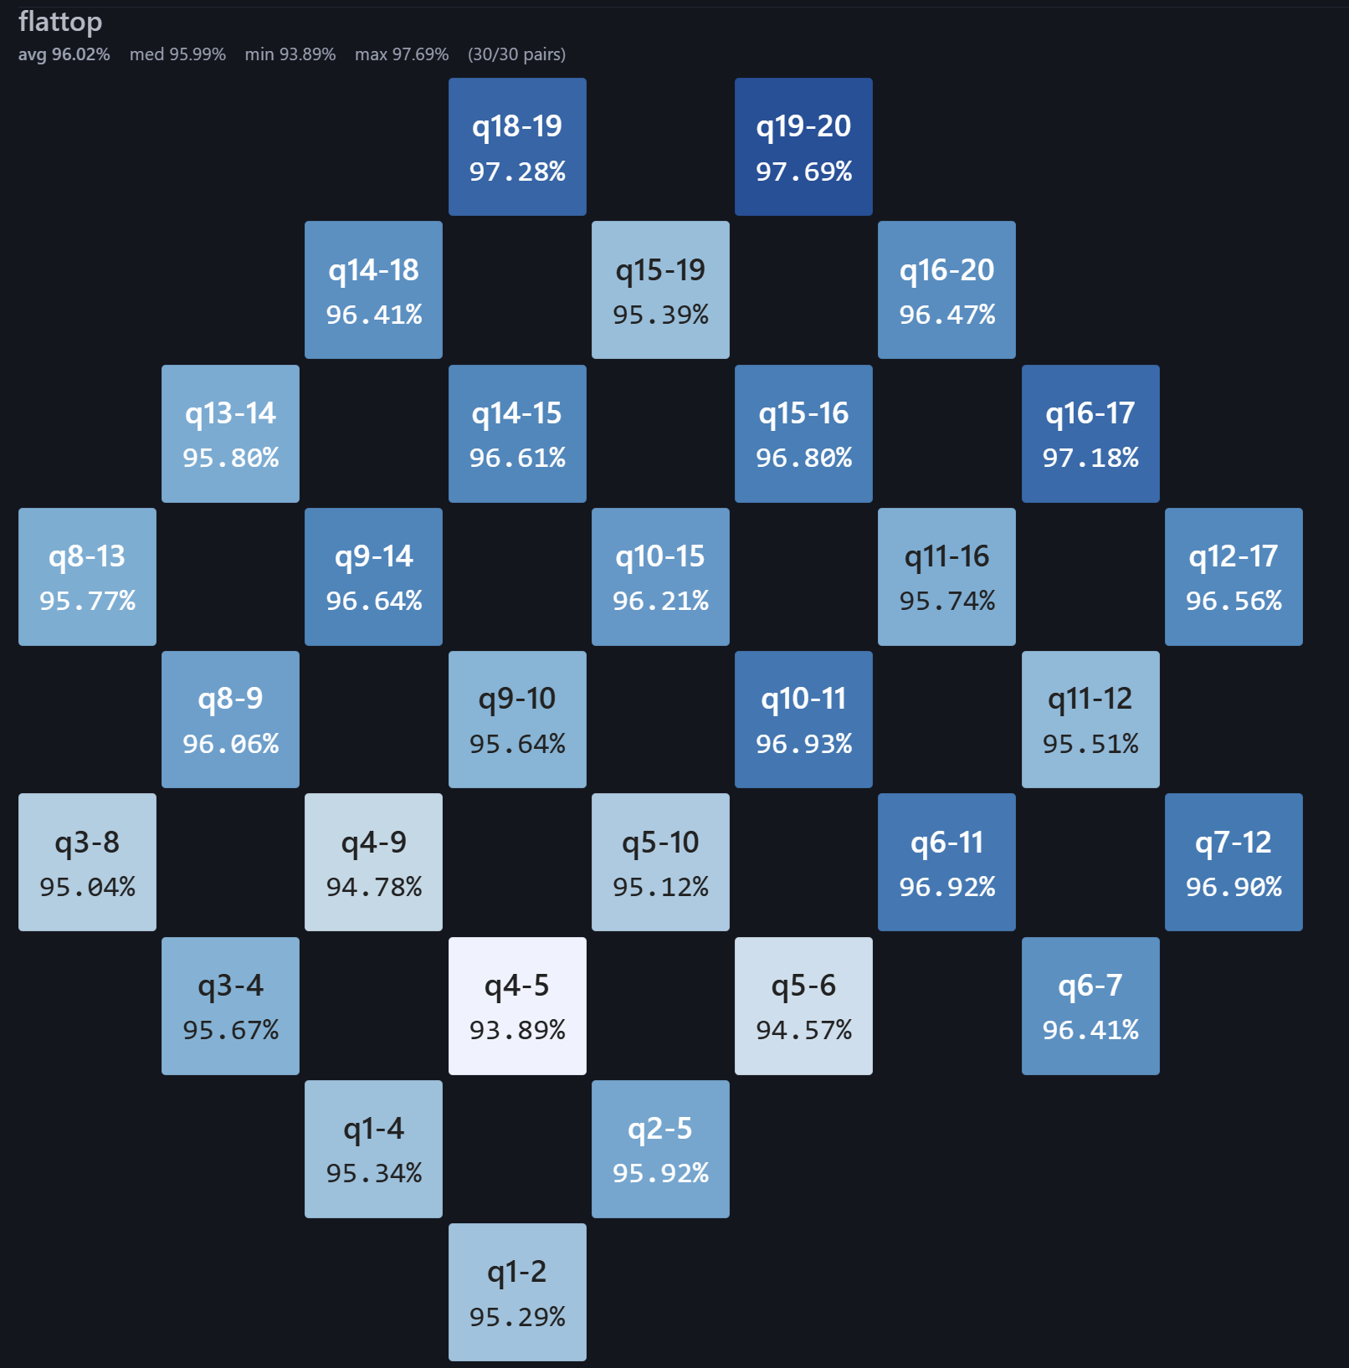
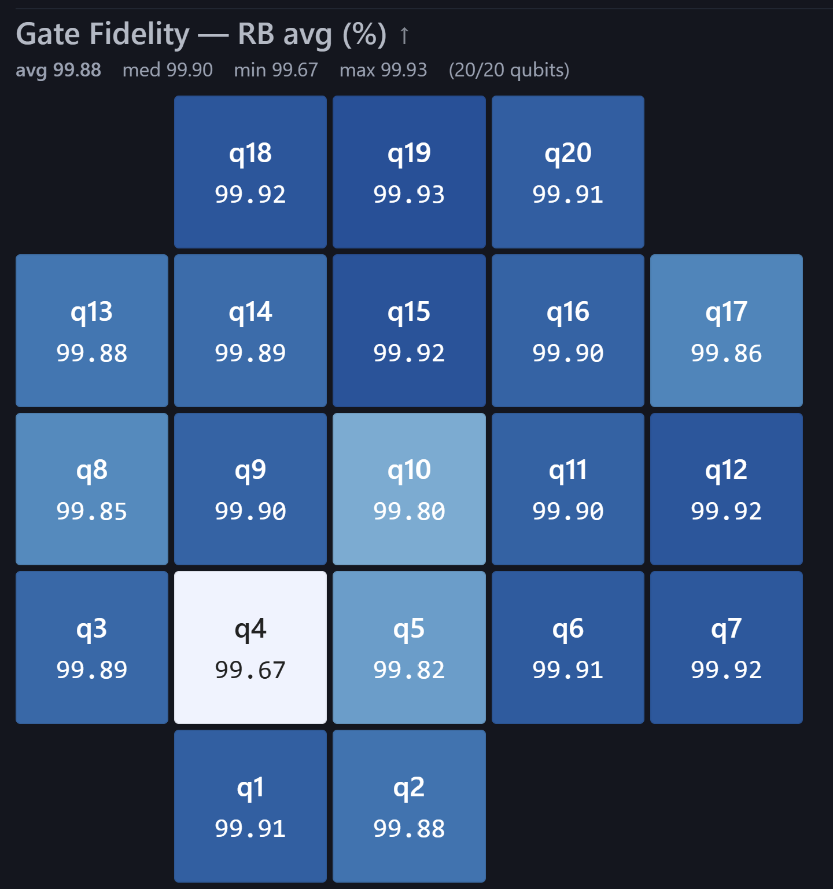
QPU Update

Slide 3
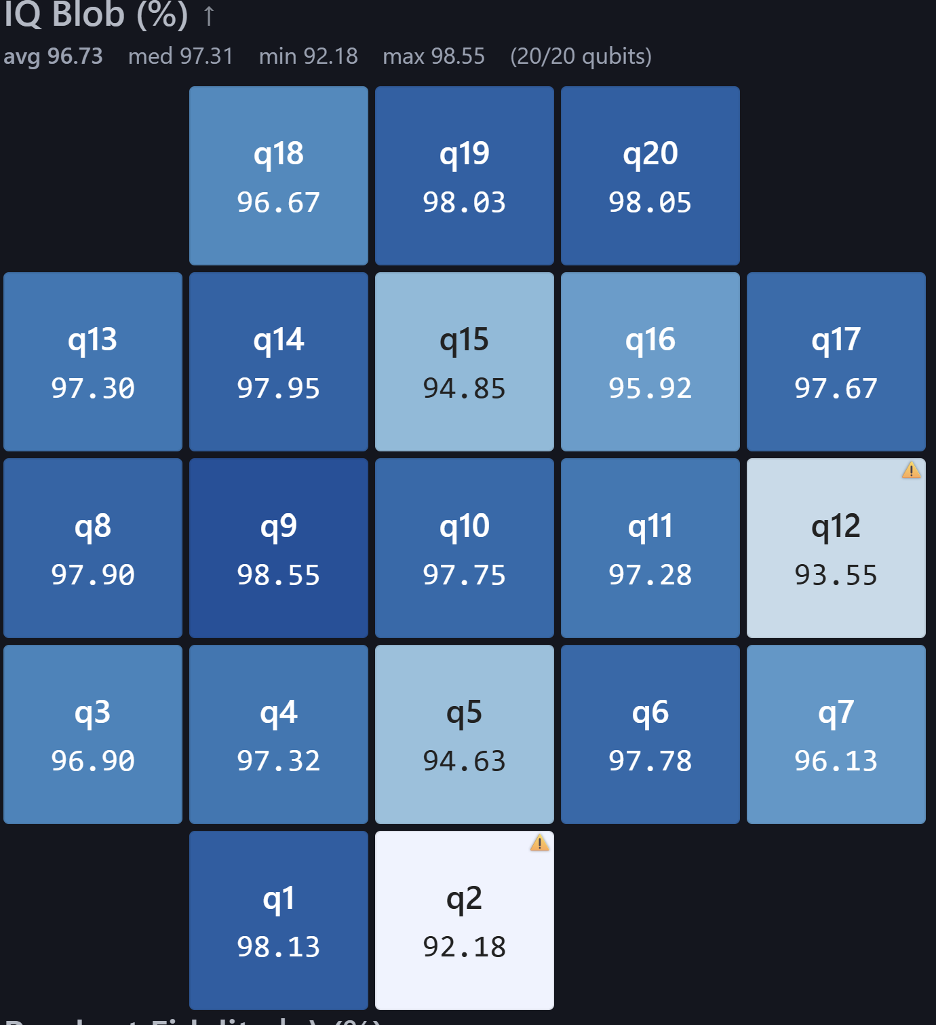
QPU Update
Grafana logging started
Simultaneous qubit usage seems to be poor, will check QM’s calibration
Readout fidelity is generally poor
Tested Arthur’s Qibo-QM bridge, found an issue and reported to him on Github
Will be sticking to the custom solution for now

Slide 4
Bimonthly Forecast
Sept
Qblox Pre-demo Meeting
A* Qibosoq collaboration
Oct+
Qblox Demo
Paul on leave from 4th Oct to 15th Oct

