Slide 1
NQCH/QCIF Update - Hardware
17/8/26 - Paul

Slide 2
QPU Update
Installation of QM Demo System onto 5Q and 20Q completed
Calibration of 20Q with QM
Coupler flux biasing [Should be completed today]
Single qubit tuneup [Should be completed by tomorrow]
Two qubit flux characterization [Should start tomorrow]

Slide 3
Cloud re-bringup
QM should finish the 20Q calibration next week
Project 1: QM direct backend
Aims to directly compile Qibo circuits into Qua bypassing Qibolab
Initial implementation using transpiled circuits working
Can enable active reset via environment variable
Stopgap implementation as Arthur is working on a full version
Project 2: Qibolab integration
Work needs to be done to ensure compatiability (qibolab-qm asks for qm-qua=1.2.6 but we need qm-qua=1.3.1)
Need to convert existing QM parameter set into Qibolab parameter set
Need to add QDAC support into Qibolab driver

Slide 4
QM Backend for Qibo
On init
Backend will load instrument config and pulse parameters from store
On circuit execution
Start instrument connection
Compile circuit into Qua program
Execute program and organize results to requested measurement regs
Return measurement outcomes
Circuit compilation
Measurement streams are initialized first, followed by flux biases
While iterating circuit gate queue, place RX90 and VZ pulses
CZ gate is handled by pre-defined macros

Slide 5
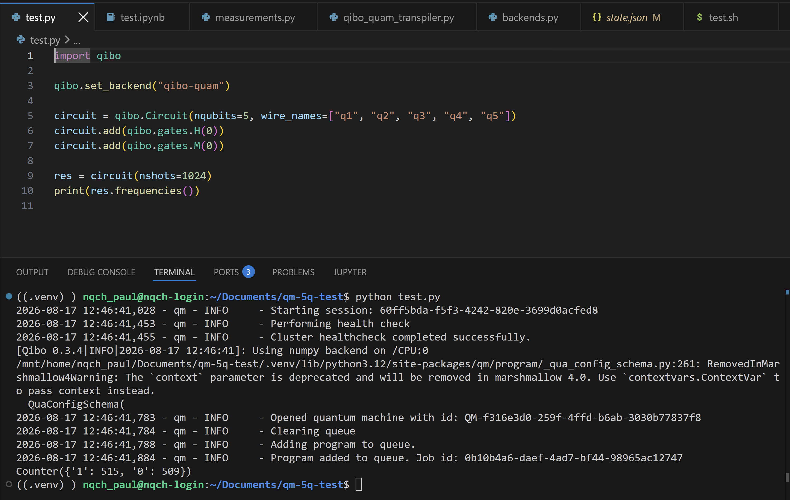

Slide 6
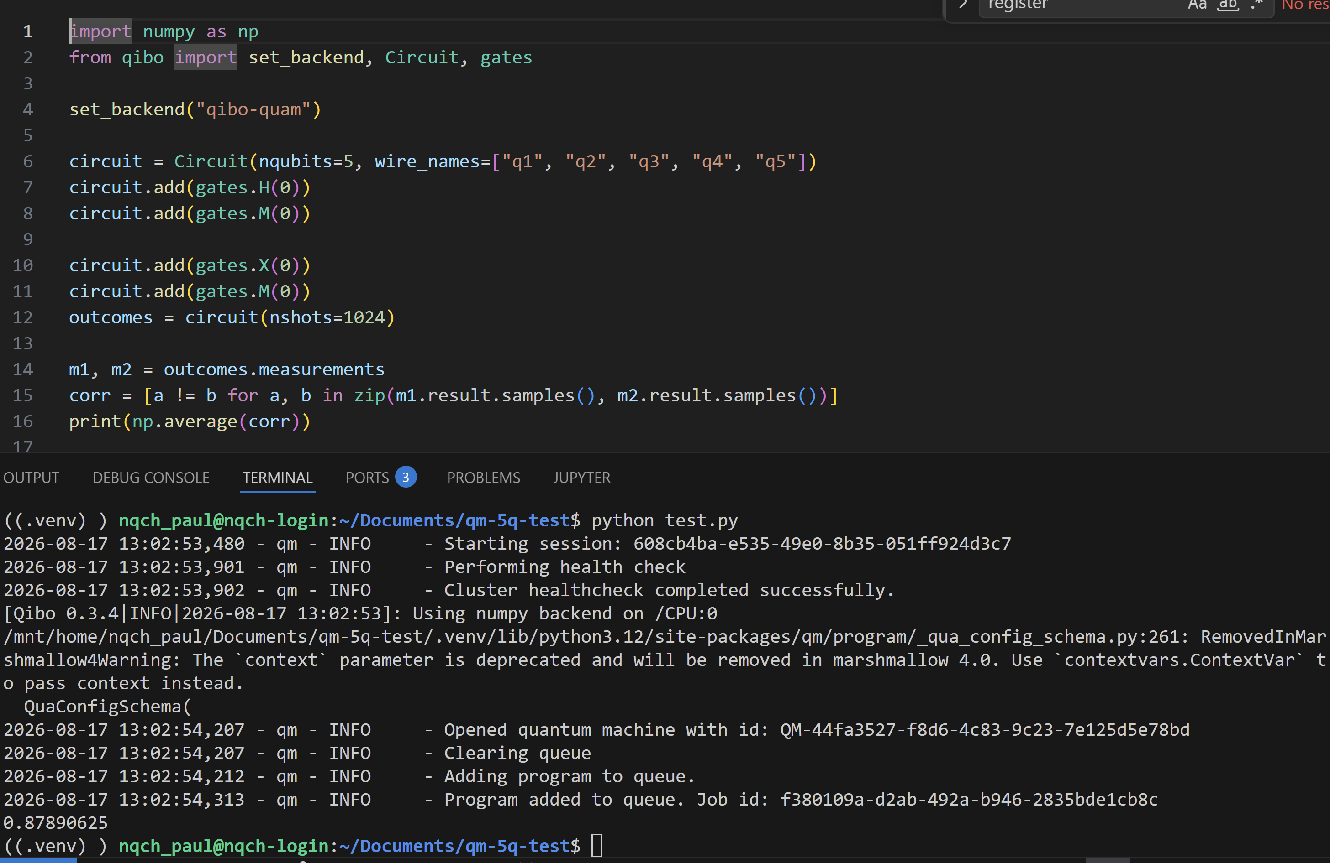

Slide 7
Bimonthly Forecast
Aug
QM Demo [Ongoing]
Week 35: QM finishes 20Q calibration and handsover to CQT
Oct
Qblox Demo
Paul on leave from 4th Oct to 15th Oct

