Slide 1
NQCH/QCIF Update - Hardware
27/7/26 - Paul

Slide 2
General Status
Keysight 20Q update – DRAG pulses and full readout working
Power Failure Incident

Slide 3
Cluster Updates
17/7/26: Regular patching, no noteworthy CVEs
Python
Moved default qibo module to qibo-ks-274
GPU libs not installed on this venv yet
qcaas (Quarko) sim backend deployment tested and working

Slide 4
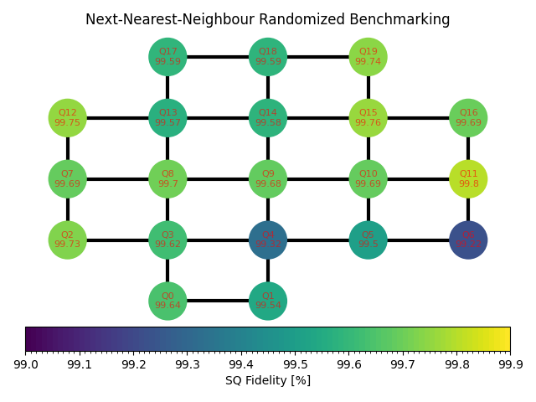
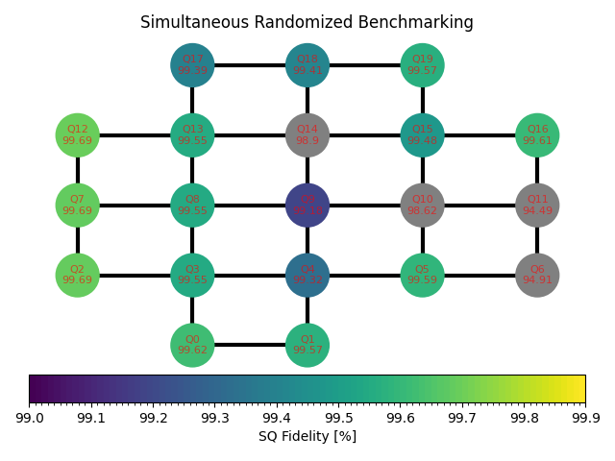
20Q Keysight Update
DRAG pulses and full readout working
Next step is to fix the couplers
Additionally diagnose potential 2Q Keysight AWG issue

Slide 5
Power Failure Incident
Timeline
25/7 1520 | Communication lost with control instrumentation
25/7 1523 | Fridge overpressure warning
25/7 1600 | Arrival on-site to find partial power trip
25/7 1605 | Started mixture recovery
25/7 1620 | Contacted Hizrat and Easy Services after trying to diagnose fault
25/7 1700 | Easy Services arrived and found cause of electrical fault
25/7 2300 | Easy Services finished installing replacement temporary part
26/7 1100 | Started mixture condensation
26/7 1300 | Condensation complete

Slide 6
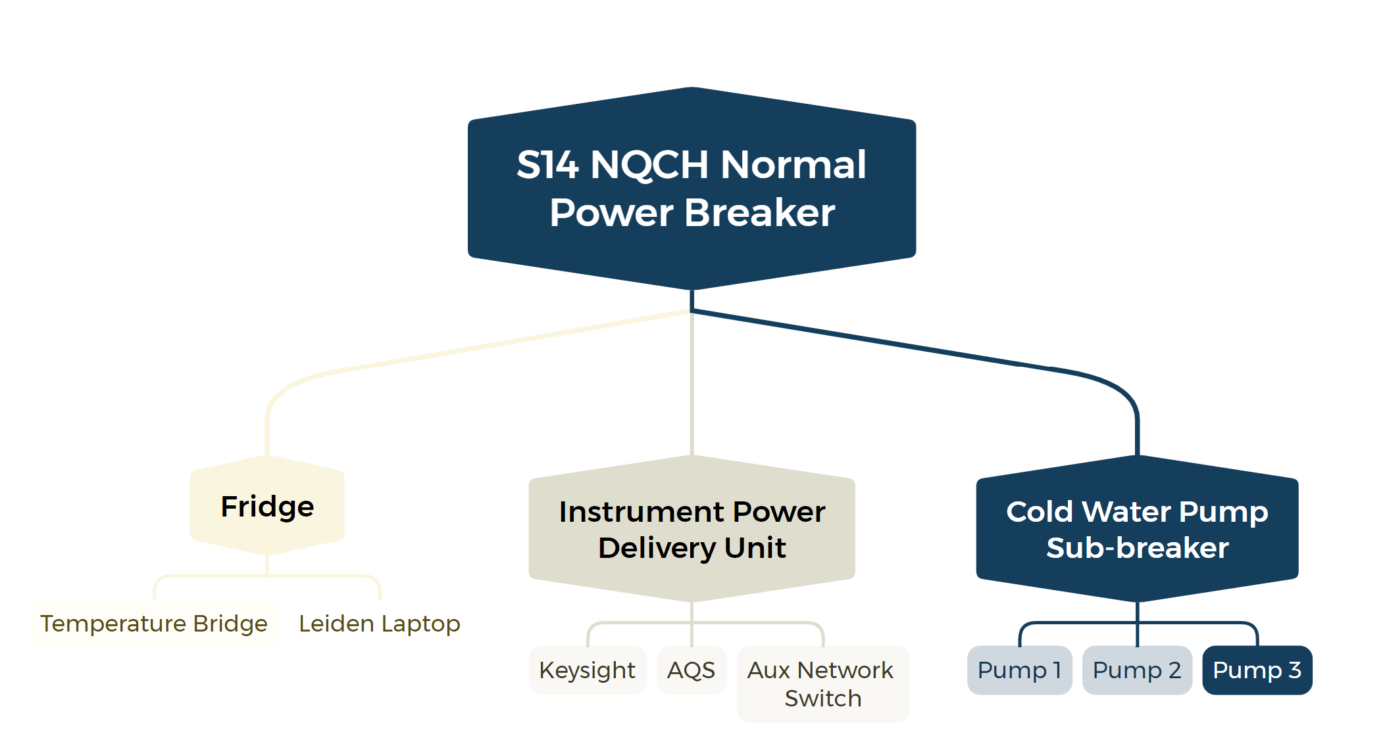
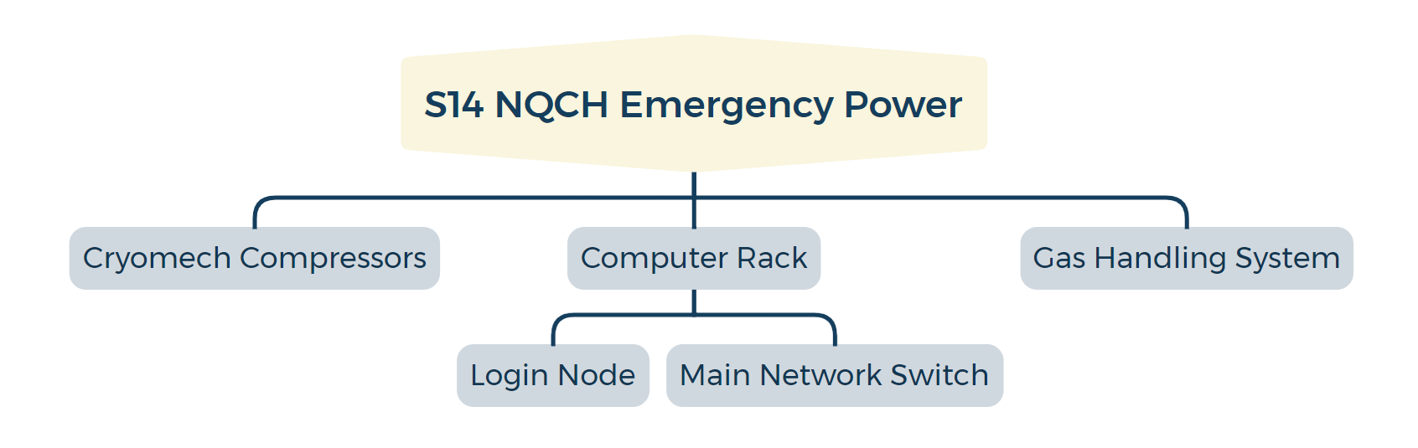

Slide 7
Post-incident
Normal power disruption caused cold water pumps and temperature sensing to fail, but login node on emergency power was able to inform us of over-pressure
Cold water monitoring also failed because the aux network switch was on normal power supply
Cold water supply has tripped before
Remedial steps
Will engage Hizrat to add more emergency power supply so we can switch critical infrastructure away from point of failure
Will engage Leiden on why mixture auto-recovery did not trigger

Slide 8
Qibocal
Coupler Ramsey [Stale]
An attempt for deterministic/automatic calibration of the coupler bias
Opened PR #1510 as draft implementation
Parallel RB
Opened PR #1490 to accelerate benchmarking
Merged
Circuit Measurement Rework
Opened PR #1532 to clean measurement assignment in Qibocal
Waiting for review
Optimize circuit-based workflows
Waiting for #1532 to be completed before starting work
Introduce parallelization/batching to certain protocols

Slide 9
Bimonthly Forecast
Aug
QM Demo
Sept/Oct
Qblox Demo
Oct
Paul on leave from 4th Oct to 15th Oct

