Slide 1
NQCH/QCIF Update - Hardware
3/8/26 - Paul

Slide 2
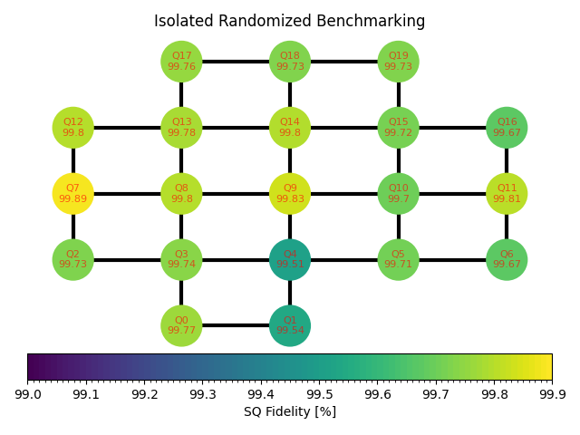
QPU Update
Increased average single qubit gate fidelity by increasing sensitivity of rotation error measurement
Q6 seems to have a crosstalk issue
Two-qubit gates have a chance for random job failure and channel lockup
Running a sequence with different channels seems to free this lockup
Initial set of parameters uploaded

Slide 3
Power Failure post-incident
Engaging buildings team to lay down more emergency power supply lines to diversify power dependency

Slide 4
Bimonthly Forecast
Aug
QM Demo
Sept/Oct
Qblox Demo
Oct
Paul on leave from 4th Oct to 15th Oct

