Slide 1
Data Structures and Algorithms
School of Big Data & Software Engineering
Chongqing University
Chongqing, China
Lectured by Chunqiang Hu
chu@cqu.edu.cn

Slide 2
7 Internal Sorting
7.1 Sorting Terminology and Notation
7.2 Three Θ(n²) Sorting Algorithms
7.3 Shellsort
7.4 Mergesort
7.5 Quicksort
7.6 Heapsort
7.7 Binsort and Radix Sort
7.8 An Empirical Comparison of Sorting Algorithms
7.9 Lower Bounds for Sorting
7.10 Further Reading
7.11 Exercises
7.12 Projects

Slide 3
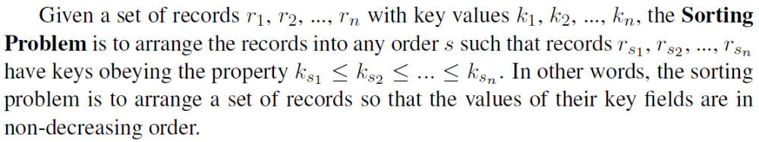
7.1 Sorting Terminology and Notation
Each record contains a field called the key.
  Linear order: comparison.
Measures of cost:
  Comparisons
  Swaps

Slide 4
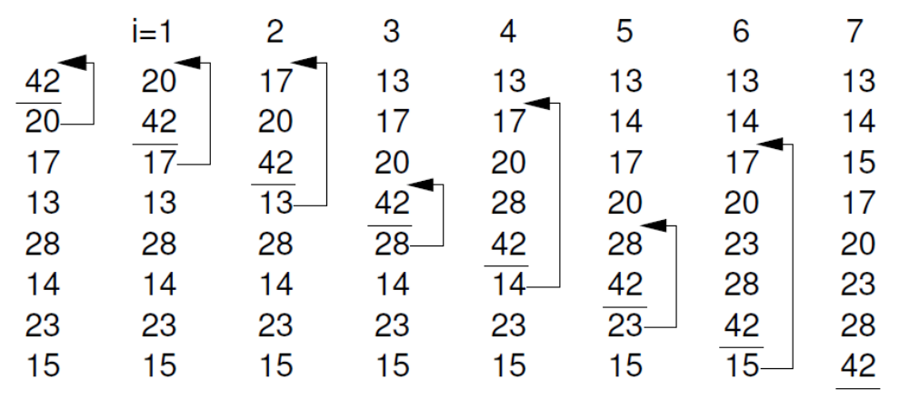
7.2 Three Θ(n²) Sorting Algorithms
Insertion Sort

Slide 5
7.2 Three Θ(n²) Sorting Algorithms
Insertion Sort
Best Case:
Worst Case:
Average Case:
template <typename E, typename Comp>
void inssort(E A[], int n) {
for (int i=1; i<n; i++)
for (int j=i; (j>0) &&(Comp::prior(A[j], A[j-1]));
j--)
swap(A, j, j-1);
}

Slide 6
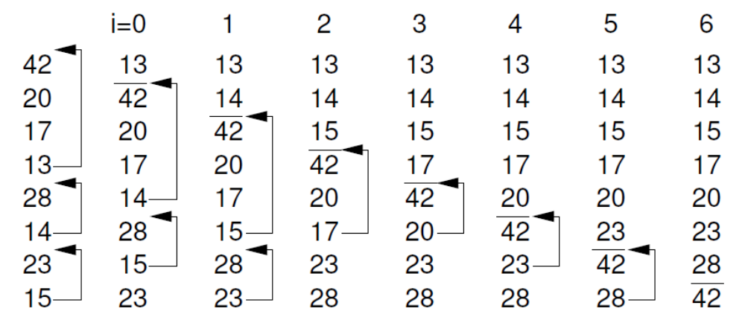
7.2 Three Θ(n²) Sorting Algorithms
Bubble Sort

Slide 7
7.2 Three Θ(n²) Sorting Algorithms
Bubble Sort
Best Case:
Worst Case:
Average Case:
template <typename E, typename Comp>
void bubsort(E A[], int n) {
for (int i=0; i<n-1; i++)
for (int j=n-1; j>i; j--)
if (Comp::prior(A[j], A[j-1]))
swap(A, j, j-1);
}

Slide 8
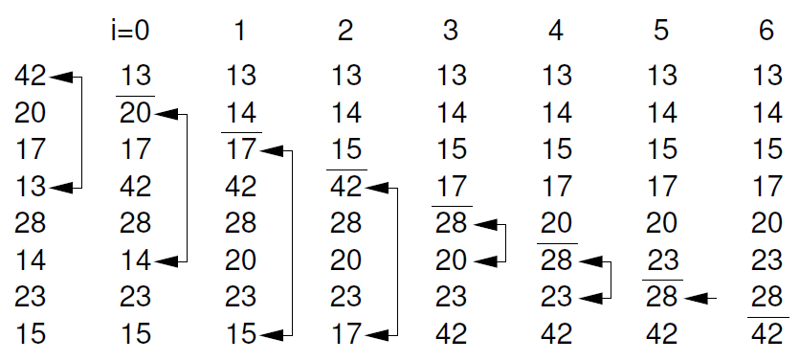
7.2 Three Θ(n²) Sorting Algorithms
Selection Sort

Slide 9
7.2 Three Θ(n²) Sorting Algorithms
Selection Sort
Best Case:
Worst Case:
Average Case:
template <typename E, typename Comp>
void selsort(E A[], int n) {
for (int i=0; i<n-1; i++) {
int lowindex = i;
for (int j=n-1; j>i; j--)
if (Comp::prior(A[j], A[lowindex]))
lowindex = j;
swap(A, i, lowindex);
}
}

Slide 10
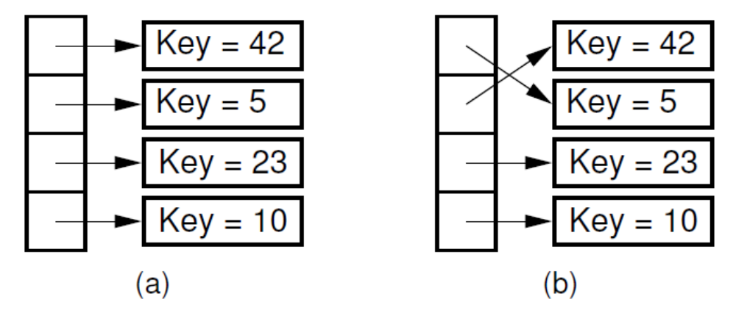
7.2 Three Θ(n²) Sorting Algorithms
Pointer Swapping

Slide 11
7.2 Three Θ(n²) Sorting Algorithms
The Cost of Exchange Sorting(交换排序)
  All of the sorts so far rely on exchanges of adjacent records.
  What is the average number of exchanges required?
    Consider permuation X and its reverse, X’
    Together, every pair requires n(n-1)/2 exchanges.

Slide 12
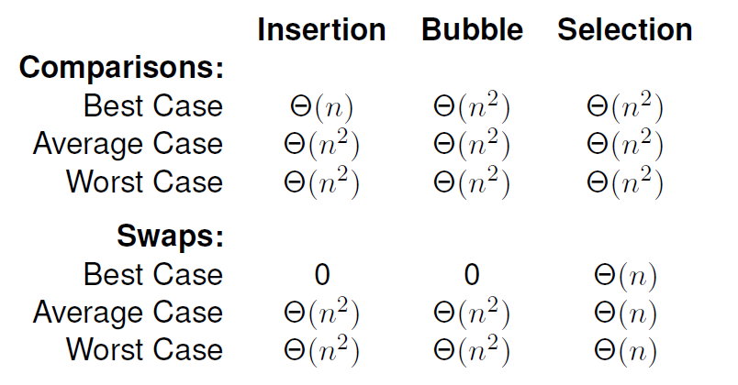
7.2 Three Θ(n²) Sorting Algorithms
The Cost of Exchange Sorting

Slide 13
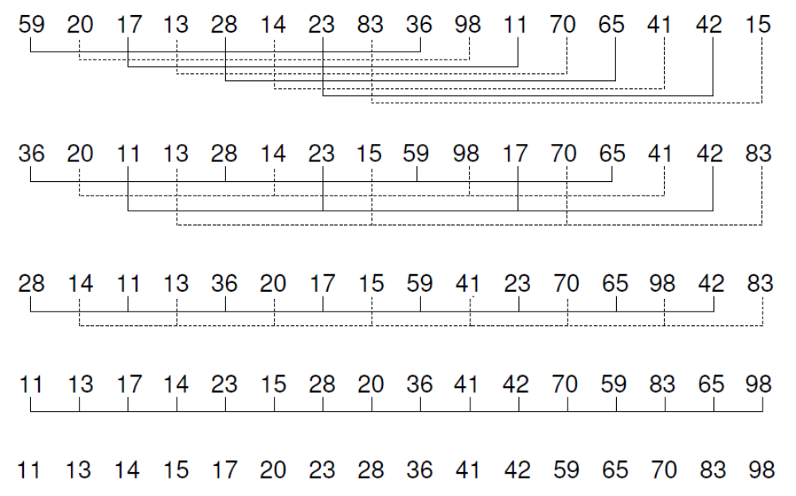
7.3 Shellsort

Slide 14
7.3 Shellsort
template <typename E, typename Comp>
void inssort2(E A[], int n, int incr) {
for (int i=incr; i<n; i+=incr)
for (int j=i; (j>=incr) &&
(Comp::prior(A[j], A[j-incr])); j-=incr)
swap(A, j, j-incr);
}
template <typename E, typename Comp>
void shellsort(E A[], int n) {
for (int i=n/2; i>2; i/=2)
for (int j=0; j<i; j++)
inssort2<E,Comp>(&A[j], n-j, i);
inssort2<E,Comp>(A, n, 1);
}

Slide 15
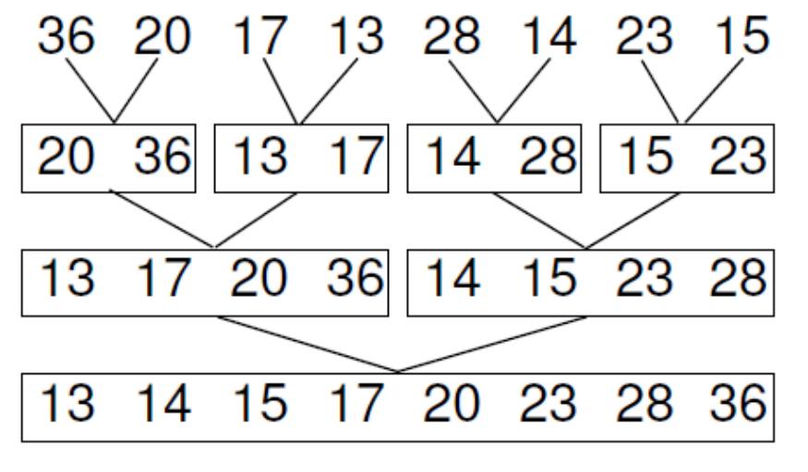
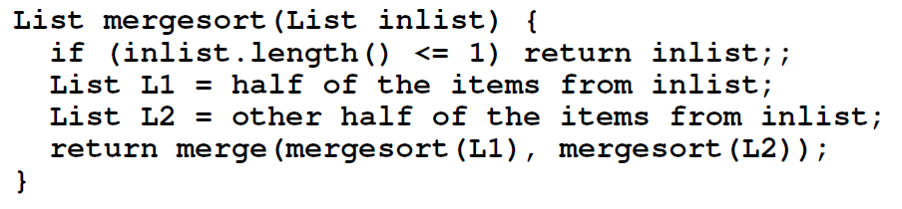
7.4 Mergesort

Slide 16
7.4 Mergesort
template <typename E, typename Comp>
void mergesort(E A[], E temp[], int left, int right) {
if (left == right) return;
int mid = (left+right)/2;
mergesort<E,Comp>(A, temp, left, mid);
mergesort<E,Comp>(A, temp, mid+1, right);
for (int i=left; i<=right; i++)
temp[i] = A[i];
// Do the merge operation back to A
int i1 = left; int i2 = mid + 1;
for (int curr=left; curr<=right; curr++) {
if (i1 == mid+1)
A[curr] = temp[i2++];
else if (i2 > right)
A[curr] = temp[i1++];
else if (Comp::prior(temp[i1], temp[i2]))
A[curr] = temp[i1++];
else A[curr] = temp[i2++];
}
}

Slide 17
7.4 Mergesort
template <typename E, typename Comp>
void mergesort(E A[], E temp[], int left, int right) {
if ((right-left) <= THRESHOLD) {
inssort<E,Comp>(&A[left], right-left+1);
return;
}
int i, j, k, mid = (left+right)/2;
mergesort<E,Comp>(A, temp, left, mid);
mergesort<E,Comp>(A, temp, mid+1, right);
// Do the merge operation. First, copy 2 halves to temp.
for (i=mid; i>=left; i--) temp[i] = A[i];
for (j=1; j<=right-mid; j++) temp[right-j+1] = A[j+mid];
// Merge sublists back to A
for (i=left,j=right,k=left; k<=right; k++)
if (Comp::prior(temp[i], temp[j])) A[k] = temp[i++];
else A[k] = temp[j--];
}

Slide 18
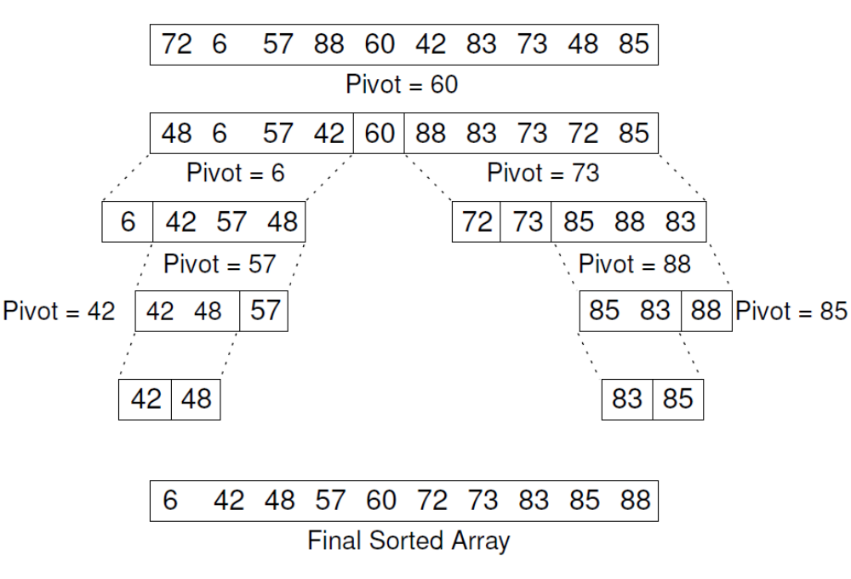
7.5 Quicksort

Slide 19
7.5 Quicksort
Implementation for Quicksort
template <typename E, typename Comp>
void qsort(E array[], int i, int j) {
if ((j-i) <= THRESHOLD) return;
int pivotindex = findpivot(array, i, j);
swap(array, pivotindex, j);
int k = partition<E,Comp>(array, i-1, j, array[j]);
swap(array, k, j);
qsort<E,Comp>(array, i, k-1);
qsort<E,Comp>(array, k+1, j);
}

Slide 20
7.5 Quicksort
Implementation for Quicksort
template <typename E, typename Comp>
inline int partition(E A[], int l, int r, E& pivot) {
do {
while (Comp::prior(A[++l], pivot));
while ((l < r) && Comp::prior(pivot, A[--r]));
swap(A, l, r);
} while (l < r);
return l;
}
template <typename E>
inline int findpivot(E A[], int i, int j)
{ return (i+j)/2; }

Slide 21
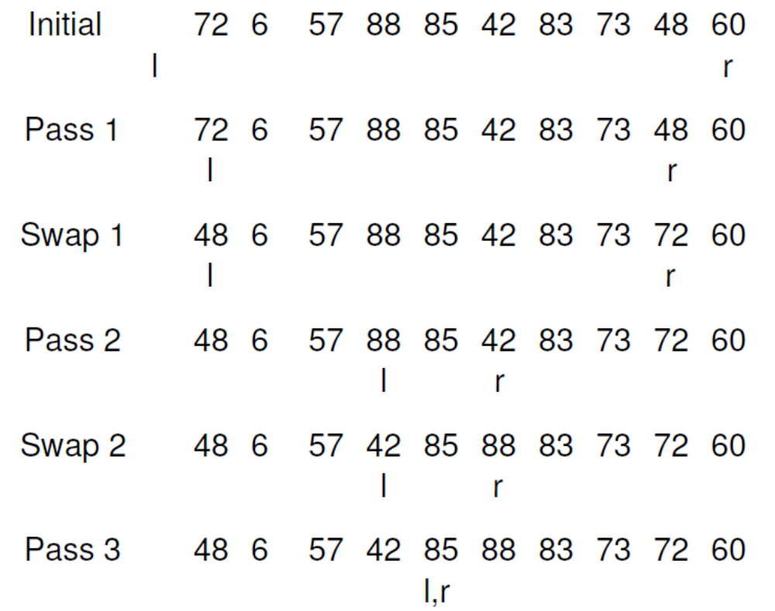
7.5 Quicksort

Slide 22
7.5 Quicksort
Best case: Always partition in half.
Worst case: Bad partition.
Average case:
T(n) = n + 1 + 1/(n-1) Σ(T(k) + T(n-k))
Optimizations for Quicksort:
  Better Pivot
  Better algorithm for small sublists
  Eliminate recursion

Slide 23
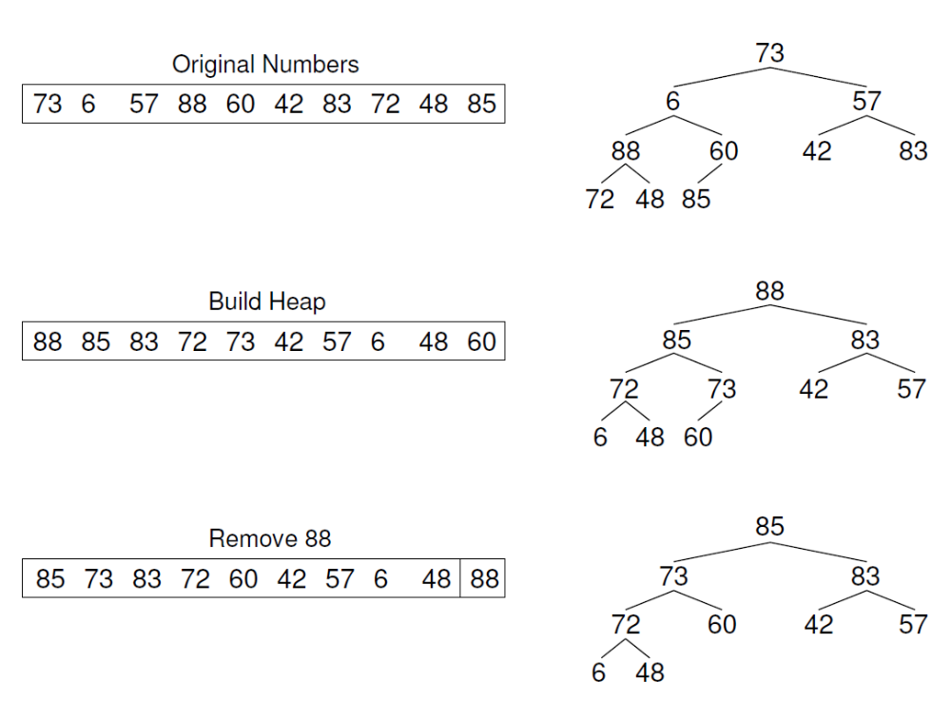
7.6 Heapsort

Slide 24
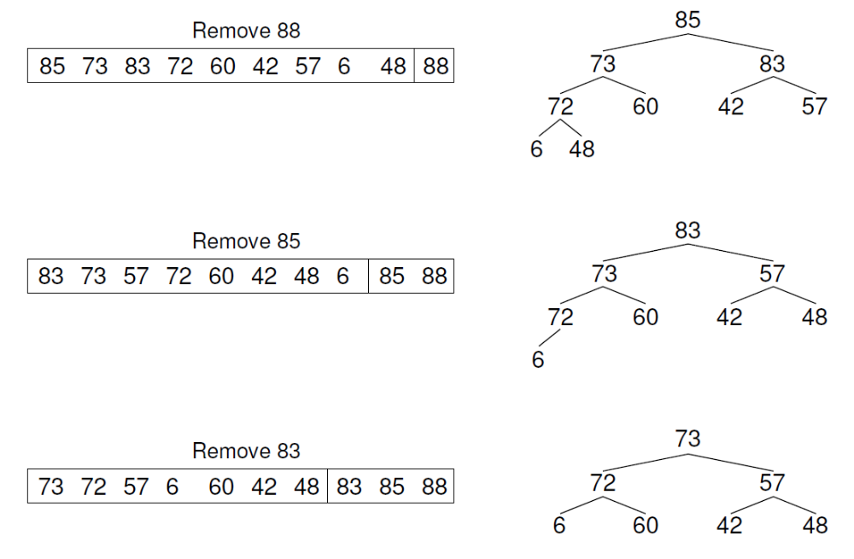
7.6 Heapsort

Slide 25
7.6 Heapsort
Implementation for Heapsort
Use a max-heap, so that elements end up sorted within the array.
Cost of heapsort:
Cost of finding K largest elements:
template <typename E, typename Comp>
void heapsort(E A[], int n) {
E maxval;
heap<E,Comp> H(A, n, n);
for (int i=0; i<n; i++)
maxval = H.removefirst();
}

Slide 26
7.7 Binsort and Radix Sort
Binsort
template <typename E, class getKey>
void binsort(E A[], int n) {
List<E> B[MaxKeyValue];
E item;
for (int i=0; i<n; i++) B[A[i]].append(getKey::key(A[i]));
for (int i=0; i<MaxKeyValue; i++)
for (B[i].setStart(); B[i].getValue(item); B[i].next())
output(item);
}

Slide 27
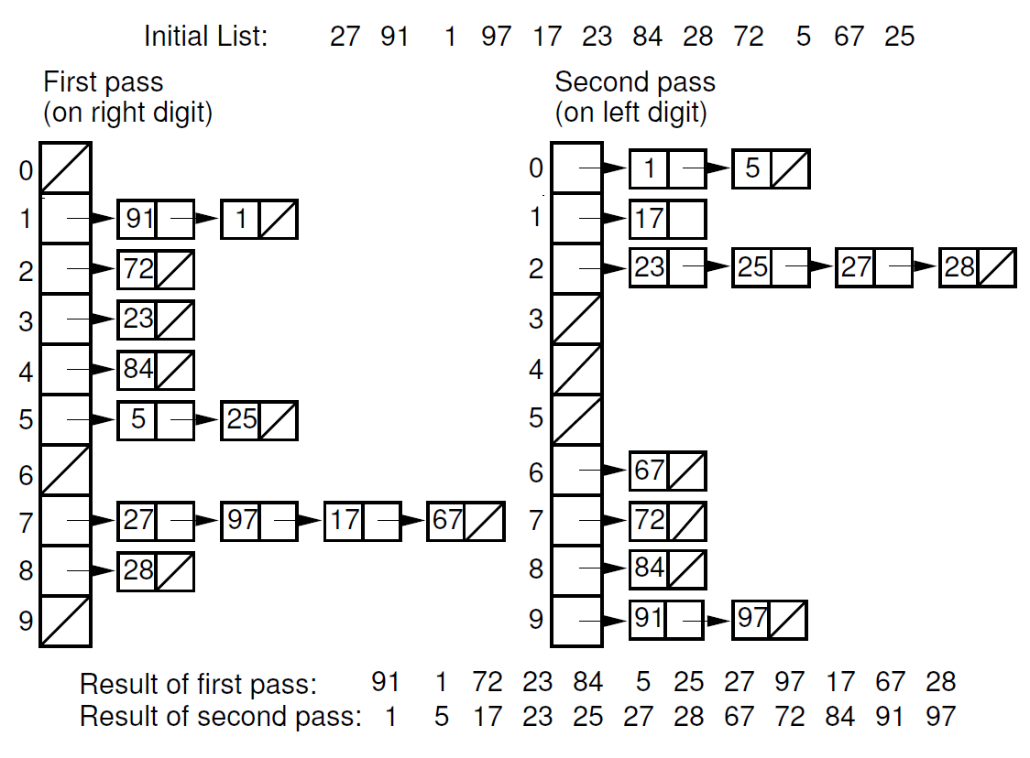
7.7 Binsort and Radix Sort

Slide 28
7.7 Binsort and Radix Sort
template <typename E, typename getKey>
void radix(E A[], E B[],
int n, int k, int r, int cnt[]) {
int j;
for (int i=0, rtoi=1; i<k; i++, rtoi*=r) {
for (j=0; j<r; j++) cnt[j] = 0;
// Count the number of records for each bin on this pass
for (j=0; j<n; j++) cnt[(getKey::key(A[j])/rtoi)%r]++;
// Index B: cnt[j] will be index for last slot of bin j.
for (j=1; j<r; j++) cnt[j] = cnt[j-1] + cnt[j];
// Put records into bins, work from bottom of each bin.
// Since bins fill from bottom, j counts downwards
for (j=n-1; j>=0; j--)
B[--cnt[(getKey::key(A[j])/rtoi)%r]] = A[j];
for (j=0; j<n; j++) A[j] = B[j];
}
}

Slide 29
7.7 Binsort and Radix Sort
Cost: Θ (nk + rk)
How do n, k, and r relate?
If key range is small, then this can be Θ (n).
If there are n distinct keys, then the length of a key must be at least log n.
  Thus, Radix Sort is Θ (n log n) in general case

Slide 30
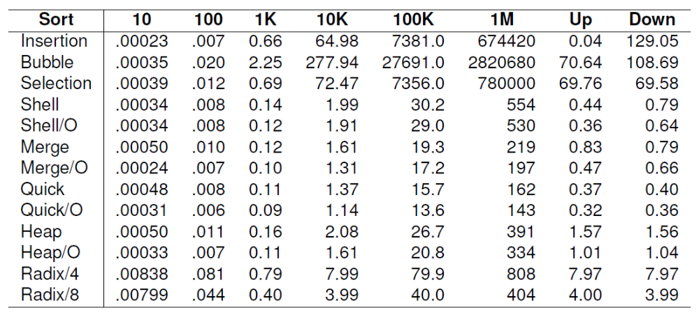
7.8 An Empirical Comparison of Sorting Algorithms

Slide 31
7.9 Lower Bounds for Sorting
We would like to know a lower bound for all possible sorting algorithms.
Sorting is O(n log n) (average, worst cases) because we know of algorithms with this upper bound.
Sorting I/O takes Ω(n) time.
We will now prove Ω(n log n) lower bound for sorting.

Slide 32
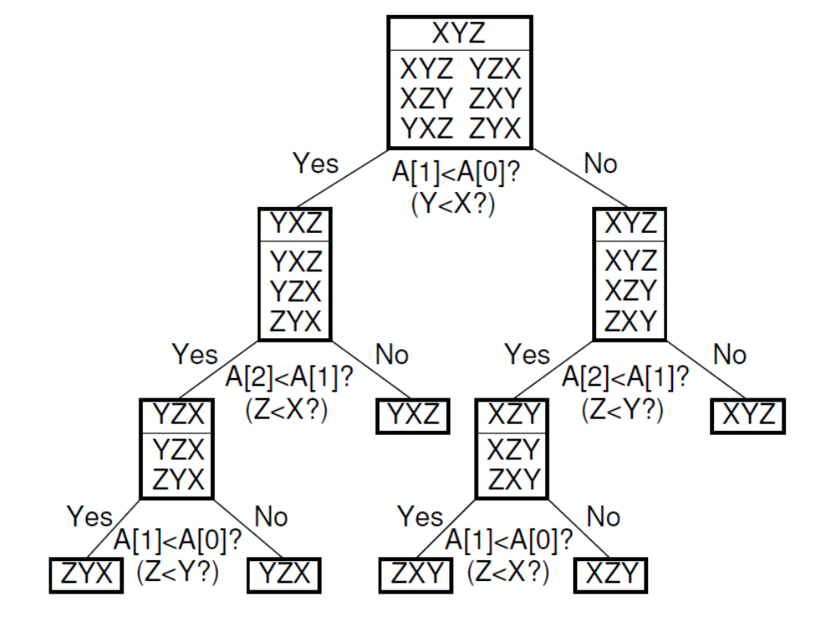
7.9 Lower Bounds for Sorting

Slide 33
7.9 Lower Bounds for Sorting
Lower Bound Proof
  There are n! permutations.
  A sorting algorithm can be viewed as determining which permutation has been input.
  Each leaf node of the decision tree corresponds to one permutation.
  A tree with n nodes has Ω(log n) levels, so the tree with n! leaves has Ω(log n!) = Ω(n log n) levels.
Which node in the decision tree corresponds to the worst case?

Slide 34
Summary
7.1 Sorting Terminology and Notation
7.2 Three Θ(n²) Sorting Algorithms
7.3 Shellsort
7.4 Mergesort
7.5 Quicksort
7.6 Heapsort
7.7 Binsort and Radix Sort
7.8 An Empirical Comparison of Sorting Algorithms
7.9 Lower Bounds for Sorting
7.10 Further Reading
7.11 Exercises
7.12 Projects

