Slide 1
Data Structures and Algorithms
School of Big Data & Software Engineering
Chongqing University
Chongqing, China
Lectured by Chunqiang Hu
chu@cqu.edu.cn

Slide 2
8 File Processing and External Sorting
8.1 Primary versus Secondary Storage
8.2 Disk Drives
8.3 Buffers and Buffer Pools
8.4 The Programmer’s View of Files
8.5 External Sorting
8.6 Further Reading
8.7 Exercises
8.8 Projects

Slide 3
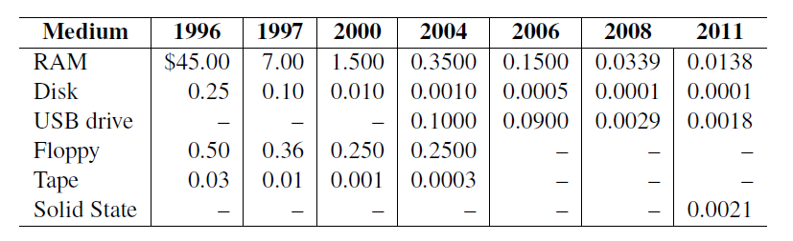
8.1 Primary versus Secondary Storage
Primary storage: Main memory (RAM)
Secondary Storage: Peripheral devices
  Disk drives
  Tape drives
  Flash drives

Slide 4
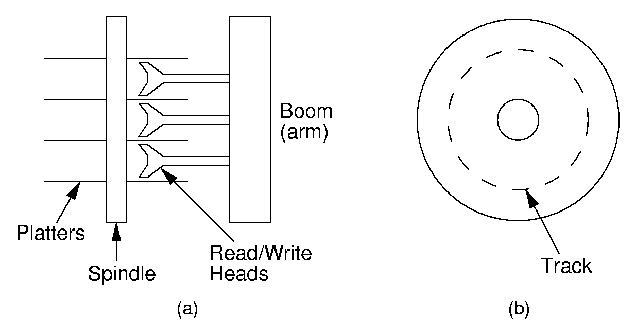
8.2 Disk Drives

Slide 5
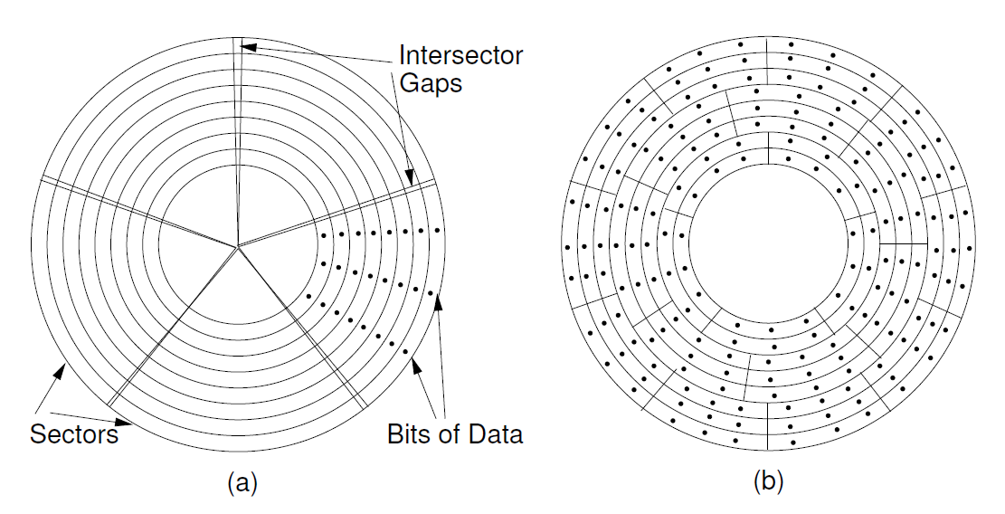
8.2 Disk Drives

Slide 6
8.3 Buffers and Buffer Pools
Buffers
  The information in a sector is stored in a buffer or cache.
  If the next I/O access is to the same buffer, then no need to go to disk.
  There are usually one or more input buffers and one or more output buffers.
Buffer Pools
  A series of buffers used by an application to cache disk data is called a buffer pool.
  Virtual memory uses a buffer pool to imitate greater RAM memory by actually storing information on disk and “swapping” between disk and RAM.

Slide 7
8.4 The Programmer’s View of Files
The C++ programmer’s logical view of a random access file is a single stream of bytes.
Interaction with a file can be viewed as a communications channel for issuing one of three instructions:
  Read bytes from the current position in the file
  Write bytes to the current position in the file
  Move the current position within the file.

Slide 8
8.5 External Sorting
Problem: Sorting data sets too large to fit into main memory.
  Assume data are stored on disk drive.
To sort, portions of the data must be brought into main memory, processed, and returned to disk.
An external sort should minimize disk accesses.

Slide 9
8.5 External Sorting
Model of External Computation
  Secondary memory is divided into equal-sized blocks (512, 1024, etc…)
  A basic I/O operation transfers the contents of one disk block to/from main memory.
  Under certain circumstances, reading blocks of a file in sequential order is more efficient. (When?)
  Primary goal is to minimize I/O operations.
  Assume only one disk drive is available.

Slide 10
8.5 External Sorting
Key Sorting
  Often, records are large, keys are small.
    Ex: Payroll entries keyed on ID number
  Approach 1: Read in entire records, sort them, then write them out again.
  Approach 2: Read only the key values, store with each key the location on disk of its associated record.
  After keys are sorted the records can be read and rewritten in sorted order.

Slide 11
8.5 External Sorting
Simple Approaches to External Sorting
  1. Split the file into two files.
  2. Read in a block from each file.
  3. Take first record from each block, output them in sorted order.
  4. Take next record from each block, output them to a second file in sorted order.
  5. Repeat until finished, alternating between output files. Read new input blocks as needed.
  6. Repeat steps 2-5, except this time input files have runs of two sorted records that are merged together.
  7. Each pass through the files provides larger runs.

Slide 12
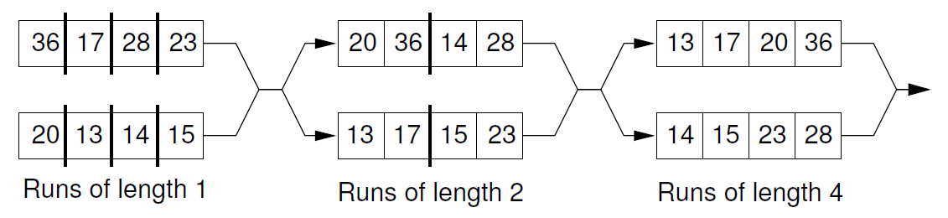
8.5 External Sorting
Simple Approaches to External Sorting

Slide 13
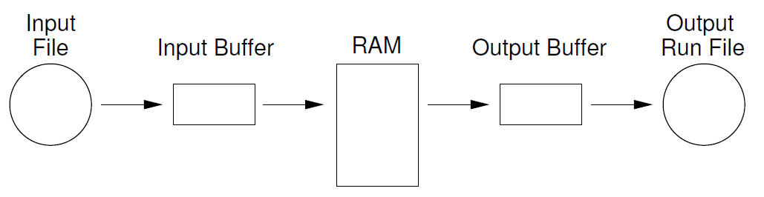
8.5 External Sorting
Replacement Selection

Slide 14
8.5 External Sorting
Replacement Selection
  Break available memory into an array for the heap, an input buffer, and an output buffer.
  Fill the array from disk.
  Make a min-heap.
  Send the smallest value (root) to the output buffer.
  If the next key in the file is greater than the last value output, then
    Replace the root with this key
  else
    Replace the root with the last key in the array
  Add the next record in the file to a new.

Slide 15
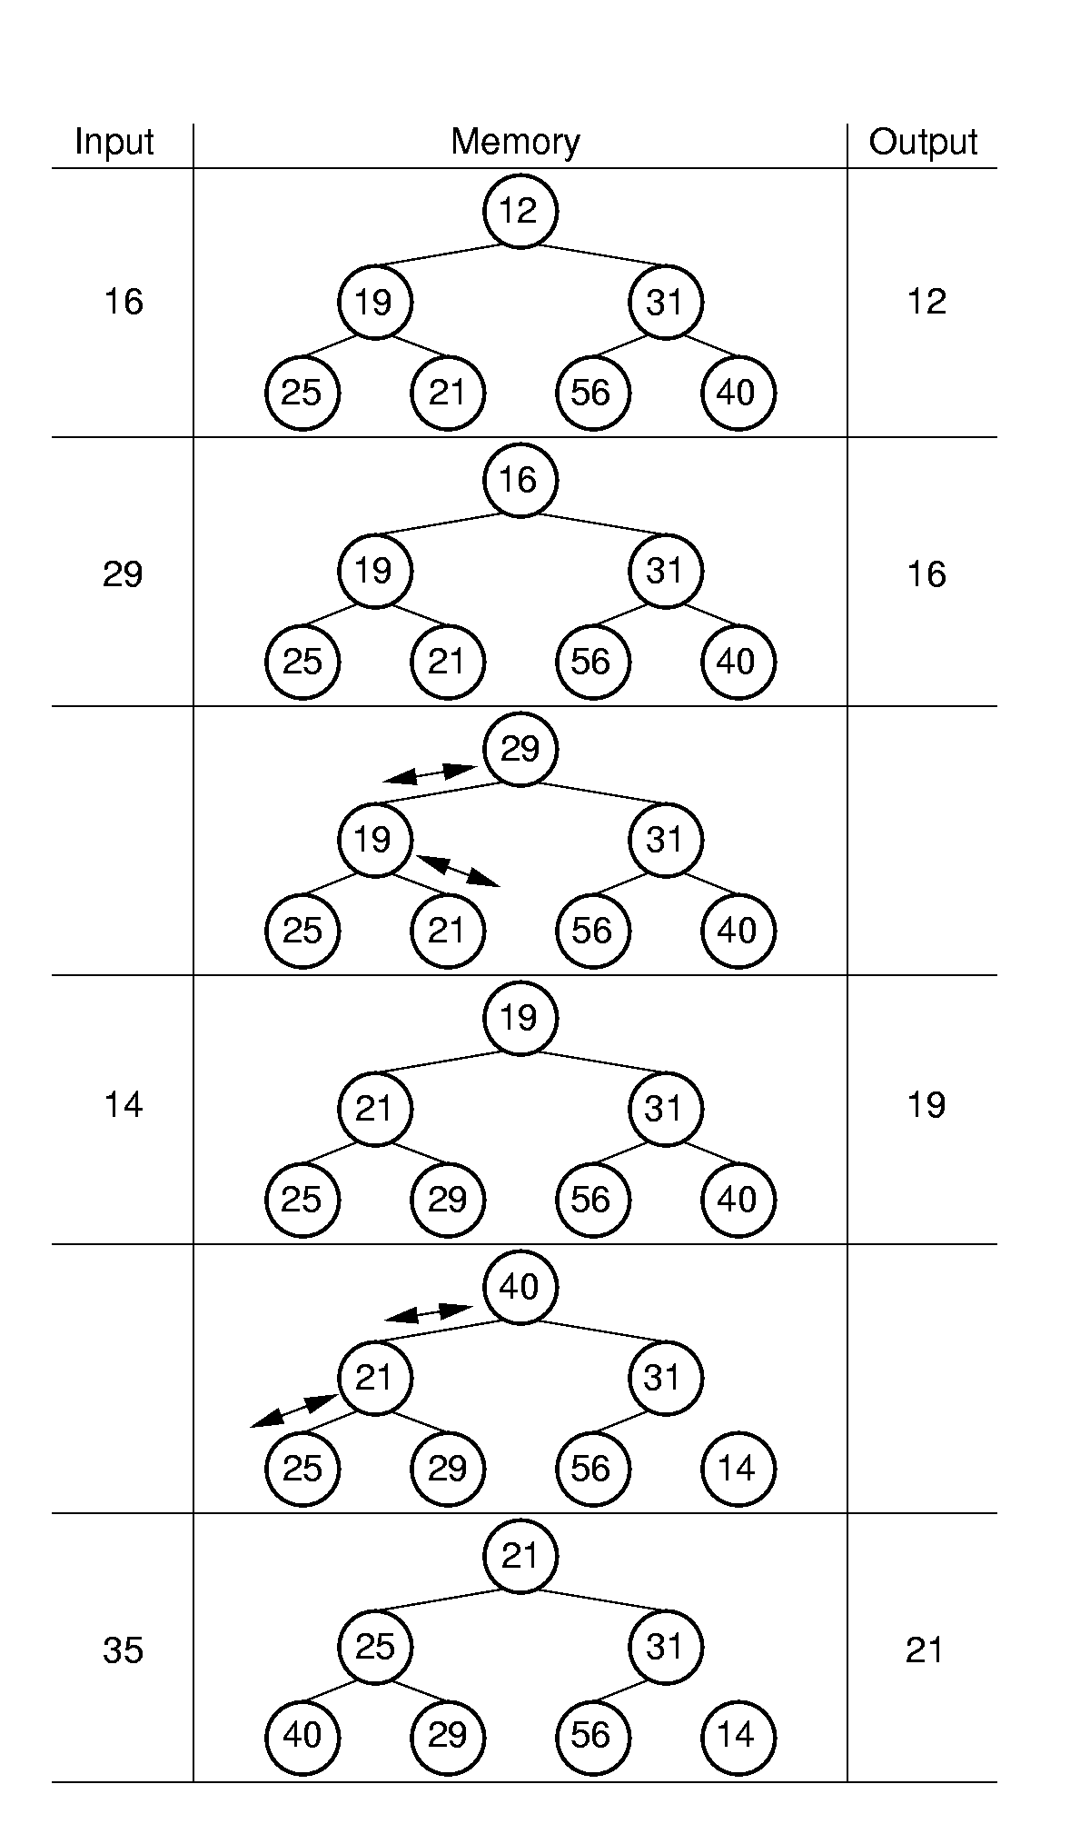
8.5 External Sorting
Replacement Selection

Slide 16
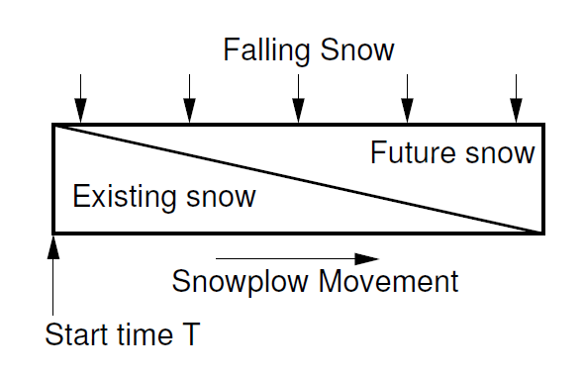
8.5 External Sorting
Replacement Selection

Slide 17
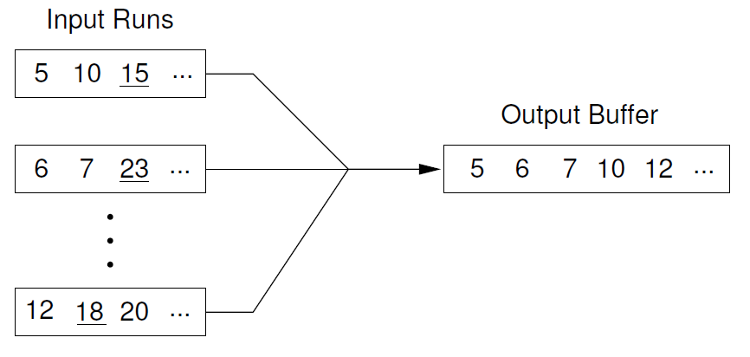
8.5 External Sorting
Multiway Merging

Slide 18
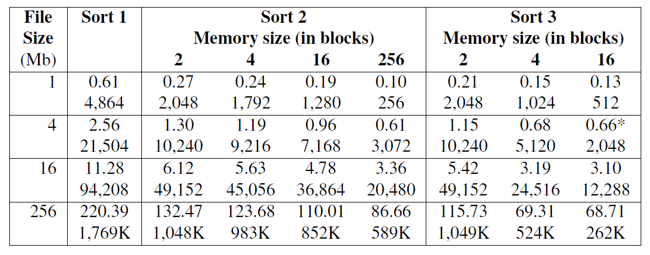
8.5 External Sorting
Multiway Merging

Slide 19
Summary
8.1 Primary versus Secondary Storage
8.2 Disk Drives
8.3 Buffers and Buffer Pools
8.4 The Programmer’s View of Files
8.5 External Sorting
8.6 Further Reading
8.7 Exercises
8.8 Projects

