Slide 1
Data Structures and Algorithms
School of Big Data & Software Engineering
Chongqing University
Chongqing, China
Lectured by Chunqiang Hu
chu@cqu.edu.cn

Slide 2
4 Lists, Stacks, and Queues
4.1 Lists(线性表)
4.2 Stacks(栈)
4.3 Queues (队列)
4.4 Dictionaries
4.5 Further Reading
4.6 Exercises
4.7 Projects

Slide 3
4.1 Lists
A list is a finite, ordered sequence(序列) of data items.
Important concept: List elements have a position.
Notation: <a₀, a₁, …, a_{n-1}>
What operations should we implement?

Slide 4
4.1 Lists
List Implementation Concepts
  Our list implementation will support the concept of a current position.
  Operations will act relative to the current position.
<20, 23 | 12, 15>
current position

Slide 5
4.1 Lists
template <typename E> class List { // List ADT
private:
void operator =(const List&) {}
List(const List&) {}
public:
List() {}
virtual ~List() {}
virtual void clear() = 0;
virtual void insert(const E& item) = 0;
virtual void append(const E& item) = 0;
virtual E remove() = 0;
virtual void moveToStart() = 0;
virtual void moveToEnd() = 0;
virtual void prev() = 0;
virtual void next() = 0;
virtual int length() const = 0;
virtual int currPos() const = 0;
virtual void moveToPos(int pos) = 0;
virtual const E& getValue() const = 0;
};

Slide 6
4.1 Lists
List ADT Examples
  List: < 20, 23 | 12, 15 >
  L.insert(10);
  Result: < 20, 23 | 10, 12, 15 >
Iterate through the whole list:
for (L.moveToStart(); L.currPos()<L.length(); L.next()) {
it = L.getValue();
doSomething(it);
}

Slide 7
4.1 Lists
List Find Function
bool find(List<int>& L, int K) {
int it;
for (L.moveToStart(); L.currPos()<L.length(); L.next()) {
it = L.getValue();
if (K == it) return true; // Found K
}
return false; // K not found
}

Slide 8
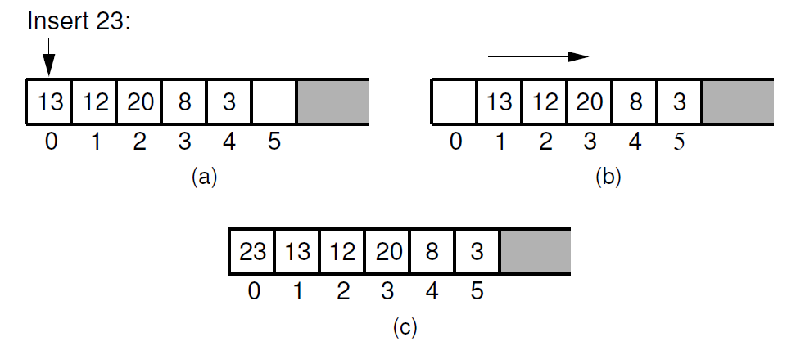
4.1 Lists
Array-Based List Implementation(顺序表实现)

Slide 9
4.1 Lists
Array-Based List Implementation
template <typename E>//Array-based list implementation
class AList : public List<E> {
private:
int maxSize;
int listSize;
int curr;
E* listArray;
public:
AList(int size=defaultSize) {
maxSize = size;
listSize = curr = 0;
listArray = new E[maxSize];
}
~AList() { delete [] listArray; }
void clear() {
delete [] listArray;
listSize = curr = 0;
listArray = new E[maxSize];
}

Slide 10
4.1 Lists
void insert(const E& it) {
Assert(listSize < maxSize, "List capacity exceeded");
for(int i=listSize; i>curr; i--)
listArray[i] = listArray[i-1];
listArray[curr] = it;
listSize++;
}
void append(const E& it) {
Assert(listSize < maxSize, "List capacity exceeded");
listArray[listSize++] = it;
}
E remove() {
Assert((curr>=0) && (curr < listSize), "No element");
E it = listArray[curr];
for(int i=curr; i<listSize-1; i++)
listArray[i] = listArray[i+1];
listSize--;
return it;
}

Slide 11
4.1 Lists
void moveToStart() { curr = 0; }
void moveToEnd() { curr = listSize; }
void prev() { if (curr != 0) curr--; }
void next() { if (curr < listSize) curr++; }
int length() const { return listSize; }
int currPos() const { return curr; }
void moveToPos(int pos) {
Assert ((pos>=0)&&(pos<=listSize), "Pos out of range");
curr = pos;
}
const E& getValue() const {
Assert((curr>=0)&&(curr<listSize),"No current element");
return listArray[curr];
}
};
各个成员函数的时间复杂度？

Slide 12
4.1 Lists
Linked Lists(链表实现)
template <typename E> class Link {
public:
E element; // Value for this node
Link *next; // Pointer to next node in list
// Constructors
Link(const E& elemval, Link* nextval =NULL)
{ element = elemval; next = nextval; }
Link(Link* nextval =NULL) { next = nextval; }
};
结点类定义

Slide 13
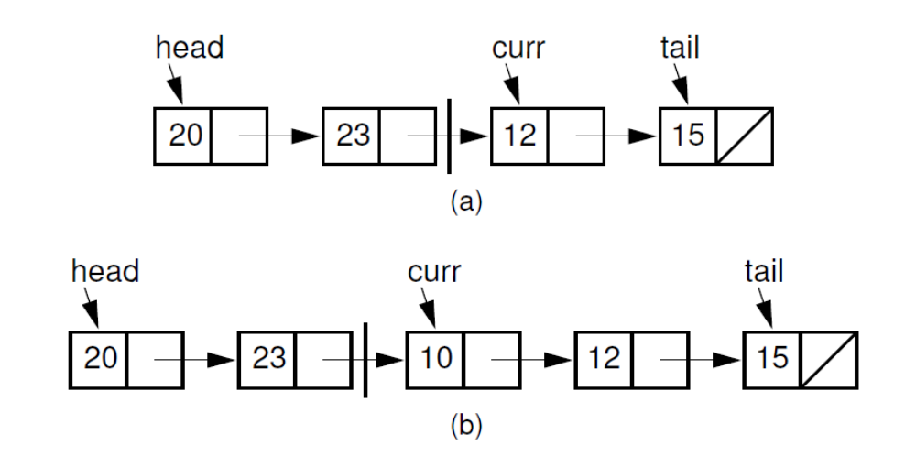
4.1 Lists
Linked Lists
curr指向位置是否合理？

Slide 14
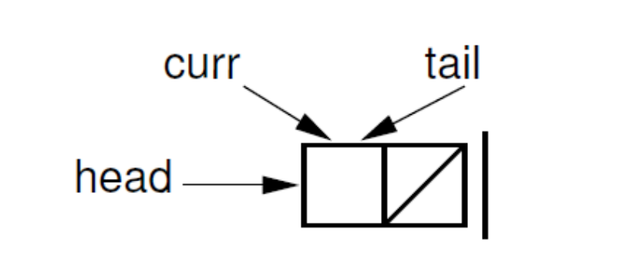
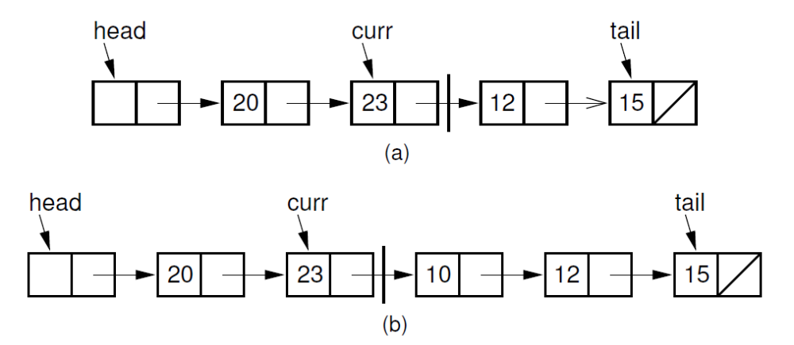
4.1 Lists
Linked Lists
表头结点

Slide 15
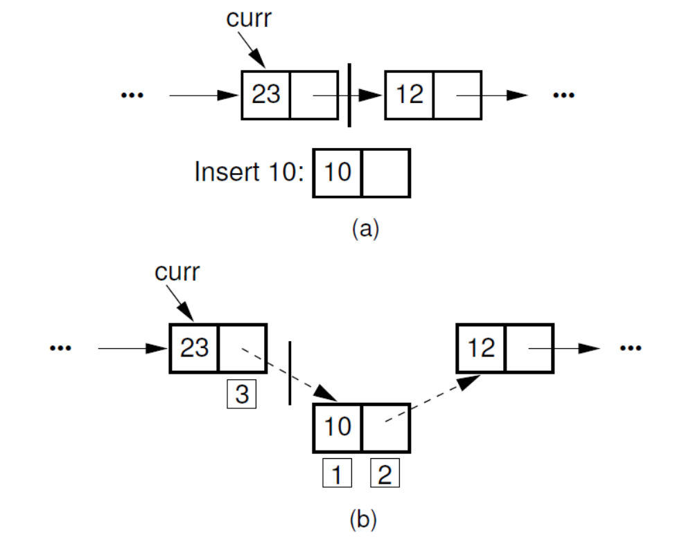
4.1 Lists
Linked Lists

Slide 16
4.1 Lists
Linked Lists
// Insert "it" at current position
void insert(const E& it) {
curr->next = new Link<E>(it, curr->next);
if (tail == curr) tail = curr->next; // New tail
cnt++;
}
void append(const E& it) { // Append "it" to list
tail = tail->next = new Link<E>(it, NULL);
cnt++;
}

Slide 17
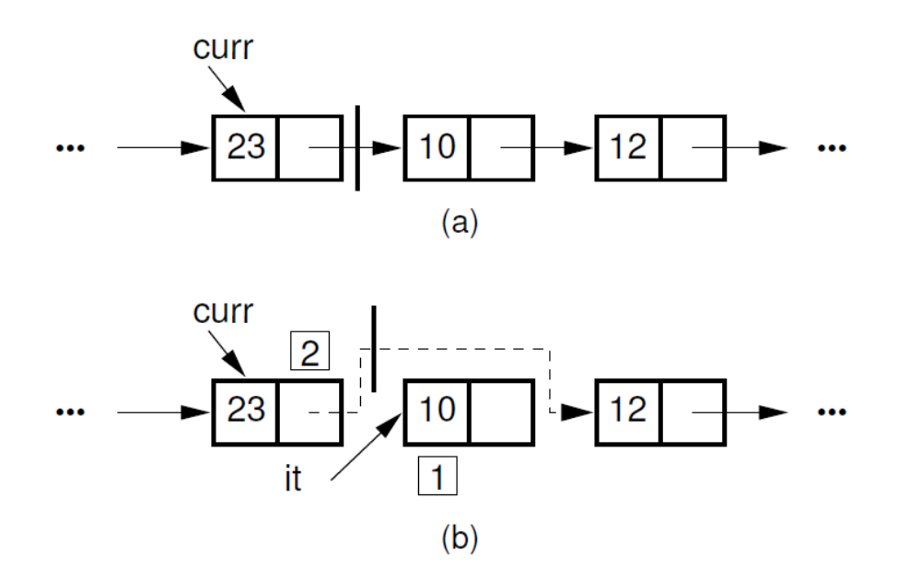
4.1 Lists
Linked Lists

Slide 18
4.1 Lists
Linked Lists
// Remove and return current element
E remove() {
Assert(curr->next != NULL, "No element");
E it = curr->next->element; // Remember value
Link<E>* ltemp = curr->next; // Remember link node
if (tail == curr->next) tail = curr; // Reset tail
curr->next = curr->next->next; // Remove from list
delete ltemp; // Reclaim space
cnt--; // Decrement the count
return it;
}

Slide 19
4.1 Lists
Comparison of List Implementations
Array-Based Lists:
  Insertion and deletion are Θ(n).
  Prev and direct access are Θ(1).
  Array must be allocated in advance.
  No overhead if all array positions are full.
Linked Lists:
  Insertion and deletion are Θ(1).
  Prev and direct access are Θ(n).
  Space grows with number of elements.
  Every element requires overhead.

Slide 20
4.1 Lists
Space Comparison
“Break-even” point:
DE = n(P + E);
n = DE
P + E
E: Space for data value.
P: Space for pointer.
D: Number of elements in array.

Slide 21
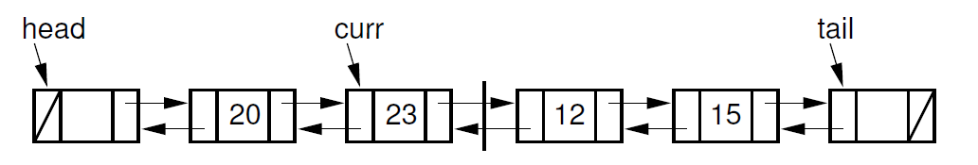
4.1 Lists
Doubly Linked Lists(双链表)

Slide 22
4.1 Lists
Doubly Linked Lists
template <typename E> class Link {
private:
static Link<E>* freelist; // Reference to freelist head
public:
E element; // Value for this node
Link* next; // Pointer to next node in list
Link* prev; // Pointer to previous node
// Constructors
Link(const E& it, Link* prevp, Link* nextp) {
element = it;
prev = prevp;
next = nextp;
}

Slide 23
4.1 Lists
Link(Link* prevp =NULL, Link* nextp =NULL) {
prev = prevp;
next = nextp;
}
void* operator new(size_t) { // Overloaded new operator
if (freelist == NULL) return ::new Link; // Create space
Link<E>* temp = freelist; // Can take from freelist
freelist = freelist->next;
return temp; // Return the link
}
void operator delete(void* ptr) {
((Link<E>*)ptr)->next = freelist; // Put on freelist
freelist = (Link<E>*)ptr;
}
};

Slide 24
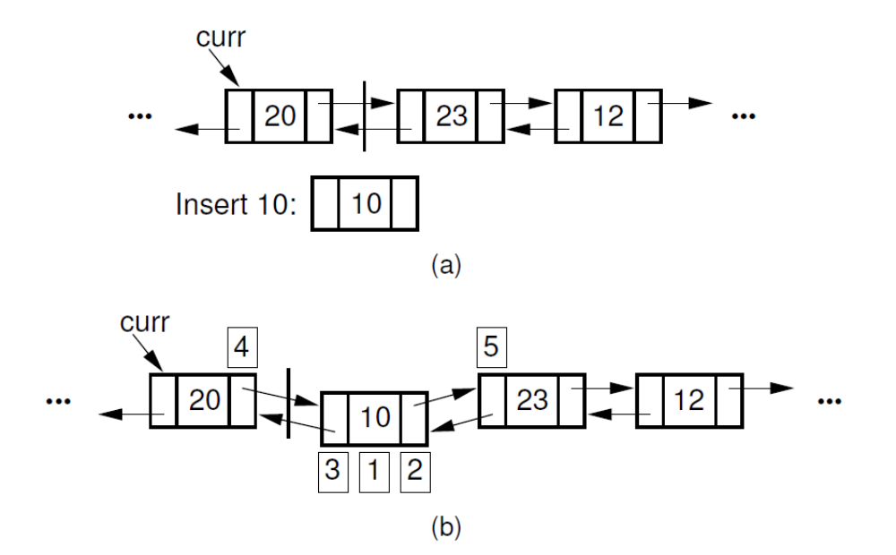
4.1 Lists
Doubly Linked Lists

Slide 25
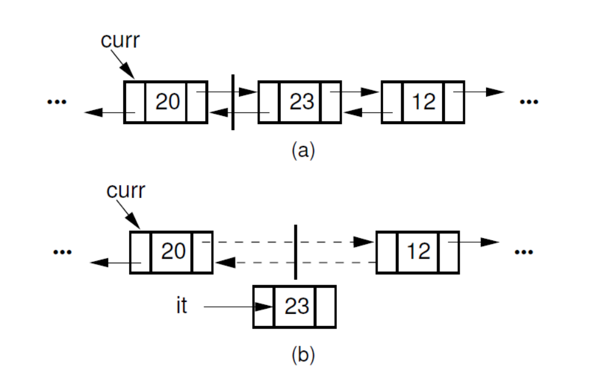
4.1 Lists
Doubly Linked Lists

Slide 26
4.1 Lists
Doubly Linked Lists
void insert(const E& it) {
curr->next = curr->next->prev =
new Link<E>(it, curr, curr->next);
cnt++;
}
void append(const E& it) {
tail->prev = tail->prev->next =
new Link<E>(it, tail->prev, tail);
cnt++;
}

Slide 27
4.1 Lists
Doubly Linked Lists
E remove() {
if (curr->next == tail) // Nothing to remove
return NULL;
E it = curr->next->element; // Remember value
Link<E>* ltemp = curr->next; // Remember link node
curr->next->next->prev = curr;
curr->next = curr->next->next; // Remove from list
delete ltemp; // Reclaim space
cnt--; // Decrement cnt
return it;
}
void prev() {
if (curr != head) // Can't back up from list head
curr = curr->prev;
}

Slide 28
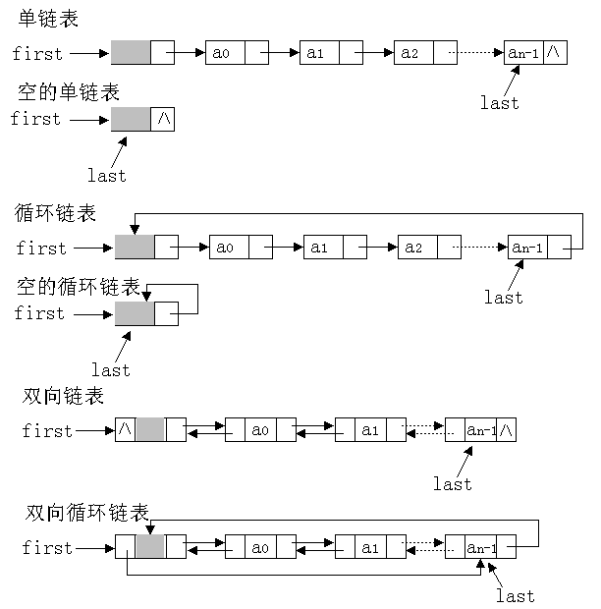
几种主要链表比较

Slide 29
4.2 Stacks
LIFO: Last In, First Out.
Restricted form of list: Insert and remove only at front of list.
Notation:
  Insert: PUSH
  Remove: POP
  The accessible element is called TOP.

Slide 30
4.2 Stacks
Stack ADT
template <typename E> class Stack {
private:
void operator =(const Stack&) {}
Stack(const Stack&) {}
public:
Stack() {}
virtual ~Stack() {}
virtual void clear() = 0;
virtual void push(const E& it) = 0;
virtual E pop() = 0;
virtual const E& topValue() const = 0;
virtual int length() const = 0;
};

Slide 31
4.2 Stacks
Array-Based Stacks
template <typename E> class AStack: public Stack<E> {
private:
int maxSize;
int top;
E *listArray;
public:
AStack(int size =defaultSize)
{ maxSize = size; top = 0; listArray = new E[size]; }
~AStack() { delete [] listArray; }
...
};

Slide 32
4.2 Stacks
Linked Stacks
template <typename E> class LStack: public Stack<E> {
private:
Link<E>* top;
int size;
public:
LStack(int sz =defaultSize) // Constructor
{ top = NULL; size = 0; }
~LStack() { clear(); } // Destructor
...
};

Slide 33
小结
实际应用中，顺序栈比链式栈用得更广泛些
  顺序栈容易根据栈顶位置，进行相对位移，快速定位并读取栈的内部元素
  顺序栈读取内部元素的时间为O(1)，而链式栈则需要沿着指针链游走，显然慢些，读取第k个元素需要时间为O(k)
    一般来说，栈不允许“读取内部元素”，只能在栈顶操作

Slide 34
4.3 Queues
FIFO: First in, First Out
Restricted form of list: Insert at one end, remove from the other.
Notation:
  Insert: Enqueue
  Delete: Dequeue
  First element: Front
  Last element: Rear

Slide 35
4.3 Queues
Queue ADT
template <typename E> class Queue {
private:
void operator =(const Queue&) {}
Queue(const Queue&) {}
public:
Queue() {} // Default
virtual ~Queue() {} // Base destructor
virtual void clear() = 0;
virtual void enqueue(const E&) = 0;
virtual E dequeue() = 0;
virtual const E& frontValue() const = 0;
virtual int length() const = 0;
};

Slide 36
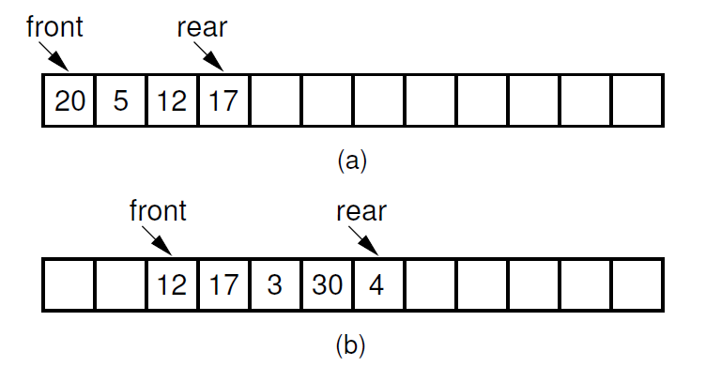
4.3 Queues
Array-Based Queues

Slide 37
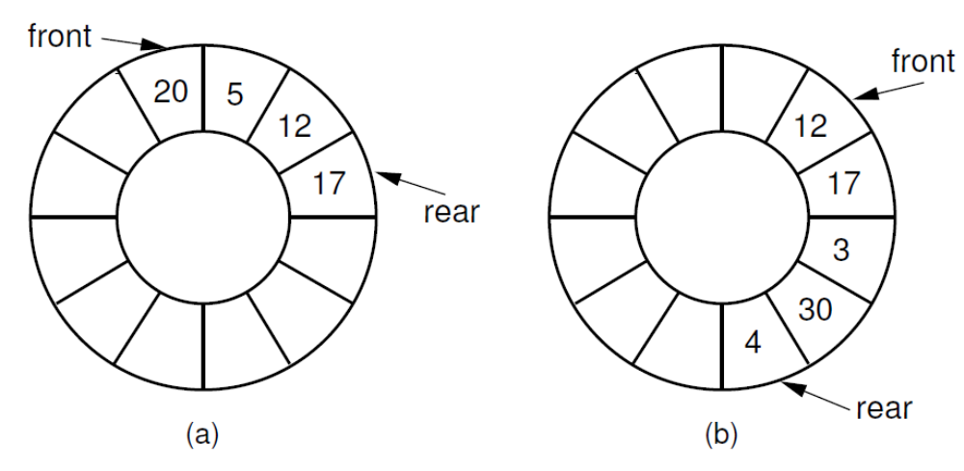
4.3 Queues
Array-Based Queues

Slide 38
4.3 Queues
Array-Based Queues
template <typename E> class AQueue: public Queue<E> {
private:
int maxSize;
int front;
int rear;
E *listArray;
public:
AQueue(int size =defaultSize) {
maxSize = size+1;
rear = 0; front = 1;
listArray = new E[maxSize];
}
…
};

Slide 39
4.3 Queues
Linked Queues
template <typename E> class LQueue: public Queue<E> {
private:
Link<E>* front;
Link<E>* rear;
int size;
public:
LQueue(int sz =defaultSize) // Constructor
{ front = rear = new Link<E>(); size = 0; }
…
};

Slide 40
队列的应用
消息缓冲器
邮件缓冲器
计算机的硬设备之间的通信也需要队列作为数据缓冲
操作系统中也使用队列

Slide 41
例：从队列前端取出
float Queue::DeQueue()
{
float temp;
//判队列非空，否则队列已空，异常退出运行
assert(!curr_len== 0);
temp = Qlist[front];
curr_len--;
front = (front+1) % maxsize;
return temp;
}

Slide 42
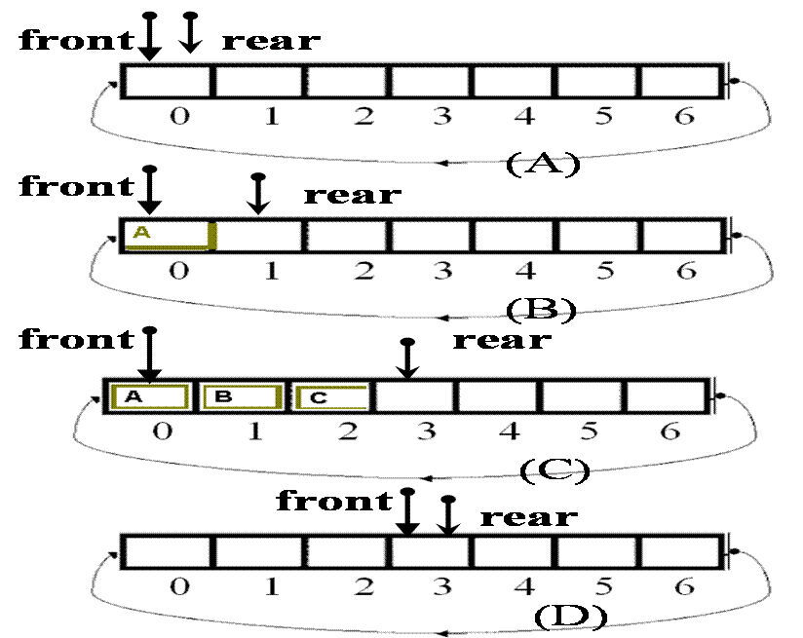
队列的运行示意图

Slide 43
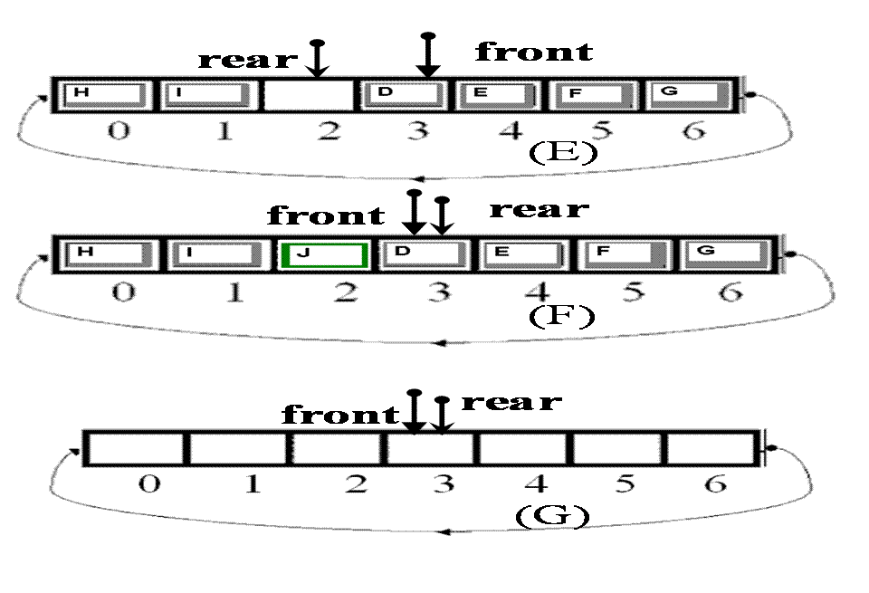
队列的运行示意图

Slide 44
4.3 链式队列
单链表队列
链接指针的方向是从队列的前端向尾端链接

Slide 45
队列的类定义
#include <assert.h>
Class Queue {
// linked Queue，单链表，其结点类型为ListNode
private:
ListPtr front,rear;
int curr_len;
public：
//创建一个空队列，不用指定最大长度
Queue::Queue() {
front = rear = NULL;
curr_len = 0;
}；
…
}；

Slide 46
自单链队列前端取出
ELEM Queue:: DeQueue()
{
//判队列非空，否则队空异常退出
assert(curr_len != 0);
//暂存队列顶内容
ELEM result = front->data;
ListPtr temp;
temp = front; //老前端指针

Slide 47
front = front->link ; //新前端指针
delete temp;
curr_len--;
if （curr_len == 0）
rear = front = NULL;
return result;
}

Slide 48
4.3 顺序队列与链式队列的比较
顺序队列
  固定的存储空间
  方便访问队列内部元素
链式队列
  可以满足浪涌大小无法估计的情况
  访问队列内部元素不方便

Slide 49
变种的栈或队列结构
双端队列
双栈
超队列
超栈

Slide 50
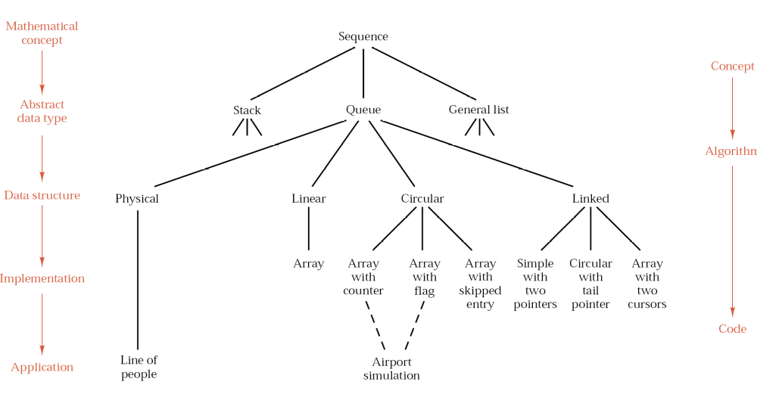
Summary

Slide 51
Summary
4.1 Lists
4.2 Stacks
4.3 Queues
4.4 Dictionaries
4.5 Further Reading
4.6 Exercises
4.7 Projects

