Slide 1
Data Structures and Algorithms
School of Big Data & Software Engineering
Chongqing University
Chongqing, China
Lectured by Chunqiang Hu
chu@cqu.edu.cn

Slide 2
5 Binary Trees
5.1 Definitions and Properties
5.2 Binary Tree Traversals
5.3 Binary Tree Node Implementations
5.4 Binary Search Trees
5.5 Heaps and Priority Queues
5.6 Huffman Coding Trees
5.7 Further Reading
5.8 Exercises
5.9 Projects

Slide 3
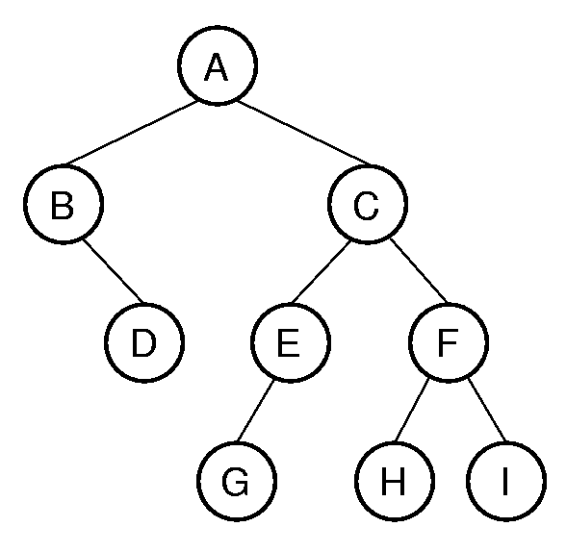
5.1 Definitions and Properties
Binary Trees
  A binary tree is made up of a finite set of nodes that is either empty or consists of a node called the root together with two binary trees, called the left and right subtrees, which are disjoint from each other and from the root.(左右子树，递归定义)
  Notation: node, children, edge, parent, ancestor, descendant, path, depth, height, level, leaf node, internal node, subtree.

Slide 4
5.1 Definitions and Properties
Binary Trees
  二叉树的高度定义为二叉树中层数最大的叶结点的层数加1
  二叉树的深度定义为二叉树中层数最大的叶结点的层数

Slide 5
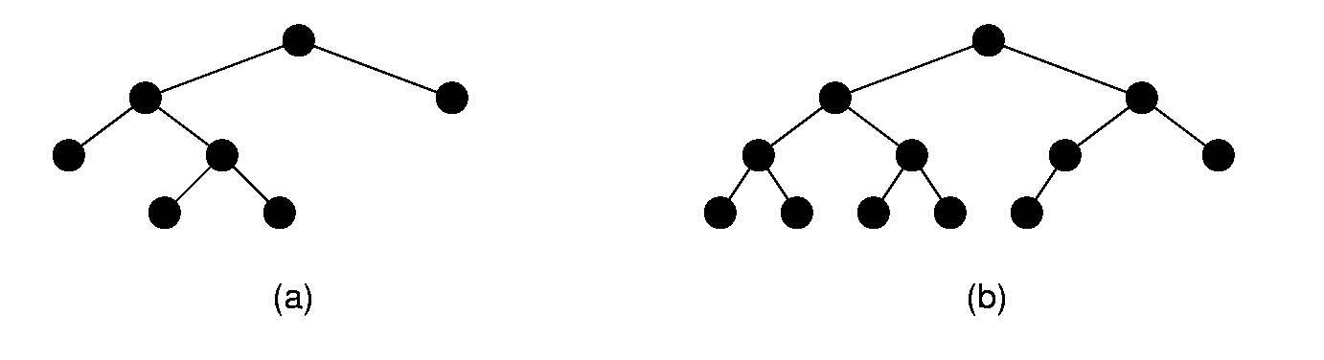
5.1 Definitions and Properties
Full and Complete Binary Trees
  Full binary tree: Each node is either a leaf or internal node with exactly two non-empty children.(满二叉树)
  Complete binary tree: If the height of the tree is d, then all leaves except possibly level d are completely full. The bottom level has all nodes to the left side.(完全二叉树)

Slide 6
5.1 Definitions and Properties
Full Binary Tree Theorem
  Theorem: The number of leaves in a non-empty full binary tree is one more than the number of internal nodes.(非空满二叉树的叶结点数等于其分支结点数加1)
  Proof (by Mathematical Induction):
  Base case: A full binary tree with 1 internal node must have two leaf nodes.
  Induction Hypothesis: Assume any full binary tree T containing n-1 internal nodes has n leaves.

Slide 7
5.1 Definitions and Properties
Full Binary Tree Theorem
  Induction Step: Given tree T with n internal nodes, pick internal node I with two leaf children. Remove I’s children, call resulting tree T’.
  By induction hypothesis, T’ is a full binary tree with n leaves.
  Restore I’s two children. The number of internal nodes has now gone up by 1 to reach n. The number of leaves has also gone up by 1.

Slide 8
5.1 Definitions and Properties
Full Binary Tree Theorem
  Theorem: The number of null pointers in a non-empty tree is one more than the number of nodes in the tree.(一棵非空二叉树空子树的数目等于其结点数加1)
  Proof: Replace all null pointers with a pointer to an empty leaf node. This is a full binary tree.

Slide 9
5.1 Definitions and Properties
Binary Tree Node Class
// Binary tree node abstract class
template <typename E> class BinNode {
public:
virtual ~BinNode() {}
virtual E& element() = 0;
virtual void setElement(const E&) = 0;
virtual BinNode* left() const = 0;
virtual void setLeft(BinNode*) = 0;
virtual BinNode* right() const = 0;
virtual void setRight(BinNode*) = 0;
virtual bool isLeaf() = 0;
};

Slide 10
5.2 Binary Tree Traversals
Traversals
  Any process for visiting the nodes in some order is called a traversal.
  Any traversal that lists every node in the tree exactly once is called an enumeration of the tree’s nodes.
  Preorder traversal: Visit each node before visiting its children.
  Inorder traversal: Visit the left subtree, then the node, then the right subtree.
  Postorder traversal: Visit each node after visiting its children.

Slide 11
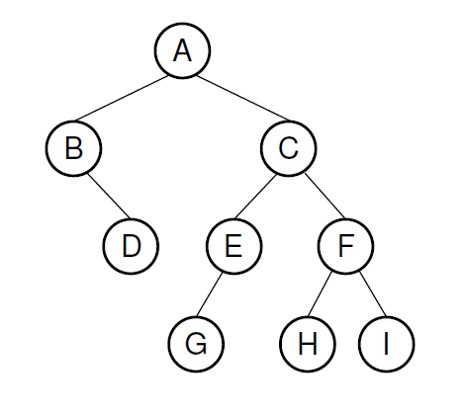
5.2 Binary Tree Traversals
Preorder traversal: A B D C E G F H I
Inorder traversal: B D A G E C H F I
Postorder traversal: D B G E H I F C A

Slide 12
下面我们再给出一种遍历二叉树的方法
（1）对一棵二叉树中序遍历时，若我们将二叉树严格地按左子树的所有结点位于根结点的左侧，右子树的所有结点位于根右侧的形式绘制，就可以对每个结点做一条垂线，映射到下面的水平线上，由此得到的顺序就是该二叉树的中序遍历序列。

Slide 13
A
B C
D E F
G H
D G B A E C H F

Slide 14
5.2 Binary Tree Traversals
Traversals
template <typename E>
void preorder(BinNode<E>* root) {
if (root == NULL) return;
visit(root);
preorder(root->left());
preorder(root->right());
}
template <typename E>
void preorder2(BinNode<E>* root) {
visit(root);
if (root->left() != NULL) preorder2(root->left());
if (root->right() != NULL) preorder2(root->right());
}

Slide 15
5.2 Binary Tree Traversals
Traversals
template <typename E>
int count(BinNode<E>* root) {
if (root == NULL) return 0;
return 1 + count(root->left())
+ count(root->right());
}
template <typename Key, typename E>
bool checkBST(BSTNode<Key,E>* root, Key low, Key high) {
if (root == NULL) return true;
Key rootkey = root->key();
if ((rootkey < low) || (rootkey > high))
return false;
if (!checkBST<Key,E>(root->left(), low, rootkey))
return false;
return checkBST<Key,E>(root->right(), rootkey, high);
}

Slide 16
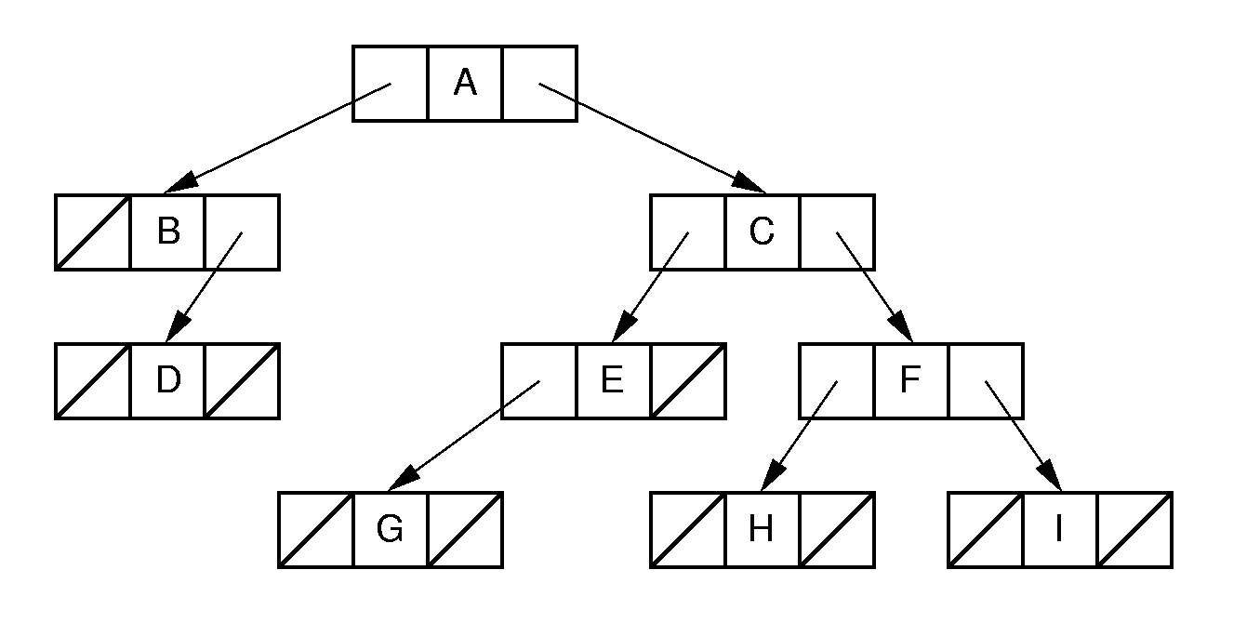
5.3 Binary Tree Node Implementations
Binary Tree Implementation

Slide 17
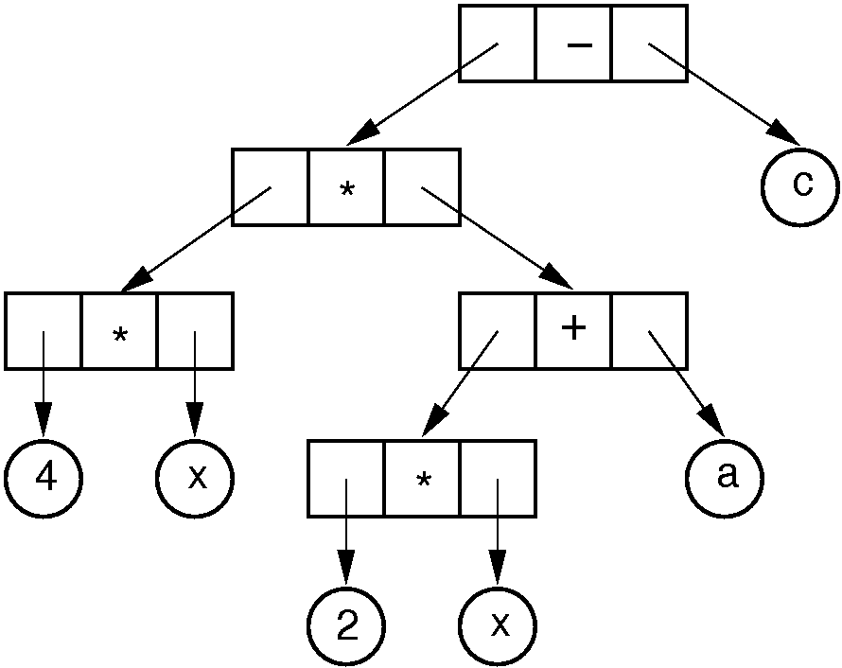
5.3 Binary Tree Node Implementations
Binary Tree Implementation

Slide 18
5.3 Binary Tree Node Implementations
template <typename Key, typename E>
class BSTNode : public BinNode<E> {
private:
Key k; E it; BSTNode* lc; BSTNode* rc;
public:
BSTNode() { lc = rc = NULL; }
BSTNode(Key K, E e, BSTNode* l =NULL, BSTNode* r =NULL)
{ k = K; it = e; lc = l; rc = r; }
~BSTNode() {}
E& element() { return it; }
void setElement(const E& e) { it = e; }
Key& key() { return k; }
void setKey(const Key& K) { k = K; }
inline BSTNode* left() const { return lc; }
void setLeft(BinNode<E>* b) { lc = (BSTNode*)b; }
inline BSTNode* right() const { return rc; }
void setRight(BinNode<E>* b) { rc = (BSTNode*)b; }
bool isLeaf() { return (lc == NULL) && (rc == NULL); }
};

Slide 19
5.3 Binary Tree Node Implementations
Space Overhead
  From the Full Binary Tree Theorem:
    Half of the pointers are null.
  If leaves store only data, then overhead depends on whether the tree is full.
  Ex: Full tree, all nodes the same, with two pointers to children and one to element:
    Total space required is (2p + d)n
    Overhead: 2pn
    If p = d, this means 2p/(2p + d) = 2/3 overhead.
  Case: Do not store any actual data, but rather a pointer to the data record. Each node typically store three pointers
    Total space required is (3p + d)n
    Overhead: 3pn
    If p = d, this means 3p/(3p + d) = 3/4 overhead.

Slide 20
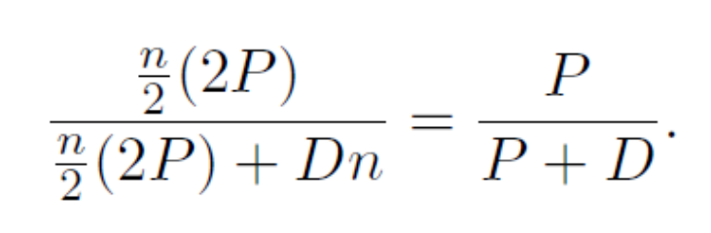
5.3 Binary Tree Node Implementations
Eliminate pointers from the leaf nodes:
This is 1/2 if p = d.
(2p)/(2p + d) if data only at leaves ⇒ 2/3 overhead.
Note that some method is needed to distinguish leaves from internal nodes.

Slide 21
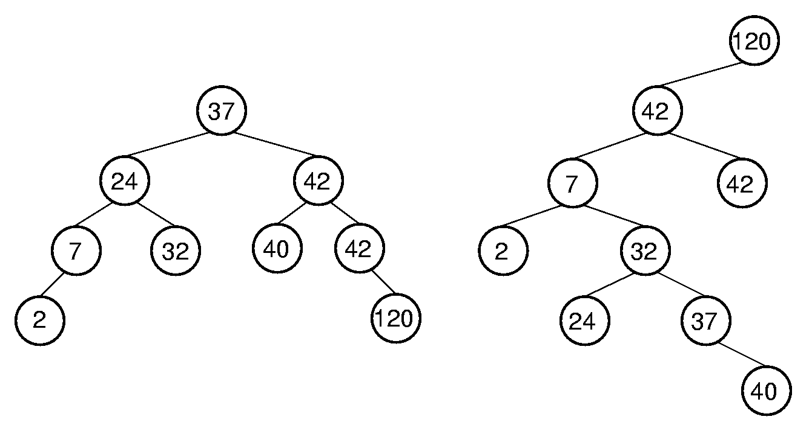
5.4 Binary Search Trees
BST Property: All elements stored in the left subtree of a node with value K have values < K. All elements stored in the right subtree of a node with value K have values >= K.

Slide 22
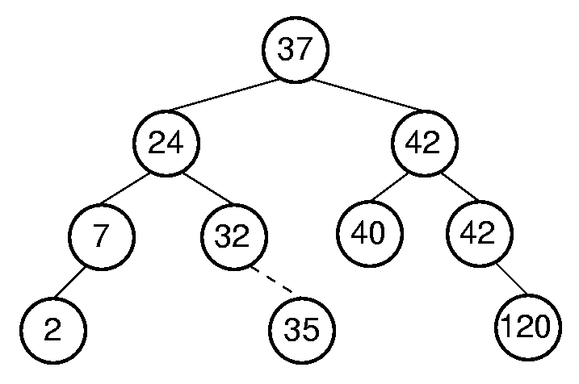
5.4 Binary Search Trees
BST Insert

Slide 23
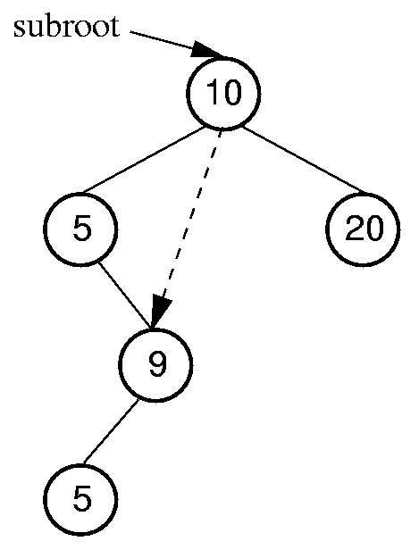
5.4 Binary Search Trees
Get/Remove Minimum Value

Slide 24
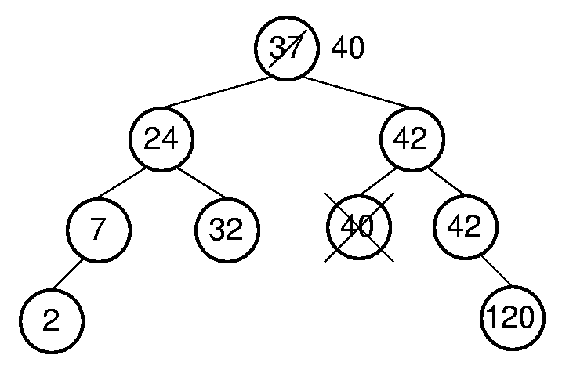
5.4 Binary Search Trees
BST Remove

Slide 25
5.4 Binary Search Trees
Time Complexity of BST Operations
  Find: O(h)
  Insert: O(h)
  Delete: O(h)
  h = height of the tree
  h is O(log n) if tree is balanced. What is the worst case?

Slide 26
5.5 Heaps and Priority Queues
Priority Queues(优先队列)
  Problem: We want a data structure that stores records as they come (insert), but on request, releases the record with the greatest value (removemax)
  Example: Scheduling jobs in a multi-tasking operating system.

Slide 27
5.5 Heaps and Priority Queues
Possible Solutions:
  insert appends to an array or a linked list ( O(1) ) and then removemax determines the maximum by scanning the list ( O(n) )(线性表：先无序后查找)
  A linked list is used and is in decreasing order; insert places an element in its correct position ( O(n) ) and removemax simply removes the head of the list
  ( O(1) ). (线性表：先排序后直接移除)
  Use a heap – both insert and removemax are
  O( log n ) operations(堆)

Slide 28
5.5 Heaps and Priority Queues
Heap: Complete binary tree with the heap property:
  Min-heap: All values less than child values.
  Max-heap: All values greater than child values.
The values are partially ordered.(局部有序)
Heap representation: Normally the array-based complete binary tree representation.

Slide 29
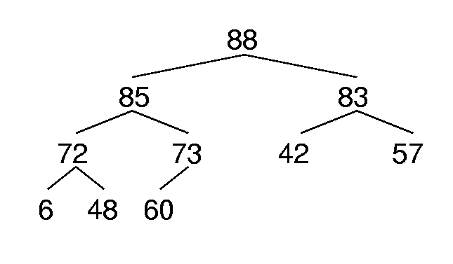
5.5 Heaps and Priority Queues
Max Heap Example
88 85 83 72 73 42 57 6 48 60

Slide 30
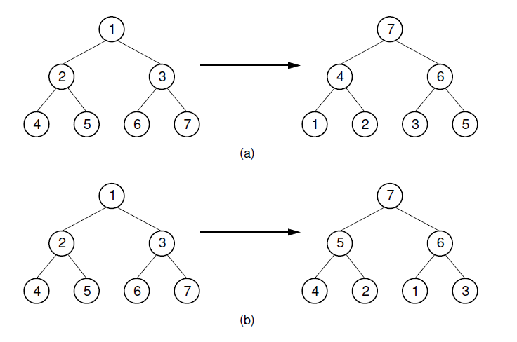
5.5 Heaps and Priority Queues
两种交换建堆

Slide 31
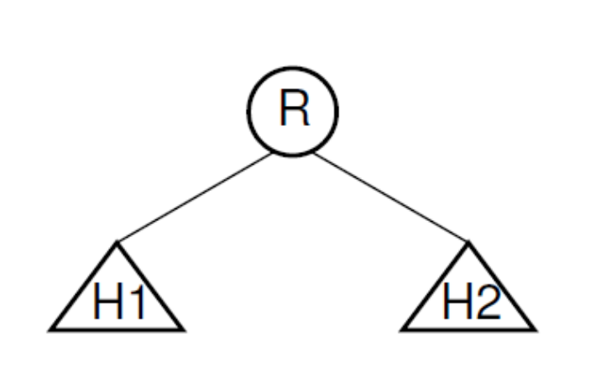
5.5 Heaps and Priority Queues
Insert

Slide 32
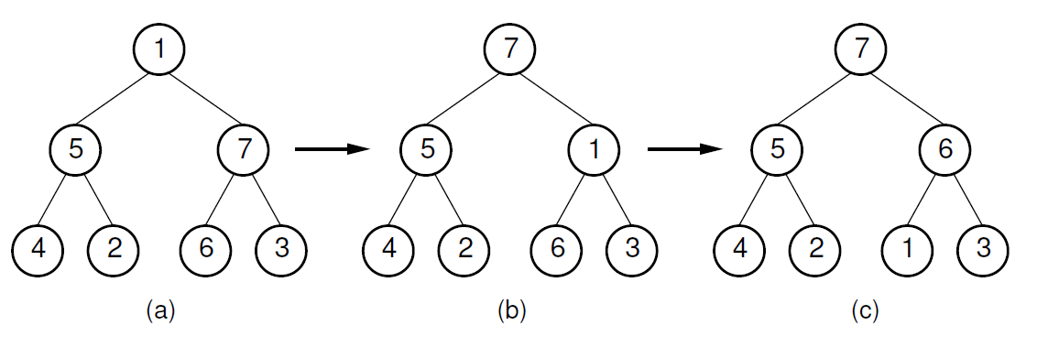
5.5 Heaps and Priority Queues
Siftdown

Slide 33
5.5 Heaps and Priority Queues
siftdown
void siftdown(int pos) {
while (!isLeaf(pos)) { // Stop if pos is a leaf
int j = leftchild(pos);
int rc = rightchild(pos);
if ((rc < n) && Comp::prior(Heap[rc], Heap[j]))
j = rc; // Set j to greater child's value
if (Comp::prior(Heap[pos], Heap[j])) return; // Done
swap(Heap, pos, j);
pos = j; // Move down
}
}

Slide 34
5.5 Heaps and Priority Queues
Heap Building Analysis
Insert into the heap one value at a time:
  Push each new value down the tree from the root to where it belongs
  ∑log i = Θ(n log n)
Starting with full array, work from bottom up
  Since nodes below form a heap, just need to push current node down (at worst, go to bottom)
  Most nodes are at the bottom, so not far to go
  When i is the level of the node counting from the bottom starting with 1, this is ∑(i-1) n/2^{i} = Θ(n).

Slide 35
5.6 Huffman Coding Trees
Huffman Coding Trees
Fixed-length coding.
  ASCII codes: 8 bits per character.
Variable-length coding
  Can take advantage of relative frequency of letters to save space.
Build the tree with minimum external path weight.
Z | K | M | C | U | D | L | E
2 | 7 | 24 | 32 | 37 | 42 | 42 | 120

Slide 36
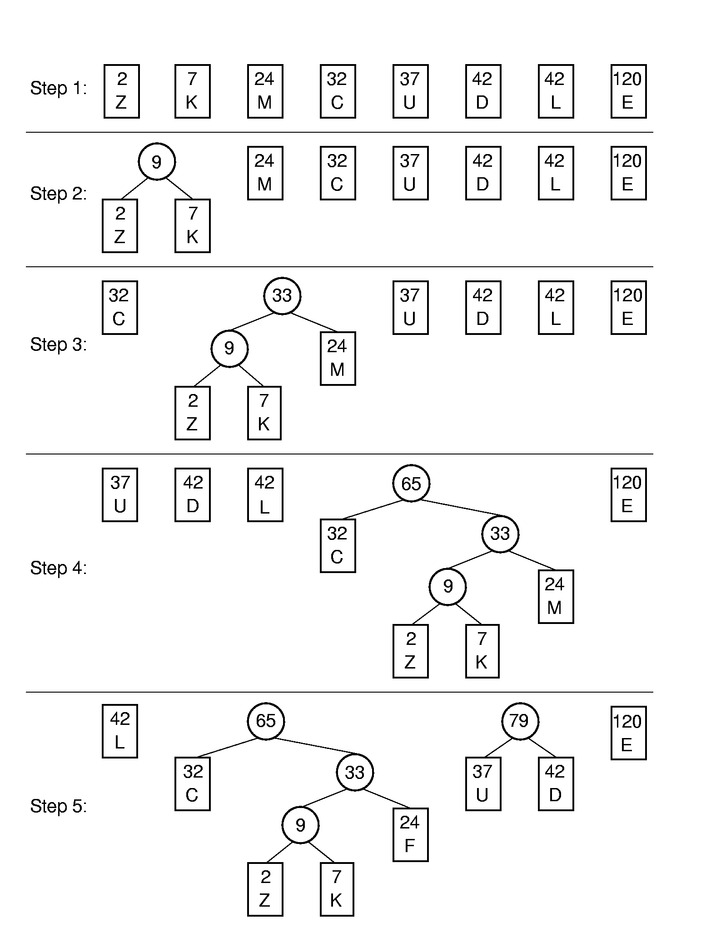
5.6 Huffman Coding Trees
Huffman Tree Construction

Slide 37
5.6 Huffman Coding Trees
Huffman Tree Construction

Slide 38
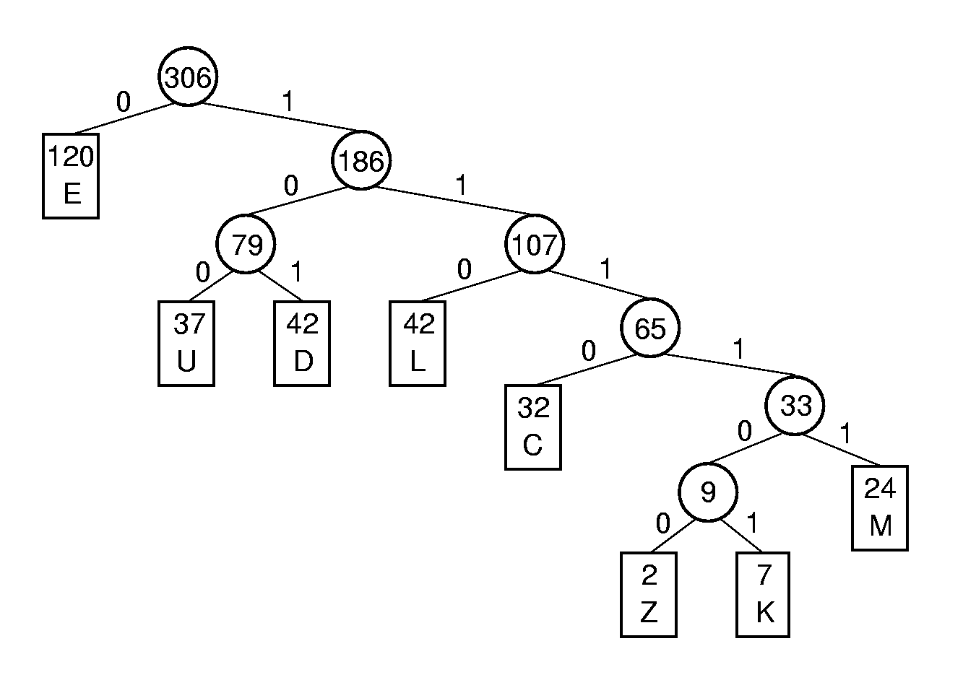
5.6 Huffman Coding Trees
Assigning Codes
Letter | Freq | Code | Bits
C | 32
D | 42
E | 120
M | 24
K | 7
L | 42
U | 37
Z | 2

Slide 39
5.6 Huffman Coding Trees
Coding and Decoding
  A set of codes is said to meet the prefix property if no code in the set is the prefix of another.
Code for DEED:
Decode 1011001110111101:
Expected cost per letter:

Slide 40
Summary
5.1 Definitions and Properties
5.2 Binary Tree Traversals
5.3 Binary Tree Node Implementations
5.4 Binary Search Trees
5.5 Heaps and Priority Queues
5.6 Huffman Coding Trees
5.7 Further Reading
5.8 Exercises
5.9 Projects

