Slide 1
Data Structures and Algorithms
School of Big Data & Software Engineering
Chongqing University
Chongqing, China
Lectured by Chunqiang Hu
chu@cqu.edu.cn

Slide 2
6 Non-Binary Trees
6.1 General Tree Definitions and Terminology
6.2 The Parent Pointer Implementation
6.3 General Tree Implementations
6.4 K-ary Trees
6.5 Sequential Tree Implementations
6.6 Further Reading
6.7 Exercises
6.8 Projects

Slide 3
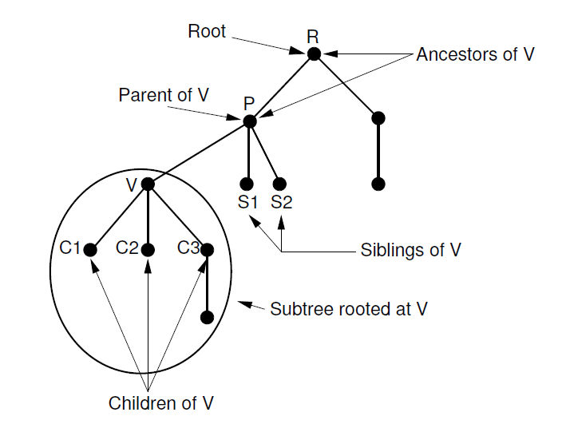
6.1 General Tree Definitions and Terminology

Slide 4
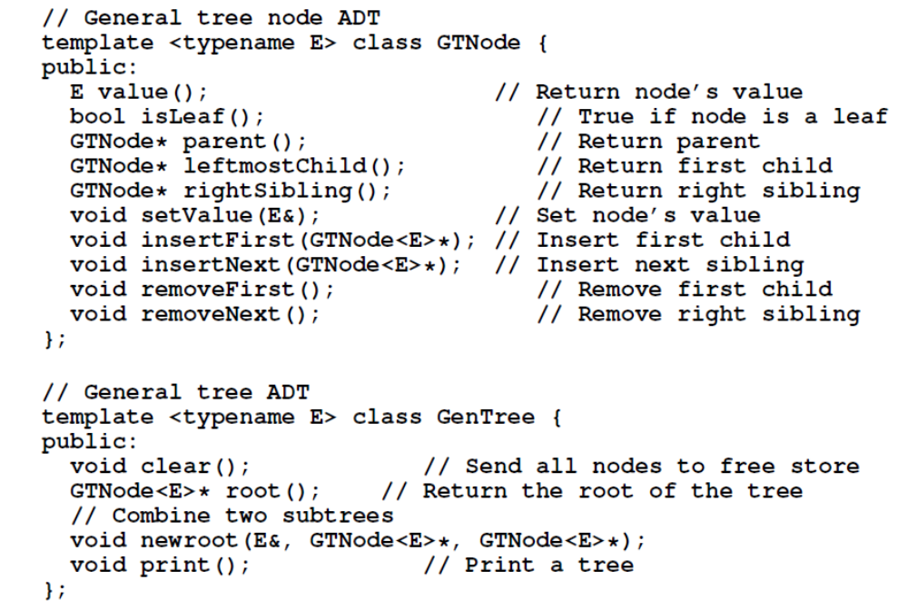
6.1 General Tree Definitions and Terminology

Slide 5
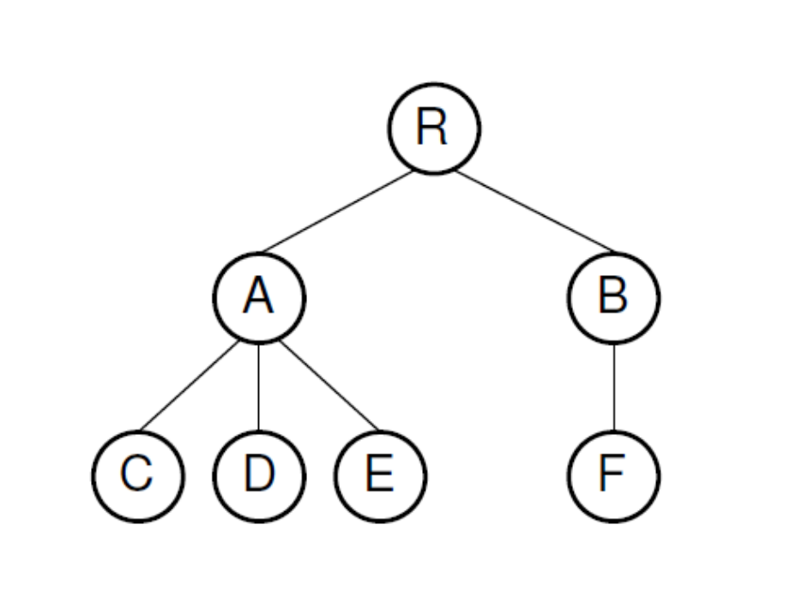
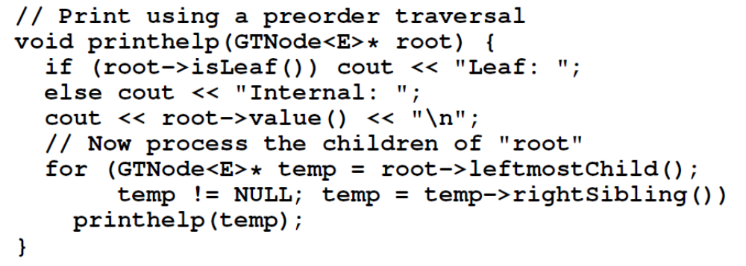
6.1 General Tree Definitions and Terminology
General Tree Traversals
Preorder traversal: R A C D E B F
Postorder traversal: C D E A F B R

Slide 6
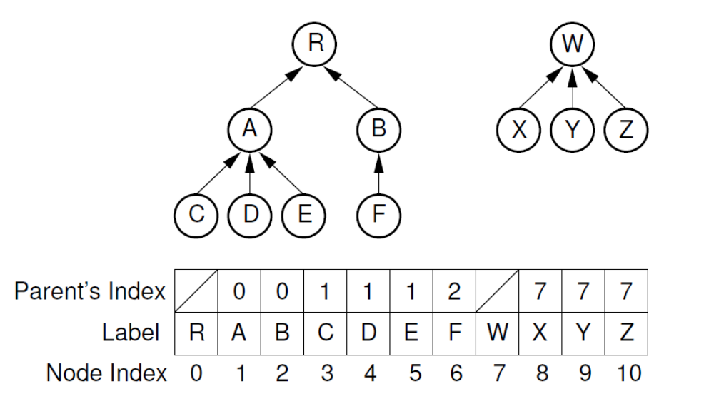
6.2 The Parent Pointer Implementation

Slide 7
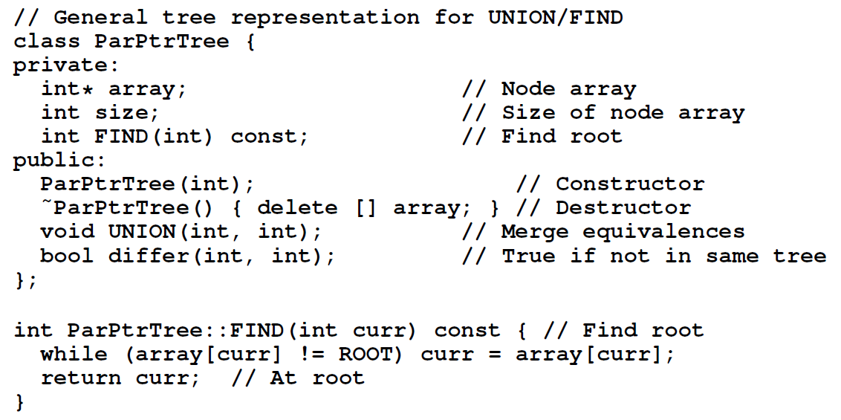
6.2 The Parent Pointer Implementation
UNION/FIND algorithm

Slide 8
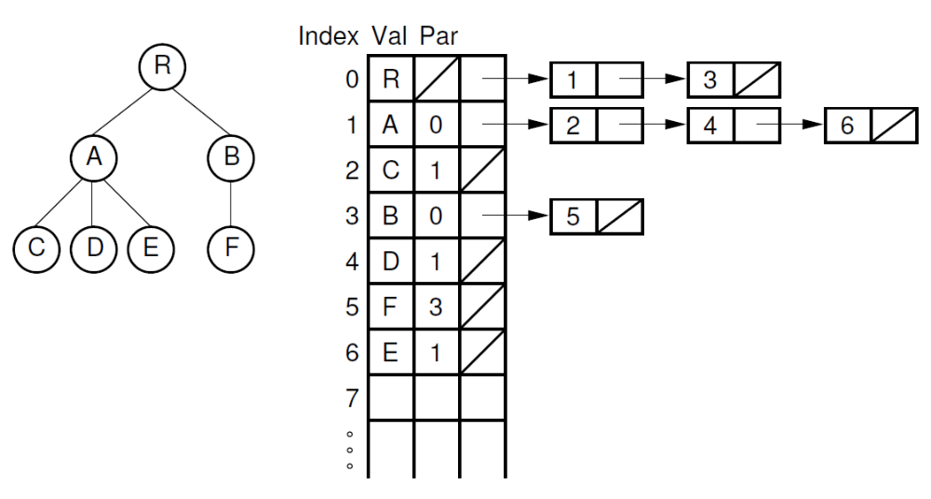
6.3 General Tree Implementations
List of Children(子结点表表示法)

Slide 9
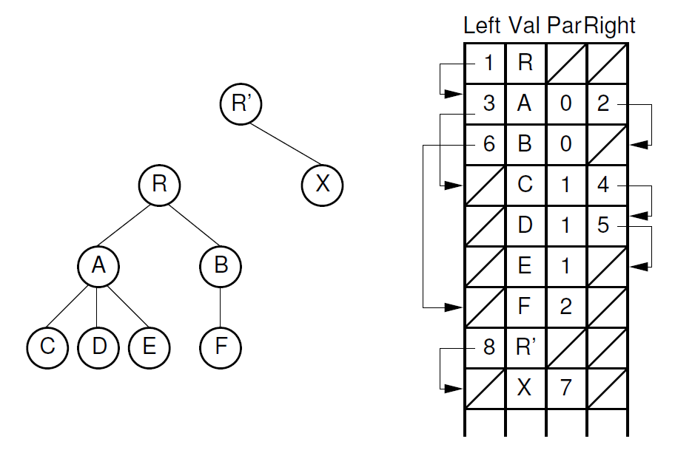
6.3 General Tree Implementations
The Left-Child/Right-Sibling Implementation(左子结点/右兄弟结点表示法)

Slide 10
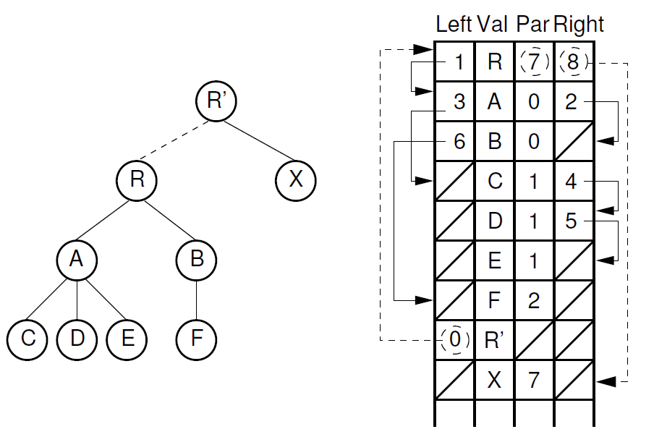
6.3 General Tree Implementations
The Left-Child/Right-Sibling Implementation

Slide 11
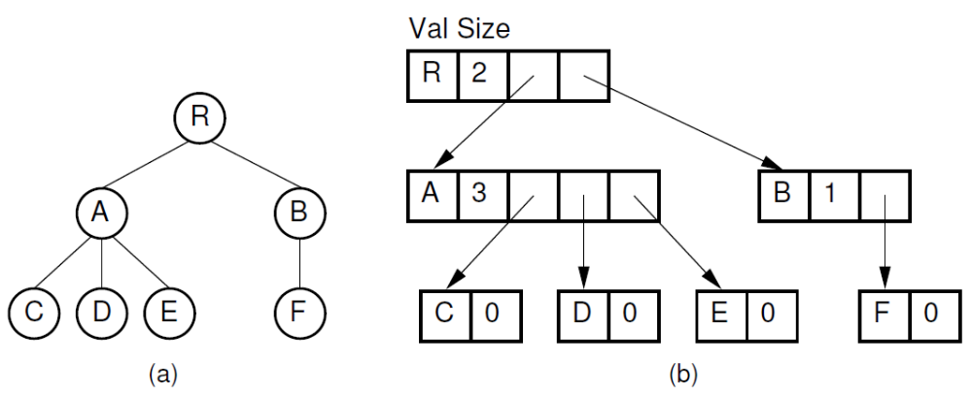
6.3 General Tree Implementations
Dynamic Node Implementation(动态结点表示法)

Slide 12
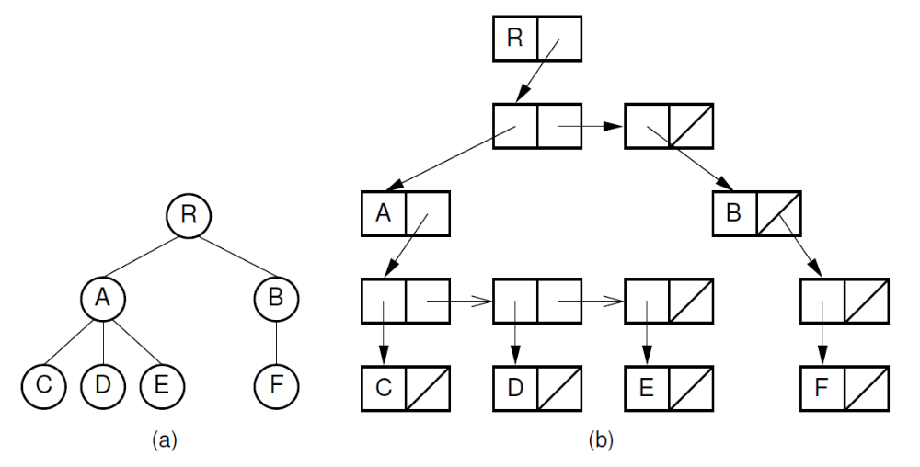
6.3 General Tree Implementations
Dynamic Node Implementation

Slide 13
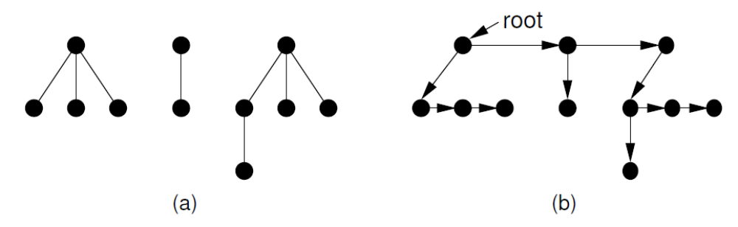
6.3 General Tree Implementations
Dynamic “Left-Child/Right-Sibling” Implementation (动态左子结点/右兄弟结点表示法)

Slide 14
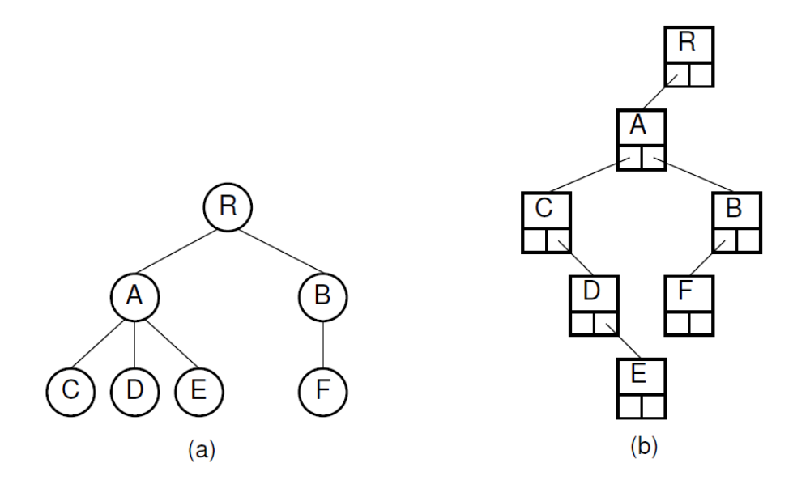
6.3 General Tree Implementations
Dynamic "Left-Child/Right-Sibling" Implementation

Slide 15
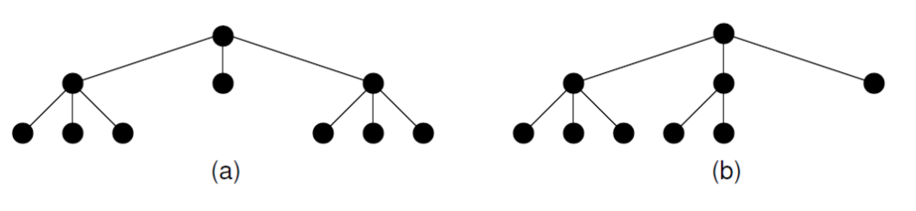
6.4 K-ary Trees
Full and complete 3-ary trees(满/完全3叉树)

Slide 16
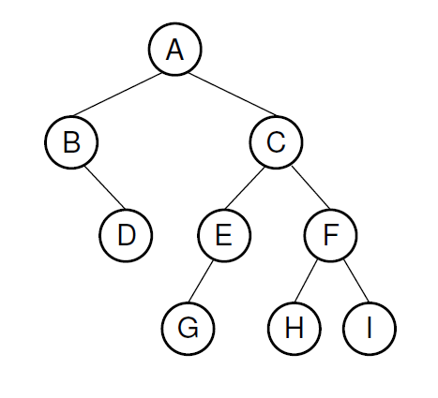
6.5 Sequential Tree Implementations
Example:
For binary trees, us a symbol to mark null links.
AB/D//CEG///FH//I//
For full binary trees, use a bit to indicate internal nodes.
A’B’/DC’E’G/F’HI
Another approach is to store a separate bit vector to represent the status of each node.
11001100100

Slide 17
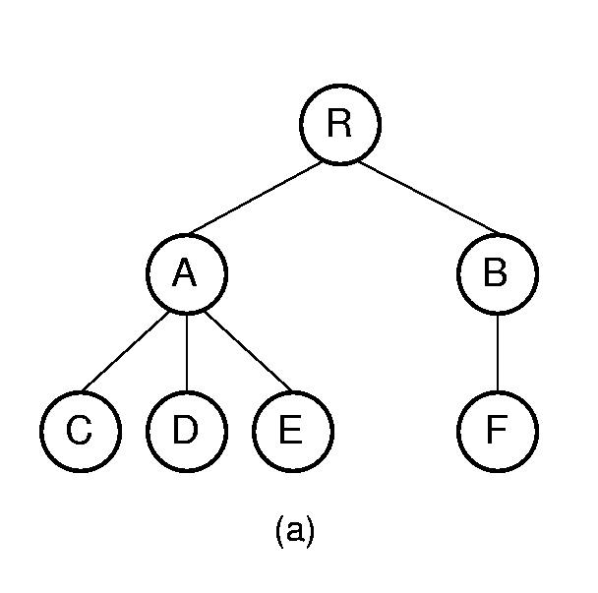
6.5 Sequential Tree Implementations
Example: For general trees, mark the end of each subtree.
RAC)D)E))BF)))

Slide 18
Summary
6.1 General Tree Definitions and Terminology
6.2 The Parent Pointer Implementation
6.3 General Tree Implementations
6.4 K-ary Trees
6.5 Sequential Tree Implementations
6.6 Further Reading
6.7 Exercises
6.8 Projects

