Slide 1
SMOTE
Synthetic Minority Over-sampling Technique

Slide 2
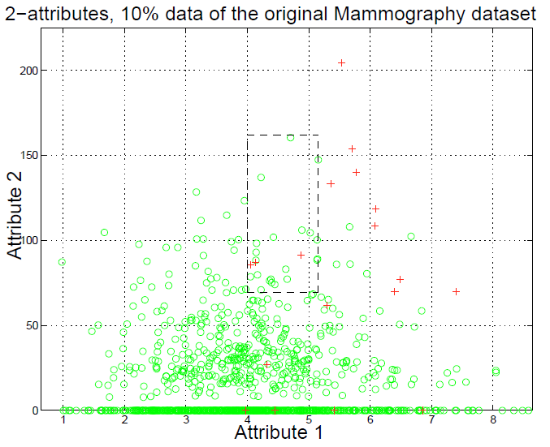
class-imbalance
It contains three minority class samples
shown by ‘+’ as false negatives.
If we replicate the minority class, the decision region for the minority class becomes very specific and will cause new splits in the decision tree.
This will lead to more terminal nodes
(leaves)as the learning algorithm tries to learn more and more specific regions of the minority class; in essence, overfitting.

Slide 3
SMOTE
Synthetic Minority Over-sampling Technique
minority class is over-sampled by creating “synthetic” examples rather than by over-sampling with replacement.
They created extra training data by performing certain operations on real data.

Slide 4
SMOTE
Neighbors from the k nearest neighbors are randomly chosen. For instance, if the amount of over-sampling needed is 200%, only two neighbors from the five nearest neighbors are chosen and one sample is generated in the direction of each.
Take the difference between the feature vector (sample) under consideration and its nearest neighbor.
Multiply this difference by a random number between 0 and 1, and add it to the feature vector under consideration.
This causes the selection of a random point along the line segment between two specific features.

Slide 5
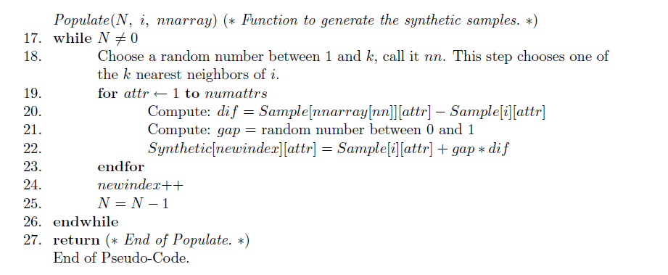
SMOTE

Slide 6
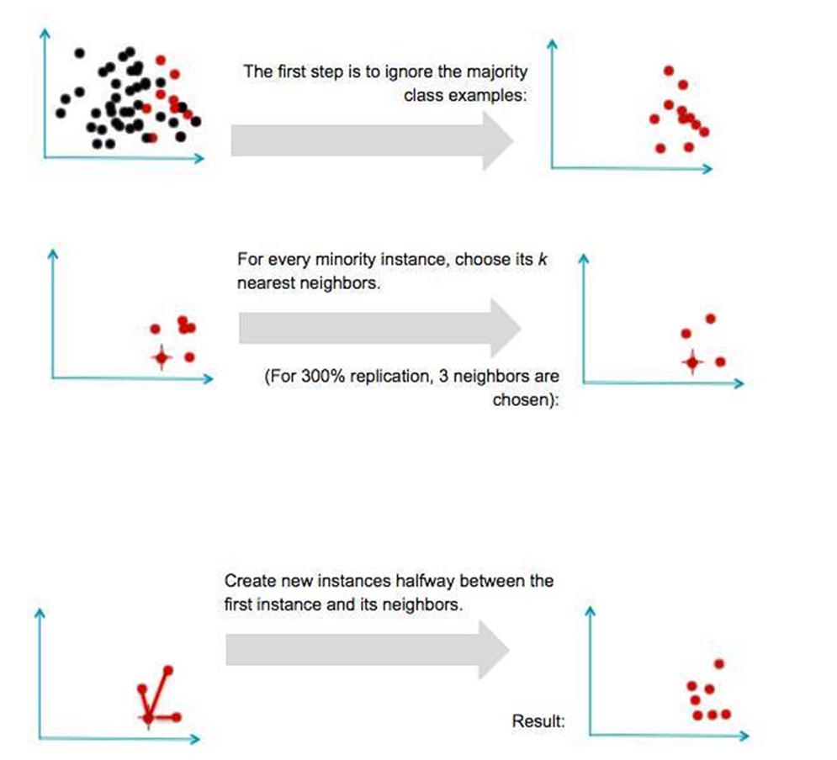
SMOTE

Slide 7
Random Forests 随机森林
在机器学习中，随机森林是一个包含多个决策树的分类器， 并且其输出的类别是由个别树输出的类别的众数而定。
简单来说，随机森林就是由多棵CART（Classification And Regression Tree）构成的。
当存在分类不平衡的情况时，随机森林能够提供平衡数据集误差的有效方法。

Slide 8
Random Forests 随机森林
1.假设我们设定训练集中的样本个数为N，然后通过有重置的重复多次抽样来获得这N个样本，这样的抽样结果将作为我们生成决策树的训练集；
2.如果有M个输入变量，每个节点都将随机选择m(m<M)个特定的变量，然后运用这m个变量来确定最佳的分裂点。在决策树的生成过程中，m的值是保持不变的；
3.每棵决策树都最大可能地进行生长而不进行剪枝；
4.通过对所有的决策树进行加总来预测新的数据（在分类时采用多数投票，在回归时采用平均）。

Slide 9
Random Forests 随机森林
(1)从当前树的根节点开始，根据当前节点的阈值th，判断是进入左节点(<th)还是进入右节点(>=th)，直到到达，某个叶子节点，并输出预测值。
(2)重复执行(1)直到所有t棵树都输出了预测值。如果是分类问题，则输出为所有树中预测概率总和最大的那一个类，即对每个c(j)的p进行累计；如果是回归问题，则输出为所有树的输出的平均值。

Slide 10
