Slide 1
Java Inheritance

Slide 2
Inheritance
Animal
Dog
Dalmatian
Poodle
Cat
A Dog is an Animal
Dog extends Animal
A Cat is an Animal
Cat extends Animal

Slide 3
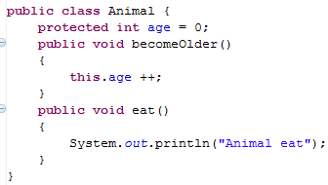
Animal
age
0

Slide 4
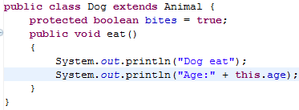
Dog
age
bites
Animal
age
0
true
0

Slide 5
Animal myAnimal= new Animal();
myAnimal.becomeOlder();
myAnimal.eat();

Slide 6
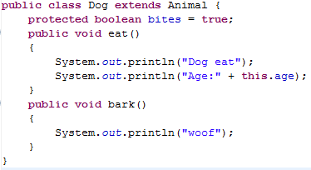
Dog myDog = new Dog();
myDog.eat();
myDog.bark(); // does this work? ___
myDog.becomeOlder();

Slide 7
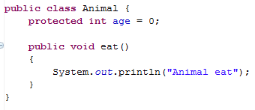
Animal myAnimal= new Animal();
myAnimal.bark();
↑Does this work???? _________

Slide 8
Subclasses (Children)
Declare new instance/class variables
Declare new methods
Override old implementations with new implementations
Access instance/class variables of the superclass (parent) *
Access methods of the superclass*
* only public, protected or default ones

Slide 9
Inheritance Puzzles
Dog d = new Animal();
Does this work? _______
No it doesn’t compile, If I want a Dog, an Animal will be NOT be acceptable because I might want to call a method that only a Dog can do!

Slide 10
Inheritance Puzzles
Animal a = new Dog();
Does this work? _______
YES it compiles and runs - If I want an Animal , a Dog will be acceptable because everything an Animal can do a Dog can do too!
Animal a = (Animal) new Dog();

