Slide 1
Java Servlet

Slide 2
What are Servlets?
Java code that run on server-side
Run in a container
Helps with client-server communications
Not necessarily over HTTP
But usually over HTTP (Our focus is on HTTP)

Slide 3
What are Servlets?
Web pages with dynamic content
Easy coordination between Servlets to make Web applications more manageable
Containers support many features
Sessions, persistence, resource management (e.g., database connections) and security, etc.

Slide 4
Why Java Servlets Instead of CGI?
Efficient, Convenient, Powerful, Portable, Secure, Inexpensive
Lightweight threads instead of OS threads created
Single copy of code brought into memory for all threads versus per thread
Data (session state) can be stored across threads within servlet container
Java is portable and secure
Requires little expense once servlet container integrated with web server

Slide 5
Servlet Structure
Java servlet are objects on server side
Managed by servlet container
Loads/unloads servlets
Directs requests to servlets
Request → doGet(), doPost()
Each request is run as its own thread

Slide 6
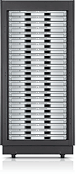

Web App with Servlets
GET …
Servlet
doGet()
…
…
HEADERS
BODY
Servlet Container
HTML Document

Slide 7
Servlet Lifecycle (Creation to Destruction)
Single instance created
init() method called
You can override init() in your subclass of HttpServlet to do some initial coding
init() is NOT called again on further requests

Slide 8
Servlet Lifecycle (Service Method)
On each request, the server spawns a new thread and calls service()
service() checks HTTP request type and calls appropriate doXXXX (Get, Post, Put...)
Don't override service (unless you really know what you're doing)

Slide 9
Servlet Lifecycle (destroy())
For some reason (servlet idle, etc) the server may want to remove the servlet from memory
destroy() allows you to close DB connections, wrap up, etc...
Don't count on destroy to write persistent state (server may crash before you ever get here!)

Slide 10
Accessing Request Components
getParameter("param1")
getCookies() => Cookie[]
getContentLength()
getContentType()
getHeaderNames()

Slide 11
Environment Variables
JavaServlets do not require you to use the environment variables used in CGI
Individual functions:
req.getPathInfo()
req.getRemoteHost()
req.getQueryString()

Slide 12
Setting Response Components
Set status first!
setStatus(int)
HttpServletResponse.SC_OK...
sendError(int, String)
sendRedirect(String url)

Slide 13
Setting Response Components
Set headers
setHeader( String name, String value)
setContentType(“text/html”)
Output body
PrintWriter out = response.getWriter();
out.println("<HTML><HEAD>...")

Slide 14
Creating a Servlet
Extend HTTPServlet
Implement doGet
Implement doPost
The methods
should get an input (the HTTP request)
Should create an output (the HTTP response)

Slide 15
Creating a Servlet
ServletRequest
HTTPServletRequest
Implement doGet
Implement doPost
ServletResponse
HTTPServletResponse

Slide 16
HTTP Methods
POST:
Designed for Posting information
Data sent in two steps
Browser contacts server
Sends data
GET:
Contacts server and sends data in single step
Appends data to action URL separated by question mark
Designed to get information

Slide 17
Simple Steps for Java Servlets
1. Subclass of HttpServlet
2. Override doGet(....) method
3. HttpServletRequest
getParameter("paramName")
4. HttpServletResponse
set Content Type
get PrintWriter
send text to client via PrintWriter

Slide 18
import java.io.*;
import javax.servlet.*;
import javax.servlet.http.*;
public class Hello extends HttpServlet {
public void doGet(HttpServletRequest request,
HttpServletResponse response)
throws IOException, ServletException
{
response.setContentType("text/html");
PrintWriter out = response.getWriter();
out.println("<html>");
out.println("<head>");
out.println("<title>Hello World!</title>");
out.println("</head>");
out.println("<body>");
out.println("<h1>Hello World!</h1>");
out.println("</body>");
out.println("</html>");
} // doGet
} // Hello

Slide 19
Calling the Servlet
Calling the servlet is done from the Web browser:
http://host:port/servlet/ServletName
Project Directory

Slide 20
HttpServlet Request Handling
Web Server
HttpServlet subclass
GET request
service()
doGet()
response
POST request
doPost()
response

Slide 21
Handling a User Request
The servlet gets parameters from HTML forms
<form action=… method=…> …</form>
action – the name of the processing server
method – the HTTP method to use when passing parameters to the server

Slide 22
HTML <input> Tag
Inside a form, INPUT tags define fields for data entry
Standard input types include: buttons, checkboxes, password field, radio buttons, text fields, image-buttons, text areas, hidden fields, etc.

Slide 23
Example
<HTML>
…
<form method=“GET”
action=“http://localhost:8080/servlet/myservlet”>
…
<INPUT name=“x” type=“text”>
<INPUT name=“y” type=“text”>
<INPUT type=“submit”>
</form>
…
</HTML>
http://localhost:8080/servlet/myservlet?x=19&y=104

Slide 24
Getting the Parameters Values
request.getParameter(“x”);
request.getParameter(“y”);
If there are multiple values for the parameter, use
getParameterValues
If you don’t know the names of the parameters, use
getParameterNames

Slide 25
<!DOCTYPE HTML PUBLIC "-//W3C//DTD HTML 4.0 Transitional//EN">
<HTML>
<HEAD>
<TITLE>Sending Parameters</TITLE>
</HEAD>
<BODY BGCOLOR="#CC90E0">
<H1 ALIGN="LEFT">Please enter the parameters</H1>
<FORM ACTION=SetColors METHOD=“GET”>
<TABLE>
<TR><TD>Background color:</TD>
<TD><INPUT TYPE="TEXT" NAME="bgcolor"></TD></TR>
<TR><TD>Font color:</TD>
<TD><INPUT TYPE="TEXT" NAME="fgcolor"></TD></TR>
<TR><TD>Font size:</TD>
<TD><INPUT TYPE="TEXT" NAME="size"></TD></TR>
</TABLE>
<BR>
<INPUT TYPE="SUBMIT" VALUE="Show Page">
</FORM>
</BODY>
</HTML>

Slide 26
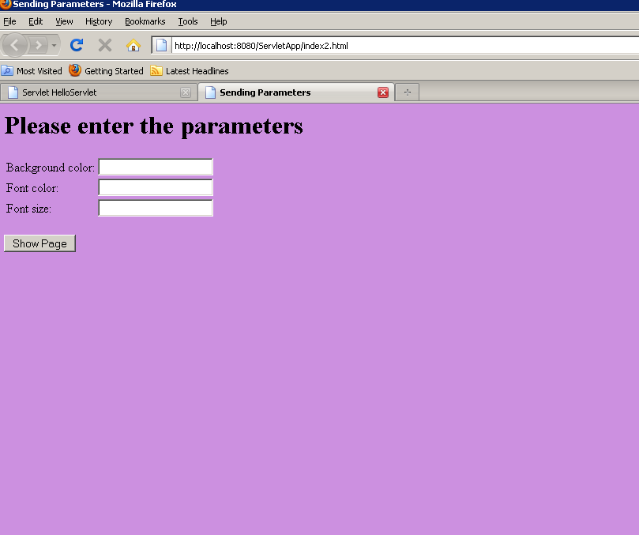
http://localhost:8080/ServletApp/index2.html

Slide 27
import java.io.*;
import javax.servlet.*;
import javax.servlet.http.*;
/**
* Creates a page according to the parameters
* given from a form
*/
@WebServlet(name = "SetColor", urlPatterns = {"/SetColor"})
public class SetColors extends HttpServlet {
public void doGet(HttpServletRequest request,
HttpServletResponse response)
throws ServletException, IOException {
String title = "Set Colors Example";
response.setContentType("text/html");
PrintWriter out = response.getWriter();
String bg = request.getParameter("bgcolor");
String fg = request.getParameter("fgcolor");
String size = request.getParameter("size");

Slide 28
out.println("<HTML><HEAD><TITLE>" + title +
"</TITLE></HEAD>");
out.println("<BODY text='" + fg +
"' bgcolor='" + bg + "'>");
out.println("<H1>" + title + "</H1>");
out.println("<FONT size='" + size + "'>");
out.println("You requested a background color " +
bg + "<P>");
out.println("You requested a font color " +
fg + "<P>");
out.println("You requested a font size " +
size + "<P>");
out.println("</FONT></BODY></HTML>");
}
}

Slide 29
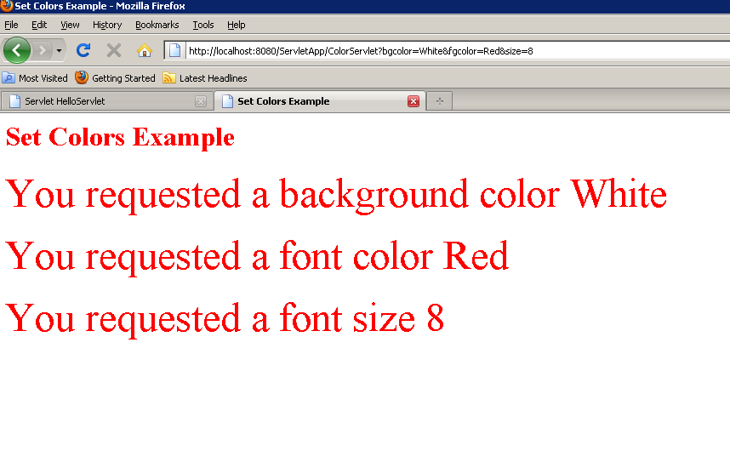
http://localhost:8080/ServletApp/ColorServlet?bgcolor=White
&fgcolor=Red&size=8

Slide 30
public class NamedHello extends HttpServlet {
public void doGet(HttpServletRequest request,
HttpServletResponse response)
throws IOException, ServletException
{
response.setContentType("text/html");
PrintWriter out = response.getWriter();
String name = request.getParameter("yourname");
out.println("<html>");
out.println("<head>");
out.println("<title>Hello, Tell me your name again!</title>");
out.println("</head>");
out.println("<body>");
if(name!=null)
{
out.println("<h2>Hello, " + name + "</h2> <br>");
}
else
out.println("<h2>Hello! whats your name</h2> <br>");
out.println("<form action=\"NamedHello\" method=\"GET\">");
out.println("<input type=text length=20 name=yourname><br>");
out.println("<input value=\"Submit\" type=submit></form>");
out.println("</body>");
out.println("</html>");
}}

Slide 31
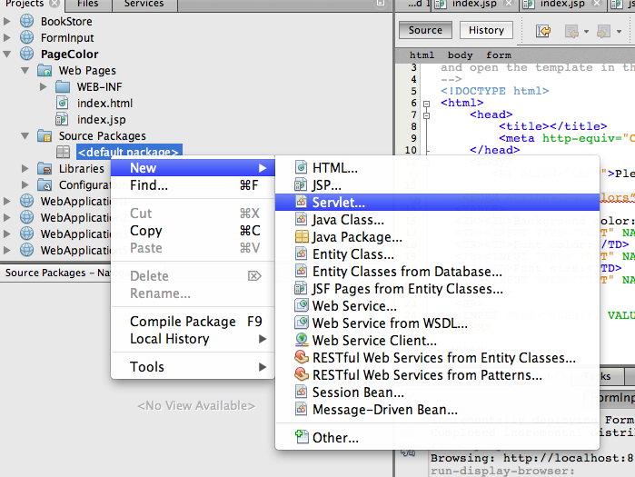
Right click on source packages and select Servelet to create sevlet class

Slide 32
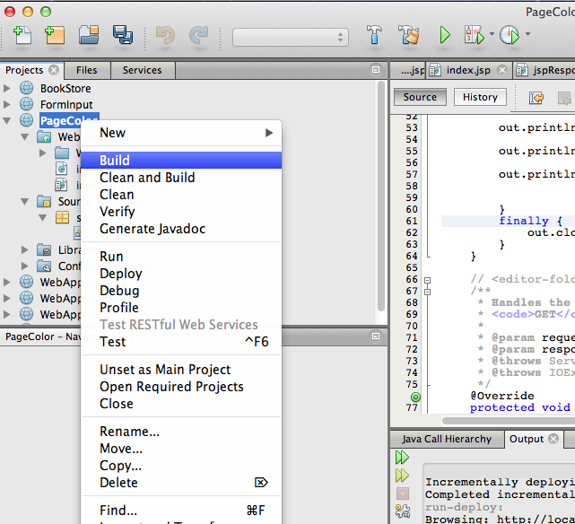
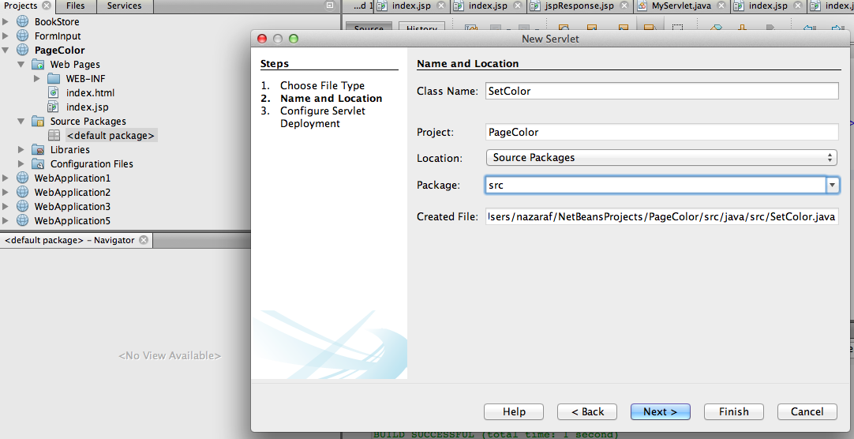
Right click on project folder then select build to build projrct

Slide 33
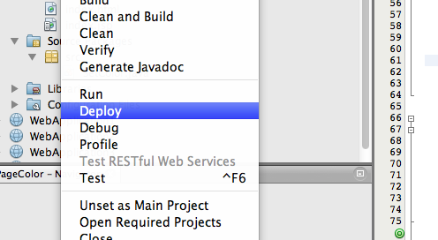
Right click on project folder then select deploy to deploy projrct on server

Slide 34
