Slide 1
Java Server Pages Standard Tag Library
(JSTL )

Slide 2
What is a Custom Tag Library
Collection of custom actions (tags) made available in a JSP page.
JSTL saves programmers from having to develop custom tag libraries for a range of common tasks, such as if statements, conditional loops etc
Makes it possible to write JSP pages without the use of scripting elements (embedded java fragments of code)
code is easier to maintain
logic is separated from presentation

Slide 3
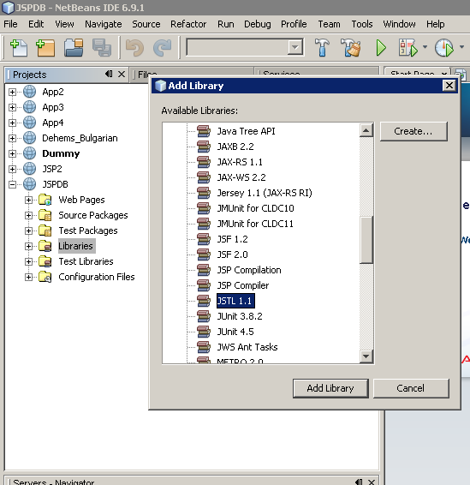
Importing JSTL Library
Right click on libraries folder of your project then click Add Library
Select JSTL 1.1 and Add Library

Slide 4
Declaring Tag Library
<%@taglib prefix=“c” uri=“http://java.sun.com/jsp/jstl/core” %>
which elements are part of a custom tag library
where to find the Java class or tag file that
implements the custom action

Slide 5
Declaring a Custom Tag Library
A URI is a string that tells the container how to locate the tag library, where it finds the tag file name or java class for all actions in the library
When the server is started
it locates all tag library files,
for each of them gets the default URI
A default URI must be a globally unique string

Slide 6
JSTL URIs and Default Prefixes
Library | URI | Prefix
Core | http://java.sun.com/jsp/jstl/core | c
XML Processing | http://java.sun.com/jsp/jstl/xml | x
Formatting | http://java.sun.com/jsp/jstl/fmt | fmt
Database Access | http://java.sun.com/jsp/jstl/sql | sql
Functions | http://java.sun.com/jsp/jstl/functions | fn

Slide 7
Using Actions from a Tag Library
The syntax:
<prefix:action-name attr1=“value1” attr2=“value2”>
action_body
</prefix:action-name>
or (with no body)
<prefix: action-name attr1=“value1” attr2=“value2” />

Slide 8
Looping Tags
Looping with explicit numeric values
<c:forEach var="name" begin=“a" end=“a" step="z">
something … < c:out value="${name}"/>
</c:forEach>
• Looping over data structures
– Can loop down arrays, strings, collections, maps
<c:forEach var=”val“ items=”-collection">
something ….. <c:out value="${val}"/>
</c:forEach>

Slide 9
JSP and JSTL
JSP without JSTL
JSP with JSTL
<UL>
<%
for(int i=0; i<messages.length; i++)
{
String message = messages[i];
%>
<LI> <%= message %>
<% } %>
</UL>
<UL>
<c: forEach var= "message" items="${messages}">
<LI> <c:out value="${message}"/>
</c:forEach>
</UL>

Slide 10
Numeric Loop
<%@ taglib prefix="c“ uri="http://java.sun.com/jstl/core" %>
<UL>
<c:forEach var=i begin="1" end="10">
<LI> <c:out value="${i}"/>
</c:forEach>
</UL>

Slide 11
Array Loop
<%@ taglib prefix="c“ uri="http://java.sun.com/jstl/core" %>
<H2> Names :</H2>
<UL>
<c: forEach var=“name“ items="${names}">
<LI><c:out value="${name}"/>
</c:forEach>
</UL>

Slide 12
Conditional Evaluation Tags
One choice: if
Lots of choices: choose
<c:if test="${someTest}">
some content
</c:if>
<c:choose>
<c:when test="test1">Content1</c:when>
<c:when test="test2">Content2</c:when>
...
<c:when test="testN">ContentN</c:when>
<c:otherwise>Default Content</c:otherwise>
</c:choose>

Slide 13
IF Tag
<%@ taglib prefix="c“ uri="http://java.sun.com/jstl/core" %>
<UL>
<c:forEach var="i" begin=“5" end="12">
<LI><c:out value="${i}"/>
<c:if test="${i > 7}">
(greater than 7)
</c:if>
</c:forEach>
</UL>

Slide 14
Choose Tag
<%@ taglib prefix="c“ uri="http://java.sun.com/jstl/core" %>
<UL>
<c:forEach var="i" begin="1" end="10">
<LI><c:out value="${i}"/>
<c:choose>
<c:when test="${i < 4}">
(small)
</c:when>
<c:when test="${i < 8}">
(medium)
</c:when>
<c:otherwise>
(large)
</c:otherwise>
</c:choose>
</c:forEach/>
</UL>

Slide 15
Out Tag
Adds the value of the evaluated expression to the response buffer
Syntax
<c:out value=“expression” />

Slide 16
DataSource
Used by JSTL actions to access the database
javax.sql.DataSource is a JDBC interface that provides a connection pool mechanism to access an underlying database

Slide 17
SQL
dataSource | javax.sql.DataSource | the data source to use
var | String | Name of the variable to hold the result
sql | String | The sql statement
maxRows | String | maximum number of rows to include in the result
startRow | String | first row to include in the result
scope | String | scope of the variable

