Slide 1
CSS – Grid

Slide 2
Agenda
In this session, we will discuss:
An introduction to Grid
Grid Display
Grid-template-column
Grid-template - row
Grid - gap
Positioning Property
Creating a Web Page using Grid

Slide 3
Introduction to Grid
CSS Grid or Grid Layout is a web design layout system that helps you arrange content in rows and columns, like a grid or a table.
It's great for creating organized and responsive web page layouts, making it easier to position and align elements exactly where you want them on a webpage.
CSS Grid is well-supported by modern web browsers, making it a valuable tool for web developers and designers.

Slide 4
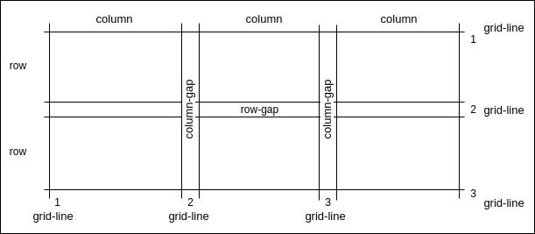
Introduction to Grid
A grid layout has a parent having one or more children. Parents are known as containers, and all children are items.

Slide 5
Grid Display
Grid Display is a way to structure web page layouts using rows and columns, like a grid. It allows you to organize content in a structured manner.
It displays the items in grid form inside a container.
For example:
.container {
display:grid
}

Slide 6

Grid-template-column
Grid-template-column property is used to define the number and size of columns within a grid container.
It's a fundamental part of creating grid-based layouts on web pages.
For example, let's say you want a grid with four columns of size 50, 80, auto, and 100 px. You would define it like this:
.container {
display: grid;
grid-template-column: 50px 80px auto 100px;
}
For “ auto value”, the size of the column is determined based on the size
of the container and the size of content present in an item.

Slide 7
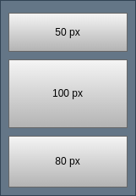
Grid-template-row
Grid-template-row property is used to define the number and size of rows within a grid container. It specifies the number of rows you want in your grid and how tall each row should be.
It complements grid-template-columns and is essential for creating grid-based layouts.
For example, suppose you want a grid with three rows of size 50px, 100px, 80px. You would define it like this:
.container {
display: grid;
grid-template-row: 50px 100px 80px;
}

Slide 8
Grid-template-row
Other values which can be assigned to grid-template-columns and grid-template-row are:
1. max-content: Sets the size of each column and row to the size of the largest item.
2. min-content: Sets the size of each column and row to the size of the smallest item.
3. inherit: Display items based on the size of the container.
4. initial: Sets all the items to the default value.

Slide 9
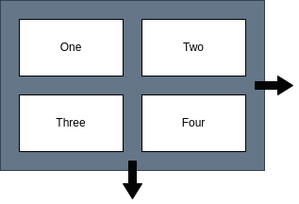
Grid-gap
Grid-gap is used to define the spacing between rows and columns within a grid.
It's a simple way to control the gap or margin between grid items.
For Example, let's say you have a grid and you want a 20-pixel gap between the rows and columns. You can define it like this:
.grid-container {
display: grid;
grid-gap: 20px;
}
row-gap: 20px
col-gap: 20px

Slide 10
Positioning Property
The CSS Grid positioning property allows you to precisely control where grid items are placed within a grid container.
These properties are assigned to items of the container directly.
There are multiple properties that help with positioning items in a grid, including grid-row, grid-column, grid-area, and others.

Slide 11
Positioning Property
grid-row-start: Sets the row where a grid item should start within a grid container.
For example, let's say you have a grid container with three rows, and you want to place an item in the second row. You can use grid-row-start like this:
.grid-item {
grid-row-start: 2; /* Item starts in the second row */
}
grid-row-end: Sets the row where a grid item should end within a grid container.
For example, let's say you have a grid container with three rows, and you want to place an item in the second row and make it end in the third row. You can use grid-row-end like this:
.grid-item {
grid-row-start: 2; /* Item starts in the second row */
grid-row-end: 3; /* Item ends in the third row */
}

Slide 12
Positioning Property
grid-column-start: It defines on which column-line, item will start.
grid-column-end: It defines on which column-line, item will end.
grid-row: It combines grid-row-start and grid-row-end properties into one to set both the starting and ending row positions for a grid item.
For example, suppose you have a grid container with three rows, and you want to place an item in the second row. You can use grid-row like this:
.grid-item {
grid-row: 2 / 3; /* Item starts in the second row and ends in the third row */
}

Slide 13
Positioning Property
grid-column: Combines grid-column-start and grid-column-end properties into one to set both the starting and ending column positions for a grid item.
For example, suppose you have a grid container with three columns, and you want to place an item in the second column and make it span to the third column. You can use grid-column like this:
.grid-item {
grid-column: 2 / 3; /* Item starts in the second column and ends in the third column */
}
grid-area: It is shorthand for row and column, with grid area, we can give row and column values at a time.
Grid-area: row-start/column-start/row-end/column-end

Slide 14
Create a Web Page using Grid
index.html
<!DOCTYPE html>
<html lang="en">
<head>
<meta charset="UTF-8">
<meta name="viewport" content="width=device-width, initial-scale=1.0">
<title>Responsive Flexbox Layout</title>
<link rel="stylesheet" href="style.css">
</head>

Slide 15
Create a Web Page using Grid
index.html
<body>
<div class="grid-container">
<div class="grid-item header">Header</div>
<div class="grid-item sidebar">Sidebar</div>
<div class="grid-item main">Main Content</div>
<div class="grid-item footer">Footer</div>
</div>
</body>
</html>

Slide 16
Create a Web Page using Grid
style.css
.grid-container {
display: grid;
grid-template-columns: 100px 200px; /* Two columns, 100px wide and 200px wide */
grid-template-rows: auto 100px; /* Two rows, the first adjusts to content, the second is 100px tall */
grid-gap: 20px; /* Gap between grid items */
}
.grid-item {
padding: 20px;
border: 1px solid #ccc;
}
.header {
grid-column: 1 / 3; /* Item spans from column 1 to column 3 */
grid-row: 1; /* Item is in the first row */
background-color: lightblue;
}

Slide 17
Create a Web Page using Grid
style.css
.sidebar {
grid-column: 1; /* Item is in the first column */
grid-row: 2; /* Item is in the second row */
background-color: lightgreen;
}
.main {
grid-column: 2 / 3; /* Item spans from column 2 to column 3 */
grid-row: 2; /* Item is in the second row */
background-color: lightyellow;
}
.footer {
grid-column: 1 / 3; /* Item spans from column 1 to column 3 */
grid-row: 3; /* Item is in the third row */
background-color: lightcoral;
}

Slide 18
Summary
Here’s a brief recap:
CSS Grid or Grid Layout is a web design layout system that helps you arrange content in rows and columns, like a grid or a table.
Grid Display is a way to structure web page layouts using rows and columns.
Grid-template-column and Grid-template-row property is used to define the number and size of columns and rows within a grid container.
Grid-gap is used to define the spacing between rows and columns within a grid.
The CSS Grid positioning property allows you to precisely control where grid items are placed within a grid container.

