Slide 1

Cover Page
Title: "Microsoft 365 Productivity Insights Dashboard"
Subtitle: A Data-Driven Analysis of Workplace Productivity & Collaboration
Name: Tanmay Sharma
Role: Data /Business Analyst
Date: 2025/08/30

Slide 2
Project Overview
📌 Objective of the project
Analyze workplace productivity using Microsoft 365 data
Measure collaboration through meetings, emails, chats & documents
Identify top-performing employees, departments, and locations
Tools Used: python + Azure + MySQL + Power BI

Slide 3
Data Sources
Employees Data
Meetings Data
Emails Data
Teams Usage Data
Documents Data

Slide 4
Dashboard Highlights (KPIs)
Total Meetings: 7M
Total Emails: 5050
Total Chats: 18K
Total Docs Shared: 3357

Slide 5
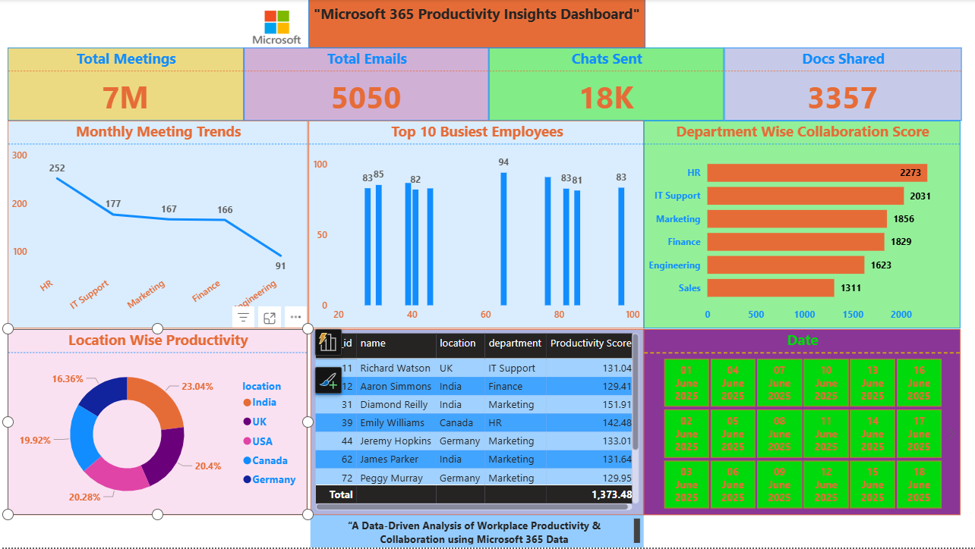
Key Insights (Charts)
📈 Monthly Meeting Trends – downward trend showing efficiency gains
👩‍💼 Top 10 Busiest Employees – recognizing high contributors
🏢 Department-wise Collaboration – HR & IT Support most collaborative
🌍 Location-wise Productivity – balanced contribution across regions

Slide 6
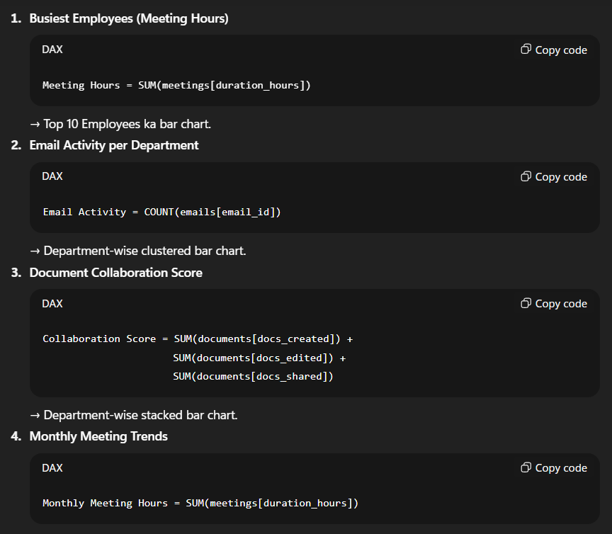
Productivity Score (Advanced Metric)
Formula combining meetings, emails, docs, chats
Top employees based on productivity score
Helps measure quality + quantity of collaboration

Slide 7
Dashboard Highlights:

Slide 8
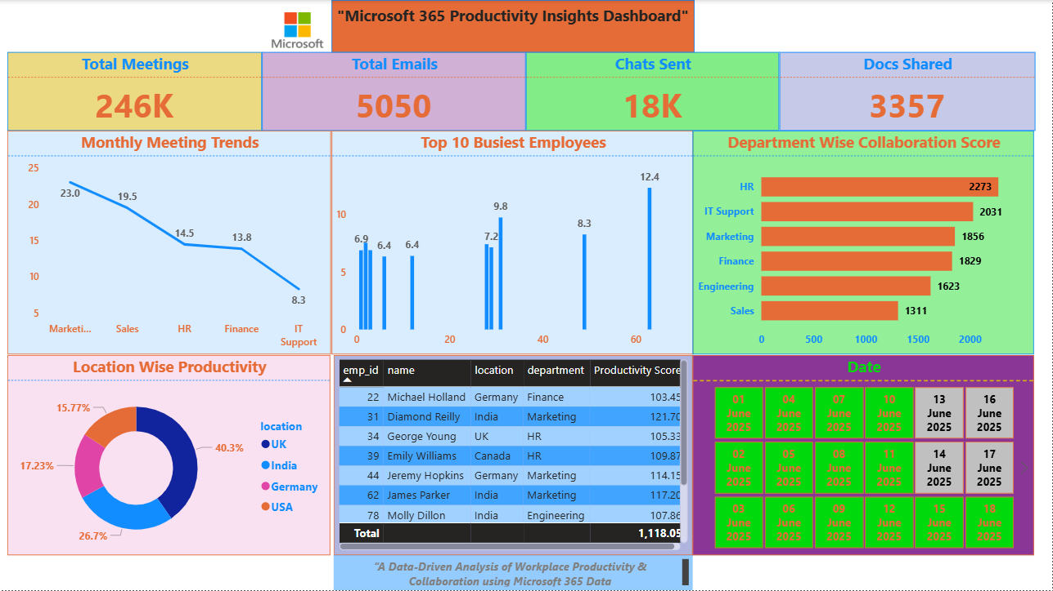

Slide 9
Business Impact
Helps identify team collaboration gaps
Supports HR & Management decisions
Drives employee performance analysis
Boosts data-driven workplace strategy

Slide 10
Conclusion & Next Steps
Dashboard provides holistic view of productivity
Can be extended with:
Real-time refresh
Predictive analytics (ML models)
Role-based insights

Slide 11
Thank You:
LinkedIn: LinkedIn
Project: Project Link
Git hub: Git hub
Blog: Hashnode_@tanmay27

