Slide 1
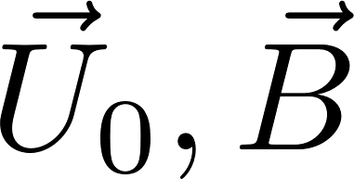
i++
n
Pre-Smoother
add. Schwarz
y
block solver
Exit
b
Restriction
Residual Minimization
a
y
direct solver
Prolongation
n
K-cycle
Post-Smoother
add. Schwarz
block solver

