Slide 1
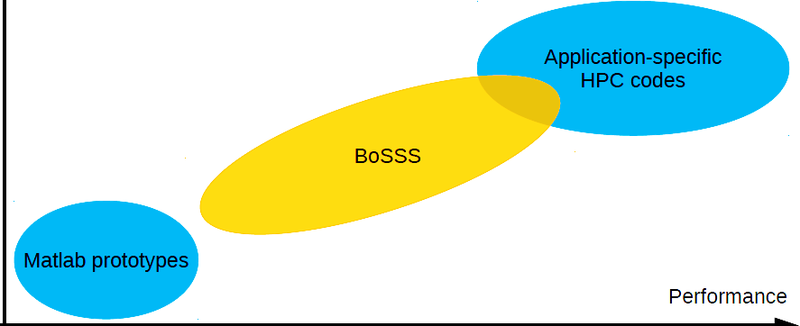
The BoSSS code
non-monolithic, modular structure:
multiple solvers (incompressible, low-Mach, compressible, multiphase)
common parts: a hurd of libraries
encourage collaboration by sharing large pars of the code
code quality: version control and automatic testing
preventing divergence of development
MPI parallel, parallel IO, partially GPU-accelerated
Geared towards rapid development, but still decent performance
development time

Slide 2
Modular structure
Hurd of libraries – organized in layers
Incompressible flow solver
Low-Mach flow solver
Compressible flow solver
Layer 4 “application”:
temporal discretization
post-processing, plotting
Layer 3 “solution”:
grid handling
input/ output
DG discretization
XDG discretization
numerical integration
Layer 2 “foundation”:
Layer 1 “platform”:
wrappers & utilities
GPU-accel. Sparse solvers
Layer 0: native, 3rd party
MPI
LAPACK
Hypre
ParMETIS
PARDISO
BLAS
CUDA

Slide 3
BoSSS philosophy
End user
incompressible multiphase, XDG 3 files / 1427 lines
incompressible IBM 4 files / 759 lines
compressible IBM 178 files / 13860 lines
Application layer "User"
etc.
performant, parallel
implementation
operator evaluation
operator linearization
cut-cell-integration time discretization
workflow management
BoSSSpad worksheets
utilities
file I/O
data import/export
var. post-processing (lift, drag)
testing & verification
BoSSS herd of libraries "User benefit"
> 1000 files > 300'000 lines
native performance libraries
MPI, BLAS, LAPACK, CUDA, var. Solvers (Pardiso, Hypre, ...)
Third party

Slide 4
development time
Application-specific HPC code
BoSSS
Future development
MATLAB prototypes
MATLAB prototypes
performance

Slide 5
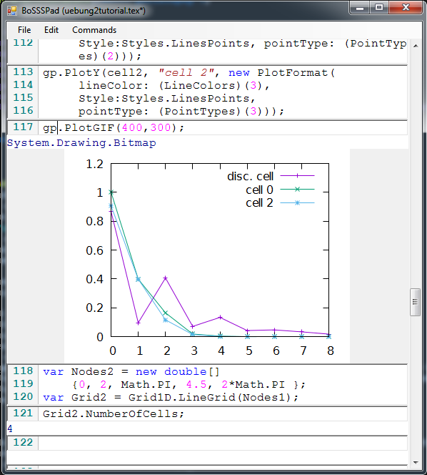
BoSSSpad
data organization
rapid prototyping of new solvers
workflow mangement (e.g. submission of HPC jobs)
analysis and post-processing (e.g lift & drag computation)
data import & export
documentation & tutorials
BoSSS software library & utilities

