Slide 1
Restricted but not forgotten: Rethinking restricted data
October 28th, 2025
Anneliese Eber, MSc, MLIS Research Data Management Librarian
aeber@uwaterloo.ca
Alyssa Roussy
MLIS Co-op Student, Research Data Management
aroussy4@uwo.ca

Slide 2




Introduction
Research Data Management Librarian
Background in anthropology & archaeology
Research interests in addressing challenges & barriers to managing data in biological anthropology

Slide 3
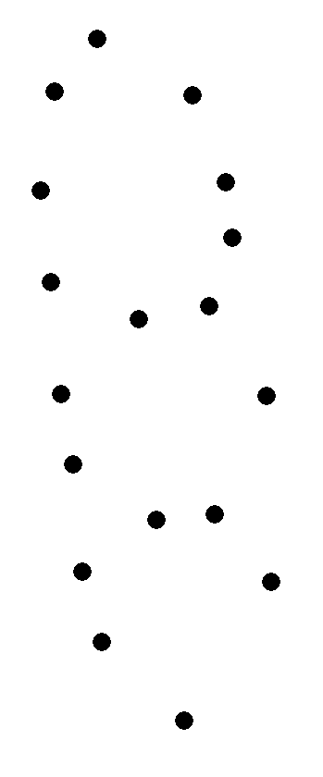
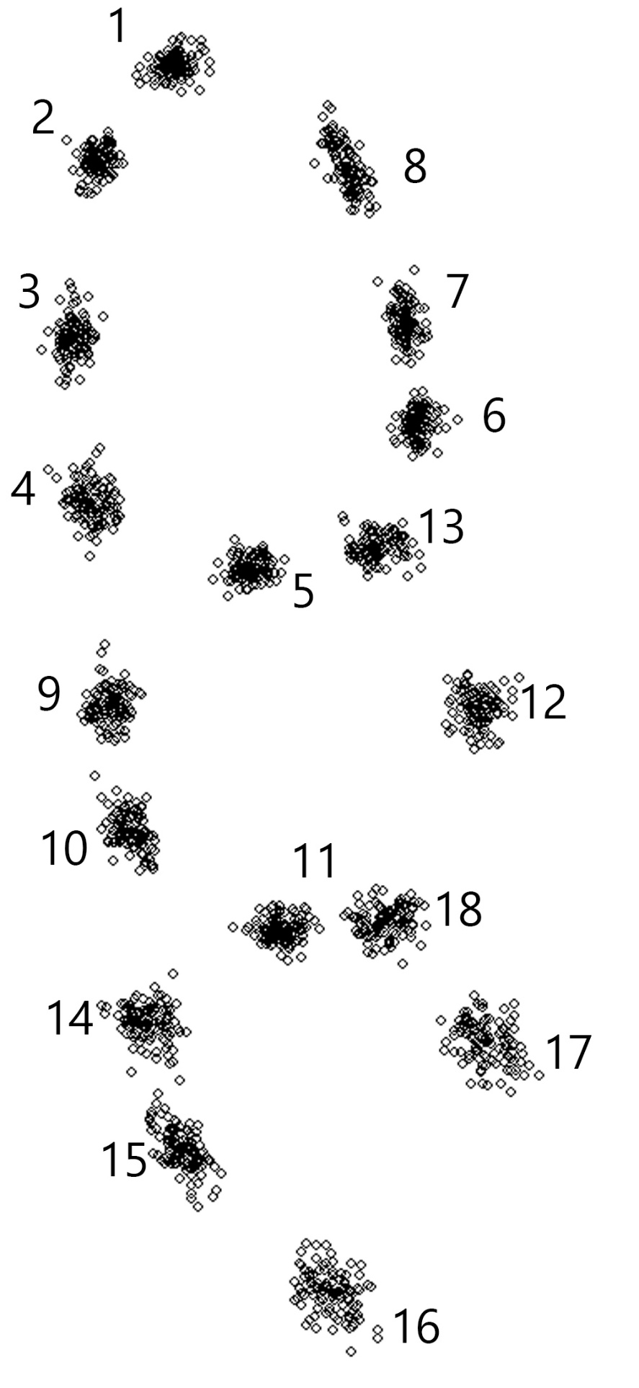
Agenda
What’s the point?
Rethinking restricted data
What is it?
How does it become restricted?
Case study
Working with restricted data
Where do we go from here: Changing the narrative

Slide 4
What’s the point?

Slide 5
What’s the point? Why do we share data?
Responsible Research
Reproducibility
Replicability
Integrity
Transparency
Credibility
Accountability

Slide 6

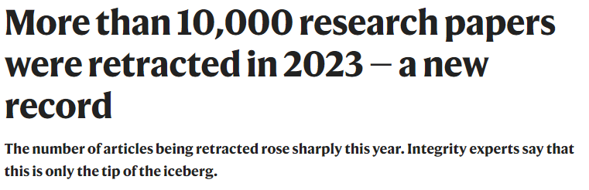
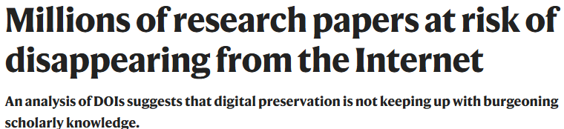
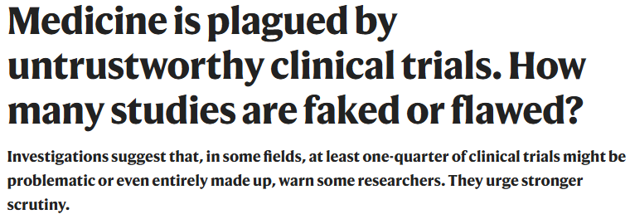
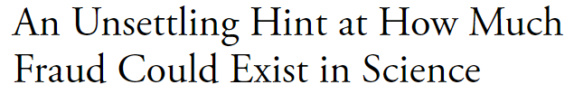

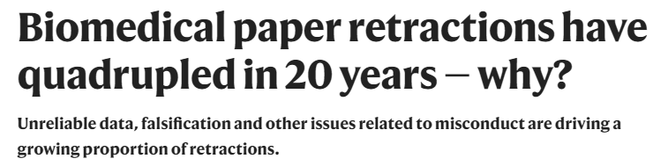
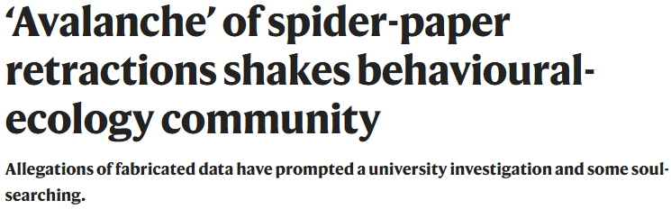
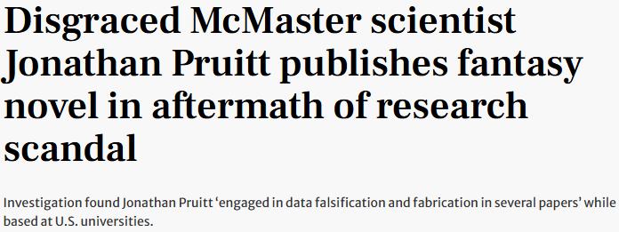
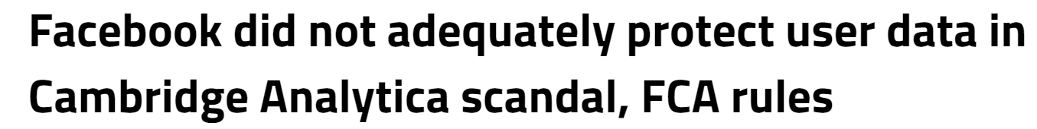
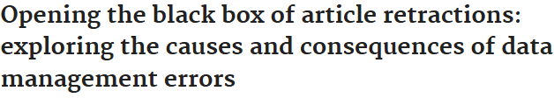
When we don’t share data

Slide 7
Big picture problems
Leads to questionable credibility
All estimations of replicability are sub-optimal
Negative impact on health outcomes & public health
Erodes trust in science & research

Slide 8
Responsible(?) research in 2025
Responsible & transparent research is more important than ever and must be:
Data-driven not belief-driven
Evidence-based
Transparent
Reproducible
Correlation ≠ causation
Data –> claims not claims –> data
“It is not proof. We’re doing the studies to make the proof.”
RFK Jr.
October 9th, 2025

Slide 9
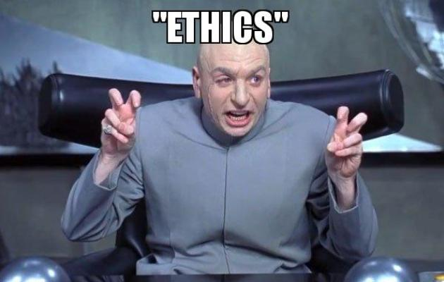
Responsible research
Upholds ethical standards
Minimizes potential harm(s)
Considers wider impact of work on:
Society
Environment
Community
Is transparent & reproducible
Policy compliance
Responsible data collection, analysis, storage, and sharing (where possible)

Slide 10
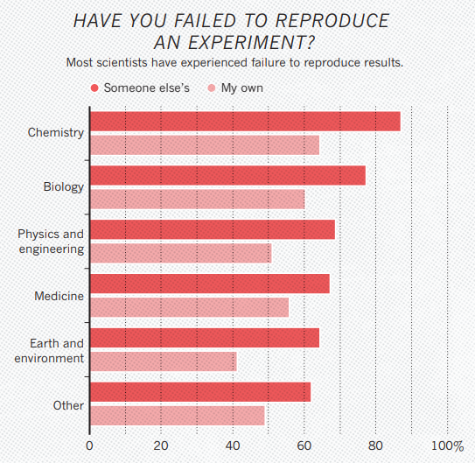
How did we get here?
Individual level
Questionable research practices
Excluding outliers
Not reporting unsatisfactory results
Not reporting negative results
Lack of access to methodological information & research data
Mismanagement of data[sets]
Cognitive bias
Baker, 2016
Notes:
Important to remember that these things are not always be intentional, these things could happen by mistake, improper training of grad students, lack of understanding of stats, etc.
-will talk more about not reporting unsatisfactory results or negative results in a few minutes but it’s a reasonably significant problem and while it happens at the individual level, it’s incentivized at a much higher level

Slide 11
How did we get here?
Structural level
Misaligned incentives
Tenure & promotion programs
Publish or perish
Publication metrics
Prioritization of quantity over quality
Better reception of hypothesis-supporting research
Less likely to report negative results
Journals resist publishing null results or replication studies
Rewards for novel research (nature pubs, etc.)
Publishers
“lack of contribution”
Leads to publication bias

Slide 12
Challenges to sharing data
Data sovereignty & ownership
Ethical considerations
Legal obligations
Commercial reasons

Slide 13
rethinking restricted data

Slide 14
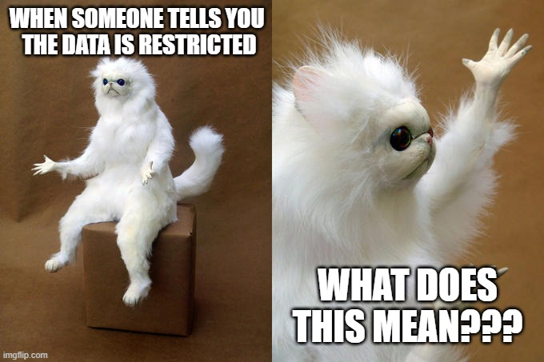
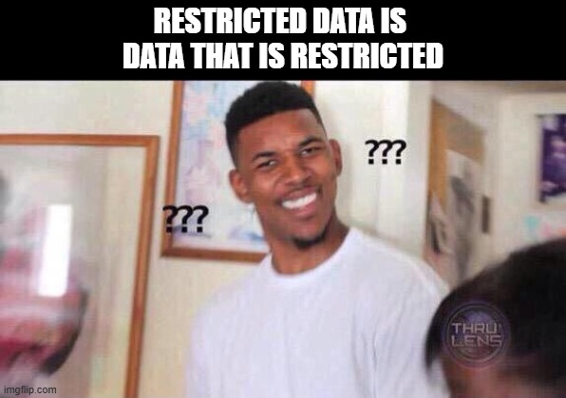
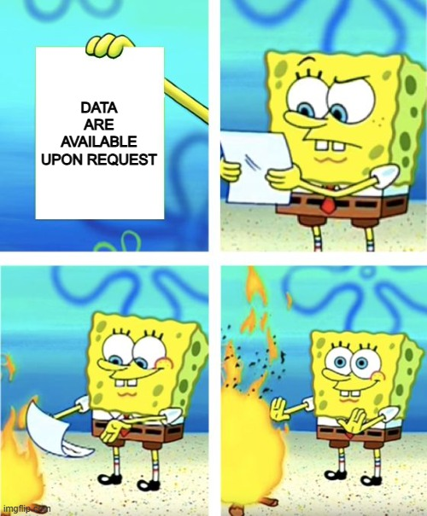
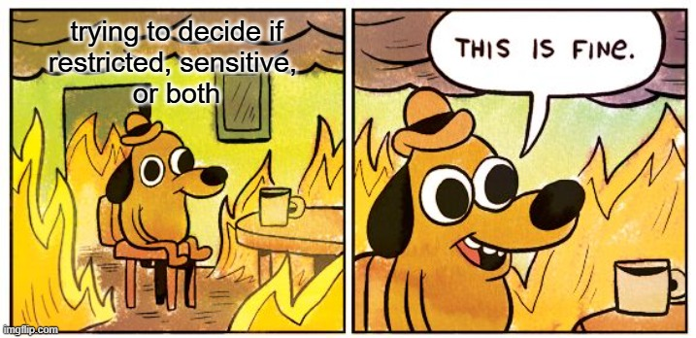
What are restricted data?

Slide 15
Defining the unknown
“data that are not immediately accessible because they are restricted due to commercial, ethical, or legal reasons, or they are only available upon request” (Read et al., 2024)
“data that cannot be released directly to the public research community due to possible risk(s) to study participants as well as the confidentiality promised to them” (National Institutes of Health)
“Restricted access means that there is openly accessible information on how to obtain the data, but that the data are sensitive in some way, so access to them must be requested” (Swedish National Data Service)

Slide 16
Restricted what? What’s the difference?
Restricted data
Restricted use
Restricted access

Slide 17
Why are things restricted?
Confidentiality
Varying privacy legislation
Copyrighted material
Collaborative research
Embargo
Career built on data
Scrutiny from peers
Unfamiliar with metadata
Lack of shared metadata standards
Potential data misuse
Perceived limited value of data
Lack of funding

Slide 18
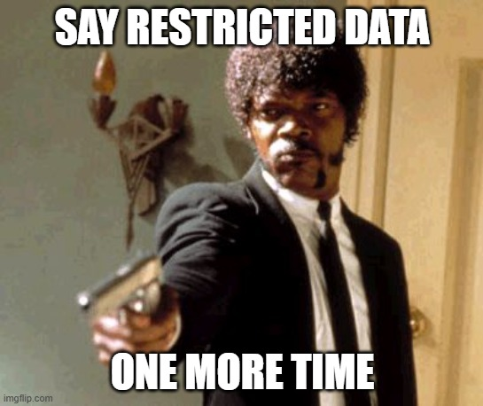
Unique challenges
Complex & time-consuming approvals
Difficult to navigate request processes
Resource intensive to access
Lack sufficient documentation (more than usual)
Often poor quality
Sparse or non-existent metadata limit discovery
Inadequate infrastructure for data sharing
Can’t use what you don’t know is there

Slide 19
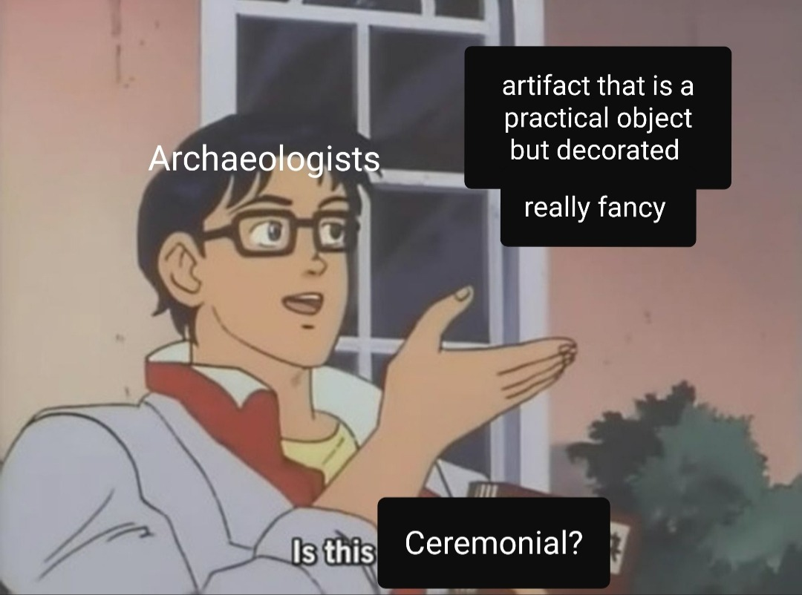
Restricted data: Limited to health contexts?
Restricted data appears across many disciplines
Disciplines may have different reasons for restricting data
Inter-disciplinary research may add additional challenges
Extractive research appears in many disciplines
Historically extractive disciplines may have additional considerations

Slide 20
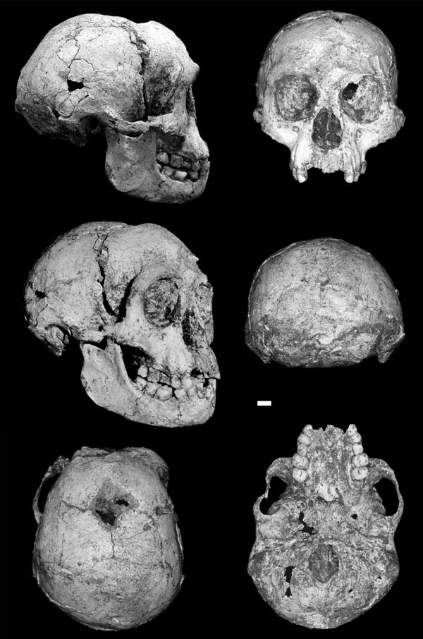
Sharing fossil data: A case study
Fossils are unique—literally one of a kind
Often considered cultural heritage
Subject to modern geopolitics based on modern borders
Extremely fragile to work with
Researchers often build their careers on a small set of data
Single site
Single fossil or set of fossils
Brown et al., 2004

Slide 21
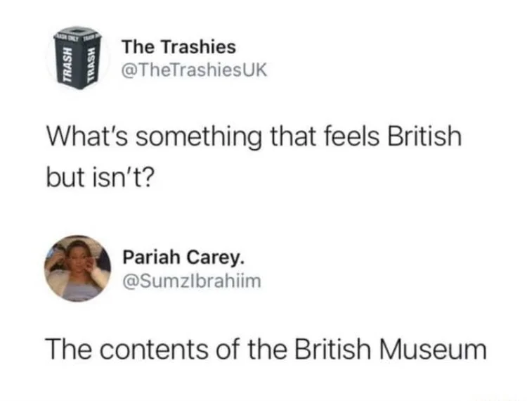
Sharing fossil data: Sociocultural challenges
Anthropology & archaeology have a deeply colonial history
Historically extractive research & well-known for it
Research often done by Western researchers and excludes local communities and researchers
Artifacts & fossil remains often leave their country of origin

Slide 22
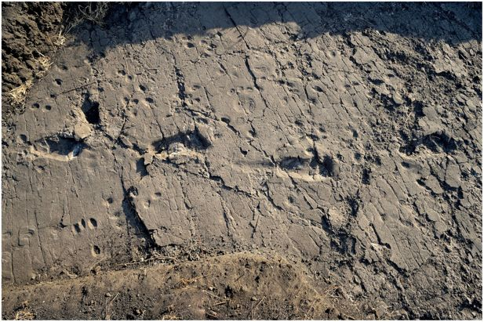
Sharing fossil data: Physical challenges
Fossils don’t travel well, if at all
Extremely expensive to transport fossils
Securely packing & air travel
Research & import permits
Storage
Extremely expensive to travel to fossils
Research permits
Travelling with [expensive] equipment
Masao et al., 2016

Slide 23
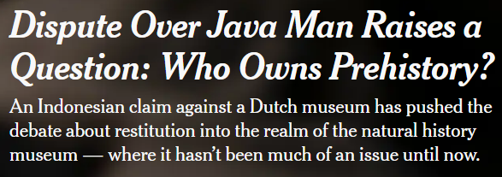
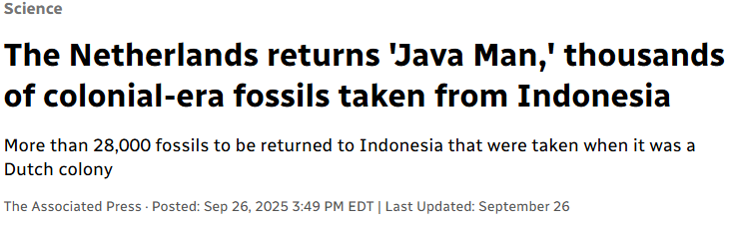
Sharing fossil data: Questions of ownership
Found within a country (e.g., Kenya)
Found by a researcher (likely not from the same country)
Finders keepers this is not
May represent human history & lineage
Who ‘owns’ history? Can someone ‘own’ something that old?
What about scans or replicas of fossils?
Who owns those?
Ownership vs. authorship?
Associated Press
Siegal, 2022

Slide 24
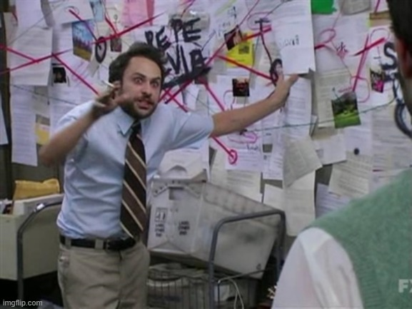
Sharing fossil data: Complex to navigate
Complications add up on top of one another
Eventually it becomes easier to just call the data restricted
No single solution
Continually evolving policies
“Data available upon request”: Maybe…
Shifts in research culture

Slide 25
Sharing fossil data: Data sovereignty
Whose data are they? Whose data should they be?
Museum & institutional data agreements
Ambiguous authorship & ownership of data
Colonial history of data collection

Slide 26
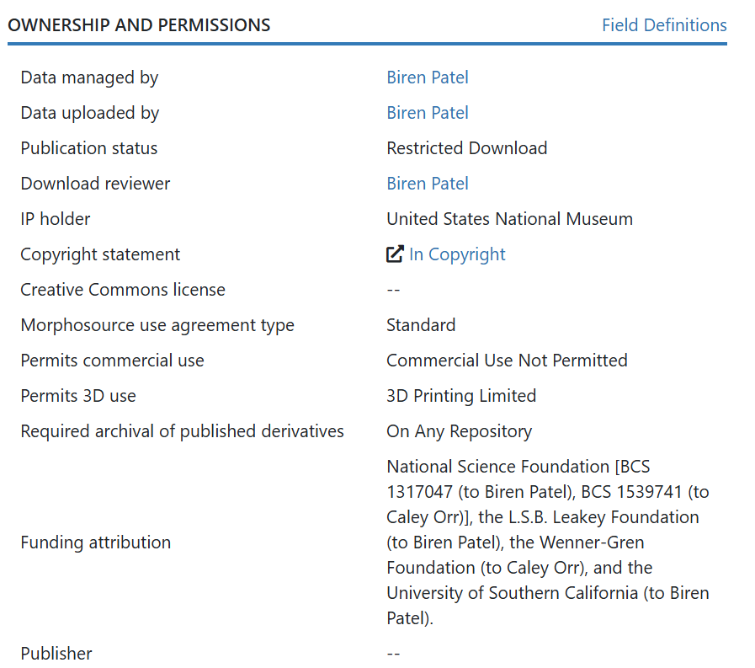
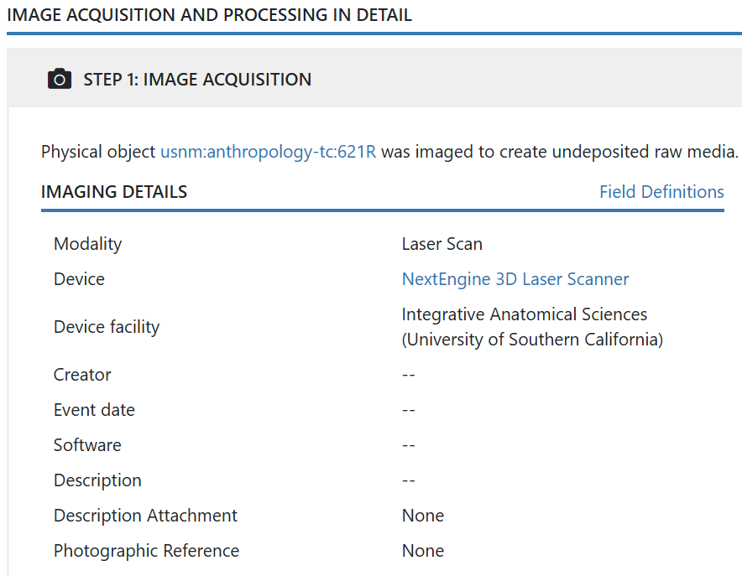
Trying and [sort of] succeeding
ark:/87602/m4/M56923

Slide 27
Working with Restricted data

Slide 28
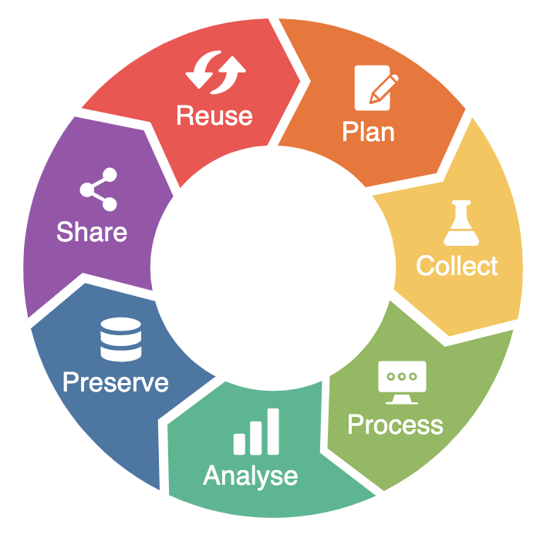
Research data lifecycle
Research
Data Lifecycle
NFDI4Microbiota Knowledge Base, 2024
Notes:
Key concept within RDM
Represents stage data go through before, during and after a research project
Each stage entails various data management activities
Plan: anticipate resources you need, consider policies you need to comply with; look at existing data sources or templates
Collect: Involves the methods to collect or acquire data; begin generating metadata, documenting and organizing data and checking quality of data
Process: Prepare your data for use, e.g., entering, transcribing, digitizing, deriving, anonymizing
Analyze: Interpreting your data
Preserve: Keeping it available beyond the timeline of your project, make it so it's reusable e.g., using sustainable formats, archiving data
Share: Release the data for reuse, cycle starts again

Slide 29
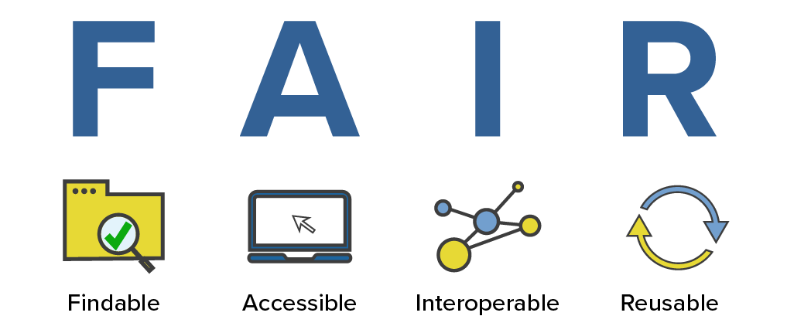
FAIR data
Notes:
Through good RDM practices, we want to create FAIR data
Aim to make research more findable and reusable
Guiding principles published in 2016 article in Scientific Data
Highly relevant as we see increased volumes, complexity and speed of data creation

Slide 30
Present- and future-proofing data
Findable | Accessible | Interoperable | Reusable
Humans and computers should be able to easily find metadata and data | Once the user finds the data, they need to know how to access them and may require details around authentication and authorization | Data usually need to be integrated with other data and need to interoperate with applications or workflows for analysis, storage, and processing | Metadata and data should be well-described so that they can be replicated and/or combined in different settings
Notes:
Findable: data and metadata discoverable by both humans and computers
Accessible: does not mean open data, but that at least the metadata is always accessible
Interoperable: Data can be used by researchers from other locations
Reusable: Data is described, licensed, and share in a way that makes wide reuse possible

Slide 31
Fair for who?
Before data can be FAIR for others, it must first be FAIR for you
If you can’t find or access your data, you can’t make it FAIR for others
Prioritize making sure you can find, access, open, and reuse your own data
This will help make it reusable in the future
Baker, 2016

Slide 32
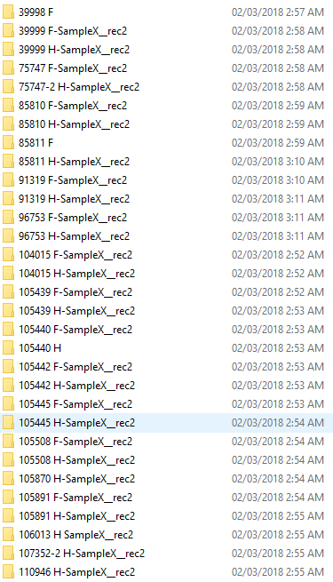

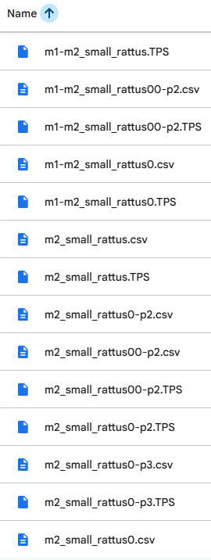
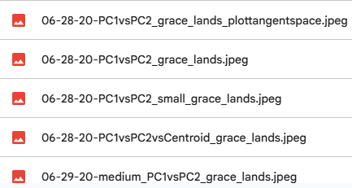

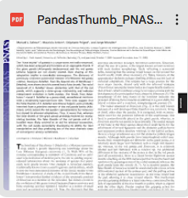



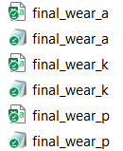
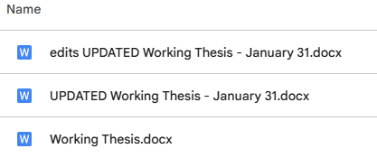

File name hall of shame

Slide 33
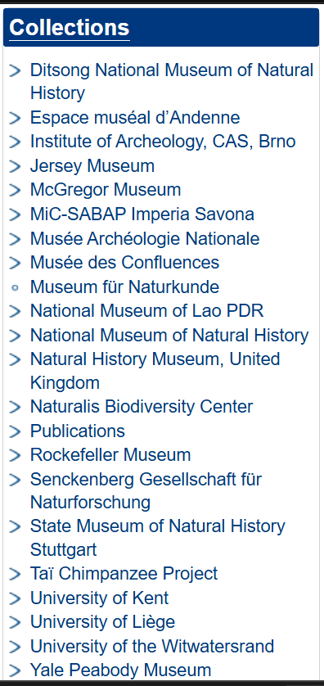
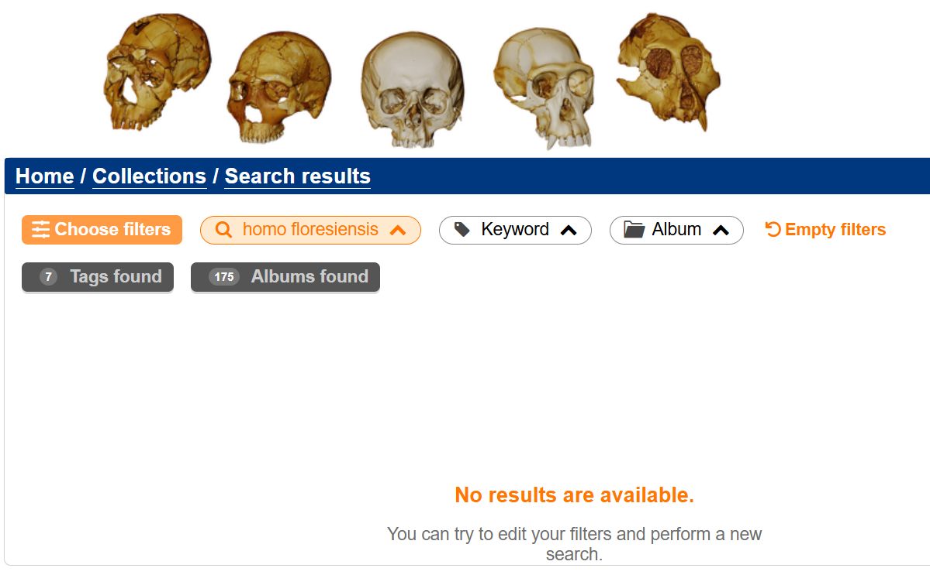
Finding the unfindable

Slide 34
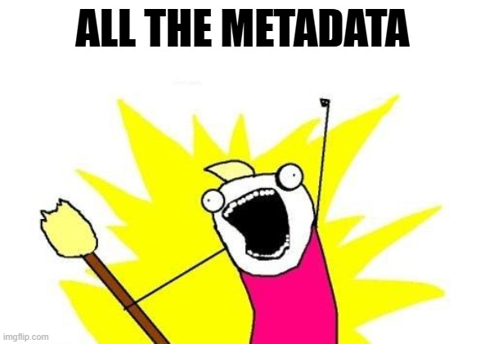
FAIR-ify as you go
Create documentation—lots of it
Saves files in interoperable formats
Avoid acronyms—document those you do use
Avoid missing values—document why values are missing
Keep track of any ethical, legal, or commercial restrictions you have & what data they apply to
Consider any consent required for data sharing early

Slide 35



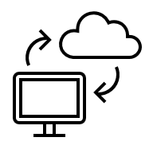


Key tips
Create a folder structure
Name files [well]
Version files numerically
Cleanup unsorted files regularly
Backup files
Document ✨everything✨
Huh?

Slide 36
Data management planning
Create a data management plan
Think about your research holistically
Planning will help you anticipate challenges before they happen
May be able to avoid some challenges
Think about consent and data sharing early
Data collection​
Documentation & metadata​
Storage & backup ​
Preservation ​
Sharing & reuse​
Responsibilities & resources​
Ethics & legal compliance

Slide 37


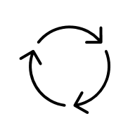
Creating a DMP
As detailed as possible/needed
Different levels of details for different templates, funders, etc.
Project-specific details
The more project-specific the better
File naming conventions
File versioning details
Considers the lifespan of a project
Before a project starts until after it finishes

Slide 38
Research data management
Organization, maintenance, and archiving of research data throughout the project’s life
Includes processes undertaken to create organized, documented, accessible, and reusable quality research data

Slide 39
Benefits of RDM
Workflow Efficiency
Saves time long-term
Easier to find files
Organized data
Academic Reputation
Signifies research excellence
Increased citations
Visibility & recognition of scholarly work
Contribution to research community
Better research replicability
Long-term cost savings
Increased data integrity

Slide 40
Where do we go from here?

Slide 41

Credits & licensing
Creative Commons
Except where otherwise noted, this item's license is described as Attribution-Non-Commercial 4.0 International (CC BY-NC) and is free to share and adapt with appropriate attribution/credit given to Anneliese Eber of the University of Waterloo Library for non-commercial use.

